Slide 1
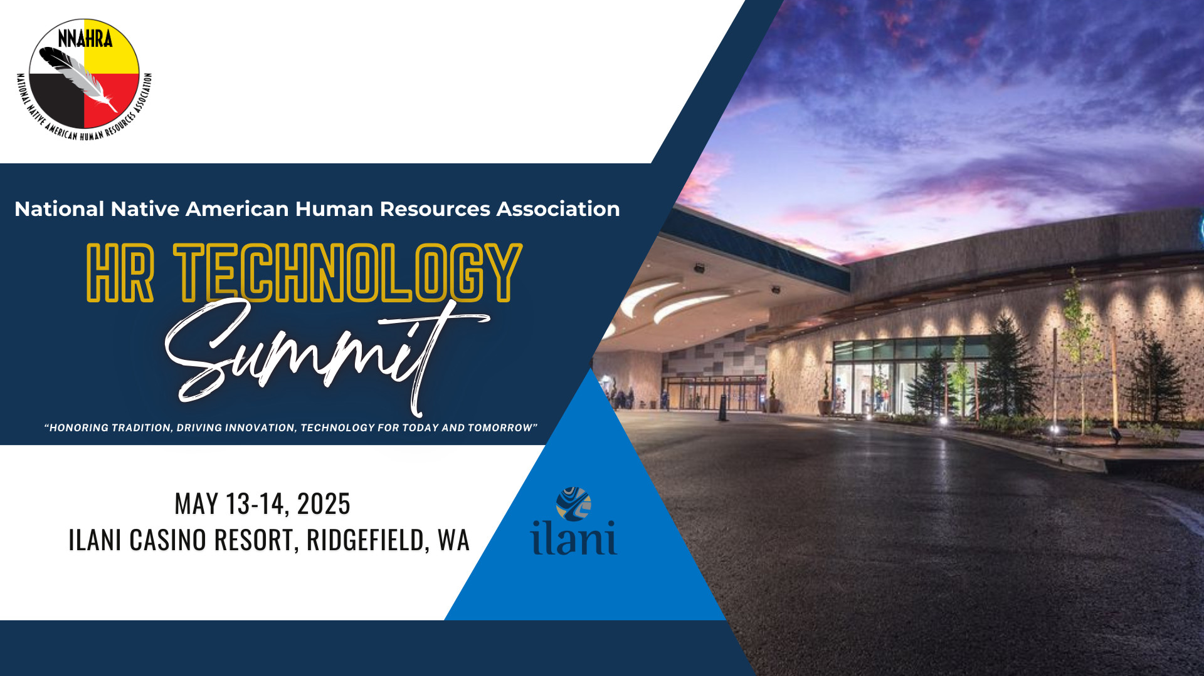

Slide 2
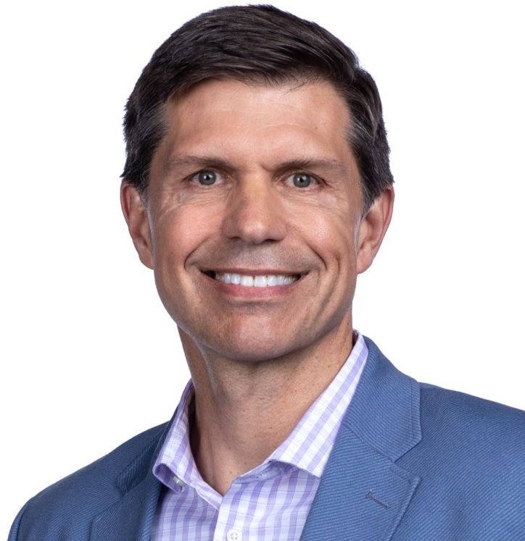

Beyond the go-live: How PwC helped Ilani Casino Resort modernize HR & finance, and optimize Workday for the future
Chris Cameron
Gina St. George
Workday Transformation and Innovation Leader, PwC
Chief Financial Officer
ilani

Slide 3
Introductions
01
Challenges for the industry
02
The case for change
03
Lessons learned – key takeaways
04
Q&A
05

Slide 4









Integrated resorts, gaming, and entertainment - why it's so complex

Slide 5


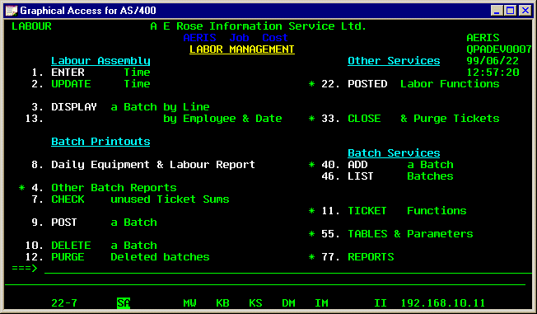

Transformations must address the finance and people requirements driven by diverse lines of business
Customer service is a priority and core value, placing the technology and people driving customer experiences as a top priority. Timely and relevant understanding of the key financial performance metrics across multiple lines of business and attracting and retaining an hourly workforce that can experience high turnover is challenging. Further, for Gaming companies, who operate in a highly regulated industry, the ability to demonstrate compliance across several areas of finance and HR is critical.
A journey to Workday often is a transition from antiquated systems, including green screen ERP technology that remains dominant in the gaming industry. Such sweeping change places a priority on the ability to not only deliver Workday technology but to also manage the massive change that are introduced to finance, HR and payroll operations.

Slide 6
The journey to drive scalable, best in class, services across finance, HR and payroll
Challenges
Impact & Outcomes
High Volume Recruiting – high turnover
Multiple jobs (6+ jobs could be applicable for any one worker)
Tipping allocation rules, different rules per job, possibly by location – GITCA & TEPA impact
Job architecture (challenging for gaming) & harmonization
Supervisor org structures – how managers of people align to workers demands flexibility, multiple managers (shift supervisor, floor managers, etc.)
Performance, lack of consistent standards for reviews, merit and incentive processes and cycles
Manual processes are inefficient and prone to errors = increased risks
Tracking mandatory training and certifications
Union CBA structure alignment
Regulatory and operational compliance oversight bifurcated and manual
Efficient and effective recruiting, drive key acquisition metrics – time to hire, higher quality matches to open positions – candidate pools
Attract, retain and develop people with improved insights into the skills and learning needed to build extraordinary service and experiences for our customers
Optimized Job architecture to support operations and enables key Workday functionality driven from job structure and organization data
Enable a services organization to improve customer (employee) services and enables scaling finance and HR functions
Harmonized performance processes, transparent and consistent, and automated with audit trails
Single source of truth for worker certifications & licenses (regulatory impacts), that can proactively monitor status and expiry alerts
Alignment to all Union CBA’s and impacts to HR, pay progression, COLA, etc.
Broadened process automation, few manual touchpoints

Slide 7
Measuring the case for change – Key outcomes and value
Sunset Systems – consolidate to a common platform
Operational efficiencies – shared services
Value of improved processes (qualitative & efficiency), such as
HCM/PR: talent acquisition & retention, career development, improved workforce management capabilities
Finance: period & YE closing, consolidations, reporting (annual, quarterly), source system detail (accounting center), improved financial planning & analysis
Technical: system consolidation, data harmonization, reduced integration landscape
Customer Service – employee & manager self service, improved access to information to support day to day functions.
End of Life Systems – legacy systems approaching end of life require upgrades (costly) or replacement – opportunity to reduce integrations
Scalability – Growth plans need to be supported by system capabilities, M&A, etc.
Transparency – Visibility to audit trails and data relevant to roles in a self-service simplified format
Global – Single global platform
Process Harmonization – Alignment of HR and Finance processes and underlying data models, along with ongoing governance structure

Slide 8
Built to Scale
Scaling Smart: The Built to Scale with Workday approach Achieving operational agility and resilience doesn’t always mean starting from scratch. PwC's Built to Scale with Workday provides a structured pathway for medium enterprises to modernize their finance and HR functions—strategically, efficiently and with confidence—enabled by AI.
What it enables: A streamlined transition to Workday with AI-driven automation and pre-built integrations A strategic, phased implementation approach tailored for scalability Enhanced decision-making with industry-informed best practices A balance between customization and standardization for optimal efficiency | What it avoids: A one-size-fits-all approach—solutions are designed to fit your organization’s unique needs Disruptive, high-risk transformations—our methodology minimizes operational impact Rigid implementation—flexibility ensures alignment with evolving business demands Hidden complexities—our process is transparent, structured, and focused on outcomes
With PwC and Workday, scaling isn’t about overhauling everything—it’s about making the right moves at the right time to build a future-ready enterprise.
PwC Industry Model Tenants
Efficiency
Scalability
Risk Reduction
Adoption of Leading Practices
Enhanced Decision-Making
Stability
GenAI
8

Slide 9
Key takeaways
Clearly defined scope and achievable plan
Timeline with clear milestones that is based off agreed upon functionality and scope of deployment
Customize training
Training is a tool to drive adoption. Customize training as needed and tailor it to the audience
Dedicated team of experts and core stakeholders
Fully dedicated core team able to make swift decisions in order to meet the aggressive timelines for go-live
Focus on data and conversion
Create a conversion strategy with dedicated resources. This includes time to cleanse, transform and test.
Embed change management and engage early
Communicate early and often and engage employees at the right time and right place to drive understanding and adoption
Develop go-live strategy
Establish a clearly defined, communicated and understood go-live plan, including UAT, cut-over, post go-live support, roles & responsibilities, third party communication strategy and support
Budget appropriately
Be prepared to handle additional needs discovered after implementation has begun
Identify key performance metrics up front
Determine what success looks like up front, measure to these metrics and identify areas that need course correction early

