Slide 1


Slide 2



Your Presenters
Mike Hamilton
Paul Tucker

Slide 3
This Presentation Is…
A bit of education
Some examples of the types of common attacks
Some tips on how to avoid becoming the wrong kind of headline

Slide 4
What is Risk?
R = P * I
P: The likelihood, or probability that a threat is realized
Preventive controls reduce that likelihood
I: The impact (usually financial) of that realized threat
Detection and rapid, effective response address the impact term

Slide 5
Cybersecurity and HR Data Protection
Tribal Risk
Unauthorized disclosure of protected records
Theft (business email compromise)
Extortion (ransomware)
Intentional disruption
Being used to attack business partners
Failure to comply with regulation
Where Concentrated
Human services and Tribal health
Tribal law enforcement
Treasury
Gaming operations
HR records!!
Collateral damage can include brand damage, customer flight, regulatory action, civil litigation and accusations of negligence

Slide 6
How Do “They” Get Info Your Network?
Both the Verizon and Mandiant reports just release show that SMBs are being preferentially targeted, 3rd party compromises are increasing, vulnerability exploit has been automated, e-mail phishing has dropped off, and credential abuse has evolved from password stuffing to defeating multi-factor authentication.
Three Prevalent Methods
Credential Abuse
Social Engineering
Vulnerability Exploit

Slide 7

Account Takeover
Account takeover fraud involves cybercriminals gaining unauthorized access to a victim’s online accounts, such as banking, email, or social media accounts.
How the scam operates:
A scammer posing as a bank fraud investigator tricks the customer into visiting a fake website and entering her login credentials and MFA code, allowing the scammer to access the account and transfer funds.
Recent Trends:
57% of consumers believe companies do not do enough to protect their accounts from takeover.
“Account takeover attacks have increased by 330% in the past two years.
Account takeover losses are estimated to reach $13 billion globally by 2024.

Slide 8
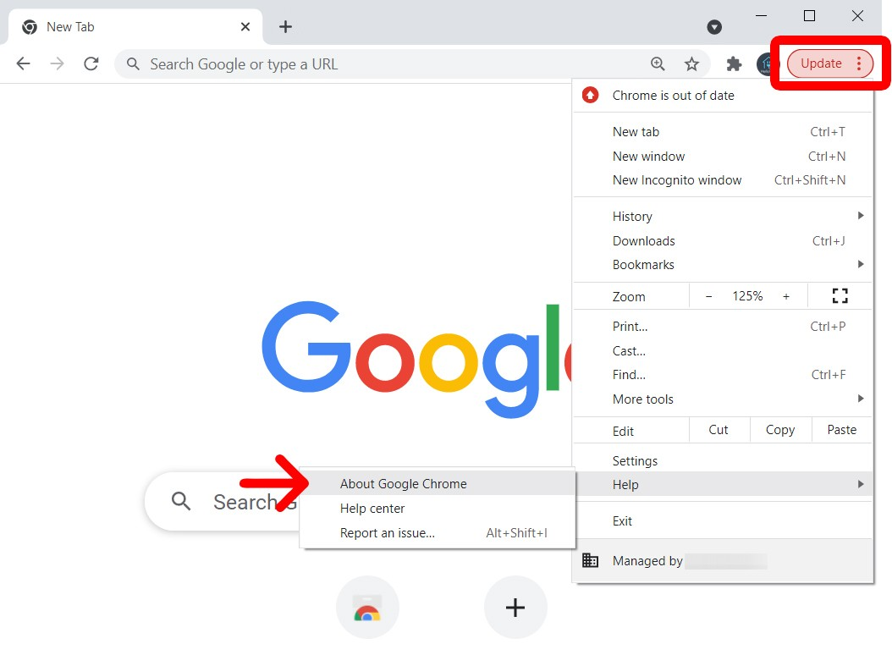
Mid-Range Methods
Credential stuffing
Causing “MFA Fatigue”
Infostealers
An unpatched browser + site rigged with an infostealer + bait to draw you to that site: All your credentials now belong to the bad guy

Slide 9
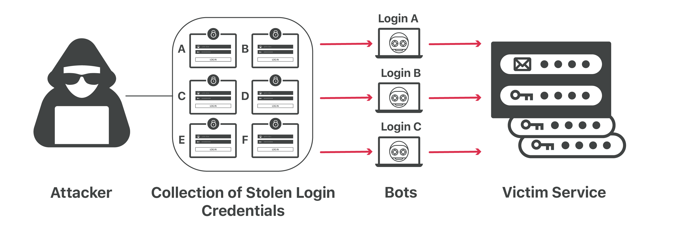
Credential Stuffing
Image Credit: OWASP Foundation

Slide 10
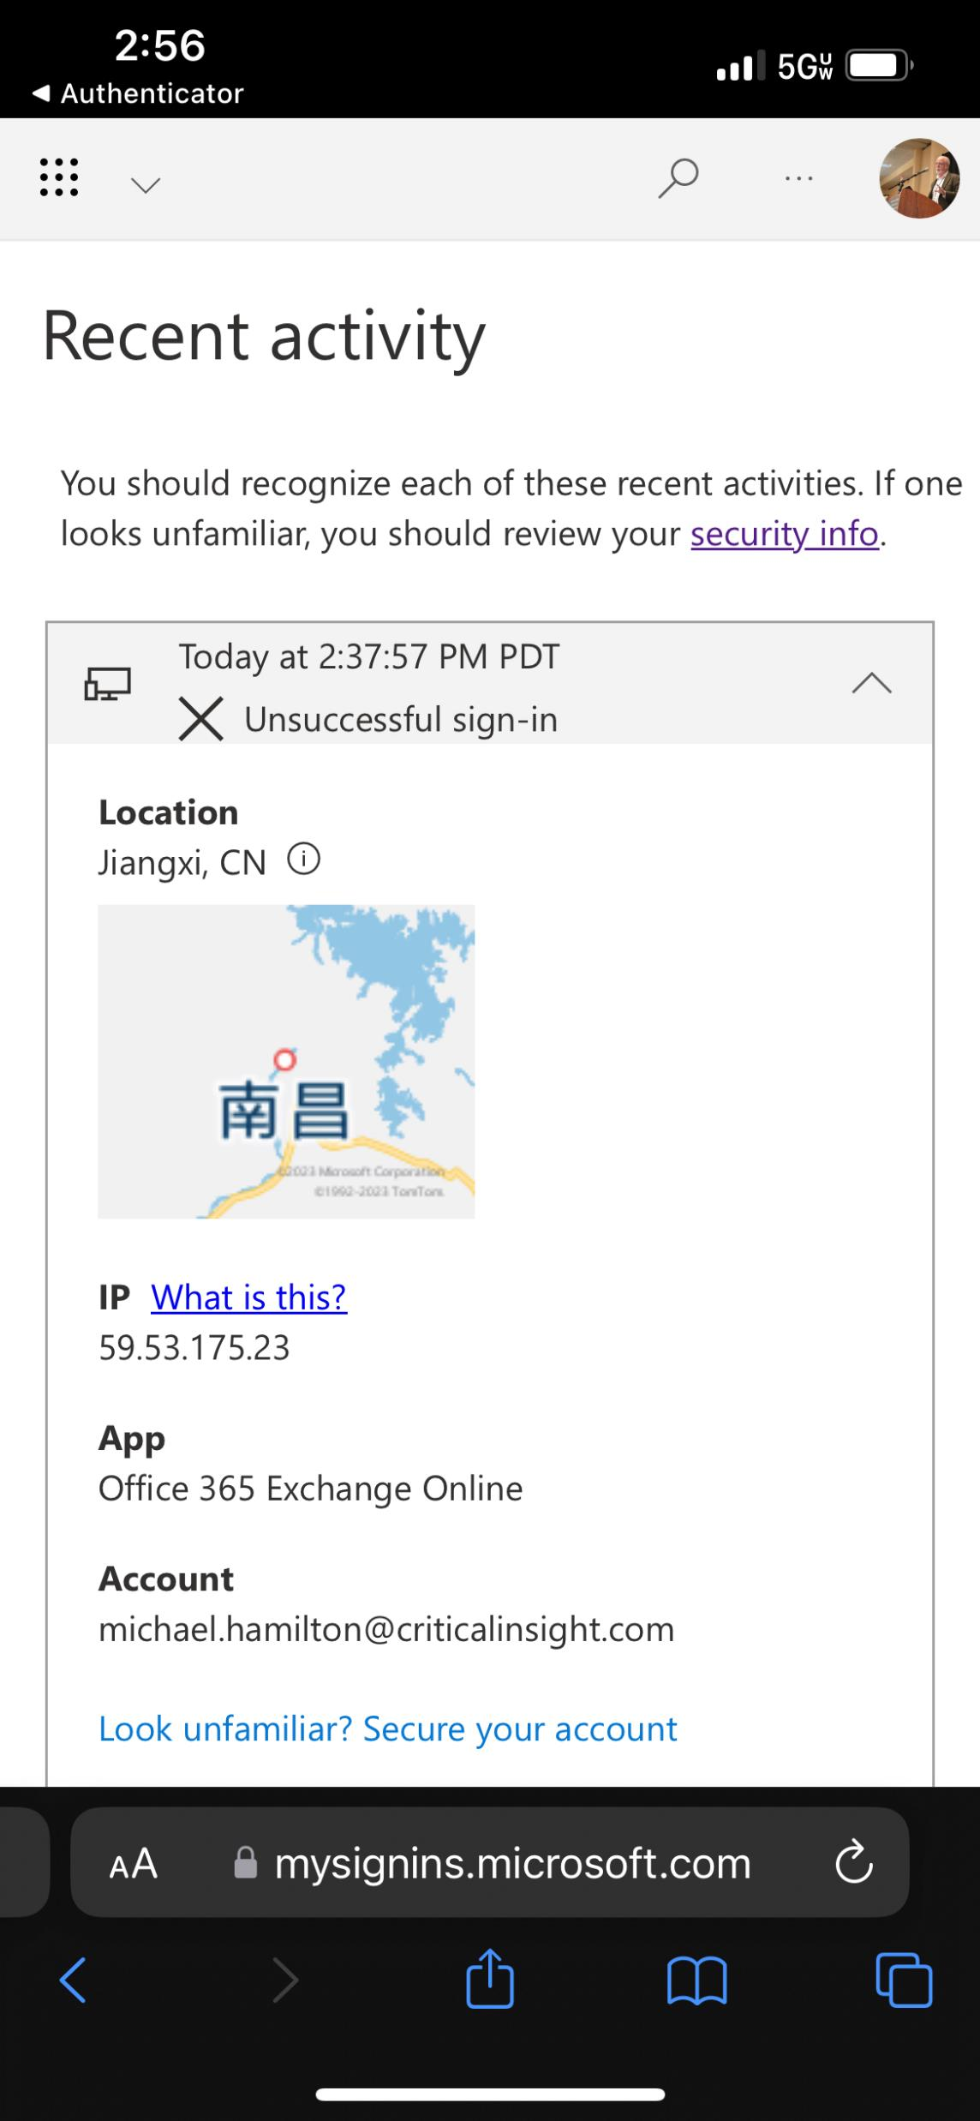
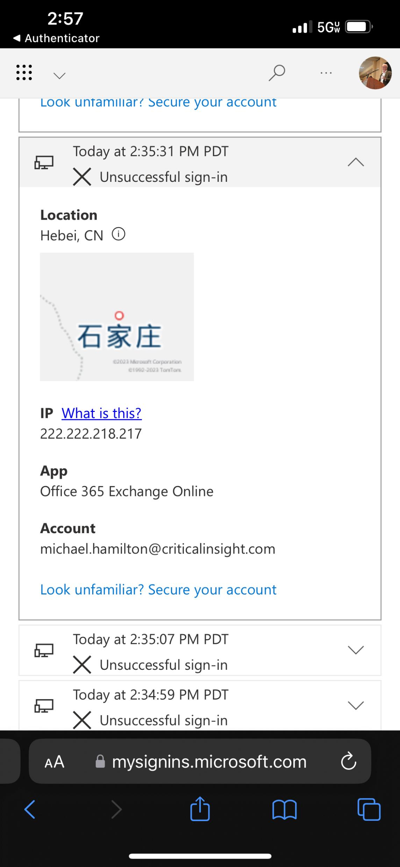
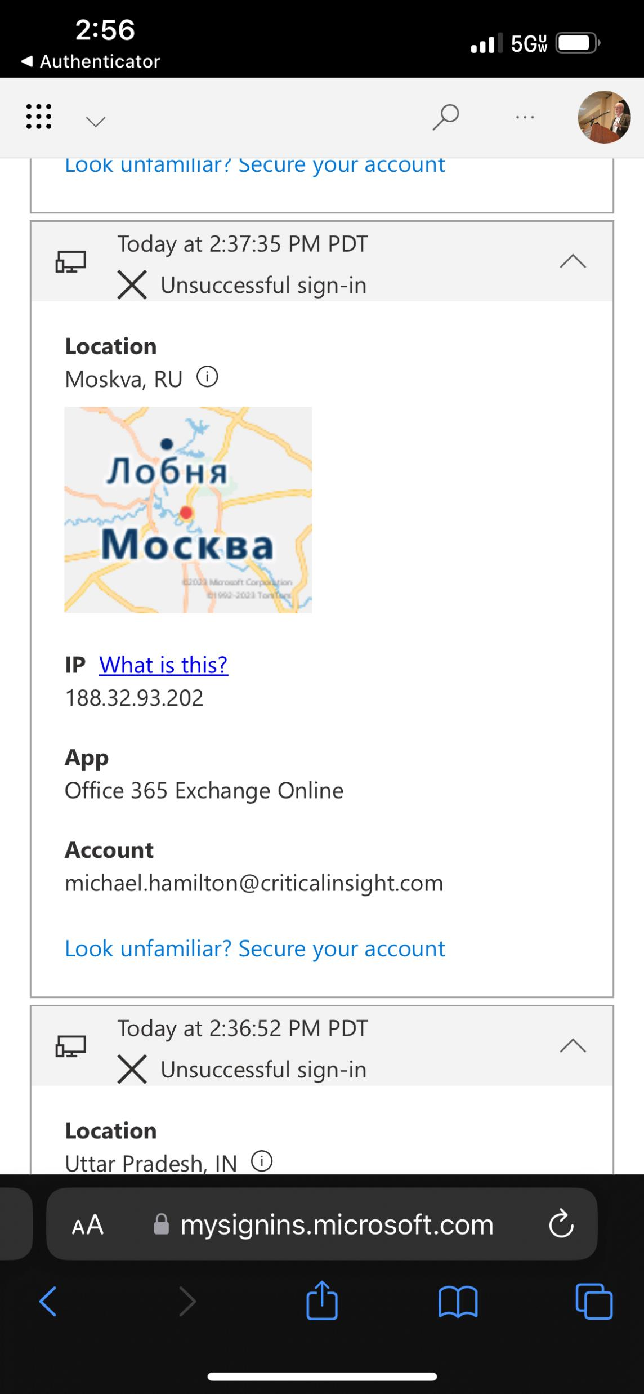
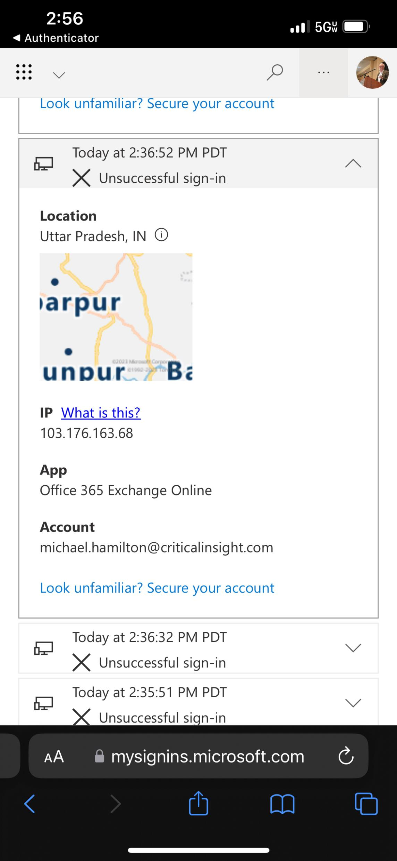
Bot Attack!
A failed login every 20 seconds that went on for days.
Note it’s coming from all over the world – this is not someone at a keyboard.

Slide 11
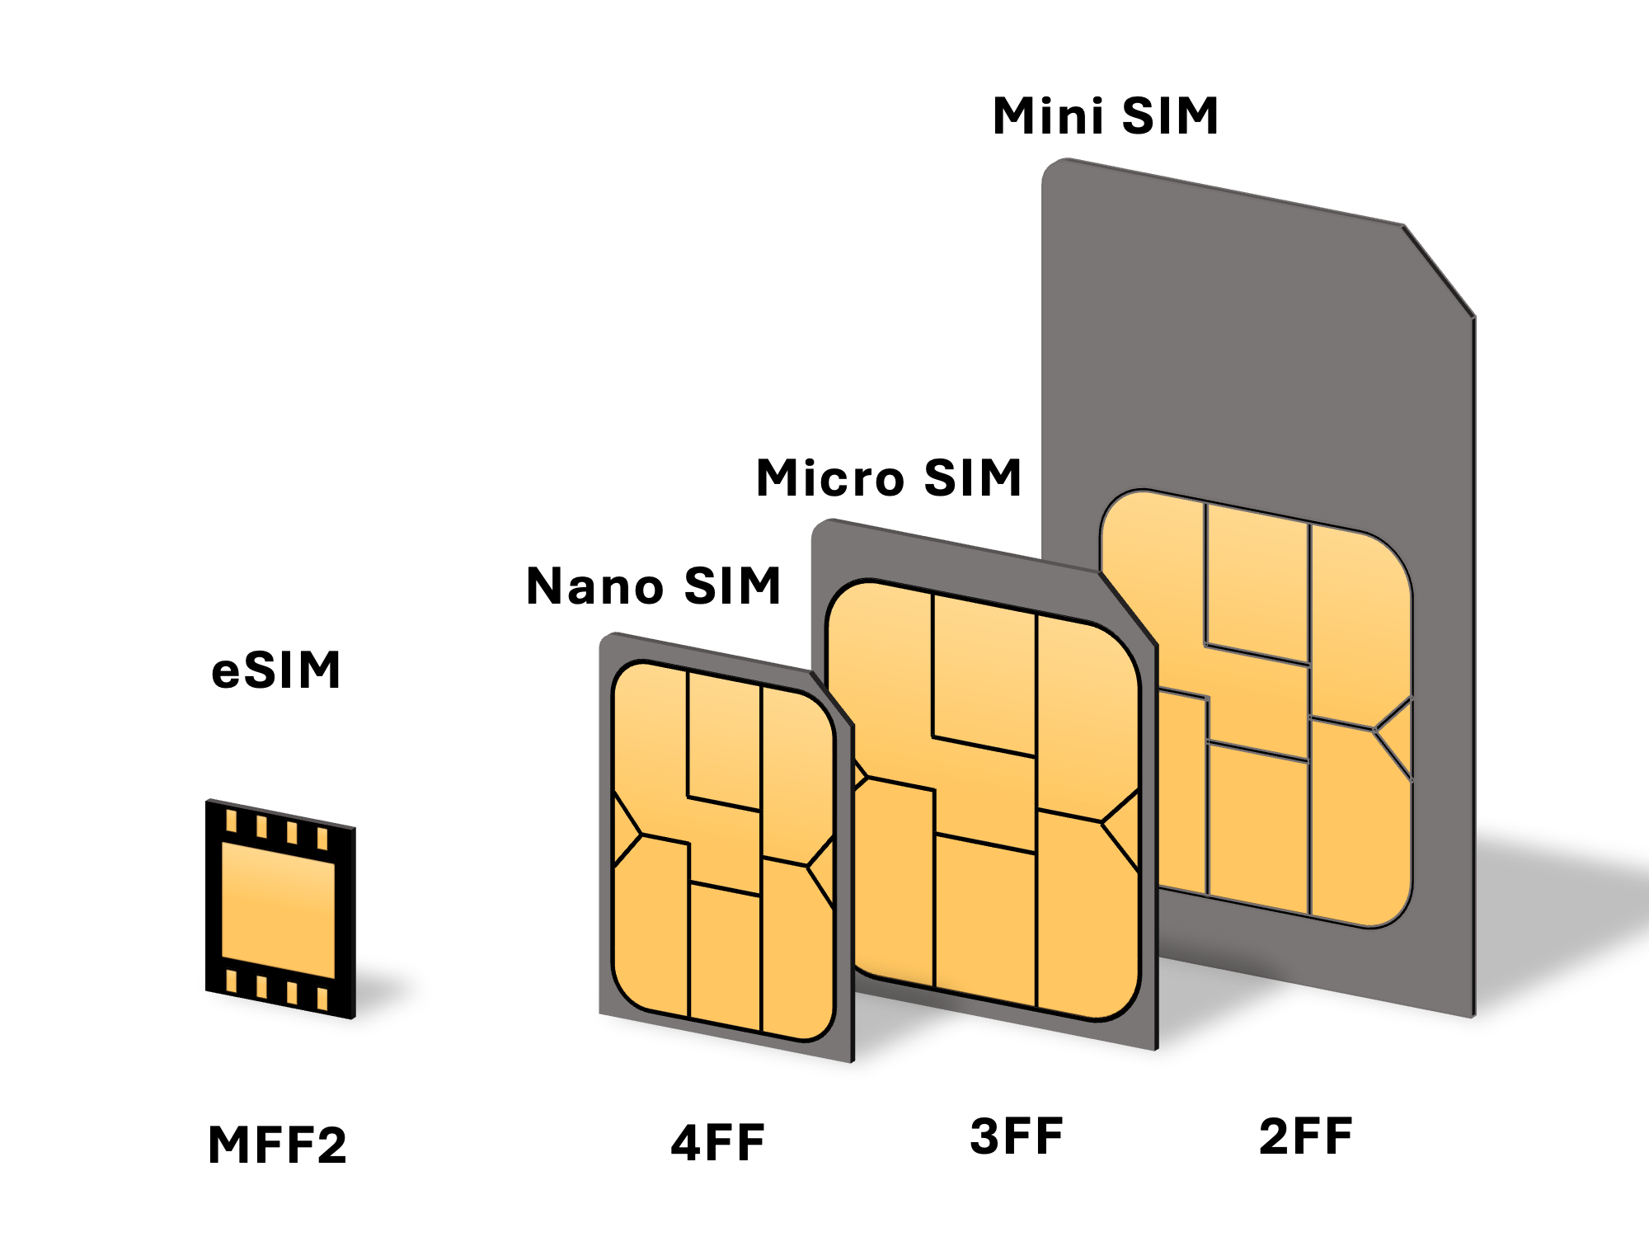
High-End Methods
SIM-swapping
Active session token stripping and reuse
Threats of violence to disclose a password
Image Credit: Wikipedia

Slide 12
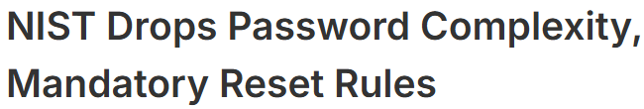
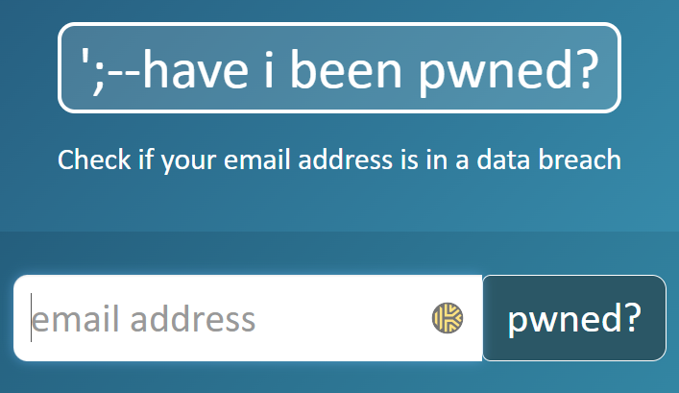
Avoiding Credential Abuse
Use pass phrases – first sentence of a book, or five words separated by spaces
Combine with multi-factor authentication (we’ll come back to that)
Use a password vault, and unique passwords with every system or service you access. PW Manager
Do NOT store passwords in browsers
Check your e-mail addresses on haveibeenpwned.com

Slide 13
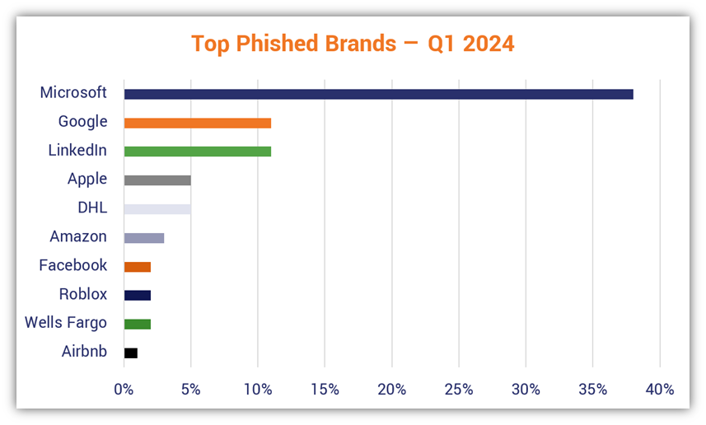
Social Engineering: Phishing
Fake lookalike sites that simulate known brands and products: Sharepoint, Microsoft, DocuSign, DropBox, Adobe, many others
Get you to give up credentials, follow a link, download a file, etc.
Easy-to-use kits
Images Credit: The SSL Store

Slide 14
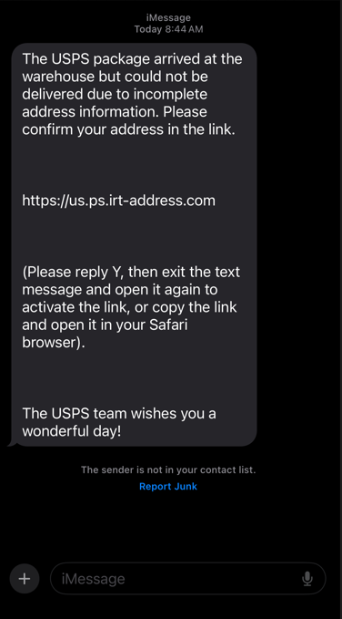
SMS Phishing (Smishing)
Phishing over SMS (text)
Not expected
Doesn’t include tracking information
The instructions are strange
VirusTotal says malicious/phishing
Could compromise your phone

Slide 15
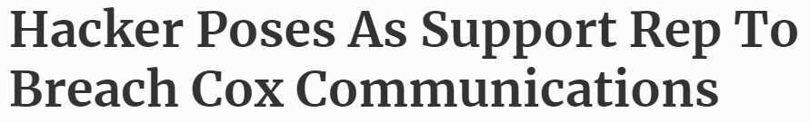

Voice Phishing (Vishing)
Taking a caller’s word at face value can result in compromise
Verify the identity of the caller as independently as possible
Do not type a URL someone gives you over the phone
Grandchild in trouble – classic scam
Now using deepfakes to simulate voice

Slide 16
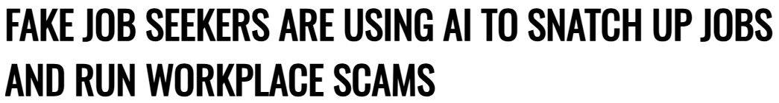
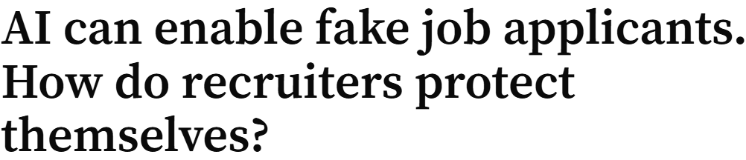
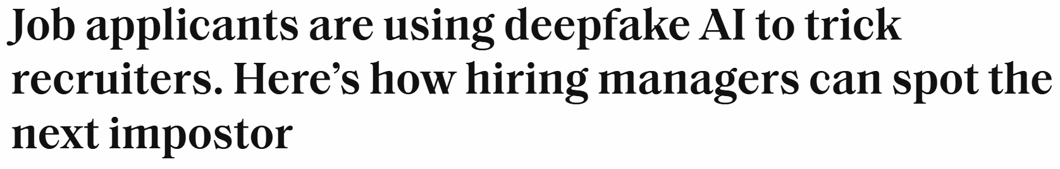
Fake Job Applicants
LinkedIn history: is it new, thin, sketchy?
Video interviews: ask the candidate to hold a hand in front of face
Look for glitchy
Ask: “How fat is Kim Jon Un, really?”

Slide 17
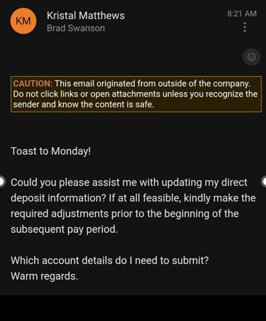
Account Redirection
Routing number comes back to SoFi Bank out of Utah (think its like an internet bank?). IS this something you can forward to Lance for the takedown? Infor below:
Routing Number: 031101334
Account Number: 411012363901
Account Type: Checking
Mike,
I sent it to SoFi internal as well as USSS, FBI, and DHS/ICE contacts for review.
~Lance

Slide 18
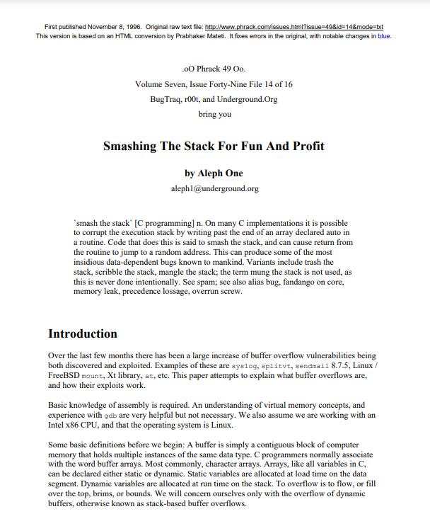
Vulnerability Exploit
Vulnerabilities can be problems in how the software was coded – for example allowing the memory space assigned to a variable in the software to be exceeded (known as a “buffer overflow”).

Slide 19
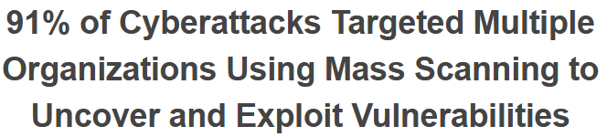
It’s Now A Race!
When a patch is released and a vulnerability made public:
Criminals and nation-states go to work immediately
The patch is reverse-engineered to find out what it “fixes”
The Internet is scanned for vulnerable targets
Exploit is automated

Slide 20
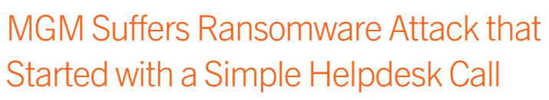
Gaming – What We See
Flat networks
Lack of multi-factor authentication
No response plan for cyber incidents
Failure to meet general standards of practice
Impacts
Unauthorized disclosure of customer information
Inability to operate – direct hit to revenue
Brand damage
Increased insurance costs
Regulatory action
Civil litigation

Slide 21
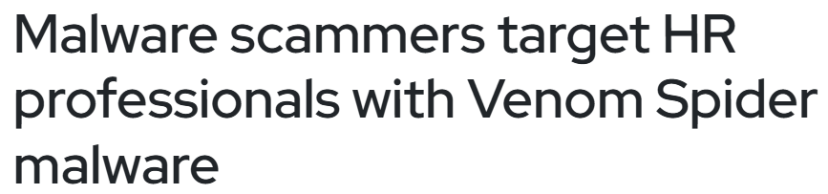
HR and Cybersecurity
Educate users on the “bait” and tactics they’ll be seeing
Account redirection
Deepfake audio and video of executives
Fake job applicants
Participate in risk governance and policy management
Use good judgement in managing passwords and credentials
Enforce cybersecurity policies using HR process
Pro Tip: Implement a policy of personal use on personally devices only
This will make 40% of the threats magically disappear!

Slide 22
Avoiding Civil Litigation
After stolen records become public and litigation is threatened, be ready to show your papers
Current risk assessment and corrective action plan
Evidence of annual penetration test, policy review, tabletop exercise, employee awareness training
Quarterly access authorization reviews, vulnerability management, risk governance committee notes
In many states (and hopefully soon nationally) this creates a safe harbor from civil litigation and some regulatory actions

Slide 23

Building a Culture of Cyber Security
Leadership Commitment
Establish Clear Policies and Procedures
Foster Open Communication
Invest in Training and Education
Appoint Cyber Champions
Integrate Security into Business Strategy

Slide 24
End-to-End Cybersecurity: Prepare, Detect, Respond
From strategic program development to real-time threat response, Lumifi provides a complete cybersecurity framework to safeguard your organization.

Slide 25
Stay Connected
:
Daily IT Security News Blast – Curated by myself for >15 years
Free monthly security awareness trainings online
Regular online urgent panel webinars and podcasts
Learn about our non-profit partner, PISCES: www.pisces-intl.org

