Slide 1
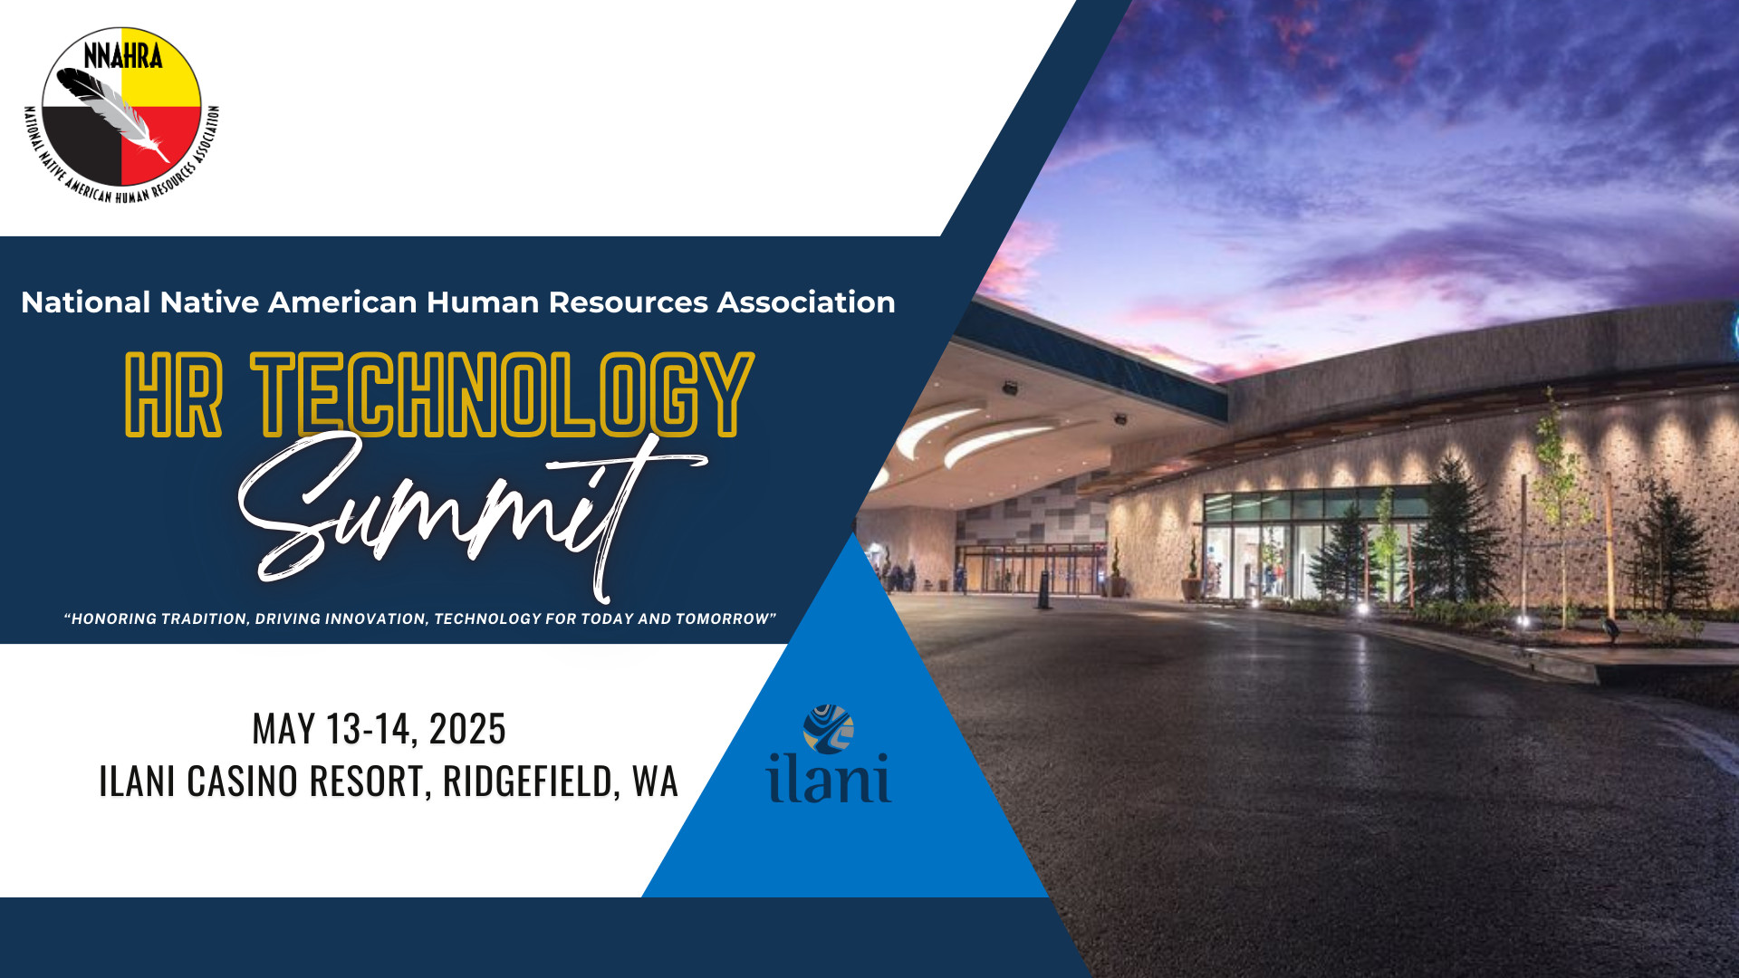

Slide 2
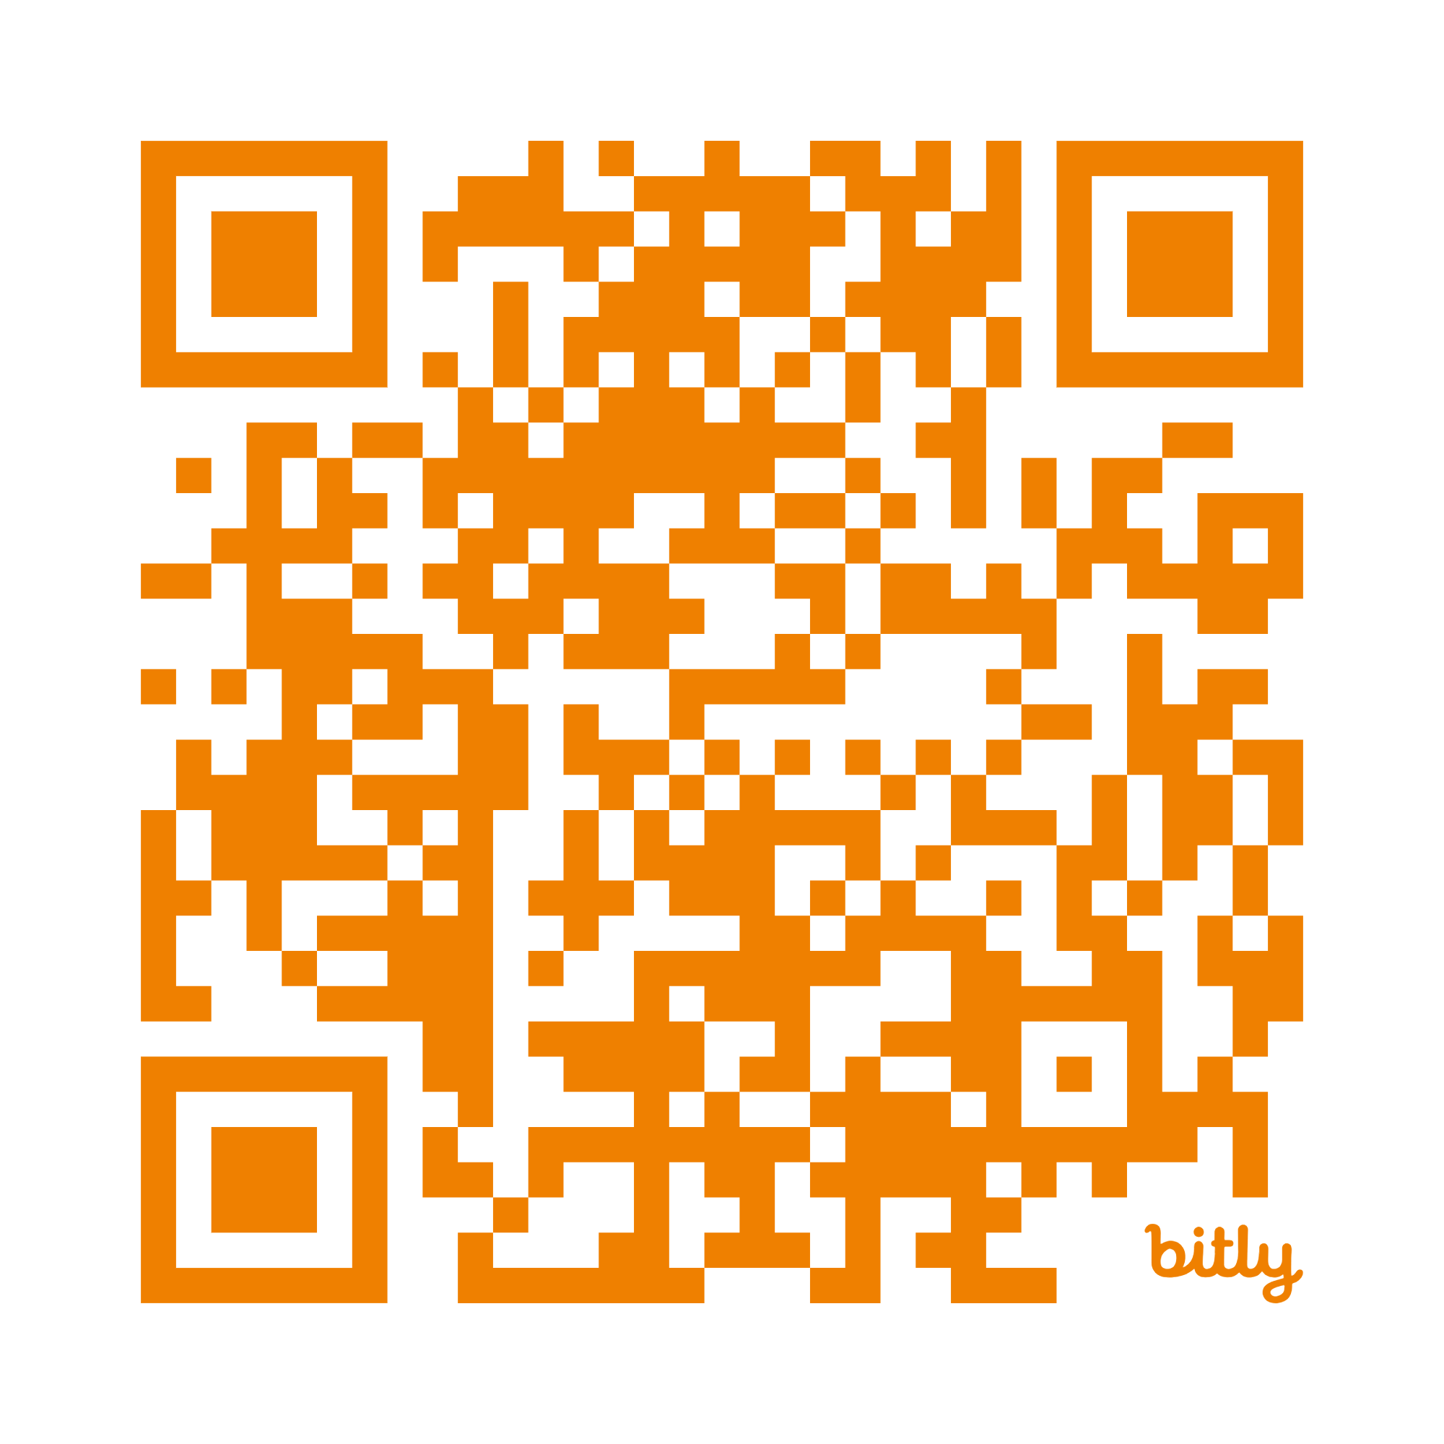

AI-Driven Performance Evaluations
Enhancing Fairness,
Efficiency, and Employee Growth

Slide 3
What We’ll Cover
Change. The only constant.
Why. Why and how AI assists.
Efficiency. Seamless Systems, Continuous Feedback & Real-Time Insights
Fairness. Reducing Bias & Favoritism
Authenticity. Personalized Employee Insights & Goals
Ethics. Ethical Considerations & HR’s Role
Notes:
AI in Performance Reviews – Automating performance tracking, feedback analysis, and goal-setting.
Reducing Bias & Enhancing Fairness – Leveraging AI to ensure objective, data-driven evaluations.
Continuous Feedback & Real-Time Insights – Moving beyond annual reviews with AI-driven performance coaching.
Personalized Employee Development – Using AI to identify skills gaps and career growth opportunities.
Ethical Considerations & HR’s Role – Ensuring transparency, employee trust, and compliance in AI-assisted evaluations.

Slide 4

“Change the way you look at things and the things you look at change.”
~ Dr. Wayne W. Dyer

Slide 5
2 Reasons that Change Is Difficult
1. Humans are emotional.
  Our feelings show up strong. We worry about things that we don’t know.
2. We are wired to assume the worst.
  Did you know?! → The brain interprets change the same way that it interprets pain.

Slide 6
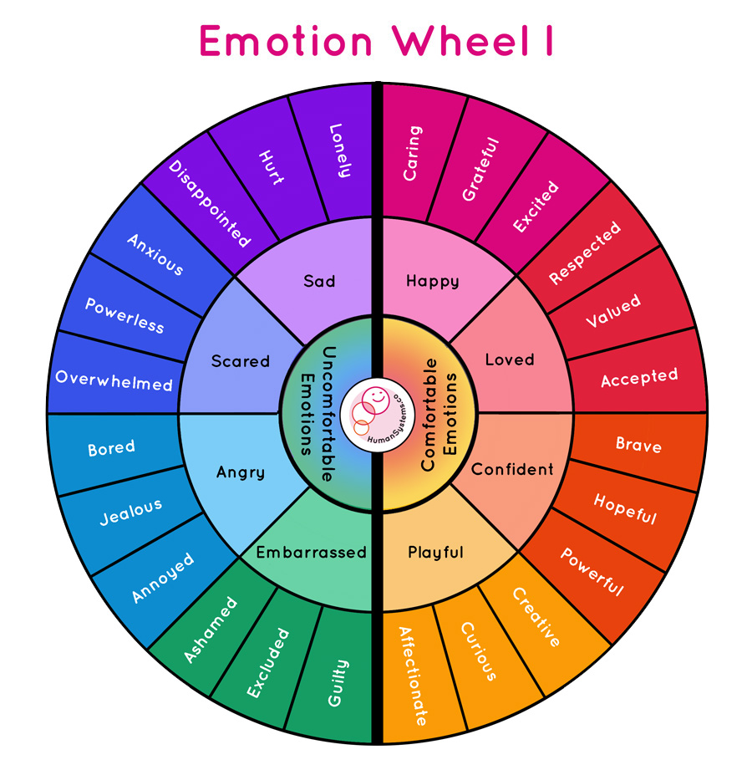
Notes:
AI in Performance Reviews – Automating performance tracking, feedback analysis, and goal-setting.
Reducing Bias & Enhancing Fairness – Leveraging AI to ensure objective, data-driven evaluations.
Continuous Feedback & Real-Time Insights – Moving beyond annual reviews with AI-driven performance coaching.
Personalized Employee Development – Using AI to identify skills gaps and career growth opportunities.
Ethical Considerations & HR’s Role – Ensuring transparency, employee trust, and compliance in AI-assisted evaluations.

Slide 7
Change is good!

Slide 8
RIGHT????

Slide 9
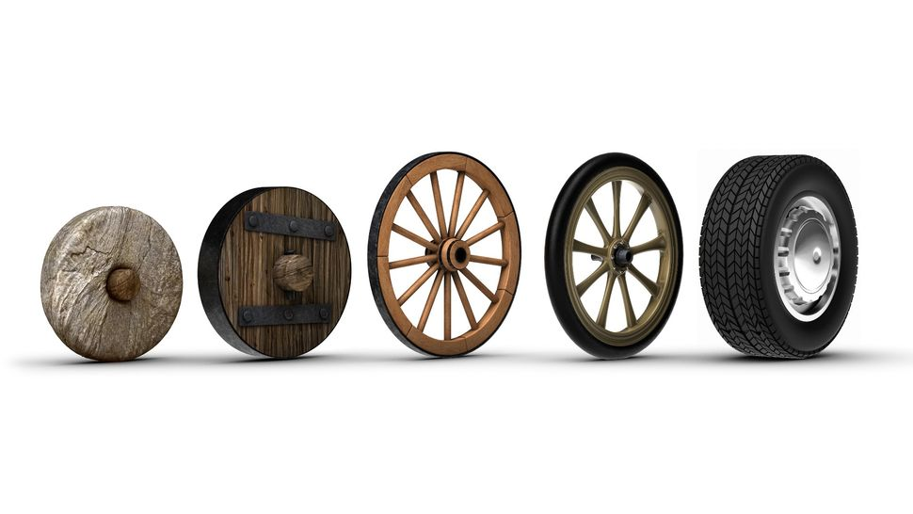
Famous Advancements in Technology

Slide 10
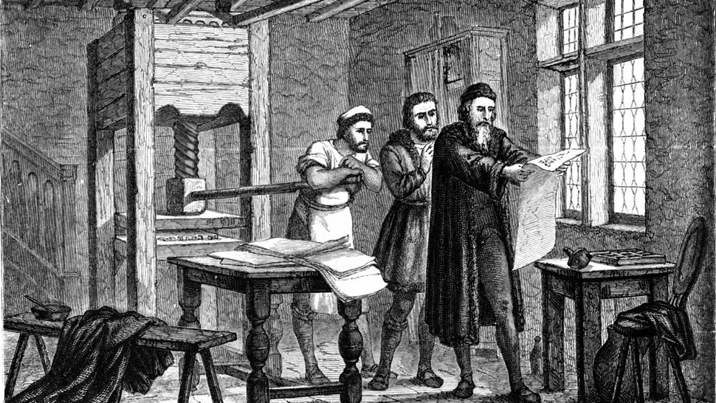
Famous Advancements in Technology

Slide 11

Famous Advancements in Technology

Slide 12
Implementing Change Successfully
Go slow.
  Give your brain time to scan and relax.
Stay optimistic.
  Picture what success looks like. See it. Feel it.
Keep at it.
  Recognize that it takes time to forge a new path.

Slide 13
🤖 Surprisingly AI-Powered Tools
📧 Email & Communication
  Gmail Smart Compose / Auto-Reply – Suggests phrases and auto-completes emails using AI.
  Grammarly – Uses AI to analyze tone, grammar, clarity, and suggest rephrasing.
  Outlook's “Suggested Replies” and “Schedule Send” – Predictive suggestions based on content.
Notes:
Streamlining the Process: AI tools like Express Evaluations automate tedious administrative tasks—sending reminders, collecting feedback, and tracking goal progress—freeing HR to focus on strategy and coaching.

Slide 14
🤖 Surprisingly AI-Powered Tools
📅 Scheduling & Productivity
  Calendly’s Meeting Insights – Learns from your patterns to suggest optimal meeting times.
  Notion AI – Helps summarize notes, generate content, and organize tasks intelligently.
  Otter.ai – Transcribes meetings and creates smart summaries and action items.
Notes:
Streamlining the Process: AI tools like Express Evaluations automate tedious administrative tasks—sending reminders, collecting feedback, and tracking goal progress—freeing HR to focus on strategy and coaching.

Slide 15
🤖 AI-Powered Tools in HR
💼 HR & Recruiting
  LinkedIn Recruiter – Uses AI to recommend candidates and job matches.
  Indeed / ZipRecruiter Smart Match – AI ranks applicants and matches jobs to skills.
  BambooHR’s Performance Module – Uses AI to flag feedback trends and engagement.
Notes:
Streamlining the Process: AI tools like Express Evaluations automate tedious administrative tasks—sending reminders, collecting feedback, and tracking goal progress—freeing HR to focus on strategy and coaching.

Slide 16
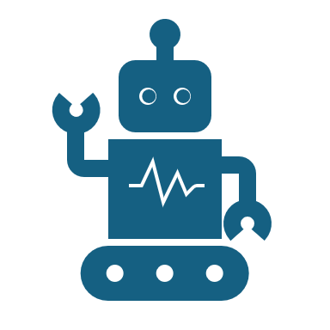
Let’s Discuss!
What excites you, or concerns you, most about using AI in performance evaluations?
Notes:
Automating performance tracking, feedback analysis, and goal-setting.
Streamlining the Process: AI tools like Express Evaluations automate tedious administrative tasks—sending reminders, collecting feedback, and tracking goal progress—freeing HR to focus on strategy and coaching.
Smarter Goal Alignment: AI can analyze past performance data to suggest individualized goals aligned with organizational priorities.
Real-Time Analytics: Instead of waiting for year-end data, AI helps managers track performance trends throughout the review period—supporting proactive interventions.
Human + Machine = Better Together: AI shouldn't replace human judgment but enhance it—giving HR and leaders clearer insights while maintaining the human touch.

Slide 17
AI in Performance Reviews. Why?
Notes:
Automating performance tracking, feedback analysis, and goal-setting.
There are FOUR Main Reasons that we’re exploring this and nudging you to consider integrating AI into your Performance Evaluations Process. … .
Streamlining the Process
Smarter Goal Alignment
Real-Time Analytics
Human + Machine = Better Together

Slide 18
Streamlining the Process
Tech platforms help us automate tasks so that HR professionals and leaders can focus on:
STRATEGY & COACHING.
Notes:
Streamlining the Process: AI tools like Express Evaluations automate tedious administrative tasks—sending reminders, collecting feedback, and tracking goal progress—freeing HR to focus on strategy and coaching.

Slide 19
Smarter Goal Alignment
When given plenty of information, AI can analyze performance data to suggest
INDIVIDUALIZED GOALS
that align with your organization’s mission, values, and
ORGANIZATIONAL PRIORITIES.
Notes:
Smarter Goal Alignment: AI can analyze past performance data to suggest individualized goals aligned with organization’s mission, vision, values, and organizational priorities.

Slide 20
Real-Time Analytics
AI helps managers track performance trends throughout the review period supporting
PROACTIVE INTERVENTIONS.
Notes:
Real-Time Analytics: Instead of waiting for year-end data, AI helps managers track performance trends throughout the review period—supporting proactive interventions.

Slide 21
Human + Machine = Better Together
AI is never meant to replace
HUMAN JUDGMENT
but, rather, it should
ENHANCE it.
AI gives HR and leaders clearer insights while maintaining the human touch.
Notes:
Human + Machine = Better Together: AI shouldn't replace human judgment but enhance it—giving HR and leaders clearer insights while maintaining the human touch.
PITFALLS FOR HR PROS TO BEWARE OF:
1. Losing the Human Element
Risk → Delivering performance feedback, evaluations, or HR decisions without personal insight or empathy.
Employees may feel dehumanized or unheard, which can erode trust and engagement. HR is a human-first profession. AI should support, never replace, thoughtful leadership.
2. Misinterpreting AI Outputs as Final Truth
Risk → Treating AI-generated summaries, ratings, or recommendations as objective and unquestionable.
AI tools can reflect inherent bias in the data or algorithms. Without human review, there's a risk of reinforcing inequality or making inaccurate conclusions.
3. Using AI to Avoid Difficult Conversations
Risk → Relying on AI to generate feedback or communication without taking the time to understand the issue or prepare for a thoughtful dialogue.
Avoiding discomfort shortchanges leadership development and denies employees the dignity of honest, human-centered feedback.

Slide 22

AI for Efficiency

Slide 23
Let’s Discuss!
In your current system, what is the hardest part about staying on track?
Notes:
Automating performance tracking, feedback analysis, and goal-setting.
Streamlining the Process: AI tools like Express Evaluations automate tedious administrative tasks—sending reminders, collecting feedback, and tracking goal progress—freeing HR to focus on strategy and coaching.
Smarter Goal Alignment: AI can analyze past performance data to suggest individualized goals aligned with organizational priorities.
Real-Time Analytics: Instead of waiting for year-end data, AI helps managers track performance trends throughout the review period—supporting proactive interventions.
Human + Machine = Better Together: AI shouldn't replace human judgment but enhance it—giving HR and leaders clearer insights while maintaining the human touch.

Slide 24
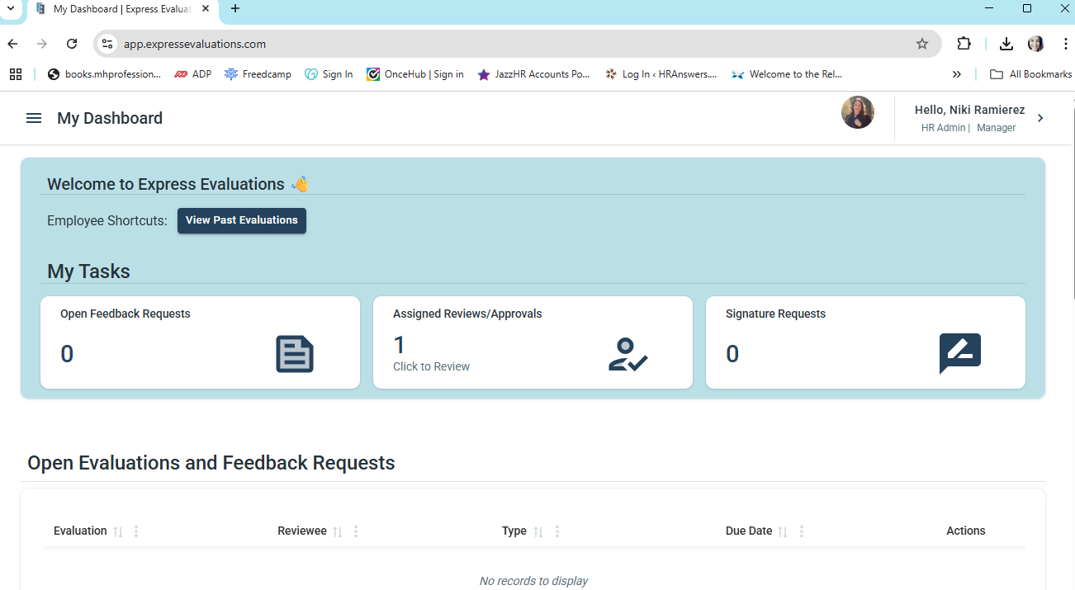
Centralized Efficiency.

Slide 25
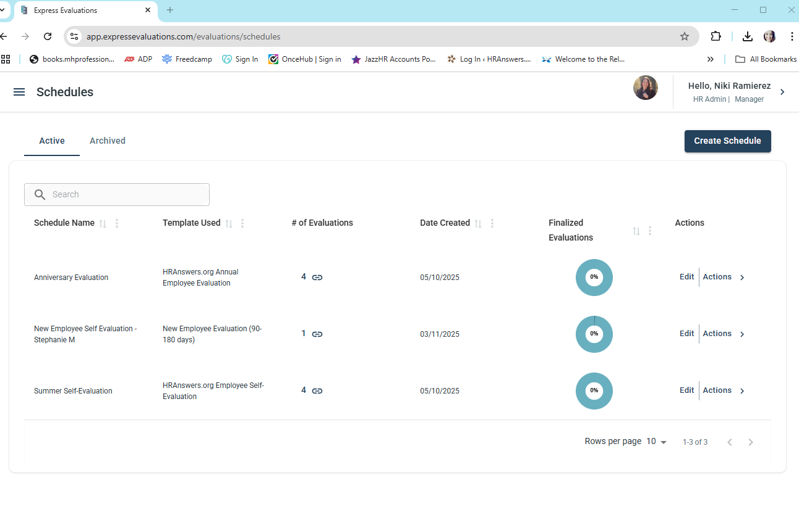
Automating Performance Tracking: Scheduling.

Slide 26
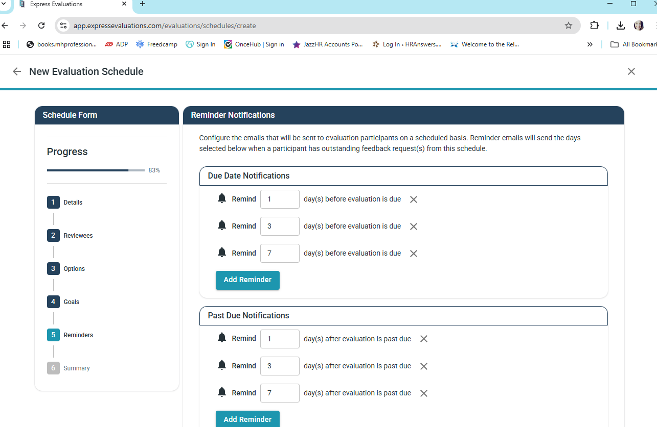
Automating Performance Tracking: Reminders.

Slide 27
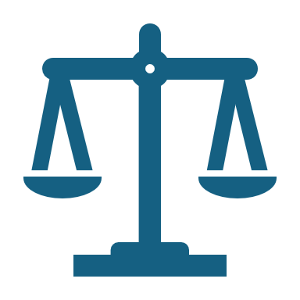
AI for Fairness
Notes:
Two long-term employees, Marissa and Daniel, have been competing for the same internal promotion.
Both have solid tenure and qualifications, but tensions have been rising—especially after Marissa was selected for the role.
Soon after the decision, Daniel—who is a family member of the newly elected tribal governor—filed a complaint with HR, alleging that the process was unfair and that personal relationships may have influenced the outcome. He believes his recent contributions were overlooked, and that his performance was not evaluated objectively.
Where AI Could Help:
The HR team recognizes that while they followed standard procedures, the performance evaluation process relied heavily on manager narratives and lacked structured data.
Moving forward, they decide to implement an AI-powered evaluation tool that:
Tracks objective performance metrics (project completion, accuracy, timeliness)
Analyzes peer and stakeholder feedback using natural language processing to detect themes and tone
Provides a data visualization of growth, skill use, and goals over time
By using AI to standardize how performance is measured and presented, HR can reduce perception of favoritism, ensure decisions are grounded in consistent, transparent data, and restore trust—even in politically sensitive environments.
Takeaway:
While AI won’t remove all conflict, it creates a clearer and more equitable structure that supports fairness and helps HR confidently explain and defend promotion decisions, especially in culturally nuanced and high-stakes settings like tribal governance.

Slide 28
AI Generated Feedback & Goals
Bias Mitigation Through Data
→ Metrics, not personalities or relationships
Standardized Evaluations
→ All employees reviewed on equal footing
Language Analysis
→ Detection of biased feedback
Equity in Action
→ Reflects the respect for all participants

Slide 29

AI for Authenticity & Action

Slide 30
AI Generated Feedback & Goals
AI can propose
ACTIONABLE GOALS
that are aligned not only with what the employee needs to improve, but also with what your
ORGANIZATION
stands for.
Notes:
AI can propose ACTIONABLE GOALS that are aligned not only with what the employee needs to improve, but also with what the ORGANIZATION stands for.

Slide 31
HOW?
AI synthesizes input such as:
  Job responsibilities
  Descriptions of standard rating scales
  Core competencies
  Company’s mission and values
→ And helps you identify performance gaps
Notes:
I have a favorite book… Perfect Phrases for Documenting Employee Performance Problems
AI tools such as ChatGPT can be used by HR professionals to analyze job performance data, role requirements, and organizational values to generate tailored, growth-oriented goals for employees.

Slide 32
Make it Meaningful
Use structured performance definitions to analyze where the employee currently stands and what’s needed to reach the next level.
Generate goal language that’s aligned with the employee’s role and rating.
  For example, moving from “Needs Improvement” to “Effective Performance.”
Notes:
AI tools like ChatGPT can help HR professionals translate performance ratings into meaningful conversations and individualized development goals by:
Using structured performance definitions (like the ones you provided) to analyze where the employee currently stands and what’s needed to reach the next level.
Generating goal language that’s aligned with the employee’s role and rating—for example, moving from “Needs Improvement” to “Effective Performance.”
Framing feedback in ways that promote accountability while maintaining dignity, motivation, and connection to the organization’s values.

Slide 33

Make it More Meaningful
Ask for help to frame feedback in ways that promote accountability while maintaining dignity, motivation, and connection to the organization’s values.
Notes:
AI tools like ChatGPT can help HR professionals translate performance ratings into meaningful conversations and individualized development goals by:
Using structured performance definitions (like the ones you provided) to analyze where the employee currently stands and what’s needed to reach the next level.
Generating goal language that’s aligned with the employee’s role and rating—for example, moving from “Needs Improvement” to “Effective Performance.”
Framing feedback in ways that promote accountability while maintaining dignity, motivation, and connection to the organization’s values.

Slide 34
Sample Prompt 1: Collaboration Challenges
Prompt – Asking for help with conversation flow:
  "Can you help me write professional, compassionate feedback for my HR Assistant who received a 'needs improvement' rating in collaboration? …

Slide 35
Sample Prompt 1: Collaboration Challenges
Performance Review Language – Collaboration Challenges
  … issues include reluctance to share information with teammates and others, difficulty accepting others’ input, and frequent solo decision-making.
  I want to address the concerns clearly but also highlight the employee’s strengths and outline specific next steps for improving teamwork. ...

Slide 36
Sample Prompt 1: Collaboration Challenges
Performance Review Language – Collaboration Challenges
  … And, the feedback needs to be fair, unbiased, and needs to align with our organizational mission and values.”

Slide 37
Let’s Try It Out!

Slide 38
HR Assistant – Sample Prompt #2
Prompt – Asking for help writing a goal.
  “I’m preparing feedback for an HR Assistant who received a ‘Needs Improvement’ rating in attention to detail and stakeholder-centered communication. …

Slide 39
HR Assistant – Sample Prompt #2
Prompt:
  … Please help me write a constructive, values-based goal statement.
  Include language that reflects the formal rating definition, acknowledges the employee’s potential, and outlines a specific improvement goal that could help them move toward ‘Effective Performance.’”

Slide 40
Sample Prompt #2 – Goal Statement
  DRAFT:
  Before responding to questions or requests from colleagues or other stakeholders, pause to gather 2–3 pieces of background information (prior communication with the person requesting your assistance, service history, standard policies, procedures and HR guidance) to inform a more complete response.
  → Track this habit in a journal or shared doc and identify one weekly example where this improved someone's experience collaborating with you.

Slide 41
Sample Improvement Goal
Why it works:
Defines the root of missed or incomplete responses
Moves the employee toward demonstrating sound professional judgment
Reinforces the values of service, compliance, and education while aiming for a consistent standard of performance.
Notes:
This goal addresses the root of missed or incomplete responses and moves the employee toward demonstrating sound professional judgment, reinforcing the values of service, compliance, and education while aiming for a consistent standard of performance.

Slide 42
What I “Taught” ChatGPT
Before asking for assistance, I taught ChatGPT:
  About our industry (personal narrative/company documents)
  All about our mission and values (internal company documents)
  The entire job description (for HR Assistant)
  Our rating scale (from the performance evaluation)
  The categories of performance being evaluated (from the performance evaluation)

Slide 43
Level-Up Your Partnership
Structure Your Request Clearly:
When drafting feedback, provide ChatGPT with specific context, outline what the situation is, include objective examples, and state the intended outcomes.
For instance, mention what was observed, why it matters, and what positive change you’re hoping for.
  → Why? This structured prompt helps generate language that not only communicates the issues but does so in a way that’s supportive and forward-looking.

Slide 44
Level-Up Your Partnership
Ask for Positive Framing and Growth-Oriented Language:
Request that the draft includes empathetic and developmental language.
Ask ChatGPT to "frame the feedback so that it recognizes the employee’s strengths and potential while suggesting clear, actionable next steps."
  → Why? Emphasizing a growth mindset in the prompt encourages the AI to produce responses that focus on improvement rather than just the negative aspects, making the feedback more likely to be received as a constructive opportunity.

Slide 45
Let’s Discuss!
How can you make sure that AI tools align with cultural values and community-centered practices?
Notes:
Automating performance tracking, feedback analysis, and goal-setting.
Streamlining the Process: AI tools like Express Evaluations automate tedious administrative tasks—sending reminders, collecting feedback, and tracking goal progress—freeing HR to focus on strategy and coaching.
Smarter Goal Alignment: AI can analyze past performance data to suggest individualized goals aligned with organizational priorities.
Real-Time Analytics: Instead of waiting for year-end data, AI helps managers track performance trends throughout the review period—supporting proactive interventions.
Human + Machine = Better Together: AI shouldn't replace human judgment but enhance it—giving HR and leaders clearer insights while maintaining the human touch.

Slide 46
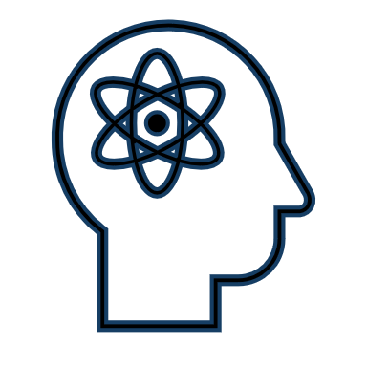
Ethics
& AI
Notes:
Bias Mitigation Through Data: AI can help reduce unconscious bias by analyzing performance metrics, not personalities—highlighting consistency in how employees are evaluated.
Standardized Evaluations: Tools like Express Evaluations allow organizations to create standardized, repeatable templates that ensure all employees are reviewed on equal footing.
Language Analysis: Some platforms use NLP to detect biased language in feedback, helping HR train managers on more inclusive communication.
Equity in Action: For tribal enterprises, fairness isn't just a best practice—it’s a reflection of shared community values and respect for every contributor.

Slide 47
Compliance First
Take time to research and make sure AI systems align with privacy policies, tribal regulations, and any applicable union or employment agreements.
Notes:
Compliance First: Make sure AI systems align with privacy laws, tribal regulations, and any applicable union or employment agreements.

Slide 48
HR as Ethical Gatekeepers
HR must set clear expectations and boundaries to guide how AI is used.
Meet with your Council, Board, CEO, etc. to discuss first
Focus on ensuring it enhances, not harms, the employee experience.
Notes:
HR as Ethical Gatekeepers: HR must guide how AI is used—ensuring it enhances, not harms, the employee experience.

Slide 49
Be Transparent
Transparency builds trust.
Always inform employees about how AI tools are used, what data is collected, and how it's applied in employment decisions.
Notes:
Transparency Builds Trust: Always inform employees about how AI tools are used, what data is collected, and how it's applied in decisions.

Slide 50
Avoid Over-Reliance
AI provides ________ not final ________.
Human review is essential to avoid ________, ________ in algorithms, or ________ loss.
Notes:
Avoid Over-Reliance: AI provides insights—not final judgments. Human review is essential to avoid errors, bias in algorithms, or context loss.

Slide 51

Stay in the
Driver’s Seat
Select tools that allow full control over evaluation design and data visibility, keeping HR in the driver’s seat.
Avoid using systems that only offer a “cookie-cutter” approach or single format or rating scale.
Notes:
Express Evaluations Example: This tool allows full control over evaluation design and data visibility—keeping HR in the driver’s seat.

Slide 52
Homework.
What ethical guardrails does your organization need to put in place before brining AI into the performance review process?
Notes:
Automating performance tracking, feedback analysis, and goal-setting.
Streamlining the Process: AI tools like Express Evaluations automate tedious administrative tasks—sending reminders, collecting feedback, and tracking goal progress—freeing HR to focus on strategy and coaching.
Smarter Goal Alignment: AI can analyze past performance data to suggest individualized goals aligned with organizational priorities.
Real-Time Analytics: Instead of waiting for year-end data, AI helps managers track performance trends throughout the review period—supporting proactive interventions.
Human + Machine = Better Together: AI shouldn't replace human judgment but enhance it—giving HR and leaders clearer insights while maintaining the human touch.

Slide 53
Before We Go:
1. What is one thing that you’re taking away from this session?
2. What’s one thing you want to learn more about?
Notes:
Automating performance tracking, feedback analysis, and goal-setting.
Streamlining the Process: AI tools like Express Evaluations automate tedious administrative tasks—sending reminders, collecting feedback, and tracking goal progress—freeing HR to focus on strategy and coaching.
Smarter Goal Alignment: AI can analyze past performance data to suggest individualized goals aligned with organizational priorities.
Real-Time Analytics: Instead of waiting for year-end data, AI helps managers track performance trends throughout the review period—supporting proactive interventions.
Human + Machine = Better Together: AI shouldn't replace human judgment but enhance it—giving HR and leaders clearer insights while maintaining the human touch.

Slide 54
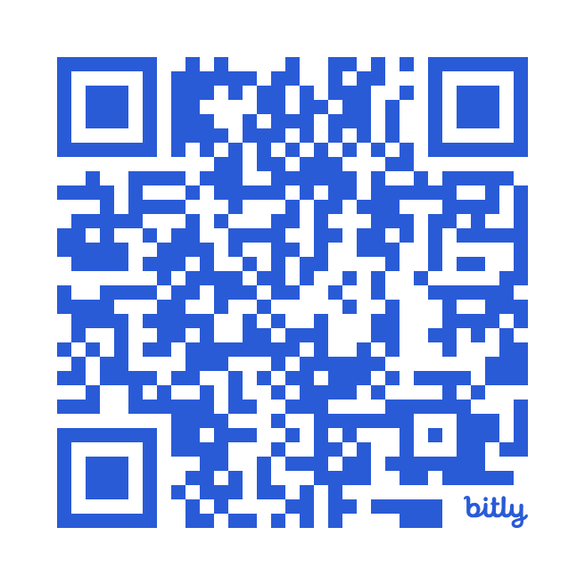

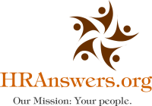
Let’s Keep The Conversation Going.
Reach out to your facilitator:
Niki Ramirez, MBA – THRP, SPHR
Founder & Principal Consultant
HRAnswers.org
call: (602) 715-1300
email: nramirez@hranswers.org

Slide 55

Your Facilitator:
Niki Ramirez, MBA | SPHR | SHRM-CP | THRP
I’m a certified human resources consultant, team workshop facilitator, and the founder of HRAnswers.org. We focus on providing practical, impactful HR consultation to business leaders and HR professionals so that they can relax and focus on their goals.
We believe that professional human resources support isn’t only for big companies with huge budgets. Extra HR support is something that every size organization deserves! We help our clients create HR and training programs that align with their organizational goals and culture, to yield maximum results.
Our mission: To create a positive ripple in the world through HR consulting.

