Slide 1
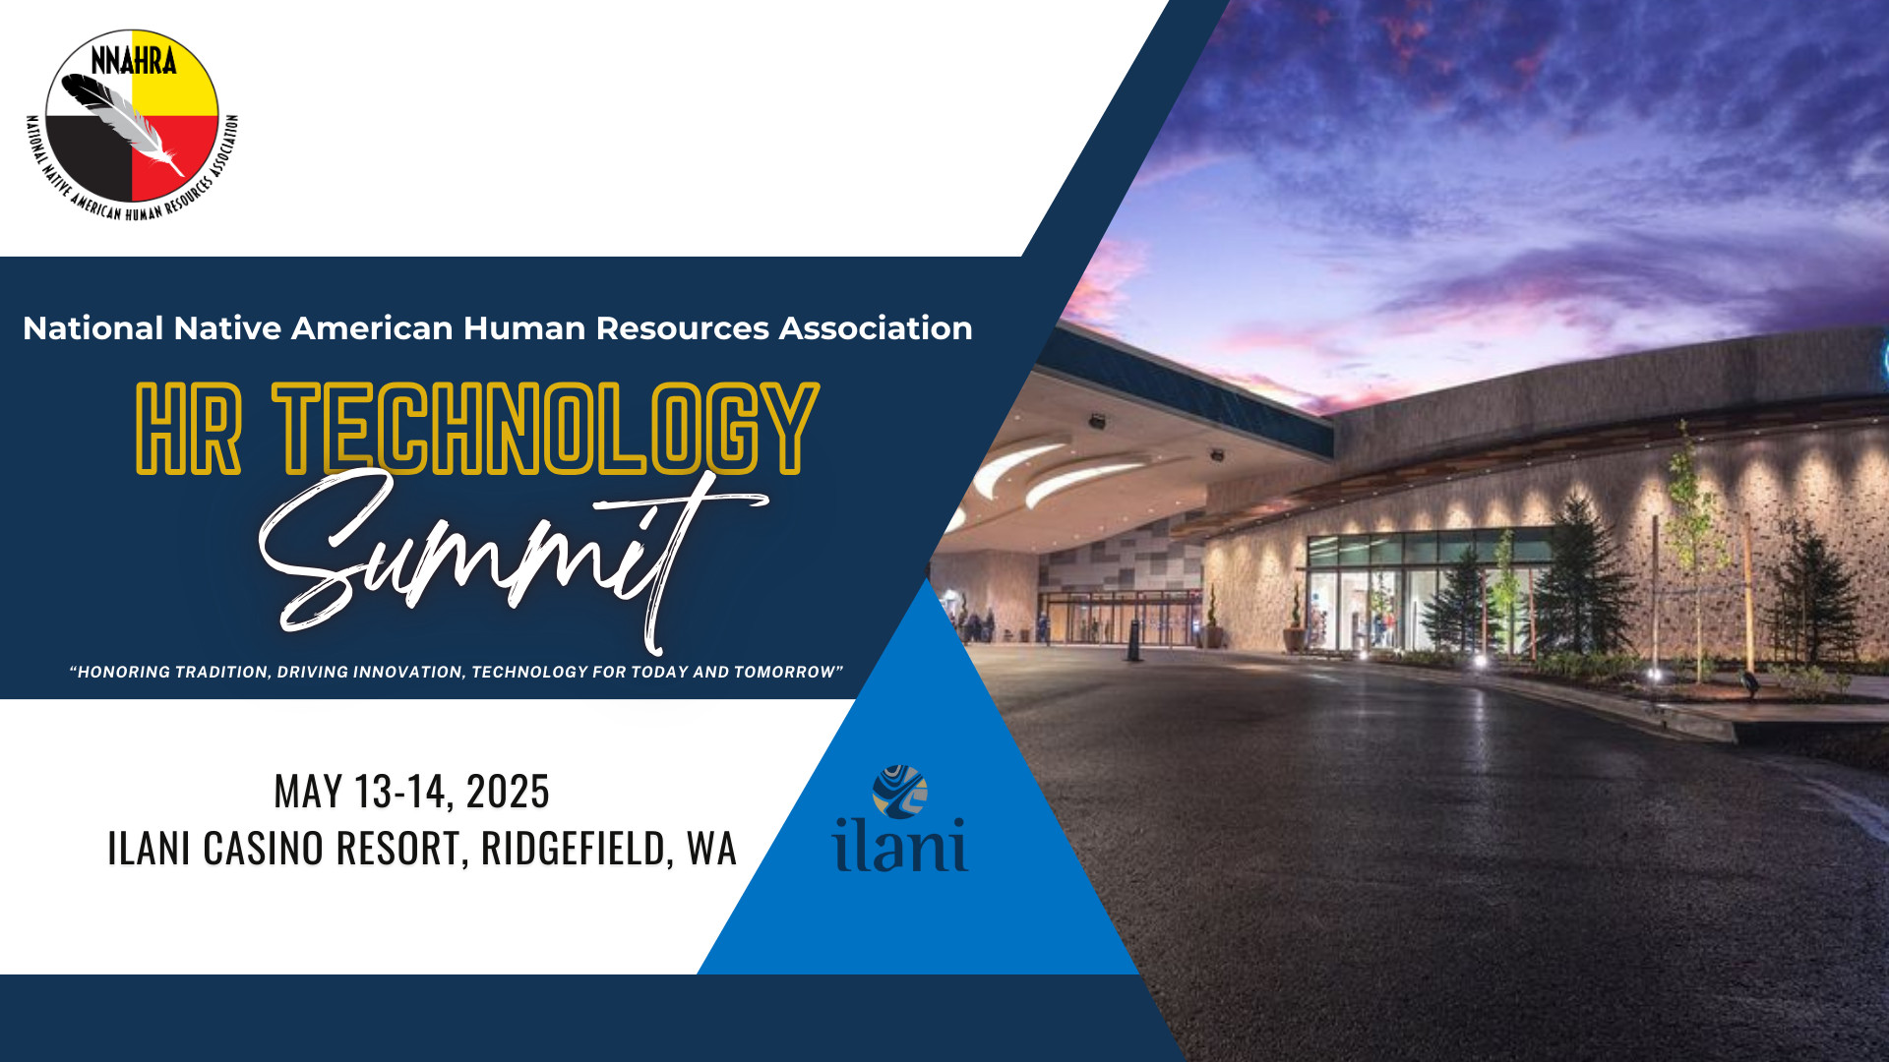

Slide 2

From Likes to Loyalty: How Social Media Shapes Employer Brand & Culture
Exploring social media's impact on workplace dynamics
By Charles Walters, CHRO, Isleta Resort & Casino
Notes:
AI-generated content may be incorrect. --- In today's digital age, social media plays a pivotal role in shaping employer branding and workplace culture. This presentation will explore how organizations can leverage social media to attract talent, engage employees, enhance workplace culture, and build authentic employer brands.

Slide 3

Agenda Items
Leveraging Social Media to Attract Talent
Cultivating Long-Term Engagement
Enhancing Workplace Culture
Building an Authentic Employer Brand
Notes:
We will begin by discussing how to use social media to attract top talent, focusing on authentic job posts and showcasing company values. Next, we will explore strategies for cultivating long-term engagement with employees through interactive content. We will then look at enhancing workplace culture before moving on to building an authentic employer brand. Finally, we will review best practices from HR professionals in tribal governments and resorts.

Slide 4

Leveraging Social Media to Attract Talent
Notes:
Attracting the right talent through social media requires a strategic approach. Organizations must understand their target audience and the platforms where they engage, crafting messages that resonate with potential candidates.

Slide 5

Identifying Target Audience and Platforms
Understanding Your Audience
Identifying your target audience is crucial for effective recruitment on social media. It helps tailor your approach to meet their preferences.
Demographics and Preferences
Different demographics prefer different social media platforms. Understanding these preferences guides your recruitment strategy.
Platform Selection
Knowing where your ideal candidates spend their time online allows you to select the most effective platforms for your recruitment efforts.
Notes:
The first step in leveraging social media for recruitment is identifying your target audience. Different demographics prefer different platforms, so it’s essential to know where your ideal candidates spend their time online.

Slide 6

Crafting Authentic Job Posts and Content
Importance of Authenticity
Authenticity is crucial in job postings as it attracts the right candidates who resonate with the company culture.
Conversational Tone
Using a conversational tone in job posts helps create a friendly approach that engages potential candidates effectively.
Showcasing Work Environment
Provide insights into the actual work environment to help candidates envision themselves in the role and organization.
Notes:
Authenticity is key when crafting job posts. Use a conversational tone and provide insights into the actual work environment, making sure candidates can envision themselves in the role and company culture.

Slide 7

Showcasing Company Values and Culture
Engaging Visuals
Use captivating visuals to represent your company's values and culture, making it relatable and engaging for your audience.
Behind-the-Scenes Content
Share behind-the-scenes stories that highlight daily operations and the work environment, providing an authentic view of your company.
Employee Testimonials
Highlight employee testimonials that reflect personal experiences and how the company's values resonate with them.
Core Values Initiatives
Showcase initiatives that embody your company's core values, demonstrating commitment to those values in practice.
Notes:
Showcase your company’s values and culture through engaging visuals and stories. Share behind-the-scenes content, employee testimonials, and highlight initiatives that reflect your core values.

Slide 8

Cultivating Long-Term Engagement
Notes:
Once talent is attracted, fostering long-term engagement is crucial for retention. Organizations must create interactive content and enable employees to share their experiences and stories.

Slide 9
Interactive and Engaging Content Strategies
Employee Involvement
Involving employees in the content creation process fosters ownership and encourages creativity within the organization.
Polls and Quizzes
Using polls and quizzes can make content more engaging and provide valuable insights into employee preferences.
Enhancing Engagement
Interactive content strengthens community among staff and enhances overall engagement, leading to a vibrant workplace culture.
Notes:
Develop strategies that involve employees in the content creation process. Polls, quizzes, and interactive posts can strengthen community and enhance engagement among staff.

Slide 10

Employee Advocacy and Storytelling
Personal Story Sharing
Encouraging employees to share their personal stories creates authentic connections with the audience and enhances brand visibility.
Humanizing the Brand
When employees share their experiences, it humanizes the brand and makes it more relatable to clients and candidates.
Building Trust
Storytelling helps in building trust with potential candidates and clients by showcasing the company's culture and values.
Notes:
Encourage employees to share their personal stories and experiences on social media. This not only humanizes the brand but also builds trust with potential candidates and clients.

Slide 11

Continuous Feedback and Engagement Loops
Understanding Employee Needs
Feedback loops allow organizations to gauge employee sentiments and better understand their needs, fostering a supportive work environment.
Improving Engagement
By actively seeking feedback, organizations can boost employee engagement, ensuring that team members feel valued and motivated.
Regular Surveys
Conducting regular surveys helps capture employee opinions and insights, leading to informed decisions that enhance workplace satisfaction.
Notes:
Implementing feedback loops can help organizations understand employee needs and improve engagement. Regular surveys and open discussions ensure everyone feels heard and valued.

Slide 12

Enhancing Workplace Culture
Notes:
A positive workplace culture is essential for employee satisfaction and retention. Organizations should actively promote inclusivity, celebrate achievements, and support mental health.

Slide 13

Promoting Inclusivity and Diversity
Attracting Diverse Talent
An inclusive workplace encourages a wide range of applicants, enhancing the talent pool and promoting innovation.
Fostering Innovation
Diversity in the workplace leads to varied perspectives, which can significantly stimulate creative solutions and innovative thinking.
Valuing Employees
Creating an environment of respect and value for all employees encourages engagement and retention within the organization.
Notes:
An inclusive workplace attracts diverse talent and fosters innovation. Companies must prioritize diversity initiatives, creating an environment where all employees feel valued and respected.

Slide 14
Celebrating Employee Achievements and Milestones
Boosting Employee Morale
Recognizing employee achievements significantly boosts morale, encouraging them to perform at their best.
Fostering Team Belonging
Celebrating milestones fosters a strong sense of belonging among employees, enhancing team cohesion.
Positive Company Culture
Sharing these celebrations on social media reinforces a positive company culture and attracts top talent.
Notes:
Recognizing and celebrating employee achievements boosts morale and fosters a sense of belonging. Share these celebrations on social media to reinforce a positive culture.

Slide 15

Supporting Mental Health and Well-Being
Mental Health Initiatives
Organizations should prioritize mental health initiatives to foster a supportive and healthy workplace culture.
Resource Sharing
Sharing mental health resources can empower employees to seek help and understand their well-being.
Healthy Work-Life Balance
Creating programs that promote a healthy work-life balance is essential for employee well-being and productivity.
Notes:
Organizations should actively support mental health and well-being initiatives. Share resources and create programs that promote a healthy work-life balance.

Slide 16

Building an Authentic Employer Brand
Notes:
An authentic employer brand helps attract and retain talent. Transparency and consistency in communication reinforce trust among potential and current employees.

Slide 17
Transparency and Integrity in Communication
Open Communication
Open and honest communication fosters trust within an organization, leading to a positive company culture.
Building Credibility
Transparent communication enhances the organization's credibility and strengthens the relationship with stakeholders.
Strong Employer Brand
When organizations communicate their values and culture clearly, they attract and retain top talent.
Notes:
Organizations must communicate openly and honestly about their practices, values, and culture. This builds credibility and a strong employer brand.

Slide 18
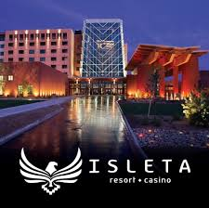
Consistency in Branding Across Platforms
Importance of Consistent Branding
Consistent branding across platforms enhances recognition and credibility, making it easier for customers to identify your brand.
Strengthening Brand Identity
A coherent message across platforms solidifies brand identity, fostering trust and loyalty among consumers.
Impact on Customer Engagement
Consistent messaging encourages higher customer engagement and interaction across social media channels.
Notes:
Ensure that the branding and messaging are consistent across all social media platforms. This coherence strengthens brand identity and recognition.

Slide 19

Real-World Examples From Isleta Resort & Casino
Social Media Strategies
Isleta Resort & Casino has effectively utilized social media strategies to enhance visibility and engagement with potential employees.
Authentic Storytelling
The resort employs authentic storytelling to connect with audiences, sharing genuine employee experiences and brand narratives.
Employee Engagement
Engaging employees in social media initiatives fosters a sense of community and strengthens the employer brand at Isleta Resort & Casino.
Notes:
Isleta Resort & Casino has successfully implemented various social media strategies to enhance its employer brand. Their use of authentic storytelling and employee engagement showcases best practices in action.

Slide 20
Conclusion
Employer Branding
Social media plays a crucial role in shaping an organization's employer brand, making it essential for attracting talent.
Talent Attraction and Retention
Leveraging social media effectively helps organizations attract and retain top talent in a competitive market.
Fostering Engagement
Effective use of social media fosters employee engagement, creating a vibrant workplace culture that resonates with everyone.
Notes:
Social media is a powerful tool for shaping employer brand and culture. By leveraging it effectively, organizations can attract and retain talent, foster engagement, and build a strong workplace culture that resonates with employees and candidates alike.

Slide 21


