Slide 1
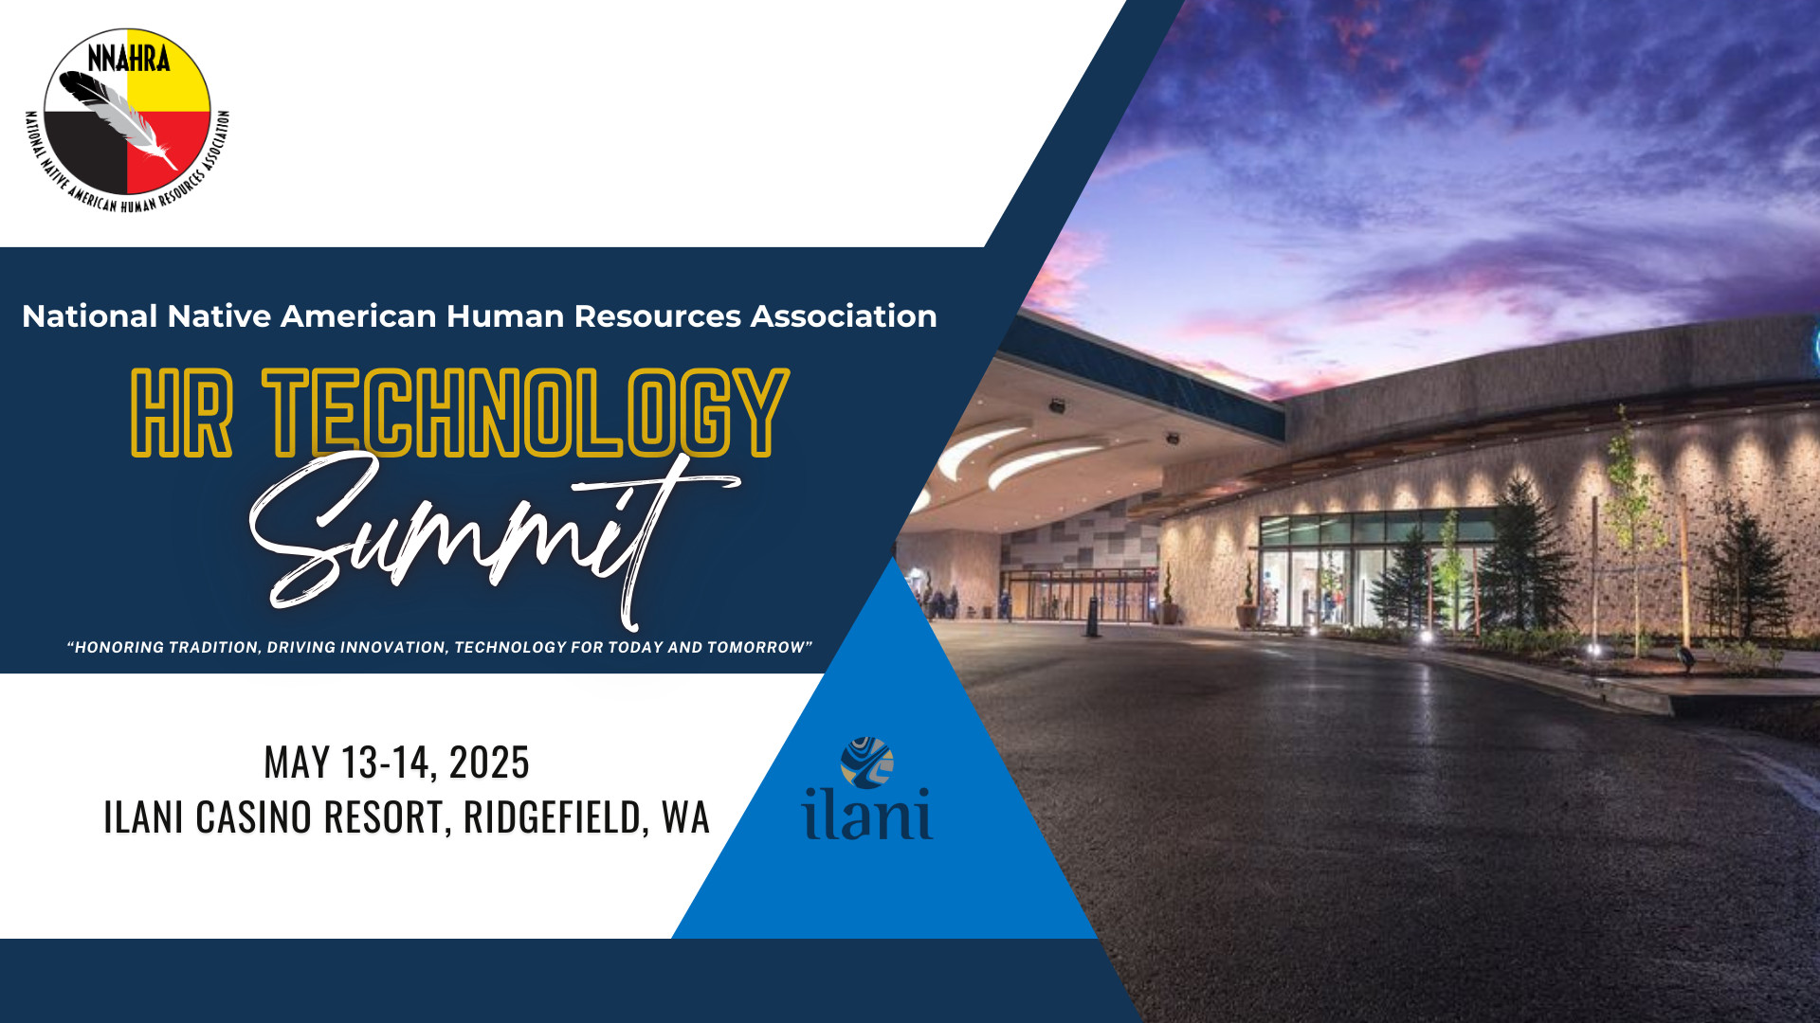

AI and Data Analytics for the Employee Lifecycle:
Navigating Employee Acquisition,
Retention & Turnover.

Slide 2

Where We’re Headed
Introductions
Illustrative Case Studies
Employee Lifecycle Framework
Opportunities, Pitfalls & Pro Tips
Case Studies Revisited

Slide 3


S3 Management Group
S3 has spent more than 15 years establishing itself as the leading provider of Employee Risk Management Solutions in Indian Country. Currently serving more than 100 tribal entities, 40,000 employees and $1.5bn payroll
Jeff Yates
Vice President of Marketing & Business Development

Slide 4

AI – the importance of clarity!

Slide 5

AI – the importance of clarity!
Old School Definition:
artificial intelligence noun
1: the capability of computer systems or algorithms to imitate intelligent human behavior
2: a branch of computer science dealing with the simulation of intelligent human behavior by computers

Slide 6
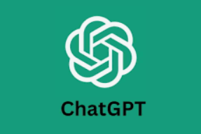
AI – the importance of clarity!
Modern Day Definition:
Artificial intelligence (AI) refers to the simulation of human intelligence in machines that are programmed to think and learn like humans. It encompasses a broad range of technologies and applications where machines perform tasks that typically require human intelligence, such as visual perception, speech recognition, decision-making, and language translation. AI systems often rely on algorithms and data to analyze patterns, make predictions, and improve over time through experience, resembling cognitive functions associated with human minds.

Slide 7
🧠 Reframing AI for HR: Partnership, Not Replacement
KEY TAKEAWAYS
AI is not here to take our jobs—it’s here to take on the tasks we don’t want to do.
The future of HR will not be about replacing people with machines. It will be about equipping HR professionals with sharper, faster, and smarter tools to deliver even greater impact.
Think of AI as your strategic co-pilot—handling the repetitive, manual, and administrative work so that you can focus more deeply on the human side of Human Resources.

Slide 8
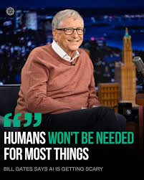
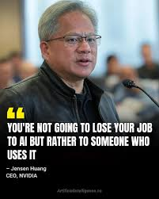
Friend or Foe: AI & Data Analytics in HR
Vs.

Slide 9
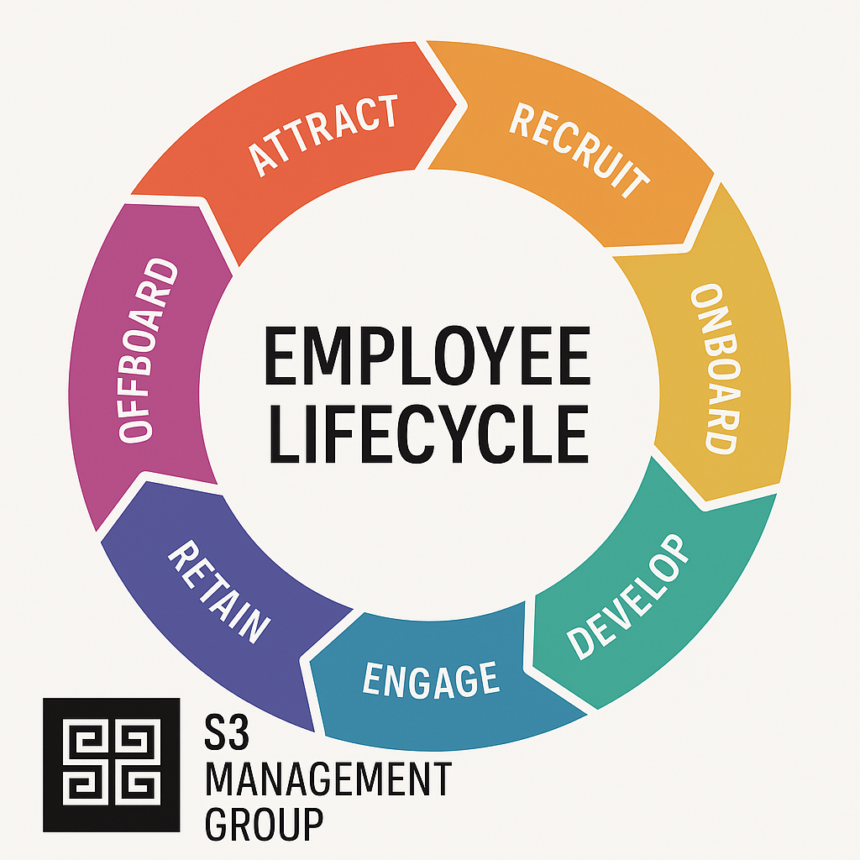
Employee Risk: Lifecycle Framework

Slide 10
Employee Lifecycle Risks & Impact
Risk Category Qualitative Risks Quantitative Risks
Employee Acquisition Cultural misalignment 30 – 400% of salary in hiring/turnover cost
Poor skills fit risk of negligent hiring lawsuits
Unsafe hires
Employee Misconduct Workplace toxicity Legal settlements & litigation
Harassment/bullying Brand damage
Ethical violations Increased turnover
Retention Disengagement 17 - 21% drop in productivity
Career stagnation Loss of top performers
Poor leadership Declining morale
Turnover Team disruption 30 – 150% of salary lost per exit
Institutional knowledge loss Recruitment & training expense
Unemployment Workforce instability Severance costs
Negative employer reputation Rising unemployment premiums
Legal/claims exposure

Slide 11
Case Study #1: Uber – Workplace Toxicity
Background In 2017, former Uber engineer Susan Fowler published a blog post detailing systemic sexual harassment and discrimination within the company. Her revelations highlighted a toxic work environment where complaints were often ignored, and perpetrators faced minimal consequences.
Legal and Financial Consequences
$10 Million Settlement (2018): Uber agreed to legal/financial settlements for more than 500 workers
$4.4 Million EEOC Settlement (2019): The EEOC found reasonable cause to believe that Uber permitted a culture of sexual harassment and retaliation.
Organizational Impact
Leadership Changes: In 2017, CEO Travis Kalanick resigned amid mounting pressure from investors and the public due to the company's toxic culture and multiple scandals.
Employee Terminations: An internal investigation led by former U.S. Attorney General Eric Holder resulted in over 20 employees being fired for misconduct, including sexual harassment and discrimination.
Reputational Damage: The widespread media coverage of Uber's internal issues significantly tarnished its public image, leading to customer distrust and challenges in talent acquisition and retention.
Strong probability this could have been prevented with AI and
predictive analytics!

Slide 12

Case Study #2: McDonald’s – the Power of a Bad Hire
McDonald’s Franchisee negligently hires a manager with a history of adverse behavior
  Legal and Financial Consequences
  $4.35 Million Settlement (2024)
  Corporate costs of training & harassment prevention resources
  Organizational Impact
  Leadership Changes
  Toxic work environment
  Reputational Damage
  Industry strikes in 12 U.S. cities aimed at protesting sexual harassment in McDonalds stores
Strong probability this could have been prevented with AI and
predictive analytics!

Slide 13

Case in Point – Closer to Home!
Let's Talk About Resumes...
Let's pause to talk about resumes:
Leonardo da Vinci is credited with the earliest resume – dating back to 1482 when he wrote to the
Duke of Milan
2023 Resume Lab Survey – 70% of jobseekers admit to lying, 52% about job title and skills
2025 Monster Survey
  99% correct spelling gets you hired 3x more often
  89% of hiring managers look for skills on the resume
Resume tricks
  key word game – white letters on the bottom
  ChatGPT
  Google how to write the perfect resume – 239,000,000 recommendations in .32 seconds

Slide 14
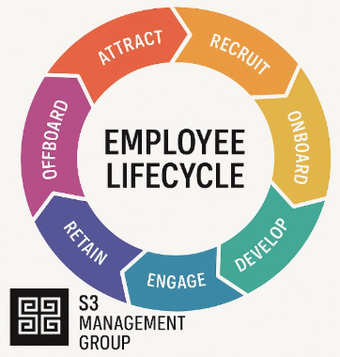
Opportunities & Pitfalls
How AI and Data Analytics is Assisting HR in
Recruiting
Retention
Workplace Misconduct
Separations & Unemployment
All of these help Employers Attract, Protect & Retain Employees!

Slide 15
Opportunities & Pitfalls - Recruiting
OPPORTUNITIES: AI is revolutionizing recruiting practices in numerous ways. Here are some of the top ways AI is used in recruiting:
Resume Screening: AI algorithms can quickly analyze resumes to identify relevant skills and experience
Candidate Sourcing: AI tools can search databases and social media to find potential candidates who match specific criteria.
Chatbots for Initial Interaction: Chatbots powered by AI can engage with candidates, answer questions, and schedule interviews, providing a seamless initial interaction.
Predictive Analytics and Skills Assessment: AI algorithms predict candidate success based on historical data, improving hiring decisions. It can also evaluate candidate's skills through testing, providing objective insights
Video Interviews: AI analyzes facial expressions, tone, and speech patterns in video interviews to assess candidate suitability.

Slide 16
Opportunities & Pitfalls - Recruiting
PITFALLS: Here are some key flaws and concerns with using AI in the hiring process:
1. Bias in, Bias out - If the training data contains historical bias (e.g., favoring certain schools, genders, or ethnicities), AI can learn and replicate that bias.
2. Lack of Transparency - Many AI models don’t explain why they make certain decisions.
3. Over-Reliance on Keywords – AI may favor resumes that use the right “buzzwords,” even if the actual experience is less relevant.
4. Candidate Experience Risks - Automated processes (e.g., chatbots) can feel impersonal, frustrating, or dismissive to candidates, especially if something goes wrong or they can’t get human support.
5. The Right Kind of Testing - use of skills and assessments can be beneficial, but it's critical to utilize solutions that are accurate and effective. Typical behavioral testing provides a snapshot of the person the day they take the test, but there is a far greater need to understand the true internal hard wiring of a person

Slide 17
Opportunities & Pitfalls - Retention
OPPORTUNITIES: How companies are using AI to improve retention of new hires, especially during the first year:
1. Predictive Analytics for Turnover Risk - AI analyzes data like candidate's background, onboarding experience, engagement levels, and team dynamics, and it can flag employees who might be at higher risk of quitting.
2 . Personalized Onboarding Experiences - AI can tailor onboarding content to each employee’s role, location, learning style, and pace. Personalized guidance helps new hires feel supported and reduces confusion or early frustration.
3. Smart Scheduling and Workload Balancing - AI can analyze workload data and suggest when an employee might be overwhelmed, helping managers adjust tasks and prevent burnout.
4. Better Hiring to Begin With - Hiring the right person from the start is the best retention strategy. AI improves job-person fit by analyzing qualifications, best fit internal wiring, and preferred work environments.
5. Address the Mental Wellness of Employees – There are a variety of ways that a company's approach to mental wellness will increase their odds of retaining (even attracting employees):
  Early Detection of Burnout and Stress
  24/7 AI-Powered Support (Chatbots & Virtual Coaches)
  Improved Work-Life Balance Insights

Slide 18
Opportunities & Pitfalls – Workplace Misconduct
Opportunities: How AI Can Help Prevent or Address Workplace Misconduct
1. Monitoring Communication for Red Flags - AI can scan internal emails, chats (like Slack or Teams), and other digital communication for signs of harassment, bullying and discriminatory language
2. Anonymous Reporting and Case Tracking - AI-enabled tools can make it easier for employees to report misconduct anonymously and securely.
3. Bias Detection in Promotions or Pay - AI tools can audit HR decisions to detect and alert when there are unexplained disparities in promotions, pay raises, and performance ratings. Helps reduce systemic bias and inequality before it escalates to formal complaints.
4. Training and Education - AI can personalize ethics and misconduct prevention training to each employee’s risk profile, role, and past behavior. Makes compliance programs more engaging and relevant.

Slide 19
Opportunities & Pitfalls - Workplace Misconduct
Pitfalls: Risks & Ethical Concerns with AI in Misconduct Detection
1. Privacy Intrusion - Monitoring employee messages can feel creepy or invasive if done without transparency, and over-monitoring can create a "surveillance culture" that kills trust.
2. Lack of Context - AI can detect what was said, but not why or how — it can miss power dynamics, intent, or nonverbal behavior.
3. Anonymous Reporting still puts the investigative work on HR and Employee Relations – AI can provide a simple way to report incidents, but it fails to address the workload related to investigations. More importantly, AI cannot remove the fact that internal investigations are always at risk of internal bias.

Slide 20
Opportunities & Pitfalls – Unemployment
Opportunities
1- Predictive Analytics for Turnover
  Identify at-risk employees before they leave using behavioral, performance, and engagement data.
  Enables proactive retention strategies and workforce planning.
2- Optimized Hiring and Fit Prediction
  Match candidates to roles more effectively based on science and alignment to your organization
  Reduce early-stage turnover and hiring costs.
3- Real-Time Workforce Insights
  Track sentiment, engagement, and productivity trends.
  Respond to emerging organizational risks before they result in job loss or disengagement.
  Track separation and UI loss trends to facilitate proactive lifecycle management, "ie. the data tells the story"
4- Improved Offboarding Decisions
  Identify where reassignments, retraining, or phased exits can reduce abrupt layoffs and associated claims.

Slide 21
Opportunities & Pitfalls - Unemployment
PITFALLS
Bias and Discrimination Risks
AI models can reinforce existing biases if trained on flawed data (e.g., demographic patterns in past layoffs).
Can lead to discriminatory practices, legal liability, and brand damage.
Over-reliance on Automation
Decisions like layoffs or promotions made solely by AI can be dehumanizing or contextually flawed.
Human oversight is imperative (HITL).
Ethical Concerns
Predicting unemployment risk could be perceived as “profiling” employees unfairly.
Could harm morale if not handled professionally.

Slide 22
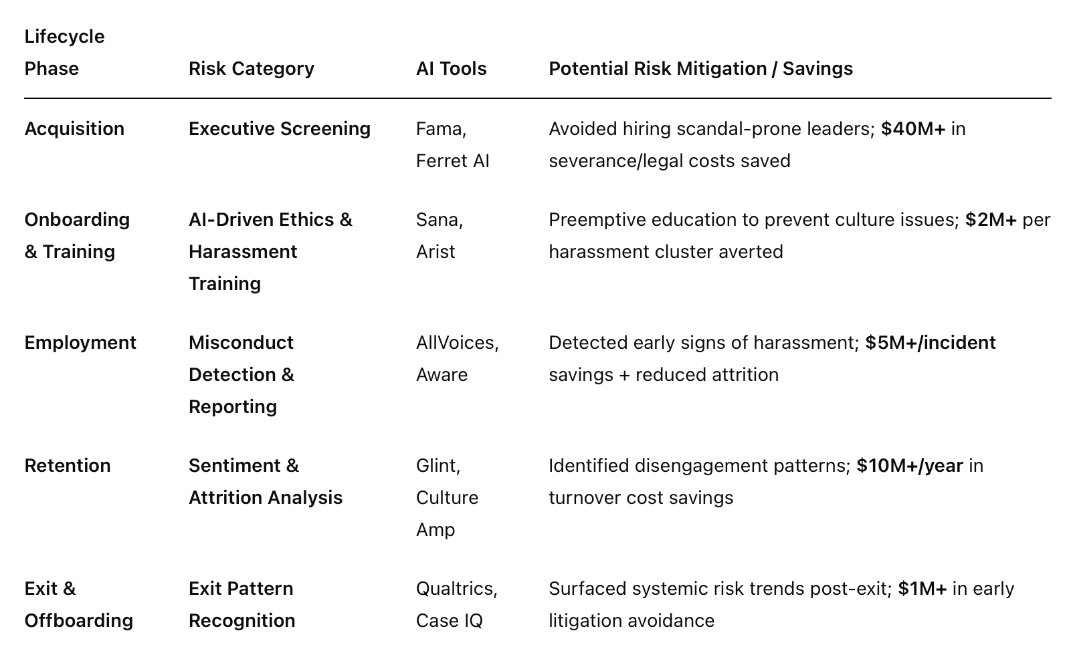
Case Study Revisited: McDonalds Risk Mitigation Through the Lifecycle Lens

Slide 23
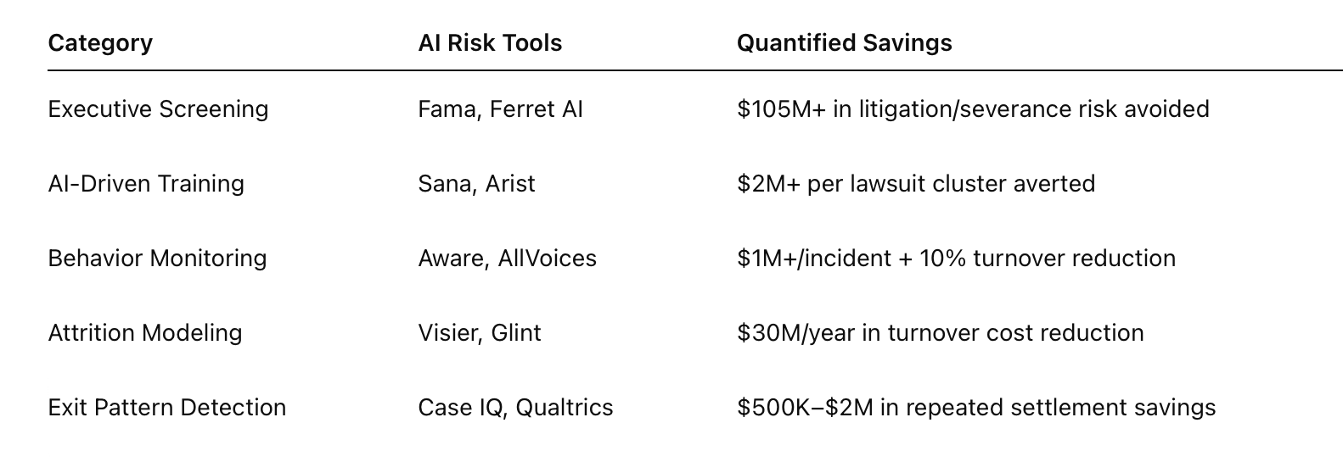
Case Study Revisited: Uber Risk Mitigation Through the Lifecycle Lens

Slide 24
The Importance of HR with Employee Lifecycle Risk
If people are your greatest asset, they’re also your greatest potential risk.
By its nature, HR is on the front lines—whether you choose to be or not. Not leaning in creates exposure and leaves HR vulnerable, reactive and replaceable.
Final Thoughts to Consider:
HR is the Gatekeeper to Employee Risk
People Risk Management Elevates HR
The Cost of Avoidance is Real….and Rising!
Only HR has the full Lifecycle View
People Risk is Business Risk

Slide 25
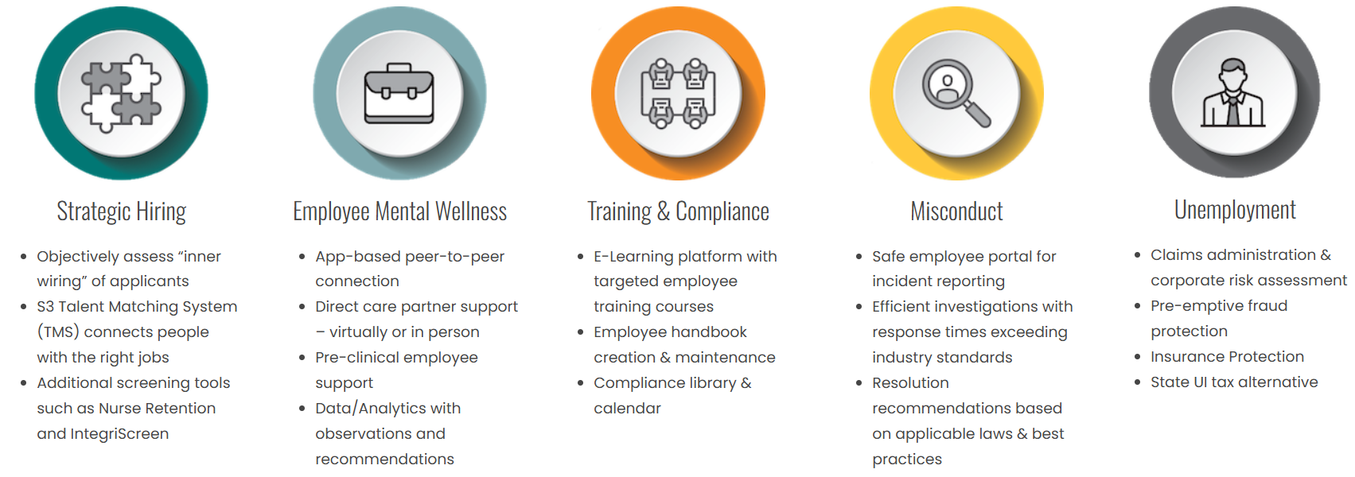
The S3 Sentinel: Minimizing Employee Lifecycle Risk

Slide 26

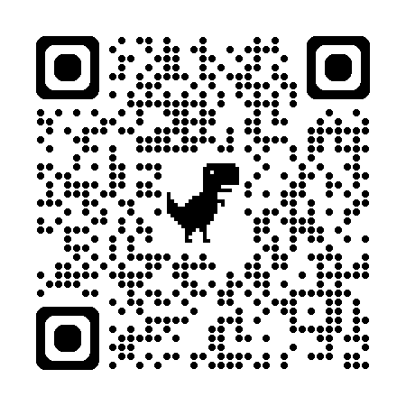
Questions or Comments?
Jared.Smith@S3ManagementGroup.com
Jeff.Yates@S3ManagementGroup.com
Let us know how we can help!!

