Slide 1


Slide 2


Mike Day
Executive Officer,
TribalHub
TribalHub is the largest community of technology-minded leaders from tribal governments and enterprises.
For over 25 years, we have collaborated with tribal government, health, gaming, hospitality, and other sectors to build a robust network and provide industry-leading events, membership programs, and services.

Slide 3
Weaving the Future:
How Technology is Transforming HR in Tribal Nations
Technology continues to change our lives and our world. It is reshaping the way we work and live.
Technology CHANGE is continuous and exponential
  It is disruptive in our lives and in our workplaces
  It creates both opportunities and challenges
  Our ability to leverage technology will be a key factor in our personal, professional and organizational success.

Slide 4
Setting the Stage:
The Ever-Evolving World of Work
In this room we have HR leaders from small tribes, mid-size tribes and large tribes or tribal owned enterprises. You each represent and support your own teams as well as all organizational employees. Those employees range from youthful individuals that are likely to be energized and excited to be starting their careers - to those long time employees that hold vast operational wisdom, but perhaps are contemplating retirement and maybe hoping to avoid drastic change.
Humans struggle with Change -
Technology IS Change

Slide 5
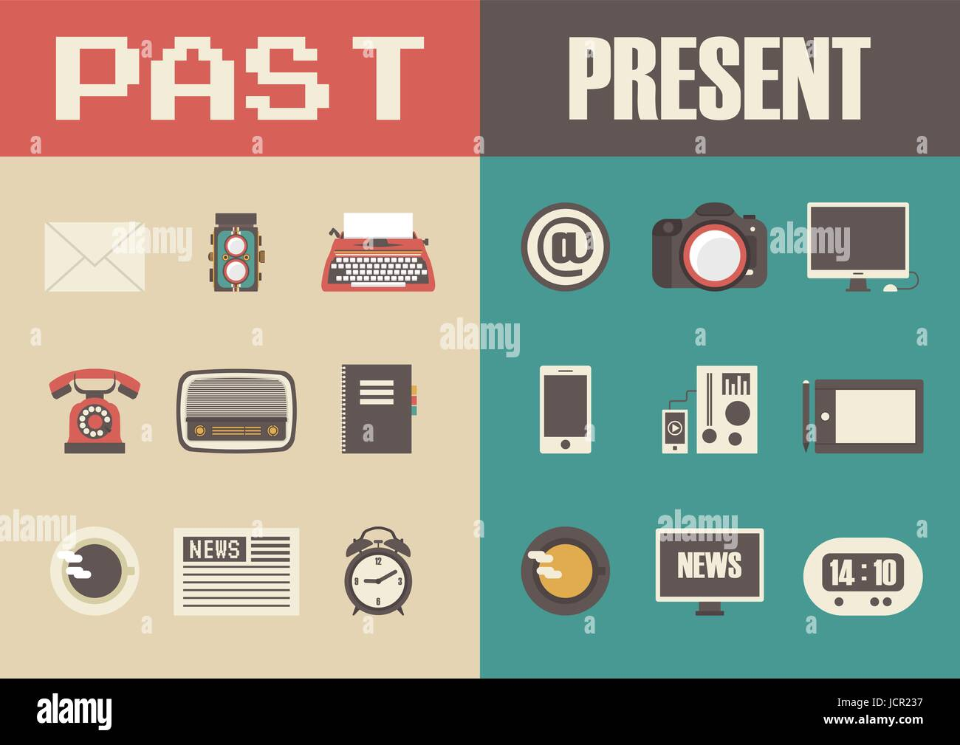
Technology Transformation: Tech Progression (Past 35 Years)
Let’s go back just a few years - a time when many in this room were likely just starting their work careers:
No Windows - DOS and Green Screen
Pagers - no smart phones
Dial-up Internet (You can still hear that sound…)
Limited and expensive storage - little data
No Wi-Fi
No Google, Apple, Amazon, Cloud, Social Media….
Now:
Cloud, Mobile, Connectivity Everywhere
Digital Everything
Big Data and it’s all about the data
CyberSecurity front and center
Social Media, video and cameras everywhere
Data-driven decision-making
Exponential speed of change and disruption

Slide 6

HR's Transformation: A Look Back (Past 25 Years)
Then
Paper-based processes
Dot-Matrix printers (you can still hear them…)
Manual record-keeping
Time-consuming administrative tasks
Limited data analysis
Basic applicant tracking
Legacy HR data systems
Now
Online recruitment and ATS
HRIS and HCM systems
Automated processes
Performance management software
LMS
Data-driven decision-making
Employee self-service

Slide 7
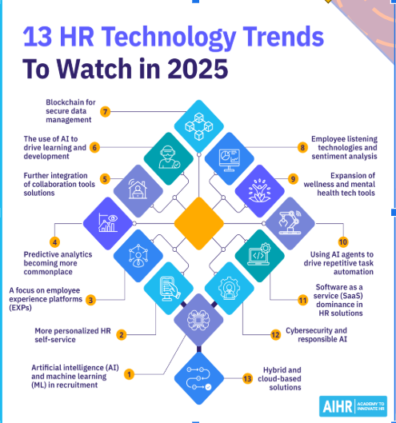
We are in the Digital Age of HR and introducing disruptive AI…
Overview of current trends in HR technology:
Mobile HR applications
Integration of social media into HR practices
More Self-Service
Modernization of job descriptions/functions
Technology upskilling
Role in policies around AI ethics and AI bias

Slide 8

How will tech change our workplace in coming years?
The truth is… nobody can be completely certain as we truly are at a another technology disruption point, but here is what we do know….

Slide 9

How might tech change our workplace in coming years?
Innovation continues at an exponential and almost unbelievable pace: Take quantum computing development, and then imagine what happens when we start powering AI systems with this?
Google’s new quantum chip ''Willow'' (introduced in Dec24) can solve problems in under 5 minutes that would take 10 septillion years ( 25 zeros on 1 i.e. 10,000,000,000,000,000,000,000,000 ) for the world’s fastest supercomputer.

Slide 10
How might tech change our workplace in coming years?
The futurists and economists are doing what they do, which is make predictions: “By 2030, AI could potentially displace a significant number of jobs, with estimates ranging from 92 million to potentially 300 million globally. McKinsey & Company suggests that 400 to 800 million individuals could be displaced due to automation, including AI. However, the World Economic Forum predicts that while 92 million jobs will be displaced, 170 million new jobs will be created, resulting in a net gain of 78 million jobs. “
April 7, 2025
HEADLINE NEWS:
Shopify CEO Tobi Lütke tells employees to prove AI can’t do the job before asking for resources

Slide 11
What is most likely: The Impact of AI on HR
      Benefits
          Increased efficiency
          Reduced bias
          Improved experience
          More/improved learning
      Challenges
          Algorithmic bias
          Data privacy
          Job or job duty displacement and upskill training
          Promoting Human touch
          Reducing Fear of Change
HR has an important role in preparing and helping their tribe or tribal enterprise through technology disruption - which is a fancy description of CHANGE

Slide 12

HR can promote humanity in tech and AI
Remember this scene from the movie GoodWill Hunting?
AI
Humans

Slide 13
Think Augmentation NOT Replacement of positions
  Think about your own job and what you do each day/week
    Which tasks/duties are monotonous, tedious or time consuming?
    Can an AI agent perform those, or be used to increase speed or accuracy?
  Now think about a new position/title that does that for EVERY job/title
  Add IT team in loop to manage, secure, monitor all these AI agents
Although AI can certainly replace some jobs/functions, it is much more likely to Augment existing jobs to allow team members to be more productive on more meaningful and valuable work.

Slide 14
NEXT UP…
Data from TribalHub, collected over the years from Tribes and Tribal Enterprises Nationwide.

Slide 15
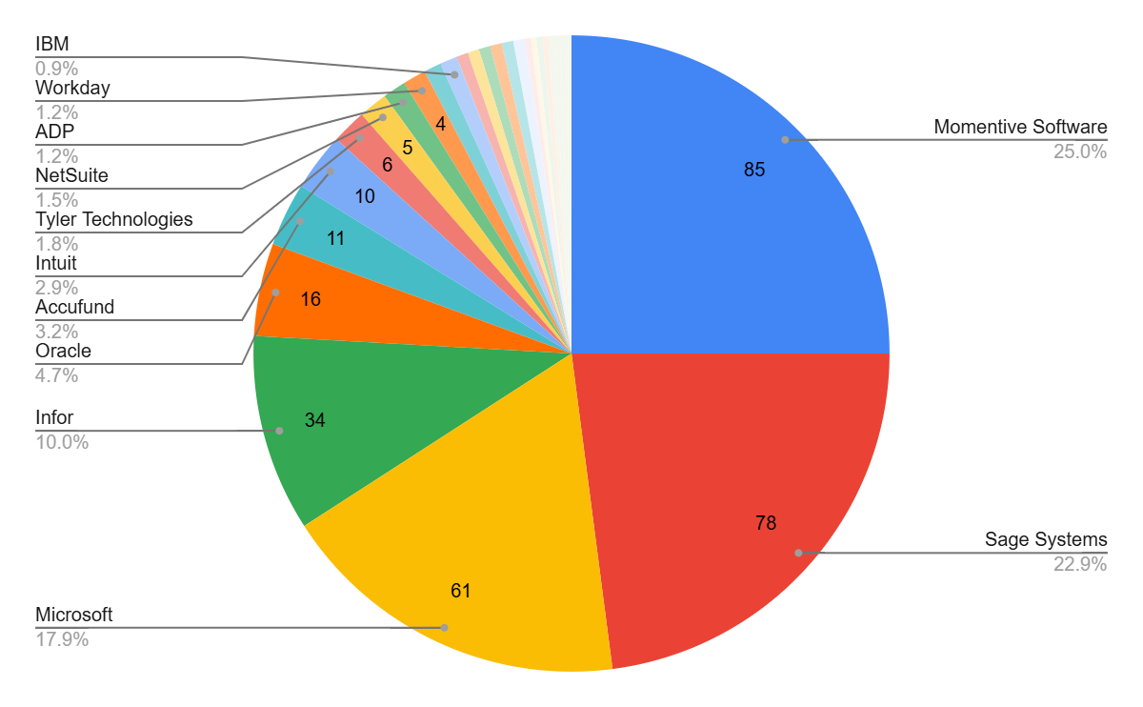
Tribal Entities Using ERP by Vendor
Top 10 ERP Systems Among Tribes
Vendor | Count
Momentive Software | 25.0%
Sage Systems | 22.9%
Microsoft | 17.9%
Infor | 10.0%
Oracle | 4.7%
Accufund | 3.2%
Intuit | 2.9%
Tyler Technologies | 1.8%
NetSuite | 1.5%
ADP | 1.2%
Workday | 1.2%
Other vendors (used by 1–3 tribes): IBM, SAP, Blackbaud, Epicor, and others including custom-built and lesser-known systems.
Source: Internal database counts from survey submissions (2019–2025).

Slide 16
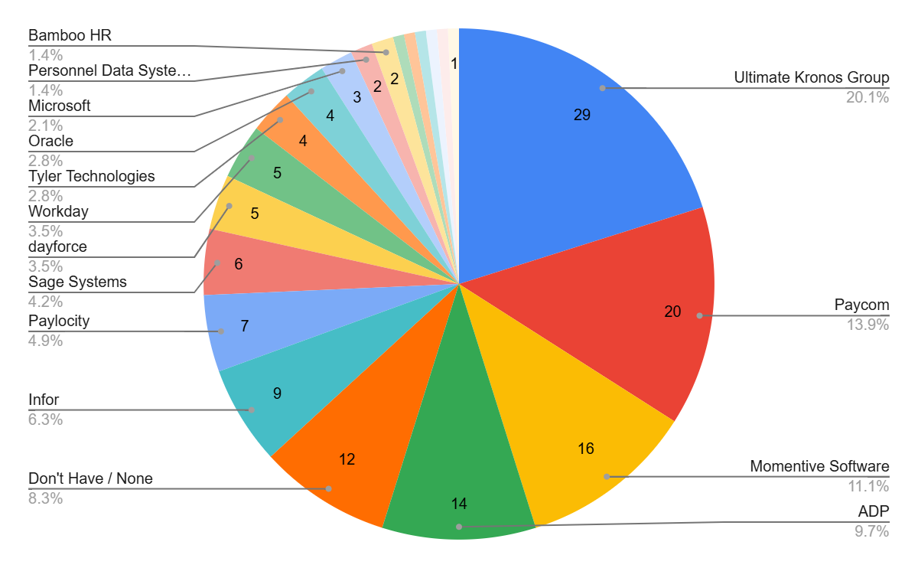
Tribal Entities Using HCM/HRIS by Vendor​
Top 10 HCM/HRIS Among Tribes
Vendor | Count
Ultimate Kronos Group | 20.1%
Paycom | 13.9%
Momentive Software | 11.1%
ADP | 9.7%
Don't Have / None | 8.3%
Infor | 6.3%
Paylocity | 4.9%
Sage Systems | 4.2%
dayforce | 3.5%
Workday | 3.5%
Tyler Technologies | 2.8%
Oracle | 2.8%
Other vendors (used by 1–3 tribes): Microsoft, PDS, Bamboo HR, Harris, SAP, iCIMS, iSolved, DocStar, and Namely.
Source: Internal database counts from survey submissions (2019–2025).

Slide 17
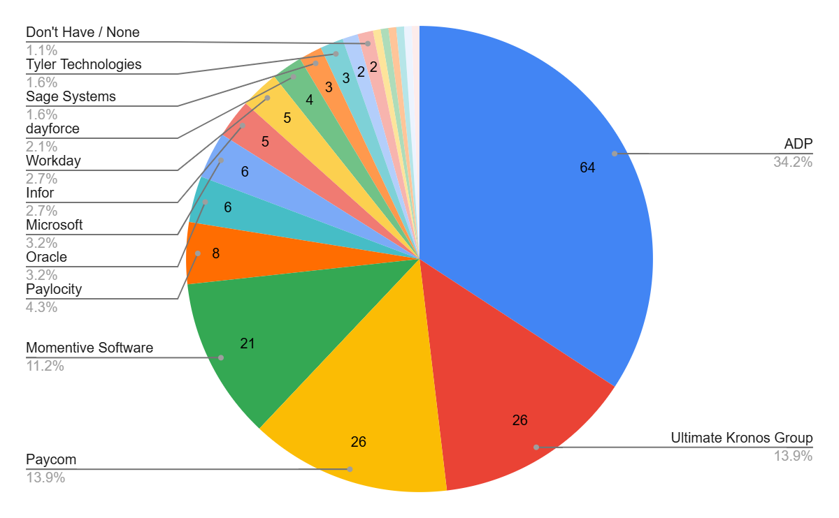
Tribal Entities Using Payroll Processing by Vendor​
Top 10 Payroll Systems Among Tribes
Vendor | %
ADP | 34.2%
Ultimate Kronos Group | 13.9%
Paycom | 13.9%
Momentive Software | 11.2%
Paylocity | 4.3%
Oracle | 3.2%
Microsoft | 3.2%
Infor | 2.7%
Workday | 2.7%
dayforce | 2.1%
Other vendors (used by 1–3 tribes): Sage Systems, Tyler Technologies, PDS, Deltek, Microix, Intellibee, iSolved, Paychex, and Harris.
Source: Internal database counts from survey submissions (2019–2025).

Slide 18
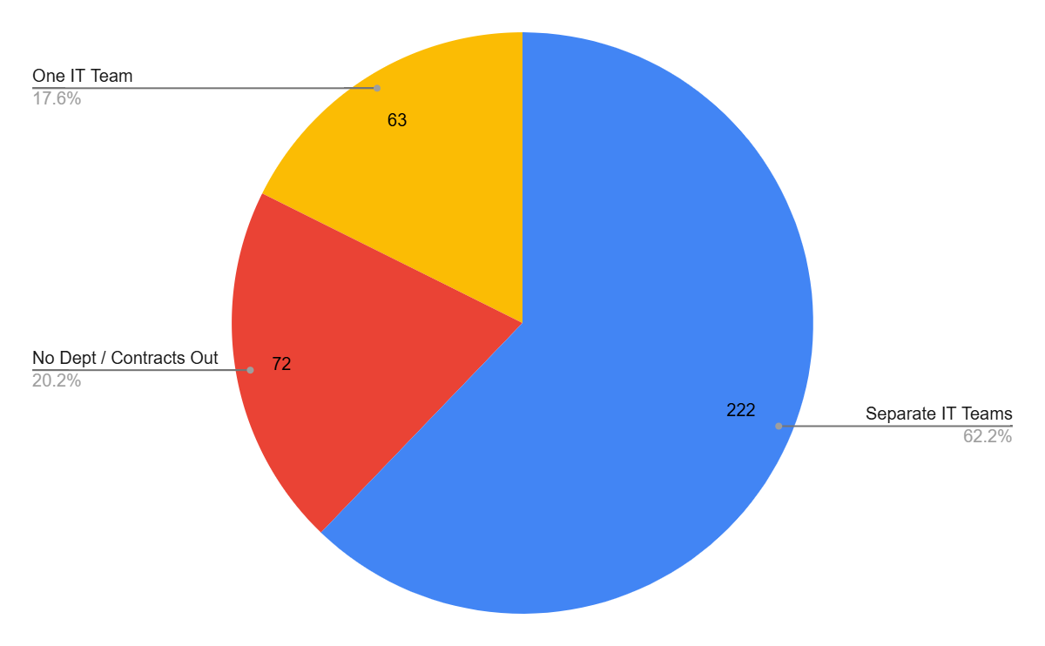
IT Department Structure
One IT Team vs. Separate IT Teams for Tribal Government & Gaming
Source: Internal database counts from survey submissions (2019–2025).

Slide 19
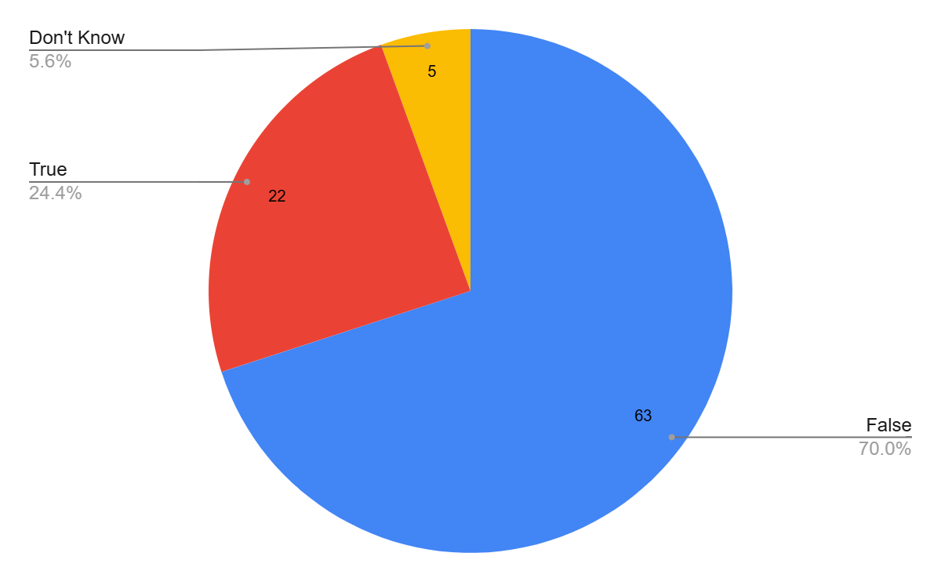
We Have a Clear AI Use Policy in Place
Source: Data based on regional attendees' responses to the 2025 How Prepared Is Your Tribe for AI survey.

Slide 20
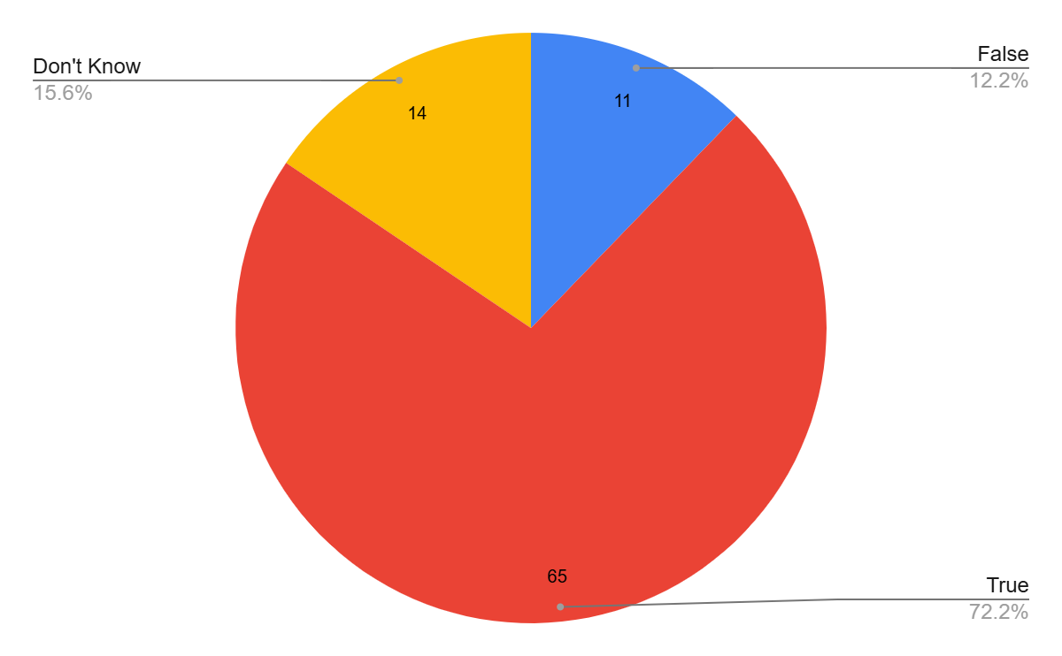
Our Employees Already Use AI For Work
(regardless of any policy prohibiting AI use)
Source: Data based on regional attendees' responses to the 2025 How Prepared Is Your Tribe for AI survey.

Slide 21
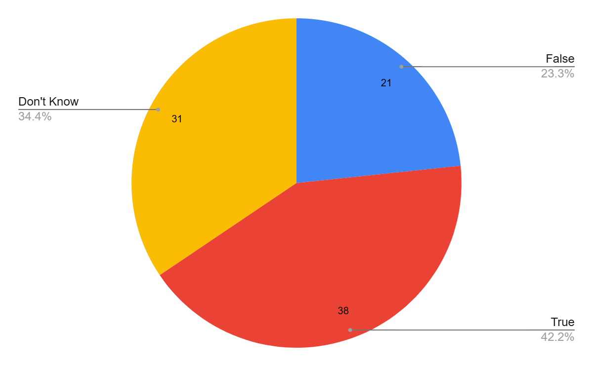
We Have Financial Resources to Implement AI
Source: Data based on regional attendees' responses to the 2025 How Prepared Is Your Tribe for AI survey.

Slide 22
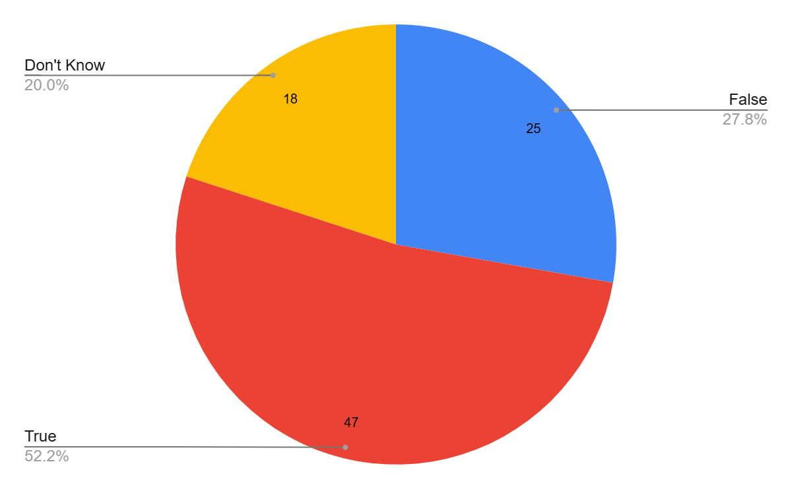
We Have Effective Change Management Resources
and Processes
Source: Data based on regional attendees' responses to the 2025 How Prepared Is Your Tribe for AI survey.

Slide 23
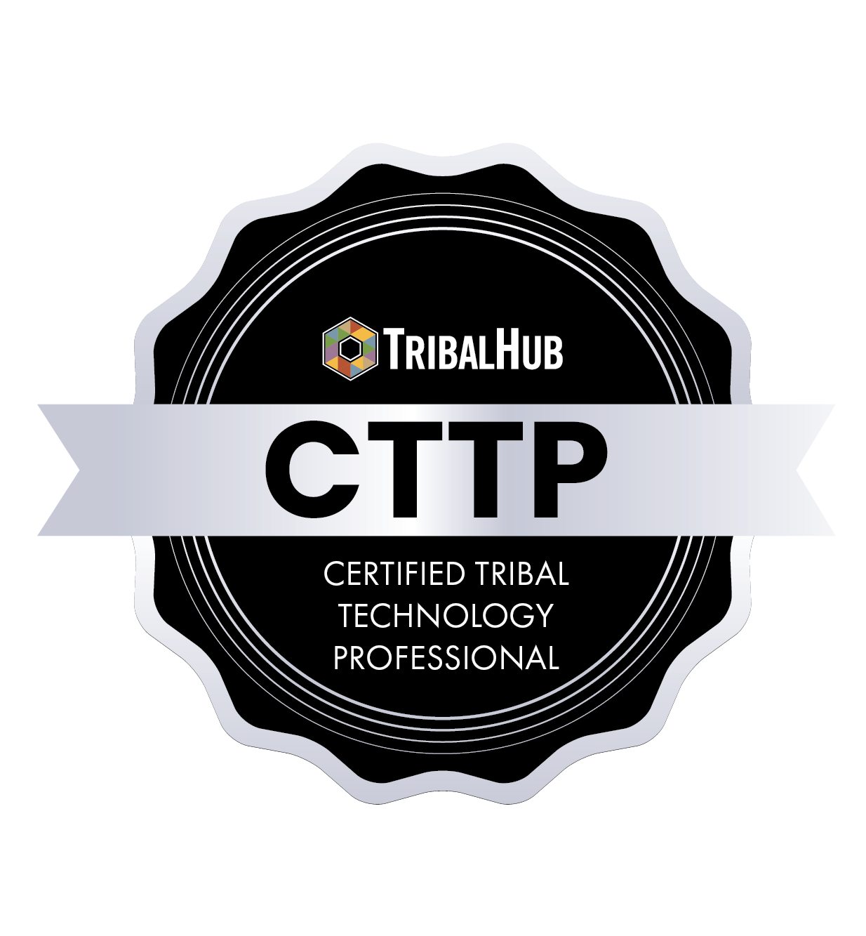
Registration for the 2025 Inaugural CTTP Program is coming soon!
When: November 17-21, 2025
Where: Tucson, AZ
Designed to give anyone looking to succeed or advance in technology within a tribe or tribal enterprise the unique tools, connections, practices, understanding and keys to becoming more successful in moving their tribe or tribal enterprise forward while boosting their own career opportunities.
NEW!
IT Wage Survey
Coming in 2025- specific to IT titles and positions only.

Slide 24
In Summary - and as you will learn more about during this event….
The only constant is continuous change and technology IS change.
Technology will continue to play an ever increasing role in the success of individuals, teams, departments and entire organizations
HR plays an important role in understanding and preparing their tribe for change

Slide 25
Mike Day
Executive Officer,
TribalHub
Thank You!
If you have any questions, please contact me at:
mday@TribalHub.com

