Slide 1
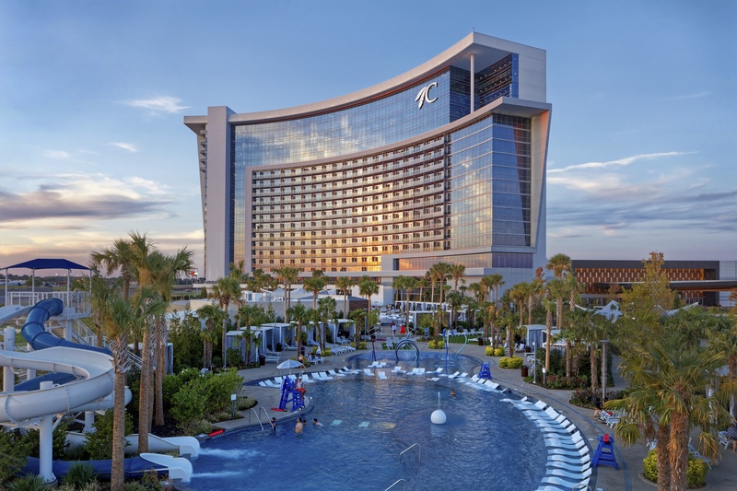


Pathways Community Mentorship
Development Program
September 24th, 2024
Durant, Oklahoma

Slide 2


Agenda
Understanding the Purpose
History of Pathways
Participant Impact
Developing Your Program
Questions

Slide 3
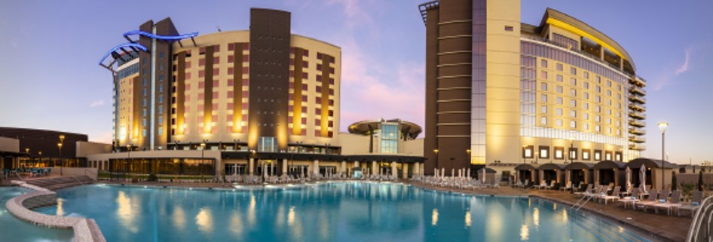
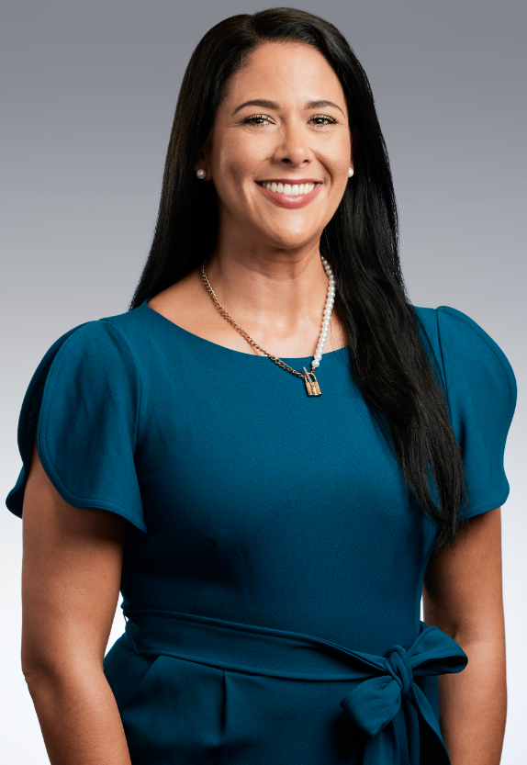
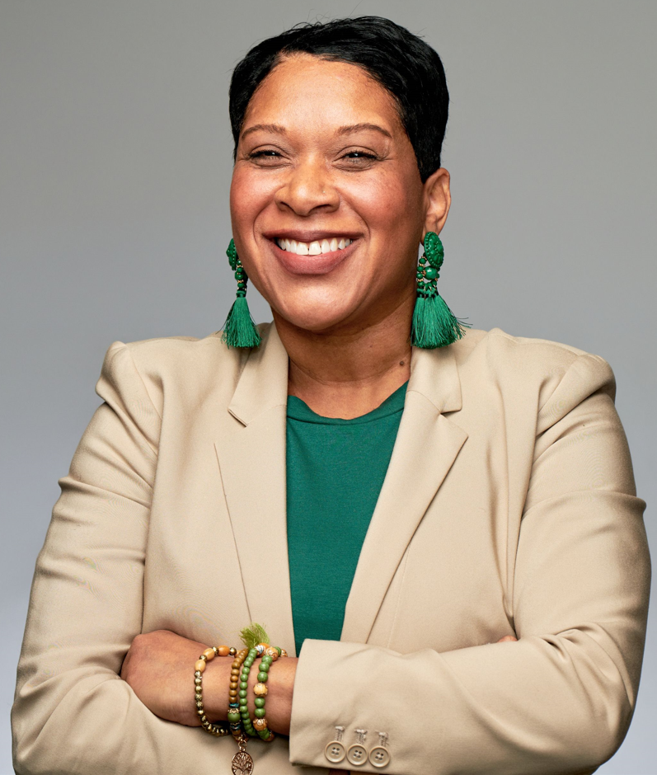

Meet the Development Team at Gila River Resorts & Casinos
Kamie Best
Davina Aleem
Learning & Development Manager
Human Resource Program Coordinator

Slide 4
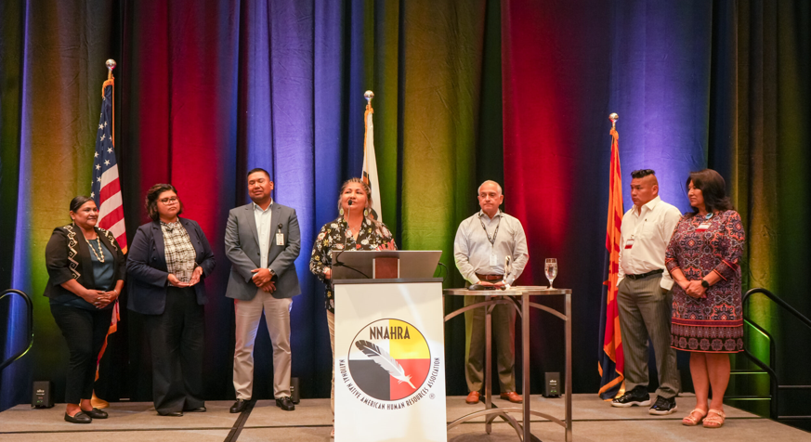
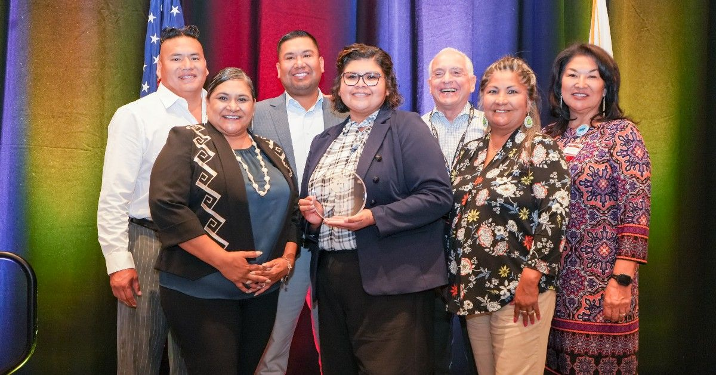
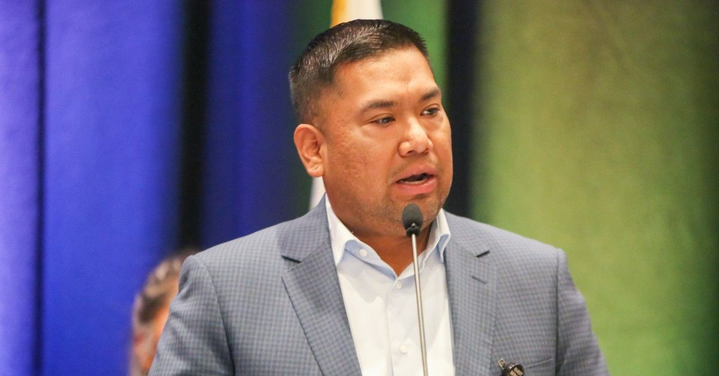
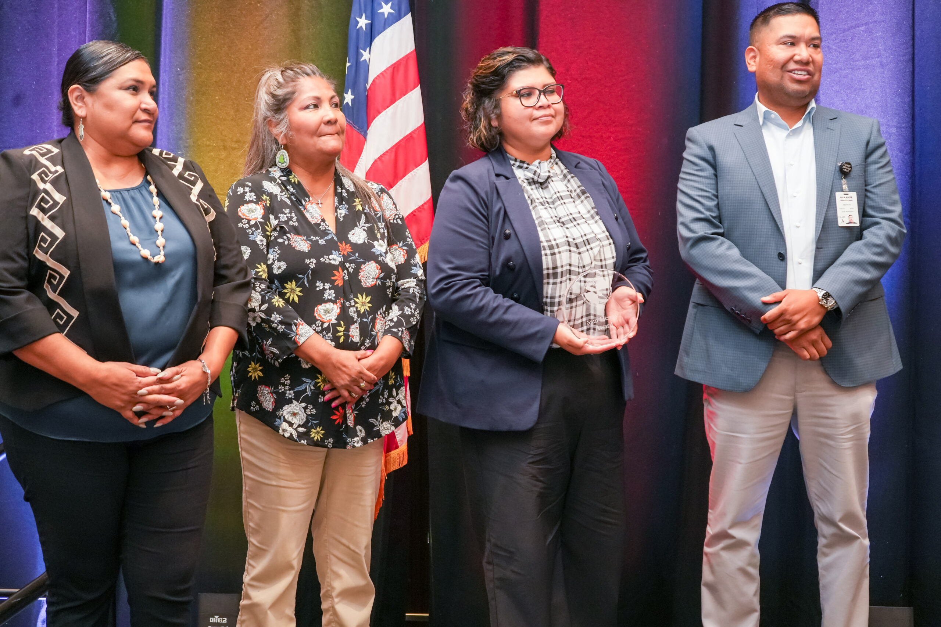
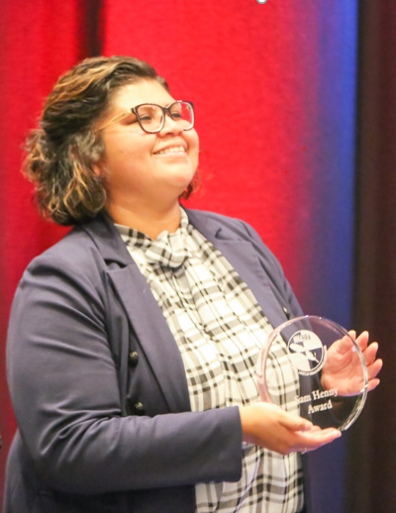
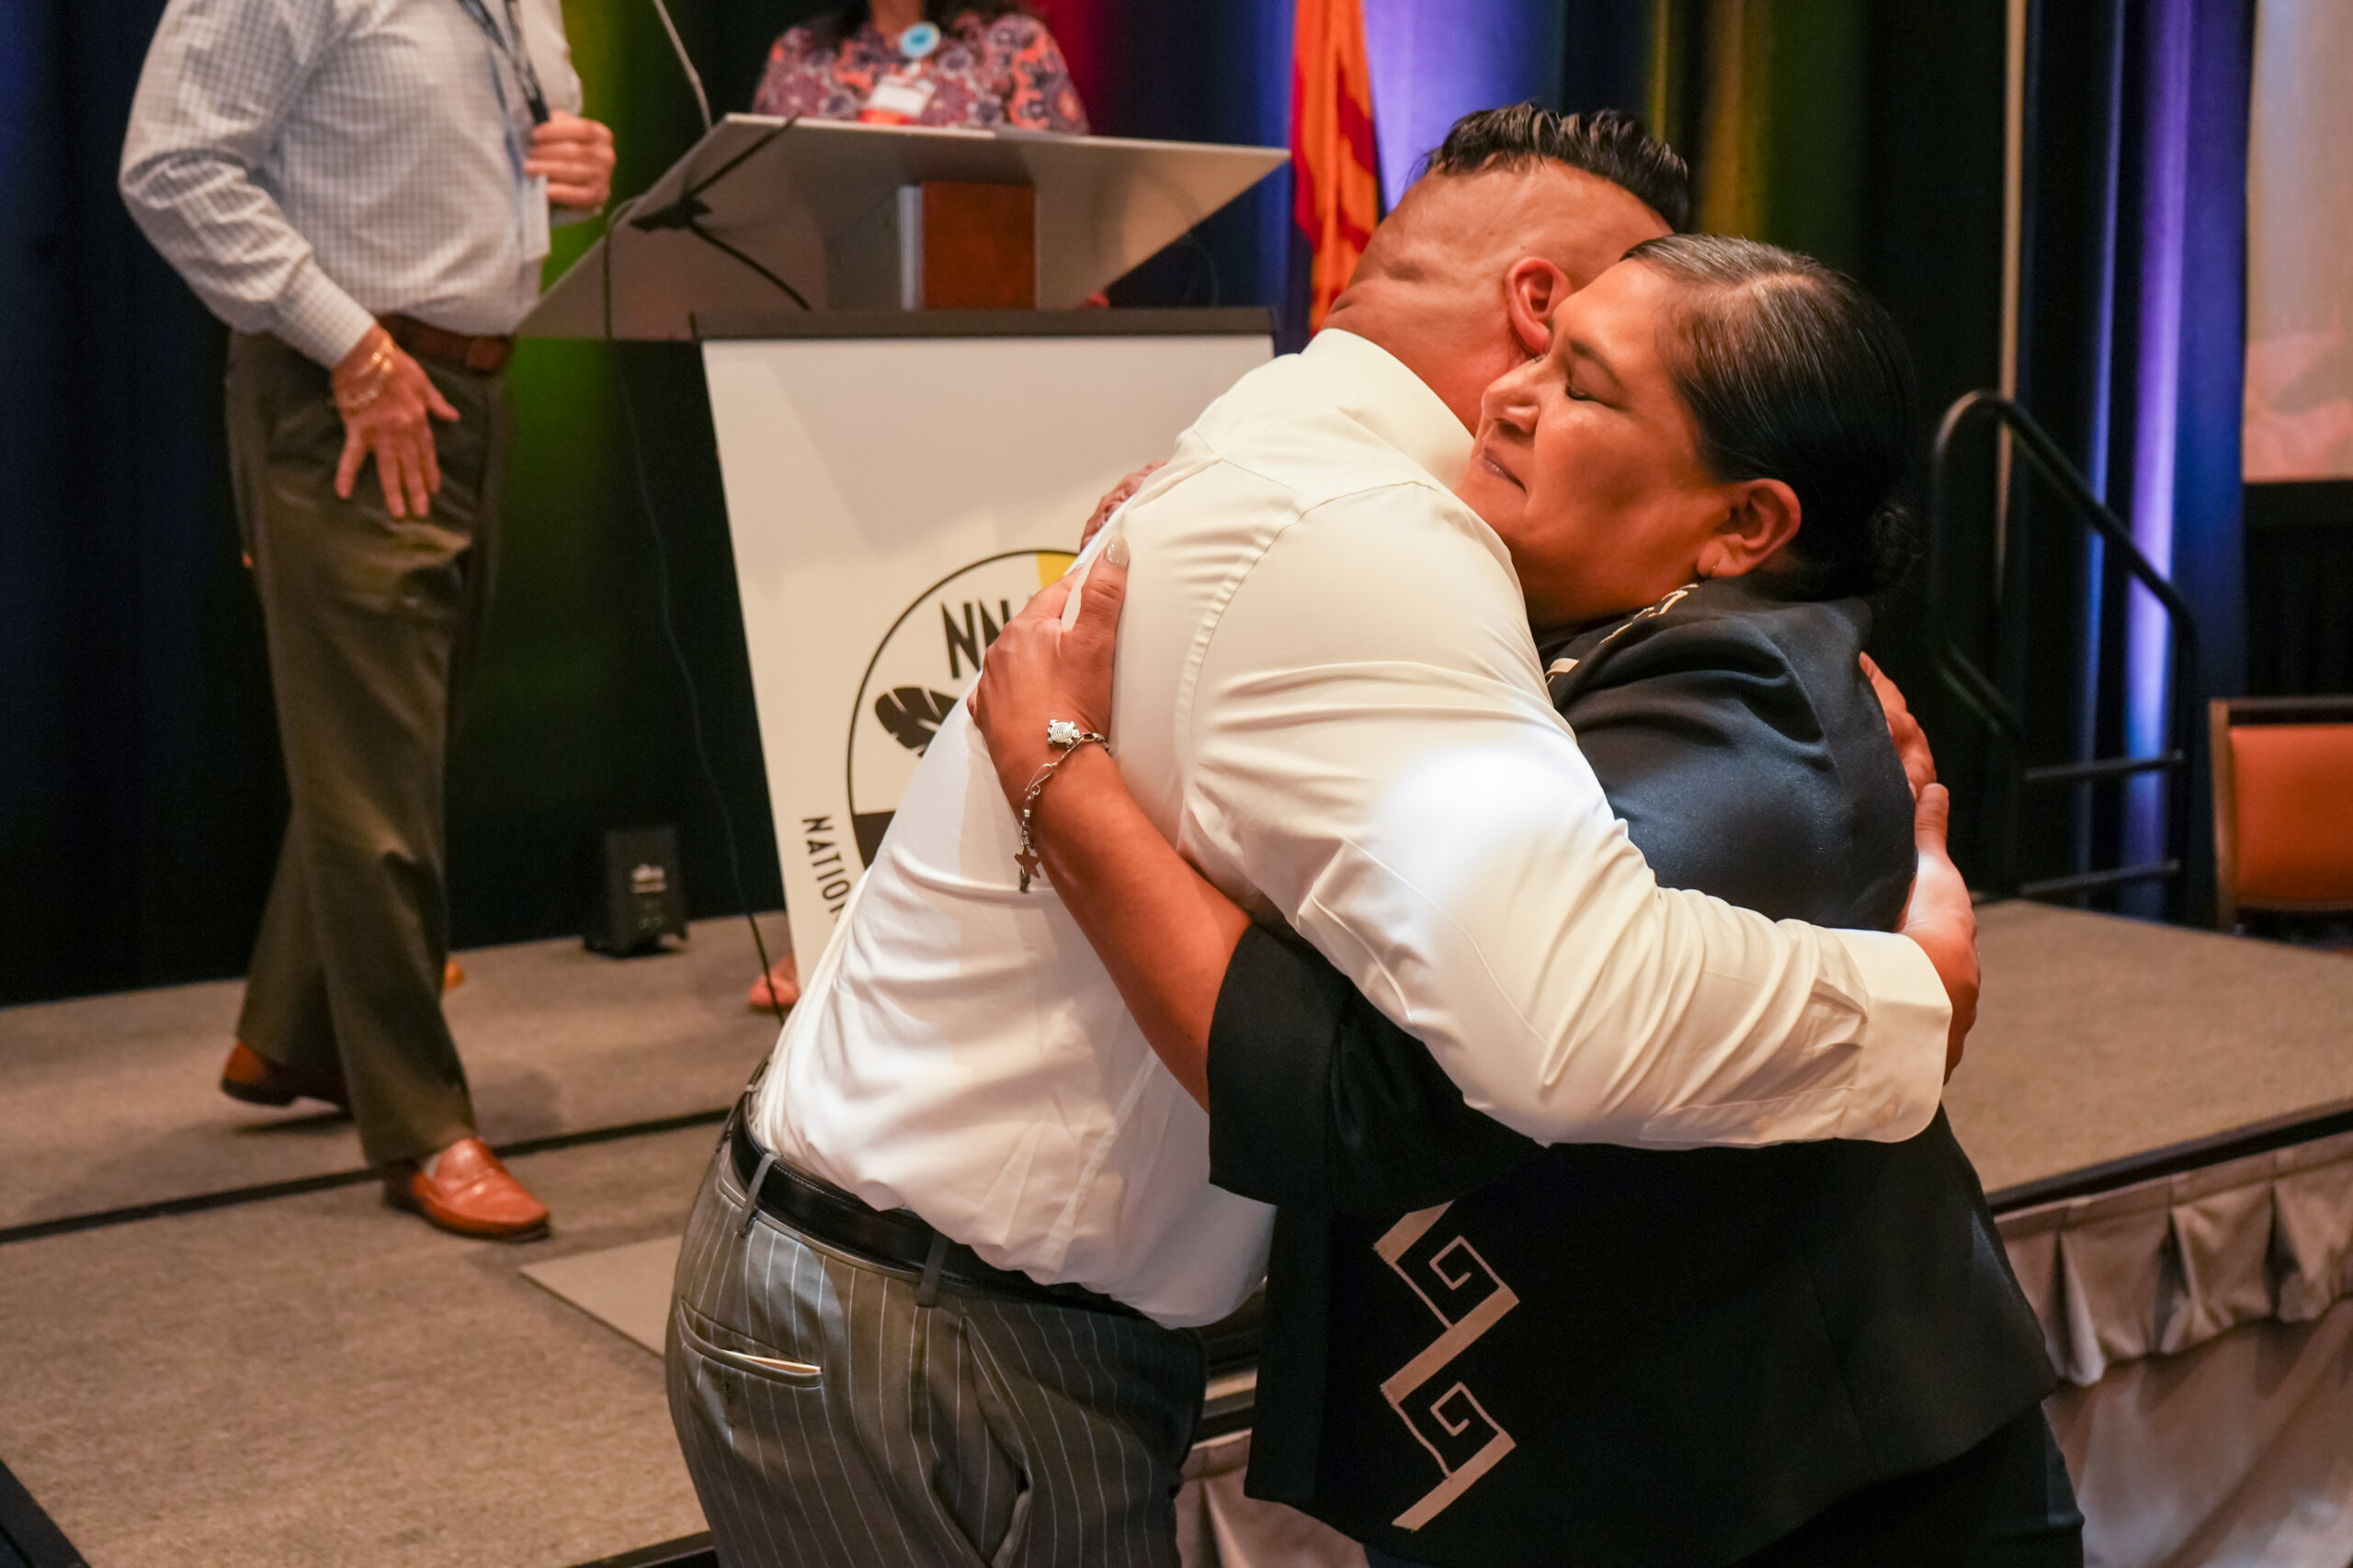
2023 Sam Henry Award Recipients

Slide 5
Understanding the Purpose
Gila River Resorts & Casinos (GRRC) takes pride in the Pathways Community Mentorship Program as it strengthens our goals as an organization and secures our mission statement:
“The mission of Gila River Resorts & Casinos is to generate income for the Community, to provide employment opportunities for the Community, and to participate in the economic growth of the Gila River Indian Community.”
Notes:
Note- GRRC History, after establishing 3 properties by 2009, the inception of the Pathways Program was created to ensure we meet our mission statement. (23,233 GRIC Members)

Slide 6
Understanding the Purpose Con’t
The Gila River Resorts and Casino’s (GRRC) Pathways Mentorship Program’s goal is to provide Gila River Indian Community Members (GRIC) with sufficient training opportunities to ensure that they acquire the experience and skills necessary to assume management and leadership positions within GRRC.
The Pathways Mentorship Program offers two (2) Development Programs:
Level 1 Program- Assistant Supervisor, Supervisor or Manager positions
Level 2 Program- Assistant Director and above positions

Slide 7
Pathways Program Statistics
52 Program Participants Overall
  45 Successful Program Completions
  3 Sr. Leadership Members are graduates of the program
  Currently in Progress:
    1 Previous Mentee in the 2nd year of the Level 2 Program
    1 Current Mentee in the 1st year of the Level 2 Program

Slide 8
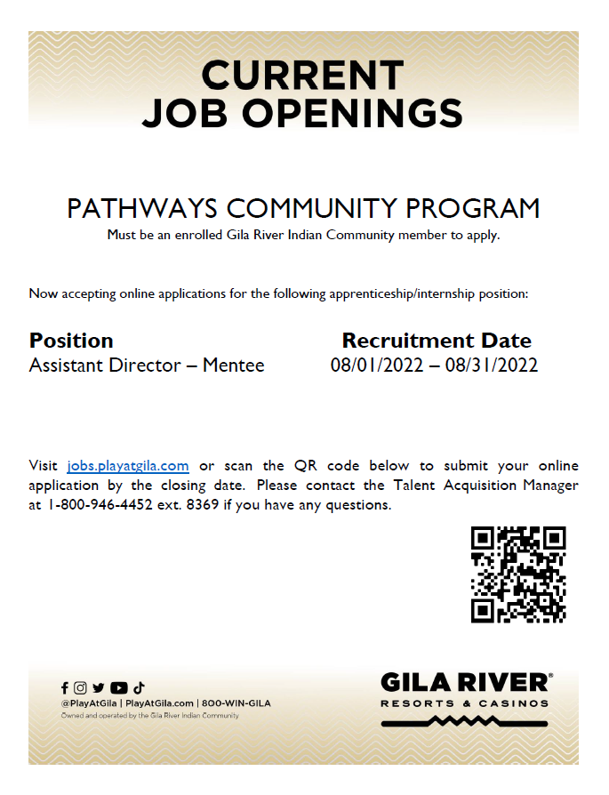
Qualifying Criteria and Attracting Prospective Candidates
High School Diploma or equivalent required.
Must have a minimum of three years of experience in the same or similar field.
Must have a minimum of three years of experience in a management position.
Must be a self-starter with the ability to work independently.
Must be detail-oriented with strong analytical skills.
Must possess excellent organizational skills with the ability to manage multiple activities.
Must be capable of working in a fast-paced environment with the ability to prioritize deadlines.
Must have the ability to establish and maintain effective working relationships as well as to gain the cooperation of guests and fellow team members.
Must have strong interpersonal and communication skills, both written and oral.
In this position the person must have, or an ability to acquire within one year, an in-depth knowledge and thorough understanding of Enterprise Policies and Procedures, governmental regulations, and technical rules relevant to their responsibilities.

Slide 9
Pathways Level 1 Program
Potential positions consist of an Assistant Supervisor role, a Supervisor role, or a Manager role.
The Mentee would have a personalized Development Work Plan that would include…
Development Activities
Competency Measurements
Program Duration
Six (6) months for a Supervisory position up to One (1) year for a Managerial position, dependent on the Mentee’s previous work experience and knowledge.
Once the Mentee completes the Program, he/she will assume the position.
Notes:
Program 1 is designed for GRIC members who show the potential and desire to achieve to be an Assistant Supervisor, Supervisor or Manager in a GRRC Department.
Develop Activities consists of specific technical capabilities, skills/abilities necessary to be proficient in the stated competency areas. Activities and actions would help provide learning and practice opportunities like job shadowing, projects, presentations, tasks, and on-the-job training.
Development Work Plan specifies in detail the skills, abilities and knowledge an individual must possess to be considered “qualified” for a position as outlined in the position description. Based on the Mentee’s previous background, development tools and competency measurements are identified to determine the most appropriate means for which the Mentee will gain and demonstrate the necessary qualifications to be successful in the position for which the mentorship program is applied.

Slide 10
Pathways Level 2 Program
Potential positions consist of an Assistant Director and above.
The Mentee would have a tailored Rotational Development Work Plan that would include…
Development Activities
Rotations throughout the Casino Departments
Competency Measurements
Program Duration
Two (2) years
  Year 1, Rotational Development Work Plan and Final Project.
  Year 2, Work as the Assistant Director Mentee in the assigned Department selected by the CEO.
Once the Mentee completes the 2nd Year of the Program, he/she will remain in the Assistant Director Position. He/she will become the successor to the next successor in the highest position (i.e. Assistant Director to Director) when the Director or above leaves the position.
Notes:
Program 2 is designed for GRIC members who show the potential and desire to achieve to be an Assistant Director or above, and have some college education and/or previous experience in a leadership role.
Final Project-
Project Objectives:
Uses tools & resources
Create a strategic plan and execution
Choose Topic(s):
Improve operational efficiency
Generate revenue
Promote cost saving initiative
Casino Department Rotations- each rotation can be from a couple of days to 2-3 weeks to 1-2 months long depending on the Mentee’s previous knowledge of the departments. During the rotation the Mentee will observe, shadow and learn about each department. The Mentee would work with the leadership in the department and line level employees.

Slide 11
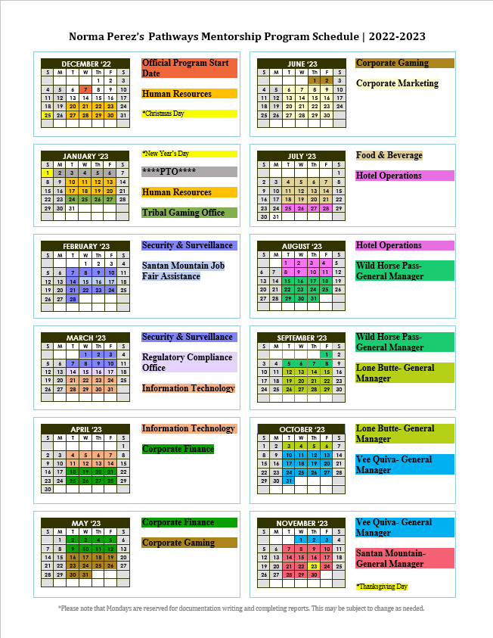
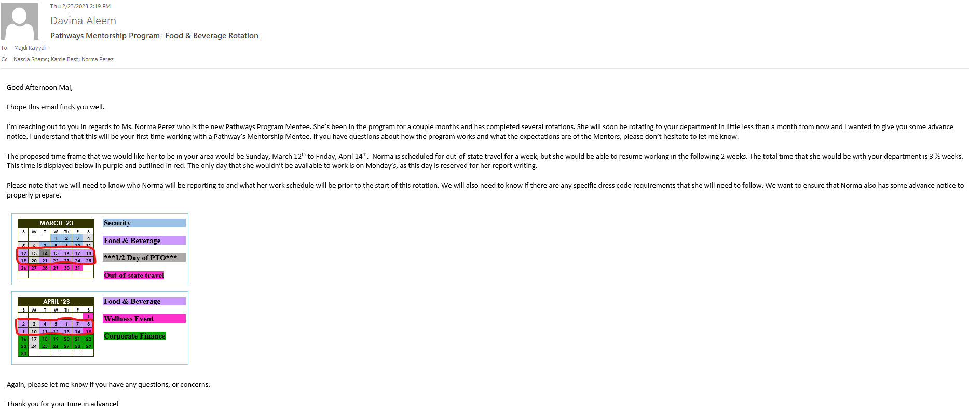
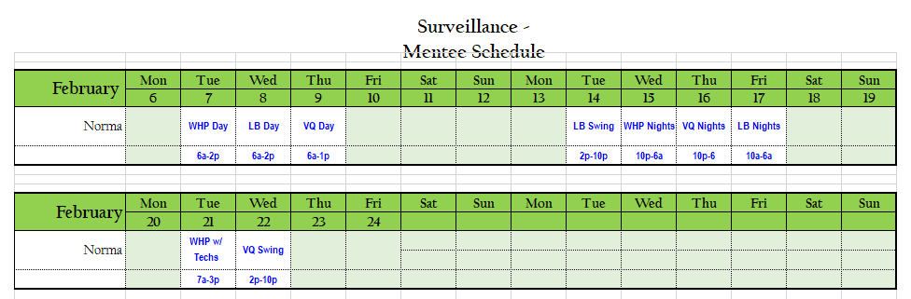
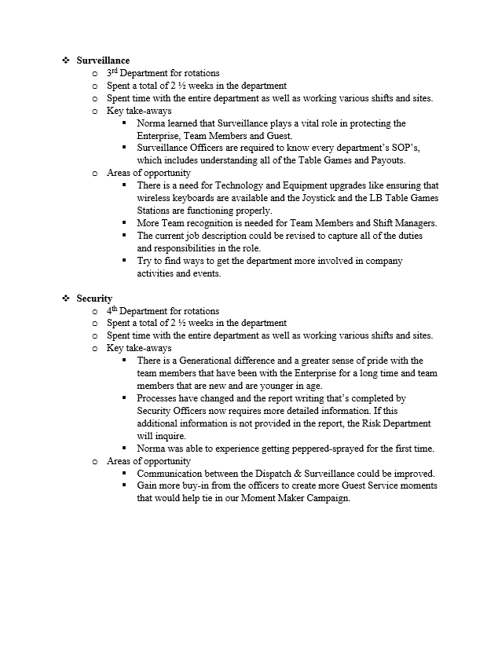
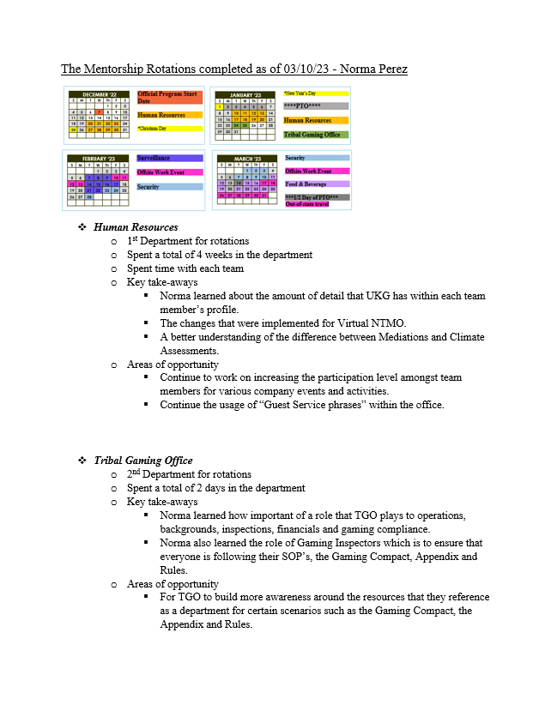
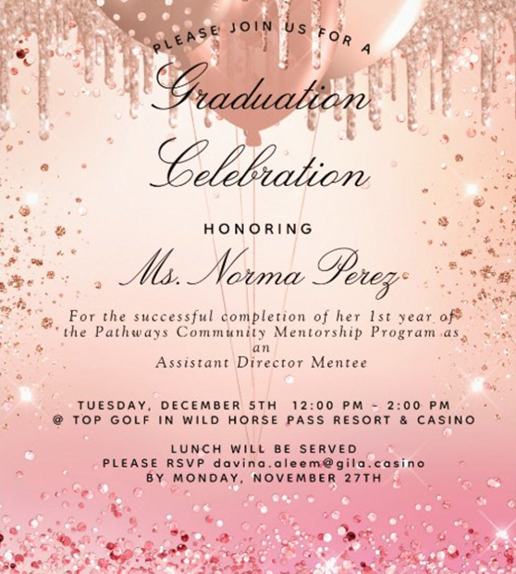
Norma’s Pathways Program Path

Slide 12
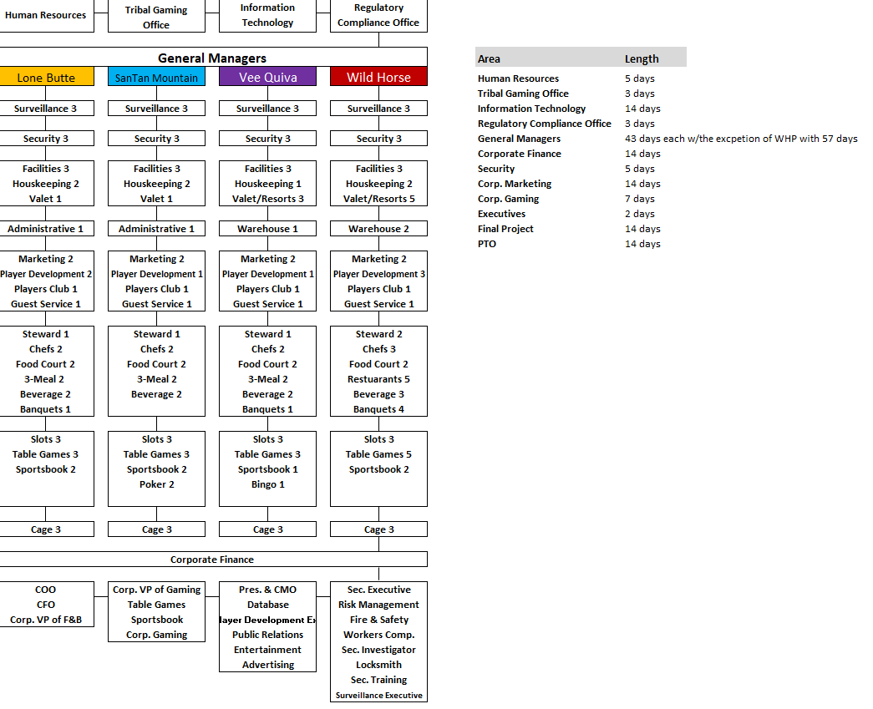
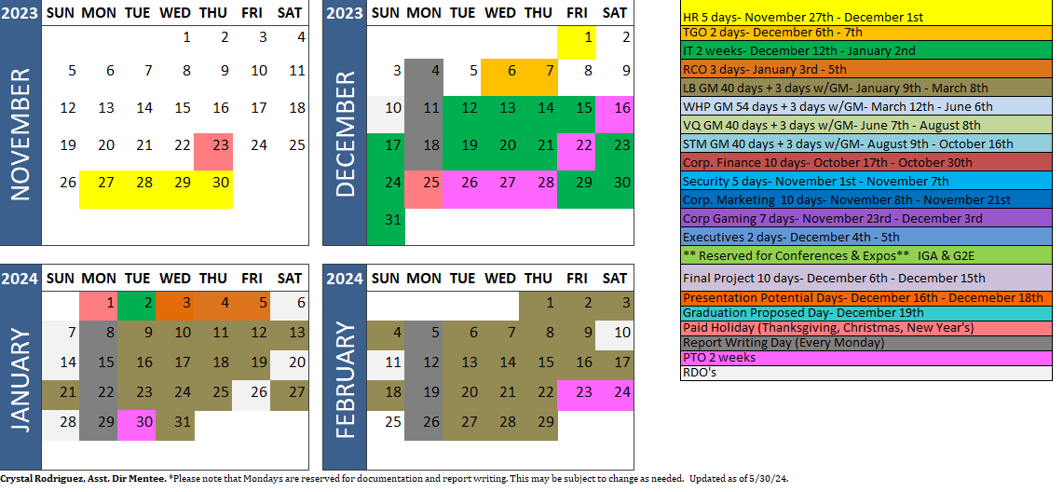
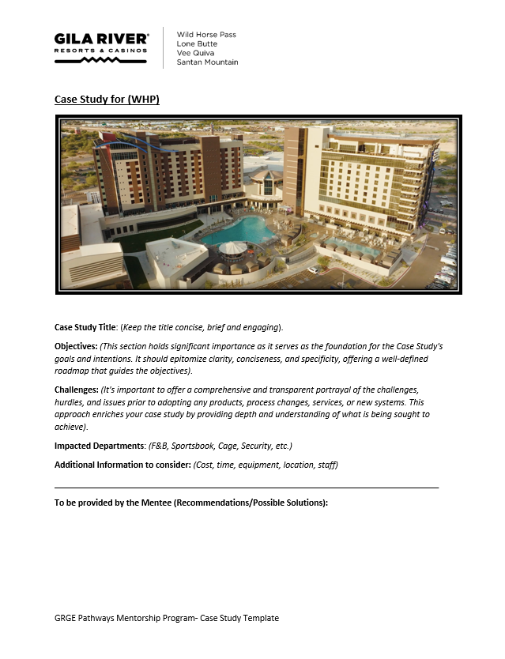
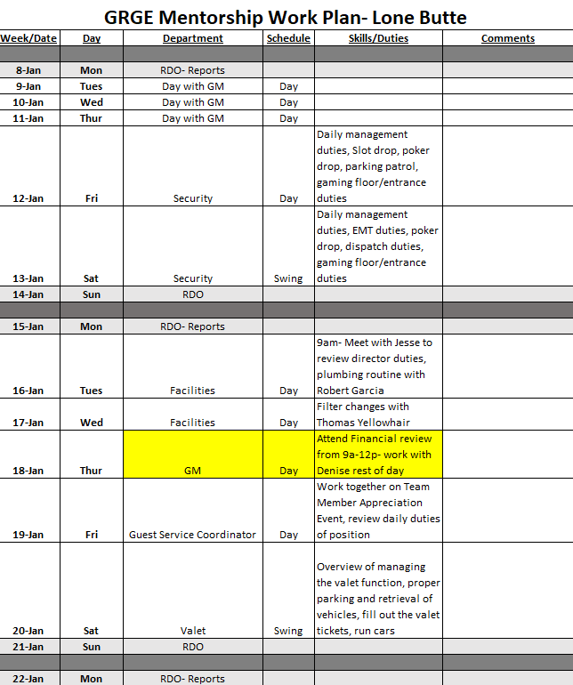
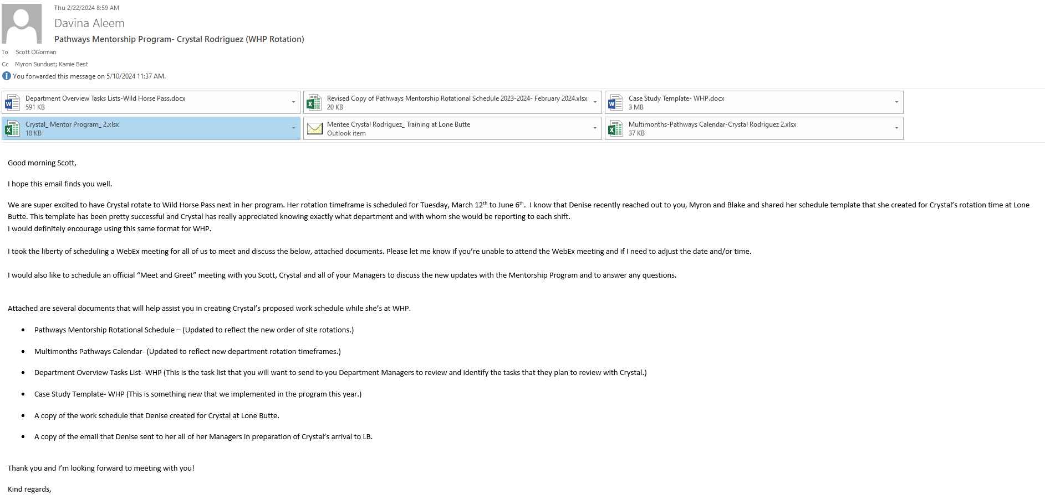
Crystal’s Pathways Program Path

Slide 13
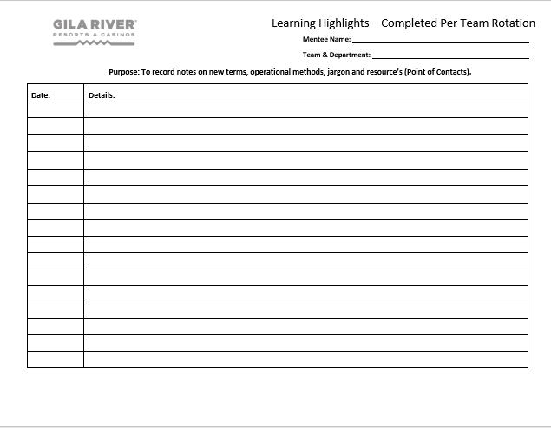
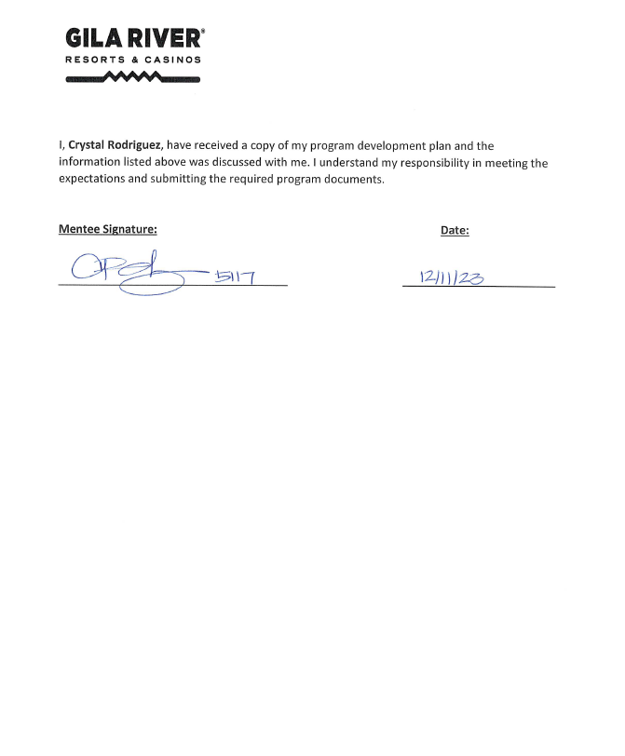
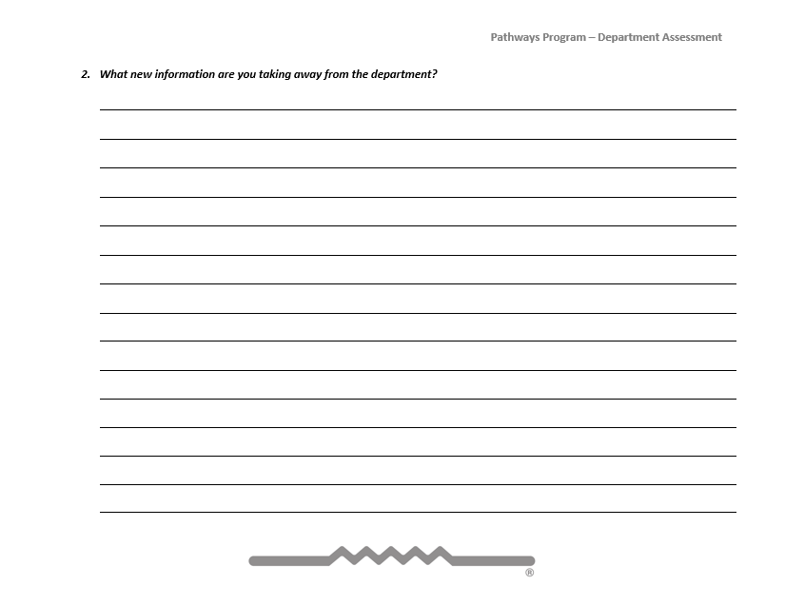
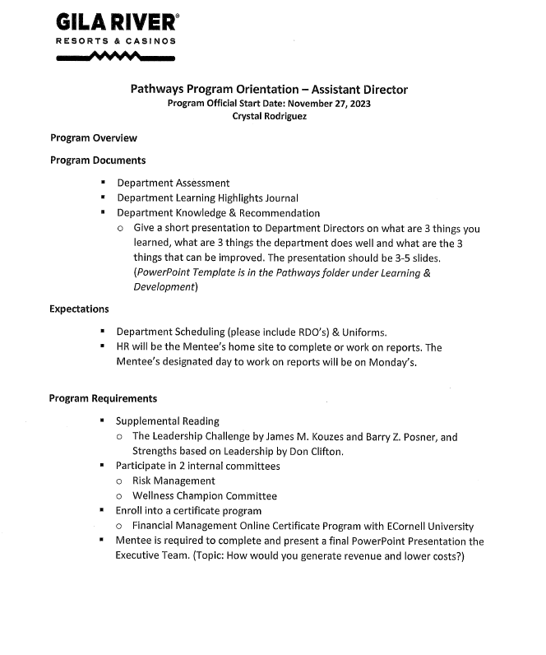
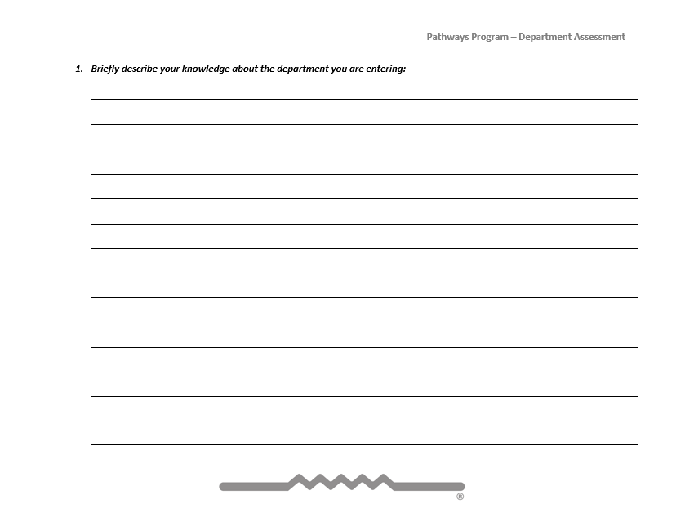
Additional Program Documents
Program Orientation Contract
Learning Highlights
Department Assessment
PowerPoint Template
  To capture what was learned
  Things that the Department does well
  Suggested areas of opportunities
  Department presentation after the completion of the rotation

Slide 14
Best Practices Checklist
Determine if there is a true business need to have a Developmental Program.
Create a plan that would be most beneficial for your prospective Mentors, Interns, and Mentees, (i.e. Apprenticeship, Internship, Rotational Development Plan (RDP), and 1:1 Mentoring).
Determine what the selection criteria would require, and how you would advertise and promote the opportunity within your organization.
Decide who the “Liaison” will be and what’s involved with overseeing and managing the program.
Gain the support and buy-in from Executive Management, Department Heads, and Tribal Council (if applicable).
Track and evaluate successes and areas of opportunities often and be flexible in making adjustments to meet the needs of your organization and the participants.
Having effective communication skills is essential for consistency and clarity.
Don’t be afraid to ask for feedback and be open to receiving feedback.
Don’t forget to have “FUN”. You’re helping to positively impact people’s lives in your organization by providing growth opportunities! ☺

Slide 15
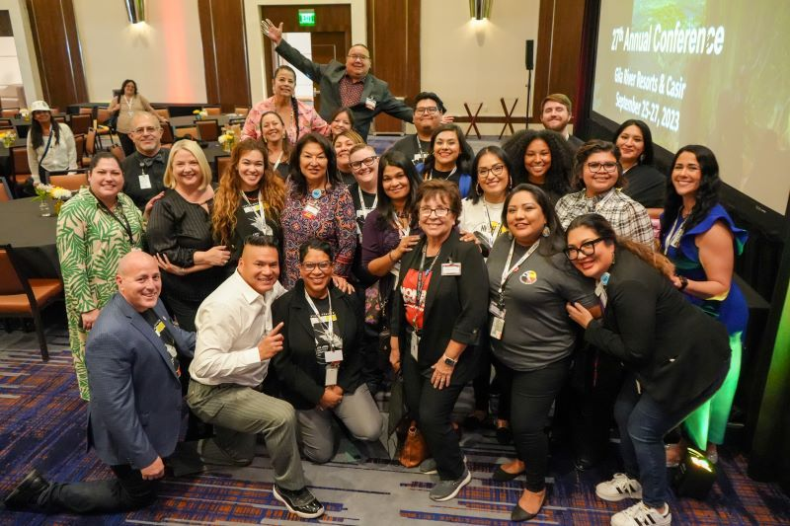
Questions?

Slide 16
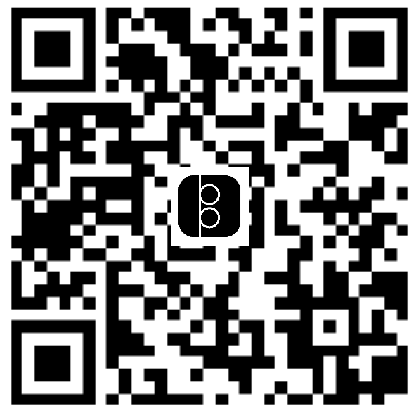
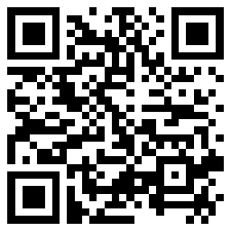
Contact Us
Kamie Best
Davina Aleem
Learning & Development Manager
Kamie.Best@Gila.Casino
Human Resource Program Coordinator
Davina.Aleem@Gila.Casino

Slide 17


Thank you for attending our Session!
www.playatgila.com

