Slide 1


Recruiting At Scale:
Intro to High Volume Hiring & Specialized Recruiting

Slide 2

Agenda
Choctaw Nation History
Choctaw Nation by the numbers
Mission, vision, values
Job For the Day temporary jobs program
Tribal Advocacy
High Volume Recruiting (Job Fairs / Open Interviews)
Targeted Recruiting (Hard to find / Basic techniques)
Budget, Tools & Technologies
Q & A (Challenge, interrupt, cheer/jeer let’s talk about it if you don’t understand or are skeptical)

Slide 3





Slide 4
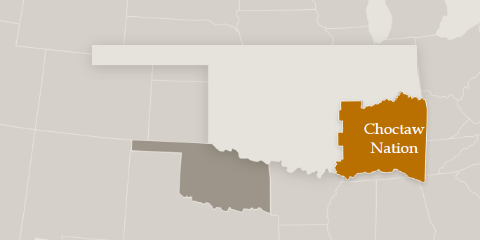
Choctaw Nation Facts
Third largest tribe in the United States. In August of 2020, the Supreme Court ruled in McGirt v. Oklahoma that the federal government never officially dissolved the Muskogee Creek reservation, a decision that extends to the Choctaw Nation as well.
The Choctaw Nation’s reservation covers nearly 11,000 square miles in southeastern Oklahoma. The region’s topography includes mountains, rivers, lakes and woodlands. (8 states can fit within reservation)
255,000 Tribal members worldwide
Economic impact of $3.2 billion to region
13,000 Associates

Slide 5

MISSION: To the Choctaw proud, ours is the sovereign nation offering opportunities
for growth and prosperity.

Slide 6

VISION: Living out the Chahta spirit of faith, family and culture.

Slide 7
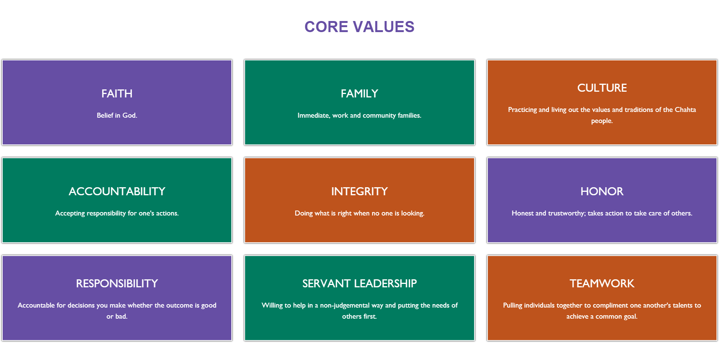

Slide 8
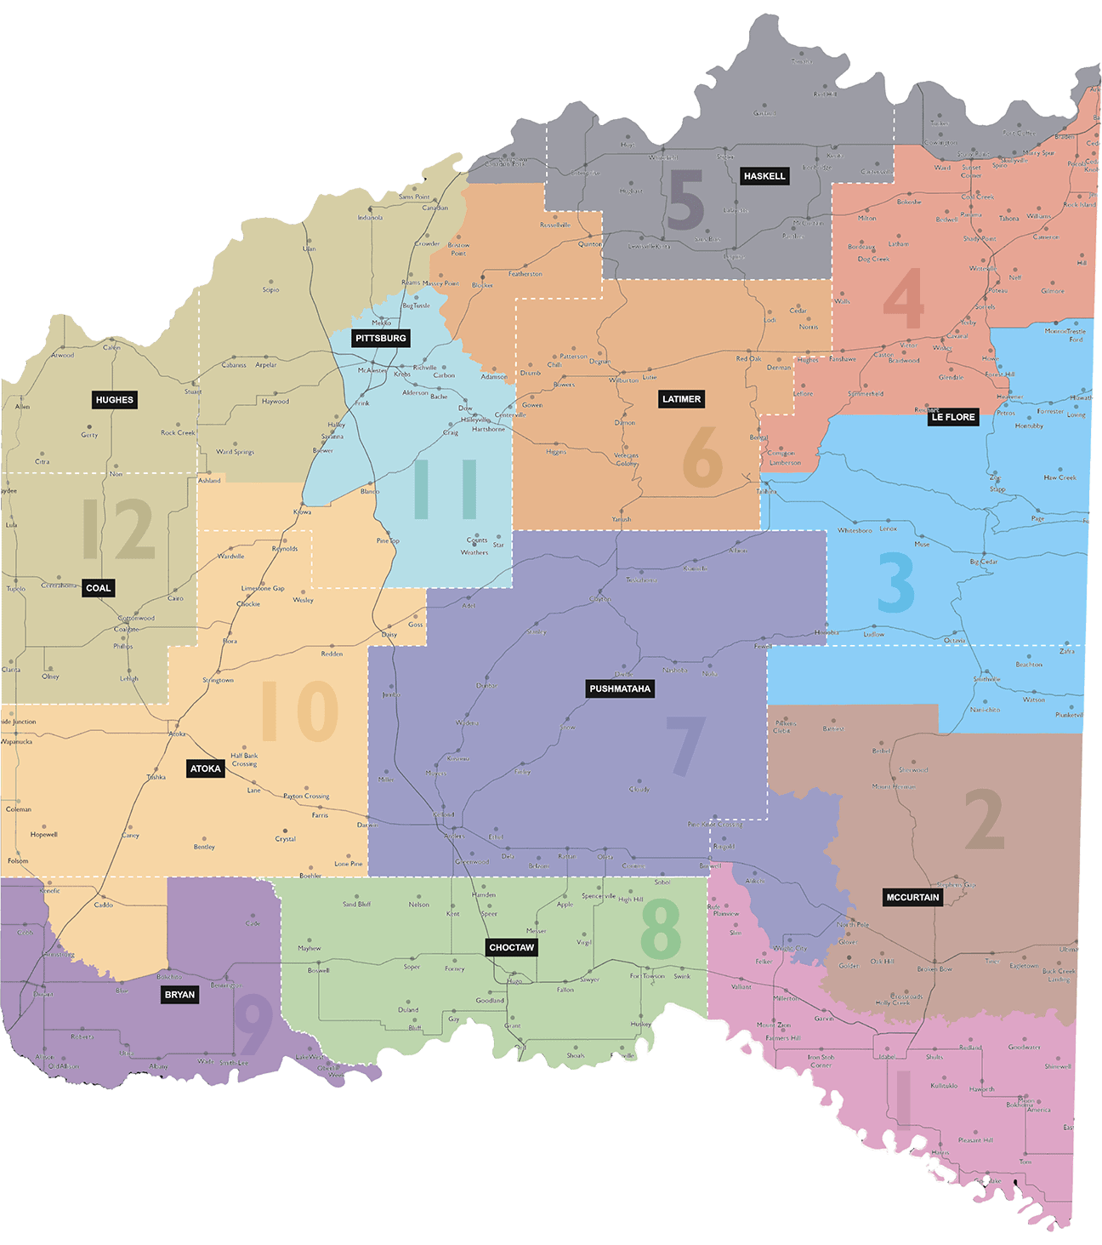
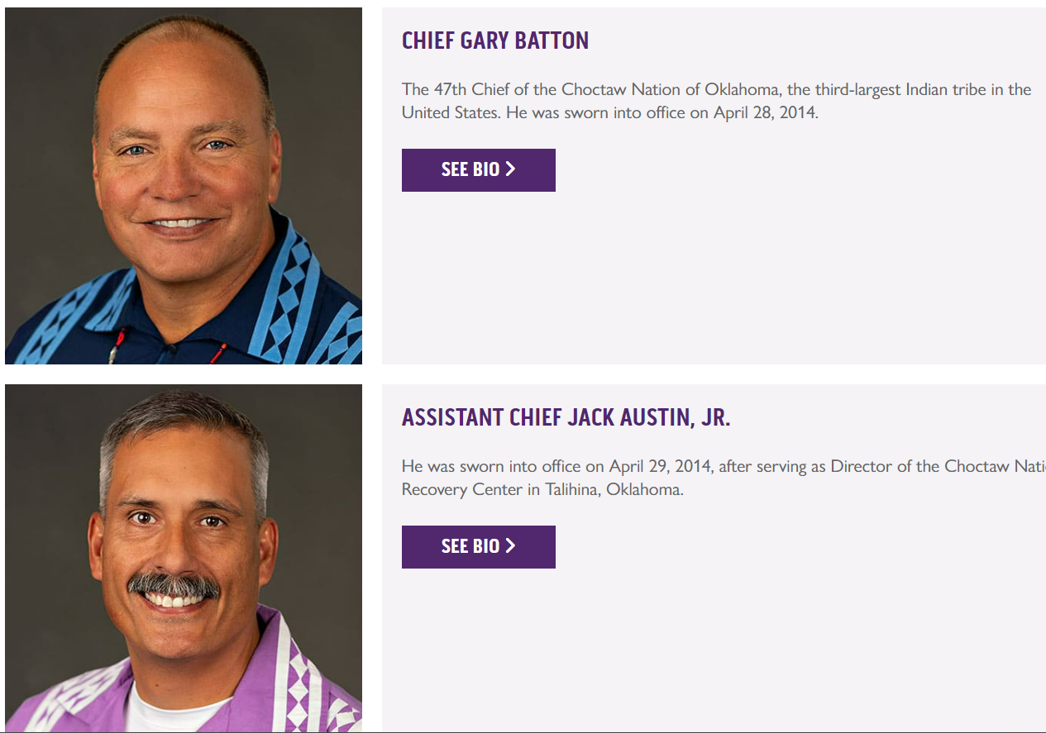
Leadership model similar to US
Executive Branch: Chief / Assistant Chief
Legislative Branch: Councilman for each district
Judicial Branch

Slide 9

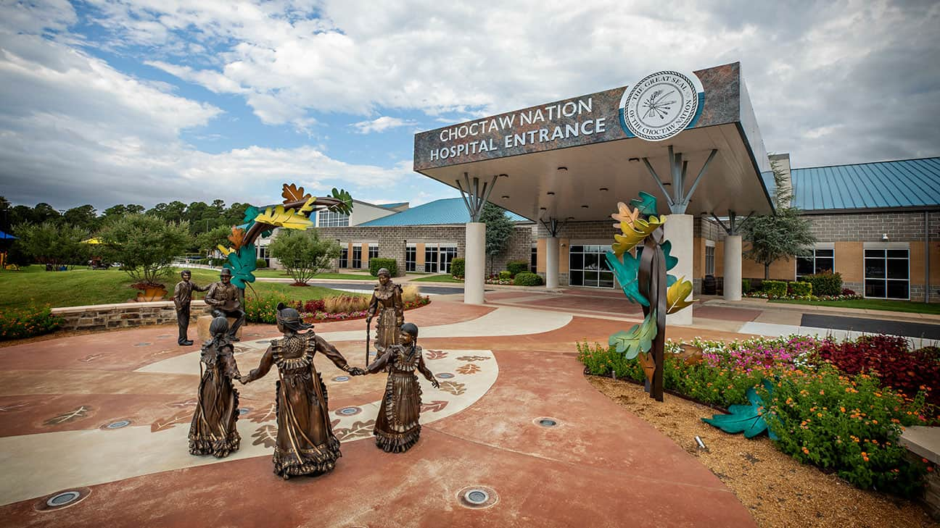




Slide 10
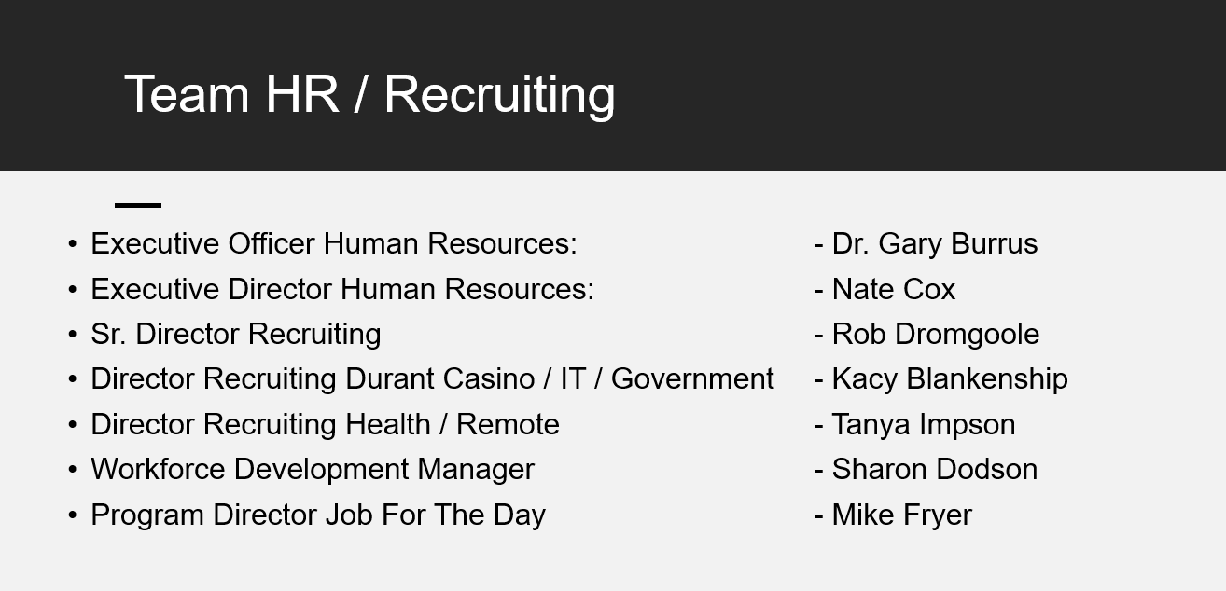

Slide 11

Recruiting in Three parts
Temporary Job Placement (Job For the Day)
Tribal Advocacy
High Volume & Targeted Recruiting
$5.5 million budget / 65 staff

Slide 12

Temporary work placement for Tribal Members
Terms: 8 Weeks/$13 an hour (all placements), up to 40 hours per week
Weekly pay for temporary associates
Work opportunities with CNO businesses and programs located on the Choctaw Nation Reservation
Can reapply for JFTD if work history was satisfactory
FY24: 902 total placements through July only
Over 5200 placements in its short history!

Slide 13

Tribal Advocacy
Resume preparation
Interview preparation
Walk-ins
Internship program / co-op
Partner with recruiting team

Slide 14
Recruiting is about changing lives
David
Recruiter met tribal member David while volunteering at a Senior lunch. No ID. No home. No transportation. No money.
Recruiter helped secure new ID, shelter, clothing for interview, and ultimately a new role.
Kim
Recruiter met tribal member at community center, she moved from California with no money or a place to live. Enough money for hotel for a week. She had a car. Secured interview and offer in 1-week. Secured housing. We donated a bed, clothing.

Slide 15
Recruiting Team Structure
Rob Dromgoole, Head of Recruiting
Tanya Impson, Director Recruiting Health & Remote
Health Manager: Kristen Gardner FY23: 1,261 hires
Remote Manager: Jacie Payne FY23: 1,769 hires
Kacy Blankenship, Director Recruiting Durant Property & Government
Government & IT Manager: Regan Williams FY23: 1,166 hires
F&B Manager: Lane Mcintyre FY23: 1,221 hires
Gaming Manager: Jesse Carney FY23: 1,763 hires
Mike Fryer, Director JFTD / Sharon Dodson, TA FY23: 889 hires
FY23: 8,069 hires (230 per recruiter)

Slide 16
Hiring Transactions by quarter

Slide 17

High Volume Recruiting
Evergreen Requisitions
Indeed Sponsored Jobs
Indeed resume finder outreach
In Person Job Fairs
Weekly Open Interview Events
Community Outreach

Slide 18

Evergreen Requisition
Perpetual posting for roles that are always open
Sponsor Indeed postings, not just scrape
Refresh position every 30 days in your HRIS
Disposition people who apply
Respond to candidates withing 24-48 hours of application
Contact candidates via phone & EZtext, send Calendly link for interview times

Slide 19


2 types of Indeed
Free Indeed:
Internet job search free for all. Worse, you’re pushed below companies that pay. It’s the leftovers path. Leftovers can work in job sparse areas. If you’re only job in area, maybe okay. Lose people when going to ATS
Sponsor Indeed:
Top of fold strategy. It’ll also push/recommend your position. For some remote areas may not be needed. If you use this option, monitor it to ensure costs are managed. Sponsor offers your secret weapon. Candidate experience.
EZ Apply: No resume needed, phone #, name, email

Slide 20
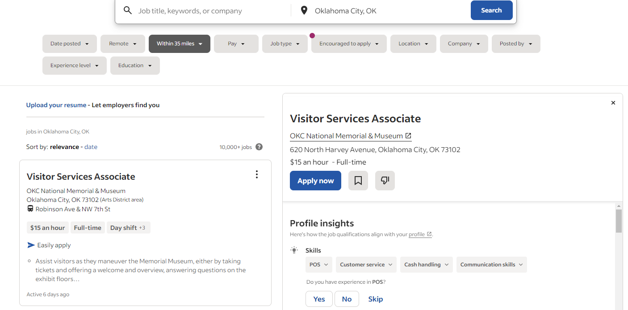


Slide 21
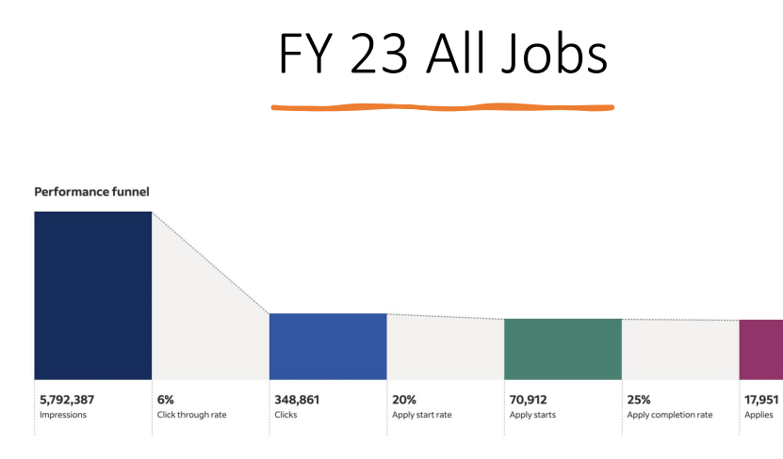


Slide 22
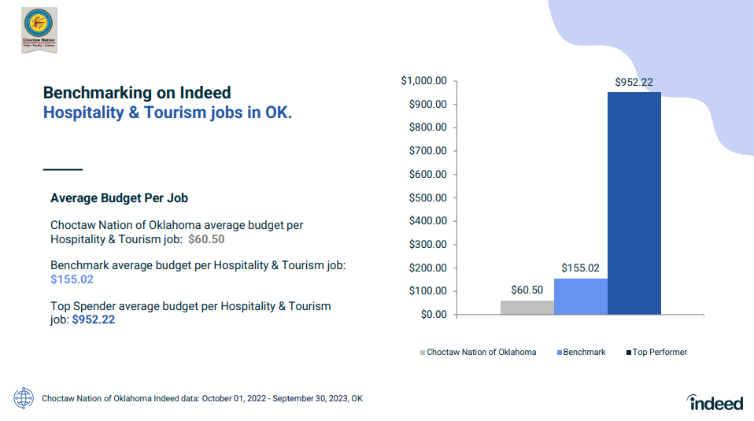

Slide 23
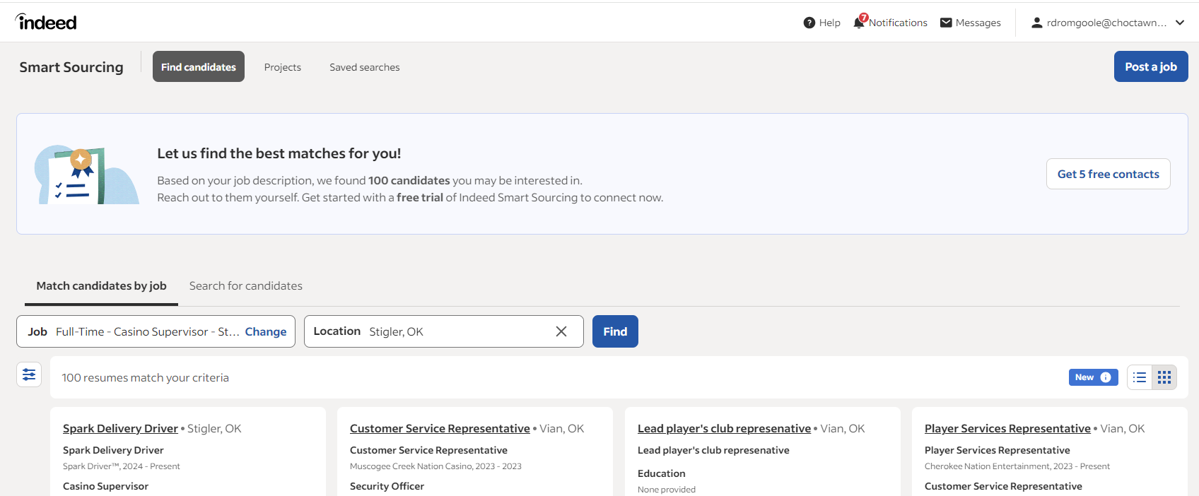


Slide 24
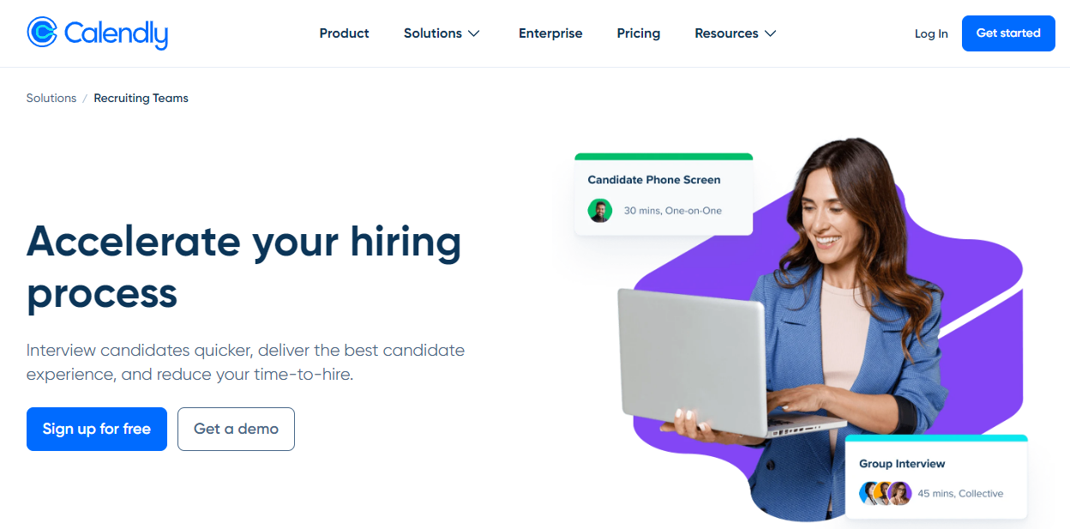

Slide 25
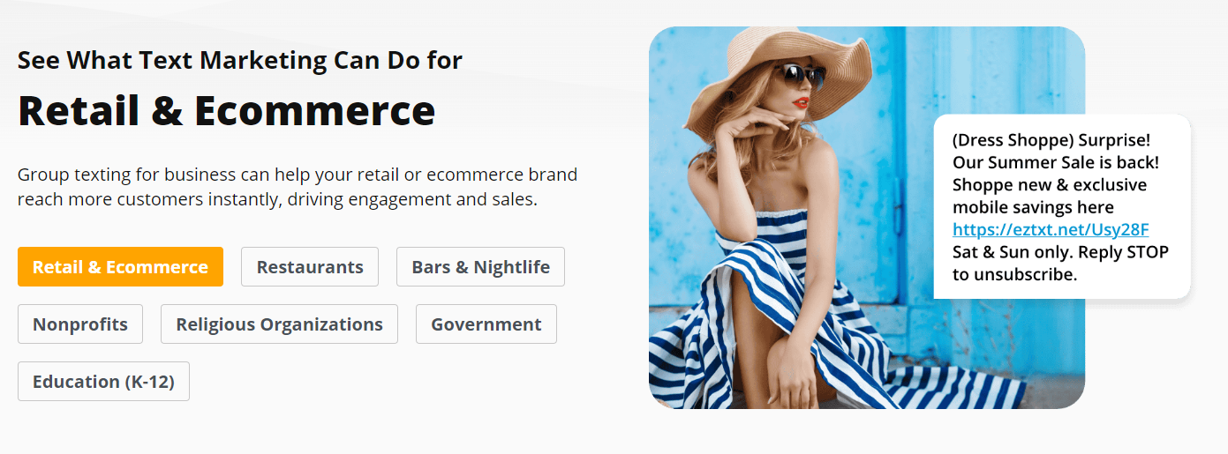
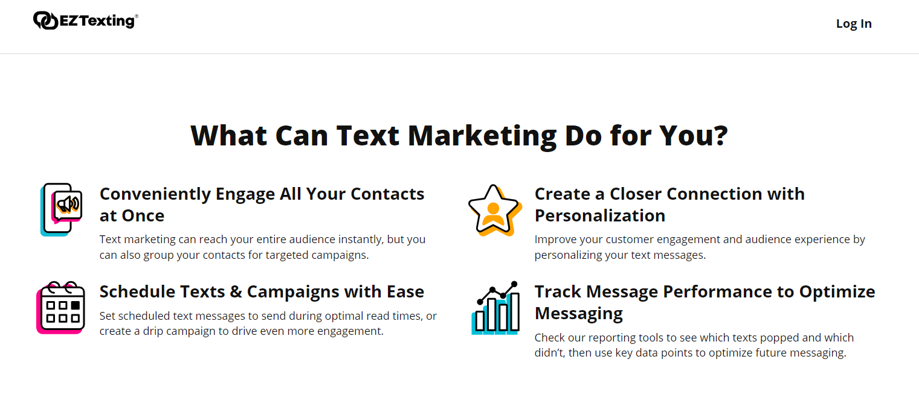


Slide 26
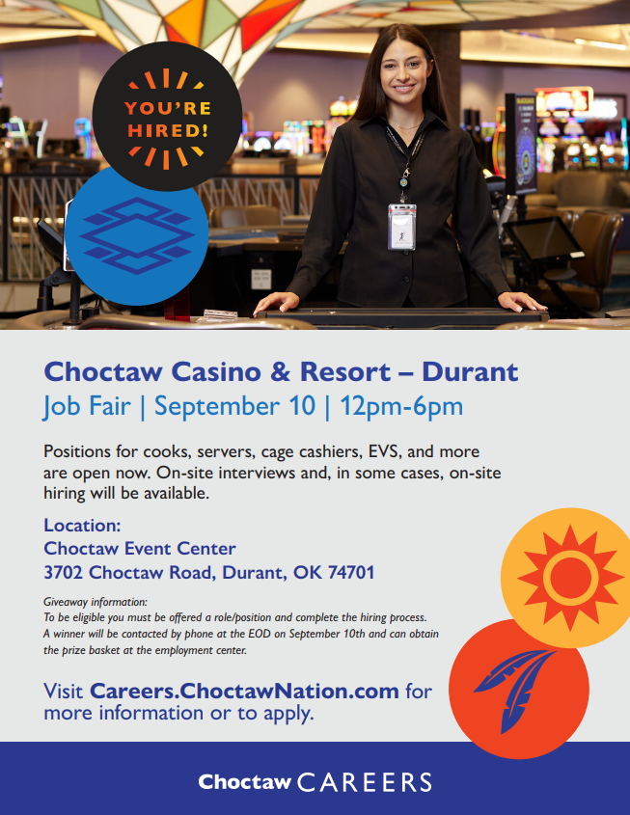
In person job fairs
Hiring managers on site
Offers on the spot
Drug testing on site
HR on site
Recruiters on site
Average 100-hires per event

Slide 27

Job fair basics
Market via Facebook, use employees, hiring managers, marketing department and your recruiters.
Guerilla market. Community bulletin boards, churches, fliers on businesses, loan offices, apartments, everywhere.
Text previous/current candidates about event
Advertise your jobs via sponsored Indeed, call/text and schedule interview day of job fair
Get your local news involved, they love positive stories
Aim for 3:1 interview to hire ratio
Train managers on how to interview first. 15 minutes, yes or no then, no decide later.
Job Fair Flow Matters (Corral/circle, recruiter sign in, interest forms, HR eligibility check, interview, offer, no one leaves without talking to someone)

Slide 28

Open Interviews
Set time every week
Hiring managers on site
Offers on the spot
Rejected candidates recycled
Flow matters (Pre-screen form/past work history, tribal status passed to manager)
Aim for 3:1 interview to hire ratio
Consistent in everything, and buy in from hiring managers

Slide 29

Community Outreach
Serving elders (giving back, also promote hiring events)
Local unemployment offices
Visiting high schools
Visiting colleges
PR whenever possible about fact you are actively hiring
Participation in community events
Hands of Hope

Slide 30
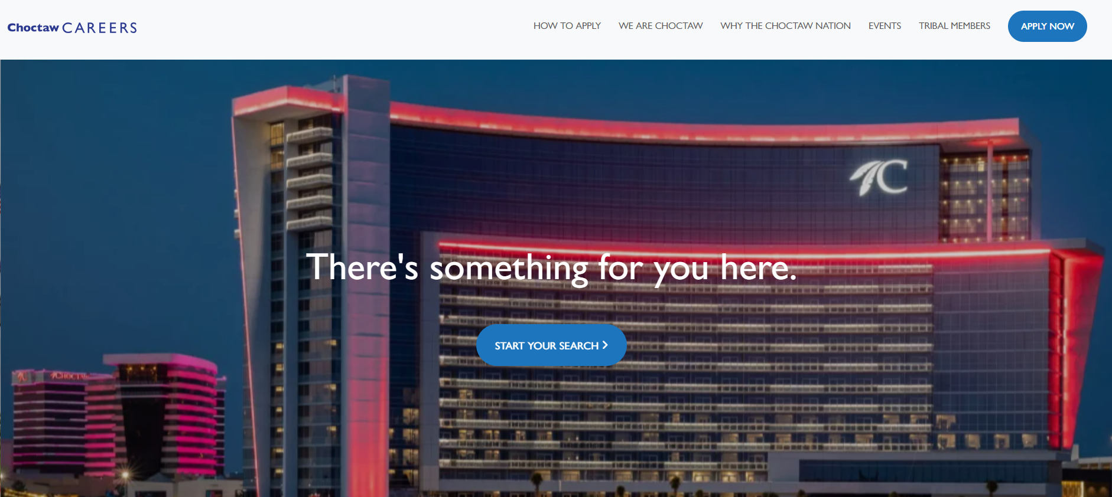
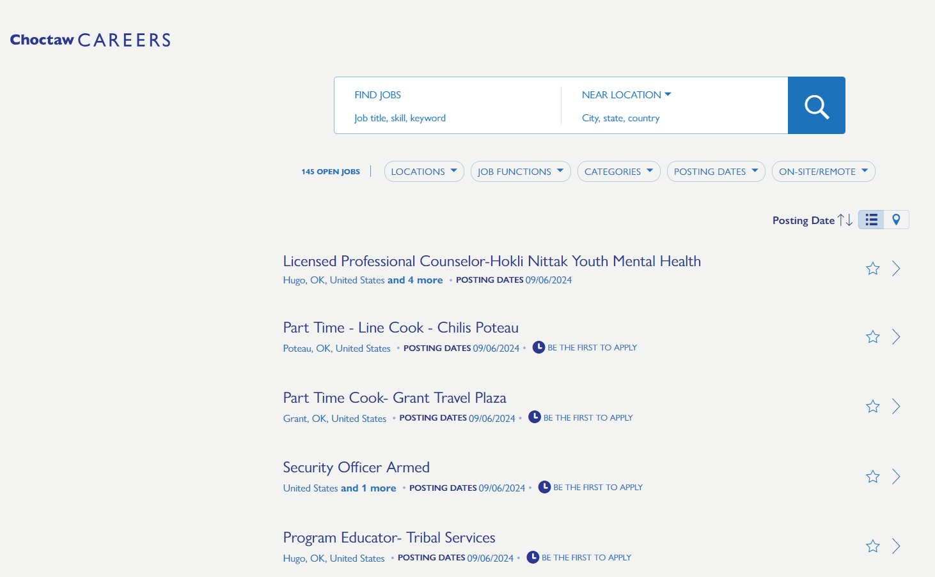
Career Site
Average about 150 posted, 500 open
Average about 2,200 applicants per week (114k per year)
Most traffic organic
We allow people to apply with no resume

Slide 31
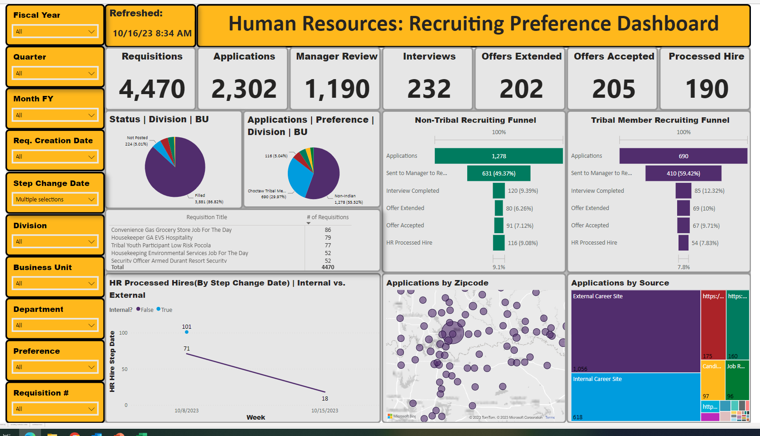

Slide 32
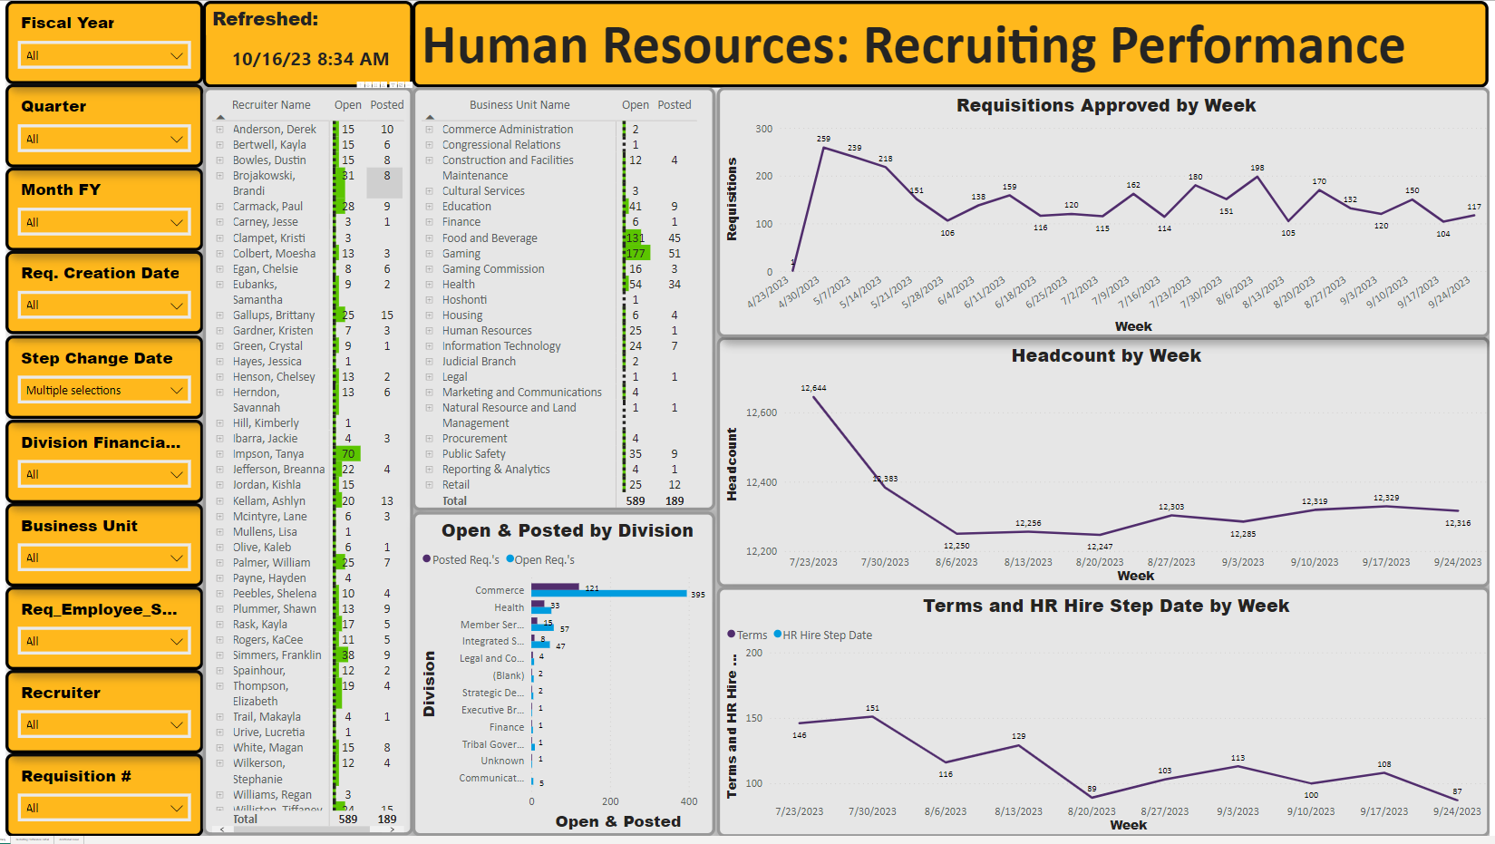

Slide 33
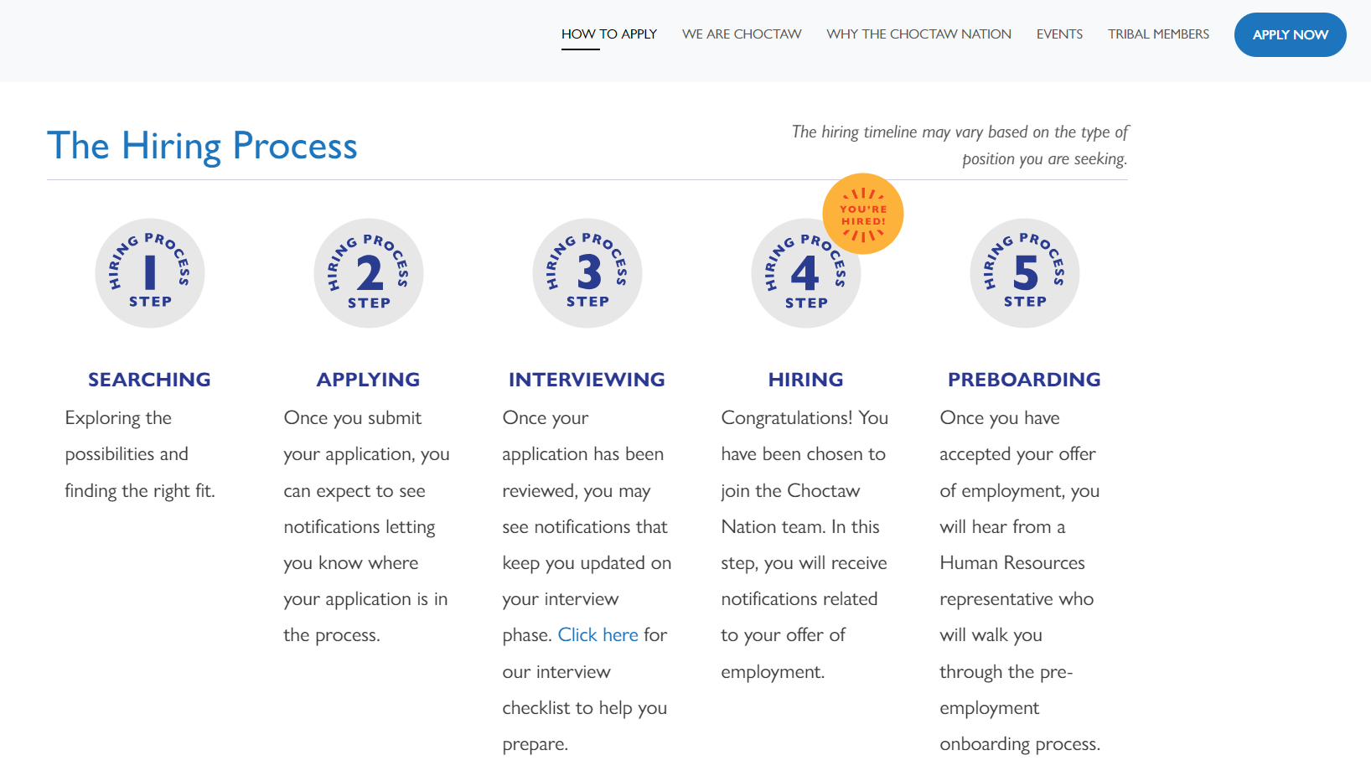

Slide 34

Specialized Recruiting
Know the role, do an intake
Performance Profile versus Position Description (this matters)
When you re-post, LinkedIn will push role to targeted talent
Know your EVP
Find them (LI, AI, Google)
Contact them (you’ve become sales)

Slide 35


Slide 36
Performance Profile
95% of All Job Descriptions Prevent Companies from Hiring the Best Talent
Here is a story about the other 5%...
Rather than asking the standard questions we often hear from most when they take a new assignment – “What are you looking for?” he instead asked her the following five questions:
What does the person need to do to be considered successful in this role and how will you measure it?
What’s the major objective or biggest challenge?
What do the best people do differently than average people in this role?
Are there any team or managerial issues that need to be addressed?
How would you describe the environment that this person will be working in?

Slide 37
How Performance Profiles Work
Job descriptions that are skill-based traditionally emphasize the job itself and the essential skills necessary for its execution. For instance, when seeking to hire a sales employee, a job description might read:
Bachelor’s degree / 3-5 years sales experience required / Strong interpersonal abilities are important / Willingness to acquire product knowledge expected / Attention to detail is essential
Valid, but does not offer clarity on what the person in this role is actually expected to do. Skills-based job descriptions concentrate on desired qualities of a candidate, disregarding factors such as ideal results and performance. Performance-based profile centers on the specific outcomes that must be accomplished. It offers more comprehensive insights into preferred work styles and daily responsibilities that define success in the position. Here’s what an effective performance profile for the above role might look like:
- Attain a monthly target of 20 new customer acquisitions / Efficiently handle multiple projects within a high-pressure work environment / Arrange and submit sales forms and payment transactions to accounting / Successfully meet a quarterly sales quota of $20,000 / Analyze performance patterns to enhance the rate of successful customer acquisitions
Easier to assess/interview against

Slide 38
Build a Performance Profile
www.adlerconcepts.com
Traditional
- Ph.D. Physics
5-7 Years experience
Industry knowledge
Strong interpersonal skills
HpGE experience
Performance Profile
- Advanced research in radiation detection
Increase funding with DOE NE client base
Actively publish in leading physics journals
Increase performance of HpGE equipment
Notes:
I stopped using traditional job descriptions when taking an assignment from a hiring manager. Instead I now find out what the person needs to do to ace the performance review. These are the same performance objectives we provide to our new hires during the onboarding process, so it made sense to use the same approach when defining the new job. Also, by clarifying job objectives up- ront we get buy-in from the hiring manager, the interviewing team, and the candidates before the person is hired. This list of performance objectives is called a performance profile.

Slide 39

Find them
Here’s a list of some of the top chefs in the U.S. who specialize in Asian cuisine, including both traditional and fusion approaches:
1. **David Chang** – Known for his innovative take on Asian cuisine and founder of the Momofuku restaurant group.
2. **Roy Choi** – Pioneer of Korean-Mexican fusion food and founder of the Kogi BBQ food truck.
3. **Ming Tsai** – A celebrity chef specializing in East-West fusion cuisine and host of the show *Simply Ming*.
4. **Masaharu Morimoto** – A renowned Japanese chef, known for his work on *Iron Chef* and his restaurant Morimoto.
5. **Nobu Matsuhisa** – Famous for his Japanese-Peruvian fusion cuisine, particularly through his Nobu restaurants.
6. **Dale Talde** – A Filipino-American chef known for his creative takes on Filipino and Asian cuisine, with several restaurants in the U.S.
7. **Takashi Yagihashi** – Renowned for blending Japanese and French cuisine, with restaurants like Slurping Turtle.
8. **Kristen Kish** – *Top Chef* winner and known for her elevated approach to Asian flavors.
9. **Jet Tila** – A chef specializing in Thai and Southeast Asian cuisine, and a prominent culinary personality.
10. **Charles Phan** – Known for his modern take on Vietnamese cuisine at the acclaimed restaurant Slanted
These chefs have made significant contributions to the culinary world by mastering and innovating Asian cuisines
Used Chat GPT to generate list
Use LinkedIn
Use Google
Find phone number -

Slide 40
Top 10 Native American Casinos in America
1. **Foxwoods Resort Casino** – Ledyard, Connecticut
- Operated by the Mashantucket Pequot Tribal Nation, Foxwoods is one of the largest casinos in the world with over 340,000 square feet of gaming space.
2. **Mohegan Sun** – Uncasville, Connecticut
- Owned by the Mohegan Tribe, Mohegan Sun offers over 300,000 square feet of gaming, plus luxury hotels, entertainment, and dining.
3. **WinStar World Casino** – Thackerville, Oklahoma
- Operated by the Chickasaw Nation, WinStar is the largest casino in the U.S. with 370,000 square feet of gaming space and a wide range of amenities.
4. **Seminole Hard Rock Hotel & Casino** – Hollywood, Florida
- Run by the Seminole Tribe of Florida, this casino is famous for its iconic guitar-shaped hotel and expansive gaming floor.
5. **Pechanga Resort & Casino** – Temecula, California
- Owned by the Pechanga Band of Luiseño Indians, Pechanga is the largest casino in California with a gaming floor of over 200,000 square feet.
6. **Choctaw Casino & Resort** – Durant, Oklahoma
- Managed by the Choctaw Nation of Oklahoma, this casino offers a wide range of gaming, dining, and entertainment options.
7. **San Manuel Casino (Yaamava' Resort & Casino)** – Highland, California
- Run by the San Manuel Band of Mission Indians, it boasts a large gaming area and upscale amenities.
8. **Harrah’s Cherokee Casino Resort** – Cherokee, North Carolina
- Owned by the Eastern Band of Cherokee Indians, this casino offers over 150,000 square feet of gaming space and is one of the premier casinos in the southeastern U.S.
9. **Morongo Casino Resort & Spa** – Cabazon, California
- Operated by the Morongo Band of Mission Indians, this casino is known for its large gaming space and luxurious resort accommodations.
10. **Talking Stick Resort & Casino** – Scottsdale, Arizona
- Managed by the Salt River Pima-Maricopa Indian Community, this casino features over 240,000 square feet of gaming and a wide array of entertainment and dining options.

Slide 41
Special Team Exercise
Assume You are Bringing in a Fully Vetted Top Candidate You Desperately Want To Close For Serious Discussion with the tribe’s Assistant Chief and Key Team members
List the top 5-10 things that you could do [poorly] to ensure that the Candidate will never return or consider a position with your organization again.

Slide 42
Want a copy, just let us know:
Rob Dromgoole
509-740-4222
rdromgoole@choctawnation.com

Slide 43

Your prospect answers!!!!
www.adlerconcepts.com
“Hi, my name is ____ with ____. Your name has been mentioned to me on a confidential basis, as someone I should contact on a search effort I am leading for a top ____. Would you be open to exploring a new career opportunity if it was clearly superior to what you are doing today?”
“Great. Let me just ask you a few questions about your background, and then I’ll give you quick overview of the opportunity.”
Have a script and be confident (you are an expert)
Be vague at first
Get them to provide a quick profile
Stay in control of the conversation
Notes:
It’s pretty hard to say no to this. To ensure a 99% “yes” response to this opening pitch, never mention the title of the job or the location. It’s always better to say, “I’m conducting a search for a senior-level position in marketing (for example), and your name came to my attention as someone I should connect with.”
The key to success at the initial contact phase is to first gain candidate interest by being vague, and then straight away ask the candidate to give you a quick profile of his or her background. Under no circumstances should you tell the candidate anything about the job at this point. This will only give the candidate a chance to say no. Recruiters must stay in control and make the decision if the candidate is qualified for the job, not the other way around. At this initial point, a strong candidate is only trying to get you off the phone?? and they’ll use superficial data to make any excuse to get rid of you. You can’t let them do this. You must decide if the candidate is worthy. If not, then you can either network with this candidate, or move on. If you let the candidate make the decision to proceed, you lose a potential current or future candidate, plus an immediate networking opportunity. To prevent this from happening, immediately after the initial “yes” say, “Great. Let me just ask you a few questions about your background, and then I’ll give you quick overview of the job.” Despite the best openings, you’ll still encounter plenty of objections.

Slide 44
Common objections
www.adlerconcepts.com
I’m happy where I’m at ….
“Understand, however, 95% of people who I contact like this are at least open to
exploring a situation. What about your role is so compelling that you would
not even consider evaluating something different?”
“Your background is interesting. I would like to consider you for this role, or perhaps
something like it in the future? I’m consistently involved in searching for top
talent in ____, I would like to be in a position to call you about something over
the next 6 – 9 months. Would you be open to that?
“Since you’re not interested in the opportunity, let me tell you a little about it anyway.
This is a high-impact role with a great organization, and someone you know might find this job a good match.”
Keep them talking … at least get referrals
Notes:
Appear to accept this as fact; you can ask why or change the subject. Most of the time, this is just a ploy to get you off the phone. To overcome this objection, you’re going to need to first engage the candidate by talking about something else, like networking, and then through this process indirectly convince the person that your position is really more attractive. While you can try to obtain the candidate’s profile right away, you don’t want to put the candidate’s defensives up, so changing the subject is a good idea. There are many techniques you can use at this point.
If the candidate answers yes, prepare the profile and then try to recruit the person again for your current opening. Alternatively, you can try an end-around approach. In this case, you’ll first explain the position to the candidate, network, and then attempt to convince the candidate to explore it him or herself. To use this technique, you’ll need to prepare a compelling two-minute profile of the job ahead of time. While vague, this profile describes the compelling nature of the job, some of the big challenges, and the impact these initiatives will have on the company’s success. Before you describe the profile to a reluctant candidate, you need to position your remarks. For candidates who are happy in their job, use the profile as a means to network with the candidate.
Then go on with your job profile. At the end, you can either network with the candidate, or ask the candidate if this job would be of interest now that they know a little about it. If the answer is yes, obtain the candidate’s profile before you start networking. If the answer is no, you can still obtain it by asking if the person would like to hear about future opportunities. The key is to keep the candidate talking. This way, you’ll be able to obtain some good referrals, and possibly even get the candidate to reconsider.

Slide 45
Common objections
www.adlerconcepts.com
I’m too busy to talk ….
“Understand, can I have just 2 minutes to provide an overview and 2 minutes to explain the job?
“Would you have time later today to discuss the opportunity on an exploratory basis only?”
Schedule appointment = 70% increase in honoring time
If you ‘close upon a concern’ and they still won’t talk, it’s something else
Create a job stretch
Persist, usually it’s a ‘not interested’ objection
Notes:
“I’m too busy to talk.” Just say “fine” and ask for two minutes for the overview, and two minutes to explain the job. Everyone will give you four minutes. You could try to schedule another call, but it’s best to profile the person once you have them on the phone. First, get the candidate’s quick profile, then quickly describe the job in compelling fashion. Even if the candidate seems good, express a slight concern that the candidate might not be strong enough in a certain area (you need to create job stretch), but that you’d like to explore this in more depth in a subsequent phone conversation. If the job really isn’t big enough, you’ll never close the candidate, so it’s important to look for these points during the first discussion. The “I’m too busy” objection is normally an “I’m not interested” objection, so it’s best to persist. If it’s a question of confidentiality and the person can’t talk, then just schedule a more convenient time to talk. You must then get the candidate’s home number at this point. This is critical. If you can’t get the home number, then you’re not doing your job as a recruiter.
Another technique that works well here is if they're too busy to talk and they ask you to call back to schedule the appointment, suggest that you tentatively schedule an appointment now and that you'll call back to confirm.
Microsoft conducted a study that showed there is a 70 percent greater chance an activity will happen if it's scheduled in the calender. So, in our scenario, there is a 70 percent greater likelihood the prospect will honor the appointment and meet with you if you can get him or her to put it in their calendar.

Slide 46
Common objections
www.adlerconcepts.com
What’s the compensation?
“Before I address that, I would like you to think about the best jobs you have ever held, those that gave you the most personal satisfaction. Were the reasons they were the best jobs due to the money you were earning or due to the impact you were having at your organization?”
“If the opportunity I am contacting you about offered you a chance to maximize your impact and person satisfaction, plus offered competitive compensation, wouldn’t it make sense to at least discuss it for 5-10 minutes?”
Do not provide an immediate answer
Most people leave for other reasons (usually a boss)
If you buy someone, there’s always another headhunter call
Notes:
“I’m too busy to talk.” Just say “fine” and ask for two minutes for the overview, and two minutes to explain the job. Everyone will give you four minutes. You could try to schedule another call, but it’s best to profile the person once you have them on the phone. First, get the candidate’s quick profile, then quickly describe the job in compelling fashion. Even if the candidate seems good, express a slight concern that the candidate might not be strong enough in a certain area (you need to create job stretch), but that you’d like to explore this in more depth in a subsequent phone conversation. If the job really isn’t big enough, you’ll never close the candidate, so it’s important to look for these points during the first discussion. The “I’m too busy” objection is normally an “I’m not interested” objection, so it’s best to persist. If it’s a question of confidentiality and the person can’t talk, then just schedule a more convenient time to talk. You must then get the candidate’s home number at this point. This is critical. If you can’t get the home number, then you’re not doing your job as a recruiter.
Another technique that works well here is if they're too busy to talk and they ask you to call back to schedule the appointment, suggest that you tentatively schedule an appointment now and that you'll call back to confirm.
Microsoft conducted a study that showed there is a 70 percent greater chance an activity will happen if it's scheduled in the calender. So, in our scenario, there is a 70 percent greater likelihood the prospect will honor the appointment and meet with you if you can get him or her to put it in their calendar.

Slide 47
Common objections
www.adlerconcepts.com
I’m pretty far down the path with a few other companies.
“Great, but let me ask you this: if the opportunity I’m representing is better than what you are now considering, wouldn’t it make sense to at least compare the two?
If they have offers in this market—they’re good, don’t let them get away.
Position your role as the one with more ‘stretch’
Get information about deadlines etc.
Notes:
I don't like the company. If your company is struggling, or has received some bad press, you'll need to conduct some preventative PR to offset the recruiting damage. One way is to describe the impact the person could have in restoring the company's image. It's also possible the company reputation is based on old information, and a turn-around has begun. In this case, make sure you have some real evidence you can use to offset the negative beliefs. As you begin these damage control efforts, make sure you understand the candidate's concern and then ask, "If we can demonstrate that your concerns, while true in the past, have been rectified, would you be open to explore an opportunity with our company?" Of course, then you have to prove your case, but at least you're moving the process forward. (FYI: this is an example of the classic "close upon a concern" close.)

Slide 48
Common objections
www.adlerconcepts.com
The role isn’t big enough.
“If it turns out the job is bigger than imagined, or if it can be made bigger, would you at least be open to discuss it further?”
“Is it okay if I ask you a few questions about your background to better understand the scope, span of control, and complexity of the positions you have held?”
Try to dig into prospect’s background
Determine if opportunity is larger than what prospect thinks
Perhaps the role can be expanded?
Notes:
The job isn't big enough. Maybe it is, maybe it isn't, but if you've withheld some vital information at the beginning of your conversation this is an easy concern to address. Anticipating a concern and handling it before it's brought up is much better than handling it afterwards. But if you gave too much away up-front and the candidate believes it to be true, one recourse you have is to ask the candidate, "If it turns out the job is bigger than imagined, or if it can be made bigger, would you at least be open to discuss it further?" If possible, ask something like this to get the candidate to give you a little more information about his background: "Is is okay if I ask you a few questions about your background to better understand the scope, span of control, and complexity of the jobs you've held?" Then go on to look for possible gaps in the candidate's background such as team size, job impact made, challenges faced, etc., to see if the job you're representing is actually bigger than what the candidate believes. If not, talk to your hiring manager to see if it can be made bigger.

Slide 49
Common objections
www.adlerconcepts.com
I can’t relocate ….
“For a great career opportunity would you ever consider relocation?”
“If the job were local, would you have a potential interest?”
Accept as fact but engage anyway
You cannot overcome this in 1 call, could take months
Imply job might be bigger for right candidate
Network and develop rapport
Call later and say a key leader wants to ‘just talk’ about role
Notes:
I don't like the company. If your company is struggling, or has received some bad press, you'll need to conduct some preventative PR to offset the recruiting damage. One way is to describe the impact the person could have in restoring the company's image. It's also possible the company reputation is based on old information, and a turn-around has begun. In this case, make sure you have some real evidence you can use to offset the negative beliefs. As you begin these damage control efforts, make sure you understand the candidate's concern and then ask, "If we can demonstrate that your concerns, while true in the past, have been rectified, would you be open to explore an opportunity with our company?" Of course, then you have to prove your case, but at least you're moving the process forward. (FYI: this is an example of the classic "close upon a concern" close.)

