Slide 1


28th Annual Conference
September 23-25, 2024
Durant, Oklahoma

Slide 2




Mastering Financial Wellness: Strategies for a Healthy Financial Future
Presented by: Tina Herndon

Slide 3



How does personal finance affect an employer?

Slide 4


PwC 2023 Employee Wellness Survey
49% say it is hard to meet monthly expenses (up 44%)
44% say they struggle to pay minimum payments
28% of employees run out of money between paydays
15% who make $100k run out of money
39% retail workers said they run out of money
Source: PricewaterhouseCoopers, International’s 2023 Employee Financial Wellness Survey

Slide 5
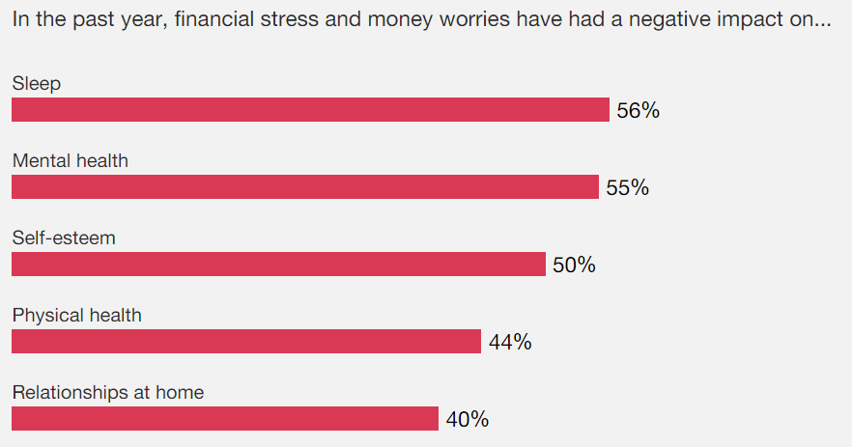


PwC 2023 Employee Wellness Survey
Source: PricewaterhouseCoopers, International’s 2023 Employee Financial Wellness Survey

Slide 6
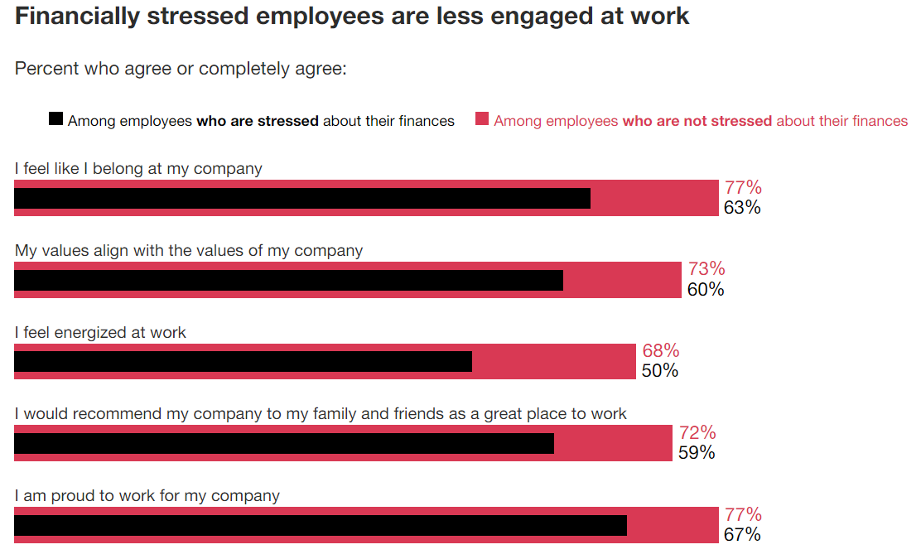


PwC 2023 Employee Wellness Survey
Source: PricewaterhouseCoopers, International’s 2023 Employee Financial Wellness Survey

Slide 7
How does personal finance affect employee wellness?

Slide 8



What does wellness mean?

Slide 9


What is a Healthy Financial Future?
Good Credit
Low Expenses
Sufficient Income
High cost of education
Lack of opportunity
Income stagnation
High inflation
Lack of financial education
Limited physical access
Lack of transportation
Cultural

Slide 10


Psychology and Money
Shame and Guilt
Fear
Euphoria
Procrastination
Bigger than lazy
Overwhelmed
Goal seems too big
Where to start
Money mistakes
Lack of knowledge
Lack of direction
Imposter Syndrome
Consequences
Societal demands
Façade will fade
Limited knowledge
Neurodivergence
Financial windfall
Change of income

Slide 11
Meet
Alice
ALICE is
A L
IC
E
= Asset Limited
= Income Constrained
= Employed
Making Tough Choices

Slide 12



What’s up with ALICE
Their life is a secret tornado
Time is ambiguous
Limited vocabulary = anger
Trust & respect is earned
Judgement is expected
Look for differences not similarities
Better budgets are not always the solution
Societal sabotage is real
Financial resources and good support can change their entire life

Slide 13
How can a financial institution help employers serve their employees?

Slide 14
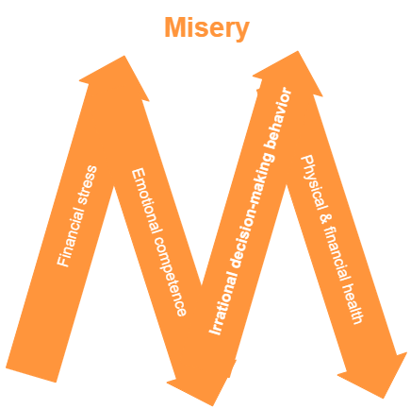
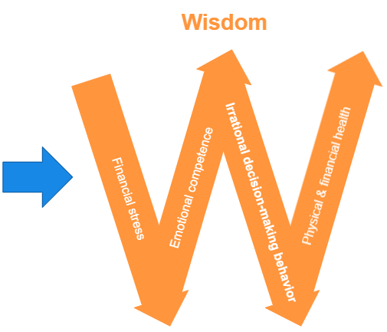

Source: Think2Perform Behavioral Financial Advice

Slide 15

Partnering with a Financial Institution
.
Financial Education
.
Financial Counseling
.
Financial Planning
Employee Lending
.

Slide 16


.
Financial Education
Group presentations
  Multifaceted learning
  Questions answered
Online resources
  Confidential
  Convenient
Newsletters and articles
  Easily shared
  Timely topics

Slide 17



.
Financial Coaching
Confidential 1:1 conversations
  Help create improvement strategies
  Questions are answered privately
  Accountability partner
  Ongoing development support
  Uncovers resources

Slide 18


Financial Advisors
.
Retirement strategies
Investment guidance
  401k, IRAs
  Avoid large losses and mistakes
Ensures sufficient insurance
  Life insurance
  Other insurance
Estate planning
  End of life planning
  Survivor’s benefits

Slide 19



Employee Lending
.
Good interest rates
Resource for building credit
  Reports to all three credit bureaus?
Nonpredatory small-dollar lending
  Outsource employee loans
Building banking relationship
  Refer struggling employees
  Can help with resources

Slide 20
WIIFM…What’s in it for me?
Financial Institutions
Brand exposure
Field of membership
Better borrowers
Employee morale
Security of larger accounts
Community giveback
Employer
Lower financial stress for employees
Sponsorship available
Referral resource for financial conversations
Free workplace culture investment

Slide 21
Is financial education something my employees will want to do?

Slide 22






Let’s have some educational fun?

Slide 23


Financial Facts and Money Myths

Slide 24




I can stop saving for an emergency someday.

Slide 25

I can stop saving for an emergency someday.
Recommended savings = 3-6 mos. of essential living expenses
Households may choose to invest after they have “enough” savings
Start saving again immediately if emergency funds are used.

Slide 26

I can use rent and utility payments to increase my credit score.
&

Slide 27

Experian Boost allows you to build a nontraditional credit score.
Only Experian offers this option
This doesn’t always increase scores
Not every lender will pull Experian
Can work for credit with TFCU

Slide 28
I can pull a free credit report from AnnualCreditReport.com yearly.

Slide 29

I can pull a free credit report at AnnualCreditReport.com yearly.
You can now pull your credit reports weekly
Direct access to credit bureaus
May pull all three credit reports
May dispute errors on website
Pulling credit reports can help with fraud detection and money motivation.

Slide 30

Julie’s Credit Journey

Slide 31




Psychology of Money
Presented by Tina Herndon
TFCU Financial Educator

Slide 32
Freeze Exercise
What am I…
Thinking
Feeling
Doing
What should
I be…
Practice = Emotional Intelligence
Source: Think2Perform Behavioral Financial Advice

Slide 33


To schedule a virtual or in-person workshop for your school or organization, please contact us at
405.319.2185
or
FinancialEducationDept@TinkerFCU.org

Slide 34


Slide 35




BALANCE is a financial education and counseling service. Services include money management counseling, debt repayment options, credit report review and more.
Call toll-free 888.456.2227 or visit TinkerFCU.balancepro.org
/BALANCEPro
@BAL_Pro
findyourbalanceblog.org

Slide 36

Business Partner Perks
Employees qualify for TFCU membership
Live or virtual Business Development Officer meetings to discuss TFCU accounts and services
Free financial education opportunities
Sponsorships & giveaways are possible
405-319-2180
silversg@tinkerfcu.org

Slide 37

TFCU Accounts
Does it cost you to not have a bank account?
$25 + $25 New Member Perk
Free Checking & Savings Accounts
No Monthly Service Fees or Minimum Balances
Free Online Banking
Direct Deposit / Payroll Deduction
Surcharge-free ATM network
Co-Op Shared Branching
Free Financial Counseling
TFCU Member Givebacks

Slide 38


THANK YOU!
Tina Herndon
Financial Educator
Tinker Federal Credit Union
Email: herndont@tinkerfcu.org
LinkedIn: @TinaHerndon
To schedule a workshop call or email:
405-319-2185 or FinancialEducationDept@tinkerfcu.org

