Slide 1


28th Annual Conference
September 23-25, 2024
Durant, Oklahoma

Slide 2


AGENDA
Understanding your Employer Brand
The Recruitment Process
The Importance of Candidate Experience
Innovative Interview Techniques
Onboarding Excellence

Slide 3

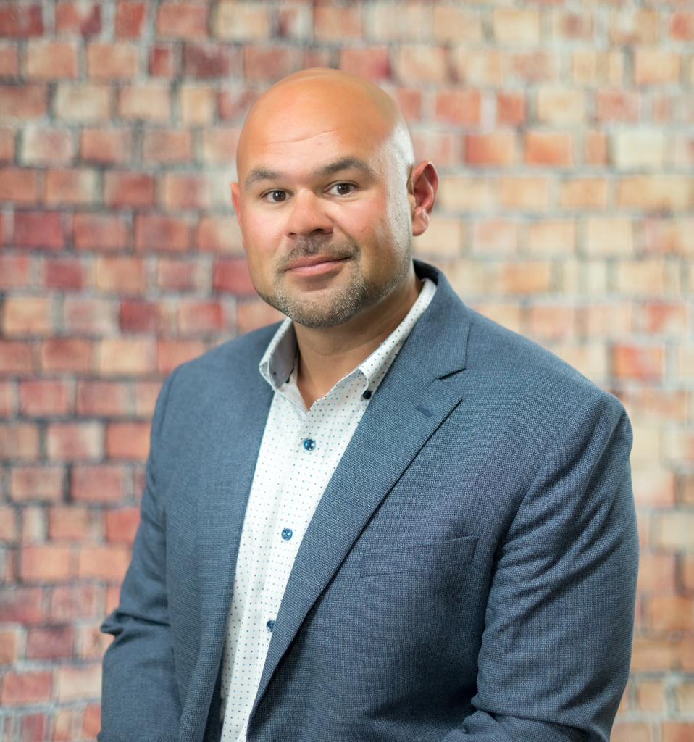
Team
Kaycee Wayka
Marcus Perez
HR Consultant
HR Consultant
Notes:
Kaycee Wayka an enrolled member of the Menominee Indian Tribe of Wisconsin, serves as a Human Resources Consultant for Indigenous Advise LLC. Her experience over the past six years have strictly been in Human Resources and has led her to many opportunities of career development, including policy development, organizational change, and business development. Kaycee earned her bachelor’s degree in organizational leadership from the University of Wisconsin – Green Bay. subsequently, she pursued her master’s degree in leadership and organizational development, specializing in HR Management at Lakeland University. Kaycee’s professional background encompasses roles such as Operations Manager at Woodland Financial Partners and HR Manager at the Wolf River Development Company. During my tenure at the latter, I honed my expertise by undergoing various training programs, including obtaining a Tribal Human Resources Certification (THRP). Currently, Kaycee also serves as a Tribal HR Consultant with the Wisconsin Indigenous Economic Development Corporation, where she has the opportunity to work with tribal organizations and tribally owned small business. Thriving in the dynamic field of Human Resources, she finds fulfillment in the ever-changing nature of the work. Crafting policies that foster empowering work environments, she aspires to help organizations become the employer of choice, where employees can flourish. Each organization holds its unique vision and goals for its HR department, and her mission is to equip them with the tools and knowledge needed to navigate the complexities of employee management and support their overall well-being. She firmly believes that HR is the backbone of every organization. Strengthening policies, nurturing positive employee relationships, and providing resources for growth are pivotal aspects of a robust HR department. She is passionate about leaving a lasting impact, ensuring that every organization she work with possesses the foundation to successfully manage and support its employees in any circumstance, fostering a culture of success and growth.
Marcus Perez is an enrolled member of the Prairie Band Potawatomi Tribe and descendent of the Menominee Nation. He currently serves as the Director of Talent Acquisition and Employee Service Center for Goodwill Greater Milwaukee & Chicago. He serves as a member of the corporate HR leadership team and oversees the talent acquisition, compliance, and Employee service functions for the over 5,000 employees in his organization. Marcus was born and raised on the Menominee Indian Reservation in NE Wisconsin where he attended school prior to enlisting in the US Army. He served from 2001-2014 including two deployments and spent the final six years of his career as a senior instructor. While serving he earned an MBA in Public Administration which helped his transition to the HR field in 2014 where he has built his second career. Over the last decade he has served in executive and senior leadership roles leading a variety of HR functions including employee relations, talent management and workforce planning, learning and development, and HR Business Partnership but his focus has always been Talent Acquisition. This is where his unique blend of experience from military service, private, public, higher education, and non-profit businesses provide perspective on the people needs of organizations and how to meet them across all industries. Marcus also serves on the Board of Directors for HSHS Hospitals in Green Bay, WI, and the Brown County United Way’s Advisory Council.

Slide 4

Understanding your Employer Brand
The importance of an employer brand- how to build it, how to use, how to maintain it

Slide 5







Organizational brand
-- a name, symbol, or other marker that businesses use to distinguish their products (or themselves) from competitor
Notes:
Brand is more than a logo- creates a feeling or understanding: What do you think/feel about….? Employer brand is different but should resonate
When you think about your company or organizations brand it’s more than just a logo. It’s what comes to mind when someone see’s your logo. (ASK WHAT THESE LOGO’S MAKE SOMEONE THINK OR FEEL) It could be value, quality, taste, maybe it’s something that because you see that logo you know that the product is cool or trendy. So that’s a company’s brand and in order to get where these iconic brands you see above are it is the culmination of everything that company does and how they present themselves.
Now an employer brand is a little bit different- granted if you have such a strong organizational brand that someone see’s the name and knows they want to work there that helps- if I was contacted to work at Nike I’m instantly interested in at least reading the description- because it’s Nike. Who wouldn’t want to work for Nike? I’m probably going to assume the job is cool, the pay is great, probably have a really nice office, so I’m interested in knowing more. But it’s not realistic for most organizations to achieve that level of brand recognition, so we have to do a little more work in communicating why someone wants to work for us.
Compare experience: Good job no brand recognition –v- less attractive job STRONG brand recognition
So now we understand we’ve got some work to do- we know our jobs are great opportunities, we pay well, we have great benefits, our work is meaningful, and on and on and on….so now we have to find a way to make sure that the applicants we want- know who we are, and why they should be interested in working for us.

Slide 6
Employer Brand
- “what you say about your company to job seekers, and what your employees say about your company as a workplace”
How do we want to be seen?
Is it consistent with our organizational values/mission?
Can we deliver this consistently/back it up?
Would our current employees agree? Would they share?
Notes:
Define in simple terms
Ask the questions above
Be honest
Conduct an audit
So now we understand we’ve got some work to do- we know our jobs are great opportunities, we pay well, we have great benefits, our work is meaningful, and on and on and on….so now we have to find a way to make sure that the applicants we want- know who we are, and why they should be interested in working for us.
The most basic definition I can think of for Employer Brand is- what you say about your company to job seekers, and what your employees say about your company as a workplace.
What we say about our company (how we market to job seekers)

Slide 7
Brand audit
- Conduct internal surveys
    What are our employees saying? Good/Bad?
Observe social media
Read reviews and/or testimonials
    What is our reputation? Good/Bad?
    Does it need to be changed? Can it be changed?
Notes:
What to ask
Where to look
What do we do with it?
Before we even get to crafting our story we have to understand we already have an Employer Brand. We already have a reputation (good or bad) and our employees are already telling a story (good or bad) about what it’s like to work here. An audit of our brand might include internal surveys, taking a look at what people are saying on social media, maybe we are large enough and show up on Glassdoor or LinkedIn. But we want to understand what our brand is today before we can go about molding it into what we want it to be.

Slide 8
Creating your brand
Create an Employer Value Proposition
  Based in fact
  Employees/Candidates will agree
  Does NOT include wage/benefits
Leverage our employees
  testimonials
Deliver on the promise
  Be sure that interactions enforce the brand/EVP
**Find ways to highlight the things that make us different
Notes:
We want to be unique so we write our EVP:
It should be a statement that is based in fact, that our employees can and will agree with, and that we are willing to back up
It doesn’t involve the specific pay or benefits (we know we have great incentives, but we also know that isn’t enough people have to want to work for us first)
It isn’t tied to a specific role, it’s based on the organization as a whole
GIVE EXAMPLE
Leverage our current employees or clients
We could share reviews or testimonials on our jobs page, social media, or on materials we would distribute to job seekers
CONTINUE EXAMPLE
Deliver on the promise
We need to make sure that whatever it is we are saying about ourselves is something that people that come to work for us will find true, and will continue to share
We also shouldn’t forget about those other things that employees find great- they may not make it into print media but they are also important in people knowing we are a great place to work
EXAMPLE

Slide 9
The Recruitment Process
How to attract, engage, and land the best candidate for your roles

Slide 10
Posting the job
Confirm brand messaging
  Templates
  Job summary
Job seekers must know
  Duties
  Requirements
  Pay/Hours
What is required/preferred
  Education
  Experience
Communicate in a way that opens the pool
  List pay or range
  Explain where you can flex
Notes:
Opportunity to tell them everything we want them to know
True to brand
Understand and Communicate what is needed
Explain why we might want to be more flexible
The work we do to create our brand helps bring people to us, it hopefully either gets their interest and brings them to us looking for a job OR it builds a positive opinion of us for them, so that when we find them with our jobs, they want to take a look.
Now that we have their attention we need to keep it- and this is where the more specific details of our offerings show up.
Job postings/descriptions:
This is our opportunity to tell the candidate everything they want to know about the job
But don’t forget to stay true to the brand we are working so hard to build
The best job postings still include information about the organization, that employer value proposition or another statement would fit right at the top
Could also just be woven into the summary or description of the job
There are some things that we have to say here:
Minimum requirements
Specific duties
Pay or Pay range
Hours or schedule information
Location etc
Differentiate between the things we NEED in a great candidate, and things we would prefer
Is this a job where we are more open to training the right person?
Do we have initiatives to support? such as DEI goals are important in some organizations, hiring people from your tribe or nation might be a strategic goal as well
Studies show that people from demographic groups that might sometimes be called underrepresented or minority including people of color, but also women, or those with disabilities or other are much less likely to apply for a job that doesn’t CLEARLY meet their need, or that they aren’t FULLY qualified for. I’ll explain…
Education- is this something absolutely mandatory? Maybe we are hiring an accountant and they MUST be a CPA, or maybe it’s a grant funded program that dictates a certain degree must be obtained, in those cases we don’t have a lot of wiggle room here. But maybe we are looking for someone in a general professional job, it could be for HR role, where the level of the role would usually ask for a degree, but we want to have the door open to people from those targeted groups to apply if maybe they aren’t all the way there. We could make a bold statement saying that we encourage people to apply even if they do not fully meet all requirements, or we’ve all seen language like a degree OR THE ABILITY TO ATTAIN one is needed.
Pay or Range- a lot of states now mandate this but it’s important even if you operate either in a state that does not or under a sovereign status to at least understand the why. When there is a range you want to provide the full range that you are willing to pay. If you know you COULD got to $80k, but you would like to pay $65k…be prepared to only get $65k candidates. You might have been just short of someone incredible for your role in what you posted but could have absolutely landed them. Don’t discourage great talent.

Slide 11
Recruiting Processes
Entry level/high volume
  More passive
  Placement is important
  Responsive
  Speed to hire
  Candidate experience
Management/Professional
  1 of 1 roles
  More active (attract or search)
  Initial contact can make or break
  Set expectations
  Candidate experience
Notes:
This will be different depending on volume and level of the roles but there are some things that you should stay consistent with:
Your brand
Your voice
Your EVP
They should all be consistent in whatever message you are sending or whichever vehicle you using.
Entry level/high volume roles
If we’ve done our work here in building a brand and creating good postings this can be fairly passive
We need to post the job on the right job boards (Indeed, etc), hang the announcement on the right bulletin boards (local job centers, schools, other places people gather), and send our openings to the right partners (workforce development agencies, colleges, etc)
We need to have a process that is responsive
How do we connect with all applicants?- Recruiters are prepared to speak to the job in detail, and have the ability to communicate quickly
How quickly can we have a candidate in for interview? Hire?
Management/Professional or One of One roles
Candidates arrive in one of two ways
They find us- LinkedIn, Indeed, our jobs page, referred by an employee, referred by a business
We find them- resume search, solicit partners, other networking
The initial contact is most important
Recruiters need to be able to speak your brand, communicate your EVP, and know the role inside and out
They understand not only the requirements and duties, but where the role fits into the organizations larger mission- the impact a hire will have
They understand the requirements as well as which are preferred and what if any exceptions can be made
This is both your one shot to understand if this candidate is someone you should spend time and effort on, as well as your one shot to sell a candidate on why they should want this role -mutual sale
Create a network of people who will refer
Create a funnel of people who may be great candidates for future roles
Understand and communicate your process (1 interview, a panel, multiple rounds, who will they be meeting, anything they should prepare, assessments that will occur, expectation of timeline)
Deliver on the promise, the candidate experience is extremely important, you will choose not to hire many more people than you will actually hire. Leave them with a positive experience and a good story to tell
**Importance of candidate experience- tie to next slide

Slide 12
Selecting Talent
Entry level/high volume
  More passive
  Placement is important
  Responsive
  Speed to hire
  Candidate experience
Management/Professional
  1 of 1 roles
  More active (attract or search)
  Initial contact can make or break
  Set expectations
  Candidate experience
Notes:
Fitting your process to the role
Should this job be a one step decision?
Does it require input from multiple stakeholders?
Who will be involved?
What do you need to learn to make the right decision?
Entry Level
There is a difference here- not all entry level roles are high volume
High volume roles should have the most simple process
QR code to schedule
Walk in interview
Automate where possible
Entry level may need more specifics but should still be efficient
Candidates have many options
ROI of time/effort
Impact of the role
Professional/Mgmt
Level is important, a department or team manager may be a quicker decision
An executive can be months long selection process
Pre determine the process- communicate it to candidates
Craft questions to determine the competencies
Engage stakeholders as SME for those competencies
Work with collaborators or client/customers
Determine ultimate decision-making authority
**Importance of candidate experience- tie to next slide

Slide 13
The Importance of Candidate Experience
The story job candidates will tell- why its important, how to make it positive, and how it impacts your organization

Slide 14
What is candidate experience?
- “how the people who apply to work with you perceive the organization and the hiring process”
Begins at initial contact
Expectations
Process
Communication
Transparency
Ends with either employee onboarding OR a final rejection email
Notes:
How the people who apply to work at your organization perceive the hiring process.
It starts at first contact
job posting
referral
message from a recruiter
From that first point of contact everything that a candidate experiences all the way to either their onboarding as a new employee or the final rejection email will add to that perception- and leave them with a story to tell. Make it a good one!
What was first contact? Was it a well written post? Did they receive a positive referral? Did our outreach make them want to work for us?
What expectations did we set? Did we deliver?
What did the process feel like? How long did it take? Was it structured?
How frequently and promptly did they receive communication? Was it clear? Was it helpful?
Did they have a good understanding of what was going on? Did everything seem secretive? Or did we communicate each step of the way
How did that final rejection or hand off to onboard feel? Did you understand why the experience was ending. Did you understand what, if anything comes next?

Slide 15
Making it a positive experience
Make each interaction an investment in your brand
Communicate clear expectations
Be open and honest- share information
Communicate frequently
Be structured
Be efficient
Be human
Notes:
We can do a lot of things to ensure that candidates have a positive experience:
Invest in the employer brand we’ve been taking about- have a jobs page that speaks to the things we find important and clearly and openly shows the things we think will be important to our employees like work life balance, compensation, benefits, sense of purpose, development opportunities.
Clearly state expectations around the process, timeline, and steps
When someone is scheduled for an interview this is not a game of gotcha, we should tell them what to expect. Don’t give them the questions but let them know what they’ll be asked about.
Tell them who they are interviewing with so they might do a little bit of LinkedIn research
Tell them how many rounds to expect and how long the process will take (doesn’t have to be exact- but you should have a very good idea)
Communicate frequently
When you say you will be contacting them- do it
When you have news to share- share it
When you speak to them- close with expectations about what will be next
Have structured interviews- candidates can feel when things are being “shot from the hip”. Make them focused around just a few competencies rather than all over the place.
Keep application forms and processes short
Move efficiently through the process
Be transparent
And if you have the ability- measure the process with a survey at the end. A simple numbered scale on satisfaction or likelihood to recommend with a free text box at the end would be perfect.

Slide 16
Innovated Interview Techniques
Why change the interview experience, Types of Interview techniques, and the overall experience and follow-through

Slide 17
Why change the interview experience?
Attract top talent
Reduce hiring biases
Enhance the interviewee experience
Focus on past experience to predict future behavior
Better assessment of soft-skills and problem-solving ability

Slide 18
Type of interview techniques
SITUTIONAL
Hypothetical scenarios posed to candidates
Assesses decision making and problem-solving skills
Test real-world thinking.
BEHAVIORAL
Also, can be measured by using hypothetical scenarios
Or ask question that start with – “Give me an example of when….” “Tell me about a time you….” Describe a conflict situation that…”
GAMIFIED ASSESSMENTS
Interactive tasks or challenges that are related to the job
Great way to engage candidates in a “enjoyable” way.
Reveals natural behavior, and competencies.

Slide 19
Overall interview experience & follow through
Keep introductions of interview panel short
More conversation vs feeling like an interrogation
Stay away from questions that only require a yes or no answer
Let them set the pace – do not cut them off
Give them a reasonable timeline of when they can expect to hear back from you
Give a solid explanation
Courtesy calls

Slide 20
Onboarding Excellence
Why it is important, Examples of onboarding tools that work, and an example timeline of efficient onboarding steps

Slide 21
Why effective onboarding is important
Acclimate new hires to Company/Tribe’s Culture
Fosters connections and relationships with team members and/or departments
Clarify job expectations and roles
Provides necessary tools and resources
Essentially effective onboarding leads to higher retention rates, increased productivity, and improved employee engagement

Slide 22
Examples of onboarding tools that work
MENTOR OR “BUDDY SYSTEM”
Pairing the new hire with a “buddy” who will act as a mentor to that new hire for their first X amount of weeks of employment.
Sit with them on their first day.
Routine check-ins
LESS PAPERWORK MORE INTERACTION
Give them the opportunity to fill out paperwork before they come into their first day.
Less time spent on the “legal” side of their employment and more time introducing them to the culture of the organization.
GOAL SETTING
Let them set their own goals for the first 30/60/90 days, after they complete onboarding.
Letting them be in charge but also developing mechanisms to hold them accountable.

Slide 23
Timeline of onboarding steps
Pre-Onboarding
Send employee a welcome email or packet that includes – what to expect on their first day, a schedule, and or any paperwork they may be able to fill out beforehand (make optional).
First Day
Give a warm welcome, introduce them to key team members, provide tour. Overall keep first day light. Ensure they have access to everything they need.
Check-In
Provide new employees with a check-in, whether it be after the first week, two weeks in or even a month. Will help give them a boost of confidence and also give them reassurance or opportunity to ask questions.
After Orientation Period
Provide employees with the option to complete a survey regarding their onboarding, after they complete their orientation/probationary period.

Slide 24
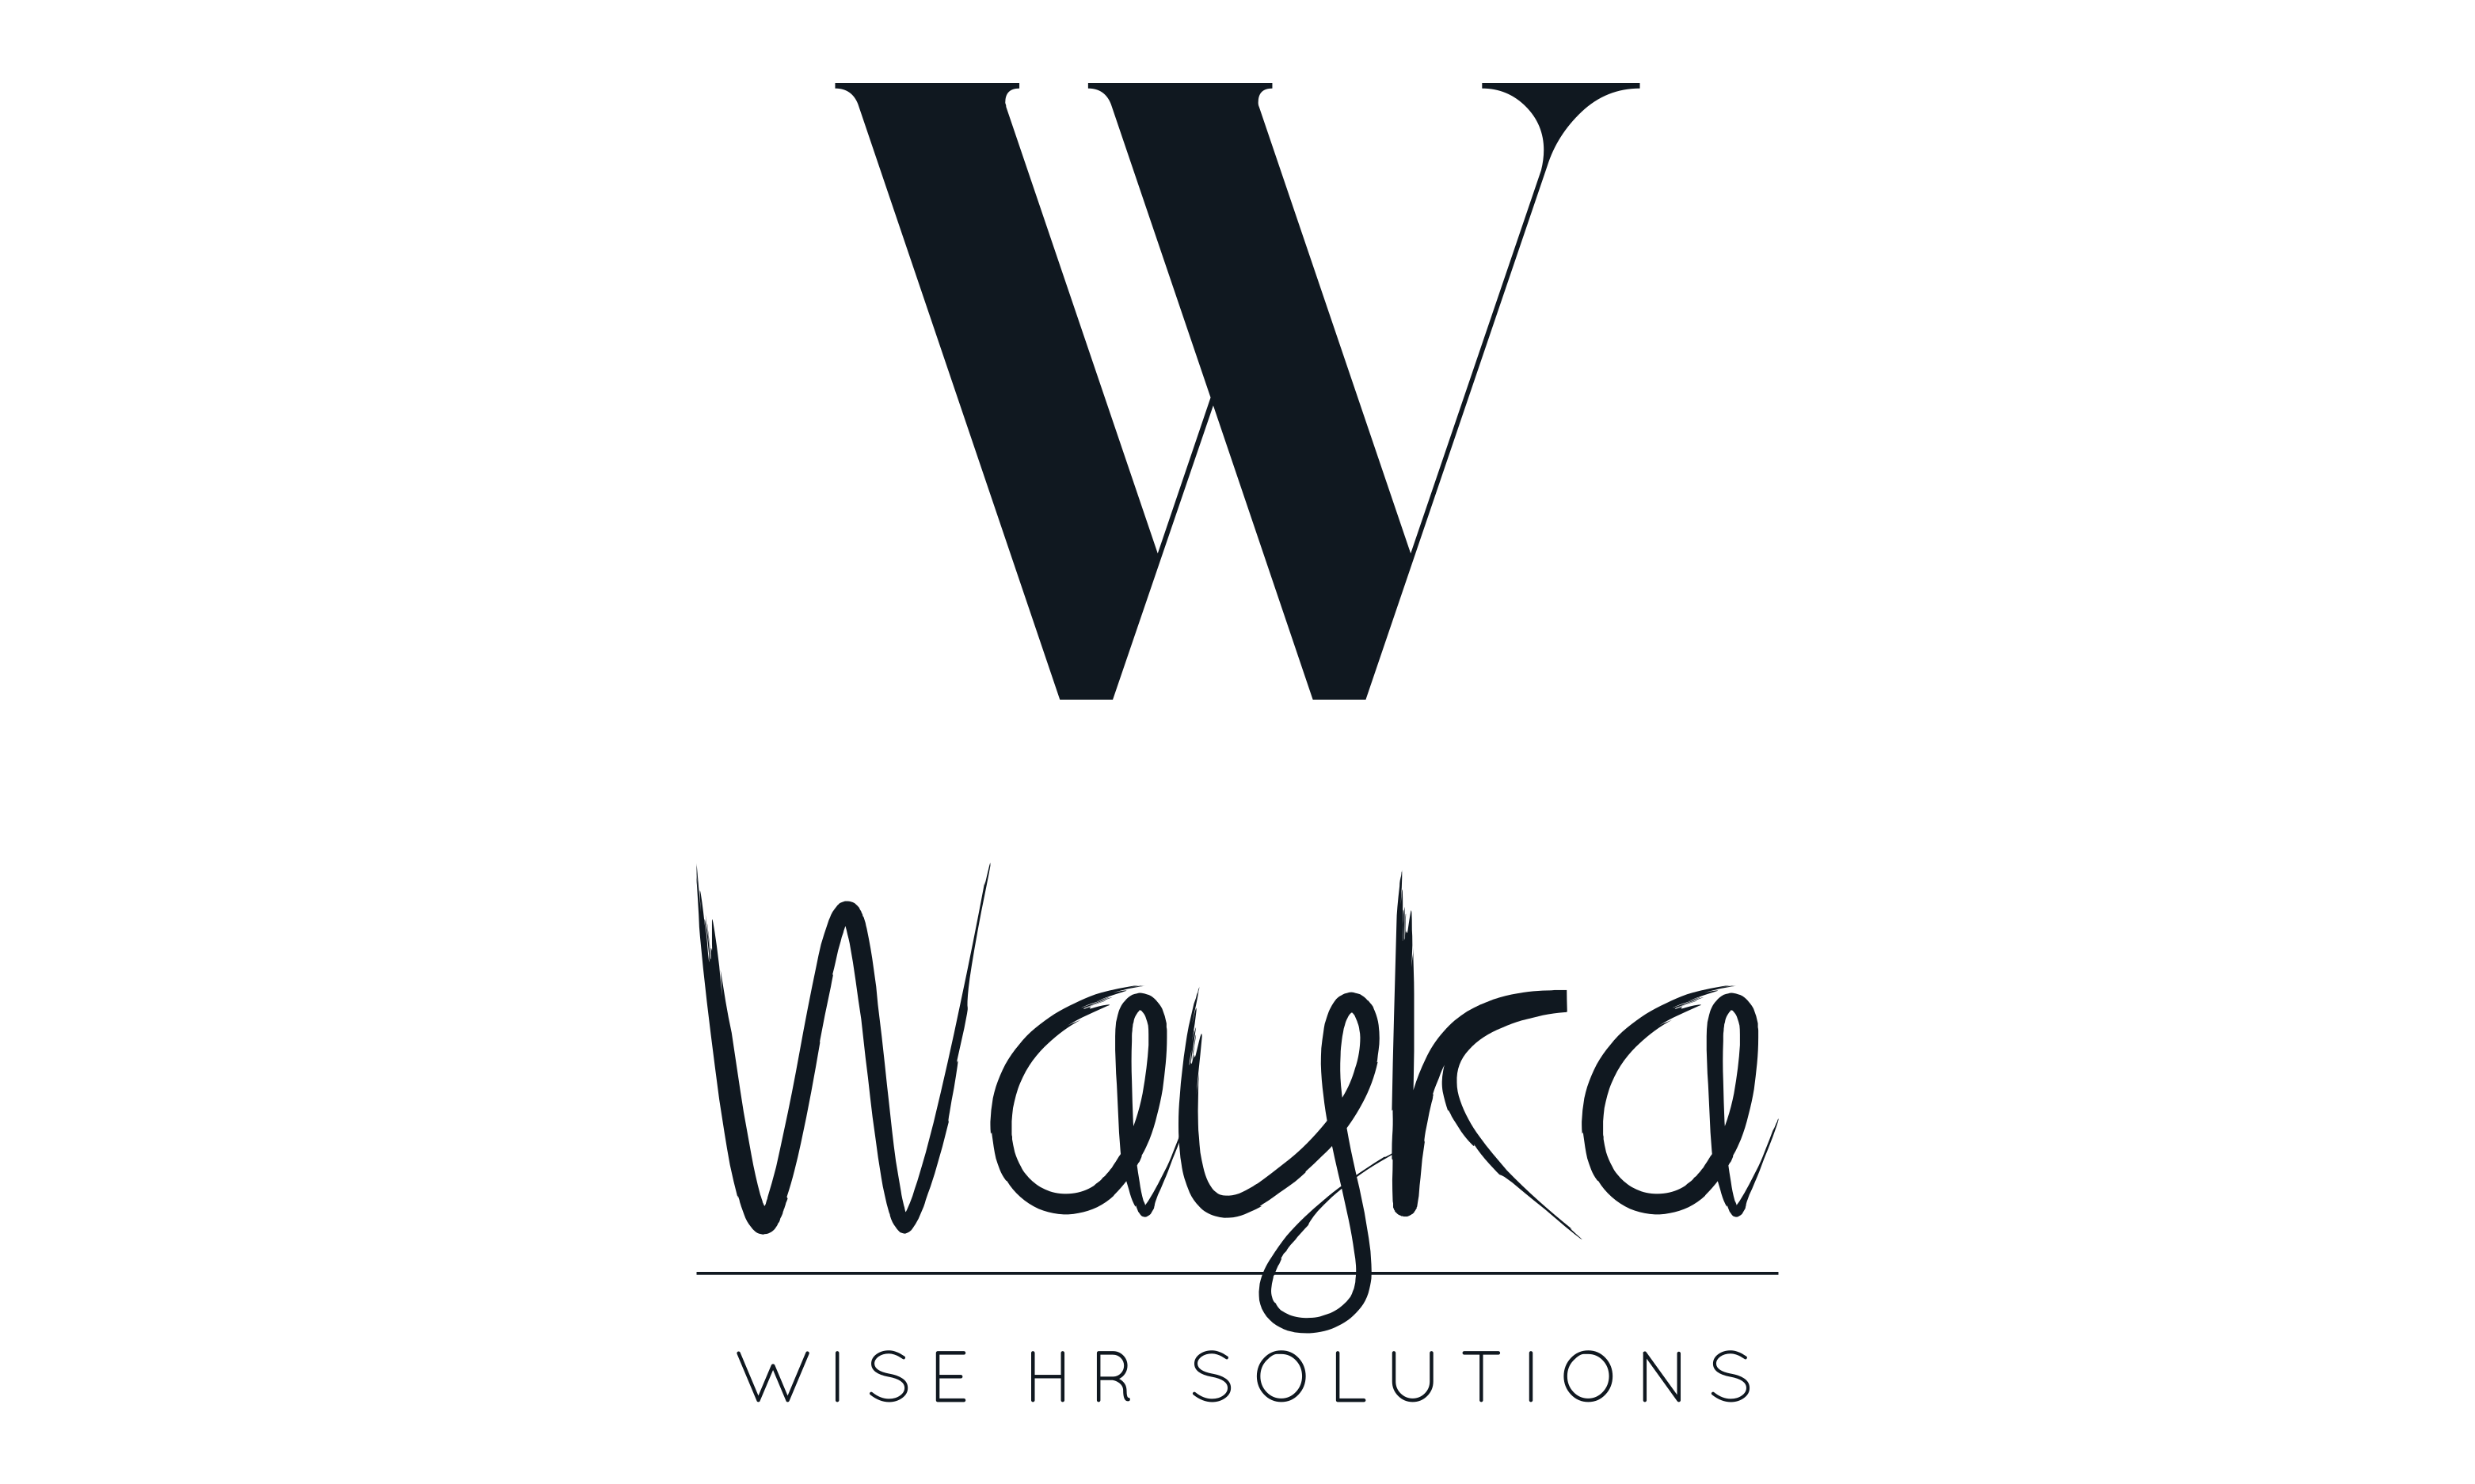
THANK YOU!
Marcus Perez – mptalentsolutions.com
Kaycee Wayka – kayceew@waykawisehr.com
        www.waykawisehr.com

