Slide 1


28th Annual Conference
September 23-25, 2024
Durant, Oklahoma

Slide 2

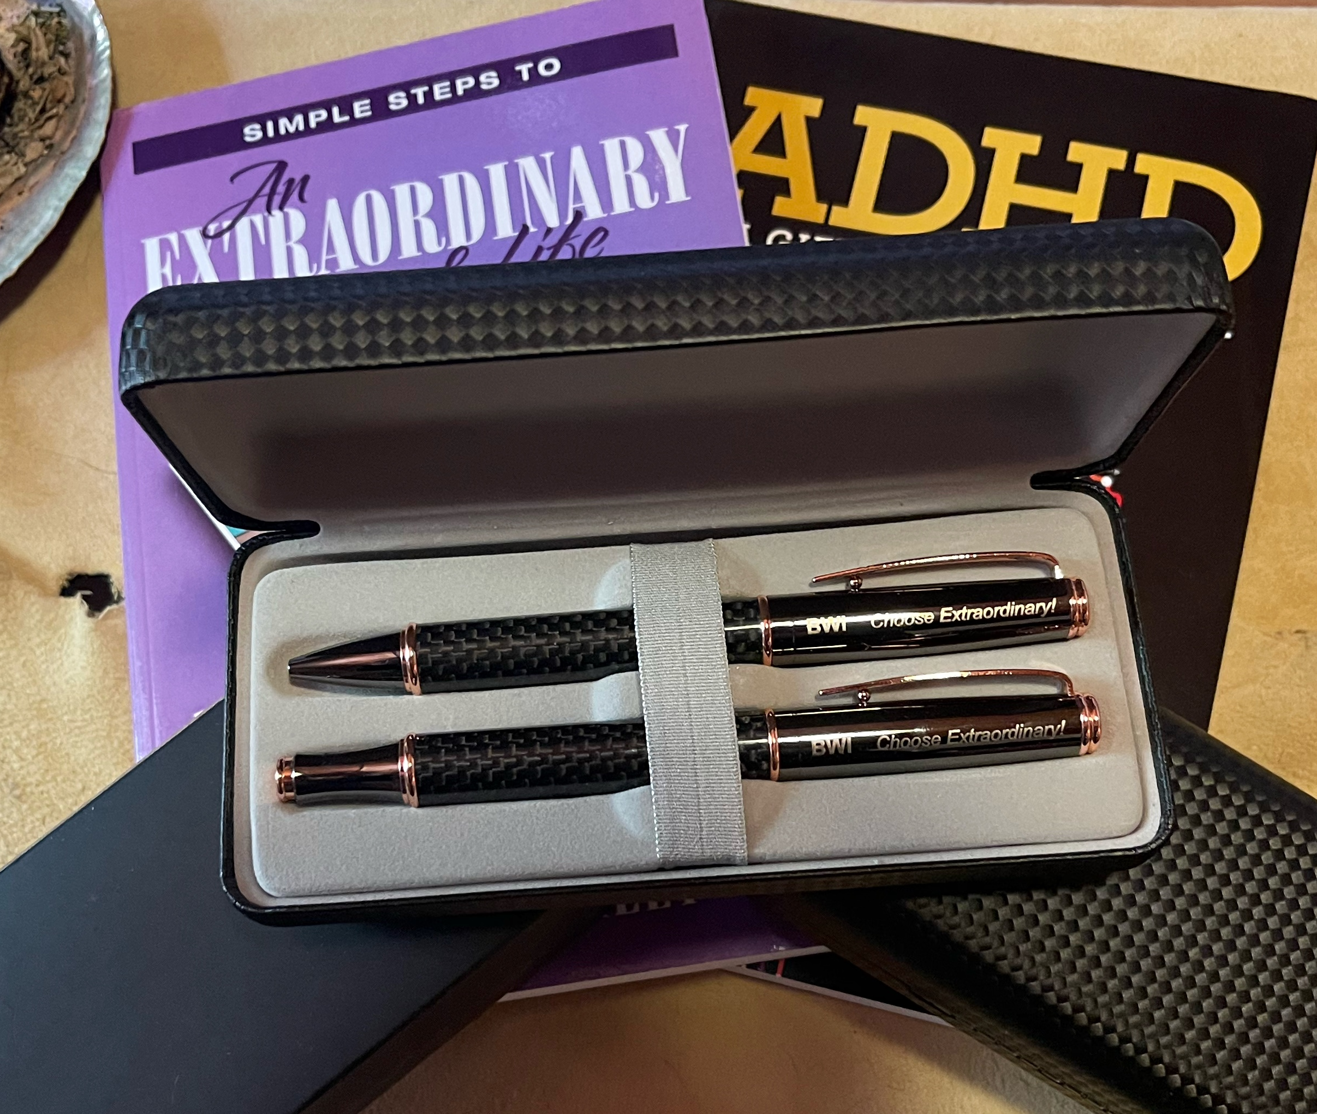


Today’s give away, an executive pen set to enter send an email to david@bwilearning.com

Slide 3
BECOMING THE LEADER THAT OTHERS WANT TO FOLLOW: Strategies for Success
Presented by David Miller

Slide 4
INSPIRING CHANGE,
INITIATING SUCCESS
Radical Leadership

Slide 5
rad·i·cal
/ˈradək(ə)l/
adjective
(especially of change or action) relating to or affecting the fundamental nature of something; far-reaching or thorough.

Slide 6

THEKISSPRINCIPLE

Slide 7
“If you want results in your life, personally or professionally, different than you are currently getting, then you have to do things differently than you are currently doing.”

Slide 8
LESS IS MORE
Essentially, the important message that you really need to understand is that less can be quite a bit more. When you think of something like sentence structure, when it actually comes down to it, the fewer words you use, the much better the sentence is likely to be. Pretty much when you have better sentences, you have a much improved understanding.

Slide 9
LESS IS MORE
Less can be more. In a sentence, for example, fewer words can lead to better understanding.

Slide 10
USING KISS AT WORK
Choose your words carefully in written communications, including when you try to write effective emails.
  Be clear about what you want to say.
  Use headings and bullets to stress key information.
  Proofread your work and take out words and information that don't add value.

Slide 11
USING KISS AT WORK
Format your communication pieces effectively:
  Use lots of white space.
  Highlight or underline key words and concepts, or use bold formatting.
  Know your audience and your objective, and develop your communication accordingly.

Slide 12
USING KISS AT WORK
Focus your problem solving:
Put the problem in the right perspective by getting to the root cause of the issue.
Simplify your systems and processes by continual reassessment.
Create support systems that encourage people to look for opportunities to improve efficiency.

Slide 13
KEY POINTS
Keeping it simple is not necessarily easy.
Details have a time and place.
Don't try to say or do everything.
Concentrate more on what really needs to be said or done.
Complex to simple = value

Slide 14
Being Overly Honest
Being Overly Honest
Gathering Intelligence
Being Composed
Gathering Intelligence
Letting Your Guard Down
Being Composed
Letting Your Guard Down
STRATEGIES FOR SUCCESS
Keeping Promises
Keeping Promises
Properly Handling Mistakes
Delivering Bad News Well
Avoiding Destructive Comments
Showing Others You Care
Notes:
Studies have shown that there are 9 common traits or behaviors for people that are successful in having transparent communications.
You can follow along with these and take any notes you’d like starting on page __ in your participant manual.
(You shouldn’t have to belabor these, this is just review of what they should’ve already read in the pre-work)
Advance

Slide 15

Being Overly Honest
Being Overly Honest
Being Composed
Gathering Intelligence
Letting Your Guard Down
Keeping Promises
Properly Handling Mistakes
Avoiding Destructive Comments
Delivering Bad News Well
Showing Others You Care
Notes:
The first is…being overly honest.
Leaders think they're overwhelmingly honest, but many followers say otherwise. In leadership assessments, over 50% of almost 13,000 peers and direct reports felt their leaders could improve in being honest and ethical.
When transparent leaders decide not to share certain information with their followers-perhaps because they do not yet have all the pieces or because, for whatever reason, they are unable to tell-the unbreakable principle of honesty requires them to say so: "I can't tell you that right now, but here's what I can say."
Overwhelming honesty should be delivered with respect and concern for others. Followers should not be left to wonder about hidden agendas. When leaders drive this core value down through their team, not only is trust built, but another fantastic result also can occur-followers become tolerant of not having all the facts.
Advance

Slide 16

Being Overly Honest
Gathering Intelligence
Being Composed
Gathering Intelligence
Letting Your Guard Down
Keeping Promises
Properly Handling Mistakes
Avoiding Destructive Comments
Delivering Bad News Well
Showing Others You Care
Notes:
The next is Gathering Intelligence
In surveys, 95% of leaders were unable to give themselves the highest rating at demonstrating an understanding of their own strengths and weaknesses. Asking others for their opinions about something conveys respect and shows that they are valued. It also promotes transparency as a reciprocal agreement. When leaders ask for feedback about their own performance and discover how others perceive them, they are better able to align their intentions with reality and develop a plan for improvement. In order to learn and grown, leaders must have self-awareness, which, ironically, requires input from others.
Advance

Slide 17

Being Overly Honest
Being Composed
Being Composed
Gathering Intelligence
Letting Your Guard Down
Keeping Promises
Properly Handling Mistakes
Avoiding Destructive Comments
Delivering Bad News Well
Showing Others You Care
Notes:
Effective and admirable leadership requires composure. Challenges, stressors, and obstacles are inherent in any organization and in any leader's path; how leaders conduct themselves during the good times and the bad can be indicative of their character, competence, and ultimately, credibility. While the call for transparency that builds credibility urges leaders to reveal their true opinions and emotions regarding relevant business issues, it does not allow for leaders to irresponsibly let it all hang out. Followers expect their leaders to be composed. And they are always watching. Also, a certain level of predictability builds trust.

Slide 18

Being Overly Honest
Letting Your Guard Down
Being Composed
Gathering Intelligence
Letting Your Guard Down
Keeping Promises
Properly Handling Mistakes
Avoiding Destructive Comments
Delivering Bad News Well
Showing Others You Care
Notes:
Leaders who keep in mind the spirit of authenticity while working hard to create meaningful connections with their followers, demonstrating sincerity of being, and revealing personal information that adds value to the context of work, will be practicing an important part of leadership transparency that builds credibility. Doing so, however, requires a certain level of maturity and self-awareness and a heightened sense of how people might perceive, dissect, and disseminate the information that is revealed. And because authenticity or personal transparency ultimately describes the quality of a relationship, leaders must create opportunities in which to engage with their followers, allowing the followers to know them.

Slide 19

Being Overly Honest
Being Composed
Gathering Intelligence
Letting Your Guard Down
Keeping Promises
Keeping Promises
Properly Handling Mistakes
Avoiding Destructive Comments
Delivering Bad News Well
Showing Others You Care
Notes:
When leaders match their words and actions and do what they say they will do, they place a high value on their commitments. Promise keeping in leadership is not always clear-cut. Sometimes leaders are forced to reconsider promises and disappoint followers. Those are the times when transparency is particularly important, because followers who understand the reasoning behind broken promises may be more accepting of the consequences.

Slide 20

Being Overly Honest
Being Composed
Gathering Intelligence
Letting Your Guard Down
Properly Handling Mistakes
Keeping Promises
Properly Handling Mistakes
Avoiding Destructive Comments
Delivering Bad News Well
Showing Others You Care
Notes:
How leaders handle mistakes actually may be more important than getting things right the first time. Even with its inherent risks-such as appearing weak, incompetent, or otherwise less than perfect-confessing mistakes signals courage, accountability, and humility. Indeed, mistakes are an opportunity to visibly demonstrate a commitment to honesty.

Slide 21

Being Overly Honest
Being Composed
Gathering Intelligence
Letting Your Guard Down
Delivering Bad News Well
Keeping Promises
Properly Handling Mistakes
Avoiding Destructive Comments
Delivering Bad News Well
Showing Others You Care
Notes:
Delivering bad news can be tricky business, yet doing it well is essential. When sensitive, controversial, or potentially hurtful information is not delivered well, people can feel betrayed, angry, and indignant. Trust is destroyed and relationships suffer. For most leaders, delivering bad news is hard, and some even opt for silence. Those on the receiving end usually appreciate bad news that is delivered promptly and with honesty, directness, care, and concern.

Slide 22
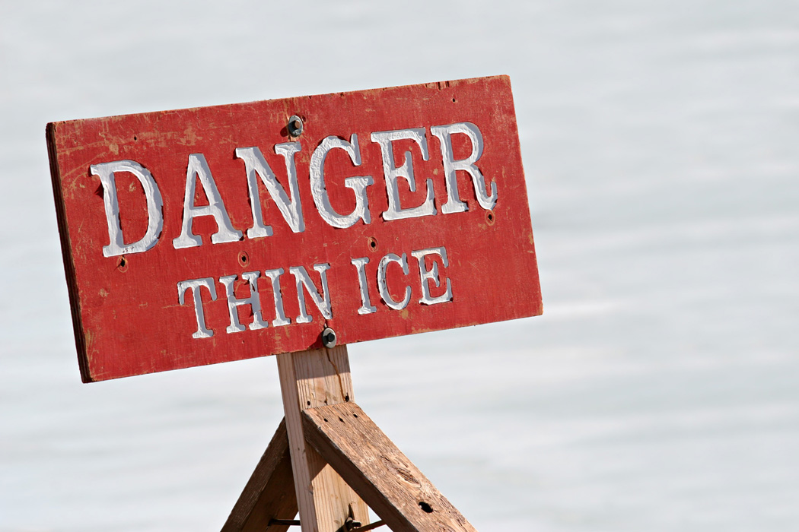
Being Overly Honest
Being Composed
Gathering Intelligence
Letting Your Guard Down
Avoiding Destructive Comments
Keeping Promises
Properly Handling Mistakes
Avoiding Destructive Comments
Delivering Bad News Well
Showing Others You Care
Notes:
In developmental assessments, 88% of leaders admitted they could improve in avoiding
destructive comments, and 83% of their bosses agreed. Language that divides or is otherwise destructive can undermine the whole reasoning behind leadership transparency-to improve relationships, increase trust, and build a credible reputation. Leaders must model and reward language that does not employ inappropriate blame or criticism, us-versus-them attitudes, or talking down.

Slide 23

Being Overly Honest
Being Composed
Gathering Intelligence
Letting Your Guard Down
Showing Others
You Care
Keeping Promises
Properly Handling Mistakes
Avoiding Destructive Comments
Delivering Bad News Well
Showing Others You Care
Notes:
In order for leaders to be successful at influencing and motivating people, their followers must have a solid answer to the question: Do you care about me? Leaders must visibly show their followers that, yes, they do care, and this is done by developing the followers, recognizing them, and seeking to know and understand them. While showing value for employees has lasting, bottom-line benefits in morale, quality, and productivity, a leader should not be motivated to demonstrate care and value for the organization's benefit alone. Such a narrow view undermines the formula and ultimately devalues the individual players in an organization. True leadership is built on a kind of social contract that says, "Follow me, and I promise that I will help you succeed." When this contract is not honored, the motivation behind a leader's strategy of transparency is put into question, and followers are led to wonder about hidden agendas.

Slide 24
Demotivating Leadership
Lack of common courtesy
Poor Listening skills
Criticizing, condemning and complaining
Cynicism/Sarcasm
Playing favorites
Secrets
Lack of interaction

Slide 25
Motivating Leadership
Build trust
Give honest, sincere appreciation
Be genuinely interested in others
Listen
Make others feel important

Slide 26
Gaining Cooperation
Avoid arguments
If you’re wrong, admit it
Let others think it is their idea
See things from a different perspective
Be empathetic to other’s ideas and needs
Challenge others

Slide 27
Coach Others
Honest appreciation
Call attention to mistakes indirectly
Talk about your own mistakes
Ask questions instead of giving orders
Allow others to save face
Praise improvement
Give them a fine reputation to live up to
Use encouragement

Slide 28
21st Century Rules of Behavior
Identify what people do well and have them do more of it.
Set clear expectations.
Set clear boundaries.
Allow mistakes yet have real consequences.
Have consequences, not threats.
Consider all ideas no matter how far-fetched.

Slide 29
21st Century Rules of Behavior
Find out what other people want and give it to them (within reason!).
Listen to what people are saying, not just what you want to hear.
Encourage debate.

Slide 30
21st Century Rules of Behavior
Deal with difficulties as they arise, rather than hoping they'll go away of their own accord.
Be less nice, but also less nasty.
Encourage active choosing.
Appear less rushed; make time for people.

Slide 31
Give it away!!!
Send an email to david@bwilearning.com

Slide 32
THANK YOU!
David Miller
david@bwilearning.com
www.bwilearning.com
479.856.3328

