Slide 1


28th Annual Conference
September 23-25, 2024
Durant, Oklahoma

Slide 2

Navigating the Path to Peace: Crafting and Implementing a Tribal Workplace Aggression and Violence Prevention Plan
Presented By Max Muller, JD, THRP
max@maxmullerassociates.com

Slide 3


Max Muller, JD, THRP
Visit Max at the Tribal Management Professional Certification (TMP) Table
TMP – A collaboration

Slide 4

Violence Against Native American & Alaska Native Women and Men
Why it matters

Slide 5


Slide 6

Aggressive Behavior
Aggressive behavior in the workplace refers to actions or attitudes that are hostile, intimidating, or intended to dominate or demean others.
This behavior can be verbal, non-verbal, or physical but does not necessarily involve physical harm.

Slide 7
Violent and Aggressive Behaviors
© Max Muller & Associates, LLC. All rights reserved. Do not post to the internet or input into any AI software, program, or platform.

Slide 8
Aggressive Behavior Examples
Verbal Aggression:
Yelling or shouting at colleagues.
Using offensive language or insults.
Making sarcastic or belittling comments.
Non-Verbal Aggression:
Hostile body language, such as glaring or rolling eyes.
Making threatening gestures.
Deliberately invading someone's personal space.
Psychological Aggression:
Spreading rumors or gossip.
Intimidation or bullying tactics.
Excluding someone from team activities or decision-making processes.

Slide 9

Violent Behavior
Violent behavior in the workplace involves actions that can cause physical harm or pose a direct threat to the safety and well-being of employees.
It is more severe than aggressive behavior and typically involves actual or threatened physical force.

Slide 10
Violent Behavior Examples
Physical Violence:
Hitting, punching, or slapping.
Pushing or shoving.
Using objects as weapons.
Threats of Violence:
Verbal threats to cause harm.
Displaying weapons or objects in a threatening manner.
Written threats or messages indicating intent to harm.
Extreme Acts of Violence:
Assault or physical attack.
Sexual assault.
Homicide or attempts to kill.

Slide 11
Impacts
Aggressive behavior can create a hostile work environment and contribute to stress and low morale among employees.
Violent behavior poses a direct threat to the safety and security of employees, necessitating immediate intervention to protect individuals and prevent further harm.

Slide 12
Why Have A Tribal Workplace Aggression and Violence Prevention Plan? (TWAVPP)
Ensuring Safety and Well-Being
Legal and Regulatory Compliance
Cultural and Community Values
Promoting a Positive Work Environment
Economic Stability and Growth
Preserving Cultural Heritage and Practices
Building Trust and Accountability
Support for Victims and Rehabilitation
Notes:
Formulating, developing, and implementing a workplace aggression and violence prevention plan is critical for any organization, including Native American governments and enterprises. Here are several reasons why it is essential:
1. Ensuring Safety and Well-Being
Protection of Employees: A comprehensive plan helps protect employees from physical and psychological harm, fostering a safe work environment.
Community Responsibility: For Native American governments and enterprises, ensuring the safety of community members and employees aligns with broader cultural values of care, respect, and community well-being.
2. Legal and Regulatory Compliance
Meeting Legal Requirements: Compliance with federal, state, and tribal laws regarding workplace safety is necessary to avoid legal penalties and ensure proper handling of workplace violence incidents.
Proactive Risk Management: Implementing a plan helps in identifying risks and taking proactive steps to mitigate them, reducing liability.
3. Cultural and Community Values
Cultural Sensitivity: Tailoring a workplace violence prevention plan to reflect cultural values and practices enhances its relevance and effectiveness within Native American communities.
Community Role Model: By setting a high standard for workplace safety, Native American enterprises can serve as role models for other organizations within and outside the community.
4. Promoting a Positive Work Environment
Employee Morale and Productivity: A safe and respectful workplace boosts employee morale, productivity, and job satisfaction, leading to better overall performance.
Recruitment and Retention: A demonstrated commitment to safety and respect attracts and retains talent, enhancing the organization's reputation as an employer of choice.
5. Economic Stability and Growth
Minimizing Disruptions: Preventing workplace violence minimizes disruptions, reducing absenteeism, turnover, and related costs.
Supporting Economic Goals: Stable and safe working conditions support broader economic goals and sustainability of Native American enterprises.
6. Preserving Cultural Heritage and Practices
Integrating Traditional Practices: Incorporating traditional conflict resolution methods and cultural practices into the plan can enrich its effectiveness and acceptance.
Upholding Tribal Sovereignty: Developing a unique workplace violence prevention plan respects tribal sovereignty and ensures that the solutions are tailored to the specific needs and values of the community.
7. Building Trust and Accountability
Transparency and Trust: A clear and communicated plan builds trust among employees, demonstrating the organization’s commitment to their safety and well-being.
Accountability: Establishing roles and responsibilities ensures that everyone understands their part in maintaining a safe work environment, promoting accountability.
8. Support for Victims and Rehabilitation
Providing Support: A well-structured plan includes support mechanisms for victims of workplace violence, such as counseling and legal assistance, helping them recover and return to work.
Rehabilitation Programs: Offering rehabilitation for perpetrators can be part of a holistic approach to addressing workplace aggression, focusing on education and behavior change.
Conclusion
By implementing a workplace aggression and violence prevention plan, Native American governments and enterprises can create a safer, more respectful, and productive work environment that aligns with their cultural values and legal obligations. This commitment not only benefits the employees but also strengthens the entire community, promoting health, safety, and economic prosperity.

Slide 13

Key Plan Elements1
Accountability: The plan should clearly define the individuals responsible for implementing and maintaining the Workplace Violence Prevention Plan.
Employee Engagement: Active employee participation should be encouraged in developing, implementing, and reviewing the plan.
Coordination: Procedures should be outlined for coordinating the execution of the plan among employees in the same department or facility.

Slide 14
Key Plan Elements2
Compliance: Stringent procedures should ensure adherence to the Workplace Violence Prevention Plan.
Communication: Clear communication channels should be established to keep everyone informed about workplace violence matters.
Emergency Response: Procedures should be established for promptly seeking assistance from law enforcement during all work shifts.
Communication: Clear communication channels should be established to keep everyone informed about workplace violence matters.

Slide 15
Key Plan Elements3
Incident Response: The plan should detail procedures for addressing workplace violence incidents and should strictly prohibit any form of retaliation against employees who report such incidents.
Training: Comprehensive training programs should be provided based on the Workplace Violence Prevention Plan.
Risk Assessment: Rigorous risk assessment procedures should be in place to identify and evaluate potential workplace violence factors.

Slide 16
Key Plan Elements4
Hazard Correction: If any hazards are identified, prompt corrective action should be taken.
Post-Incident: Procedures should guide response and investigation following workplace violence incidents.

Slide 17
Responsible Parties
© Max Muller & Associates, LLC. All rights reserved. Do not post to the internet or input into any AI software, program, or platform.

Slide 18

Tribal Council Support1
Without Tribal Council support a TWAVPP will fail
Authority and Legitimacy
Policy Enforcement
Resource Allocation
Cultural Sensitivity
Community Buy-In
Leadership and Advocacy
Conflict Resolution and Mediation
Monitoring and Evaluation

Slide 19
Tribal Council Support2
Policy Development:
The Tribal Council is responsible for developing policies that address workplace aggression and violence.
Includes setting clear definitions, outlining unacceptable behaviors, and establishing the consequences for such actions.
Cultural Sensitivity:
Ensuring that the policies are culturally appropriate and respect the tribe's values and traditions.

Slide 20
Tribal Council Sopport3
Leadership and Oversight:
The Tribal Council provides leadership and oversight in the implementation of the prevention plan.
Resource Allocation:
Allocating resources, including funding and personnel, to support the implementation and enforcement of the prevention plan.
This may involve setting up training programs, hiring consultants, or creating support services for affected individuals.

Slide 21
Senior Management
Identify the name(s) and job title(s) of the Senior Managers will hold ultimate responsibility for the overall implementation and success of the TWAVPP.
Their roles should encompass:
Providing Leadership: Leading by example and fostering a culture of workplace safety.
Allocating Resources: Ensuring adequate resources, including funding, personnel, and training, to support the WAVPP.
Establishing Policies: Formulating and updating policies that align with the WAVPP's objectives.
Reviewing and Approving Plans: Reviewing and approving departmental and facility-specific WAVPPs.

Slide 22
WAVPP Coordinator
Designate a person who is directly responsible for the day-to-day oversight and coordination of the WAVPP.
Their duties include:
Plan Development: Collaborating with relevant stakeholders to develop and maintain the WAVPP.
Employee Training: Organizing and facilitating WAVPP training for all employees.
Incident Reporting: Managing the reporting and investigation of workplace violence incidents.
Compliance Assurance: Ensuring compliance with all WAVPP requirements and regulations.

Slide 23
Department Supervisors / Managers
Employee Education: Ensuring that employees under their supervision are aware of the WVPP and are trained accordingly.
Incident Reporting: Promptly reporting any workplace violence incidents to the WVPP Coordinator.
Hazards Mitigation: Taking immediate corrective actions to address any identified hazards or risks.

Slide 24

All Employees
Compliance: Adhering to the WAVPP guidelines, policies, and procedures.
Reporting: Reporting any observed or experienced workplace violence incidents promptly.
Active Participation: Actively participating in training, hazard identification, and incident prevention efforts.

Slide 25

Impact of inaction; the Harm
When bystanders remain silent, targets are the ones expected to shoulder responsibility for:
avoiding,
fending off, or
shrugging off offensive behavior.
Bystander silence enables improper behavior; it normalizes sexual harassment and toxic or hostile work environments.
© Max Muller & Associates, LLC. All rights reserved. Do not post to the internet or input into any AI software, program, or platform.

Slide 26

Bystanders
Often, offensive behavior (verbal and physical) occurs in front of other people.
Research indicates bystanders are troubled by the improper actions they witness at work.
Their job satisfaction, loyalty to the organization, production, and work quality all decline while their anxiety and fear increase.
© Max Muller & Associates, LLC. All rights reserved. Do not post to the internet or input into any AI software, program, or platform.

Slide 27
Bystanders, continued
Bystanders play an important role in the process of creating a respectful workplace.
Bystanders have the power to help end improper behavior (verbal or physical) by standing up to the “wrongdoer” or reporting him/her to management.
So why don’t they use that power…?
© Max Muller & Associates, LLC. All rights reserved. Do not post to the internet or input into any AI software, program, or platform.

Slide 28

Struggle with uncertainty
© Max Muller & Associates, LLC. All rights reserved. Do not post to the internet or input into any AI software, program, or platform.

Slide 29
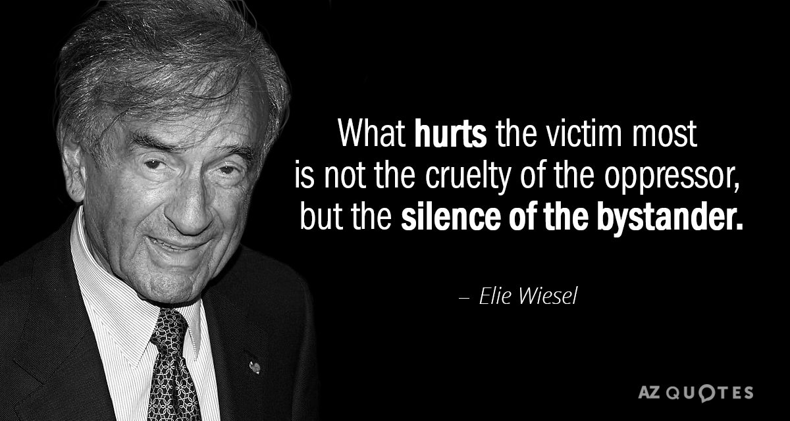
Fear of retaliation and being targeted
© Max Muller & Associates, LLC. All rights reserved. Do not post to the internet or input into any AI software, program, or platform.

Slide 30


Peer Pressure to remain silent
© Max Muller & Associates, LLC. All rights reserved. Do not post to the internet or input into any AI software, program, or platform.

Slide 31

I don’t want to get involved
In the End, we will remember not the words of our enemies but the silence of our friends.
Martin Luther King, Jr.
© Max Muller & Associates, LLC. All rights reserved. Do not post to the internet or input into any AI software, program, or platform.

Slide 32
IDENTIFYING AND EVALUATING WORKPLACE VIOLENCE HAZARDS
© Max Muller & Associates, LLC. All rights reserved. Do not post to the internet or input into any AI software, program, or platform.

Slide 33
Preparing to Draft the Balance of the Plan
How can you plan the following elements of a WAVPP without knowing what to plan around: Coordination, Emergency Response, Incident Response, Compliance, Communication, Training…?
Identify the types of aggression and violence you are most likely to encounter in YOUR workplaces.

Slide 34
Inspections
Scheduled Periodic Inspections:
Initial Inspection: When WVPP established there must be a comprehensive inspection of the workplace to identify potential workplace violence hazards.
Periodic Inspections: Scheduled inspections must be conducted at regular intervals to ensure that workplace violence hazards are continuously monitored and addressed.
The frequency of these inspections will be determined based on the nature of the worksite and its potential hazards.
© Max Muller & Associates, LLC. All rights reserved. Do not post to the internet or input into any AI software, program, or platform.

Slide 35
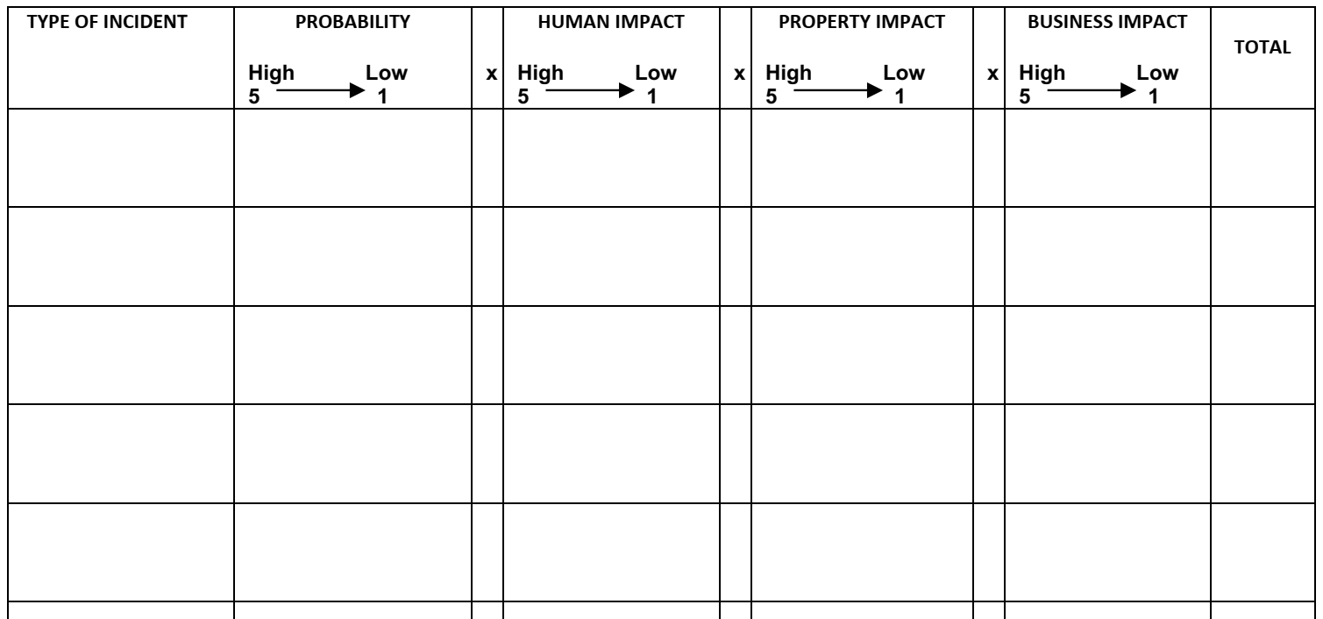
Applying Analytics – Risk Analysis
© Max Muller & Associates, LLC. All rights reserved. Do not post to the internet or input into any AI software, program, or platform.

Slide 36
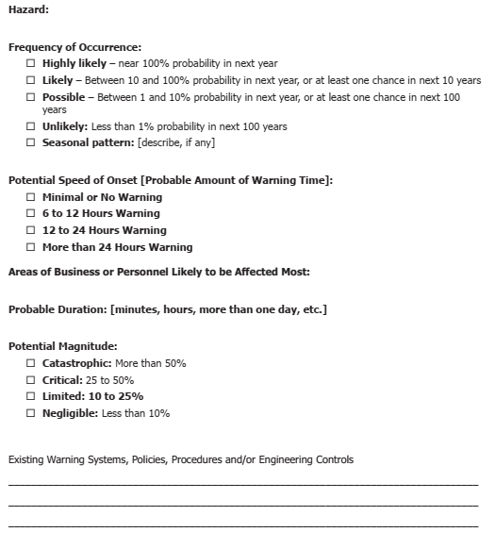
Hazard Profile Worksheet
© Max Muller & Associates, LLC. All rights reserved. Do not post to the internet or input into any AI software, program, or platform.

Slide 37
Inspections
Post-Incident Inspections:
Following each workplace violence incident, regardless of its severity, an immediate post-incident inspection will be conducted to assess the factors that contributed to the incident.
This includes examining both physical conditions and work practices.
© Max Muller & Associates, LLC. All rights reserved. Do not post to the internet or input into any AI software, program, or platform.

Slide 38
Employee Reports and Concerns
Reporting Channels: Employees must be encouraged to report any workplace violence concerns or hazards they observe promptly.
Reporting channels include supervisors, managers, the designated WVPP Coordinator, or established reporting mechanisms.
Anonymous Reporting: Confidentiality should be provided through and anonymous reporting options, such as a designated hotline or reporting form, for those who wish to make reports without fear of reprisal.
Feedback Mechanisms: Employees should be encouraged to provide feedback and report concerns regarding workplace violence hazards.
© Max Muller & Associates, LLC. All rights reserved. Do not post to the internet or input into any AI software, program, or platform.

Slide 39
Inspection Documentation
IMPORTANT: Detailed records of inspections, hazard assessments, and corrective actions must be maintained and made accessible for compliance monitoring and audit purposes.
© Max Muller & Associates, LLC. All rights reserved. Do not post to the internet or input into any AI software, program, or platform.

Slide 40
Post-Incident Response And Investigation
© Max Muller & Associates, LLC. All rights reserved. Do not post to the internet or input into any AI software, program, or platform.

Slide 41
Take Action!
Safety first
Report
Preliminary assessment
Formal investigation
Communicate
Document
Continuously improve
© Max Muller & Associates, LLC. All rights reserved. Do not post to the internet or input into any AI software, program, or platform.

Slide 42
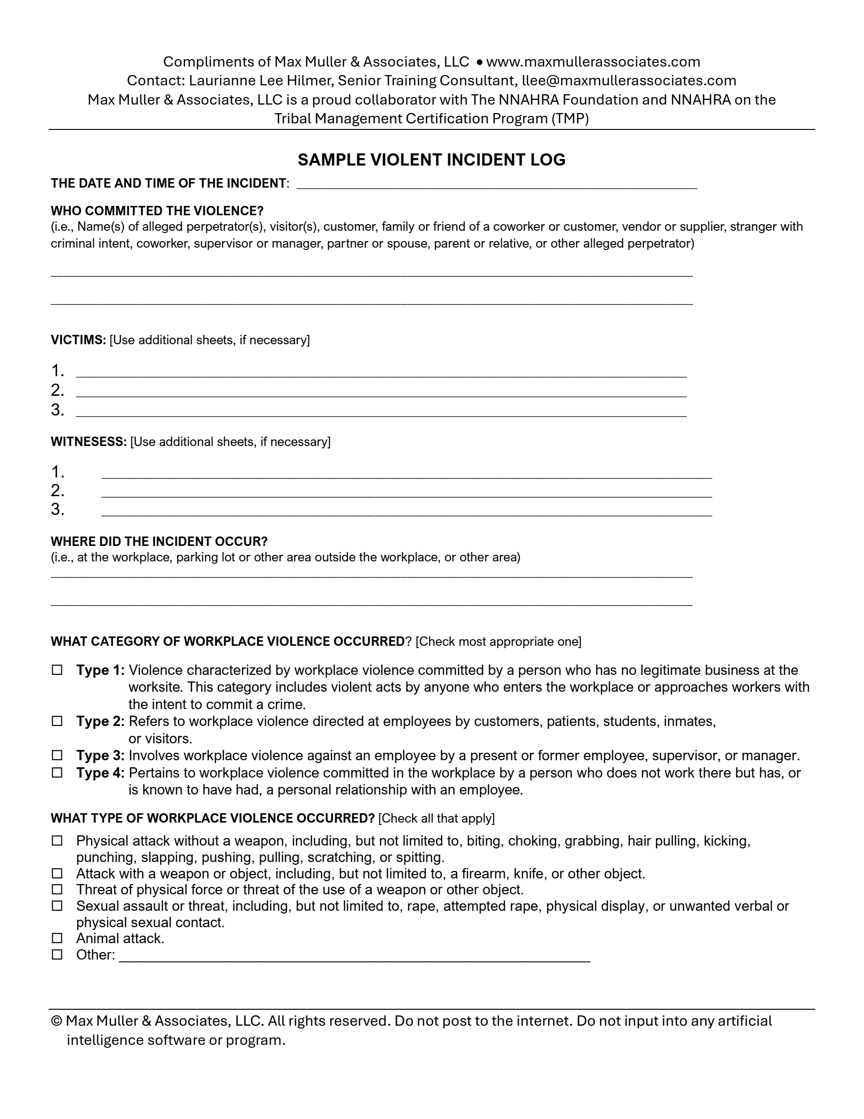
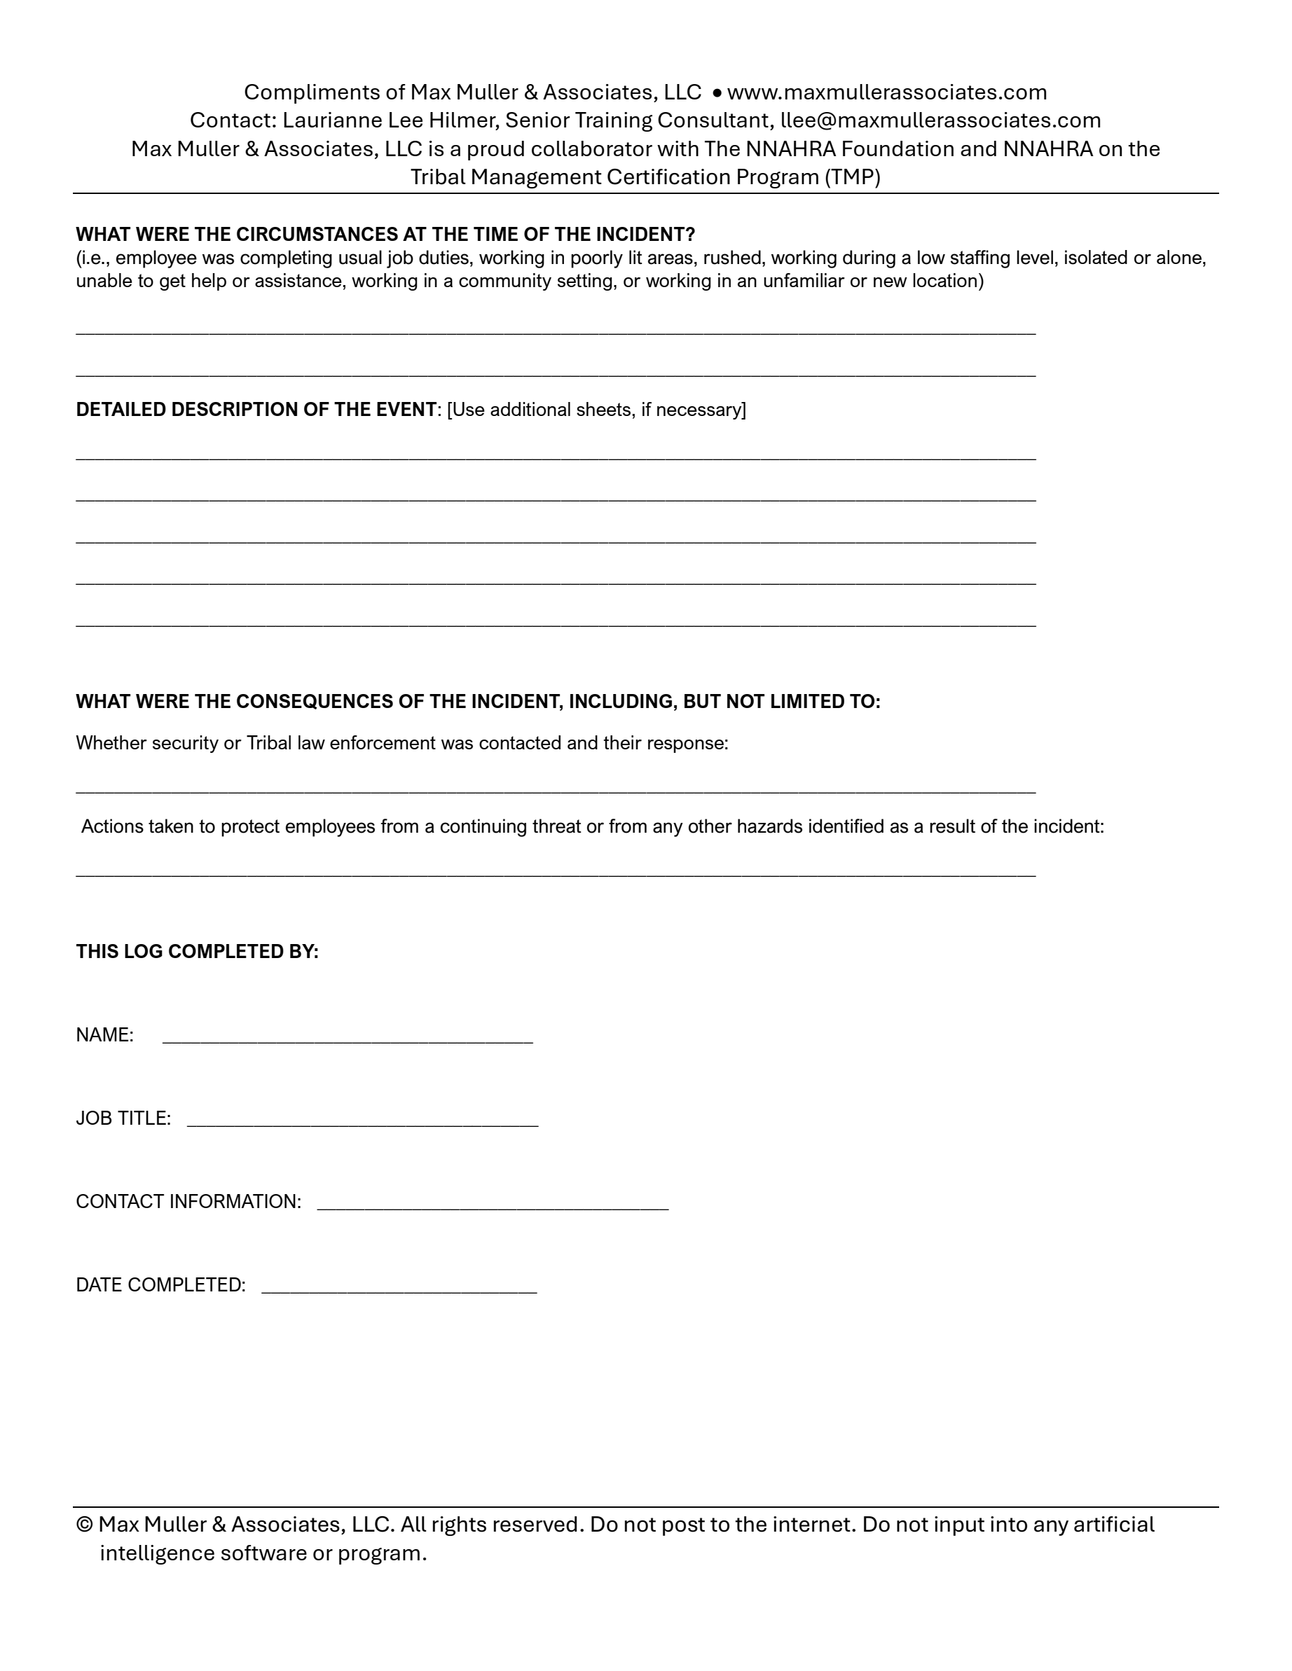
Violent Incident Log
To receive a
free copy of this
template, visit
Max / Charlene
at the TMP table
in the Exhibitors Area
© Max Muller & Associates, LLC. All rights reserved. Do not post to the internet or input into any AI software, program, or platform.

Slide 43
COORDINATION WITH OTHER EMPLOYERS IF APPLICABLE
© Max Muller & Associates, LLC. All rights reserved. Do not post to the internet or input into any AI software, program, or platform.

Slide 44
Coordination1
Communication and Collaboration
Establish Points of Contact: Designate specific points of contact within your organization to liaise with counterparts in other companies or entities operating in our shared workspace.
Regular Meetings: Conduct regular meetings or discussions with other employers to review, align, and update workplace violence prevention strategies and protocols.
© Max Muller & Associates, LLC. All rights reserved. Do not post to the internet or input into any AI software, program, or platform.

Slide 45
Coordination2
Role Clarification
Document Roles: Maintain clear documentation specifying the roles and responsibilities of each employer within the shared workspace.
Orientation and Training: Conduct orientation sessions and training programs for employees, supervisors, and managers that outline their roles in preventing and responding to workplace violence incidents.
© Max Muller & Associates, LLC. All rights reserved. Do not post to the internet or input into any AI software, program, or platform.

Slide 46
Coordination3
Training Consistency
Standardize Training Content: Collaborate with other employers to standardize the content of workplace violence prevention training to ensure that it meets regulatory requirements and aligns with our shared goals.
Training Records: Maintain records of training provided to employees, making them available for review by all employers as needed.
© Max Muller & Associates, LLC. All rights reserved. Do not post to the internet or input into any AI software, program, or platform.

Slide 47
Coordination4
Incident Reporting, Investigation, and Recordkeeping
Unified Reporting Procedures: Establish unified reporting procedures that all employers will follow when incidents occur involving any employee within the shared workspace.
Joint Investigations: When appropriate, conduct joint investigations in collaboration with other employers to ensure comprehensive and impartial investigations of workplace violence incidents.
Shared Incident Log: Establish a shared incident log accessible to all employers within the shared workspace.
© Max Muller & Associates, LLC. All rights reserved. Do not post to the internet or input into any AI software, program, or platform.

Slide 48
Annual Review
© Max Muller & Associates, LLC. All rights reserved. Do not post to the internet or input into any AI software, program, or platform.

Slide 49


Assess Effectiveness and Relevance Annually
© Max Muller & Associates, LLC. All rights reserved. Do not post to the internet or input into any AI software, program, or platform.

Slide 50
Violent Incident Log
Don’t Forget!
To receive a free copy of this template, visit Max / Charlene
at the TMP table in the Exhibitors Area
© Max Muller & Associates, LLC. All rights reserved. Do not post to the internet or input into any AI software, program, or platform.

Slide 51
28th Annual Conference
THANK YOU FOR
JOINING US TODAY!
Navigating the Path to Peace
September 23-25, 2024
Durant, Oklahoma

