Slide 1

NNAHRA 28th Annual Conference
Workforce Planning for the Closeout of Pandemic Recovery Awards

Slide 2
Summary Materials
This presentation is designed to give an overview of Treasury’s Office of Capital Access (OCA) pandemic recovery funding programs, compliance requirements, and quarterly and annual reporting processes under certain of its programs and is provided for educational purposes only. For complete information on program requirements, recipients should refer to the financial assistance agreement that governs their awards.
For information on OCA’s programs for Tribal governments, please see
https://home.treasury.gov/policy-issues/coronavirus/assistance-for-state-local-and-tribal-governments.
Notes:
FA

Slide 3


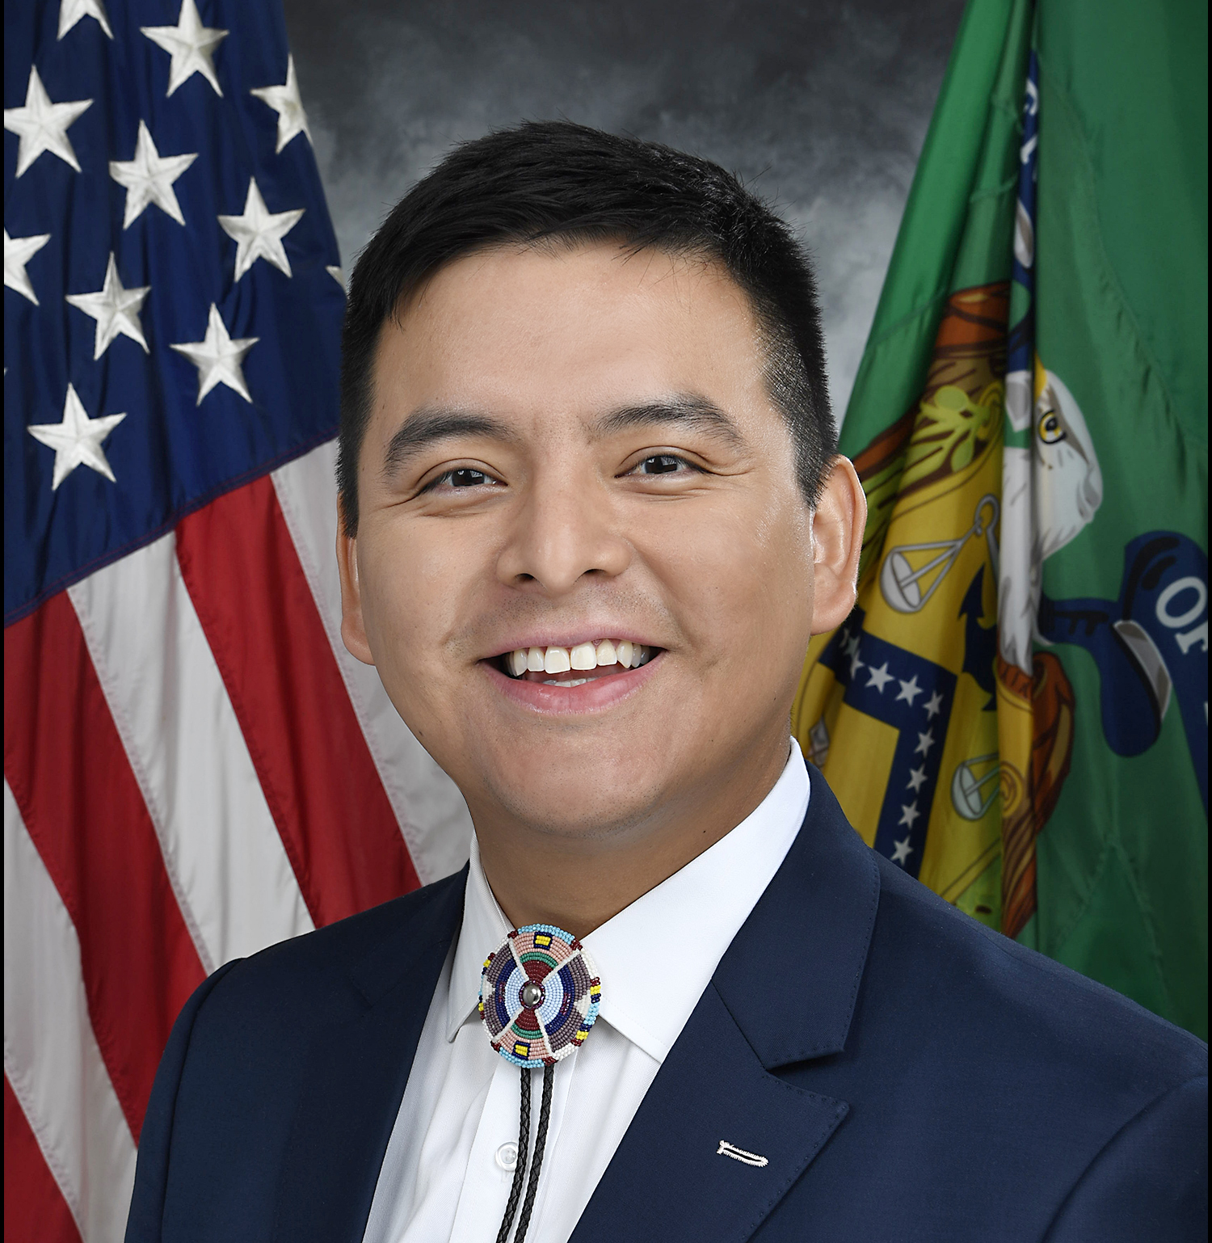



Office of Tribal and Native Affairs
Fatima Abbas (Director)
Fatima.Abbas@treasury.gov
Member of the Haliwa-Saponi Indian Tribe
Location: Washington, DC
Josh Jackson
Joshua.Jackson@treasury.gov
Member of the Cherokee Nation
Location: Washington, DC
Emery Real Bird
Emery.RealBird@treasury.gov
Member of the White Mountain Apache Tribe
Location: Washington, DC
James Colombe
James.Colombe2@treasury.gov
Member of the Rosebud Sioux Tribe
Location: Plano, TX
Jennifer Parisien
Jennifer.Parisien@treasury.gov
Member of the Turtle Mountain
Band of Chippewa
Location: San Diego, CA
Garrett Lankford
Garrett.lankford@treasury.gov
Member of the Little Shell Tribe of Chippewa Indians
Location: Washington, DC
Notes:
FA

Slide 4
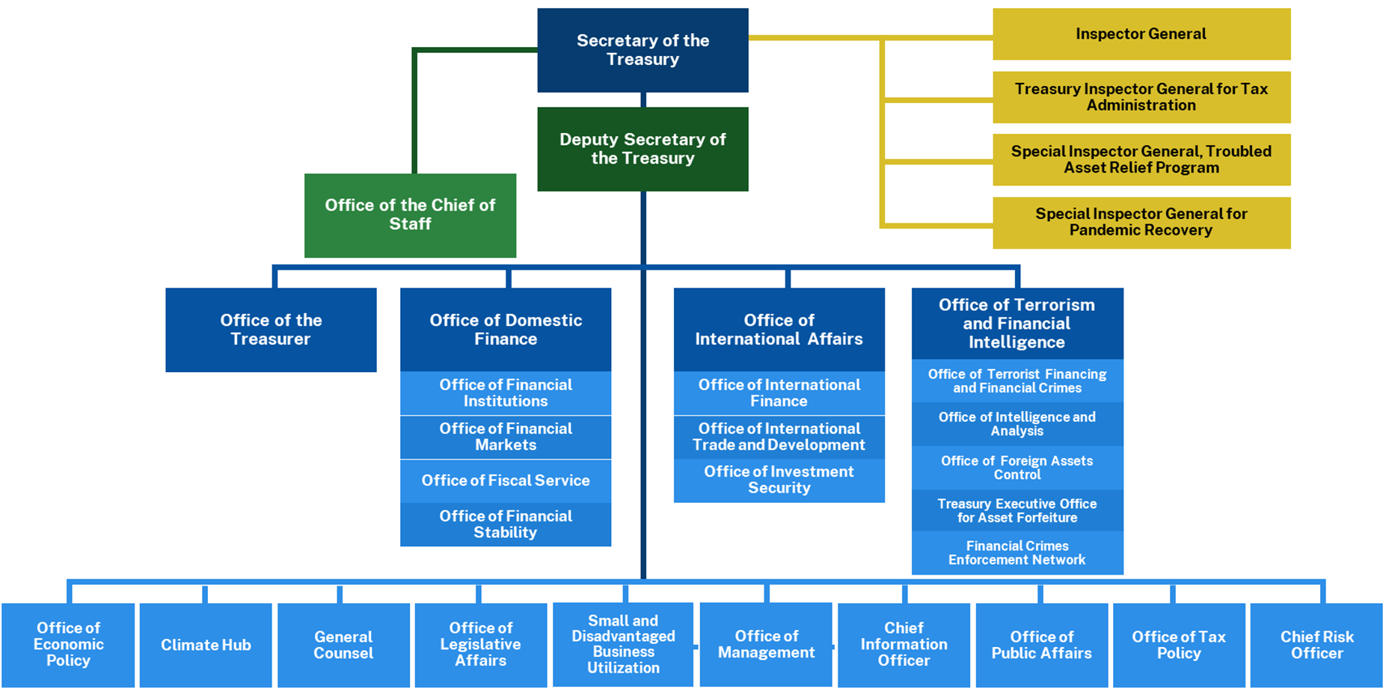
Office of the Treasurer: Office of Tribal and Native Affairs

Slide 5
1. Summary of the Recovery Programs
Notes:
FA

Slide 6
OVERVIEW OF FUNDS
Tribal Recipients
State and Local Fiscal Recovery Funds (SLFRF)
Local Assistance and Tribal Consistency Fund
Homeowner Assistance Fund (HAF)
Coronavirus Capital Projects Fund (CPF)
State Small Business Credit Initiative
SSBCI-Technical Assistance
SSBCI-SBOP
Tribal
Set-Aside
>$500MM
$20B
$500MM
$498MM
$100MM
$35.73MM
N/A
Additional Funds Available
YES
$33,417
YES
YES
$21,820
YES
N/A
N/A
N/A
Mitigate the fiscal effects of the COVID-19 pandemic
Provide funding to eligible governments for use on any governmental purpose except lobbying activity.
Emergency aid for homeowners to prevent mortgage delinquencies, defaults, foreclosures, loss of utilities, and displacement, through qualified expenses related to mortgages and housing.
Funding for critical capital projects that enable work, education, and health monitoring
Establish credit and investment opportunity for Tribal enterprises and small business owners
Provide legal, accounting, and financial advisory services to qualifying small businesses
applying for SSBCI or other jurisdiction small business programs
SBOP is a competitive TA
grant program designed to assist regions in helping small businesses connect to
opportunities related to the Investing in America Agenda
Purpose
Affordable housing, access to water, food security, job training, childcare, small business grants, and economic recovery
Governments have the discretion to use the funds for “any governmental purpose other than a lobbying activity.”
Assist homeowners on and off Tribal lands with mortgage, gas, electric, internet, water, and homeowner insurance costs, and cover home repair costs to prevent displacement.
Broadband infrastructure projects, multi-purpose community facilities, and connectivity technologies and devices
Provide access to capital via loan and investment programs for Tribal enterprises and small businesses
Provide legal advisory services to Tribal member owned businesses seeking SSBCI loans or investments
Provide legal, accounting, and financial advisory services to small businesses (as defined in the NOFO)
Example Uses of Funds
*HAF include TDHEs
Notes:
FA

Slide 7
Summary of compliance and reporting requirements
Tribal Recipients
State and Local Fiscal Recovery Funds (SLFRF)
Local Assistance and Tribal Consistency Fund
Homeowner Assistance Fund (HAF)
Coronavirus Capital Projects Fund (CPF)
State Small Business Credit Initiative
SSBCI-Technical Assistance
SSBCI-SSBOP
Obligation Deadline
12/31/2024
- - -
- - -
No Deadline
09/30/2026
12/31/2026
- - -
Expenditure Deadline
12/31/2026
Title I & Surface Transportation Projects: 9/30/2026
No Deadline
01/28/2027
12/31/2026
- - -
- - -
- - -
Yes
Exceptions to the Revenue Loss category – see FAQs for a detailed list.
Uniform Guidance
Sections
Yes
Yes
Generally No
Yes
Yes
Quarterly: Allocated Over $30mm
Annually Due April 30: Allocated Under $30mm
Quarterly: Allocated Over $5mm
Annually Due Nov 15: Allocated Under $5mm
Quarterly and Annually – see SSBCI guidelines for schedule of deadlines
Semiannually and Annually – see SSBCI TA reporting guidelines
Semiannually and Annually – see SBOP NOFO
Reporting Frequency
Annually Due March 31
Annually Due July 31
Due Date After End of Reporting Period
End of the calendar month following reporting period
See SSBCI guidelines for reporting deadline schedule
End of the calendar month following reporting period
See NOFO – anticipated to be consistent with formula TA program
Last Day of the Month
90 Days
45 Days
Single Audit
Yes – ACEE Option
Yes
Yes
Yes
No
Yes
Yes
*HAF include TDHEs
Notes:
JP

Slide 8
Compliance: Caps on Administrative Expenses
Program | Administrative Expenses | Requirement to Remit Interest Earned Annually
State and Local Fiscal Recovery Funds (SLFRF) | Generally, no cap on administrative expenses. Expenditures must be reasonable and allocable. | No See FAQ 10.1
Local Assistance and Tribal Consistency Fund (LATCF) | No cap on administrative expenses. Expenditures must be reasonable and allocable. | No
Homeowner Assistance Fund (HAF) | May not exceed 15% of the total amount of the award received. | Yes
Coronavirus Capital Projects Fund (CPF) | May not exceed 5% of the total amount of the award received or $25,000. | Yes
State Small Business Credit Initiative (SSBCI) | 5%, 3%, and 3% cap for each tranche of funds, respectively. Program income may also be used for administrative costs. See FAQs. | No - see FAQs
State Small Business Credit Initiative Technical Assistance Grant Program (SSBCI-TA) | No cap on administrative expenses. Expenditures must be reasonable and allocable. | Yes
State Small Business Credit Initiative Investing in American Small Business Opportunity Program (SSBCI-SBOP) | No cap on administrative expenses. Expenditures must be reasonable and allocable. | Yes
Recipients with awards under the HAF, CPF, SSBCI-TA, and SSBCI-SBOP programs may retain up to $500 in earned interest annually that can be used for administrative expenses. Any additional interest earned on these federal award funds beyond the $500 limit must be remitted annually to the Department of Health and Human Services Payment Management System (PMS) through an electronic medium using either Automated Clearing House (ACH) network or a Fedwire Funds Service payment. See 2 CFR 200.305(b)(9)(ii) for more details on how to return interest amounts to PMS.

Slide 9

Upcoming Deadlines
SLFRF
SSBCI
HAF
SLFRF
Reporting
Reporting
Reporting
Obligation
Deadline
10/31/2024
10/30/2024
11/15/2024
12/31/2024
Over $30mm
All recipients
Reporting Period:
July 1, 2024 – September 30, 2024
Reporting Period:
July 1, 2024 – September 30, 2024
Reporting Period:
October 1, 2023 – September 30, 2024
SLFRF
LATCF
SLFRF
SLFRF
Reporting
Reporting
Reporting
Reporting
01/31/2025
03/31/2025
04/30/2025
04/30/2025
Over $30mm
Over $30mm
Under $30mm
Reporting Period*:
October 1, 2024 – December 31, 2024
Reporting Period:
January 1, 2024 – December 31, 2024
Reporting Period**:
January 1, 2025 – March 31, 2025
Reporting Period**:
April 1, 2024 –
March 31, 2025
* This reporting period includes reporting on funds obligated and expended by December 31, 2024.
** This reporting period includes reporting on funds obligated by December 31, 2024 and expended by March 31, 2025.

Slide 10
Preparing Staff for the SLFRF Obligation Deadline

Slide 11
What is an obligation?
Treasury implemented the statutory requirement that SLFRF funds may only be used to cover costs incurred by December 31, 2024, by providing that a cost is considered incurred if a recipient has incurred an obligation by December 31, 2024.
Treasury defined “obligation” as “an order placed for property and services and entering into contracts, subawards, and similar transactions that require payment.”
The Obligation IFR amended the definition of “obligation” and provided additional guidance.
In Section 17 of the SLFRF FAQs, Treasury has provided further guidance and clarification about what constitutes an obligation.
  Similar transactions that require payment include certain interagency agreements (FAQ 17.6) and payroll expenses (FAQ 17.7).

Slide 12
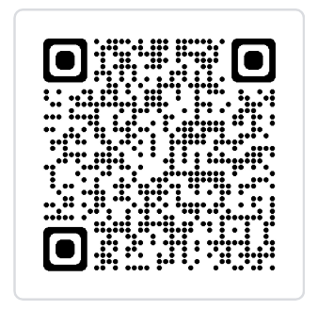
What is an obligation?
Statutory requirement that SLFRF funds may only be used to cover costs incurred by December 31, 2024; a cost is considered incurred if a recipient has incurred an obligation by that date.​
All recipients must expend their SLFRF funds by December 31, 2026, except for Surface Transportation and Title I projects, which have an earlier deadline of September 30, 2026.
An obligation is:
An order placed for property and services and entry into contracts, subawards, and similar transactions that require payment, which may include:
    An order placed for property or services
    Contract
    Subaward
    Similar transactions that require payment, which may include
        Certain interagency agreements (including MOUs) (see FAQs 17.6 and 17.23)
        Under certain circumstances, payroll expenses for recipients’ employees (see FAQ 17.7)
A requirement under federal law or regulation or a provision of the SLFRF award terms and conditions to which the recipient becomes subject as a result of receiving or expending SLFRF funds.
Treasury released FAQs to provide additional clarifications on these items in ​FAQs Section 17.

Slide 13
An obligation is NOT:
A Tribal resolution, adopted budget, or budget amendment
An appropriation of SLFRF funds
An executive order
A written or oral intention to enter into a contract
A grant of legal authority to enter into a contract
Claiming funds under the revenue loss category
Moving SLFRF funds to a general fund as revenue loss but not further establishing an obligation with those funds by 12/31/2024

Slide 14
Case Study #1: Are budgets or a resolution for payroll an obligation?
Definition of Obligation
  Case example: A Tribal council passed an SLFRF project plan budget, which includes employing five staff members via resolution and outlines exactly how SLFRF funds are to be used.
  Question: Has the Tribe obligated its SLFRF funds?
  Response: No. A resolution, budget and/or appropriation authority for SLFRF funds is not considered an obligation. The Tribe will need to obligate its funds through at least one of the following mechanisms and report the project(s) in their Project and Expenditure report due January 31, 2025 (quarterly reporters) or April 30, 2025 (annual reporters):
    An order placed for property or services
    Contract
    Subaward
    Transactions similar to contracts and subawards that require payment, such as:
      Interagency agreements (see FAQs 17.6 and 17.23)
      Personnel costs (see FAQ 17.7)
    Compliance with certain administrative and legal requirements of the SLFRF program (see FAQ 17.10)

Slide 15
Personnel Costs in 2025 and 2026
Treasury will consider a recipient to have incurred an obligation to use funds to cover personnel costs for an employee through December 31, 2026, if the employee is serving in a position that was established and filled prior to December 31, 2024.
Personnel costs must be expended in connection with an eligible use of SLFRF. Examples:
  Tribal government employees carrying out an Elder Nutrition Program
  Tribal government employees developing broadband projects
  Housing Authority employees overseeing contracts to build affordable housing
  See FAQ: 17.7 for more information.

Slide 16
Personnel Costs in 2025 and 2026
Eligible personnel costs include:
  All salaries and wages
  Covered benefits (including leave, insurance, and retirement expenses)
  Payroll taxes
See FAQ: 17.7 for more information.

Slide 17
Can a recipient replace or rearrange personnel after the obligation deadline?
  Yes. If the position was established and filled by December 31, 2024, a recipient may replace the employee in that position. The replacement does not need to be immediate.
  Recipients may also reorganize positions within the scope of an eligible SLFRF project after December 31, 2024.
    Example: if an eligible project employs ten job training specialists on December 31, 2024, it is permissible for the Tribe to use funds to cover payroll for one of those training specialists who is promoted to be a supervisor, so long as there are no more than ten positions covered through SLFRF funds in total.
  Recipients may not use funds to cover any new positions created after December 31, 2024.

Slide 18
Case Study #2: Payroll costs increase after obligation deadline
Payroll Increase
  Case example: A Tribe submitted a report to Treasury estimating $100,000 in SLFRF payroll costs in 2025 and 2026. However, in 2025, due to an increase in the cost of living, the Tribal council feels it is necessary to raise. The Tribe would like to consider an additional $50,000 in SLFRF funds obligated for payroll costs.
  Question: Can the Tribe use SLFRF to cover these extra costs in 2025 and 2026? If so, how?
  Response: Yes. Eligible personnel costs for employees in positions created and filled by December 31, 2024, are considered obligated, and that amount may be adjusted based on compensation in effect at the time of payment. A Tribe may raise the salaries of employees in those positions. However, a Tribe may not create new positions for the project after the obligation deadline. Treasury will update the Compliance and Reporting Guidance with additional information about how to report these funds.
  See FAQs: 17.7 and 17.8

Slide 19
Case Study #3: Payroll costs are lower than estimated
Over-estimating Costs
  Case example: A Tribe submitted a report to Treasury estimating $200,000 in SLFRF payroll costs in 2025 and 2026. However, due to the completion of the food distribution project ahead of schedule, only $150,000 is needed for payroll expenses in those years.
  Question: Can the Tribe use the unexpended $50,000 attributable to the estimate for another project?
  Response: Yes. The Tribe may expend the $50,000 for another eligible use of SLFRF funds. That eligible use must meet all the requirements of SLFRF, including the requirement to incur an obligation for that project by December 31, 2024. For example, the Tribe could apply those funds to a project for which the Tribe entered into a contract by December 31, 2024 and for which it originally used the Tribe’s general fund.
  See FAQs: 17.8 and 17.19

Slide 20
Does an interagency agreement (IAA) count as an obligation?
Yes, if it meets certain conditions.
An interagency agreement finalized by 12/31/2024 can be used to obligate funds that a government agency will expend in 2025 and 2026.
Eligible interagency agreements include memoranda of understanding (MOU) or agreement (MOA). The interagency agreement must meet these conditions:
See FAQs 17.6 and 17.23 for more information.
ONE requirement from Column A: | ALL requirements from Column B:
Imposes conditions on the use of funds by recipient agency, department, or part of government | Has specific requirements (e.g., scope of work)
Governs provision of funds from one agency, department, or part of government to another | Is signed by the parties or evidences assent of parties
Governs the procurement of goods or services | Does not disclaim binding effect or state that it doesn’t create rights or obligations

Slide 21
Case Study #3: Who can an interagency agreement be between?
Parties to Interagency Agreement
  Case example: The Tribal council has made SLFRF funds available to the social services department to cover the payroll and operational costs of an elder care program through December 31, 2026. The Tribal council has entered into an agreement with the social services department under which the social services department agrees to perform and complete in a satisfactory and proper manner the scope of work specified in accordance with the SLFRF award terms and conditions.
  Question: Would this interagency agreement constitute an obligation?
  Response: Yes, if the interagency agreement meets the conditions outlined in FAQ 17.6 and 17.23.
  See FAQ: 17.6 and 17.23

Slide 22
Is an agreement specifically between units of a Tribal government considered an obligation for purposes of SLFRF?
Yes, if it meets certain conditions. For purposes of SLFRF, Treasury considers an interagency agreement between a Tribal government’s units (including the Tribal Council), departments, agencies, or other instrumentalities of a Tribe to constitute an obligation if it meets the conditions set forth in FAQ 17.6.
A unit of a Tribal government includes:
  Department, agency, Housing Authority, or other instrumentality of the Tribe
  Enterprise organized under Tribal law if the Tribe treats the enterprise as a unit, department, agency, or other instrumentality of the Tribe
  Section 17 Corporation
  Section 3 Corporation
See FAQ: 17.23

Slide 23
Do the procurement requirements of the Uniform Guidance apply to interagency agreements between units of the Tribal government?
No. For purposes of the SLFRF program, the procurement standards of 2 CFR Part 200 (the Uniform Guidance) do not apply to an agreement between units, departments, agencies, or other instrumentalities of a Tribe.
The procurement requirements of the Uniform Guidance would need to be followed by the Tribal unit, department, agency, or other instrumentality of a Tribe with respect to the procurement of material, equipment, and supplies from outside vendors.
See FAQ: 17.23

Slide 24
Case Study #4: Can a Tribe execute an interagency agreement with an enterprise to build housing and create jobs for Tribal citizens?
Parties to Interagency Agreement
  Case example: The Tribe is building low-income housing to address housing shortages on the reservation. The Tribe has a tribally-chartered construction company that can both carry-out the project and create jobs for Tribal citizens. The Tribal council has entered into an agreement with the construction company to perform and complete in a satisfactory and proper manner the scope of work specified in accordance with the SLFRF award terms and conditions.
  Question: Would this agreement constitute an obligation?
  Response: Yes, if the agreement meets the conditions outlined in FAQ 17.6 and the construction company is a unit of a Tribal government as described in FAQ 17.23.
  See FAQs: 17.6 and 17.23

Slide 25
Workforce Planning for Closeout:
Programmatic Staff Administering SLFRF

Slide 26
Uniform Guidance: Compensation Compliance
200.430 Compensation—personal services
Is reasonable for the services rendered and conforms to the established written policy of the non-Federal entity consistently applied to both Federal and non-Federal activities;
Follows an appointment made in accordance with a non-Federal entity's laws and/or rules or written policies and meets the requirements of Federal statute, where applicable; and
Is determined and supported by 200.430 (i) Standards for Documentation of Personnel Expenses

Slide 27
Case Study #5: Can an employee charge their time based on the SLFRF approved budget and interagency agreement?
Payroll Budgets
  Case example: The Tribe is building low-income housing with their SLFRF award to address housing shortages on the reservation. The Tribal council has an interagency agreement (IAA) with the Housing Authority to carryout the construction of the project. The IAA includes an approved budget for a Construction Manager to work on the project 50% of the time. Some weeks the employee works only 30% of the week on the project.
  Question: Can this program employee charge their budgeted time of 50% to the SLFRF award?
  Response: No, budget estimates alone do not qualify as support. Charges for wages must be based on records that accurately reflect the work performed.
  See UG: 200.430(i) Standards for Documentation of Personnel Expenses

Slide 28
Case Study #6: Can unused leave be charged to SLFRF?
Payroll Estimates
  Case example: A Tribe submitted a report to Treasury estimating $100,000 in SLFRF payroll costs in 2025 and 2026. One employee hired under SLFRF is funded 75% from SLFRF and 25% by another federal grant. The employee ends their employment prior to the end of the SLFRF period of performance (no later than December 31, 2026). The Tribe’s HR policy includes leave and unused leave as a covered benefit.
  Question: Can this employee charge their unused leave payout to SLFRF?
  Response: Yes, so long as the leave was earned under the Tribe’s established leave policy, no more than 75% is charged to SLFRF, and the funded leave payout occurs prior to the expenditure deadline.
  See UG: 200.431(b) – Compensation-fringe benefits

Slide 29
Q&A

