Slide 1


28th Annual Conference
September 23-25, 2024
Durant, Oklahoma

Slide 2


Enhancing Tribal Sovereignty through Employee Benefits
Presenters:
Doug Roehm, LIC, THRP
Strategic Services Group
Charles Carlson, THRP
Benefit Intelligence

Slide 3


Discussion Topics
Traditionally Insured vs. Self-Insured
Self-Insured vs. Tribal Self-Insured
Enhancing Your Sovereignty Through Benefits
Emerging Trends & Thought Leadership

Slide 4
With a Fully-Insured Health Plan, the employer pays a certain amount each month (the premium) to the health insurance company. In return, the insurance company covers the costs of the employees’ healthcare.
Also, there is no additional risk to the employer. The employer knows exactly what their plan is going to cost each year.
The downside is if the employees are healthy and don’t use much health care, the employer has spent a significant sum and doesn’t get any of the money back.
What is a
FULLY-INSURED
Health Plan?
A Fully-Insured health plan is the traditional way to structure an employer-sponsored health plan. With a Fully-Insured health plan:
  The employer pays a premium to the insurance carrier
  The premium rates are typically fixed for a year, based on the number of employees enrolled in the plan each month.
  The monthly premium normally only changes during the year if the number of enrolled employees in the plan changes.
    The insurance carrier collects the premiums and pays the health care claims based on the coverage benefits outlined in the policy purchased.
    The covered persons (that is, employees and dependents) are responsible to pay any deductible amounts or co-payments required for covered services under the policy.

Slide 5
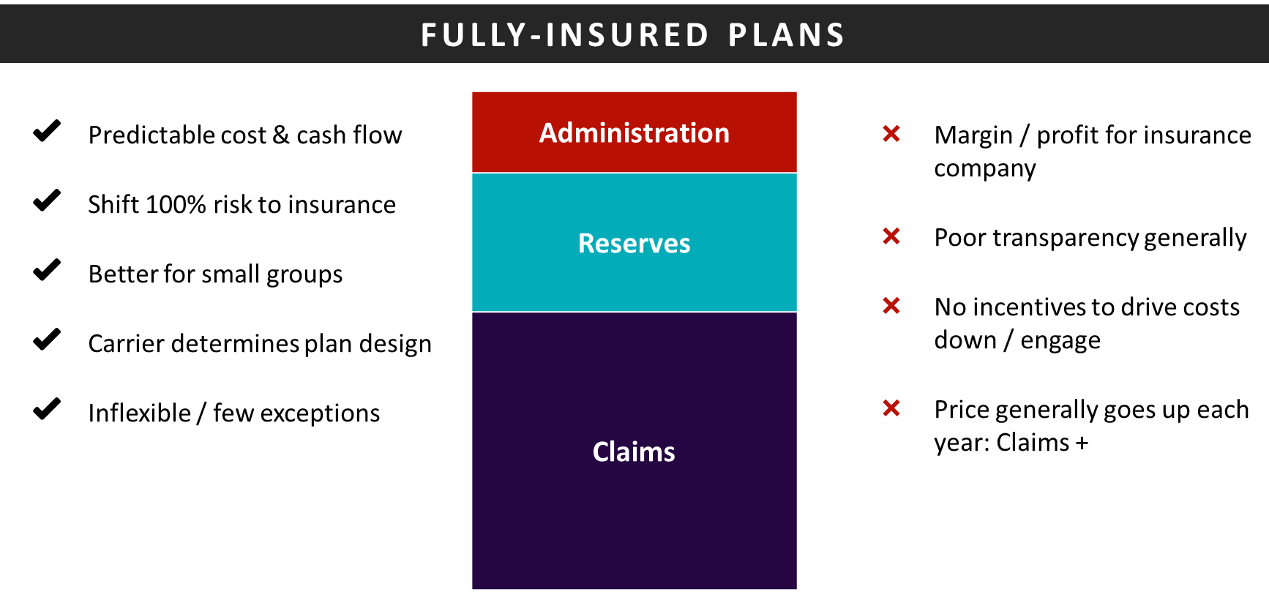

Slide 6

Self-funding involves paying the health claims of the employees as they occur.
Rather than paying fixed premiums to an insurance company—which assumes the financial risk of paying claims—the employer pays for medical claims as they are incurred.
What is a
SELF-FUNDED
Health Plan?
“With self-funding, the healthier the employees are, the lower the plan costs will be.”

Slide 7
Self-Insured Health Plan | Self-Insured Health Plan
 | FIXED COSTS |  | VARIABLE COSTS
 | Administrative Fees Stop-Loss Premiums Set Fees Charged per Employee |  | Fluctuating Health Care Claims Doctor Visits Surgeries Prescriptions Treatments
 | FIXED COSTS |  | VARIABLE COSTS
 | Comprises approximately 20% of Self-Funded plan expenses |  | Comprises approximately 80% of Self-Funded plan expenses
You determine plan design / complete flexibility
Less predictable cash flow
Lower expenses / remove margin
Full transparency / reporting
Stop loss contract – key
Level funding to self funding
Realize every dollar in savings
These costs are generally billed monthly by the third-party administrator (TPA) or carrier handling plan administration and are charged based on plan enrollment.
These costs vary from month to month based on health care use by covered persons (that is, employees and dependents).

Slide 8
Two Forms of Stop-Loss Insurance Protection
Specific Stop-Loss
Also referred to as individual stop-loss, protects a plan against individual catastrophic claim occurrences.
This type of stop-loss coverage shifts responsibility for a claim to the insurer once that claim exceeds a certain dollar amount.
Aggregate Stop-Loss
This type of stop-loss coverage protects the employer against high health plan claims, cumulatively (i.e., the total sum of claims for the entire group, rather than an individual claim).
This limits a self-insured plan’s financial exposure for the entire plan year (or policy year) and protects against abnormal claim frequency across the entire group of individuals.
Example:
  An employer with a specific stop-loss attachment point of $25,000 would be responsible for the first $25,000 in claims for each individual plan participant each year.
  The stop-loss carrier would pay any claims exceeding $25,000 in a calendar year for a particular participant.
Example:
  Aggregate stop-loss insurance with an attachment point of $500,000 would begin paying for claims after the plan’s overall claims exceeded $500,000.
  Any amounts paid by a specific stop-loss policy for the same plan would not count toward the aggregate attachment point.

Slide 9


PBM Basics
Two Pricing Models
Current contract is carved in with the medical insurer;
Rebates are kept by the insurer as a profit center;
A necessary business partner for any medical plan;
Potential area of opportunity for any client looking to take on additional risk.
  A Traditional Model
  Transparent /
  Pass-Through Model

Slide 10


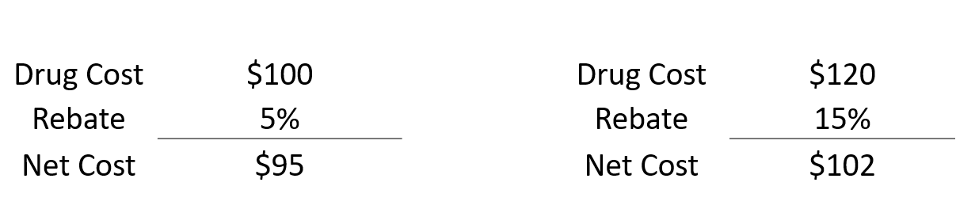
PBM Basics: How They Work
Drug A
Drug B
Under the traditional model, if a PBM is retaining any or all rebates, there is incentive to push Drug B on the formulary because of the higher rebate.
By removing the financial incentive for the PBM to push a higher re-batable drug the PBM's shift their focus to better contain expense which leads to the push for Drug A.

Slide 11
Self-Insured Health Plans
Benefits of Self-Insured Health Plans | YES |  | Disadvantages of Self-Insured Health Plans | NO
Transparency of data and ability to impact | + |  | Higher-than-expected claims | -
Improved Cash Flow & Risk Management | + |  | Prepare to get out before you go in | -
Reduced / No state premium taxes | + |  | Actively manage risk | -
Plan Design Flexibility / Customization | + |  | Finding the “right” TPA & PBM | -
Carve-In / Out for Cost Control | + |  | Compliance Requirements | -
Lower, Transparent Administration Costs | +
Avoidance of state-mandated benefits | +
Unique Tribal Solutions / Reduce Cost | +

Slide 12


Slide 13
Sample Cost Saving Strategies

Slide 14

What is Sovereignty?
SLIDO QUESTION?
(OPTIONAL – TBD)
What is Sovereignty?
Authority or autonomy of a
(person / state / tribe) to govern themselves
Ability to do what you want when you want to do it – with the authority necessary
I don’t really know
Supreme Power

Slide 15
History of Indian Health Care
Early U.S. Government treaties (1770 – 1870s) - Healthcare for land – these failed.
Bureau of Indian Affairs (BIA) - 1832-1955 - Limited support and failed.
Indian Health Service (1955) – Congress transferred responsibility to HIS to improve delivery by utilizing expertise of Public Health Service (PHS).
  Expansion from 1955 – 1975 brought some improvements. Health disparities remain significant / unmet need.
1975 Indian Self Determination and Education Assistance Act
  Landmark legislation allowed tribes to take control of their healthcare through Federal Government and movement towards self-determination
1976 Indian Health Care Improvement Act
  Congress attempts fulfillment of trust/legal obligations, increase funding, to eradicate health disparities.
2010 – Affordable Care Act included permanent reauthorization of Indian Health Care Improvement Act ensuring ongoing support/funding for IHS and programs.

Slide 16
Indian Health Service Today
Federal Funding → Annual Appropriations Meet ~ 50% of Perceived Need
(as defined by the congress)
  Supplement Federal Services & Appropriations;
  Stretch Finite Health Care Dollars; and,
  Contract Programs & Services.
Why Tribes have needed to exercise their sovereignty through self-determination:

Slide 17
Medicare-Like Rates
42 CFR 136.30
All Medicare-participating hospitals...that furnish inpatient services must accept no more than [Medicare-like rates/MLR] as payment in full for all items and services authorized by IHS, Tribal, and urban Indian organization entities...
The payment methodology...applies to all levels of care furnished by a Medicare-participating hospital [including inpatient and outpatient] that is authorized under part 136, subpart C by a contract health service (CHS) program of the Indian Health Service (IHS); or authorized by a Tribe or Tribal organization carrying out a CHS program of the IHS under [ISDEAA]...

Slide 18
Payer of Last Resort Statute
25 USC 1623(b)
Health programs operated by the Indian Health Service, Indian tribes, tribal organizations, and Urban Indian organizations... shall be the payer of last resort for services provided by such Service, tribes, or organizations to individuals eligible for services through such programs, notwithstanding any Federal, State, or local law to the contrary [Post-ACA rule].

Slide 19

Special Affordable Care Act Rules
Monthly Exchange Entry
No Cost Share for PRC Authorized Care
No Cost-Sharing for Native Americans with Income < 300% FPL
“Sponsorship” Rules Implemented
by State and Federal Health

Slide 20
Thought Leadership
Emerging Trends

Slide 21
Enhancing Sovereignty Through Benefits
Sovereignty is to self-govern and is foundational to our well-being and mental health
  With mindful mental health, teams make informed and data-backed decisions to manage change. Some of the challenges we are facing are:
    Raising Healthcare Costs
    Tighter Job Market
    Uncertain Political Climate
    Unstable Business Environment
    Social Unrest
Without sovereignty, what do we have control over?
It is hard to have sovereignty without mental health/well-being
Notes:
Let’s revisit the point of today’s conversation. Enhancing Sovereignty Through Benefits
Notice that we’re using a variety of sources for our case. When we consider trends, what is on your mind? Of the things list, what’s impacting your day? Which do you have control over, only your reaction, most likely.

Slide 22
Leaders are Under Pressure to Perform
Here are a couple of trends to notice…
      4 out of 10 senior leaders say they will likely quit in the next 12 months due to work-related stress.
      UKG, 2023
      Managers are more likely to be burned out than non-managers.
      Gallup, 2023
When mentally fatigued,
it’s hard to make good decisions.
Notes:
People are fatigued, including executives, people leaders, staff, clients, customers, vendors, partners, and stakeholders. When we are tired, making choices is hard, so we need systems, like a SWOT analysis.

Slide 23
With a SWOT Analysis, What Would We See?
What is happening in many organizations?
Psychological health is as important as physical health – it drives costs.
  “Employers must redesign their work because work impacts employee mental health.”
  Lyra
Decision makers overestimating their efforts to engage – a false assumption.
  “9 out of 10 C-suite think their employees believe they care about them,
  only 56% of employees do.”
  Deloitte
Your team (executive, people leaders, and
staff) matters.
  “A genuine culture of care is a powerful magnet for top talent, particularly for younger generations.”
  HBR
Which team are you putting on the field?
Notes:
When we consider strengths, weaknesses, opportunities, and threats, our current position is a little of each.

Slide 24
What Does Talent (Executives or Frontline) Want?
Strong Leaders
  Relationship builders
      “Managers have the same impact on people’s mental health as
      their spouses, more than anyone else.”
  Data-based decision-making, not authority-based
  Create Psychologically safe work environments
      “81% said mental health in the workplace is a factor they will
      consider when seeking job opportunities.”
Since people spend so much time (and life) at work,
they want a positive workplace and to do good work.
SOURCE: ¹UKG; ² APA
Notes:
That team we talked about, what do they want. Who are they going to follow? Someone that is business usual or offers fair pay, great benefits, a positive work environment, and a degree of sovereignty?

Slide 25
This Relates to Managing Risk
  How are you managing risk?
    Rigidity vs flexibility
    Scarcity Mindset vs Abundance Mindset
    Status Quo vs Innovation
How are these connected to the team that leads to sovereignty through benefits?
Notes:
As leaders, our role is to manage risk. How do we go about it? Is it black and white or shades of the color of joy or sadness (might be too cheesy)? Do we see the Blue Ocean or black and white?

Slide 26



Talent Leads to Sovereignty
What attracts the talent you need to have sovereignty?
    PAY
    Influenced by the operating budget.
    BENEFITS
    Influenced by innovation.
    CULTURE
    Influenced by people leader behavior.
When you create the right environment with the right people,
you develop systems that support sovereignty.
Retain and Attract Through Sovereignty, which is Mental Health/Well-Being
(Autonomy, Mastery, and Community)
Notes:
As leaders, our role is to manage risk. How do we go about it? Is it black and white or shades of the color of joy or sadness (might be too cheesy)? Do we see the Blue Ocean or black and white?

Slide 27
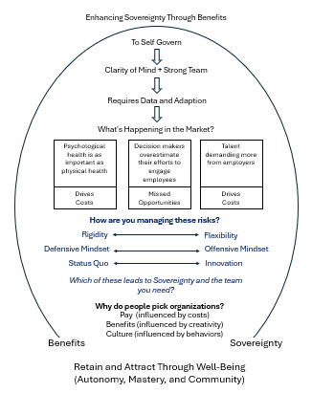
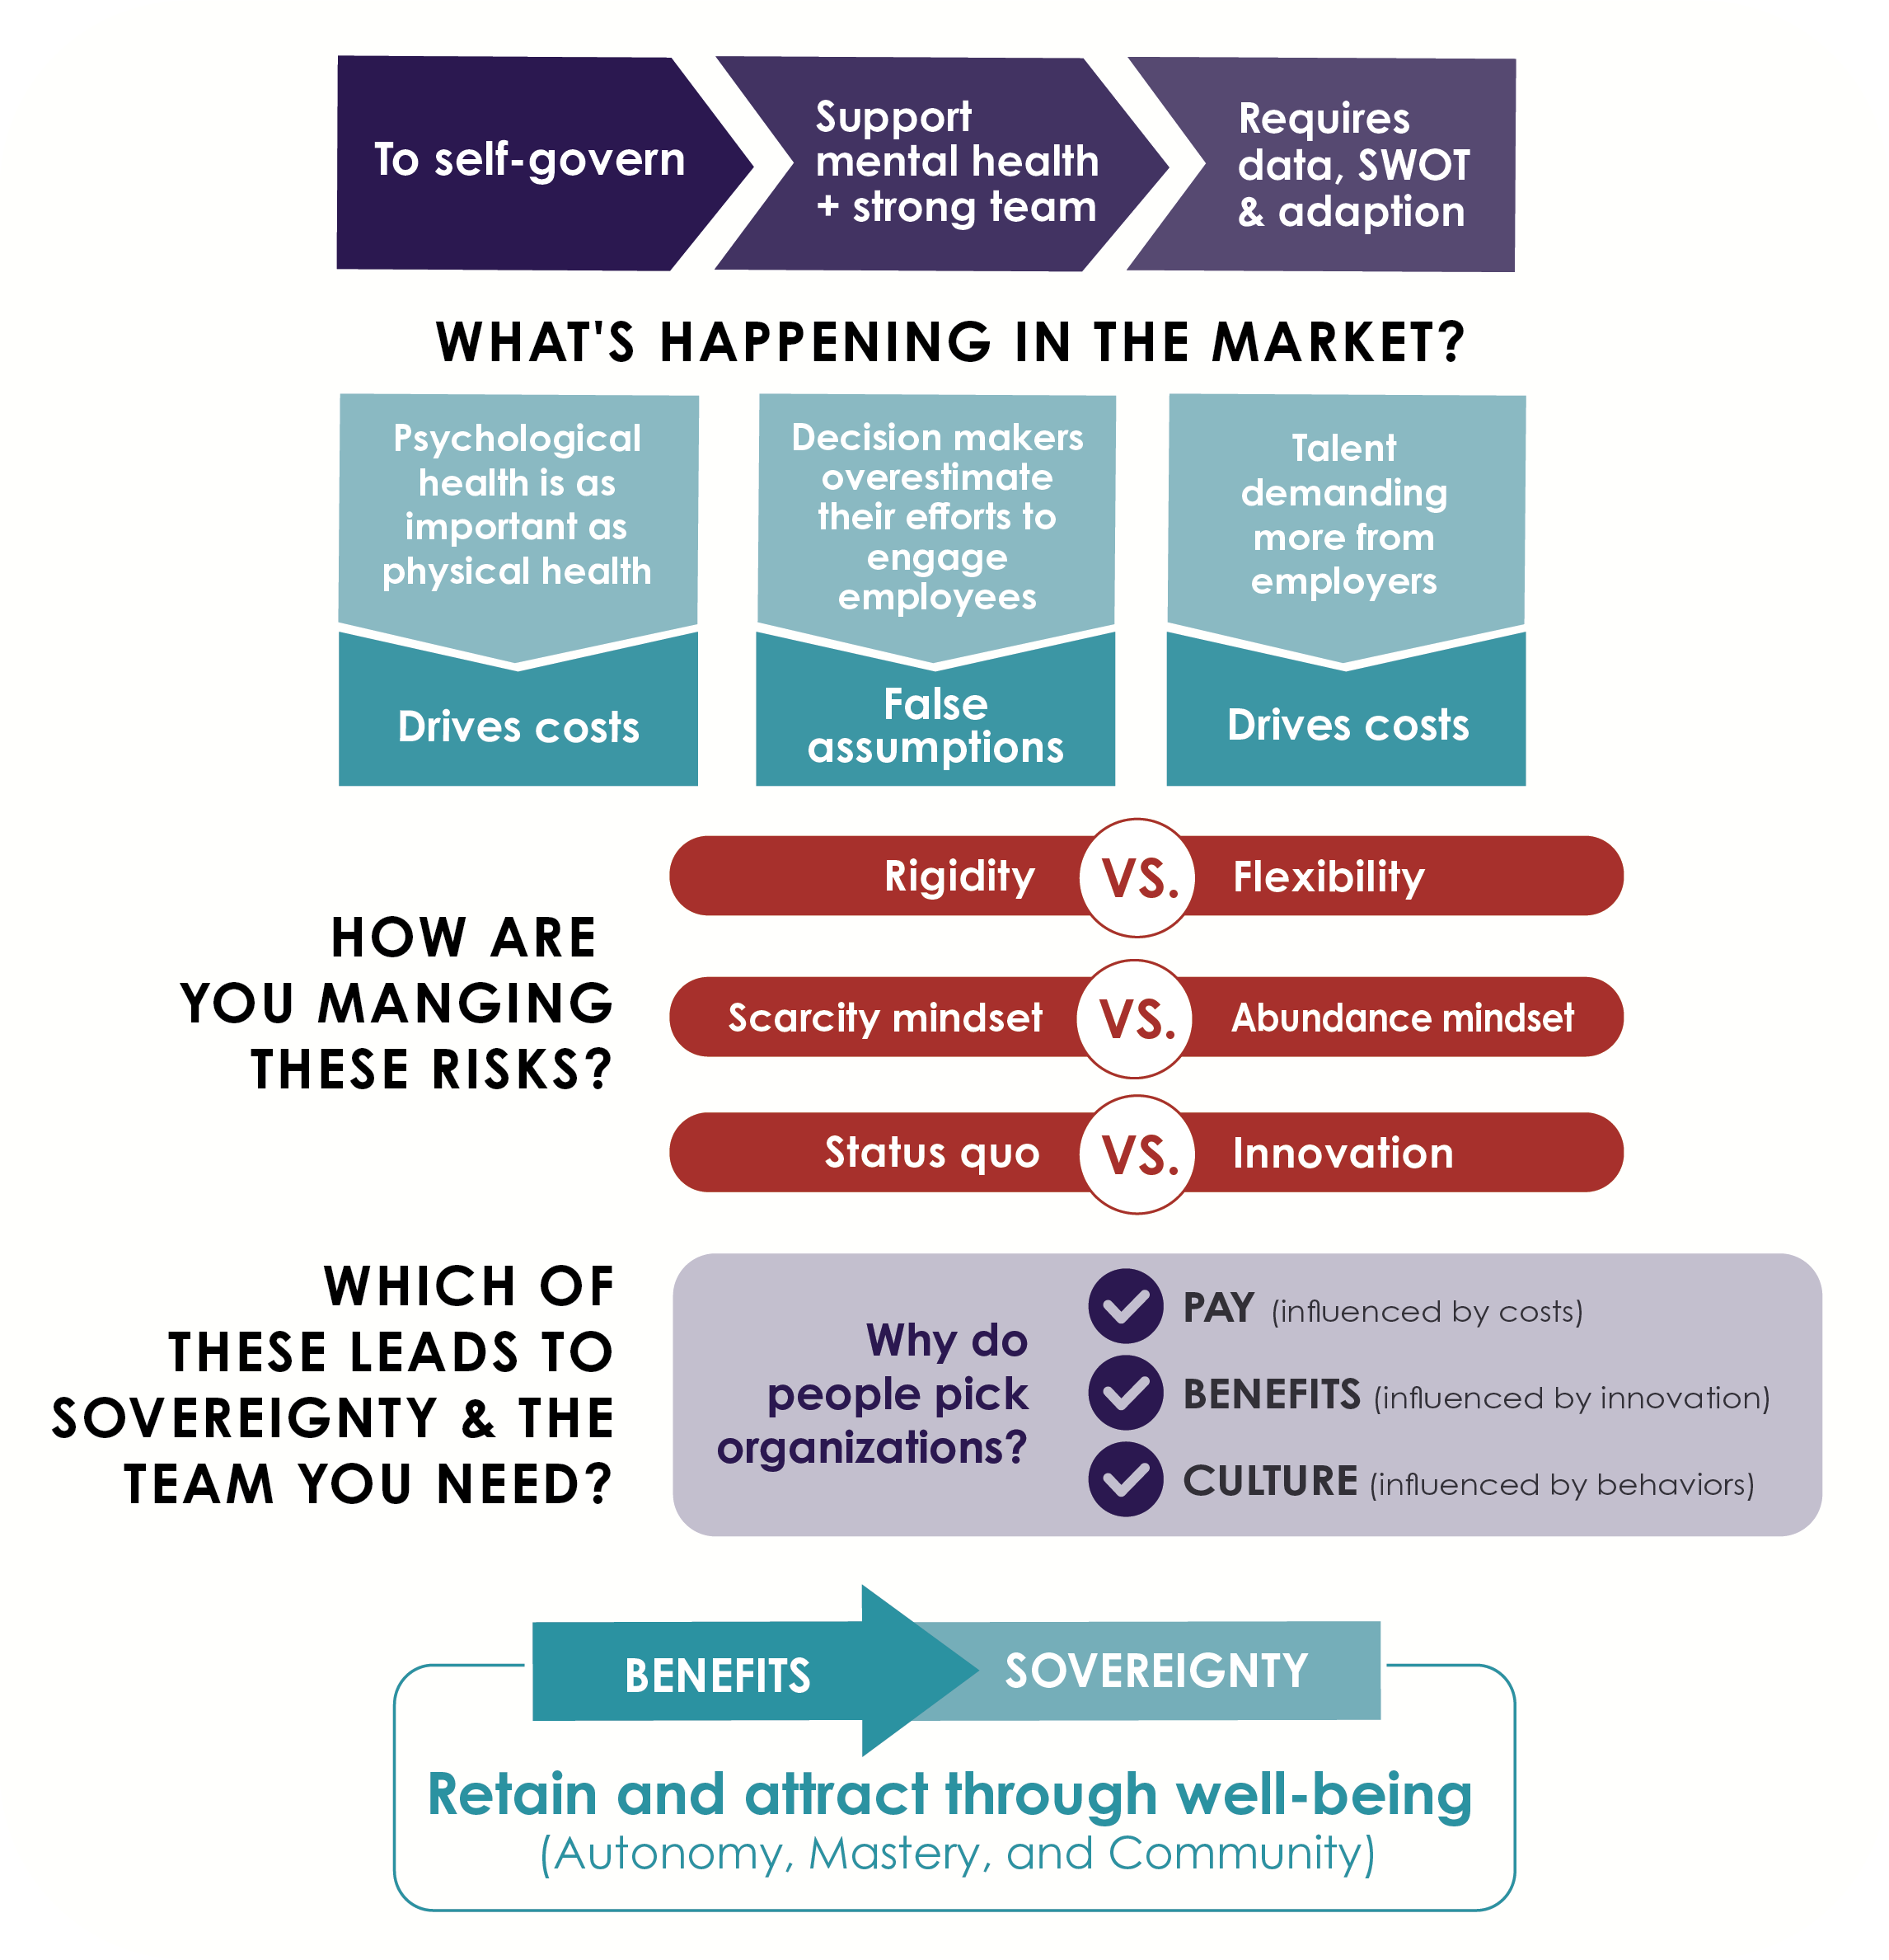
To Self-govern
Support Mental Health + Strong Team
How do we enhance sovereignty through Benefits?
How do we Enhance Sovereignty Through Benefits?
Requires Data, SWOT and Adaption
What's Happening in the Market?
Psychological health is as important as physical health
Decision makers overestimate their efforts to engage employees
Talent demanding more from employers
Drives
Costs
False Assumptions
Drives
Costs
How are you managing these risks?
Rigidity
Flexibility
Scarcity Mindset
Abundance Mindset
Status Quo
Innovation
Which of these leads to Sovereignty and the team you need?
Why do people pick organizations?
Pay (influenced by costs)
Benefits (influenced by innovation)
Culture (influenced by behaviors)
Benefits
Sovereignty
Retain and Attract Through Well-Being (Autonomy, Mastery, and Community)
Notes:
Updated graphic: If we follow the flow of selecting the right benefit package, we support the team, we use data to make decisions to address trends and manage risk, which allows us to get the right people in the rights seats to create sovereignty.

Slide 28
Why Doug Roehm & Charles Carlson?
We know tribal and have an established track record of delivering results.
Different client experience - you will know we care / we invest in relationships..
Dedicated service team that is fully engaged with you and with Indian country.
Proactively go deeper and find more savings / actionable solutions to bring value and maximize sovereignty for the tribe.
Interpret data, bring solutions/collaborate to determine best course of action.
Integration of tribal clinics, pharmacies & PRC programs with tribal self-funded health plans to maximize circulation of health dollars within the tribe.
Leverage strategic partnerships and challenge the norm to drive results.
Are transparent in all we do and are just a phone call away.
Willing to put a % of our compensation at risk.

Slide 29
Real Examples From 2023…
$1.65m claims avoided/shifted through Sponsorship on 250-person gaming facility; $2.2m removed from 566-member citizen health plan;
$2.6m+ savings on 720-person gaming entity, $10m prior spend –Sponsorship, MLR, other;
61% claim dollars from Rx spend returned through pharmacy program;
Medical/pharmacy costs decline 3 yrs. in a row;
20% stop loss refund through tribal stop loss program;
$1.1m Rx shifted to other plan;
$2m non-tribal preemie baby removed from plan through unique solution; and,
58% reduction in mental health spend through unique solution (no coverage change, increase network and service levels)

Slide 30


Thank You!
Doug Roehm, LIC, THRP
President, Strategic Services Group
Doug@ssgmi.com
M 248.568.3113
Ssgmi.com
Charles Carlson, THRP
President, Benefit Intelligence
charles@benefitintelligence.com
M 480.206.5144
BenefitIntelligence.com

