Slide 1


28th Annual Conference
September 23-25, 2024
Durant, Oklahoma

Slide 2

Cultivating Connections: Building Strong Mentorship Networks within Tribal Communities
Charles Walters – Chief Human Resources Officer – Isleta Resort & Casino
Presenter: Tribal Community Development Initiative

Slide 3



Content
1. The Importance of Mentorship in Tribal Communities
2. The Isleta Resort & Casino Mentorship Program
3. Building Strong Mentorship Networks
4. Future Directions for Tribal Mentorship

Slide 4

Section 1
The Importance of Mentorship in Tribal Communities

Slide 5



Understanding Mentorship: Definitions and Concepts
03
01
02
Mentorship Defined
Cultural Significance
Building Networks
Mentorship in tribal communities is a reciprocal relationship where experienced individuals guide and support less experienced members, fostering personal and professional growth while preserving cultural values.
This practice is deeply rooted in tribal traditions, emphasizing the importance of community, shared knowledge, and the transmission of cultural heritage from one generation to the next.
Effective mentorship networks within tribal communities enhance collaboration, strengthen social ties, and create pathways for economic and educational opportunities, ultimately benefiting the entire community.

Slide 6



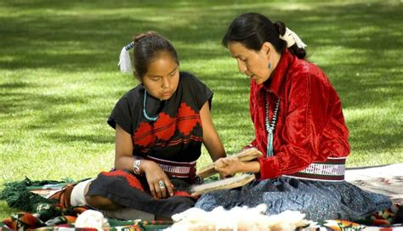
Historical Context: Mentorship in Indigenous Cultures
Traditional Mentorship Practices
Role of Elders
Adaptation and Resilience
Elders play a crucial role in mentorship, serving as guides and teachers who impart wisdom and life lessons, thereby reinforcing social cohesion and cultural identity among younger generations.
Historical challenges faced by Indigenous communities, such as colonization and cultural assimilation, have necessitated the adaptation of mentorship practices, ensuring the survival and revitalization of cultural traditions and community bonds.
Indigenous cultures, including the Pueblo of Isleta, have long utilized mentorship as a means of passing down knowledge, skills, and cultural values, often through storytelling and hands-on experiences within the community.

Slide 7
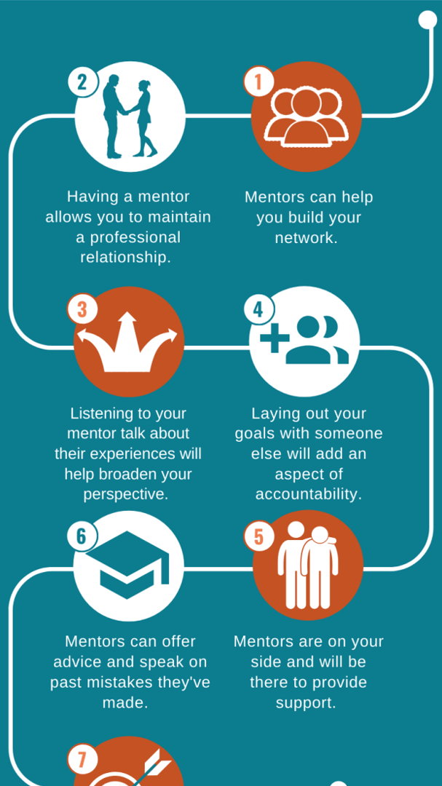
Benefits of Mentorship: Empowering Individuals and Communities
Personal Growth and Development
Mentorship provides individuals with personalized guidance, enhancing their skills, confidence, and self-efficacy, which are essential for personal and professional success within tribal contexts.
Strengthening Community Bonds
By fostering relationships between mentors and mentees, mentorship cultivates a sense of belonging and community cohesion, reinforcing cultural identity and shared values among tribal members.
Economic Empowerment
Effective mentorship programs can lead to increased educational attainment and job readiness, ultimately contributing to economic development and sustainability within tribal communities.

Slide 8

Section 2
The Isleta Resort & Casino Mentorship Program

Slide 9
Overview of the Program: Goals and Objectives
01
02
03
Program Purpose
Cultural Integration
Community Impact
The Isleta Resort & Casino Mentorship Program aims to empower Pueblo of Isleta members by fostering connections between experienced mentors and mentees, facilitating personal and professional growth within the community.
The program seeks to bridge traditional Indigenous knowledge with contemporary skills, ensuring that cultural heritage is preserved while participants gain relevant competencies for modern challenges.
By cultivating strong mentorship networks, the program aspires to enhance community cohesion, promote economic opportunities, and support the overall well-being of the Pueblo of Isleta members.

Slide 10
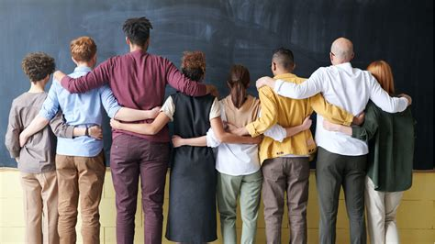


Key Components: Structure and Activities
Mentorship Pairing Process
Training and Resources
Ongoing Support and Evaluation
The program utilizes a structured approach to pair mentors with mentees based on shared interests, goals, and cultural backgrounds, ensuring meaningful and effective relationships that foster personal and professional development.
Comprehensive training sessions are provided for mentors, equipping them with the necessary skills and resources to guide their mentees effectively, while also incorporating cultural teachings that reinforce the importance of tribal heritage.
Regular check-ins and feedback mechanisms are established to monitor the progress of mentorship relationships, allowing for adjustments and continuous improvement of the program, ultimately enhancing its impact on the community.

Slide 11

Success Stories: Impact on Pueblo of Isleta Members
Empowered Youth Leaders
Several mentees have emerged as community leaders, utilizing skills gained through the mentorship program to initiate youth engagement projects that promote cultural heritage and community involvement.
Career Advancement
Participants have reported significant career growth, with many securing positions in local businesses and organizations, demonstrating the program's effectiveness in enhancing employability and professional skills.
Strengthened Community Ties
The mentorship program has fostered deeper connections among participants, leading to collaborative community initiatives that address local challenges and celebrate Pueblo traditions, reinforcing a sense of belonging.

Slide 12
Section 3
Building Strong Mentorship Networks

Slide 13
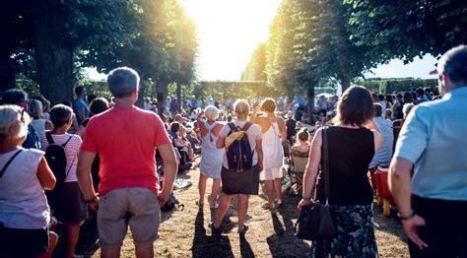


Strategies for Cultivating Connections within the Community
Identify Key Stakeholders
Facilitate Regular Networking Events
Leverage Technology for Connection
Engage community leaders, local organizations, and educational institutions to create a supportive network that promotes mentorship opportunities and resources tailored to the needs of the community.
Organize workshops, seminars, and social gatherings that encourage interaction among mentors and mentees, fostering relationships and collaboration while sharing knowledge and experiences.
Utilize digital platforms and social media to enhance communication and accessibility, allowing community members to connect with mentors beyond geographical limitations and facilitating ongoing support.

Slide 14

Engaging Stakeholders: Roles of Leaders and Participants
Leadership Engagement
Leaders play a pivotal role in fostering a culture of mentorship by actively promoting the program, providing resources, and setting clear expectations for participation, thereby encouraging community involvement and commitment.
Participant Empowerment
Participants, including both mentors and mentees, are essential in shaping the mentorship experience; their active engagement and feedback help refine the program, ensuring it meets the diverse needs of the community.
Collaborative Partnerships
Building strong mentorship networks requires collaboration among various stakeholders, including tribal leaders, local organizations, and educational institutions, to create a supportive ecosystem that enhances mentorship opportunities and community growth.

Slide 15
Overcoming Challenges: Addressing Barriers to Participation
01
02
03
Cultural Sensitivity and Awareness
Access to Resources and Support
Building Trust and Relationships
Addressing barriers to participation in mentorship programs requires a deep understanding of cultural values and traditions within tribal communities, ensuring that programs are designed to respect and integrate these elements effectively.
Many potential participants may face logistical challenges, such as transportation and access to technology; providing resources and support systems can help mitigate these barriers and encourage greater involvement in mentorship initiatives.
Establishing trust between mentors and mentees is crucial; programs must prioritize relationship-building activities that foster open communication and mutual respect, thereby enhancing participation and engagement within the community.

Slide 16
Section 4
Future Directions for Tribal Mentorship

Slide 17



Vision for Growth: Expanding the Mentorship Program
Long-term Sustainability
Enhanced Training Initiatives
Broadened Outreach Efforts
Develop a strategic plan that ensures the mentorship program's longevity by securing funding, resources, and community support, allowing for continuous growth and adaptation to the evolving needs of the Pueblo of Isleta.
Implement comprehensive training programs for mentors that incorporate both traditional knowledge and modern skills, fostering a holistic approach to mentorship that empowers participants and strengthens community ties.
Expand outreach initiatives to engage a wider audience within the Pueblo of Isleta, including underrepresented groups, to ensure inclusivity and diversity in mentorship relationships, ultimately enriching the program's impact on the community.

Slide 18
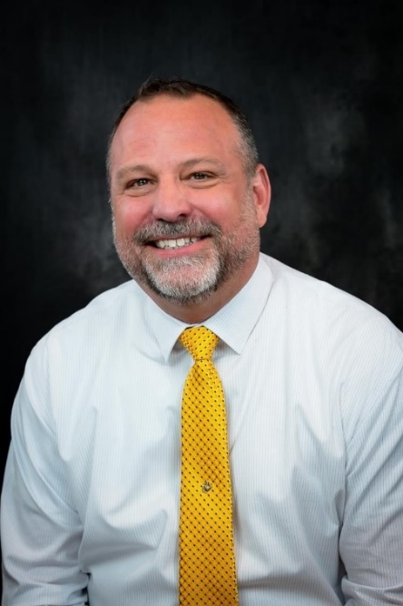
Thank You
Contact: Charles.walters@isleta.com

