Slide 1
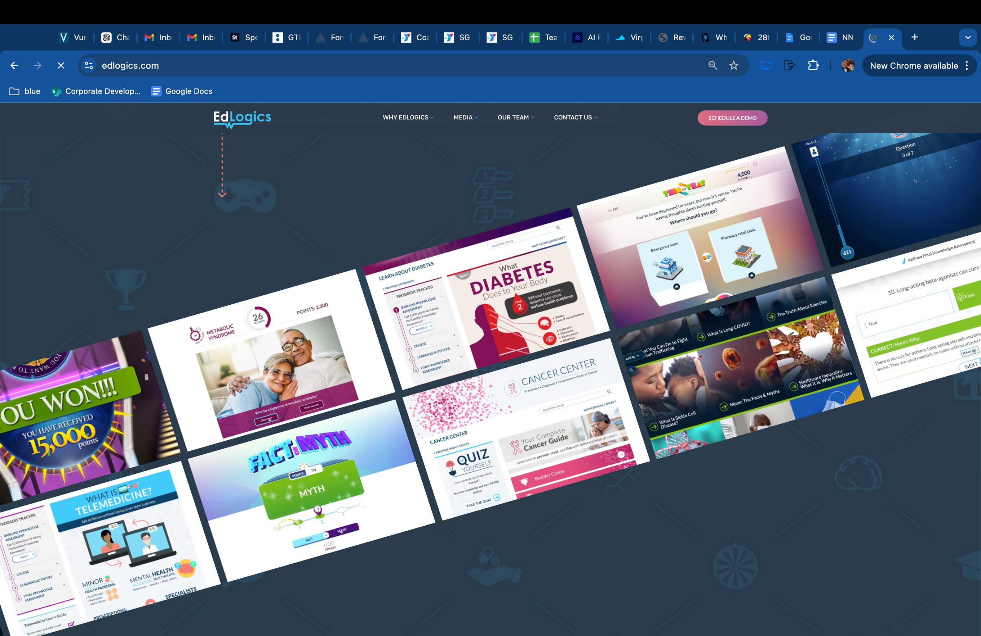


Engage
Educate
Empower
Deploying a Game-Based Approach to
Improving Health Literacy and Promoting
Awareness and Utilization of Employee Benefits

Slide 2

Session Overview
Engaging Employees Through Game-Based Learning
Empowering Better Healthcare Decisions
Streamlining Implementation for Immediate Impact with Minimal Effort

Slide 3


BRYANT PHILLIPS
Vice President, Human Resources

Slide 4


THOMAS
CHAMBERLAIN, PharmD
Founder and CEO

Slide 5


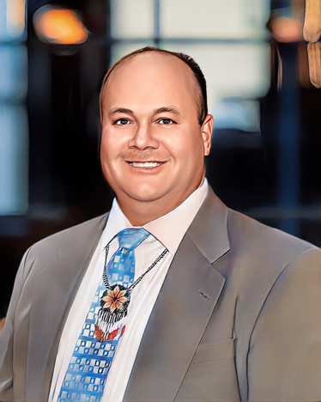



ENGAGE, EDUCATE, EMPOWER
Bryant Phillips
VP Human Resources
Tom Chamberlain, PharmD
CEO
Bringing together the entire health ecosystem to learn, collaborate, and define the future of healthcare.

Slide 6


Slide 7


APPLICATION OF GAME-BASED LEARNING
AT THE WORKSITE

Slide 8
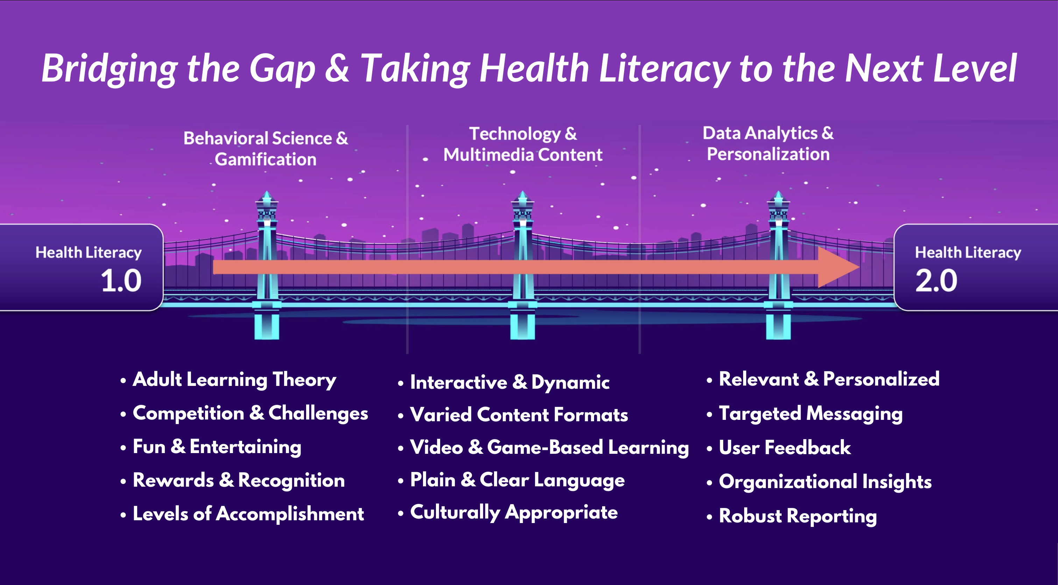

Slide 9
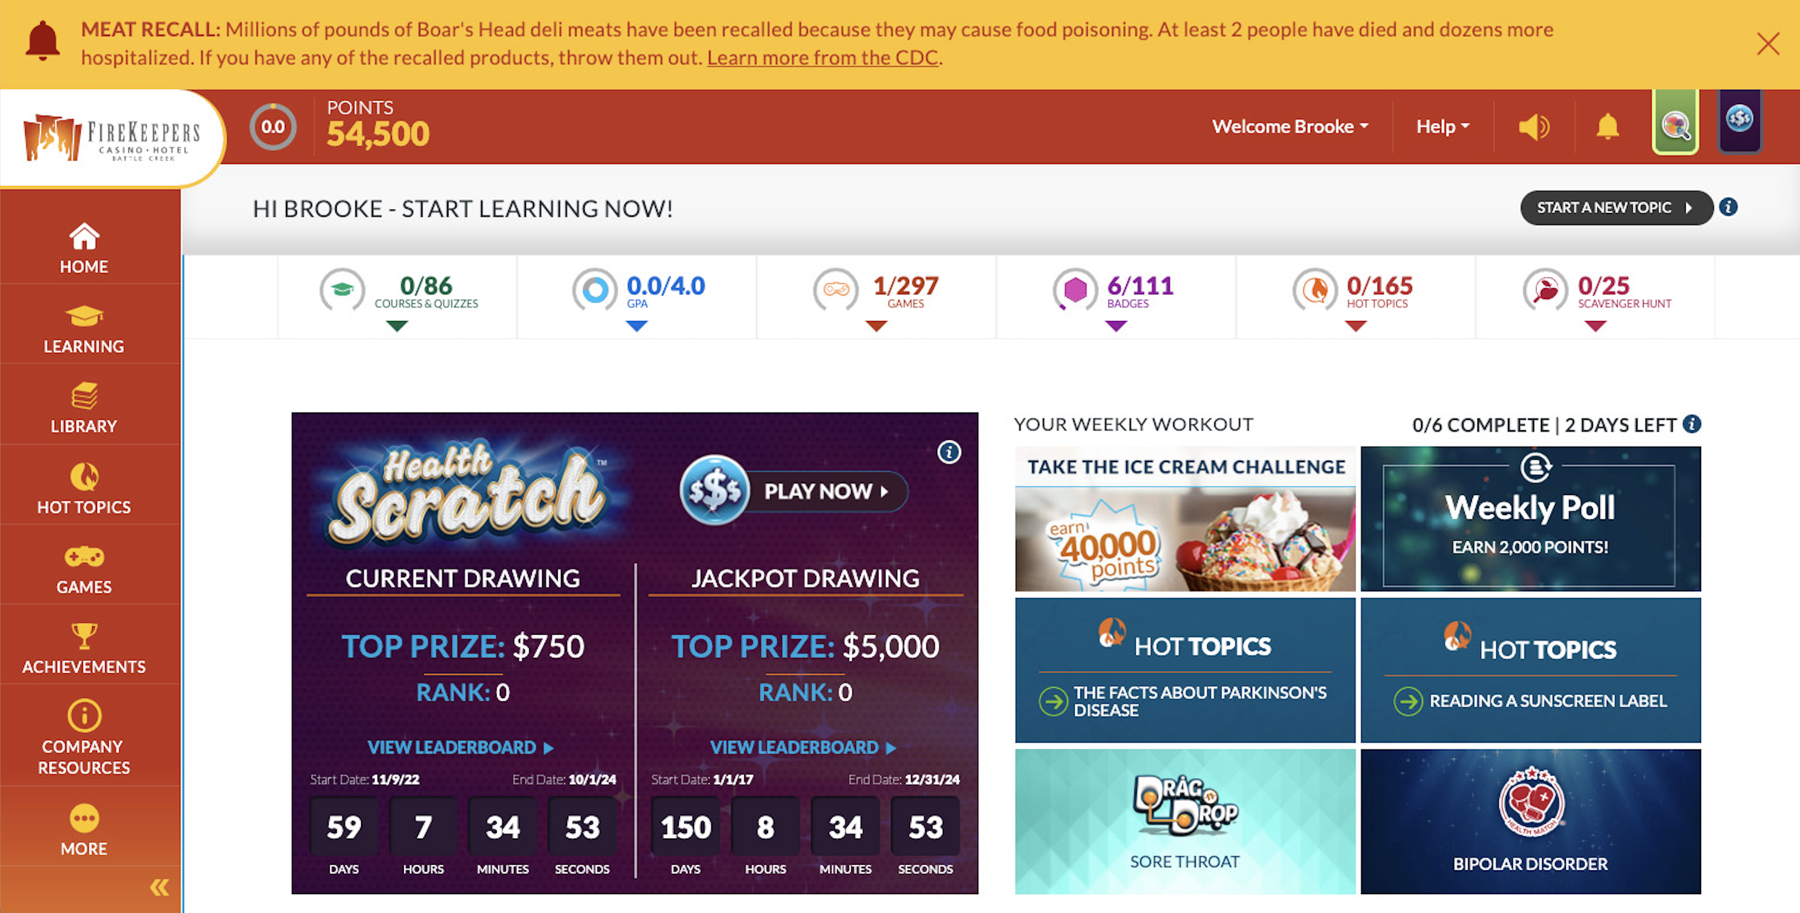
Customized and Client-Focused

Slide 10
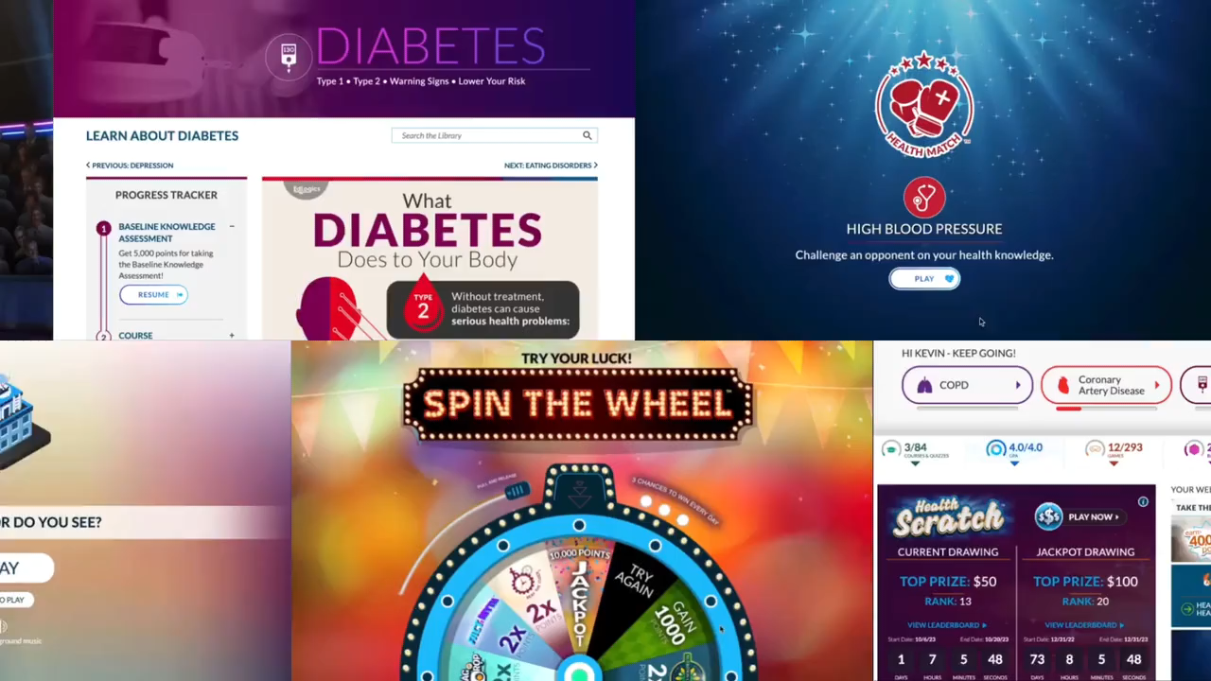

Slide 11
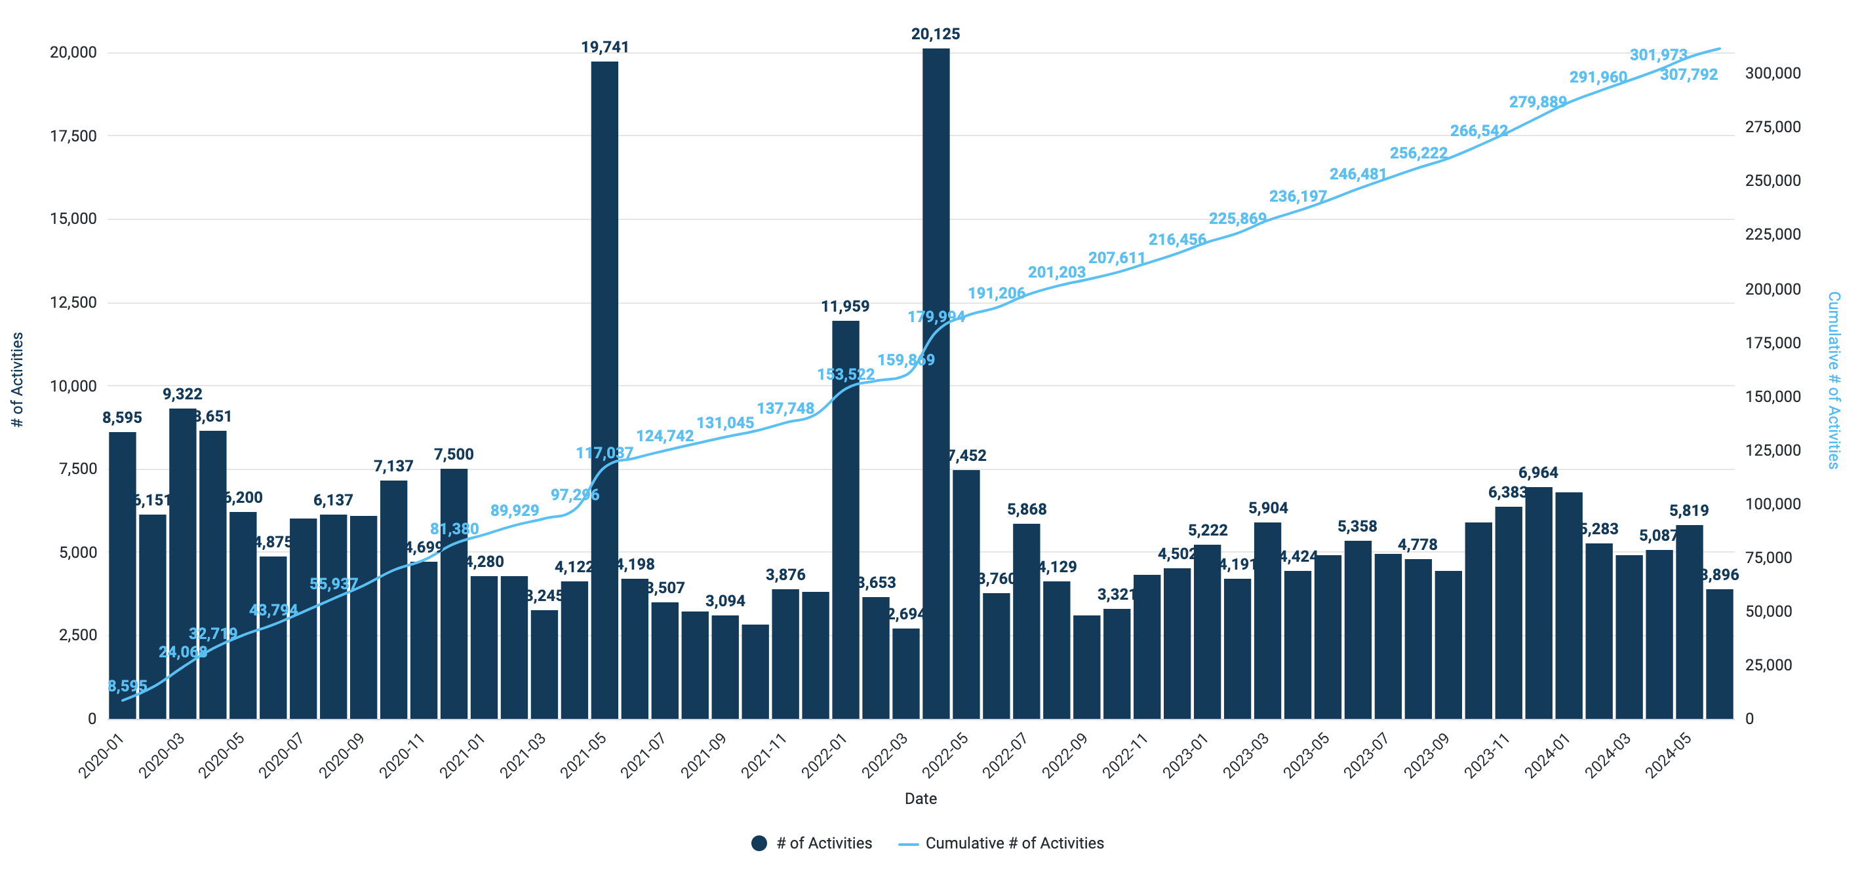
Learning Activities Completed

Slide 12
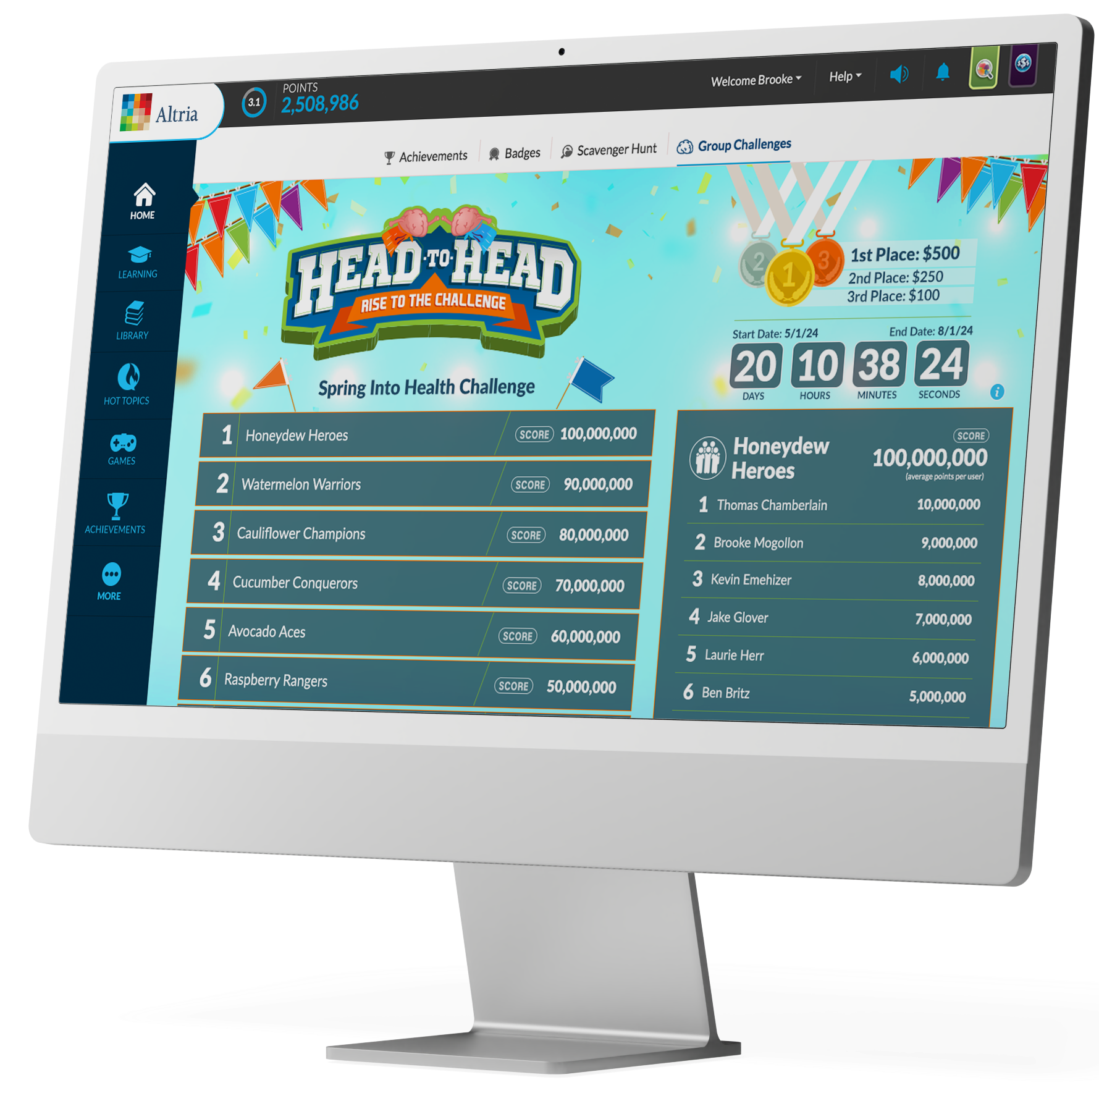


Slide 13


Slide 14
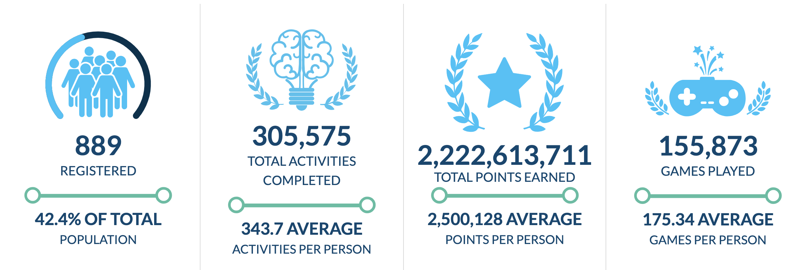
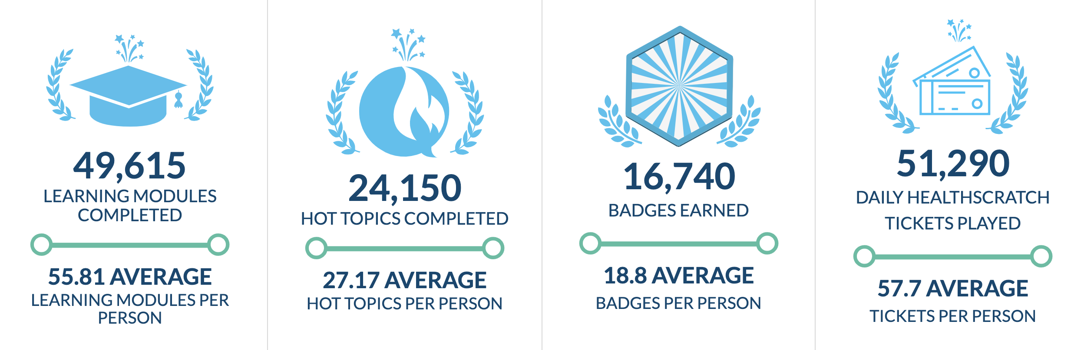
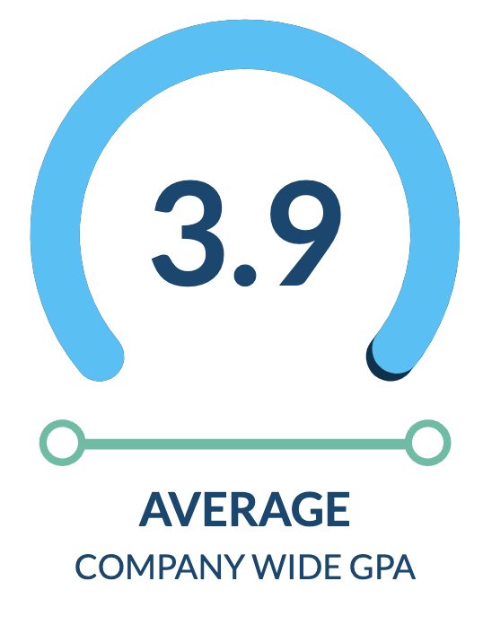
Employee Engagement

Slide 15
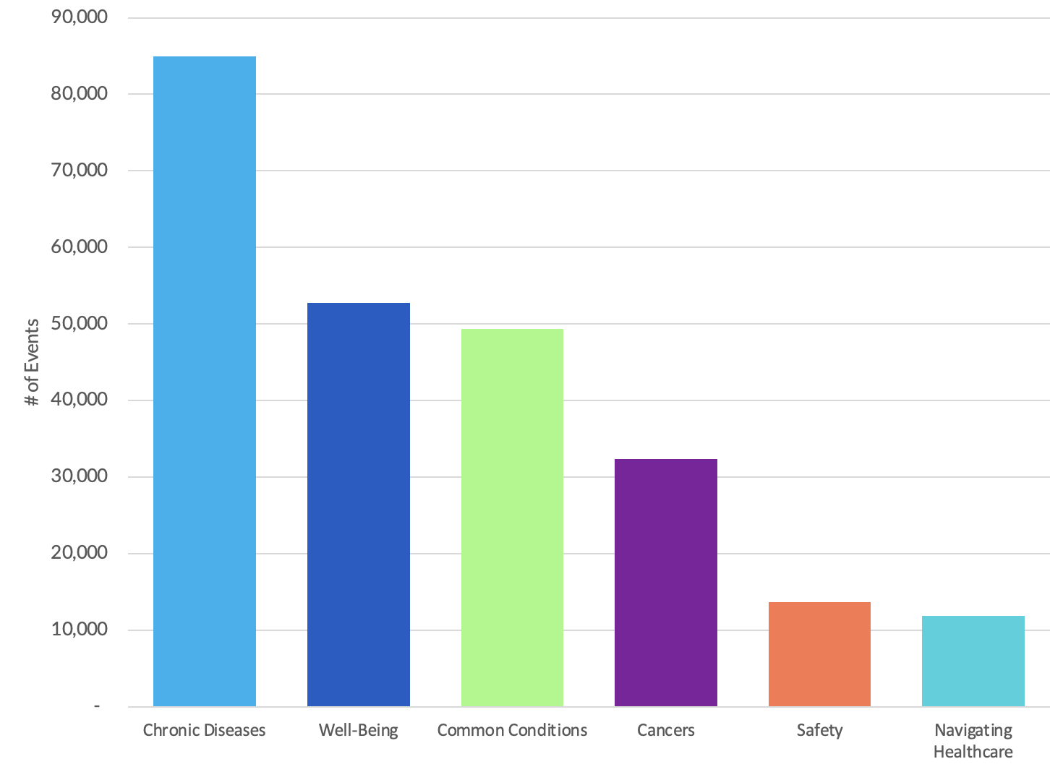
Learning Activities by Category

Slide 16
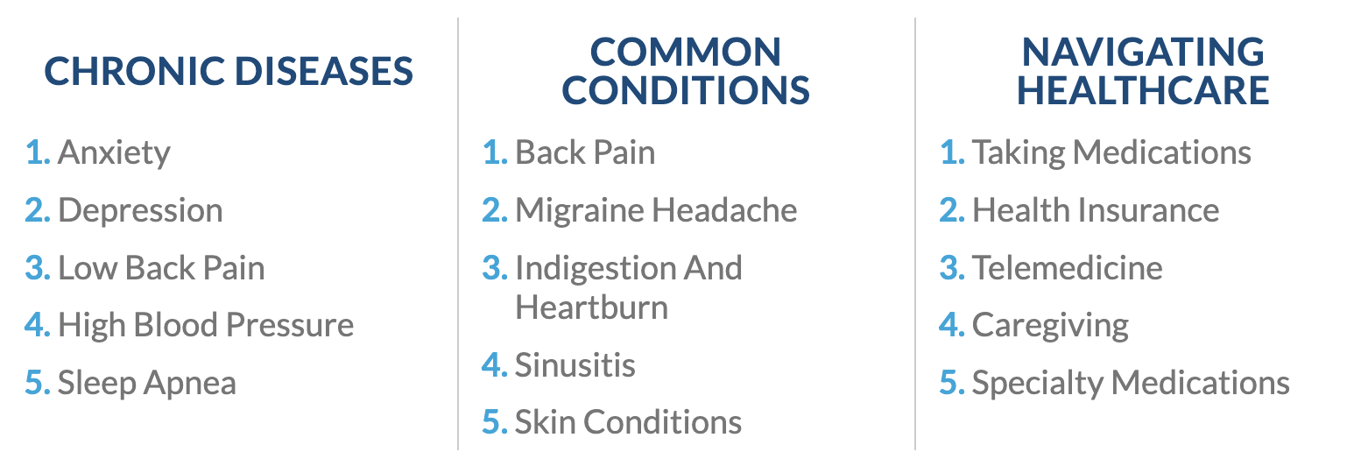
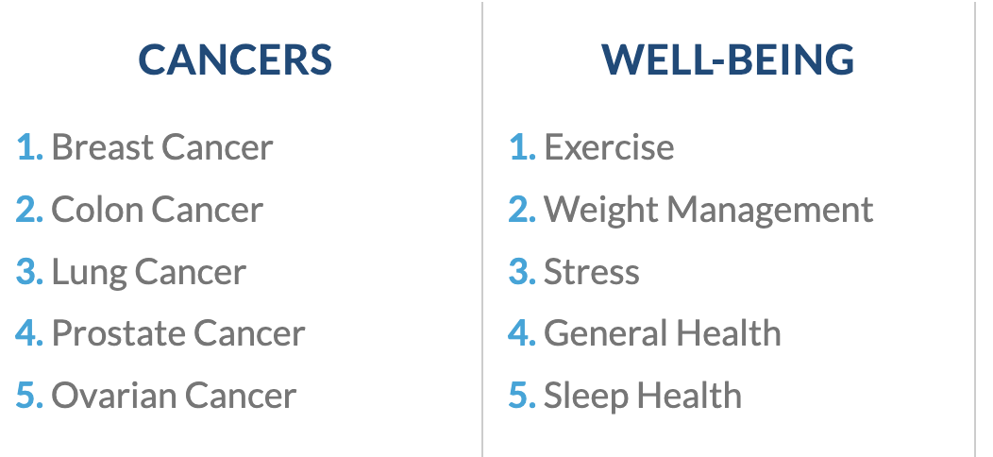
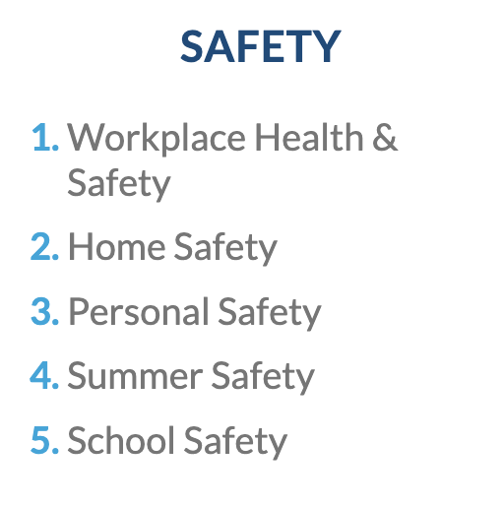
TOP 5 USER INTERESTS BY CATEGORY

Slide 17
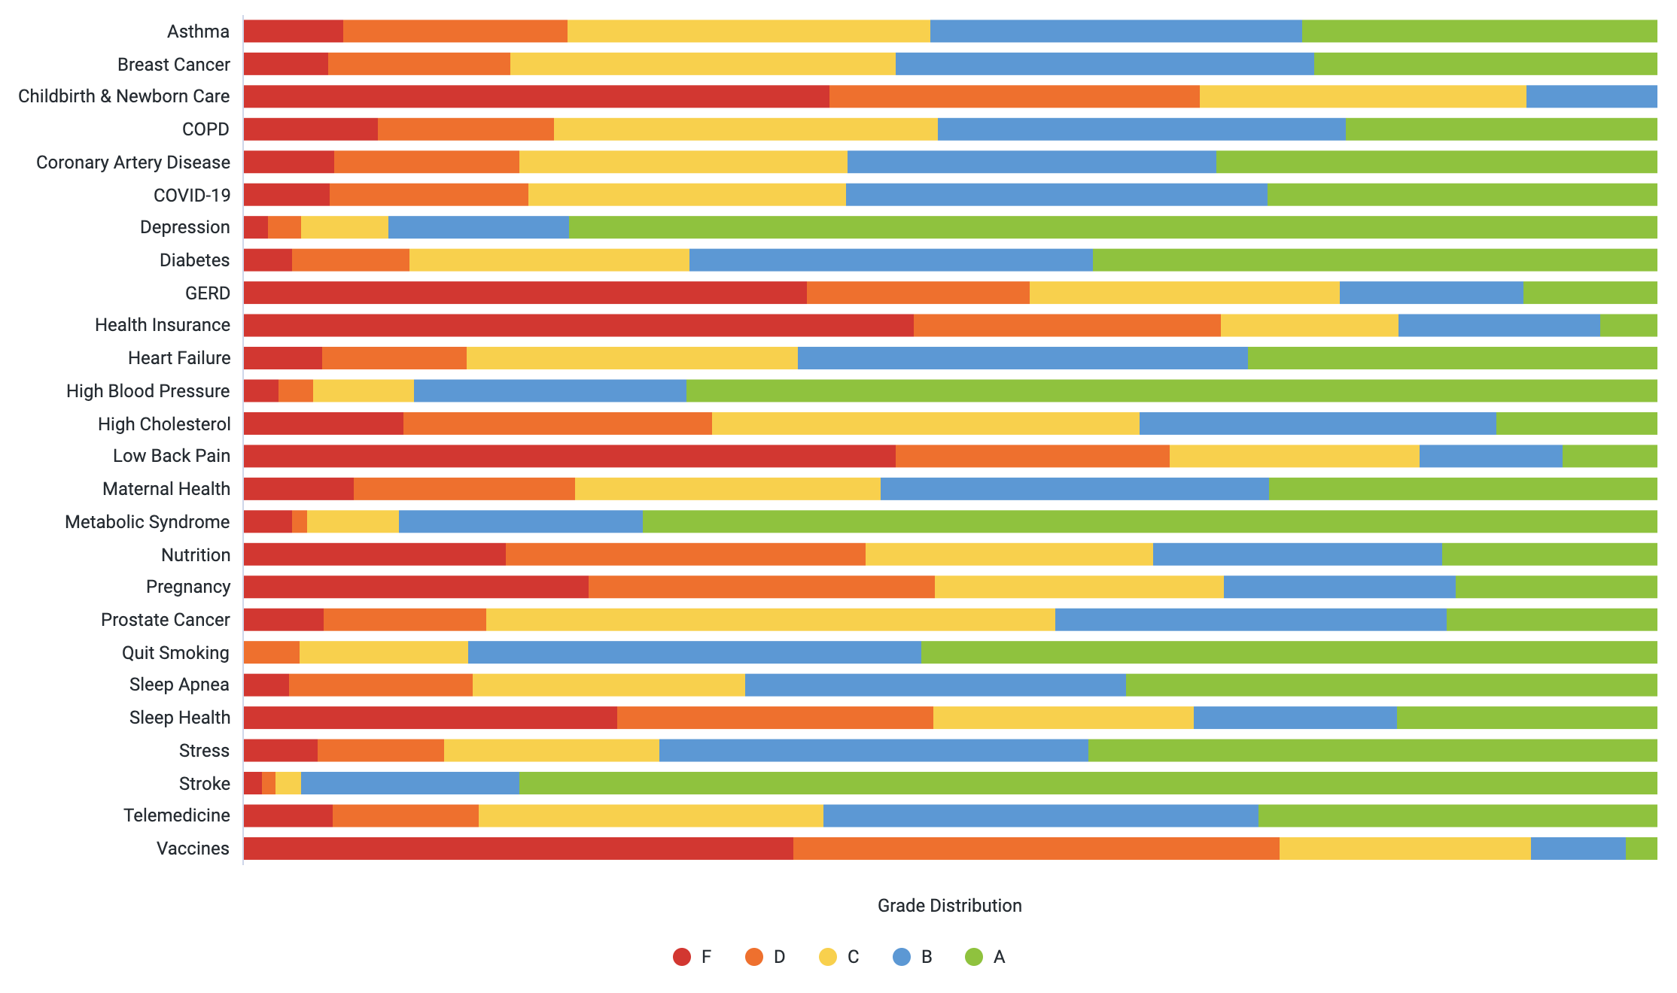
Baseline Knowledge Assessment

Slide 18
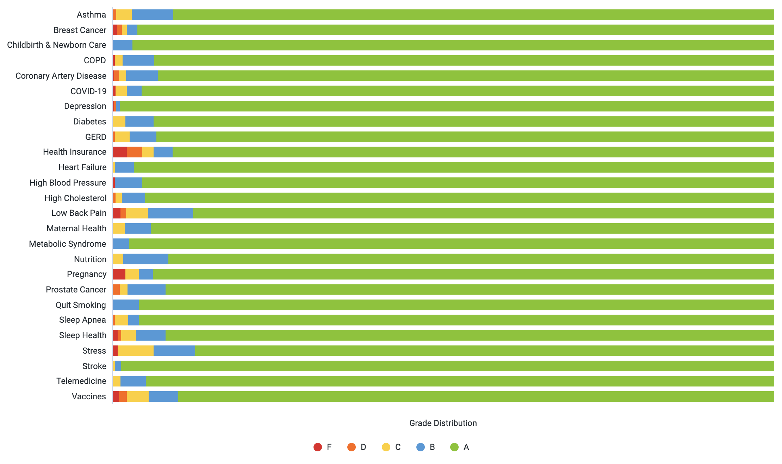
Final Knowledge Assessment

Slide 19
Select key areas of knowledge improvement
Health Insurance: 72% increase in understanding of how to calculate out-of-pocket costs with an 80/20 plan design with a deductible
Low Back Pain: 71% increase in understanding that exercise often helps with low back pain
Prostate Cancer: 68% increase in understanding that most cases of prostate cancer don’t need treatment
Coronary Artery Disease: 66% increase in understanding that smoking is the single strongest risk factor for CAD
Health Insurance: 64% increase in understanding of what co-insurance means

Slide 20
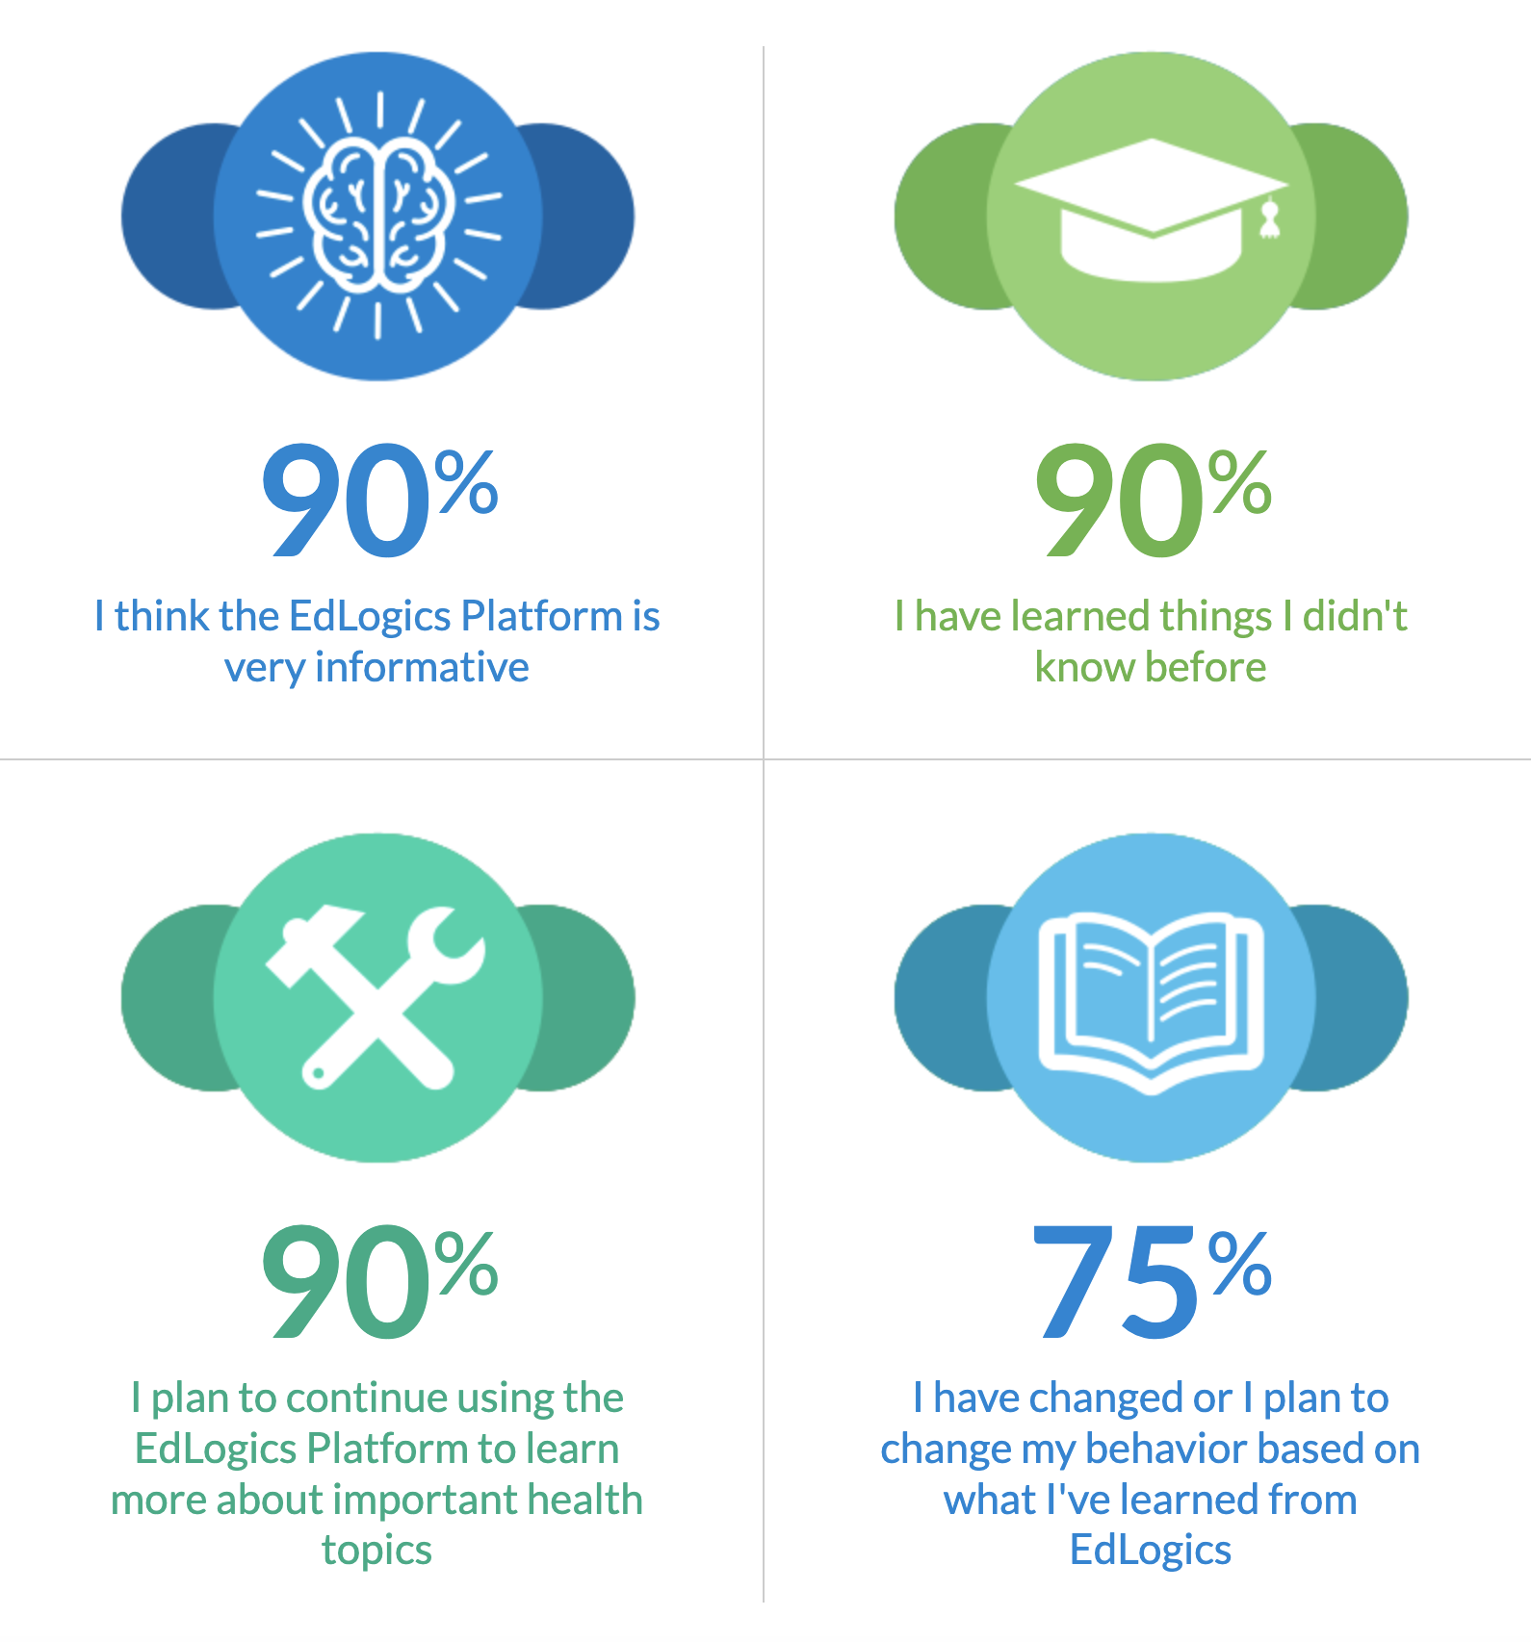
Firekeepers Experience Stats

Slide 21
Engage
Educate
Empower
OPEN
DISCUSSION

