Slide 1


28th Annual Conference
September 23-25, 2024
Durant, Oklahoma

Slide 2






Team
Chad Helgemo Marian Feher
Global Account Manager Managing Director

Slide 3


Introduction
Background on Marian & Chad
Why we are here together
How did we get into the relocation industry and what we enjoy most about what we do

Slide 4
AGENDA
What do you do today
Relocation 101
Why Relocation – Recruit and Retain
How to offer Relocation

Slide 5

What Do You Do Today?
We want to know about you

Slide 6
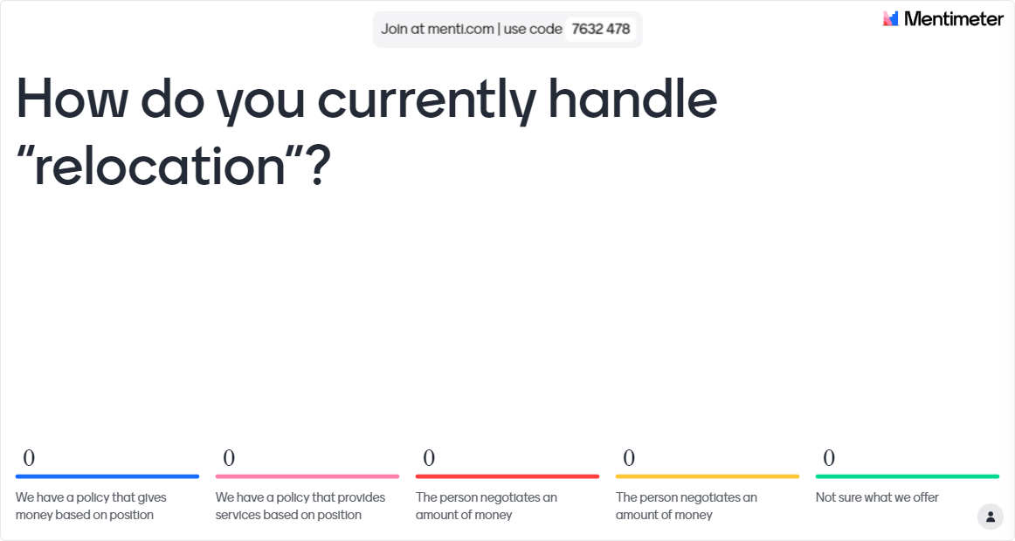

Slide 7
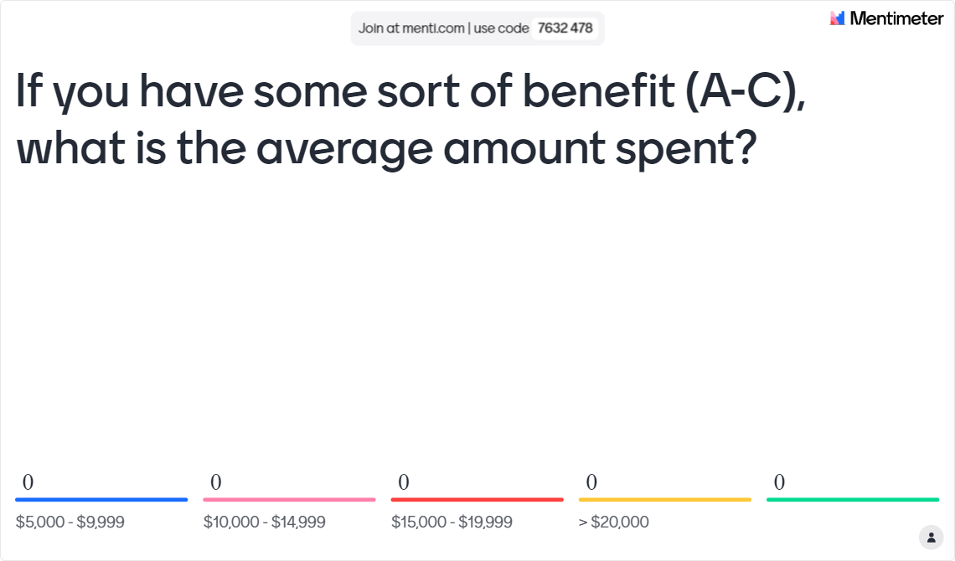

Slide 8
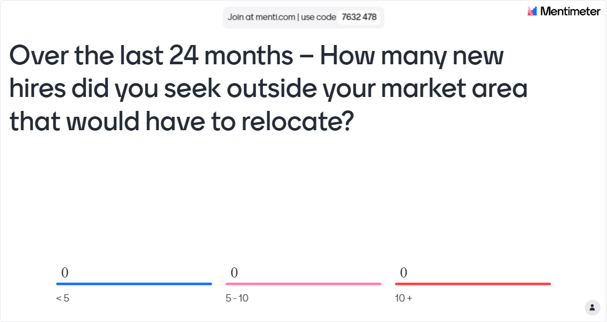

Slide 9
How do you currently handle “relocation”?
We have a policy that gives money based on position
We have a policy that provides services based on position
The person negotiates an amount of money
We never provide anything for someone to relocate
Not sure what we offer

Slide 10
If you have some sort of benefit (A-C), what is the average amount spent?
$5,000 - $10,000
$10,000 - $15,000
$15,000 - $20,000
> $20,000

Slide 11
Over the last 24 months – How many new hires did you seek outside your market area that would have to relocate?
< 5
5 - 10
10 +

Slide 12

What is Relocation
DEFINITION: the entire process of moving one or more employees from one location to another.

Slide 13

Parts of a Relocation
Home Finding
Expense Tracking
Storage
Home Sale
Temporary Living
Lease Cancellation
Final Move
Auto Shipment
Loan Applications
Household Goods
Lease Applications

Slide 14
What Relocation is NOT
Increase in Salary
Buy New Furniture
Vacation
Pay Off Debt
Increase Savings
Live in a Nicer Place
Sign On Bonus
New Car

Slide 15
Why Offer Relocation
“64% of people who moved for a job received a relocation package.”
Recruitment
Retention

Slide 16
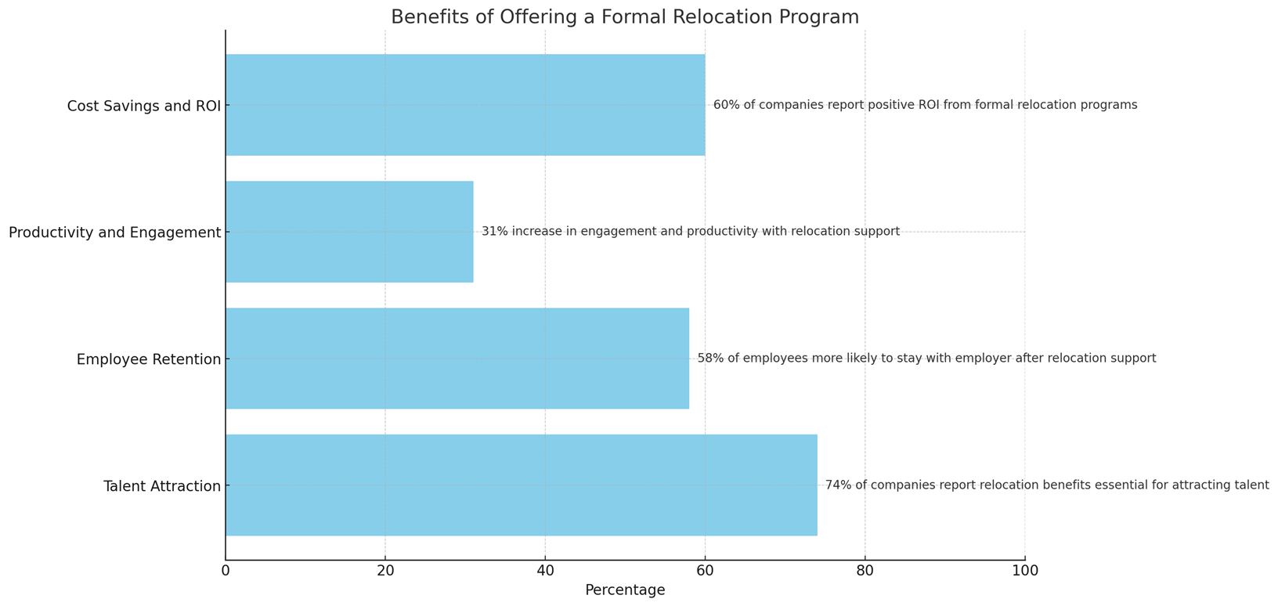
Relocation is a Valuable Tool

Slide 17
Why Offer a Formal Relocation Policy
Consistency – people talk
Ease of Administration across all areas
Recruiting Outreach
Retention – Impacts Onboarding

Slide 18
Impact on Recruiting
List in Job Posting – Opens the Pool
Enhances the Offer
Enhanced Skills and Knowledge Transfers or New Hires
“Employee relocation packages have long been a staple in corporate recruitment strategies, offering enticing incentives for individuals to uproot their lives and take on a new opportunity in a different location.”

Slide 19
Have you had a position in the last 24 months that was difficult to fill due to job specifications?
Yes
No
Unsure

Slide 20

Impact on Recruiting – Higher Caliber Candidates
Top Professionals will expect relocation
Career development is the biggest motivator with 69% of employees claiming they would relocate for the right position
Millennials who often relish the chance to broaden their business and personal horizons

Slide 21
Recruiting – Competitive Job Market
Everyone is looking for same talent
Relocation sets you apart from other organizations
62% of people are willing to relocate for career advancement or an opportunity to make more money
Many people like working remote. Relocation offers an incentive to work onsite.
80% of job seekers consider relocation assistance as a critical factor when deciding to accept a job offer

Slide 22
Recruiting Impact for You
“Offering relocation assistance demonstrates the company's commitment to supporting candidates in their transition. This could include financial support for moving expenses, temporary housing, or even assistance with finding local resources such as schools and healthcare providers. Make sure to outline these benefits clearly during the recruitment process to entice candidates who might be hesitant about relocating.”
Access to New Markets
Employee Satisfaction
Removes Last Minute Negotiations
No Annual Impact on Salary

Slide 23
Retention Impact for New Hire or Transferee
“This move was so easy I didn’t even have to use my brain”
Career Growth Opportunities
Personal Development
Stress Reduction
Enhanced Job Satisfaction
Family Satisfaction

Slide 24






Retention
Enhanced Job Satisfaction - 61% of employers believe that providing relocation assistance positively affects job satisfaction and retention.
Positive Branding - better reputation as employers, which can attract and retain top talent. This improved branding can lead to lower turnover and higher retention rates.
Long-term Commitment: Employees who receive relocation support are more likely to feel valued and appreciated by their employer, fostering a sense of loyalty and long-term commitment.
Family Satisfaction
Cost to Replace
One to two times an employee's yearly salary
$1,500 for an hourly worker
100% to 150% of an employee's annual salary for technical positions
Up to 213% of an employee's annual salary for senior executive level positions

Slide 25

How To Offer Relocation
Planning the Policy
Choosing the policy
Communicating the policy

Slide 26
Planning the Policy
??
?
Identify the Need
What positions, Why, Timeframe
Policy Objective
Recruit, Retain, Benefit
Examine the Budget
Examine the budget for each type of budget
Policy Development
What and to whom are we offering the package
Communicate the Policy
Formal Rollout and Plan of Use

Slide 27
Types Of Policy’s
An increased need to control overhead including employee relocation costs
Lump Sum
Reimbursement
Managed Cap
Managed Move
Give them Money
Easy to Budget
No Services
Overpaying some and under paying others
People use inferior services to save money
Pay them Back
Hard to Budget
No Services
No Safeguard for expenses
Time Consuming for you.
“Up to” Set Amount + Assistance
Fixed Budget
Offers Assistance
May use unreliable resources
May not cover all needs
Provides Services
Variable Costs
Benefits Capped
Full Services
Comprehensive Benefits
Best for Transferee
Onboarding
IRS Regulations
With changes in the tax laws in 2018 it is more critical to keep costs under control.

Slide 28
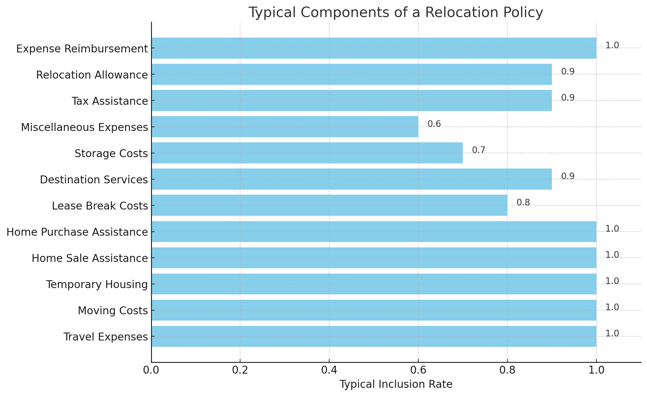
Components of the Policy
\
An increased need to control overhead including employee relocation costs
Onboarding
IRS Regulations
With changes in the tax laws in 2018 it is more critical to keep costs under control.

Slide 29

Relocation is a Taxable Benefit
Will be taxed similarly to other benefits
Taxes are due for relocation regardless of method paid
Non-members must pay all taxes
Benefits incurred at origination must be taxed based on that location
Many organizations cover tax burden for the transferee

Slide 30

Communicating the Policy
Program Rollout to HR and Hiring Managers
Incorporating in to Recruiting Material
Presented to the Transferee with the Offer
Follow Up on Satisfaction

Slide 31
"A formal relocation program not only eases the transition for employees, enhancing their productivity and satisfaction, but also strengthens the organizations ability to attract and retain top talent by demonstrating a commitment to their well-being and professional growth."

Slide 32
THANK YOU!
Any Questions??
Marian Feher
marian.feher@mobilitymatters.net
www.mobilitymatters.net
Chad Helgemo
chelgemo@alexanders.net
www.alexanders.net

