Slide 1
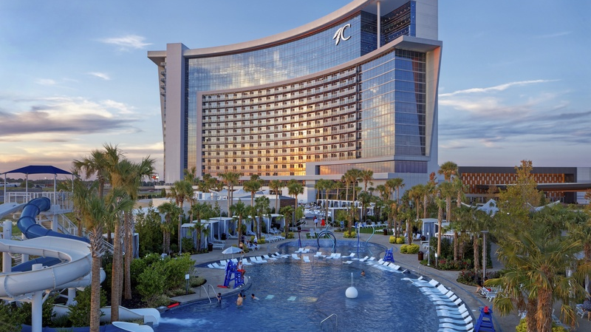

Harnessing Insights:
Leveraging Data from Surveys for Informed Decision-Making
September 23-25, 2024
Durant, Oklahoma

Slide 2


Agenda
Introduction
Introductions
Overview of Session
Overview of Surveys
National Benchmarking Survey
Summary of NBS
Trends and Findings
Interactive Activity
Salary Planning Survey
Summary of SPS
Trends in Salary Practices
Poll & Discussion
Pulse Survey Results
Time Away From Work
Generational Characteristics
Interactive Activity
Taking Action
Data Needed
Resources Available
Employer Response & Next Steps
Leveraging data from surveys to informed decision-making

Slide 3

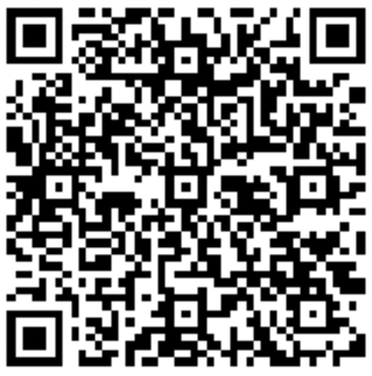


Team
Sommer Mason, CCP
Regional Vice President
Human Resources & Compensation
Consulting Practice
Sommer_Mason@ajg.com
225.290.0656

Slide 4
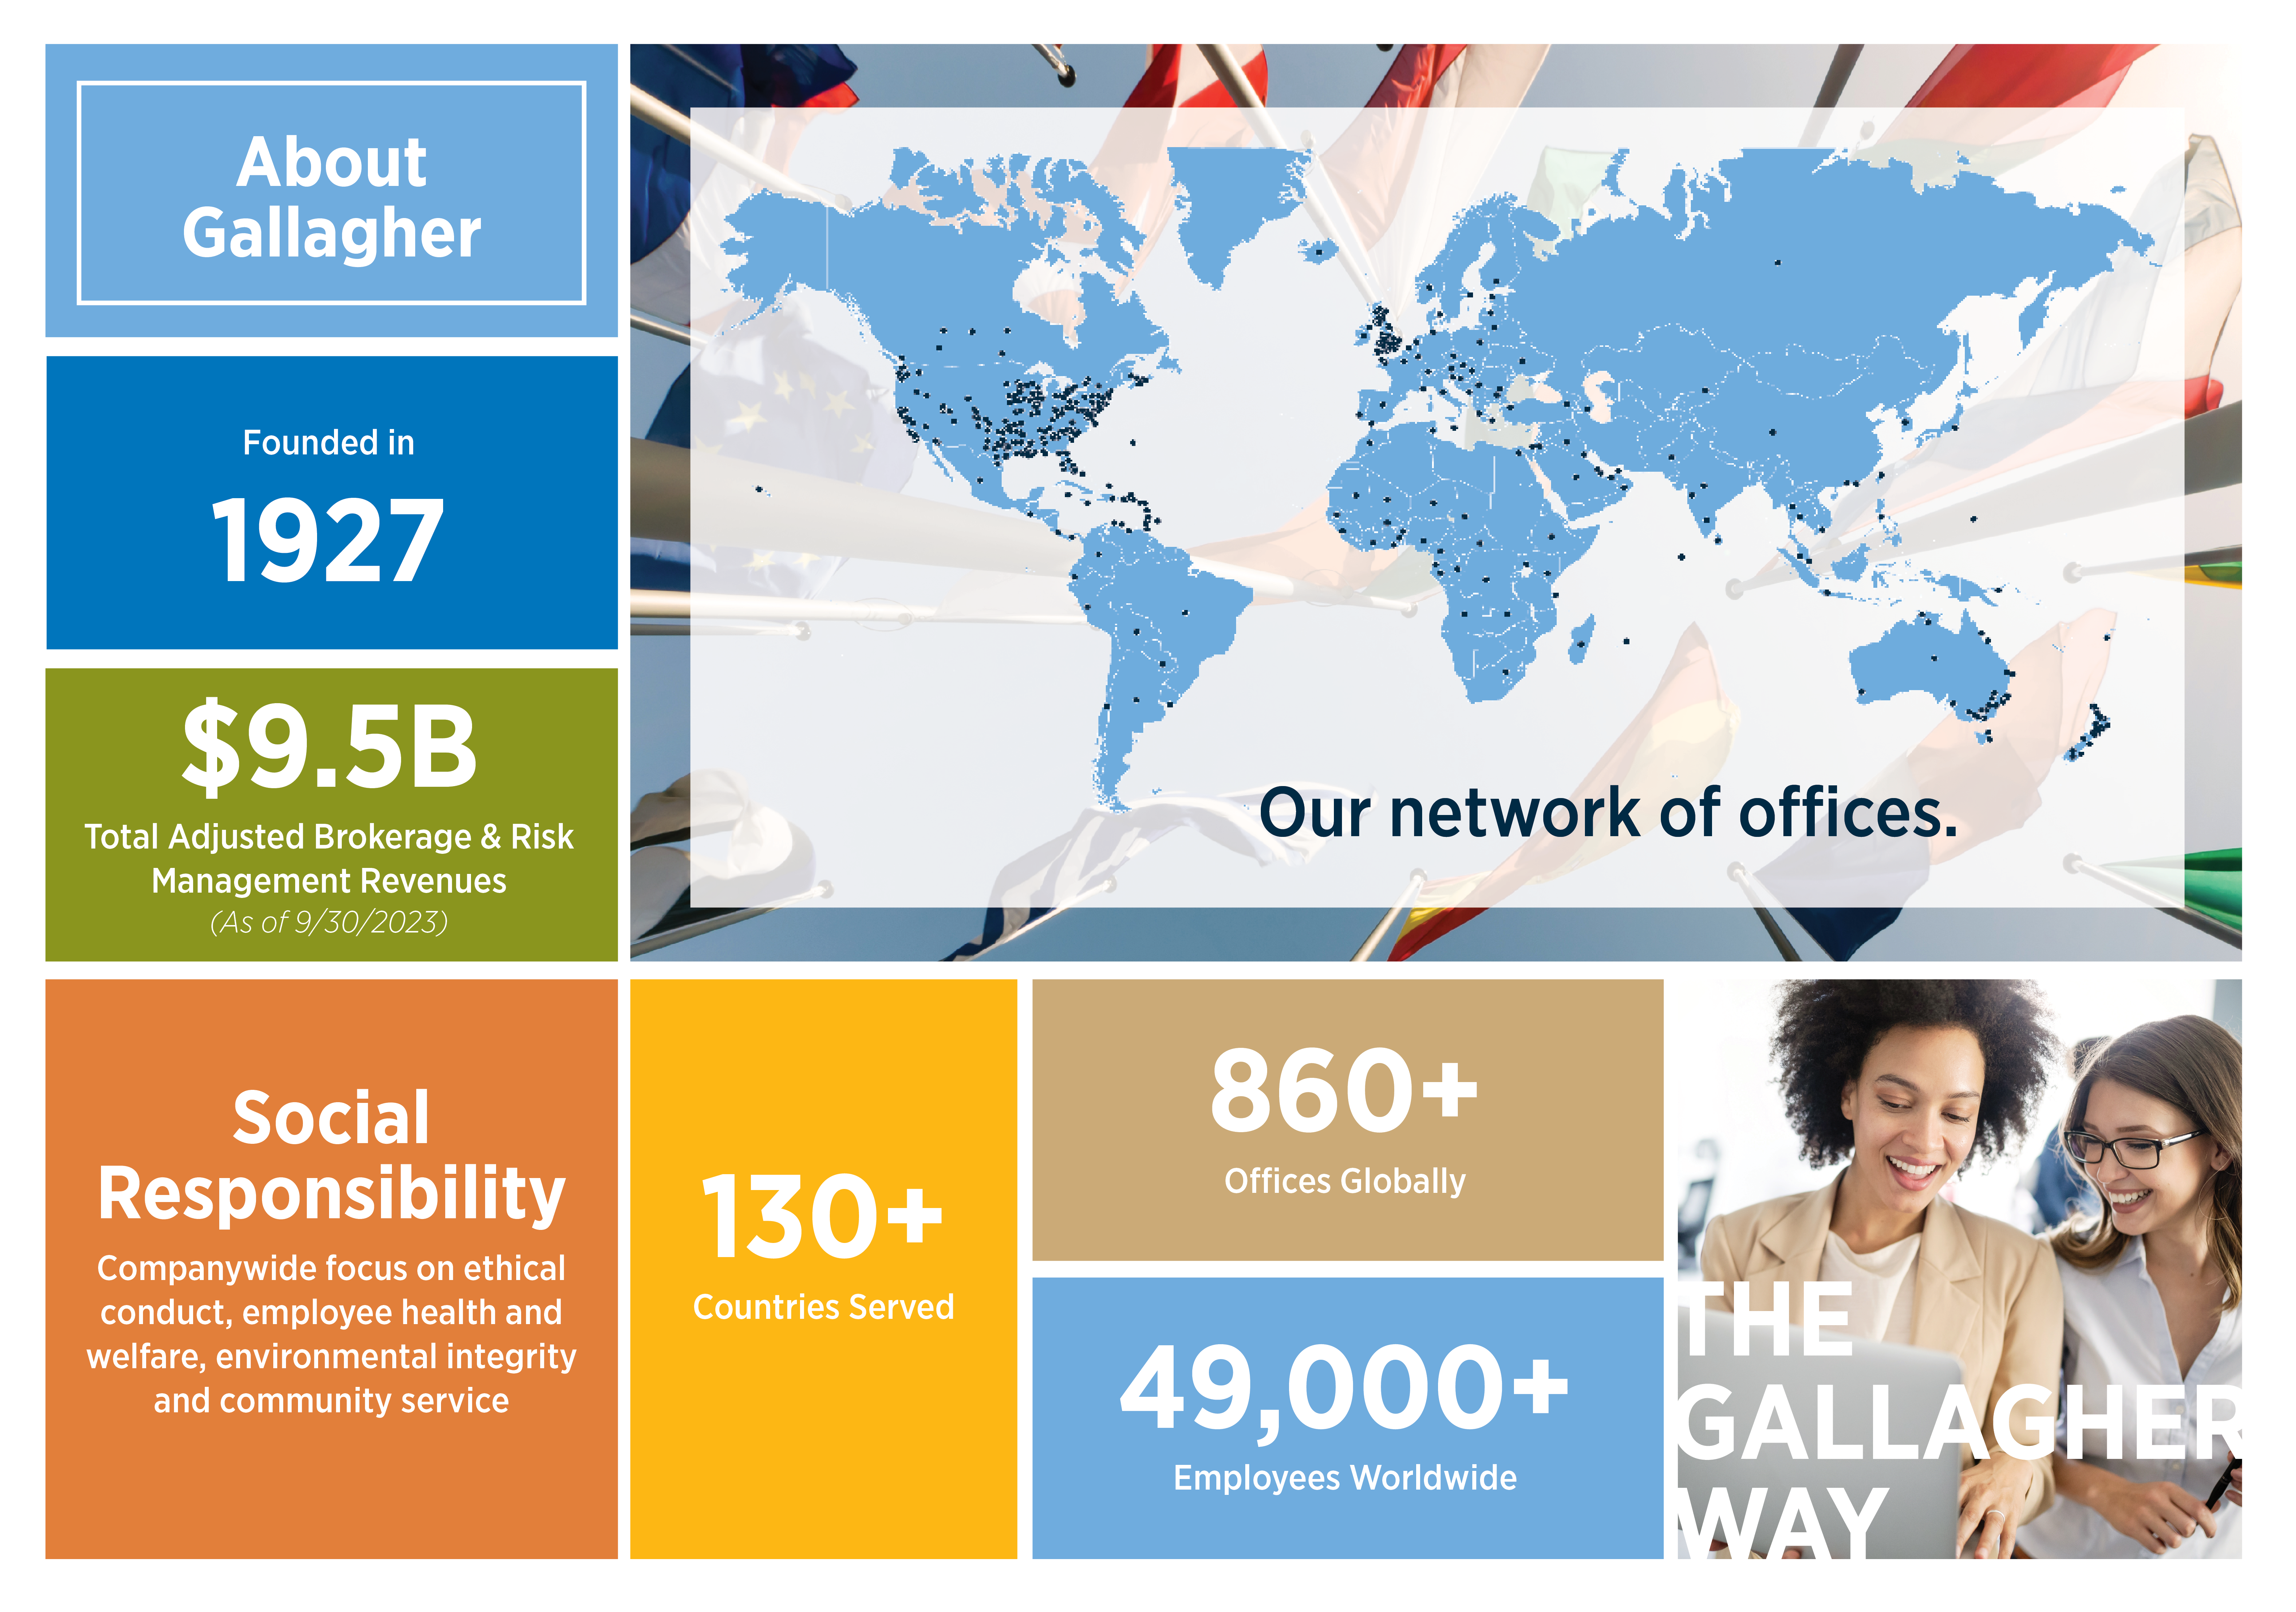
Notes:
Very brief – 30 sec explanation of Gallagher, we’re a sponsor and stop by booth.

Slide 5
Let’s Get Interactive: Introduce Yourself!
Where is your organization headquarters located?
NOTE: the QR codes have to be created and added to the deck the week before the presentation.
Notes:
Will enter QR codes week before.

Slide 6
Let’s Get Interactive: Introduce Yourself!
What is your job/role/level?
NOTE: the QR codes have to be created and added to the deck the week before the presentation.
Notes:
Will enter QR codes week before.

Slide 7
"Without data, you're just another person with an opinion.“
— W. Edwards Deming
Notes:
Story about manufacturing company - fans

Slide 8

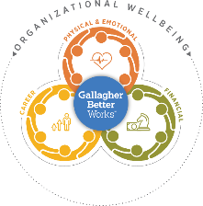
Organizational Wellbeing
Culture
Employee Behavior
Risk
Outcomes
Leadership
Policies
Trust
Diversity, Equity and Inclusion Benefits & Compensation
Recognition
Communication
Technology
Safety
Health & Fitness
Benefits
Finances
Performance
Engagement
Mental Health
Attracting & Retaining Talent
Healthcare costs
Safety
Financial Performance
Organization/Brand Reputation
Employees
Organization
Customers
It’s all connected.
Gallagher Organizational Wellbeing Poll: Generational Characteristics, May 2024

Slide 9



Best Practice: Blending Qualitative & Quantitative Data
Creating a more complete picture to elevate the employee experience
External Workforce
Data
Quantitative workforce statistics
Internal
workforce
data
Engagement Surveys
Preference Surveys
Feedback Surveys
National Benchmarking Survey
Salary Planning Survey
2024 Pulse Surveys
Employment Details
Workforce Demographics
Compensation & Benefits

Slide 10
Key Data Sources for Today’s Presentation
Harnessing Insights: Leveraging Data from Surveys for Informed Decision-Making
Highlighting Survey Trends:
Benefits & Employer Programs – National Benchmarking Survey (NBS)
Pay – Salary Planning Survey (SPS)
Hot Topics – 2024 Pulse Surveys:
  March 2024: Time Away From Work
  May, 2024: Generational Characteristics
Notes:
We'll unravel the insights gleaned from Gallagher Surveys and will analyze trends and explore the best practices adopted by Higher Ed employers. This won't be a one-way street – our session is designed to be interactive, encouraging lively discussions and valuable feedback from the room. Hear firsthand what other organizations are witnessing and implementing, adding a dynamic layer to our data-driven exploration.

Slide 11

National
Benchmarking
Survey (NBS)
Notes:
Story about manufacturing company - fans

Slide 12
National Benefits Strategy & Benchmarking Survey (NBS)
Survey Overview:
  Over 3,500 employers participate
  Current & emerging trends
  Total compensation spectrum
  Benefits design & employee experience
Topics covered in the survey:
  Medical, pharmacy, and related benefits
  Employee engagement
  Retirement, HSAs, FSAs, and more
  Organizational wellbeing and people strategy
  Diversity, Equity and Inclusion
  HR technology
Notes:
The annual national survey captures thousands of employers’ perspectives on current and emerging HR and employee benefits trends.
Survey questions cover the total compensation spectrum—offering a more holistic view into benefits design and the employee experience.
Survey Overview:
Over 3,500 employers participate
Current & emerging trends
Total compensation spectrum
Benefits design & employee experience
Topics covered in the survey:
Medical, pharmacy, and related benefits
Employee engagement
Retirement, HSAs, FSAs, and more
Organizational wellbeing and people strategy
Diversity, Equity and Inclusion
HR technology

Slide 13
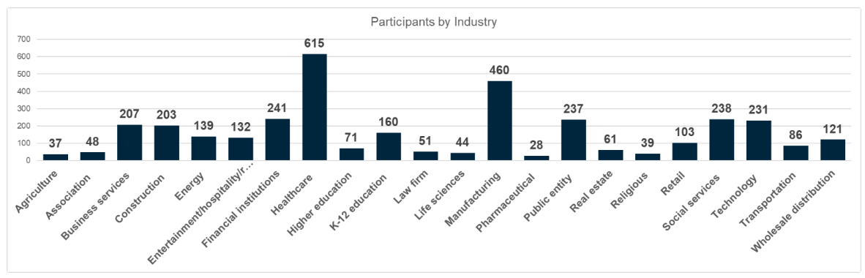
National Benchmarking Survey
Over 3,500 Participants!
*Source: Gallagher’s 2023/2024 National Benchmarking Survey.

Slide 14
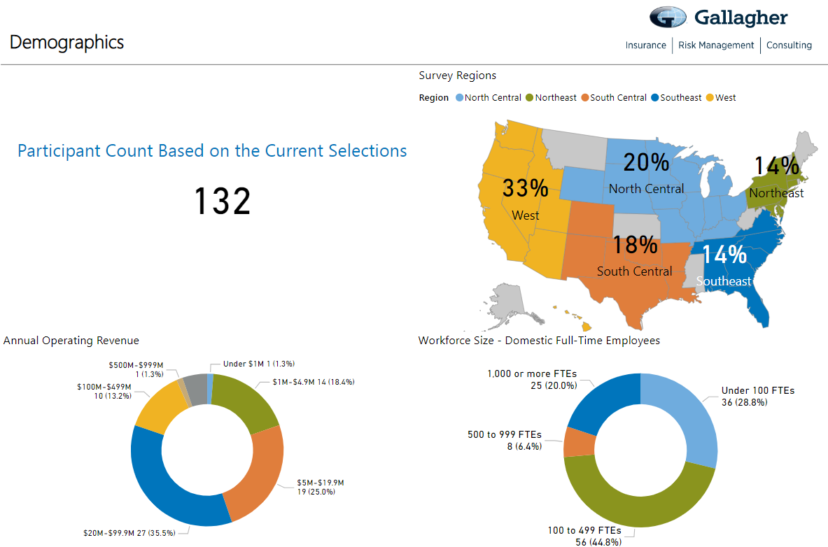

Slide 15
National Benefits Survey (NBS)
Survey Trends for Review and Discussion:
Turnover by Industry
HR Priorities by Industry
Engagement by Industry

Slide 16
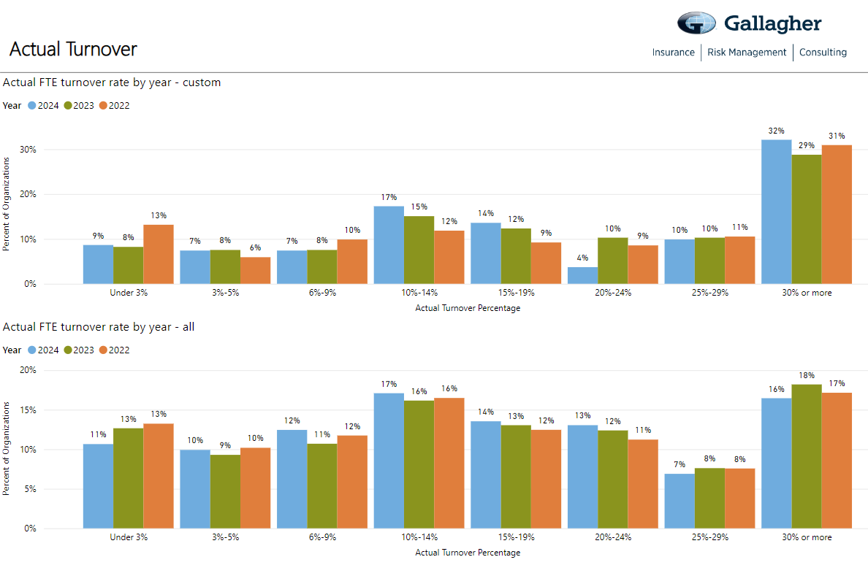
Entertainment/Hospitality
All Industries

Slide 17
Let’s Get Interactive: Turnover Rates
What is your turnover rate?
NOTE: the QR codes have to be created and added to the deck the week before the presentation.

Slide 18
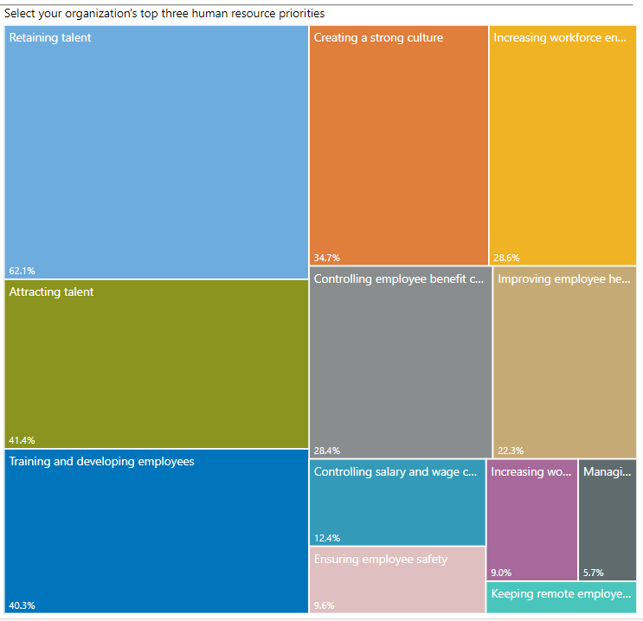
HR Priorities
All Employers – All Industries
Retaining Talent
Attracting Talent
Training & Development
Creating a Strong Culture
Increasing Workforce Engagement
Controlling Employee Benefit Costs
Improving Employee Health & Wellbeing
Controlling Salary & Wages
Ensuring Employee Safety
Increasing Workforce Inclusion & Diversity
*Source: Gallagher’s 2023/2024 National Benchmarking Survey.

Slide 19
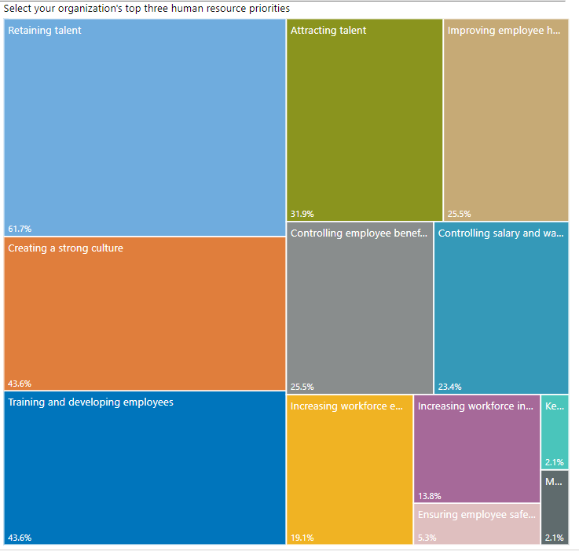
HR Priorities
Entertainment/Hospitality
Moved Up
Moved Down
No Change
Retaining Talent
Creating a Strong Culture (+3)
Training & Development (+3)
Attracting Talent (-1)
Improving Employee Health & Wellbeing (-1)
Controlling Employee Benefit Costs (- 4)
Controlling Salary & Wages (+1)
Increasing Workforce Engagement (+1)
Increasing Workforce Inclusion & Diversity (-2)
Ensuring Employee Safety (+1)
*Source: Gallagher’s 2023/2024 National Benchmarking Survey.

Slide 20
Interactive Activity
Instructions:
Partner up and take 3 minutes to discuss the following:
Do you agree the Survey Results reflect what you’ve seen in Entertainment/Hospitality?
Why do you feel there is a difference in Entertainment/Hospitality priorities vs. all other industries?
Are there any priorities you feel should have a higher or lower importance within the Entertainment/Hospitality?
After 3 minutes, I’ll ask for volunteers to share.
Entertainment/Hospitality HR Priorities
Retaining Talent
Creating a Strong Culture (+3)
Training & Development (+3)
Attracting Talent (-1)
Improving Employee Health & Wellbeing (-1)
Controlling Employee Benefit Costs (- 4)
Controlling Salary & Wages (+1)
Increasing Workforce Engagement (+1)
Increasing Workforce Inclusion & Diversity (-2)
Ensuring Employee Safety (+1)
*Source: Gallagher’s 2023/2024 National Benchmarking Survey.

Slide 21
Tactics Used to Improve Engagement
All Industries
Define clear
performance goals
Communicate with
trust and confidence
Support career path
Support career path
Provide performance-based recognition
Connect employees’
efforts to strategy,
mission, vision & values
Entertainment/
Hospitality Industry

Slide 22
Opportunities
Recognition
Strategy/Mission/Values
Notes:
Opportunities: career paths, succession planning development
Recognition: see below
Mission & values – do employees know and embody
erbal recognition: Simply expressing appreciation and acknowledging an employee's efforts in person or through a thank-you note can go a long way in making them feel valued.
Public recognition: Recognize employees in team meetings, company-wide emails, or newsletters to highlight their accomplishments and contributions.
Employee of the month/quarter/year: Establish a program to honor outstanding employees regularly, providing them with a certificate, trophy, or other tangible rewards.
Performance-based bonuses: Offer financial incentives or performance-based bonuses to employees who consistently exceed expectations or achieve specific goals.
Professional development opportunities: Provide employees with opportunities for growth and advancement, such as attending conferences, workshops, or training programs.
Flexible work arrangements: Recognize exceptional employees by offering flexible work hours, remote work options, or additional time off as a reward for their dedication and hard work.
Employee appreciation events: Organize social events, team-building activities, or company outings to celebrate and recognize employees collectively.
Personalized rewards: Tailor rewards to individual employees' interests and preferences, such as gift cards, personalized gifts, or experiences that align with their hobbies or passions.
Peer recognition programs: Encourage employees to recognize and appreciate their colleagues' efforts through a peer-to-peer recognition program, where employees can nominate and reward each other.
Promotions and career advancement: Recognize exceptional employees by offering promotions or opportunities for career advancement within the organization.

Slide 23
Interactive Activity – Let’s Boost Engagement!
Instructions:
Find a partner and get ready for an exciting brainstorming session!
Choose one of the following to focus on: Opportunities, Recognition, or Strategy/Mission/Vision.
Take 3-5 minutes to discuss and generate ideas on how we can enhance employee engagement
within your chosen topic in the entertainment/hospitality industry.
Think outside the box and focus on practical and actionable steps that can make a real difference.
Remember, this is your chance to be creative and innovative!
After 5 minutes, I may invite volunteers to share their brilliant ideas from each topic.
→ Don't be shy - let's inspire and learn from one another!
→ Get ready to make an impact on employee engagement!
Notes:
Engaging Employees in Hospitality: Opportunities, Recognition, or Mission & Values
Find a partner and get ready for an exciting brainstorming session!
Choose one of the following topics: Opportunities, Recognition, or Strategy/Mission/Vision.
Take 5 minutes to discuss and generate ideas on how we can enhance employee engagement
within your chosen topic.
Think outside the box and focus on practical and actionable steps that can make a real difference.
Remember, this is your chance to be creative and innovative!
After 5 minutes, I invite volunteers to share their brilliant ideas from each topic.
Don't be shy - let's inspire and learn from one another!
Get ready to make an impact on employee engagement!
Opportunities:
Implement a cross-training program that allows employees to gain experience in different departments, such as front desk, food and beverage, or event planning.
Offer specialized training programs for employees to enhance their skills in areas like customer service, conflict resolution, or event management.
Provide opportunities for employees to attend industry conferences, trade shows, or workshops to stay updated on the latest trends and best practices.
Create a mentorship program where experienced employees can guide and support new hires in their career development within the hospitality/entertainment industry.
Establish a career advancement framework that outlines clear paths for growth within the organization, such as moving from entry-level positions to supervisory or management roles.
Recognition:
Implement a guest feedback recognition program where employees are acknowledged and rewarded for receiving positive reviews or exceeding guest expectations.
Celebrate employee achievements and milestones, such as exceptional guest service, innovative ideas, or outstanding teamwork, through regular recognition events or ceremonies.
Provide personalized rewards or incentives for employees who consistently deliver exceptional guest experiences.
Encourage managers to regularly provide specific and timely feedback to employees, recognizing their contributions and efforts.
Organize team-building activities or employee appreciation events to foster a positive and supportive work culture within the hospitality/entertainment industry.
Strategy/Mission/Vision:
Clearly communicate the organization's mission, vision, and values to all employees, emphasizing the importance of creating memorable guest experiences.
Involve employees in the strategic planning process, seeking their input and ideas to align the organization's goals with their day-to-day operations.
Establish regular communication channels to keep employees informed about the progress and achievements related to the organization's strategic objectives.
Develop a recognition program that specifically acknowledges employees who embody the organization's values in their interactions with guests and colleagues.
Provide opportunities for employees to participate in community outreach programs or sustainability initiatives that align with the organization's mission and values.

Slide 24
Hot off the press!
2024-2025
Salary Planning
Survey
Notes:
Story about manufacturing company - fans

Slide 25
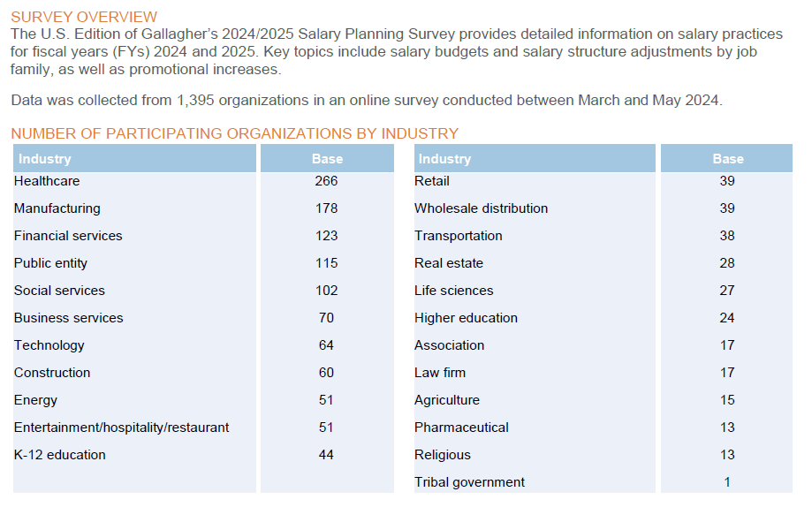
Salary Planning Survey
*Source: Gallagher’s 2024/2025 Salary Planning Survey.

Slide 26
Salary Planning Survey
Survey Trends for Review and Discussion:
Salary Increase Budgets (COLA, Merit & Other)
Promotional Salary Increase Budget
Salary Structure Increase

Slide 27
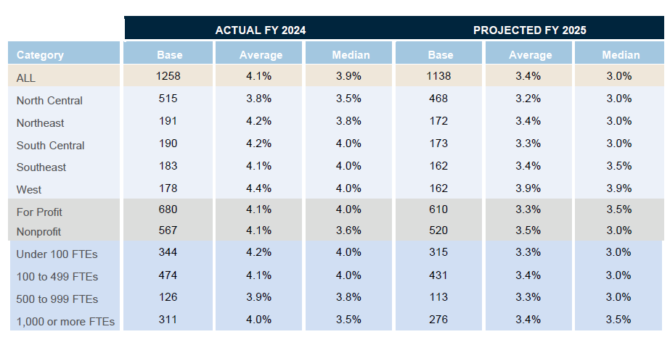
Salary Increase Budgets
Total Increase Budget for COLA, Merit & Other, Exempt Employees
*Source: Gallagher’s 2024/2025 Salary Planning Survey.
Notes:
Will salary increase budgets go down?
2023-2024: 4.0% → 3.5%
2024-2025: 3.9% → 3.0% (3.9% is 1/10th lower than last year actual & .5% higher than projected)

Slide 28
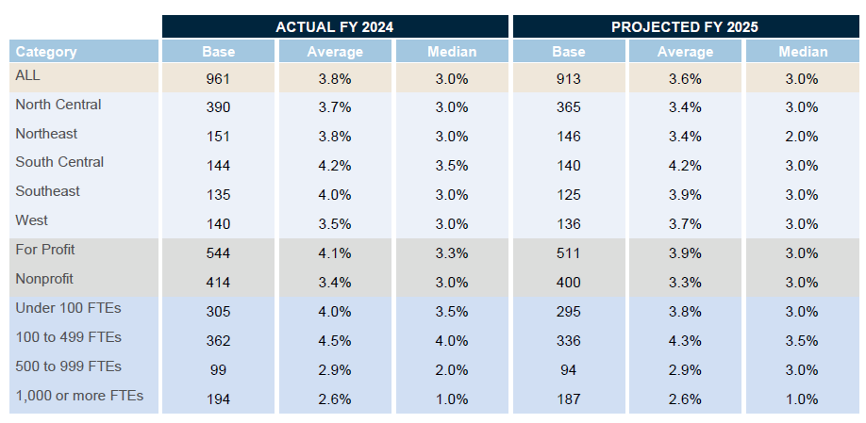
Promotional Salary Increase Budget
Total Increase Budget for ALL Levels, ALL Employees
*Source: Gallagher’s 2024/2025 Salary Planning Survey.
Notes:
Will salary increase budgets go down?
Same as last year

Slide 29
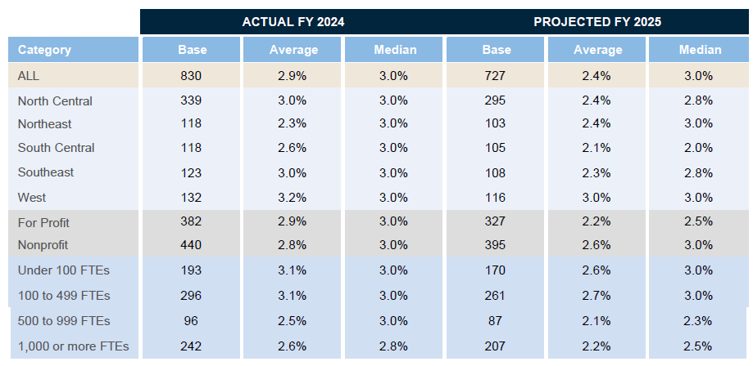
Salary Structure Increase
Total Increase to Salary Structure for Exempt Employees
*Source: Gallagher’s 2024/2025 Salary Planning Survey.
Notes:
Confirmed: Same as last year

Slide 30
Let’s Get Interactive: Salary Increase Budget
Where is your salary increase budget for 2024?
NOTE: the QR codes have to be created and added to the deck the week before the presentation.
Notes:
Will enter QR codes week before.

Slide 31
2024 Organizational
Wellbeing Poll
#1 Results
Time Away from Work
March 2024
Notes:
Story about manufacturing company - fans

Slide 32


2024 Organizational Wellbeing Poll #1
Time Away From Work
This survey was held from February 8 – March 1, 2024 with a total of 611 participants.
Employer participation by segment:
30%
<100
Employees
49%
100-1,000
employees
17%
1,000- 9,999
employees
4%
>10,000
employees
Survey Trends for Review and Discussion:
Most Common Types of Leaves
Paid Maternity
4-day Workweek

Slide 33

Types of Leaves
What types of paid leave programs does your company currently offer?
Most Common
45% 31%
Least Common
Caregiver Leave | 23%
Volunteer Leave | 22%
Unlimited PTO | 10%
Sabbatical Leave | 8%
Pawternity Leave (Pets) | 0%
Grandternity (Grandparent Leave) | 0%
54%
49%
29%
Combined PTO (Vacation and Sick time)
Separate Vacation and Sick time
Parental Leave
(baby bonding only)
Family Care Leave (policy covers bonding and care)
Military Leave (in addition to USERRA)
Gallagher Organizational Wellbeing Poll: Time Away From Work, March, 2024
AJG.com
Notes:
Parental and family care leave growing

Slide 34
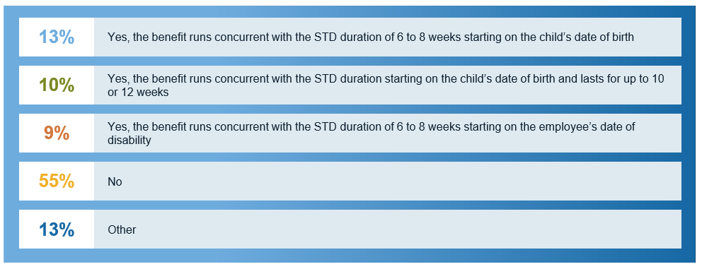
Maternity Benefit
Does your company offer a paid maternity benefit that provides 100% of total pay to the birth parent during the pregnancy disability period?
Gallagher Organizational Wellbeing Poll: Time Away From Work, March, 2024
Notes:
55% still do not pay for it; for Hospitality on NBS: 52% offer new child bonding leave.

Slide 35
4-Day Workweek
Does your company offer a 4-day workweek?
65% 22%
11%
2%
Yes, some colleagues can work a 4-day work week
Yes, all colleagues can work a 4-day work week
No, and not considering
No, but considering
Gallagher Organizational Wellbeing Poll: Time Away From Work, March, 2024
Notes:
35% allow it or considering it – do you all think this will be feasible to put in place in the future?

Slide 36
2024 Organizational
Wellbeing Poll
#2 Results
Generational Practices
May 2024
Notes:
Story about manufacturing company - fans

Slide 37
2024 Organizational Wellbeing Poll #2
Generational Characteristics
This survey was held from April 8 – May 3, 2024 with a total of 232 responders.
Responder Demographics:
33%
50%
15%
2%
Small Business
>100 Employees
Mid Market
100-999 Employees
Large Market
1,000-9,999 Employees
Jumbo Market
1,000-9,999 Employees
Survey Trends for Review and Discussion:
Largest Generations in the Workforce
Top Concerns by Generation
Leadership Trust

Slide 38




Four Generations
Working side by side
Baby Boomers
Born ~1946-1964
Gen X
Born ~1965-1976
Gen Y / Millennials
Born ~1977-1996
Gen Z
Born ~1997
Retirement – late career
Caring for elderly parent
Health issues
Adjusting to life as grandparent
Worried about having enough to retire
Value recognition
Financial rewards
Fair compensation
Work life balance
Respectful workplace
Face-to-face comms.
Structured workplace
Paying for kids’ college
Saving for retirement
Caring for both children and aging parents
Midlife challenges such as career changes, divorce, paying off debt
Flexibility | Work-life bal.
Autonomy
Provide opportunities to learn and grow
Align with their values
Family-life
Establishing careers
Starting families / getting married, having children
Home buyers
High cost of living
Burdened with student loans
Value purpose
Community/belonging
Social responsibility
DE&I
Flexible schedules
Virtual communication
Volunteer time
Starting careers
Social media pressures/ online bullying
Starting relationships seriously dating 1st time
Paying of student loans
Adulting
Managing mental health
Authenticity
Social impact
Entrepreneurial (Gig)
Opportunities for Development
Collaborative
Virtual communication
Notes:
So, we’ve talked about some of the negative stereotypes of workers and overcoming our assumptions and biases.
Go through key points….
We can talk about different generations anecdotally – but what is at the heart of this analysis is understanding where individuals are on their life journey. Different generations naturally deal with different life events than other generations. This isn’t a hard and fast rule, right? There may be boomers paying for their kids’ college tuition – or a millennial who may be providing caregiving for a parent or grandparent. These are event that are typically experienced by these generations.
We should keep in mind that there are life events that affect all generations such as grief and loss, traveling and exploring new things, the pursuit of education or professional development, buying a home, dealing with debt, experiencing disasters or major community events, health struggles, starting a new job or career for example.
The key to having a competitive advantage in this talent market is being able to tailor your total rewards approach, your HR program and delivery to the unique needs of the different cohorts within your organization. That means that we need to focus more now than ever before on the Employee Experience.

Slide 39
Your Workforce
What is the largest generation within your workforce today?
Gallagher Organizational Wellbeing Poll: Generational Characteristics, May 2024

Slide 40
Top People Concerns
What are the top people concerns for your organization’s leadership, overall and by generation?
54%
52%
52%
45%
44%
Employee engagement
Employee wellbeing
Building/ maintaining culture
Training & development
Manager effectiveness
OVERALL
43%
43%
39%
36%
35%
Attraction of new talent
DEI
Burnout
Exodus of top talent
Return to office
GEN Z
25%
Return to office
MILLENIALS
21%
Return to office
GEN X
22%
Exodus of top talent
BABY BOOMERS
23%
Exodus of top talent
Gallagher Organizational Wellbeing Poll: Generational Characteristics, May 2024

Slide 41
Leadership Trust
How would you describe the degree of leadership trust within your organization? Overall and by generation:
Gallagher Organizational Wellbeing Poll: Generational Characteristics, May 2024
Notes:
The older generations trust leadership more

Slide 42
Interactive Activity
Instructions:
Partner up and take 3 minutes to discuss the following:
Leadership trust increases with age. Why does this occur?
What are ways we can build trust with the younger generations?
  After 3 minutes, I’ll ask for several volunteers to share.
Notes:
The older generations trust leadership more – what are ways we can build trust with younger generations?

Slide 43
Taking Action!

Slide 44

Best Practice: Blending Qualitative & Quantitative Data
Creating a more complete picture to elevate the employee experience
External Workforce
Data
Quantitative workforce statistics
Internal
workforce
data
Engagement Surveys
Preference Surveys
Feedback Surveys
National Benchmarking Survey
Salary Planning Survey
2024 Pulse Surveys
Employment Details
Workforce Demographics
Compensation & Benefits
This Photo by Unknown Author is licensed under CC BY-SA

Slide 45
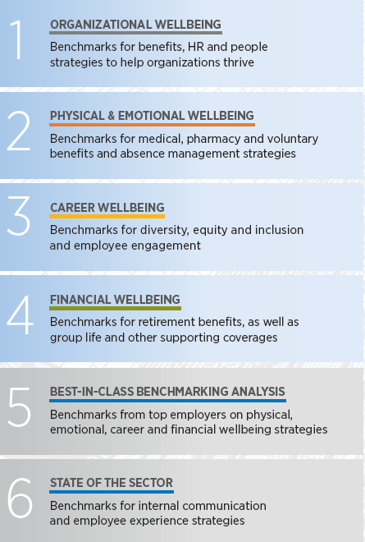


Workforce Trends Report Series
Report Launch Dates:
Contact me for Benchmarking
& Survey Data!
June 25, 2024
July 25, 2024
Sommer Mason, CCP
Regional Area Vice President
HR & Compensation Consulting
Sommer_Mason@ajg.com
Mobile: 225-290-0656
August 30, 2024
September 24, 2024
December 5, 2024
February 2025

Slide 46

46
Creating a Culture of Listening
How can we create a culture of listening in our organizations?
Notes:
We are going to give each table a question to answer and discuss as a group – and share thoughts.
What are the elements that go into creating a culture of listening:
What are some current barriers to effective listening within our organizations and how can we work to overcome them?
What strategies can we use to encourage employees at all levels of the organization to share their feedback and ideas?
How can we create a safe and inclusive environment where all voices are heard and valued?
How can we ensure that we are gathering feedback from a diverse range of employees and perspectives?
What specific action can we take to demonstrate to employees that we are truly listening to feedback and following up with meaningful changes?
How can we measure the success of our listening initiatives and ensure that we are continuously improving?

Slide 47
Creating a Culture of Listening
Critical for improving employee engagement, retention and overall business success
Open channels of communication
Act on feedback
1
4
Training for managers and leaders
Incorporate feedback into decision making
2
5
Foster safe environment
Recognize and reward employee for contributions
3
6
Notes:
Creating a culture of listening is critical for improving employee engagement, retention and overall business success. Some of the elements or factors that factor into creating a culture of listening include those listed here on this slide -
Create open channels of communication: Encourage employees to share their thoughts and feedback by providing multiple channels for communication such as suggestion boxes, feedback forms, town hall meetings, and anonymous hotlines. Make sure that these channels are easy to access and actively monitored.
Train managers and leaders: Equip managers and leaders with the skills to actively listen to their employees. This includes teaching them how to ask open-ended questions, how to show empathy, and how to encourage their team members to share their thoughts and ideas.
Foster a safe environment: Create a culture where employees feel comfortable sharing their thoughts and opinions without fear of retaliation or negative consequences. Encourage managers to create an environment where diverse perspectives and feedback are welcomed and valued.
Act on feedback: It's not enough to simply listen to feedback; companies must take action to address the concerns raised. Regularly communicate the steps being taken in response to feedback and involve employees in the process where appropriate. If changes cannot be made based on the feedback – it’s still important to understand and to show that you are listening. It’s important to be transparent with employees and explain why certain changes cannot be made, whether its due to budget, legal limitations or other factors. Maybe changes cannot be made immediately – but to show that there is a long term plan in place and communicate that long term plan to address issues will go a long way to developing trust and a culture of open communication.
Incorporate feedback into decision-making: Use employee feedback to inform business decisions and strategies. This will help employees feel valued and engaged, and it will also lead to better business outcomes.
Recognize and reward employees for their contributions: When employees feel like their opinions are valued and that they are being heard, they are more likely to feel engaged and invested in their work. Recognize and reward employees for their contributions and feedback to encourage a culture of listening.
By implementing these strategies, companies can create a culture of listening that fosters employee engagement, collaboration, and innovation.

Slide 48
Employer Response
The “worth it” equation for employees has changed
The path to ensuring your strategy and the efforts of your team are focused on the areas most important to your business and most relevant to your employees requires a multi-step Organizational Wellbeing approach.
Benchmarking
Healthcare Analytics
Compensation
Regulatory Environment/Compliance
Workforce Evaluation
People Insights
Healthcare Analytics
Generational Characteristics
Employee Engagement Surveys
Benefit Preference Surveys
Focus Groups
Organizational Wellbeing
Understanding Business Priority and Leadership Alignment
Communications
Employee Value Proposition
Leadership Development
Understand The Market
Know Your Workforce
Listen to Your Employee Voice
Align Strategic Priorities
Notes:
The path to ensuring that your efforts are focused on areas that most relevant to your employees is outlined here and includes everything we discussed today.
The first step is understanding the market and market trends.
The second is knowing your workforce – looking at your people insights, workforce demographics and general characteristics.
The third is creating a listening strategy to understand employee voice and creating a culture of listening and; finally –
The fourth requires alignment of those things into a strategy that ultimately enhances and elevates the employee experience.

Slide 49
Thank you!
Sommer Mason, CCP
Regional Area Vice President
HR & Compensation Consulting
Sommer_Mason@ajg.com
Mobile: 225-290-0656
HR & Compensation Support Services
Communication
Benefits (Total Wellbeing) Communication
Compensation Communication
Reward Communication
Retirement Communication
Internal Communication (IC)
Organizational Change Communication
Digital (Communication) Experience
Employee Value Proposition (EVP) Development and Communication
Personalized Portals
Microsites
Decision-support tools
HR & Organization Effectiveness
HR & Organization Effectiveness
Gallagher HRnow
Diversity Equity and Inclusion
People Operations (Policies, JDs, Leave)
Strategic Management, Culture and Change Consulting
Strategic HR Consulting
HR Gap, Audit & Compliance
HR on Demand
HR Outsourcing
Workforce Planning
Organizational Design and Team Effectiveness Consulting
Pre-Employment Risk Assessment
Career Transition
Succession Planning
HR Tech: Buy
HR Tech: Implement
HR Tech: Optimize
HR Tech: Strategy
HR Tech: Small Market Offering
HR Tech: UAT/OE Assistance
HR Tech: Market Check
HR Tech: Contract Reviews
HR Tech: AI Consulting
Multinational
Benefits &
Mobility
People Data
& Insights
Multinational Benefits & Mobility
Global Benefits Management
Global Benefits Philosophy & Strategy
Multinational Pooling / Global Underwriting / Captive
Benefits Benchmarking
GVISORTM
PEO/EOR Strategy
Global Retirement & Actuarial
Global M&A
Global Risk Solutions
Integrated Duty of Care
International Pension / Savings Plans
Global Mobility Solutions
Global Mobility Program Design, Consulting & Benchmarking
Full Outsourced Assignment Planning and Preparation
Communication
People
Development
Compensation & Rewards
People Data & Insights
Employer Research & Insights
People & Workplace Experiences
Employer Surveys & Benchmarking
Search
People Analytics
Benefits Benchmarking / Preference
Custom Compensation Surveys
People Development
Assessments
Leadership and Personal Development
Sales and Sales Leadership Development
Digital Learning
Coaching
Digital Coaching / Development Platform
Business Simulations
Compensation & Rewards
Assessment Portal
Learning Management System / Learning Experience Platform
Career Development / Career Management
Competency Framework Development
Instructional Design
Executive Compensation
Specialized Comp & Class Industries
Sales Compensation
Online Total Rewards
Pay Equity/Gender/Ethnicity
Market Pricing Platform
Pay Benchmarking
Pay Program / Practices / Structures
Incentive Design
Compensation & Reward Strategy
Job Measurement / Leveling
Job Architecture
Corporate Governance - Compensation Committee
Board of Directors Compensation (Board Level)
Search
Executive Search
HR Search
On-Demand CXO
Contingent Workforce
Public Sector Search and Staffing
Service Add-Ons (CEO Succession Planning, Board/Governance, Integration Projects, etc.)

Slide 50
Thank you!
Contact me for survey data!
Sommer Mason, CCP
Regional Vice President
HR & Compensation Consulting
Sommer_Mason@ajg.com
Mobile: 225-290-0656

