Slide 1


28th Annual Conference Resilient Leadership – Change Your Mindset, Change Your Outcome
September 23-25, 2024
Durant, Oklahoma

Slide 2


AGENDA
What are stressors?
What is resilience?
How do I build resilience?
Setting ourselves up for success – Resilient leadership is servant leadership
Resilience resources

Slide 3


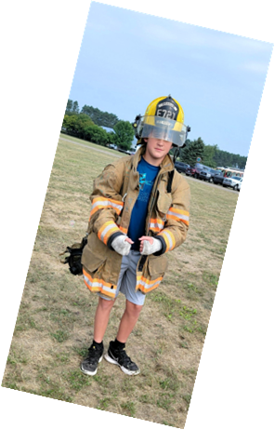
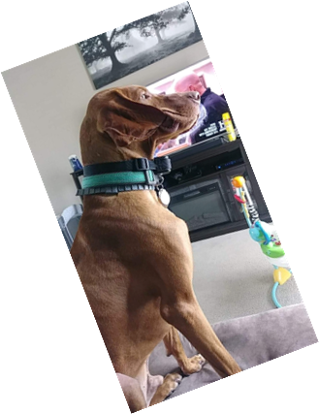

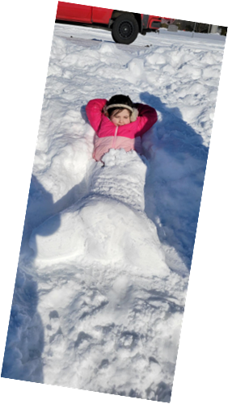


Introduction
Dad joke enthusiast to 5 unamused kids, a Vizsla & a Morkie.
Director of Licensing & Investigations with Mille Lacs Band of Ojibwe - Gaming Regulatory Authority.
Mayor of the City of Braham, MN (Pop: 1,850).
Master Sergeant, U.S. Air Force
THRP certified
U.S. Air Force certified Resilience Trainer
3 college degrees (Criminal Justice, Law Enforcement & Business Management), and another in-progress (Master of Law)
3x Combat Veteran

Slide 4
What are stressors?
Things in life that have a positive or negative effect on us mentally - which we need to build resilience to

Slide 5
“You are your own worst enemy”

Slide 6
Types of stressors
Positive
Negative
Marriage/engagement/new relationships
Promotion
New job
Birth or adoption of a child
Recognition/awards
New home
Failed relationships
Disciplinary action/job loss
Debt
Overwhelming parental duties
Loss of someone close
Current events

Slide 7
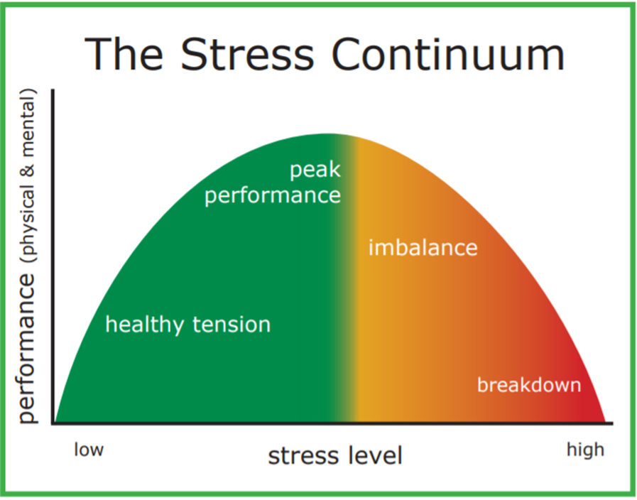
Positive stressors
Good things that happen
Still add stress due to increased expectations or responsibilities
Eustress is good stress that helps our immune system and productivity

Slide 8

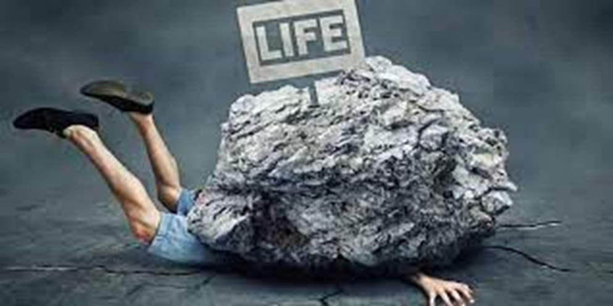


Negative stressors
Negative things that happen that cause additional stress due to feelings of anger, frustration, feeling hurt or burnt out
Distress causes harmful effects on our body/mental state

Slide 9

Rocks are naturally resilient
Some of the most beautiful rock formations exist because of the way the environment around them shaped them
They look different than how they started, but they still exist!
This is because of their natural resilience to the stresses that changed them
Weather the storm, come out changed on the other side
What you do with the change is up to you!

Slide 10
What is Resilience?
A mental state which blocks out, or enables the diversion from, the tendency to focus on the negative

Slide 11
“What you go through, you will grow through”
-Marcus Taylor
Resilience is a state of mind, a choice to push forward rather than lie down and accept defeat
Despite this, I will carry on!

Slide 12
Ways to build Resilience
Focus on the things you CAN control
Exercise
Make time for your favorite activity or hobby (do you!)
Simplify your life
Is your plate too full?
Focus on the positive not the negative, laugh whenever possible
Practice deep breathing, pause and collect yourself
Focus on the here and now
Don’t dwell on what is already in the past
Don’t dwell on what is yet to come
Learn your lessons then move on “No regerts!!”
Make time for relaxation
Never be afraid to reach out for support when you need it
Others might have similar experiences to help you through
Do not dimmish the value of counselling

Slide 13
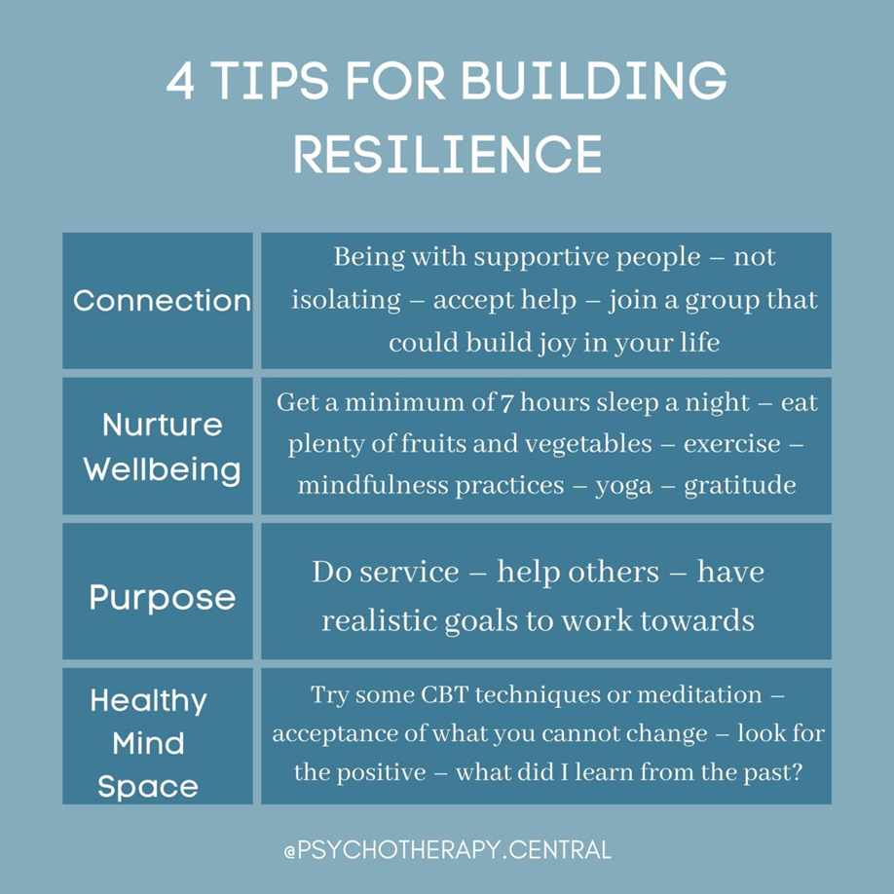
Make the choice, choose resilience…
No one can build it for you. You have to choose to want to be resilient and bounce back from difficult times.
Look inside yourself, what personal struggles have you grown through already?

Slide 14
Resilient Leadership
having resilience as a leader, will open the path to being a servant leader

Slide 15

Understanding Servant Leadership
Servant leaders support and elevate their people
Servant leaders see “team members” rather than “employees”
Servant leaders ask “How can I help you be successful?”
Career development plans & quarterly check-ins
“Where do you want to be?”
“How can I help you get there?”
Servant leaders seek out barriers to your team’s success, then remove those barriers

Slide 16
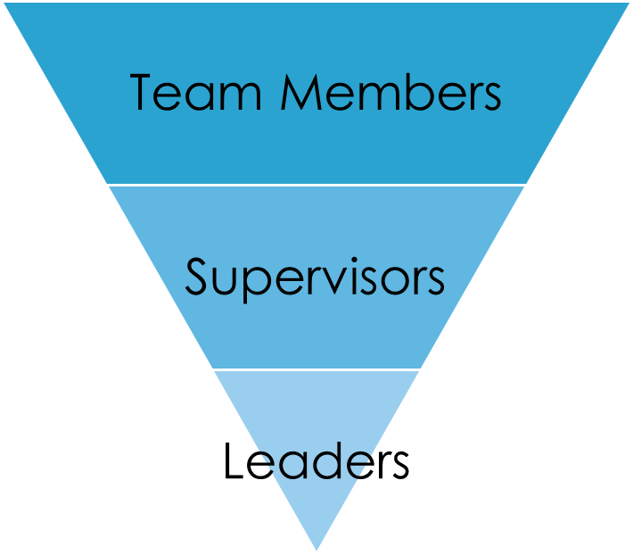
Using resiliency to be a servant leader…
Showing compassion and empathy when team members are feeling frustrated, lost or dealing with their own stressors
Never being afraid to step in and help out to lighten the load
Accepting change and being a champion for it, rather than resistant to it
Leading the charge, being the first to make adjustments then helping the team with theirs
Understanding and identifying signs of stress, proactively managing them among your team
Staying focused on the mechanism within your control to make whatever improvements you can to your processes
Turn failures into growth opportunities

Slide 17
Resilience Resources
Stress relief and mental health apps
Websites
Mindful.org
Resiliencyresources.com
Theresilienceresource.org (resiliency calculator)
National Suicide Hotline
1-800-273-8225
My personal cell
651-276-1948 (call anytime, I mean it!)

Slide 18

Resilience Mindset
#MarcusElevationTaylor, #Motiversity, #ResilienceMindset
Credit: https://www.youtube.com/motiversity

Slide 19

THANK YOU!
Nathanial W. George
gigeorge2@hotmail.com
Linkedin:
https://www.linkedin.com/in/nathanial-george-16149491

