Slide 1


28th Annual Conference
September 23-25, 2024
Durant, Oklahoma

Slide 2



Retirement plan services
Wellness@Work: Renewing confidence, recharging retirement
Kirk Buchanan
Josh Green
Vice President
Workplace Solutions
Tribal Markets
Vice President
Workplace Solutions
Tribal Markets
Tribal Sovereign Nations, Tribal Enterprises, and Alaska Native Corp. Retirement Plans
September 2024
LCN-5821723-071923
For plan sponsor use. Not for use with plan participants.
©2024 Lincoln National Corporation
2
Notes:
Hi, my name is [Presenter Name], and today I’m going to share the latest research on how employees feel about retirement saving — and how employers can help reengage their workforce.

Slide 3

Today’s agenda
Study overview
The state of retirement savings
How to motivate employees to save more
Using plan design to boost outcomes
Notes:
I’m going to share findings from our 2023 Wellness@Work survey, along with key strategies for improving retirement outcomes and motivating positive actions.

Slide 4

Study
Overview
Notes:
Let’s get started!

Slide 5

2023 Wellness@Work Study
Based on a national survey of 2,604 full-time workers who were eligible to contribute to an employer-sponsored retirement plan, including 2,104 participants and 500 non-participants. Greenwald Research, a third party market research firm, conducted the study on behalf of Lincoln Retirement Plan Services. Online interviewing took place from February 16 to March 14, 2023. Similar surveys were conducted in 2012, 2015, 2017, 2019, and 2021. Unless otherwise noted, all information provided in this presentation is from the 2023 Wellness@Work Study.
The goal? Gain insight into:
The impact of the current economic climate on participation and contributions
Ways to drive contributions and motivate saving
Impact of financial wellness programs
Interest in guaranteed income products
Participant savings behaviors and trends
Notes:
To better understand the challenges facing today’s retirement savers — and to help identify effective solutions — we conducted the Wellness@Work survey.
We retained Greenwald Research to conduct 18-minute online interviews with 2,604 full-time workers, including 2,104 participants and 500 non-participants. Similar surveys were conducted in 2012, 2015, 2017, 2019, and 2021.
Our goal was to gain insight into:
The impact of the current economic climate on participation and contributions
Ways to drive contributions and motivate saving
Impact of financial wellness programs
Interest in guaranteed income products
Participant savings behaviors and trends

Slide 6
What we learned
Challenge:
Solution:
Preparing for retirement has become more challenging in today’s economic climate
Plan design, benefits, and a personalized approach to education can help boost retirement outcomes amidst challenges
Equip employees to make confident decisions
Facilitate goal-setting
Help employees manage competing financial priorities
Make communication and education more personal
Leverage the power of plan design
Less discretionary income
Less confidence about making decisions
Concerns about investment performance
Notes:
Given the current economic climate, employees are having a hard time saving for retirement. The top challenges they face are less discretionary income, less confidence about making decisions, and concerns about investment performance.
However, we found that plan design, workplace benefits, and a personalized approach to education can help improve retirement outcomes despite these challenges. It’s important to empower employees to make confident decisions, facilitate goal-setting, help them manage competing financial priorities, make communication and education more personal, and leverage the power of plan design.

Slide 7
The state of retirement savings
Notes:
Let’s take a look at the state of retirement savings.

Slide 8
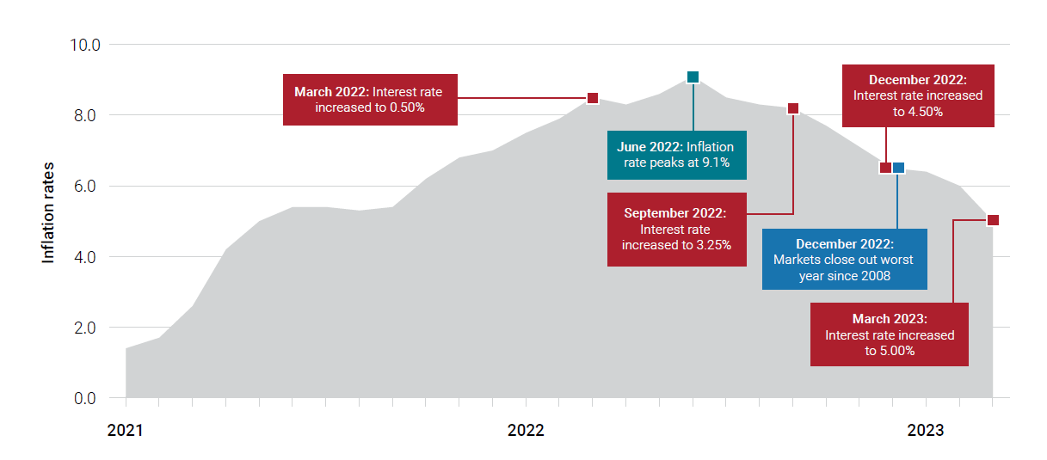
Consumers have been impacted by inflation, market fluctuations, and rising interest rates
Source: Tepper, Taylor, “Federal Funds Rate History 1990 to 2023,” Forbes Advisor, October 17, 2023, https://www.forbes.com/advisor/investing/fed-funds-rate-history/.
Notes:
In March 2023, we took the pulse of participants and non-participants and saw the dramatic effects of a turbulent 2022. Inflation, market fluctuations, and economic uncertainty had a cumulative effect on confidence and behavior, as you can see in this timeline.

Slide 9
Rising prices have impacted savers and non-savers. What percent of people who don't save in their workplace retirement plan say they used to contribute, but had to stop in the past year?

Slide 10
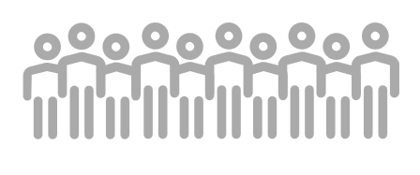
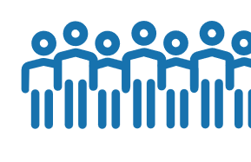
Contribution rates and confidence are down amidst a challenging economic climate
Contribution rates
More than 2/3 of participants
are saving less than they think they need to save to be on track.
14% of those who don't save in their workplace retirement plan say they used to contribute but had to stop in the past year.
Notes:
Rising prices and unsteady markets left savers and non-savers shaken. Unsurprisingly, our survey revealed a significant drop in contribution rates since 2021 after years of rising rates. Participants want to be saving more--68% say they're saving less than they think they need to save to be on track. And 14% of those who don't save in their workplace retirement plan say they used to contribute, but had to stop in the past year. We've also seen a decline in retirement confidence.

Slide 11
Contribution rates and confidence are down amidst a challenging economic climate
Participants who are extremely or very confident on all 3 key retirement readiness metrics¹
¹ The three key retirement readiness metrics are 1) having enough money to maintain the lifestyle you want in retirement, 2) being able to accumulate enough money so you can retire when you want to, and 3) being able to convert your savings into income when you retire that will last the rest of your life.
Notes:
Each year, we measure retirement confidence using a combination of three key aspects of retirement--ability to retire when you want, being able to maintain the lifestyle you want in retirement, and having income to last throughout your lifetime in retirement. In 2019, only 35% of participants felt highly confident about retirement. In 2021, in the wake of the pandemic, confidence dropped to 29%. And in 2023, amidst a challenging economic environment, confidence fell even further to 22%.

Slide 12
Rising prices have impacted savers and non-savers. What two factors intensified by the current economic climate are keeping people from saving for their future?

Slide 13

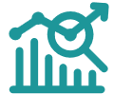
The economic climate has intensified two factors
1
Competing financial priorities
Inflation and rising interest rates
Percentage of people with debt, especially credit card has increased.
2
Lack of decision-making confidence
Less than a quarter of consumers are very confident about knowing how market volatility or inflation affects their plans or accounts.
Notes:
The current economic climate has intensified two factors: competing financial priorities and a lack of decision-making confidence. Employees with more competing financial priorities (including debts and other savings goals) are less likely to save enough for retirement. Inflation and rising interest rates further limit employees’ discretionary income. Over the past two years, the percentage of people with credit card debt and other types of debt has increased.
Employees who feel confident making decisions in their plan have better outcomes, but fewer employees are feeling confident. Investing decisions that worked in the past amidst low interest rates and relatively stable rising markets aren’t as effective in today’s environment. Less than a quarter of consumers are very confident about knowing how market volatility or inflation affects their accounts.

Slide 14
The economic climate could have a lasting impact
of participants who say they save less than needed to be on track cite inflation as the reason
of participants say 2022 investment performance made them concerned about putting more money in this year
77%
49%
of participants who save less than needed say it would be difficult to save more
of participants are very confident knowing how market volatility and inflation impacts their plan/accounts
65%
24%
Notes:
[Read slide.]

Slide 15
How to motivate employees to save more
Notes:
Given these challenges, let’s see what employees said would motivate them to save more.

Slide 16
What are some factors that would motivate employees to save more for their futures?

Slide 17
To motivate savers, first understand their financial situation
Top factors that would motivate employees to save more
Notes:
Last year we asked employees what would motivate them to save more (or start saving) for retirement, and this year we had them rank their motivators. The top two saving motivators chosen by employees in the survey were:
Having a clearer vision of the retirement lifestyle I could afford if I increased contributions
Feeling more confident about saving and investing decisions
More than half of employees in the survey cited these as motivating — even those who said it would be difficult to save more. However, it’s important to note how the motivators vary between the two groups. Almost half of those who would find it hard to save more would be motivated by a plan to reduce debt and build an emergency fund.
Both groups would be motivated by education on key topics that can help drive confident decision making, and online tools can estimate retirement income and show how increasing contributions may positively impact long-term savings.
For participants who said they’d find it hard to save more, we need to give them tools to manage everyday expenses and debt so they can better afford to save for retirement. Shorter-term goals, like paying down debt or saving for emergencies, may seem more doable right now to this group. Smaller wins can be motivating.
Participants who can more easily save more could be encouraged to set larger, specific savings goals. One-third of this group would be motivated by tracking their progress, so we need to make sure that’s easy for them.

Slide 18
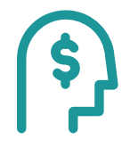
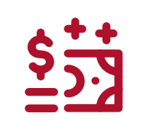
More confidence = better outcomes
More confidence = Motivation to save
More confidence = Higher savings
“Feeling more confident about saving and investing decisions” is one of workers’ top motivators, with half (50%) listing it as one of the top 3 things that would motivate them to save more or start saving.
Participants who are confident about making decisions in their plan are 2x more likely to be contributing 15%+.
Notes:
Confidence is key. Not only does it provide a strong motivation to save, but it also can drive higher contribution rates. Participants who are confident about making decisions in their plan are two times more likely to be contributing 15% or more. Feeling confident about decisions can empower employees to take positive actions in their plan.

Slide 19
What percentage of workers are interested in working with a retirement consultant as part of their employee benefits?

Slide 20
Education can help boost confidence about retirement decisions
Sixty-two percent of workers would like to receive education on topics they’re less confident about.
Eighty-two percent of workers are interested in working with a retirement consultant (or already do) [up from 77% in 2021].
Confidence on aspects of retirement plan/savings
Among all workers (% very confident)
Saving and investing
Impact of the current economy
Managing through retirement
Account management
Notes:
Empowering confident decision-making can help increase participant success. And employees told us where we can focus our education efforts. Investments, retirement income, and market volatility are key topics they need to understand more — but as you can see, confidence is low for every aspect we asked about. Employees also told us they want help. Sixty-two percent want education on topics they’re less confident about, while 82% are interested in working with a retirement consultant or financial professional. In this survey, the term “retirement consultant” was used to represent personal help from a financial professional — someone who could meet one-on-one to help them enroll in the plan or make plan changes, answer retirement savings questions, and provide education about retirement planning.

Slide 21
Unrelated Trivia Question #1 How many total people are fluent speakers of the Choctaw language??

Slide 22
Answer: Unrelated Trivia Question #1 The Choctaw language is a member of the Muskogean family which includes the Muskogee, Chickasaw, Mikasuki, Seminole, Alabama, and Koasati tribes. The Mississippi Band of Choctaws has about 5,000 fluent speakers and the Choctaw Nation of Oklahoma has 4,000-plus. The Choctaw language is also spoken in Louisiana by two state recognized tribes: the Clifton Choctaws and the Jena Band.

Slide 23
Answer: Unrelated Trivia Question #1 Halito = Hello Yakoke = Thank you

Slide 24

Benefits education, decision-making, and enrollment
Employees want to understand their benefit choices
Helping employees properly allocate their limited dollars across all employee benefits can help promote financial wellness, improves employee hiring and retention, and benefits Tribal governments and their citizens.
Notes:
Telling someone to save, save, save in their retirement plan might sounds like a good idea on the surface. But, a single parent with 4 children probably has a different set of priorities. Like disability insurance for example. If something happens and she can’t work, she’ll be taking hardship distributions or a loan from her 401k and negatively impacting her financial future.

Slide 25
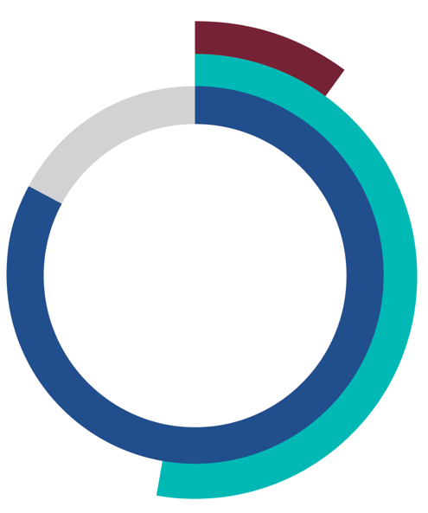
Boosting decision-making confidence can better equip workers to make changes
10%
Made changes related to retirement planning
83%
Reevaluated life/finances due to events of 2022
53%
Have taken action in response
Boosting decision-making confidence can empower workers to make changes
Notes:
Eighty-three percent of workers say they reevaluated their finances, lifestyle, work/career, and retirement expectations over the past year — slightly higher than the percentage of people reevaluating their life and their finances in 2021 amidst the pandemic. Two-thirds of all workers who reevaluated took some action — that’s 53% of all workers total. The top change people made in response to reevaluating was changes to financial habits, but only 10% said they made changes related to retirement planning. How can they if they don’t feel confident deciding what actions to take?
The willingness to take steps to change financial habits presents a significant opportunity. If we can effectively educate employees and help them feel more confident about retirement plan decision-making, they may be willing to make changes that can help them better prepare for the future.

Slide 26
What personal finance factors make it difficult to save?

Slide 27
Personal finance factors make it difficult to save
of workers have at least three competing financial priorities in addition to saving for retirement.
82%
44%
have five or more competing financial priorities.
60% say their debt is a problem.
58% have credit card debt.
35% spent some or all the money they had in an emergency fund in the past year.
34% incurred major or moderate medical expenses over the past several years; 17% have medical debt.
33% of millennials and Gen Z have student loan debt.
Eighty-three percent of workers say finances contribute to their stress, including 47% who say it’s a major or biggest factor of stress.
Notes:
Although they want to take action, personal finance factors can make it difficult for some employees to save. The majority have competing financial priorities and debt. More than a third have spent emergency fund money and incurred medical expenses. It even impacts their well-being. Eighty-three percent say finances contribute to their stress, including 47% who say it’s a major or the biggest factor.

Slide 28
What percentage of workers who have student loan debt wish their employer provided a student loan management service along with their retirement plan ?

Slide 29
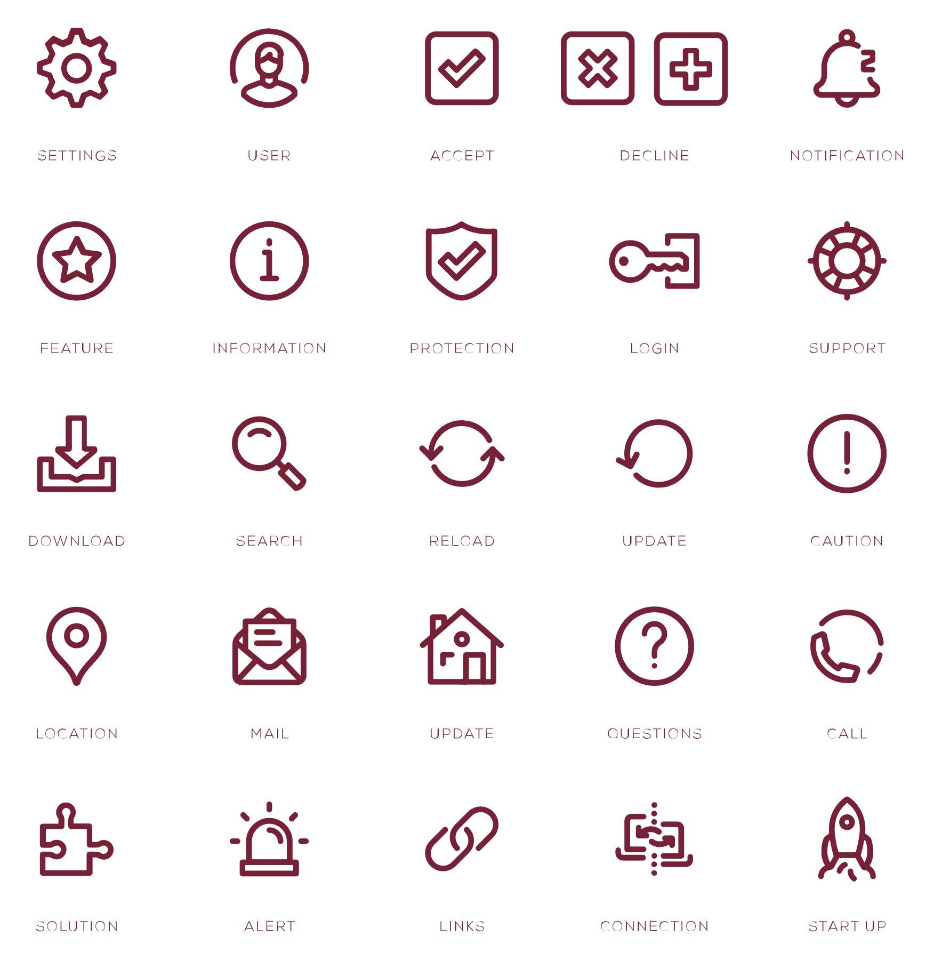
Employees are interested in solutions to tackle competing priorities
of workers who have student loans are interested in a student loan management service offered through their employer or plan provider.
83%
Eighty-five percent of workers are interested in receiving a long-term financial plan from their plan provider or employer.
of workers are interested in an emergency savings account offered through their employer/plan provider.
80%
The top 3 aspects workers found most appealing in a long-term financial plan:
A retirement income plan
A plan for short-term, medium-term, and long-term financial goals
A plan for managing debt
Nearly 9 in 10 workers are interested in supplemental health benefits (critical illness insurance, hospital indemnity insurance, or accident insurance).¹
¹ Lincoln, Wellness@Work: Group Benefits, 2022.
Notes:
The good news is that employees are interested in solutions that will help them manage competing financial priorities, and they’d like them from their employer or plan provider. A large majority are interested in an emergency savings account and supplemental health benefits. Employees with student loans are looking for student loan management services. Eighty-five percent would like a long-term financial plan, including retirement income, financial goals, and debt management. They also expressed interest in a net worth analysis, assessment of insurance needs, and estate planning. Offering them solutions may help them become successful savers.

Slide 30
Successful savers set goals, envision retirement, and discuss
Actions | Likely to be confident about retirement | Likely to contribute 15%+ to a retirement plan | Have a higher median deferral rate
Set a retirement savings goal | 4.5x more | Nearly 3.5x more | 2x higher
Envision an ideal, yet realistic, retirement | 2.9x more | Nearly 2x more | Nearly 2x higher
Discuss retirement with spouse/partner | 6.2x more | Nearly 3x more | Nearly 2x higher
Goal-setting help …
Employees who say it would be easy to save more:
More specific goals
Better able to track progress
Employees who say it would be difficult to save more might benefit from shorter-term goals to aim for and celebrate.
Notes:
Our research has shown that setting goals, envisioning their ideal retirement, and discussing their retirement vision with their partner are all habits of successful savers. Employees who take these actions are more likely to be confident, contribute 15% or more, and have a higher median deferral rate.
As we discussed earlier, employees shared what would motivate them to save more for retirement—and those motivating factors changed based on how easy or difficult it would be for individuals to save.
Participants who can more easily save more could be encouraged to set larger, specific savings goals. One-third of this group would be motivated by tracking their progress, so we need to make sure that’s easy for them. For participants who said they’d find it hard to save more, we need to give them tools to manage everyday expenses and debt so they can better afford to save for retirement. Shorter-term goals, like paying down debt or saving for emergencies, may seem more doable right now to this group. Smaller wins can be motivating.

Slide 31
Wellness tools at the workplace help people set goals, tackle competing priorities, and make more confident decisions. What percent of workers who used wellness resources at work saw a positive impact?

Slide 32
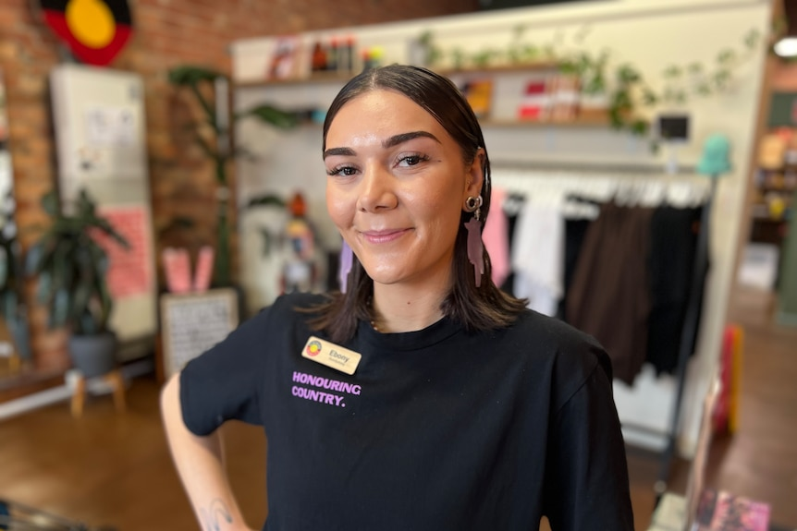
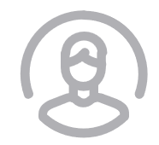
Wellness tools help savers set goals, tackle competing priorities, and make more confident decisions
Seventy-seven percent of workers
who used wellness resources saw a positive impact; 21% saw a significant positive impact.
Financial wellness tools =
Less financial stress
More confident decision-making
Feeling more educated
More likely to increase savings
Notes:
We can see that employees want and need help with financial wellness. Financial wellness tools offer an effective solution. People who use financial wellness resources report positive outcomes.
Financial wellness tools can lower stress.
- 69% of participants who’ve used financial wellness tools say they’ve helped reduce the amount of stress they feel about finances.
Financial wellness tools can increase confidence in decision-making.
- More than half of participants who’ve used financial wellness tools say they’re highly confident about making decisions in their retirement plan.
Financial wellness tools can create positive feelings about their employer.
- Participants who’ve used financial wellness tools are 2x more likely to say their employer does a good job educating them about saving for retirement.
Financial wellness tools can drive contribution increases.
- 30% of participants who’ve used financial wellness tools increased their retirement plan contributions in the past year.

Slide 33
Unrelated Trivia Question #2 What language was listed in the 1992 edition of the Guinness Book of World Records as the most complex language in the world?

Slide 34
Answer: Unrelated Trivia Question #2 The parent language of Potawatomi, Ojibwe, was listed in the 1992 edition of the Guinness Book of World Records as the most complex language in the world based on the number of verbal patterns. Potawatomi and Ojibwe have a similar structure and one of the identifying characteristics of Potawatomi is that it is heavily verb-based. Nouns are made of several smaller words that describe what the object does or how it’s used. In 2017, there were fewer than 10 first-language Potawatomi speakers and many were nearing 70 to 80 years old. In response, many Potawatomi tribes have created language programs where students can learn the Potawatomi language wherever they live.

Slide 35
Answer: Unrelated Trivia Question #2 Migwéch = Thank you

Slide 36
Benefits education, decision-making, and enrollment
Employees want to understand their benefit choices
Financial wellness is not about making one person wealthy.
It’s about helping the entire community build financial security.

Slide 37

Personalization continues to be important for effective outreach and education
It means:
Advice based on specific needs
A plan specifically for me
Step-by-step guide
Pertains to my particular situation
Dedicated financial advisor
Answers to my questions
Financial education resources
Someone I can trust
Understand my goals
Investment help
Retirement planning help
Help managing debt and savings
Support directly related to my personal financial goals and targets, not generalized guidance
Talking to a person is more personalized
Relationships matter
When asked what personalized means, employees’ answers fell into four categories:
A tailored plan for my unique needs
Getting the right type of help
Individualized assistance
Communication on my terms
©2024 Lincoln National Corporation
37
Notes:
The top reason people don’t use wellness programs? They prefer more personalized help. When asked what personalized means, employees’ answers fell into four categories: a tailored plan for my unique needs, getting the right type of help, individualized assistance, and communication on my terms. Specific examples of what consumers are looking for when they ask for personalized help are included on the right side of the slide. When we dig deeper, the desire for personalized, custom help directly related to their situation comes up again and again.

Slide 38
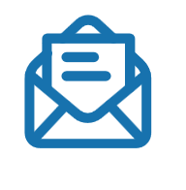
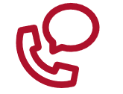
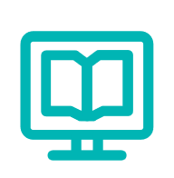


Effective outreach leverages a variety of communications
Top 3 preferences by generation
Gen Z
Millennials
23% – Sent to me by email
18% – Talk to rep by phone (or virtual call)
15% – Online educational articles/videos
22% – Sent to me by email
17% – Online educational articles/videos
16% – Talk to rep by phone (or virtual call)
Gen X
Baby Boomers
19% – Sent to me by email
16% – Talk to rep by phone (or virtual call)
15% – Online interactive tools, calculators
21% – Talk to rep by phone (or virtual call)
19% – Hard-copy materials mailed to me
16% – Sent to me by email
Notes:
23When asked their top preference for how they’d like to receive education from the provider, answers vary by generation and there is no clear top choice. As you can see, even the most-selected preferences listed on the slide were chosen by less than a quarter of participants. Effective outreach to employees requires a multi-faceted approach leveraging a variety of communication channels and tactics.

Slide 39
What are some life events that would motivate non-participants to start saving?

Slide 40
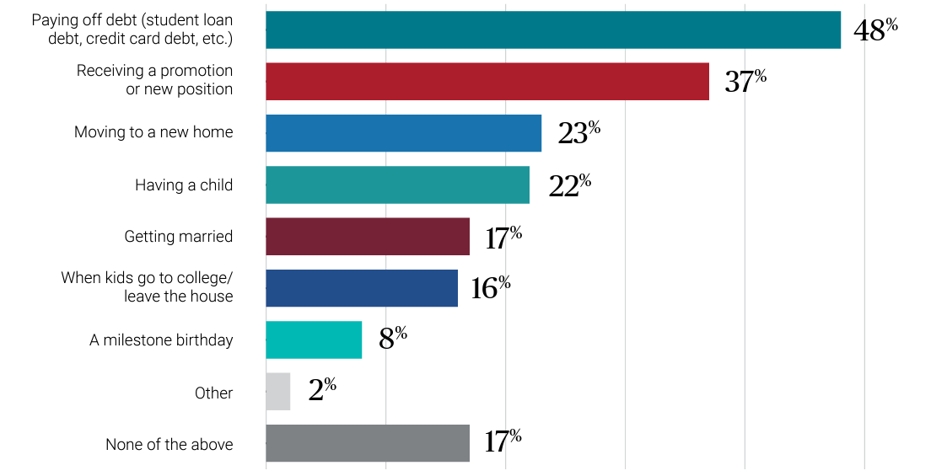
Employees think about retirement planning during personal and professional milestones
Life events that would motivate non-participants to start saving
Notes:
Milestones — both financial and personal — can motivate non-participants to start saving. Financial wellness plays a strong role here. Forty-eight percent of non-participants said paying off debt would motivate them to enroll in the plan, while 83% would be motivated by one or more of the milestones in this chart.

Slide 41
Using plan design to boost outcomes
Notes:
Now let’s look at how plan design features can help drive outcomes.

Slide 42
Answer: Unrelated Trivia Question #3 What is the most commonly spoken Native language in the U.S.?

Slide 43
Unrelated Trivia Question #3 Navajo is the most commonly spoken Native language in the U.S. with approximately 175,000 speakers. Almost 10x as many speakers as each of the two languages with the next highest numbers: Yupik and Sioux. Navajo is in the Athabaskan language family, which includes 44 languages spoken in the U.S. and Canada. In 2013 the move Star Wars was translated into Navajo.

Slide 44
Unrelated Trivia Question #3 Ahéhee = Thank you

Slide 45

Boost retirement plan participation
Retirement plans such as 401(k) and 401(a) plans, along with other employee benefits, help Indian Country compete with corporate America for talent.
Notes:
While the concept of “retirement” may not appeal to everyone in the same way, many people have no idea how they will pay for expenses later in life when they are no longer able to work.
Studies show that most people no little or nothing about their employee benefits and are struggling with their personal finances.
Increasingly, employees are looking to employers in corporate America for financial products such as retirement plans, medical insurance, and protection benefits. In order to compete for talent, employers in Indian Country must consider offering these solutions as well.

Slide 46
What percentage of non-participants wouldn’t mind if their employer auto-enrolled everyone not currently in the plan?

Slide 47



Consider a reenrollment campaign to boost participation
Almost two-thirds (62%) of non-participants would likely stay in the plan if their employer auto-enrolled everyone not currently contributing.
Almost three-fourths (74%) of non-participants wouldn’t mind if their employer auto-enrolled everyone not currently in the plan.
Four in 10 approve of an auto-enroll rate of 3%, but 37% think the default should be higher than 3%.
Notes:
How do we turn non-participants into participants? It may be simpler than you think. Automatic reenrollment makes it easy for employees, and most would likely stay in the plan. Many even approve of a default auto-enroll contribution rate that’s higher than 3%.

Slide 48
Matching contributions motivate non-participants to join and participants to save more
If a 3% match were offered:
If a 10% match were offered:
Over three-fourths (77%) of non-participants would be likely to save in the plan, including 45% who would be very/extremely likely.
Almost 90% of participants contributing less than 3% would be likely to increase their contributions to take advantage of a 3% match.
More than half (57%) of non-participants say a 10% match would make them extremely/very likely to enroll.
More than 75% of participants saving 3% to 9% say they’d be likely to increase their deferral rate to 10% if a 10% match were offered.
Notes:
Matching contributions are a powerful incentive. The survey revealed that the higher the match, the greater the incentive for non-participants to enroll. Taking steps to encourage non-participants to join the plan also has benefits for participants. Among participants whose employer doesn’t offer a match, most say they’d likely increase their contributions to meet the match if it were offered.

Slide 49
What percentage of non-participants say having a guaranteed income option in their plan would encourage them to participate ?

Slide 50
In-plan income investment options can also boost participation and deferral rates
70%
35%
72%
Seventy percent of participants are interested in “an investment option within my employer’s retirement plan that provides guaranteed payouts in retirement, similar to a pension.”
Over one-third (35%) of participants would increase their contributions if offered a guaranteed retirement income option.
Seventy-two percent of non-participants say having a guaranteed income option in their plan would encourage them to participate (up from 52% in 2021).
Notes:
Participants show a strong interest in in-plan guaranteed income options, and these products can be effective motivators, especially among those seeking financial security in the current economic climate. A third of participants would increase their contributions if offered an in-plan guarantee, while almost three-quarters of non-participants say it would encourage them to enroll.

Slide 51


Offer more financial security in uncertain times
Participant interest in guaranteed income option
Non-participant likelihood to participate if guaranteed income option offered
46% Extremely/very
22% Extremely/very
72% Extremely/very/ somewhat
52% Extremely/very/ somewhat
Help employees prioritize and optimize their finances for both short-term and long-term needs.
Notes:
The past year was filled with uncertainty. People were separated from friends and loved ones. Stock market volatility and unemployment caused financial anxiety. After living through it all, Americans want security more than ever before. The result: Interest in guaranteed retirement income products has dramatically increased, providing another way to motivate positive action.
In fact, 46% are extremely/very interested and 72% are at least somewhat interested. The research shows that interest is high across all employees including younger participants (Gen Z and millennials) and non-participants.

Slide 52
Employees have questions about in-plan income
Employees’ questions | Percentage of employees who asked this question
How much does it cost? What are the fees? | 47%
How much monthly income could I get if I invest a certain amount of money? | 40%
How safe is this investment choice? What risks are associated with it? | 38%
Can I access the money early if needed for an emergency? | 35%
What happens if I change jobs? | 32%
What happens if I need to pull money out of this investment? | 32%
How does this investment option deal with inflation? | 32%
Who can I talk to if I have questions? | 29%
Can I change my mind afterward? | 29%
Will my beneficiaries receive income? How much? | 28%
How does it compare to guaranteed income options I could get on my own outside of the plan? | 25%
How do I invest in this product? | 25%
Am I the right age for this investment option? | 24%
Can my spouse/partner also get guaranteed income? | 20%
Notes:
Naturally, they want to know more before they invest. We asked what they wanted to know before they decided so we could make sure they had the information they were looking for. As you can see, cost, potential income, and risks were the top questions. Simple materials can address these employee questions and more. Be sure to include cost, how to calculate potential income, and the financial strength of the provider to help employees make informed decisions.

Slide 53


Offer more financial security in uncertain times
of participants say they’d increase their contribution if guaranteed income, especially as part of a target-date fund, were offered
46%
of non-participants would be likely to participate if guaranteed income were offered
52%
Employee interest in guaranteed income increases if included within a target-date fund
Notes:
Guaranteed income is a powerful motivator for employee action. The study shows that:
Nearly half of interested participants say they would increase their contribution if a guaranteed income option were offered.
And half of non-participants say they would be at least somewhat likely to start participating if it were offered.
Notably, 57% say that if the guaranteed income option were part of a target-date fund, they would be even more interested.

Slide 54

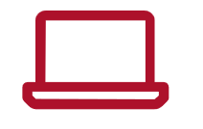
Reengaging employees with their retirement plans
Financial wellness resources
Easy-to-understand, relevant education
Personal support
Visit LincolnFinancial.com/WellnessAtWork to explore Wellness@Work and discover helpful resources.
Notes:
While inflation and investment performance have driven contribution rates and participation lower, financial wellness resources, easy-to-understand education, and personal support may help mitigate these factors. Together, let’s help employees renew their confidence and recharge their retirements. You can visit LincolnFinancial.com/WellnessAtWork to explore more Wellness@Work research and access helpful resources.

Slide 55
Helping employees build strong financial habits benefits future generations as this knowledge is passed along.

Slide 56
Thank you!
Yakoke!
Migwéch!
Ahéhee!

Slide 57
Disclosures
Lincoln Financial Group is the marketing name for Lincoln National Corporation and its affiliates, including Lincoln Retirement Services Company, LLC, The Lincoln National Life Insurance Company, Fort Wayne, IN, and, in New York, Lincoln Life & Annuity Company of New York, Syracuse, NY. Affiliates are separately responsible for their own financial and contractual obligations.
Guaranteed income solutions are offered as a group variable annuity. The guarantee is provided by a contract between the client/plan sponsor and Lincoln National Life Insurance Company that provides a plan participant with guaranteed annual retirement income. All contract and rider guarantees, including those for optional benefits, guaranteed income, or annuity payout rates, are subject to the claims-paying ability of the issuing insurance company. They are not backed by the broker-dealer or insurance agency from which this annuity is purchased or any affiliates of those entities other than the issuing company affiliates, and none makes any representations or guarantees regarding the claims-paying ability of the issuer.
A group variable annuity is a long-term investment product designed particularly for retirement purposes and may not be suitable for all investors. Group annuities contain both investment and insurance components and have fees and expenses, including administrative and advisory fees. The annuity’s value fluctuates with the market value of the underlying investment option, and all assets accumulate tax-deferred. Withdrawals may carry tax consequences, including possible tax penalties.
The content provided herein is for informational purposes only and should not be considered investment advice or a recommendation to purchase a particular investment option.
Lincoln Financial Group® affiliates, their distributors, and their respective employees, representatives, and/or insurance agents do not provide tax, accounting, or financial advice. Please consult your own independent professional as to any tax, accounting, or financial information contained herein.
Investors are advised to consider carefully the investment objectives, risks, and charges and expenses of the group variable annuity and its underlying investment option before investing. The applicable variable annuity prospectus contains this and other important information about the variable annuity and its underlying investment option. Please call 800-234-3500 for a prospectus. Carefully read it before investing or sending money. Products and features are subject to state availability. There is no additional tax-deferral benefit for an annuity contract purchased in an IRA or other tax-qualified plan.
This material is provided by The Lincoln National Life Insurance Company, Fort Wayne, IN, and, in New York, Lincoln Life & Annuity Company of New York, Syracuse, NY, and their applicable affiliates (collectively referred to as “Lincoln”). This material is intended for general use with the public. Lincoln does not provide investment advice, and this material is not intended to provide investment advice. Lincoln has financial interests that are served by the sale of Lincoln programs, products, and services.

