Slide 1


28th Annual Conference
September 23-25, 2024
Durant, Oklahoma

Slide 2


AGENDA
Professional Climate
Your Frustration
Turning Frustration into Growth
Success Record

Slide 3

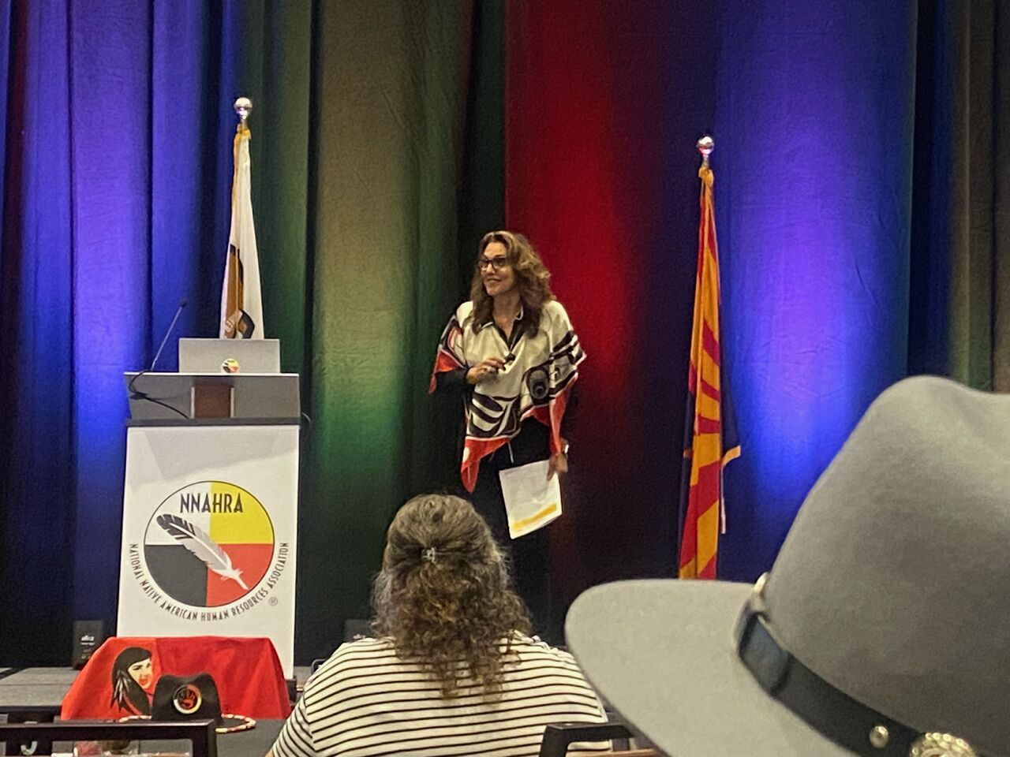
Team
Paula Allen
Director of Leadership Development and Guest Services

Slide 4


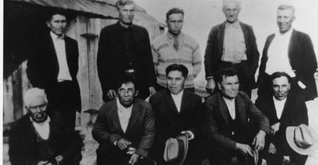



Let’s keep the momentum going

Slide 5
“It is not the critic who counts”

Slide 6

Professional Climate
Post Covid

Slide 7
What the professionals are saying
Prioritize Face Time
Self Development
Have honest and hard conversations
Monitor your loneliness
Consider a flexible hybrid approach
Create a system for the companies needs
Keep talking about caregiving obligations
Show compassion amid stress
Be sensitive to trauma and burnout
Lead with empathy
Prove your building is healthy
Make work inspiring
Be fair
Take the Enneagram

Slide 8
Timeline
Comfort
Pre-Covid – We could run our crews with confidence, pivoting when needed
Chaos
Covid hit and everything changed, it was hard to get a handle on what our needs were.
Confusion
Where are the people, why are they leaving. How can I make them stay?
Change
Our old tools don’t work and frustration sets in.
Clarity
You find new tools, and create new pathways of success.

Slide 9
Your Frustration
Aimed inward

Slide 10
What are your biggest challenges?
Professional
Culture/Tribal
Yourself
Getting your projects on the docket.
Girl Gangs (cliques)
Being part of the team
Having others challenge you
Rumors
Making time for family
Showing up for Community Events
Mentoring Youth
Volunteering on Boards
What are your irritations
How do you handle difficultly
Where can you grow?
Create actionable solutions

Slide 11
Turning Frustration into Growth
How can you grow from conflict

Slide 12
The Process For Clearing
Deciphering what the issue is and why it’s an issue.
Action
Write out your frustration – honestly
Why does it irritate you?
  Social
  Security
  Ambitions
What is my part in the situation
Write a letter of apology to the person
Either read it to them or do whatever ritual you can do to help you heal
Turn it over to the Universe and LET GO
Keep your side of the street clean.

Slide 13
Success Record
What does success look like?

Slide 14
What does success look like?
Track your success
What is the proof
rewards
Things that used to bother you, shouldn’t bother you anymore.
You will let people be themselves without crawling out of your skin.
Keep track of every success
Share your proof with friends and family
Move on to the next irritation
How do you reward yourself
How can you reward yourself?
How do you reward others?

Slide 15
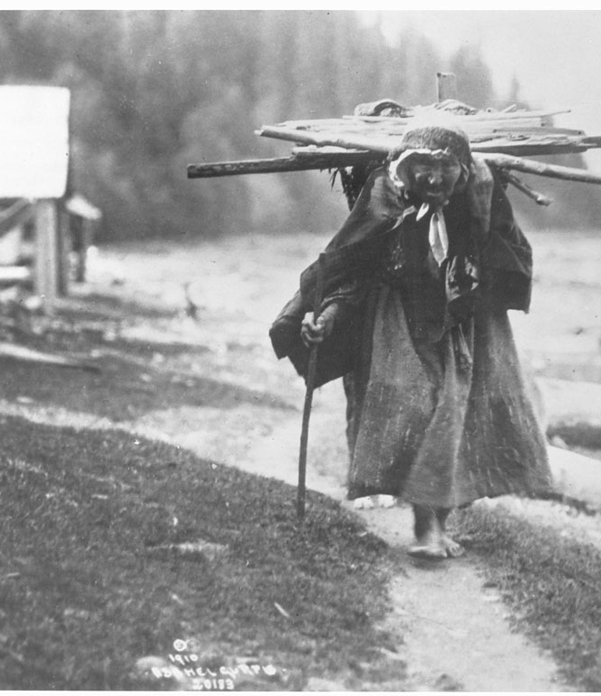

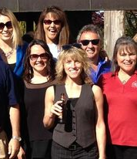
Growth Doesn’t Just Happen
You will need to be intentional with your growth game. You are in charge of your career, and you have the capacity to elevate to the next level. See you in a year to see how this process went.

Slide 16

THANK YOU!
Paula Allen
paulaallen@7cedars.com
360-808-5949

