Slide 1
Listening Strategies and tools to improve the Employee Experience

Slide 2
Session Topics
Why Employee Experience?
Is Your Organization Ready?
Listen to Learn
The Right Tool for the Job
Insights to Drive Decisions

Slide 3


Quick SURVEY

Slide 4


People have A Choice

Slide 5

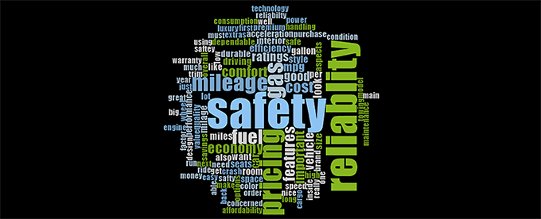
But What Are PEOPLE REALLY CHOOSING?
Pre-Experience HR
Employee Experience

Slide 6
Employee experience

Slide 7
Understanding Employee Experience
What is employee experience (XP)?
  Employee XP is the totality of an employee’s perception and experience with the organization that employs them from when they consider applying to when they leave and every phase in between.
  Employee XP focuses on the cultural, technological, and physical change and design of the organization.
  Employee XP (long-term) is not engagement (short-term)
    Engagement can be a component—and likely the outcome of an employee experience focus.
The Employee Experience Advantage Morgan, 2017.

Slide 8
Employee expectations, needs, and wants
Organizational design of employee expectations, needs and wants
EMPLOYEE XP
The Employee Experience Advantage Morgan, 2017.

Slide 9
Employee Experience
Employee expectations, needs and wants
Organization design of employee expectations, needs and wants
Organization expectations, needs and wants

Slide 10
It’s a Journey
ATTRACT
HIRE
ONBOARD
ENGAGE
PERFORM
DEVELOP
DEPART

Slide 11
Employee Experience Can Be the great maximizer of Human Resources
Why does employee experience (XP) matter?
  The best at employee experience have:
    20% fewer employees (workforce efficiency)*
    40% lower turnover
    4.3X more profit per employee
  If people (i.e. human resources) are our greatest asset, employee experience maximizes your return on investment on that asset.
The Employee Experience Advantage Morgan, 2017.

Slide 12
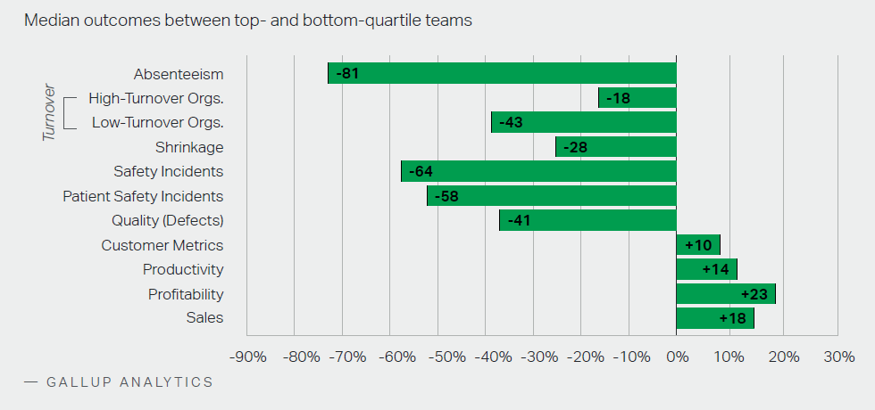
Engagement as an Outcome of positive Employee Experience

Slide 13
Are you Ready?
Assessing Organizational readiness

Slide 14
readiness Indicators
Organizational understanding and buy-in to employee experience
  Leadership understands the imperative
  HR is aligned to strategic goals and “has a seat” at the decision-making table
Organizational maturity
  Leadership ability to receive feedback and respond positively
  Ability to adapt, learn, improve
Organizational capability
  Logistics behind conducting research
  Analytics, Communications, change management resources

Slide 15
Learn to Listen; Listen to Learn

Slide 16
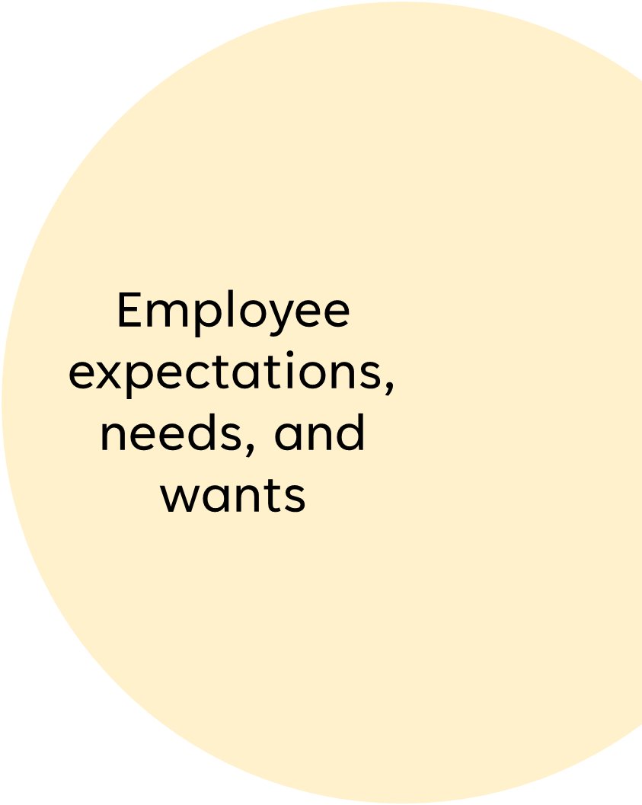
Research Is the Path to Understanding
“Organizations must do their own internal research to find out their own truth.”
The Employee Experience Advantage Morgan, 2017

Slide 17


Types of Research
Quantitative Mixed Methods Qualitative
Pre-determined methods | Both pre-determined and emerging methods | Emerging methods
Instrument based questions | Both open- and closed-ended questions | Open-ended questions
Performance data attitude data, observational data, and census data | Multiple forms of data drawing on all possibilities | Interview data, observation data, document data, and audio-visual data
Statistical analysis | Statistical and text analysis | Text and image analysis
Statistical interpretation | Across databases interpretations | Themes Patterns interpretations
“Qualitative Research for Associate Experience” Gary Burrus, Jr., 2020.

Slide 18
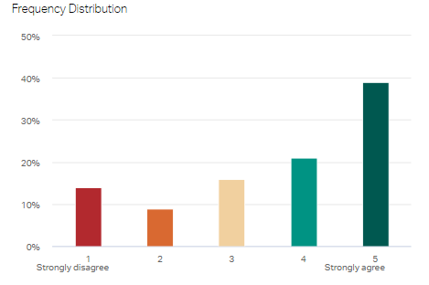
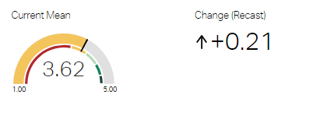
quantitative

Slide 19
Qualitative
  Managers hold State of the Team meetings (i.e. focus groups) and ask questions about employee feelings and perceptions to gain a deeper understanding of the quantitative findings
  Managers might be more intentional about observing what types of recognition most positively received
  Managers might meet with team leaders on other teams that score high in Q04 Recognition to observe or interview them about what they are doing

Slide 20
The Right tool for the job
HR Analytics
  HCM Data
  Internal data
    Recruitment data
    Case management
    Internal social platforms
Focus Groups
  Formal
  Informal (team meetings, town halls)
In-depth Qualitative
  One on ones
  Stay interviews
  Exit interviews
  Observation
Surveys
  Annual (i.e. engagement)
  Pulse
  Polls
  External studies
  Employer award applications

Slide 21
KEY INSIGHTS FOR DECISION MAKING
Key insights come from:
  Understanding organizational need
  Aligning HR with strategic goals and objectives
  Quality research
  Quality analysis
Key insights lead to:
  Better organizational decision making
  Keeping HR’s seat at the decision-making table
  Reaping the benefits of improving employee experience

Slide 22
YAKOKE (THANK YOU)
Dara McCoy
Sr. Director of Associate Experience
580-380-2519
dmccoy@choctawnation.com
www.choctawnation.com

