Slide 1


28th Annual Conference
September 23-25, 2024
Durant, Oklahoma

Slide 2

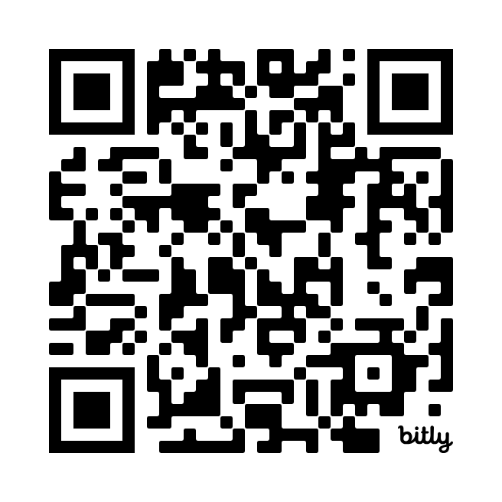

Cultivating Connections to Improve the Workplace
(And the business bottom line)
Presented by Niki Ramirez
for the NNAHRA Annual Conference 2024

Slide 3

What We’ll
Cover Today:
What do Connection & Connectedness mean at work?
What are the benefits of cultivating a deeply connected workplace culture?
What is the role of communication in social connection at work?
How does connection facilitate Inclusion, Belonging, and Psychological Safety at work?
What questions should I be asking to gauge connection in my workplace?
What does HR need to do to lay the groundwork?

Slide 4

Connection: A Workplace Definition
The bonds we form with others at work that allow us to build trust, feel seen and valued.

Slide 5


Activity: Look at this!!
Grab your phone.
Open your photo album.
Pick a photo that makes you HAPPY!
For 1-Minute: Share with a neighbor: who is in the photo, what’s happening, why is it meaningful to you?
Notes:
Connect through stories

Slide 6

In Psychology: Connectedness
“The sense of belonging and relatedness that people experience in their interactions with others.”

Slide 7
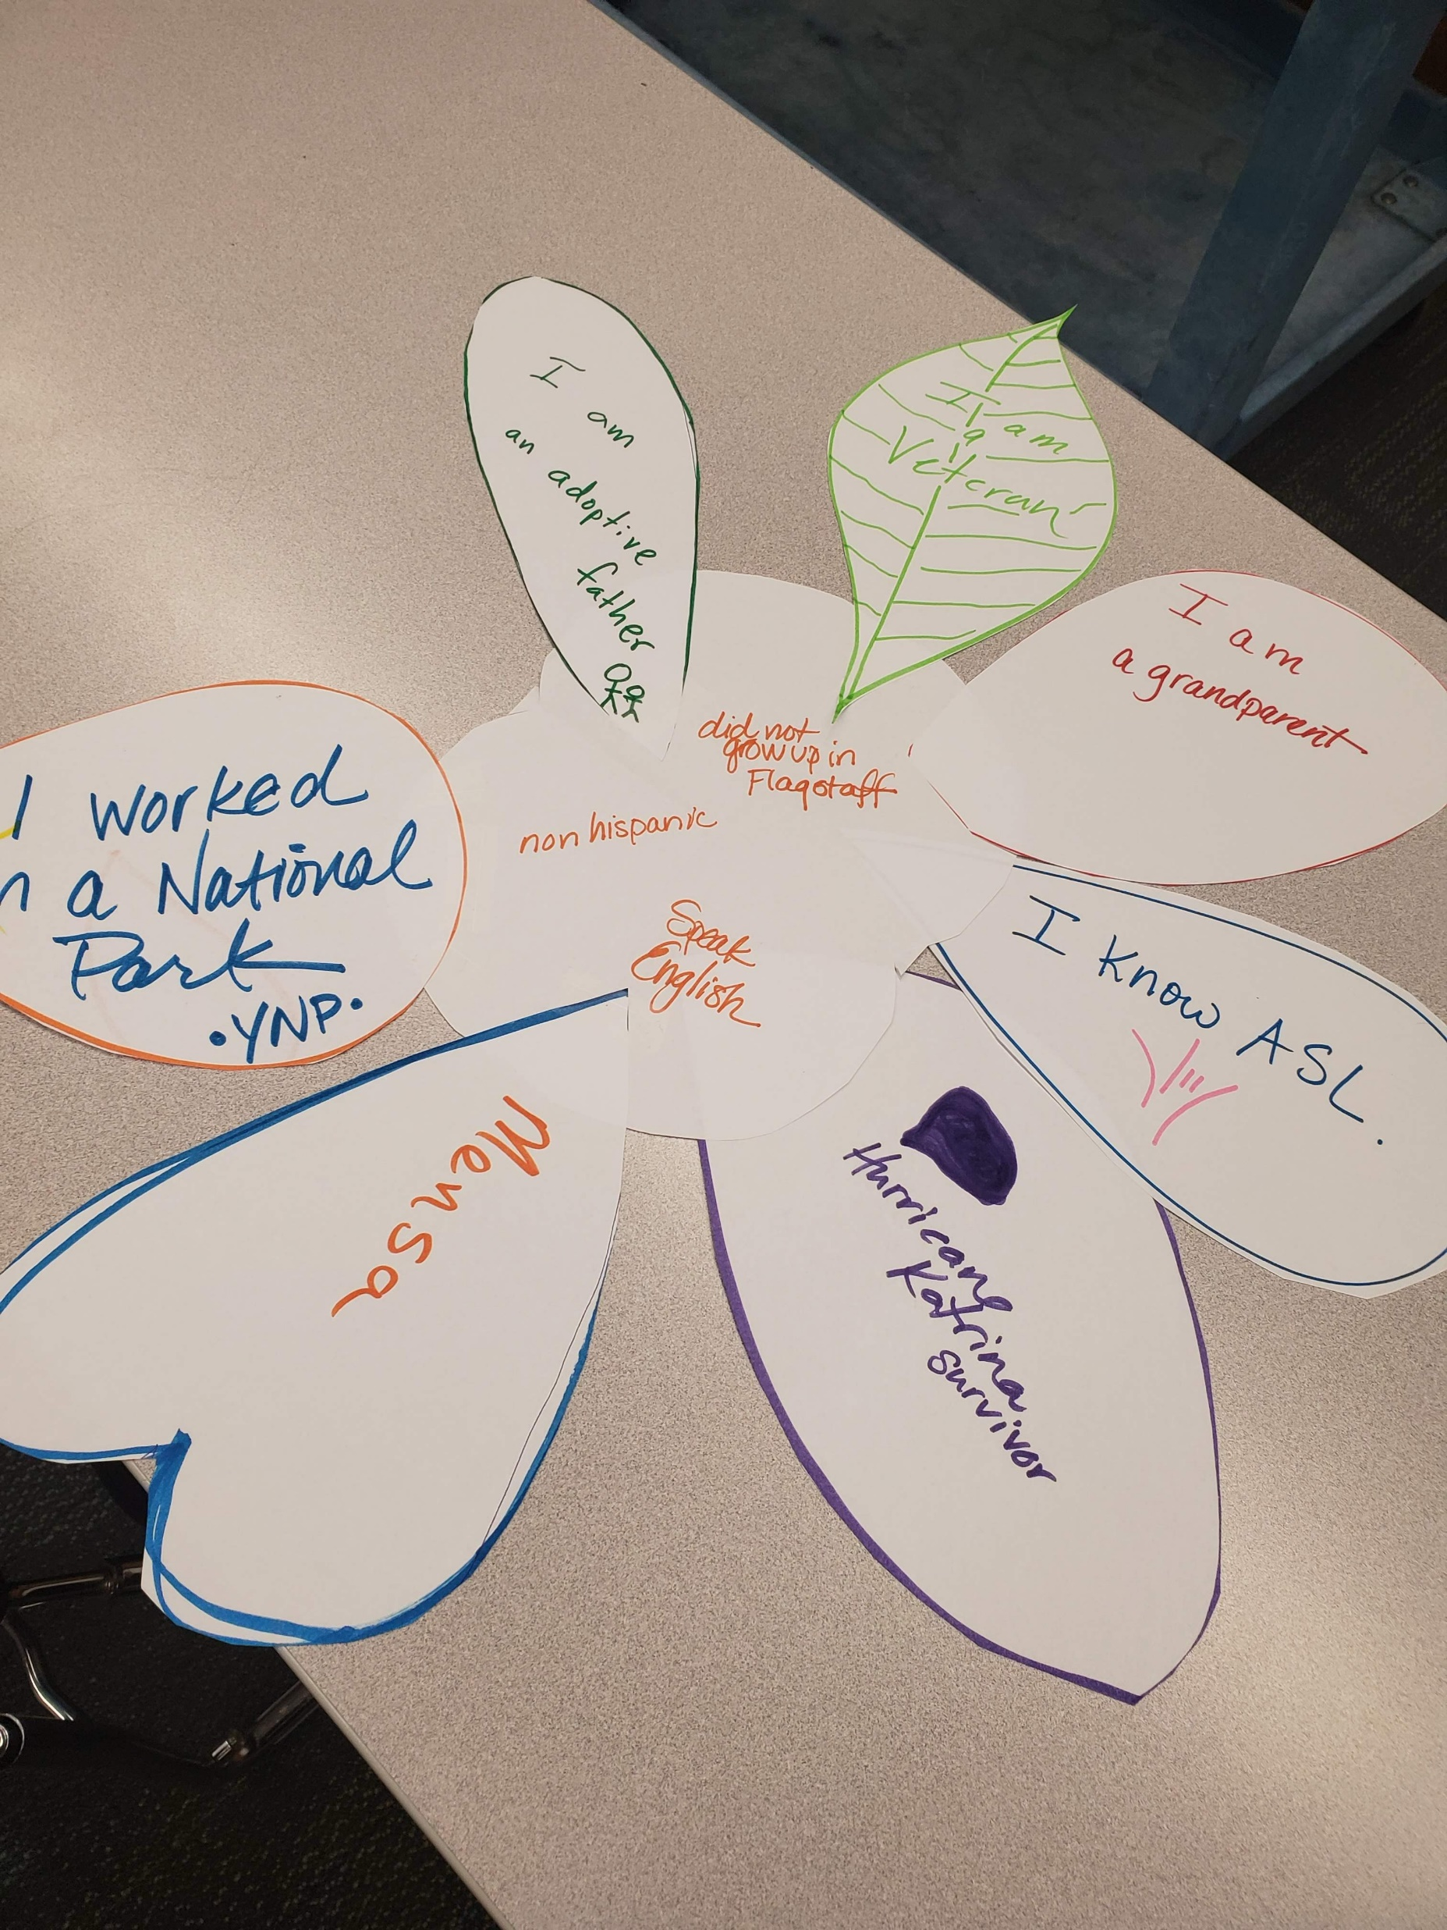
Activity Idea:
Unique & Different,
All at Once
Part 1: Each participant creates their own unique flower. On each petal they list a unique thing about themselves. Share around the group. (Make flower, 5 mins; share 1-2 mins per person)
Part 2: Then, make a team flower! Fill the petals with things that you all have in common. (10 mins)

Slide 8
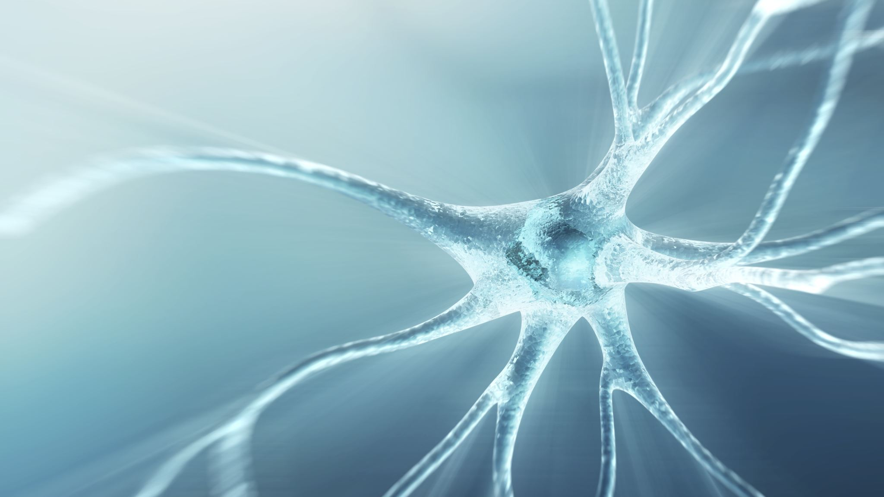
POP QUIZ:
What is it called when people work together and create something more valuable and larger than they could create on their own?
Notes:
Synergy is what is created when people work together to create something valuable, and it's based on the idea that working as a team is more effective than working alone. Effective connections and communication are key to building synergy.

Slide 9

Benefits of Connection in the Workplace

Slide 10

Let’s cut to the chase!
Think About It: With these definitions in mind, what do you think the benefits of workplace connection are?
Now, SHARE!

Slide 11
#1 Benefit of Genuine Connection:
Increased Employee Engagement
- How much? Engaged employees are ~20% more productive (Gallup)
- Why?! Stronger connection unlocks discretionary effort (HBR)
Notes:
Doing more work with the SAME labor cost. Ummmm. That’s a solid enough bottom-line impact to just dive right in!

Slide 12
Additional Workplace Benefits of Strong Connections:
Higher job satisfaction
Reduced turnover
Positive culture assists in attracting top talent
resilience; employees help one another cope with difficult times
Efforts to collaborate are more effective.
Higher Customer Satisfaction

Slide 13

42% of Turnover is Preventable
The signs and symptoms are often ignored by business leaders (Gallup).
[Full-time employee, making minimum wage costs ~ $14,000+ to replace]
Notes:
The most recent Gallup Report on Engagement estimates that organizations with high engagement enjoy a reduction in turnover of close to 60%. That is HUGE.
42% of Turnover is Preventable but often IGNORED by business leaders.
When adding direct and indirect costs … The bottom line, out the door cost to replace an employee ranges from one-half to two times their annual salary/earnings.

Slide 14

Connection & Engagement Lead to 10% Increase in Customer Satisfaction (Gallup)
Notes:
A 10% increase in client satisfaction means more repeat sales, new clients, successful referrals, and profits!

Slide 15
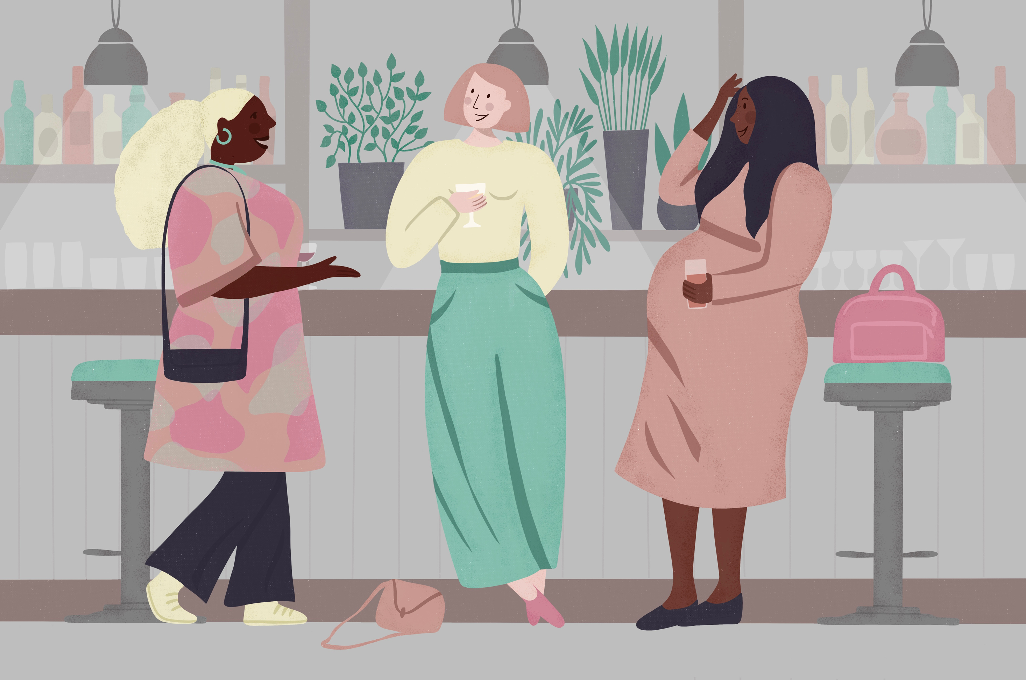
Social Connection at Work is Key
Why? A study out of Stanford University highlighted that social connections are critical to lower stress and anxiety.

Slide 16
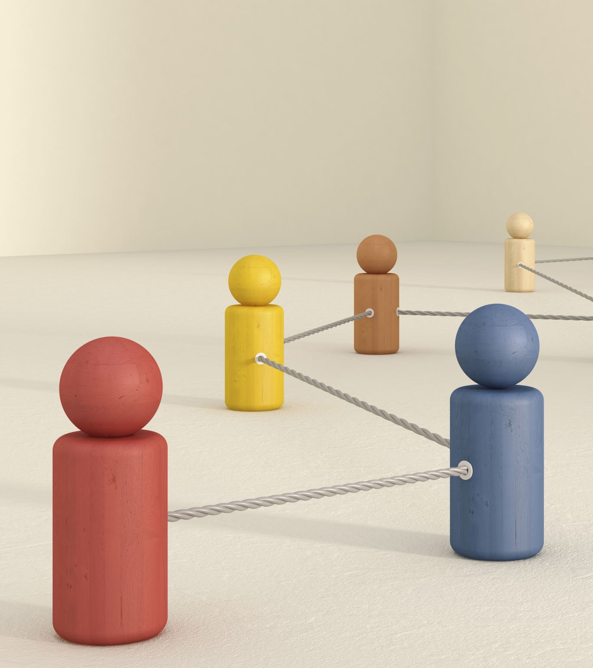
Social Connection Bottom Line$
Engaged, connected employees have 41% lower absenteeism (Gallup).
Savings: Less overtime payout + PTO/sick leave.
Increased earning potential via efficiency and effective workflows

Slide 17
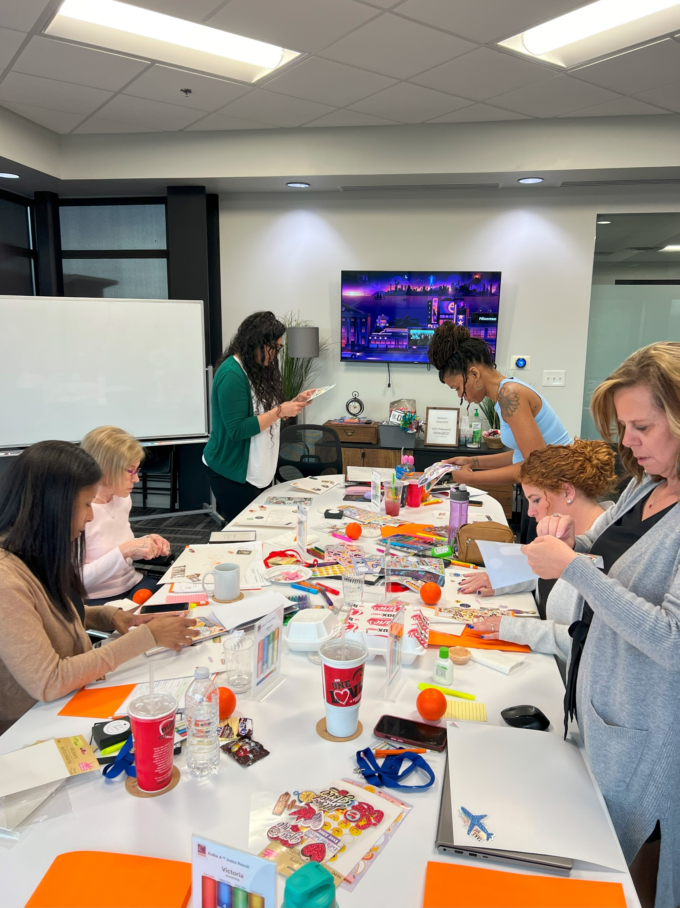
Quality Time Builds
Social Connection
Have fun and play together (World Rock Paper Scissors Day)
Listen to music
(shared Spotify list)
Do/make art together
Sharing stories (Tea Time)
Volunteer together

Slide 18
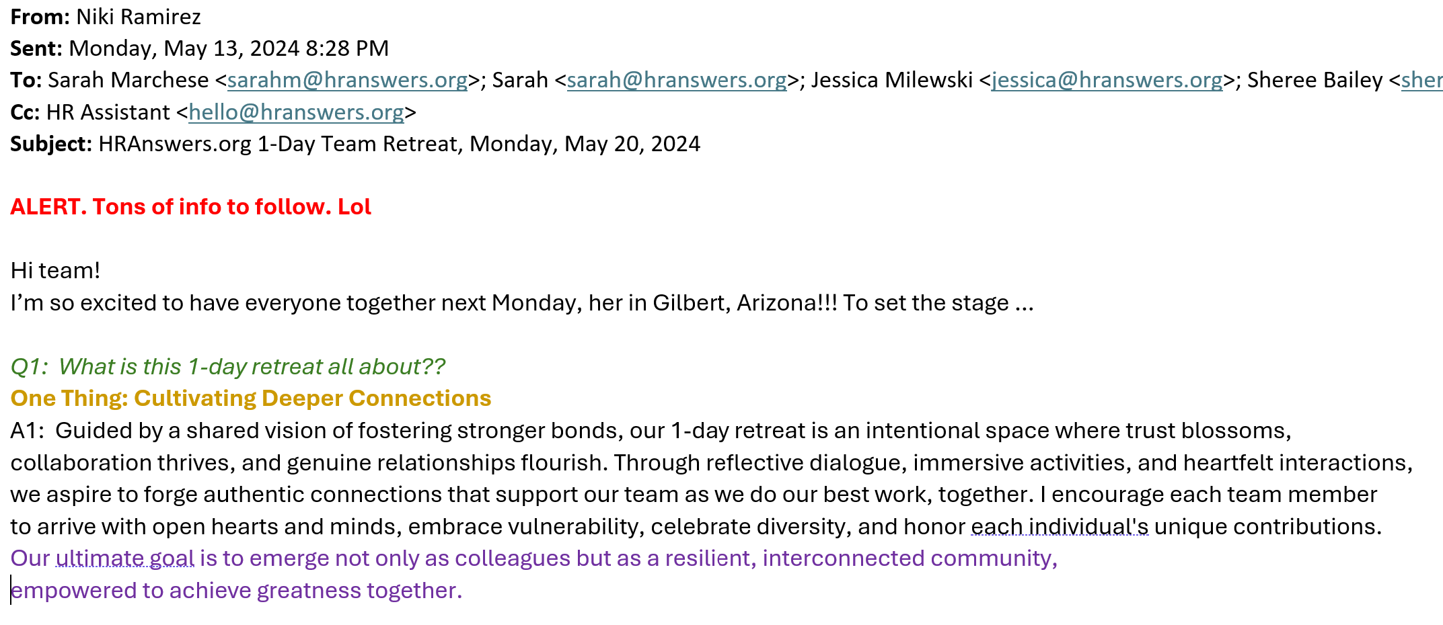
Example: An Invitation to Connect

Slide 19
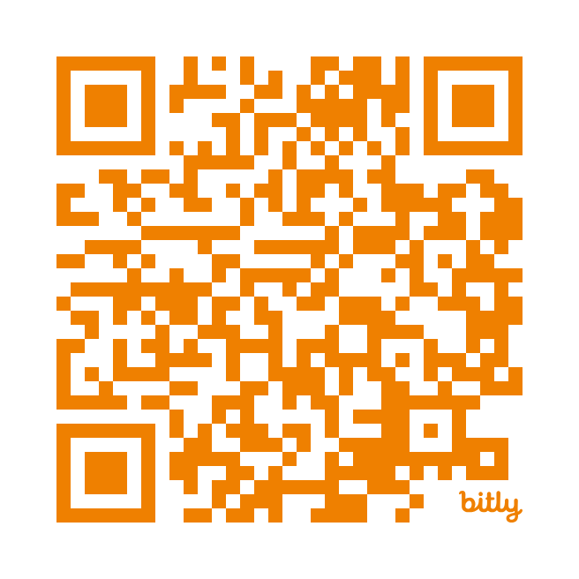
What is a song that gets you energized?
Add to Our Collective Spotify List

Slide 20

Creating the Right
Conditions for Connection

Slide 21

The Role of Communication in
Human Connection

Slide 22

Communication is the Fuel
Care is the Spark
Connection is the Result

Slide 23

Connection Requires ACTION.
We rely on interactions with others to fulfill our need for connection and belonging. (WebMD)

Slide 24
Connection Fosters Belonging
Interacting with others allows us to form personal bonds, test assumptions, and build trust.
Improved trust cultivates honesty and openness at work.
Honesty and openness facilitates accountability.

Slide 25

Social Connection & Psychological Safety

Slide 26

Give me permission to be ME!

Slide 27

Q) What is the best way for leaders to give permission for employees to be themselves at work?
Answers Include:
Lead by example.
Show people it is ok to be yourself.
Champion differences.

Slide 28

Inclusion: Let’s Get Personal
Notes:
Workplace inclusion is an environment (not an idea!!!!!!!!) where all employees feel valued and supported, regardless of their background or identity.

Slide 29
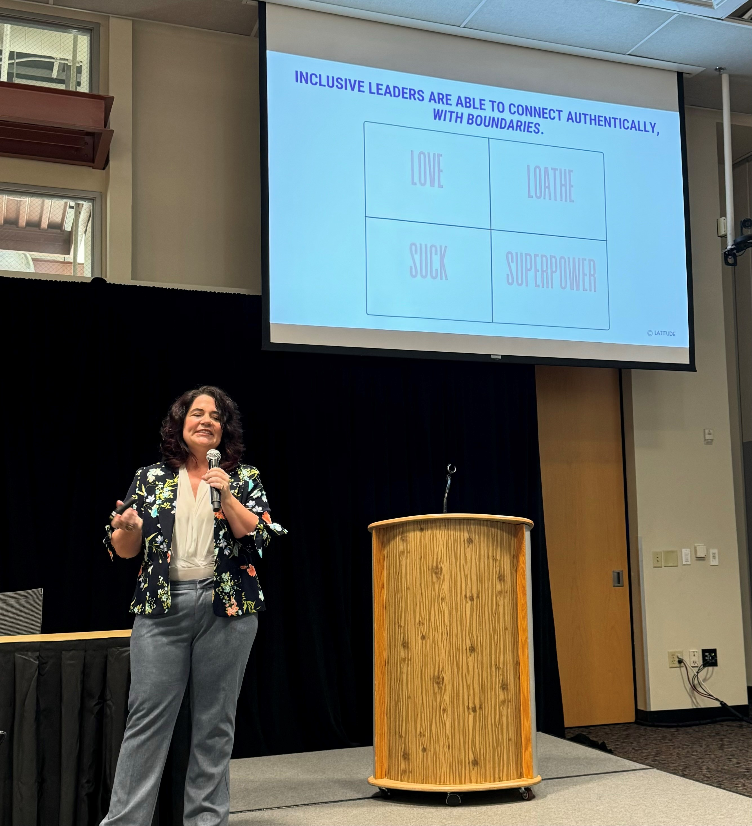
Meet/Connect with
Elena Joy Thurston,
Amazing Workshop Leader & Coach

Slide 30

Connection & Psychological Safety Facilitate Inclusion

Slide 31

Inclusion through
Connection
Your ideas are welcome
Your questions are valid
I trust you
Let’s do it your way

Slide 32

Organizational Communication Strategies that Foster Connection at Work

Slide 33
A Culture of Connection Includes:
Regular 1:1’s with supervisor/leadership
A realistic cadence for surveys and employee feedback
Team meetings that are productive
Open Office Hours
Easy access to leaders outside my “chain of command”
Social Interaction & FUN

Slide 34

Surveys as a Form of Communication
Notes:
BEWARE … bc it is a way to connect but the connection is often underutilized.

Slide 35

Speaking of Surveys … Gallup’s Q12
(Number 5) My supervisor or someone at work seems to care about me as a person.
(Number 8) The mission or purpose of my company makes me feel that my job is important.
(Number 10) I have a best friend at work.
(Number 11) In the last 6 months, someone at work has talked to me about my progress.
Notes:
Don’t bother recreating the wheel here… Get focused and use what works (if that is your style)

Slide 36

HR Department Homework

Slide 37

HR Department Homework
Review opportunities to connect through:
Individual Feedback (surveys, interviews, informal sharing, etc.)
Mentorship
Social Interaction and Fun

Slide 38

HR Department Homework
Job Description Revision:
Required ability: Establish and maintain effective working relationships with team members and other stakeholders.

Slide 39

HR Department Homework
Review Policies & Procedures:
Performance Evaluations.
Employee Growth & Development.
Code of Conduct.
Non-Discrimination/Non-Harassment

Slide 40

HR Department Homework
Provide Training to Normalize Concepts :
Non-Discrimination/Non-Harassment
Instincts Based Leadership
Emotional Intelligence at Work
Workplace Essentials: Critical Communication, Collaboration & Conflict Resolution Skills
4 Keys to Being a Great Team Member
Navigating Stress & Negativity at Work

Slide 41
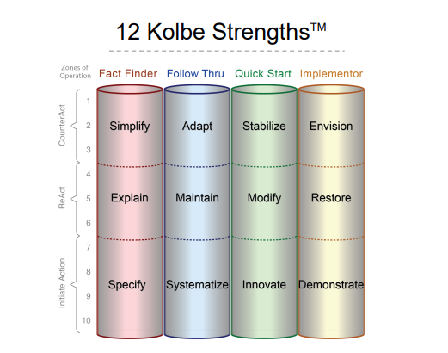
HR Department Homework
The workplace is about doing.
Connect via How People Get things Done:
Incorporate the use of assessments at the time of hire (Kolbe A) and throughout employment
Help People Open Up and Share:
Integrate assessments on-going, especially as teams change (Kolbe, Strengths Finder, DISC, etc.

Slide 42

UBUNTU
I am because we are
Notes:
Connection at work is about something much, much bigger than each of us or one of us.
So, to end our time today, I want to share a bit about Ubuntu.
Ubuntu is an African philosophy that emphasizes the importance of community and shared humanity over individualism.
At WORK:
I am because my team is.
We are because our clients are.
We are because our community is.
The word Ubuntu comes from the Nguni (isiZulu) aphorism Umuntu Ngumuntu Ngabantu, which translates to "a person is a person because of or through others".
Ubuntu can be described as a humanism that values proper behavior towards others and nature, and the capacity to express compassion, dignity, reciprocity, and mutuality.
It's often seen as a counterweight to the culture of individualism in the modern world.

Slide 43

Ubuntu at Work:
I am because my team is.
We are because our clients are.
We are because our community is.
We are cocreators.
We are interdependent.
Notes:
Learning and growing through Ubuntu – BBC
https://youtu.be/7UojwMiRpNM?si=nEnRaCr7D4Yuxnla
Responsibility to our communities, the vulnerable, and the world around us.
We are cocreators of the world. We are interdependent.
Individuality (free to be self) and Individualism (self-referencial, about me me me all of the time)
The workplace community moderates Individuality versus Individualism

Slide 44

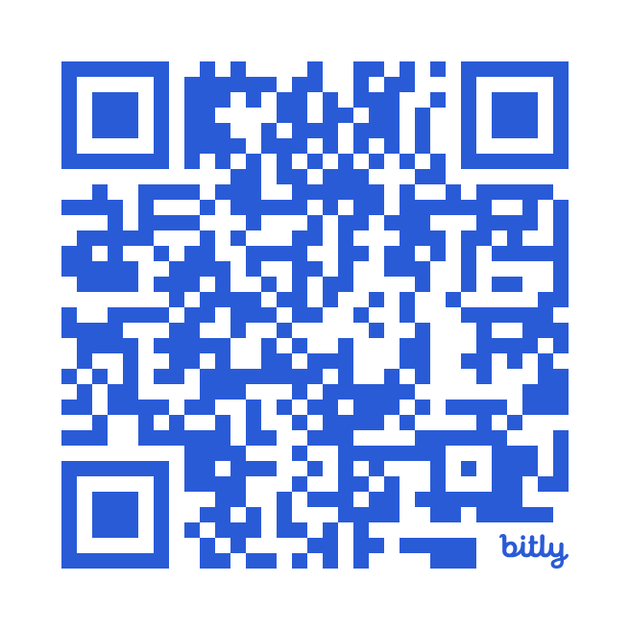
There is more to cover.
Let’s Keep The
Conversation Going.
Reach out to your facilitator:
Niki Ramirez, MBA/PHR
Founder & Principal Consultant
call: (602) 715-1300
email: nramirez@hranswers.org

Slide 45

Your Facilitator:
Niki Ramirez, MBA/PHR/SHRM-CP/THRP
I’m a certified human resources consultant and the founder of HRAnswers.org. We focus on providing practical, impactful HR consultation to business leaders and HR professionals so that they can relax and focus on their goals.
We believe that professional human resources support isn’t only for big companies with huge budgets. HR support is something that every size business deserves! We’ve taken everything that we’ve learned in big-Company HR and design a process to help small businesses create HR programs that align with their business goals and organizational culture, to yield maximum results.
Our goal is to help our clients reduce business risk and dramatically improve the employee experience. Clients trust my expert team and I to work on a variety of complex HR projects like employee handbooks, job descriptions, performance plans, and sticky hiring and termination situations.

