Slide 1


Slide 2

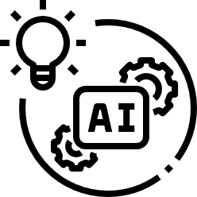
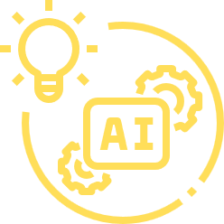

LEVERAGING AI IN HR
Presentation by
Tara Waddle, SHRM-CP
WADDLE IT BE, LLC

Slide 3

HELLO, I’M TARA!
  CEO of Waddle It Be, LLC, specializing in operational documentation and strategy for clients.
  15 years of C-Level experience with of a virtual staffing company, where I developed strategies for global remote teams to successfully collaborate on technical projects and applications.
  SHRM-CP with expertise in people operations.
  Tech enthusiast who taught herself to code, built an AI chatbot, and managed her own website.
  Communication advocate who believes effective communication is the cornerstone of success, particularly in leveraging AI in HR and business.
WADDLE IT BE, LLC

Slide 4
1
WHAT IS ARTIFICIAL INTELLIGENCE?
2
UTILIZING AI IN HR
3
TIPS & BEST PRACTICES FOR AI
WADDLE IT BE, LLC

Slide 5
LIVING IN THE AGE OF AI
Timeline of recent AI traction
  2021: 50% of companies reported using AI in at least one business function.
  2022: $387.45 billion was spent on AI tools and development of AI resources.
  2023: Organizations that invested in AI reported an ROI of 6-8%.
  2024: 68% of global consumers interact with AI-driven applications daily.
  By 2025: AI is expected to generate 97 million new jobs, higher than the 85 million jobs that will be disrupted.
CITATIONS: McKinsey Global Survey on AI, 2021 • Fortune Business Insights, 2022 • Deloitte Insights, 2023. • PwC, 2024 • World Economic Forum, “The Future of Jobs Report,” 2020
WADDLE IT BE, LLC

Slide 6
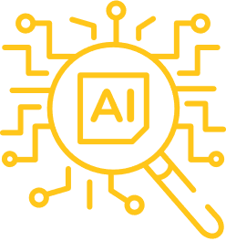

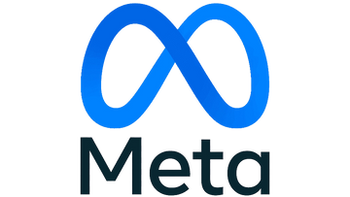




WHAT IS ARTIFICIAL INTELLIGENCE?
Is AI the key we’ve been looking for?
  “AI” = Artificial Intelligence
  Branch of computer science and applications.
  Intended to provide the “human touch” for data processing and response.
  Requires human input, guidance, and constant maintenance to be effective.
WADDLE IT BE, LLC

Slide 7
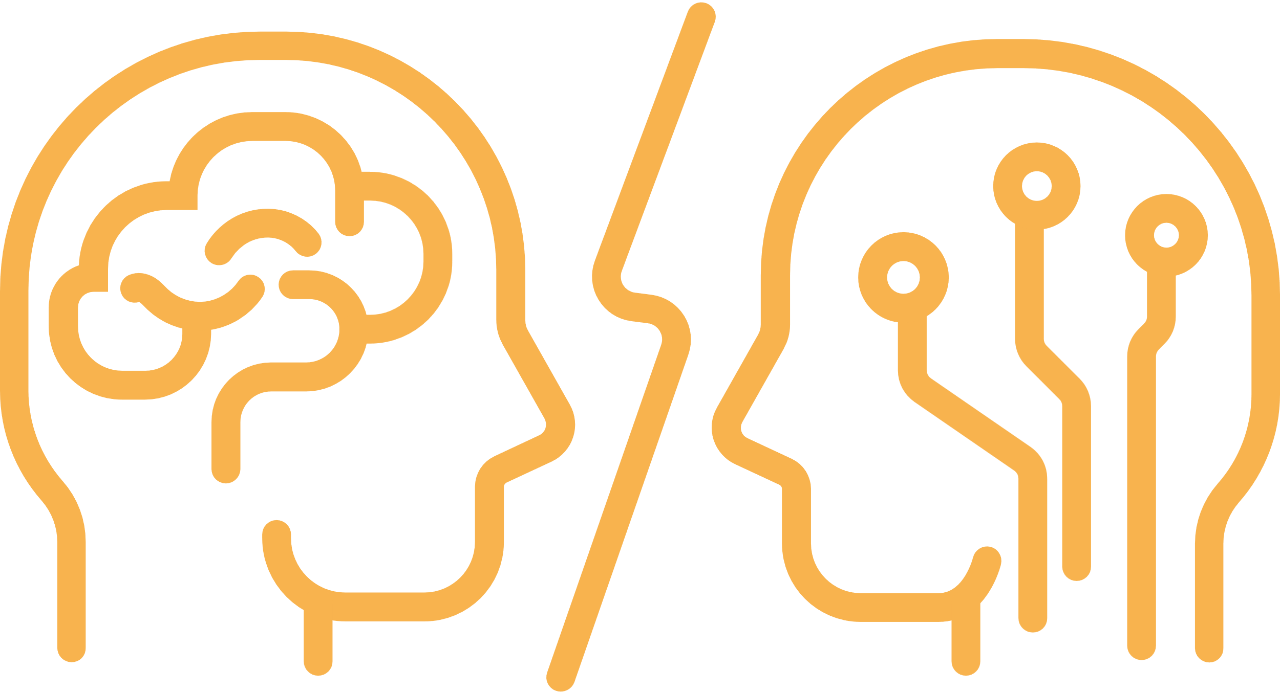
CONCERNS
ABOUT AI
When will AI start to steal our jobs?
“AI is here to augment human capability, not replace it. The future is about human creativity and ingenuity empowered by AI.”
– Satya Nadella, CEO of Microsoft (2020)
WADDLE IT BE, LLC

Slide 8


ADDRESSING MISCONCEPTIONS
What’s the difference between AI and ML?
  AI is NOT fully autonomous or infallible.
  Machine Learning = “ML”
  ML is subset of AI that enables machines to learn from data, to draw conclusions and create new data.
  Multiple variations and types of ML exist.
  AI is like our brain, while ML is like our brains learning from experiences.
WADDLE IT BE, LLC

Slide 9
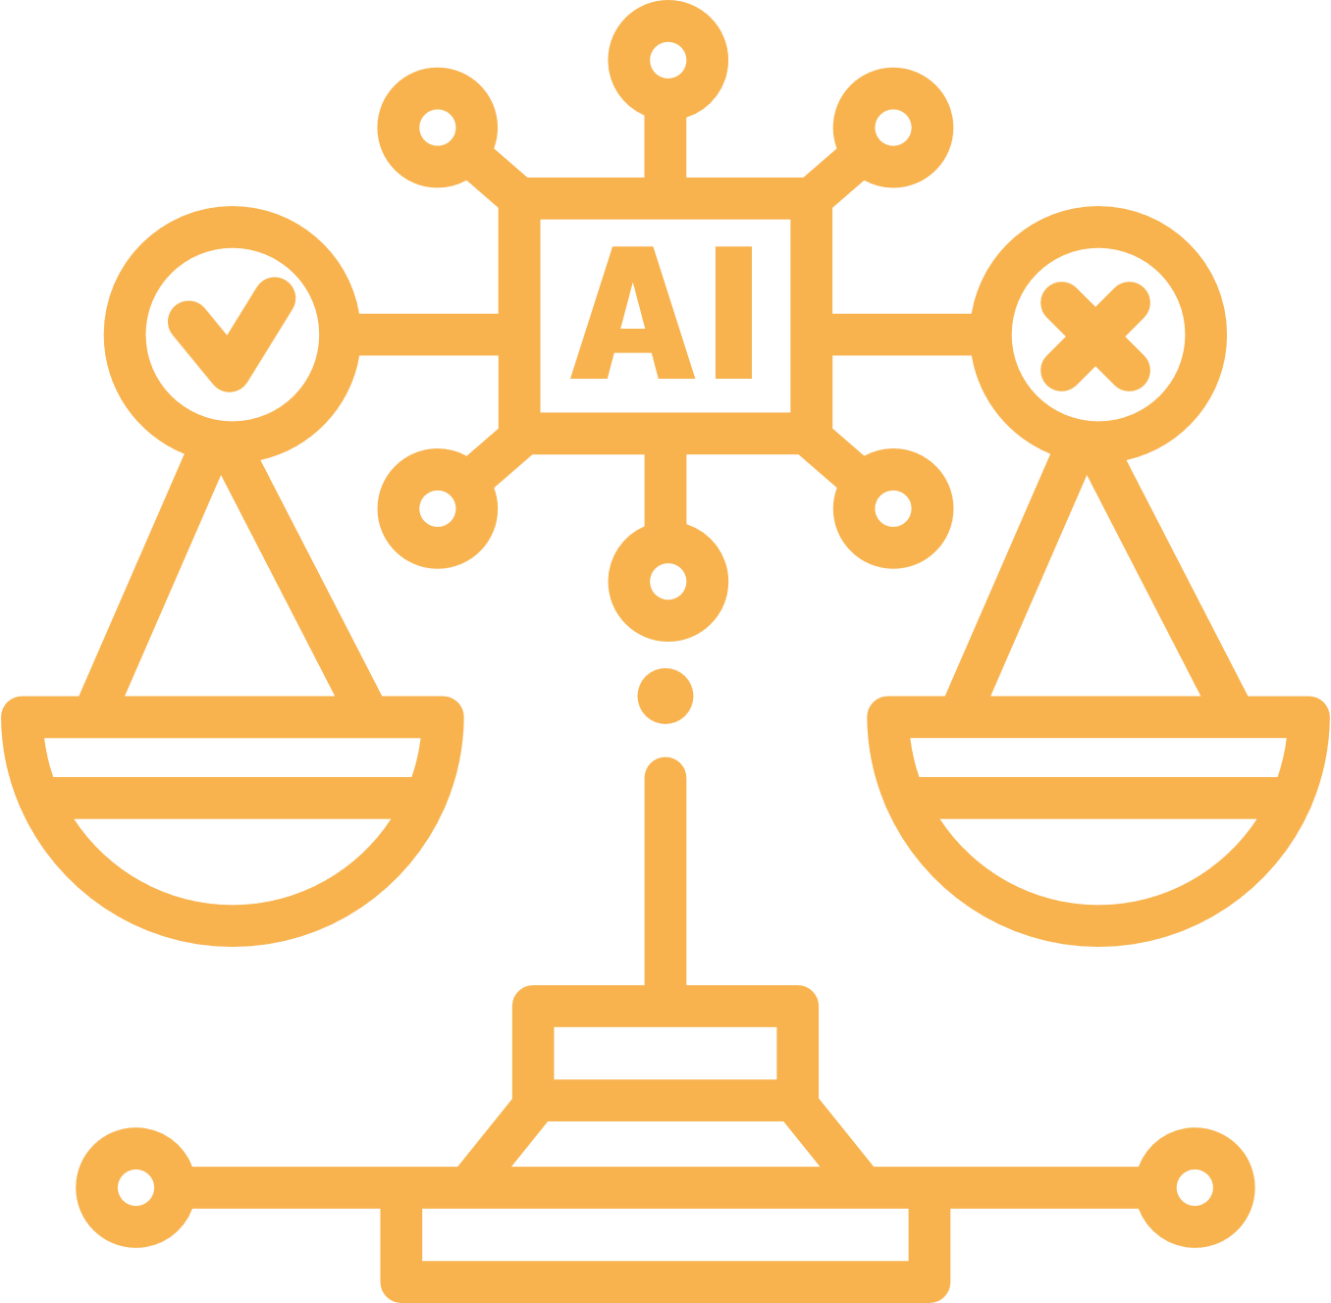
ETHICAL CONSIDERATIONS
Biases in AI data sources creates a dilemma:
Poor Data Representation
vs. Right to Privacy
WADDLE IT BE, LLC

Slide 10

LIMITATIONS OF AI
When is AI not the right solution?
AI is probably not the solution for your organization yet, if:
  You lack any data sources for AI screening, filters, and/or ML training.
  Your data sources are from external resources that may have inherent biases.
  You aren’t consistently auditing, updating, or maintaining your data sources.
  You’re using AI as the primary decision-maker over human judgement.
WADDLE IT BE, LLC

Slide 11
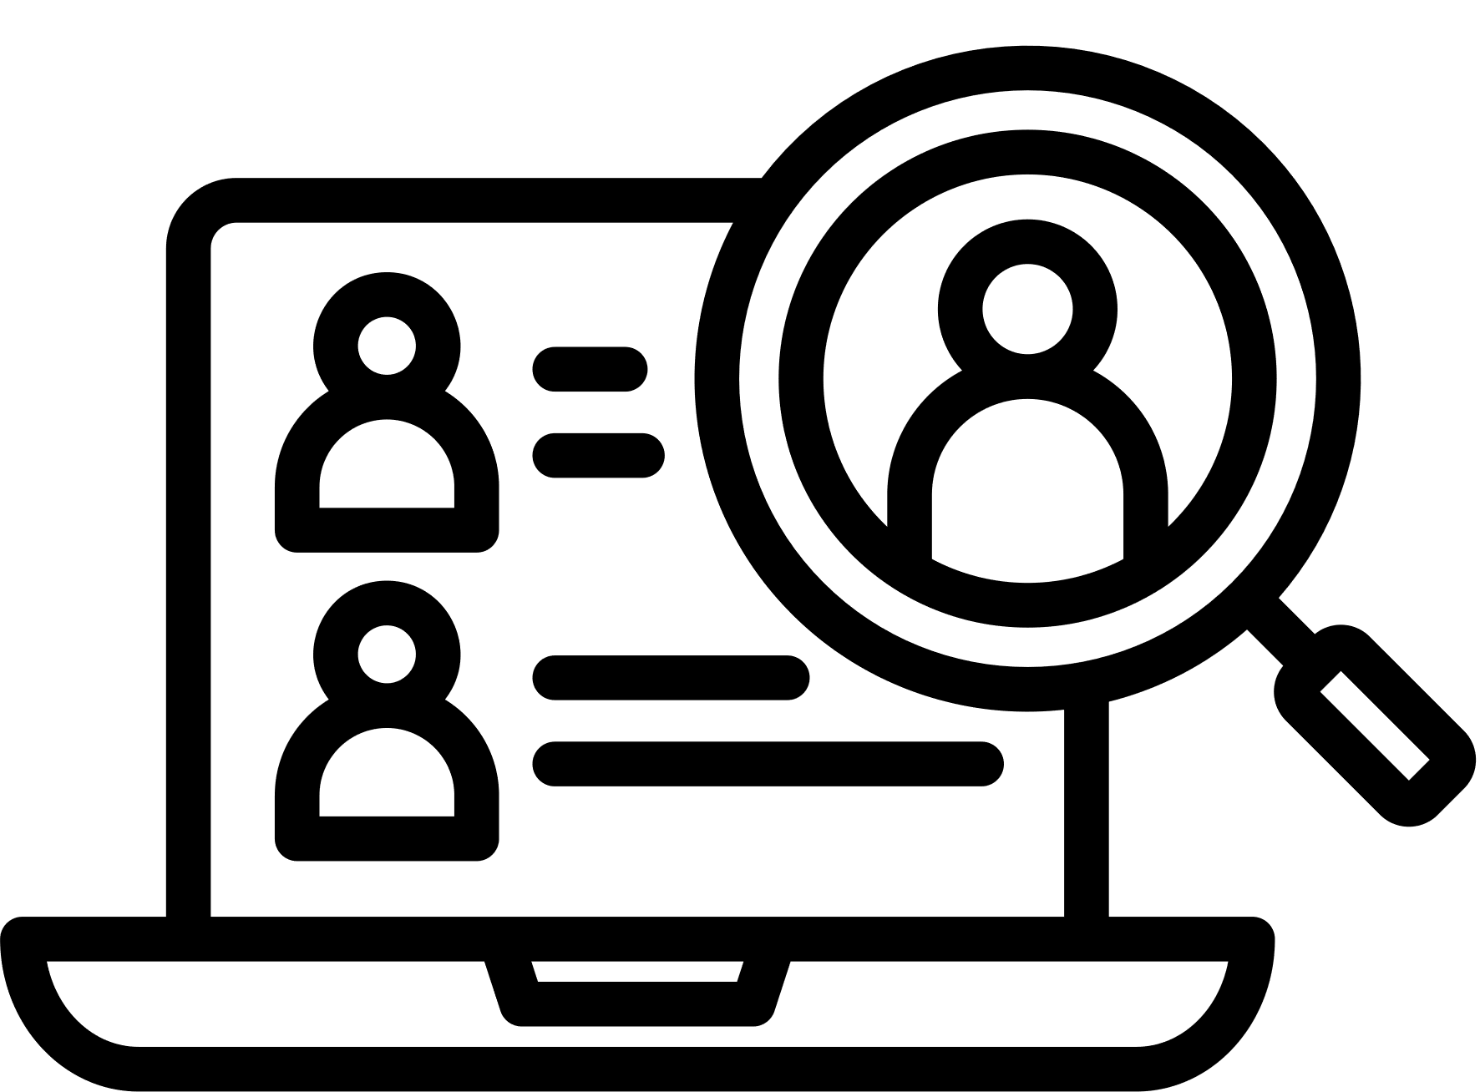

RECRUITING AND TALENT ACQUISITION
Utilizing AI in your HR operations
Applicant Tracking System
To store, filter, prioritize, and narrow down candidate search results.
Chatbots
To expand upon job descriptions, requirements, and expectations.
Resume Scanners
To schedule interviews, engage with candidates and answer FAQ’s.
To automate the candidate screening process and filter based on select criteria.
WADDLE IT BE, LLC

Slide 12

EMPLOYEE TRAINING AND DEVELOPMENT
Utilizing AI in your HR operations
Performance Management
Engagement Surveys
To monitor and assess an employee’s contributions over a period of time.
To check the pulse of the organization from the employees’ perspective.
Predictive Analytics
Research & Development
To analyze employee data and determine your organization’s future hiring needs.
To ensure your workforce can meet the industry and the organization’s needs.
WADDLE IT BE, LLC

Slide 13
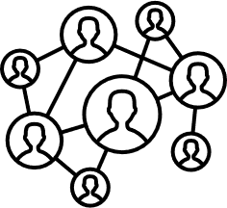
ENGAGING YOUR STAKEHOLDERS
Utilizing AI in your HR operations
Content Creation
Trend Insights
To communicate consistently using content targeted to your ideal stakeholders.
To determine the latest trends to make the most strategic decisions.
Real-Time Data Insights
Research Verification
To analyze content visibility and track engagement from stakeholders.
To reinforce your content with proven statistics and reports backed by data.
WADDLE IT BE, LLC

Slide 14

BEST PRACTICES
Tara’s Top Three Tips:
1. SET OBJECTIVES.
2. KNOW YOUR TOOLS.
3. EXPERIMENT WITH PROMPTS.
WADDLE IT BE, LLC

Slide 15
YOUR AI OBJECTIVES:
  Identify your true business needs.
  Set measurable outcomes.
  Address the gaps between human and AI.
WADDLE IT BE, LLC

Slide 16
YOUR AI TOOLS:
  Know that there is no one-size-fits all app.
  Ensure scalability and compatibility.
  Invest in data source maintenance and staff training.
WADDLE IT BE, LLC

Slide 17
CHATTING WITH YOUR AI:
  Be clear and specific with your prompts.
  Consider the context of your requests, and update accordingly.
  Resolve any potential biases with data sources.
WADDLE IT BE, LLC

Slide 18
RESOURCES
WADDLE IT BE, LLC

Slide 19
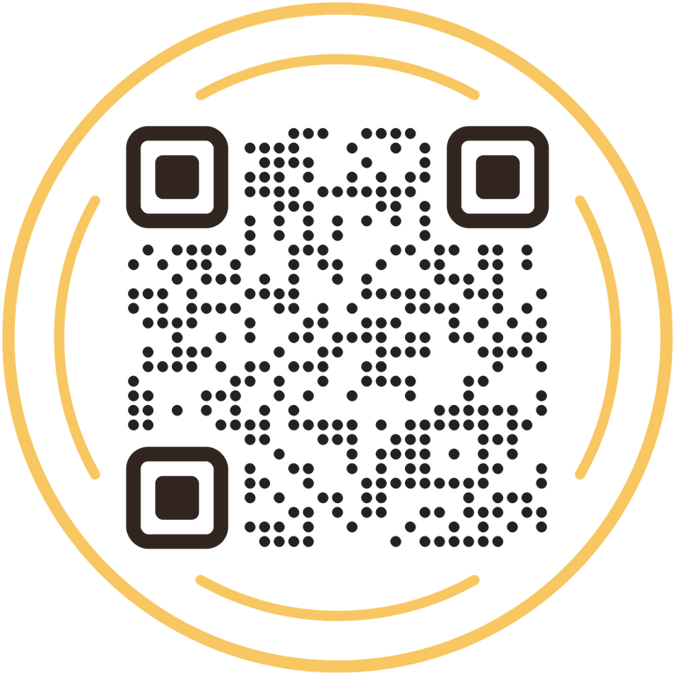
THANK YOU!
TARA WADDLE, SHRM-CP
  Operational documentation
  Technology integration
  Communications strategies for:
    Employee engagement
    Stakeholder outreach
  Workshops, team building, and one-on-one coaching.
WADDLE IT BE, LLC

