Slide 1


28th Annual Conference Starting Strong: Tips and Strategies for New Human Resources Professionals
September 23-25, 2024
Durant, Oklahoma

Slide 2






Activity: What’s the Best HR Related Advice You’ve Ever Gotten?

Slide 3



Introduction
As HR Professionals we strive for confidence in our roles
We want to be helpful
Do the right thing
Follow HR laws
Understand best practices
Make our leaders look good
Support employees and our organization in positive ways

Slide 4

AGENDA
Tips and Strategies for New HR Professionals
Understand HR Fundamentals
Develop Cultural Competency
Navigate Legal and Regulatory Frameworks
Fulfil Our Role as Leaders in the Organization
Navigate Complex Political Environments
Communicate Effectively
Build a Network to Support Your Success

Slide 5

Presenter
Denise Miño, Trainer and Consultant
NNAHRA Partner

Slide 6
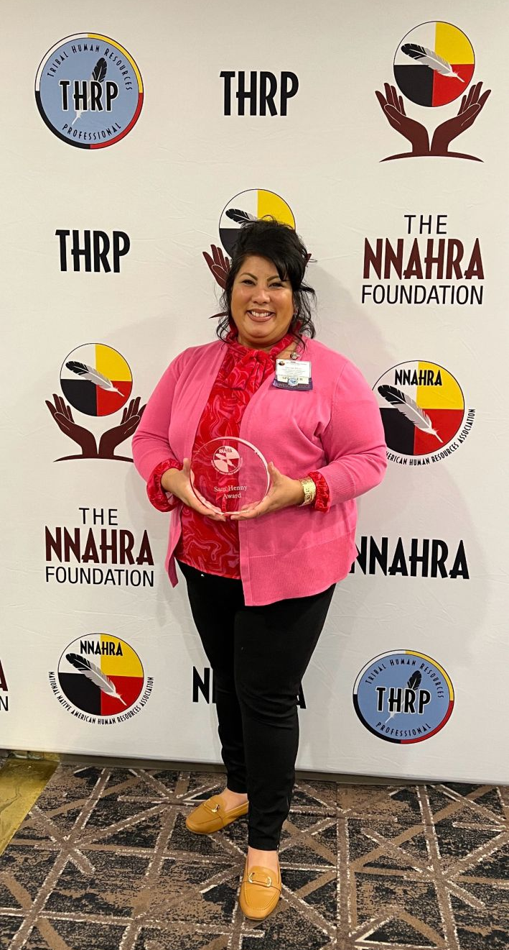
Bio: Denise Miño
Leadership and DEI Instructor, University of Washington Tacoma
Organizational Consultant and Trainer for Tribes and Nonprofits
Trainer, NNAHRA’s Tribal Management Professional (TMP) Certificate Program
Recipient of the Sam Henny Award for Outstanding HR Program of the Year 2022
Education includes: Industrial and Organizational Psychology, Human Resources, Public Health, Leadership, and Lean Six Sigma

Slide 7

1. Understanding HR Fundamentals
Learn Core Concepts of the Industry and HR’s Role in organizations

Slide 8
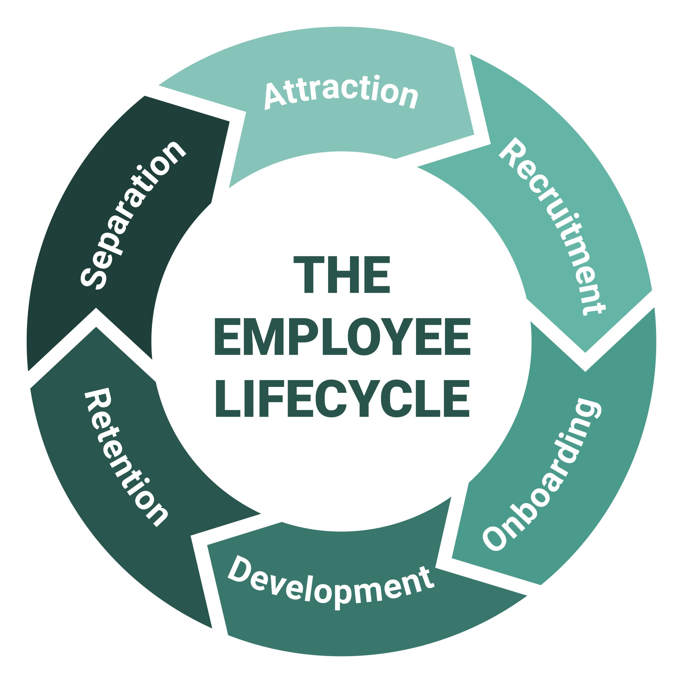
Employee Lifecycle
The Employee Lifecycle model is designed to illustrate the journey an employee takes during their time with an organization.
The six stages are:
Attraction
Recruitment
Onboarding
Development
Retention
Separation

Slide 9
HR Has Several Roles in an Organization
Strategic Partner: Aligns HR initiatives with the organization’s business goals to drive success and growth.
Change Agent: Manages and supports organizational changes, ensuring smooth transitions and minimal disruption.
Employee Advocate: Represents employee interests, addresses concerns, and fosters a positive work environment.
Organizational Developer: Improves organizational structures and processes to enhance overall effectiveness and efficiency.
Talent Manager: Manages the entire talent lifecycle, including recruitment, development, and succession planning.
Compliance Officer: Ensures the organization adheres to labor laws and regulations to mitigate risks. Culture Steward: Shapes and maintains the organizational culture, promoting core values and enhancing employee engagement.
Data Analyst: Utilizes data and analytics to drive informed decisions and evaluate the impact of HR initiatives.

Slide 10
HR’s Responsibilities May Include
HR is responsible for managing and optimizing the organization’s human capital.
Recruitment and Staffing: Finding and hiring the right talent to meet organizational needs.
Onboarding and Training: Ensuring new hires are effectively integrated and providing ongoing development opportunities.
Employee Relations: Addressing employee concerns, resolving conflicts, and fostering a positive work environment.
Compensation and Benefits: Designing competitive salary and benefits packages to attract and retain employees.
Performance Management: Evaluating employee performance, setting goals, and providing feedback to assist improvement.
Legal Compliance: Ensuring adherence to labor laws and regulations to avoid legal issues.
Organizational Development: Supporting structural and cultural changes to enhance org effectiveness.
Diversity and Inclusion: Promoting a diverse and inclusive workplace where all employees feel valued.
Strategic Planning: Aligning HR strategies with business goals to support organizational success.
Health and Safety: Creating and maintaining a safe and healthy work environment.

Slide 11

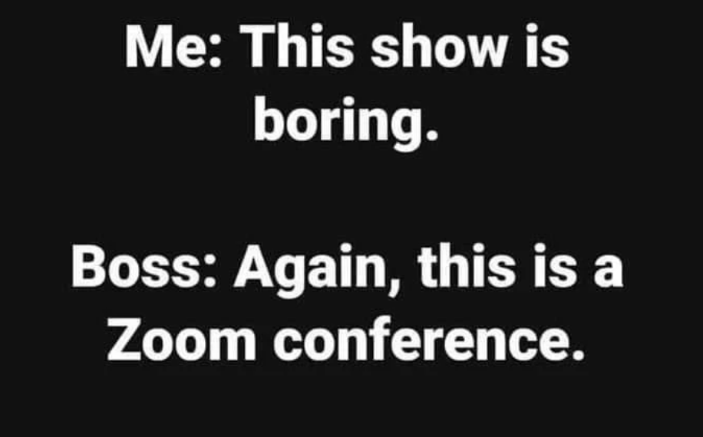
Comedy Break!

Slide 12





2. Developing Cultural Competency
Learn the importance of cultural awareness and sensitivity in HR practices when working for Native American tribes

Slide 13

Why Develop Cultural Competence?
Understanding Tribal Structure: Knowing the tribe’s organizational structure and governance is crucial for effective interactions and respecting their hierarchy and decision-making processes.
Promotes Respect: Understanding the tribe's history, traditions, and values shows respect and honors their cultural identity.
Builds Trust: Engaging respectfully and following protocols helps build trust and strengthens relationships with tribal members.
Ensures Alignment: Seeking guidance from tribal leaders ensures that actions and policies align with tribal expectations and customs.
Fosters Effective Communication: Pursuing cultural training and addressing personal biases improves communication and prevents misunderstandings.
Supports Inclusivity: Implementing inclusive practices demonstrates commitment to respecting and accommodating cultural needs.
Enhances Collaboration: Encouraging open dialogue and collaboration fosters a positive working relationship and mutual respect.
Builds Long-Term Relationships: Practicing humility and showing a willingness to learn strengthens long-term partnerships and demonstrates genuine commitment to the tribe’s well-being.

Slide 14

3. Navigating Legal and Regulatory Frameworks
Understand the legal and regulatory environment specific to Native American tribes

Slide 15




Navigating Legal and Regulatory Frameworks
Navigating HR laws when working with Native American tribes involves understanding and respecting tribal sovereignty, which impacts employment regulations, benefits, and practices.
HR professionals must balance tribal-specific standards with federal laws, integrate customary laws and cultural norms into their practices, and manage legal and compliance issues effectively.
Additionally, they must adhere to specific grant requirements related to federal funding, ensuring alignment with both tribal priorities and federal regulations.
Comprehensive training in legal, cultural, and grant-related aspects is essential to ensure respectful and compliant interactions within the tribal context.
You’re in
Indian Country

Slide 16

4. HR Staff Are Seen As Leaders
What does it means to be a leader in HR and how you can positively impact your organization through effective leadership?

Slide 17


HR Staff as Leaders
HR professionals are increasingly perceived as leaders within organizations due to their strategic role in shaping company culture, driving employee engagement, and aligning HR practices with business goals.
Everyone in HR is seen as a leader in the organization, no matter what your role.
There is a perception that you hold power and authority in the organization, and the truth is that HR does have influence in many aspects of an organization’s operations.

Slide 18
HR Staff As Leaders
Here are some examples:
Strategic Partners: HR leaders are seen as strategic partners who understand the business context and contribute to achieving organizational goals.
Problem Solvers: They possess strong problem-solving skills, enabling them to address complex issues and provide effective solutions.
Relationship Builders: HR professionals excel in communication and building relationships, which helps them gain the trust of both management and employees.
Change Managers: They are adept at managing change and uncertainty, especially in challenging times, by fostering a positive work environment and supporting employees.
Influencers: HR professionals act as influencers within the organization by shaping policies, driving cultural change, and advocating for employee well-being and development.

Slide 19


A little more humor to get us through the day!

Slide 20

5. Navigating Complex Political Environments
Develop strategies to effectively navigate the intricate political landscapes within organizations and tribal communities

Slide 21
Navigating Political Landscapes
Build Relationships: Network across departments and maintain a friendly demeanor.
Engage with Leaders and Elders: Build relationships with key figures in the community
Build Trust: Communicate transparently and involve stakeholders.
Foster Partnerships: Invest in capacity building and sustainable practices.
Implement Participatory Models: Use inclusive decision-making processes.
Seek Mentorship: Find a mentor and learn from experienced colleagues.
Understand the Landscape: Identify key players and observe decision-making dynamics.
Be Strategic: Align actions with organizational goals and focus on important issues.

Slide 22

6. Effective Communication
how to communicate confidently and professionally, avoid common pitfalls, and build positive relationships with employees and leadership

Slide 23
Effective Communication
Suggested communication strategies for working for Native American tribes:
Stay Professional: Act with honesty, avoid gossip, and maintain integrity.
Adapt to Norms: Learn about and adapt to cultural norms, and participate in cultural events.
Communicate Clearly: Use straightforward language, prepare in advance, be aware of non-verbal cues, and speak confidently but not arrogantly.
Avoid Pitfalls: Be culturally sensitive, listen actively, avoid stereotypes, and respect personal and cultural boundaries.
Build Relationships: Engage with community leaders, involve stakeholders in decisions, show respect for cultural practices, and offer support.
Foster Trust: Communicate transparently, be consistent, show empathy, and be a good listener who takes feedback into consideration.

Slide 24

7. Building a Supportive Network
Connect with fellow HR professionals and build your own network

Slide 25
Building a Supportive Network
A supportive network aids in cultural understanding, trust-building, resource access, professional growth, collaboration, challenge support, and inter-tribal information sharing.
Cultural Insight: Gain understanding of community values and practices through experienced mentors.
Trust and Credibility: Build relationships with community leaders to establish trust.
Resource Access: Connect with local resources and information specific to the community.
Professional Growth: Receive guidance and feedback to accelerate your learning and development.
Effective Collaboration: Foster collaboration and problem-solving through strong community connections.
Challenge Support: Get advice and support for navigating unique challenges in Indian Country.
Inter-Tribal Connections: Build relationships with professionals from other tribes to share information and best practices.

Slide 26
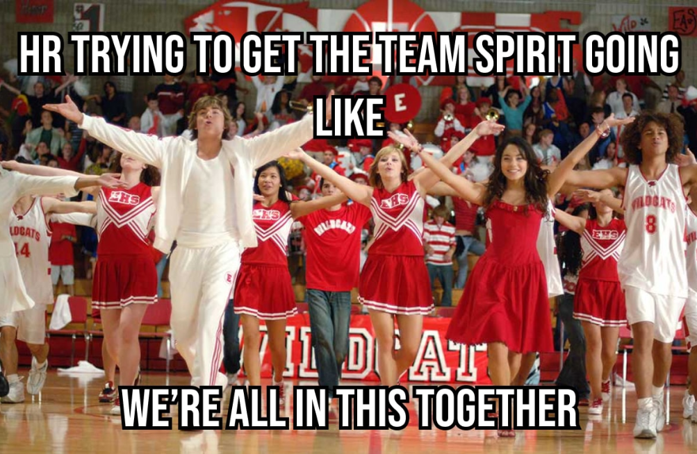

Slide 27
Strategies to Help You Navigate Your HR Role
Lead by Example: Demonstrate the values and behaviors you want to see in the organization.
Build Trust: Be transparent and consistent in your actions and communications.
Stay Informed: Keep up-to-date with HR trends and best practices to provide informed guidance.
Empower Others: Encourage and support employees to take initiative and develop their own leadership skills.
Foster Collaboration: Create an environment where teamwork and open communication are encouraged. Be flexible and open to feedback.
Clarity: Ensure that policies and procedures are clearly communicated and understood by everyone in the organization.
Consistency: Demonstrate integrity and fairness by applying policies and procedures fairly and consistently to all employees.
Accountability: Hold yourself and others accountable to the established policies and procedures. This reinforces the importance of adherence and builds credibility.

Slide 28
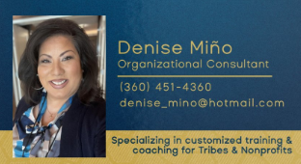
THANK YOU!

