Slide 1


28th Annual Conference
September 23-25, 2024
Durant, Oklahoma
Notes:
Presentation must be in 16X9 Format

Slide 2


Introduction
A Buyer’s Road Map To Selecting Your Next HR Technology

Slide 3




Our PDS Team
Dan Price
Enterprise Account Manager
Darrell Vandergrifft
Manager,
Solution Specialist
Notes:
Sales Executive/”Storyteller” - 37 Years Experience (34 years with PDS) in HCM Enterprise Sales. Responsible for new business and customer satisfaction SW & West US and Canada.
<My Story>
Darrell – 25+ Years of Experience in Workforce Management and HCM (10 years with PDS) responsible for managing of Enterprise Solution Specialists.
My style for these type a session is to be interactive with you. So, during this session I want you all to be open to solicit a question from me.
So, with that, my first question that I like propose …
<CLICK>

Slide 4

A Buyer’s Road Map To Selecting Your Next HR Technology
Notes:
“Are we here today to learn how to select a new HCM system?” (You should get some nods of agreement)
“We may be able to agree that we want to do more than that…..if we just focus on purchasing a how to select a new HCM system…then there is a reasonably good chance that all or you or some of you will be buying a new solution yet again in 2 or 3 years.
Consider the data from a study by Josh Bersin.
<CLICK>

Slide 5
Josh Berin’s Study
Success Is Harder To Achieve Than We Thought
32% of HR Tech Projects are significantly over budget
53% of Projects Miss Deadlines for Implementations
42% of HR Technology Projects Fail to meet all objectives Meet Customer Needs
Notes:
Consider the data from a study by Josh Bersin.
32% of HR Tech Projects are significantly over budget
53% of Projects Miss Deadlines for Implementations
42% of HR Technology Projects Fail to Meet Customer Needs
You don’t want that, right?”
“Let’s level set our conversation today.
<CLICK>

Slide 6
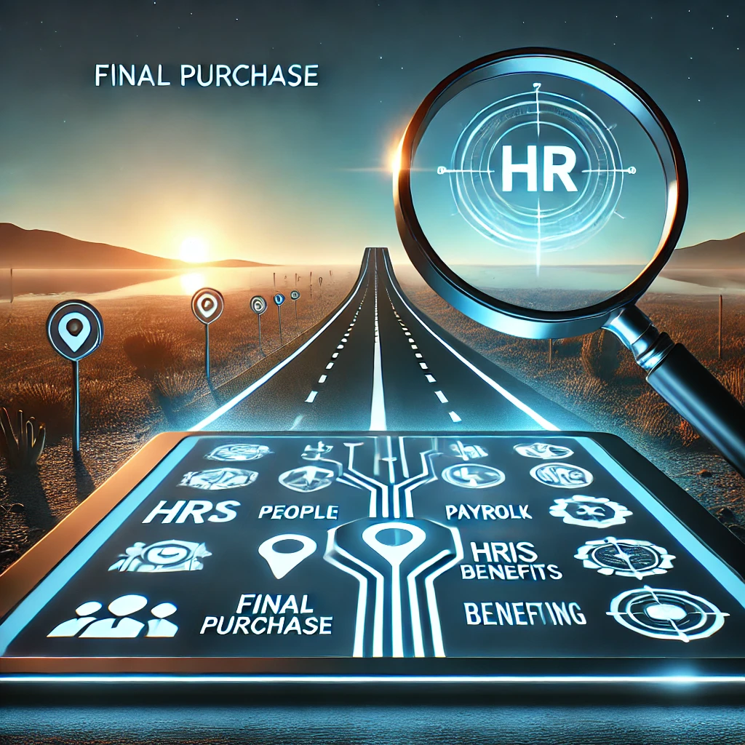
A Buyer’s Road Map To Selecting Your “Last” HR Technology
Notes:
We could be here today to work on the best process for selecting your Last HR Technology Solution you ever want to buy.
Let’s see a show of hands of how many people have been a part of a vendor selection process before?” [raise hands]
“More than one, more than two, anyone more than three? Ok. [direct to any hands still up] How many?”
“Ok. We have some experienced people here today. You have been through this before.”
Ok. Let me ask the group another question. What is our goal here today?” [Pause – see if anyone will say something – wait a second. {“Let’s level set our conversation today.}
Hopefully, someone will say “we are here for pointers on how to choose a new system or service. {If no one answers that say what they are thinking….]
Can expand that goal? Can we agree our goal to Not to find the right one for today or tomorrow, but the one that will meet your long-term needs and be a great long-term partner for your business?
Does that sound good?”
<CLICK>

Slide 7

Buy House Correlation: HCM Decision
# times (avg. 1-3x)
Life Events: Getting married, desire to have children, love to entertain need a bigger house, downsize for retirement
Big Impact: Family stability, good school district, and social status, culture, etc.
# times (avg. 1-3x)
Business Events: To be paperless, compliance, gain efficiencies via ESS & MSS, better analytics and reporting
Big impact: Your career path, health of organization, and culture.
Notes:
As adults, most of us will make “big decisions” that will impact our personal lives. And when I say, “big decisions”, I don’t mean snickers or milky ways, Country Music or Rock-n-Roll, Red or White wine, etc.
I mean, “BIG DECISIONS” like…
What college will I go to?
What do I study?
Who do I marry? (Do I marry?)
Where do I work?
Where do I live?
Do I rent or Buy my first home?
As a professional person, you too, will make “big decisions” that will impact your careers. And when I say, “big decisions”, I don’t mean, using a blue or black pen today; do I walk at lunch or drive to Chick-Filet;
I mean, “BIG DECISIONS” like…
Do I take that promotion?
Do I listen to that recruiter this time?
Should we let go “Johnny”?
Should we take the company public?
Do we finally replace our current HCM? (yes, I believe this is a big impactful moment for several reasons)
Reasons:
Professionals need to rely on the quality of their tools
Trust in their data to aid in strategic decision-making
Compliance Support and protection (nobody wants a black-eye)
It’s a career changer!!
Justifying your HCM will happen between 1-3 times in your careers, and you will have real reason for it, but you will need a solid foundation to convince your management.
How do you get started to finding your LAST HR TECHNOLOGY?
<CLICK>

Slide 8
AGENDA
Motivation
How To Get Started
  Gathering Requirements/
  HRIS/HCM Landscape
Stages of the Modern Selection Process
7 Questions Your HRIS Sales Rep Doesn’t Want You to Ask
Notes:
Bullet Points:
Most HR professionals only experience selecting an HRIS/HCM 1-3 times in their careers.
This session offers a roadmap to guide you through the process.
We'll cover the 8 stages of a real search, best practices, tools, and overcoming challenges.

Slide 9

MOTIVATION!
Why would we change your HRIS/HCM solution?
Notes:
Simple definition of Cloud Computing - An application is located and runs on servers owned and operated by third parties. But you (as a user) log into it over the Internet to use the application. To access the right to use this service, you pay a subscription (Annual, Monthly) based on your usage. This delivery is a service model - Software-as-a-Service (SaaS) – which provides on-demand access to application software and infrastructure support. The more users and the more functions used increases or decreases your fees…LIKE A UTILITY BILL.
Simple definition of On-Premise Computing – “Traditional Computing” works in the same way as Cloud Computing. However, the application is located and runs on servers licensed by your organization and maintained by your organization. As a user, you connect to it based on your IT’s chosen network policies. You pay a one-time license fee and annually pay a support and maintenance fee for updates and enhancements, and you are solely responsible for infrastructure (i.e., your environment) updates and maintenance.
So why are industry pundits and analysts so sure the move to a cloud environment is the way of the future?
<CLICK>

Slide 10
Many factors to change?
Business Needs
Technology Needs
Vendor Changes
User Satisfaction
Regulatory Compliance
Budget constraints
Notes:
The frequency with which HR professionals change their Human Resources Information System (HRIS) or Human Capital Management (HCM) solution can vary widely depending on several factors.
These factors include:
Business Needs: Changes in the business environment, such as company growth, mergers, acquisitions, or restructuring, can impact the need for a more robust or flexible HRIS/HCM system.
Technological Advancements: Rapid advancements in HR technology may prompt professionals to upgrade their systems to stay current with the latest features and capabilities.
Vendor Changes: If the vendor of the HRIS/HCM solution undergoes significant changes, such as discontinuing support or services, HR professionals may consider switching to a different solution.
User Satisfaction: If the current HRIS/HCM system fails to meet the needs of the HR team or employees, dissatisfaction may lead to the exploration of alternative solutions.
Regulatory Compliance: Changes in labor laws, compliance requirements, or data security regulations may necessitate a switch to an HRIS/HCM system that better aligns with updated legal and regulatory standards.
Budget Constraints: Financial considerations play a crucial role. If the organization faces budget constraints or if there is a more cost-effective solution available, HR professionals might opt for a change.

Slide 11






How To Get Started
Notes:
Gathering your HRIS/HCM software requirements should be one of the first activities you complete as you prepare to select a new system.
IMAGE NEEDED

Slide 12

4 Steps to Gathering
Your Requirements
Create a solid foundation
Notes:
The 4 steps:
Interview stakeholders and subject matter experts (SMEs) to determine future system needs
Review the current system or methodology for weaknesses or gaps
Document and prioritize requirements
Consider software requirement modeling options

Slide 13
4 Steps to Gathering Your Requirements
Interview stakeholders and subject matter experts to determine future needs.
Review the current system or methodology for weaknesses or gaps
Document and prioritize requirements
Consider software requirement modeling options
Notes:
The 4 steps:
Interview stakeholders and subject matter experts (SMEs) to determine future system needs
Review the current system or methodology for weaknesses or gaps
Document and prioritize requirements
Consider software requirement modeling options
Let’s quickly breakdown the four…

Slide 14
Step I. Interview Stakeholders
Define your stakeholders.
  C-Level
  Employees
  Managers,
  HR Staff
  Other Specialist – Finance or IT
Your HRMS is a source of management intelligence and decision-making through data-rich reports and dashboards.
All these stakeholders and SMEs have requirements and expectations for your new HRMS, so it is best to gather their input via written surveys, interviews, and in-person or virtual workshops for complex areas.
Notes:
An HRIS is a highly visible system. It serves the back-office needs for HR staff and can be a source of employee data in downstream systems.
A stakeholder in your HRIS project is anyone who has an interest in or influence on the selection and implementation of the new system. Often categorized by role or responsibilities, the basic HRIS stakeholder groups are:
C-suite executives and HR Leadership: these are the strategic decision-makers and influencers. They’re usually looking for strategic benefits and organization-wide impact. Once convinced, these are your senior champions. If unconvinced, they can be the exact opposite.
Employee Users: most employees won’t deal with HR on a daily basis. Their transactions might be around booking time off, work schedules, and getting paid accurately and on time. The question is, how will a new HRIS improve their day-to-day working lives?
Line managers: while individually, managers will also share the needs of the Employee Users group, they are also involved in the mundane HR transactions from the management side, authorizing time off, redeploying team members, etc. Furthermore, they are the first level of user that will benefit from any reporting and analytics functionality in the new system.
Operational HR staff: from a service delivery perspective, your HR team bring insights into how processes might be improved and where technology and automation might do the best. they’re also the people whose working lives will be most impacted.
Specialist staff: other specialist teams within the organization, such as Finance or IT, are likely to have specific input.
You’re looking to make improvements, and the first step is to get some clarity on what it is you’re aiming to improve. Not only does this mean looking at whatever current system you use and its shortfalls (often best explored by talking to the stakeholders who use it) but also understanding your organizational context. Ask yourself:
What are your present business priorities?
What are your broad plans: expansion, diversification, consolidation, acquisition?
What HRMS features might be key to achieving your current and future strategic goals?
What KPIs and other metrics are in place to measure HR and related performance?

Slide 15
Step II. Review the Current System or Methodology for Weaknesses or Gaps
What activities or HR processes include workaround steps? (Manual interventions)
Is any data missing from your HRIS?
Does anyone keep and maintain Excel spreadsheets of HR data?
Notes:
A new HRIS is an opportunity to improve or fix current flaws or faults systematically. It is relevant to interview users and receivers of your HRIS data.
What activities or HR processes include workaround steps?
Is any data missing from your HRIS?
Does anyone keep and maintain Excel spreadsheets of HR data?
Now is the time to address any perceived system weaknesses so that these requirements can be included in your future system wish list.

Slide 16
Step III. Document and Prioritize Requirements
Create Work Sessions (Teams or face-to-face) are critical to assist in the ranking of requirements
Collective Ranking Mutually Agreed
Uncertain requirements (noise) can often be removed
Circulate final ranking and Use them for RFIs, RFPs, and Demo Scripts
Notes:
IMO, as requirements are being identified, it is imperative that you document and then review and prioritized in a working session. (Using Teams or meeting face-to-face must happen). My reasoning is simple:
An important requirement that is only identified verbally can often become lost in a busy project.
An uncertain requirement can often be removed from your list during the prioritization stage when requirements are seen all together, and the true requirements emerge at the top.
Your completed requirements list should be circulated with the stakeholders and SMEs who have provided input prior to being finalized and frozen to prep for an RFI, RFP, or Demo Script.

Slide 17
Step IV. Consider Software Requirement Modeling Options
Traditional List
Use-case diagrams / Charting processes
Notes:
Traditional methods of capturing HRMS requirements often include written lists of independent requirements. Modeling requirements via use-case diagrams or sequence charts allows you to ensure that your HRIS requirements are complete across the entire employee lifecycle from the initial requisition and hiring of an employee through to termination or retirement. Stakeholders often notice missing requirements more easily when they are presented in a pictorial format. Also, modeling enables your team to highlight conflicting requirements more easily.

Slide 18

Searching the HRIS/HCM Landscape
Create a solid foundation
Notes:
Gathering your HRIS/HCM software requirements should be one of the first activities you complete as you prepare to select a new system. Let’s skip these details for another session. However,

Slide 19

How To Get Started
HRIS/HCM Market Landscape
Notes:
Just Google to get started – it’s that easy
Or I will do one better…
<CLICK>

Slide 20

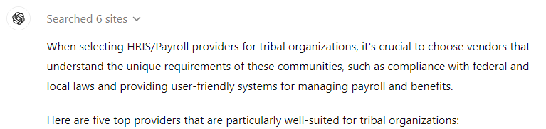
Notes:
Suggest the top 5 HRIS/Payroll providers for tribal organizations? Of course, it’s that easy…right?

Slide 21









Just Watch PGA or LPGA Tour Event of the Week
Notes:
There are non-traditional ways
Like watch a professional golf event on the weekends
Of course, this after my lawn cutting and other honey to-do list.

Slide 22


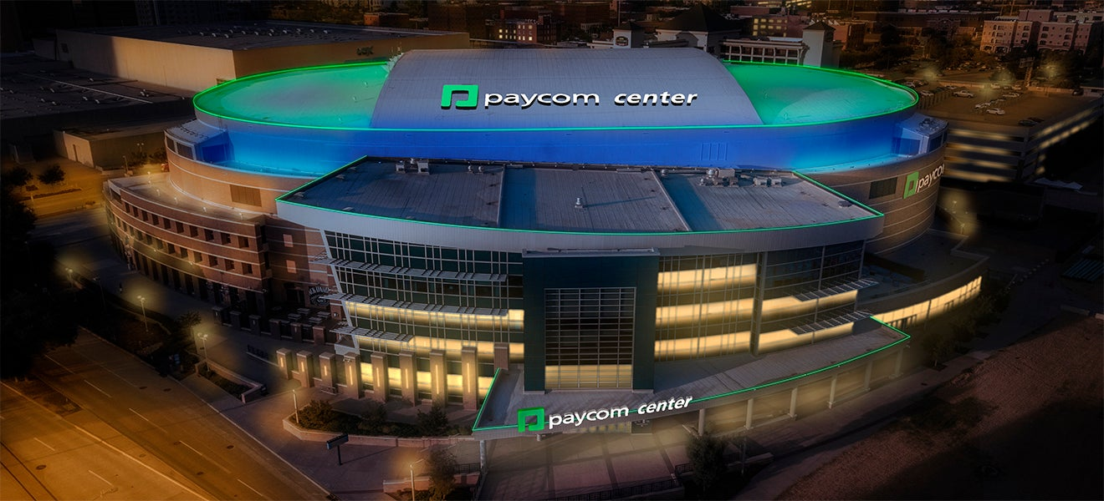



Go to Your Nearest Sports Venue
Notes:
Or go to any sports venue, you will be presented with HR Technology Branding.
I think we can all agree, whether it's searching the internet, watching TV, or going to large sports venues – these things are not the most convincing methods of narrowing a software selection of HR Technology.

Slide 23

Suggestions on
Exploring the
HRIS/HCM Landscape
Do the work! You are worth it!
Notes:
Best practices & tools in researching potential vendors
Do Your Research
Use Vendor Research Sites to learn about different vendors:
HR Technology Advice
G2
Trust Radius
CompareHRIS.com
Software Advice
HRMS World
Getapps
Matchr
SelectHub
TechAdvisor
Leverage the LinkedIn community
Solicit feedback on the best solutions for organizations like yours from LinkedIn community. You will get a lot of feedback.
Talk to Peers
Reach out to colleagues at similar organizations to see what they use and ask about their experience. You can learn a lot from their successes and challenges.

Slide 24
Suggestions on Exploring the HRIS/HCM Landscape
Do the work! You are worth it!
Notes:
Best practices & tools in researching potential vendors
Do Your Research
Use Vendor Research Sites to learn about different vendors:
HR Technology Advice
G2
Trust Radius
CompareHRIS.com
Software Advice
HRMS World
Getapps
Matchr
SelectHub
TechAdvisor
Talk to Peers
Reach out to colleagues at similar organizations to see what they use and ask about their experience. You can learn a lot from their successes and challenges.
Leverage the LinkedIn community
Solicit feedback on the best solutions for organizations like yours from LinkedIn community. You will get a lot of feedback.

Slide 25

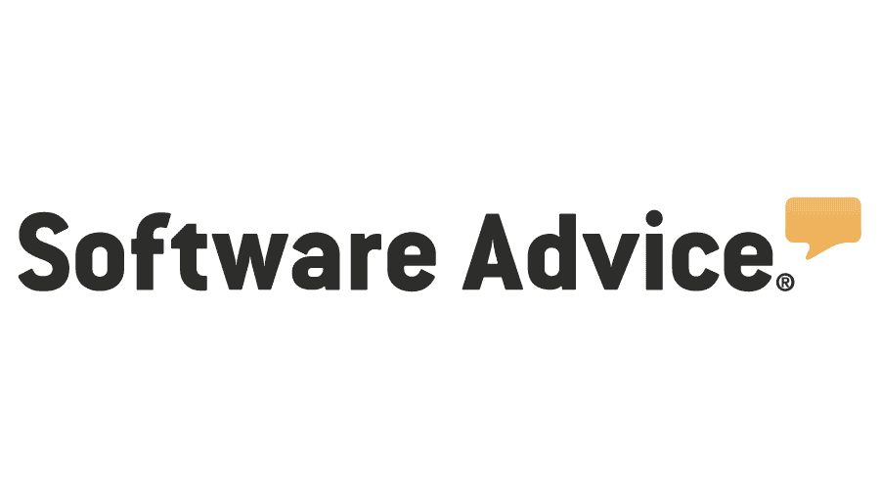








Use Vendor Research Sites
The most trusted software marketplaces, helping millions of people every year make smarter software decisions based on authentic peer reviews and Research.
Notes:
Best practices & tools in researching potential vendors
Do Your Research
Use Vendor Research Sites to learn about different vendors:
HR Technology Advice
G2
Trust Radius
CompareHRIS.com
Software Advice
HRMS World
Getapps
Matchr
SelectHub
TechAdvisor
PROS:
Offering Online Reviews from existing customers on a multitude of variables from product features, support, and services
Offering deep side to side comparison from many. These comparisons can help you in validating a short-list of vendors to focus on.
CONS:
The Beehive Effect
See example of HR Technology Advises Semi Annual Report.
<CLICK>

Slide 26

Beehive Effect
Notes:
How many of you have personally witness this experience?
Darrell and I will demonstration….
Via Phone (mobile and office)
Via Text
Via Email
Via LinkedIn
I apologize on behalf of the industry!!

Slide 27

Side-To-Side Comparison
Derived from real experiences and independent research

Slide 28
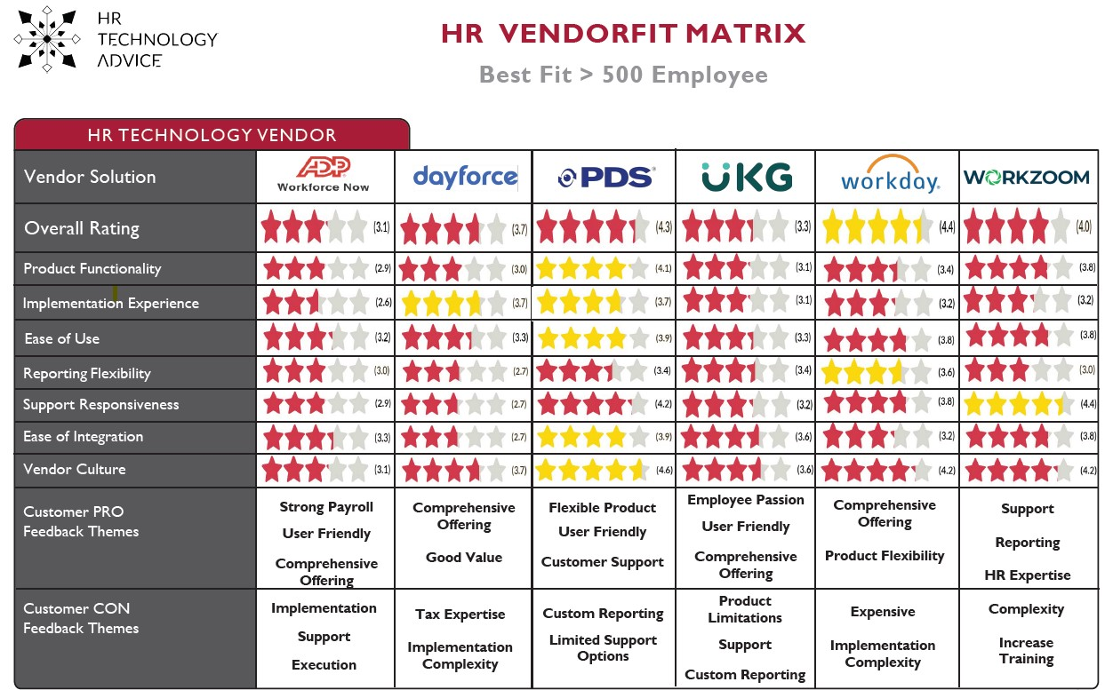
SATURN
Mercury is the closest planet to the Sun

Slide 29
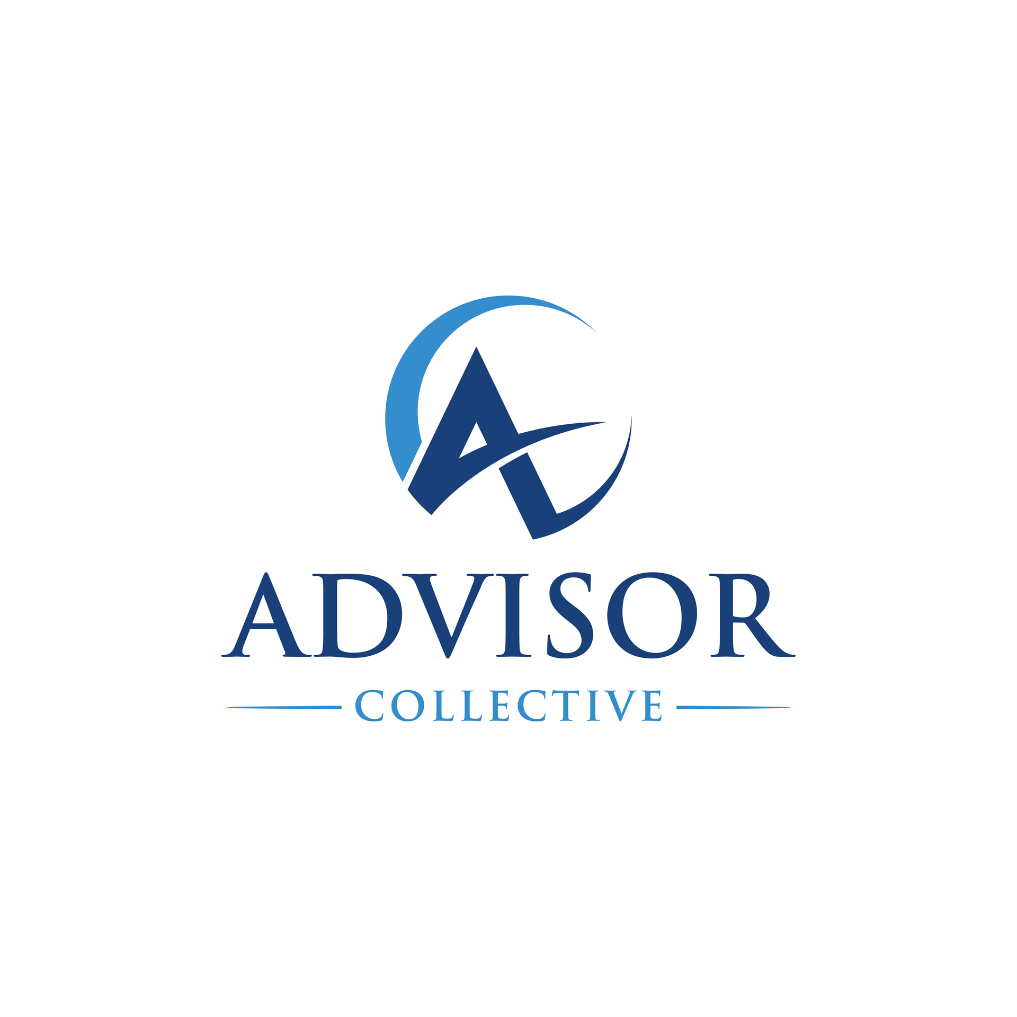

Leverage LinkedIn
Specific Groups to talk Peer-to-peer and Research Organization who specialize in HRIS/HRMS Project brokering.
Notes:
Solicit feedback on the best solutions for organizations like yours from LinkedIn community. You will get a lot of feedback, keep digging.
For Example, The Advisor Collective is a powerful association of consulting, advisory, brokerage, and implementation provider firms representing every vertical market segment, employer size, geography, and domain. Among their goals are technology provider engagement and insight generation specifically in the HR, benefits and payroll spaces.
Expanding our Voice
The Collective has assembled a wide variety of consulting, advisory, brokerage, and implementation/provider firms representing every vertical market segment, employer size, geography, and domain. Despite the theoretically competitive nature of our firms, we share a simple yet common purpose – to bring value to the employers that we serve. That value is often generated through a high level of expertise, the delight of our clients (and the employees that they support), a currency of insight, and an insatiable appetite for continuous improvement.
Economy of Scale
The pacing of the current market is relentless, and even the best of us are challenged to ensure that we keep pace with the latest thought leadership, provider capabilities, employer needs, and employee expectations. It’s our belief that the Collective can serve as a hub of common insight and market intelligence, thereby aiding in the efficient capture, inventory, and dissemination of valuable information for you and your firms.
Provider Engagement
Providers are a critical part of our ecosystem, and we firmly believe the Collective will offer a one-to-many format for provider exposure, bilateral communications, and meaningful engagement. Providers have a keen interest in the perspectives and experiences of the Collective’s membership, and we will continue to foster open and honest dialogue with all facets of the provider community. With high integrity and full respect for the confidential and competitive nature of certain provider information, the Collective will work openly with members and providers alike to embrace the wishes and needs of all parties.
Insight Generation
We envision the ability for the Collective to generate market-facing insight over time. The strength of our combined brands and market reach can bring an entirely new perspective in the forms of original research, infographics, presentation materials, and promotable outcomes. We look forward to working with you all in the prioritization of topics of interest, research committee formation, and timely execution.
OutSail
OutSail is the industry's first & only broker of HR software.

Slide 30




Use Trusted Sources
Talk To Fellow NNAHRA Members and Consultants with tribal experience
Notes:
Talk to Peers
Lean on Associations, like NNAHRA Association, like SHRM – The Advisory Committee is filled with exceptional skilled resources Example, Michael Day TribalHub
Industry Consultants
Insurance Brokers
Lean on your Financial Solution provider to recommend a solution partner

Slide 31

Stages of the Modern
Selection Process
8 MUST STEPS

Slide 32
Step 1: Initial Assessment – Sponsor support and acknowledgement of need to change
Step 2: Assessing Organizational Needs – Define needs and challenges – operational & strategic
Step 3: Assessing the Project Parameters
Resources constraints – Staff, Education, Skills, etc.
Budgetary constraints – Outline what you spend box looks like
Technological constraints – Privacy concerns, Enterprise reach, Integrations with other solutions
Time constraints – Timeline shortened due to “X” reason
Step 4: Evaluating Available Packages Against Needs and Project Parameters – Finding the perfect solution fit.
Step 5: Selecting the Project Committee – Senior Sponsor, Functional leads, Project lead, IT Support – network admin/application analyst/CIO
Step 6: Request for Proposal (RFP)
Step 7: Demonstration and Evaluation
Step 8: Choosing Between the Finalists
Notes:
A Selection Process is very disruptive and time consuming but exiting.
On average, a vendor evaluation could take 3-6 months depending on your approach. Personally, fastest was 1-day and my longest was 5 years.
This doesn’t count the prep work and justification meetings and sessions prior to going to market.
Step 1: Initial Assessment – Sponsor support and acknowledgement of need to change
Step 2: Assessing Organizational Needs – Define needs and challenges – operational & strategic
Step 3: Assessing the Project Parameters
Resources constraints – Staff, Education, Skills, etc.
Budgetary constraints – Outline what you spend box looks like
Technological constraints – Privacy concerns, Enterprise reach, Integrations with other solutions, and deployment options (On-premises or cloud)
Time constraints – Timeline shortened due to “X” reason
Step 4: Evaluating Available Packages Against Needs and Project Parameters – Finding the perfect solution fit.
Step 5: Selecting the Project Committee – Senior Sponsor, Functional leads, Project lead, IT Support – network admin/application analyst/CIO
Step 6: Request for Proposal (RFP)
Step 7: Demonstration and Evaluation
Step 8: Choosing Between the Finalists

Slide 33
7 Questions Your HRIS Sales Rep Doesn’t Want You to Ask
Be gentle☺
Notes:
When evaluating an HRIS system, digging deeper than the standard sales pitch is crucial.
Some questions can make your HRIS sales rep uncomfortable, but asking the right ones will reveal hidden limitations or weaknesses they might prefer not to discuss.
These seven questions are designed to uncover truths that could significantly impact whether the system is the right fit for your organization.
<CLICK>

Slide 34
Question #1
“What internal resources will need to dedicate to implement your solution?”
Why ask:
Reps generally downplay effort.
Get “real” understanding from the staff that will do the work
Do they have a formal Statement of Work (SOW) process?
Can they truly define existing resources needed?
Notes:
Why ask: Sales reps often downplay the internal effort required for implementation. Understanding the full scope of the process can reveal whether you’ll need additional staff, external consultants, or even extra training for your team. If the system requires extensive internal resources and expertise that your organization cannot spare, it may signal that the system is too complex for your current operations.

Slide 35
Question #2
"In what ways do customers outgrow your system?"
Why ask:
Forces the sales rep to confront the scalability limits of their system.
Identifying limitations early can save you from costly and time-consuming transitions in the future.
Notes:
Why ask: This question forces the sales rep to confront the scalability limits of their system. Knowing how and why customers eventually outgrow the solution helps you determine whether the platform can support your long-term growth. Identifying these limitations early can save you from costly and time-consuming transitions in the future.
Ex., Our company had a large convenience store chain, as a customer. For years they were paying 28,000 Employees a week with our solution. Unfortunately, they aspired to be 2X or 3X this size over the next 10-year period. Jumping into more states. They were also going through a family-owned transition to a more professionally run business bringing in new high-end C-Level folks who specialized in growing businesses. This company ended our 20+ year relationship because the new executives wanted to protect their business with a Tier-1 provider who had a track record of supporting companies of 35-50K+ business. As a middle market solution, who specialized in companies of 200-10,000 Employees, we certainly had only a few.

Slide 36
Question #3
"What parts of your solution are acquired or white-labeled?"
Why ask:
Could raise concerns about integration and support
May come with drawbacks like a disjointed user experience, reporting limitations, or integration challenges.
Applaud transparency, vendor’s overall user experience and long-term product stability.
Notes:
Why ask: Vendors may not want to admit that parts of their system are acquired or white-labeled, as this could raise concerns about integration, support, and consistency across different modules. Acquired solutions may offer faster innovation, but they often come with drawbacks like a disjointed user experience, reporting limitations, or integration challenges. Understanding this isn’t necessarily a dealbreaker but provides transparency about the overall user experience and long-term product stability.
Discuss the relationship with the other vendor – Get the history, Is it SSO?, Support calls needs addressed, what happens when relationship deteriorates?

Slide 37
Question #4
"What is involved in migrating data from our existing systems, and who is responsible for ensuring data accuracy?"
Why ask:
You’re looking for collaboration
The responsibility for data accuracy falls on your team. While most vendors offer migration automation and data integrity tools, ensuring data integrity is your responsibility.
Notes:
Why ask: Data migration is a critical step in any HRIS transition, and sales reps may be reluctant to admit that issues could arise or that much of the responsibility for data accuracy falls on your team. While vendors often assist with the migration process, ensuring data integrity is usually your responsibility. Knowing this upfront helps you prepare for potential risks and ensures you allocate the necessary resources for a smooth migration.
Diving deeper, review with your vendors what is considered convertible. Payroll History, Personnel History (Life to Date), Benefits History, and even Position History.

Slide 38
Question #5
"What is your annual customer turnover (what percentage of customers leave each year), and why do they leave?"
5-10% Turnover
Why ask:
High customer turnover is often a red flag.
Sales reps may hesitate to share these numbers but knowing how many customers leave—and why—can reveal underlying issues with the product, support, or unexpected costs.
Notes:
Why ask: High customer turnover is often a red flag. Sales reps may hesitate to share these numbers but knowing how many customers leave—and why—can reveal underlying issues with the product, support, or unexpected costs. Ideally, you want to see an annual turnover rate below 5-10%.
Note: As more and more vendors are cloud based, my concern is the perception of the buyers. Are they viewing the modern solutions as a commodity (meaning, best price wins the deal) or do they genuinely care to have a relationship with the provider.

Slide 39
Question #6
"What is the process for requesting new functionality, and how often do customer requests shape product updates?"
Why ask:
A vendor’s product roadmap doesn’t reflect THEIR customers’ feedback, this could signal slow innovation and a lack of customer-centricity.
You want a vendor who listens to its clients and incorporates their needs into future updates, discuss how they collect input.
Notes:
Why ask: If a vendor’s product roadmap doesn’t reflect customer feedback, this could signal slow innovation and a lack of customer-centricity. You want a vendor who listens to its clients and incorporates their needs into future updates. This shows that the solution will evolve in ways that align with your organization's needs, keeping the system relevant and adaptable as you grow.

Slide 40
Question #7
"What are the top 5 functionality or product updates on your release roadmap for the next 12 months?"
Why ask:
Learning if the vendor is responsive to industry changes.
A well-defined roadmap indicates that the vendor is forward-thinking and invested in continuous improvement.
Notes:
Why ask: Learning about upcoming features gives you insights into current functionality gaps and helps you determine if the vendor is responsive to industry changes. If a clear roadmap is lacking, it could raise concerns about the vendor's ability to innovate and keep up with your organization’s evolving needs. A well-defined roadmap indicates that the vendor is forward-thinking and invested in continuous improvement.
12 to 18 months is a respectable ask. Please don’t ask for 3-5 years roadmap, this is a life-time in the world of tech!
Ask for a sit down with the head of engineering or product manager.
Ask them how they communicate upcoming enhancements – ask for exmples (Product Release Notes, Recorded Webinars to Customers, etc.)

Slide 41
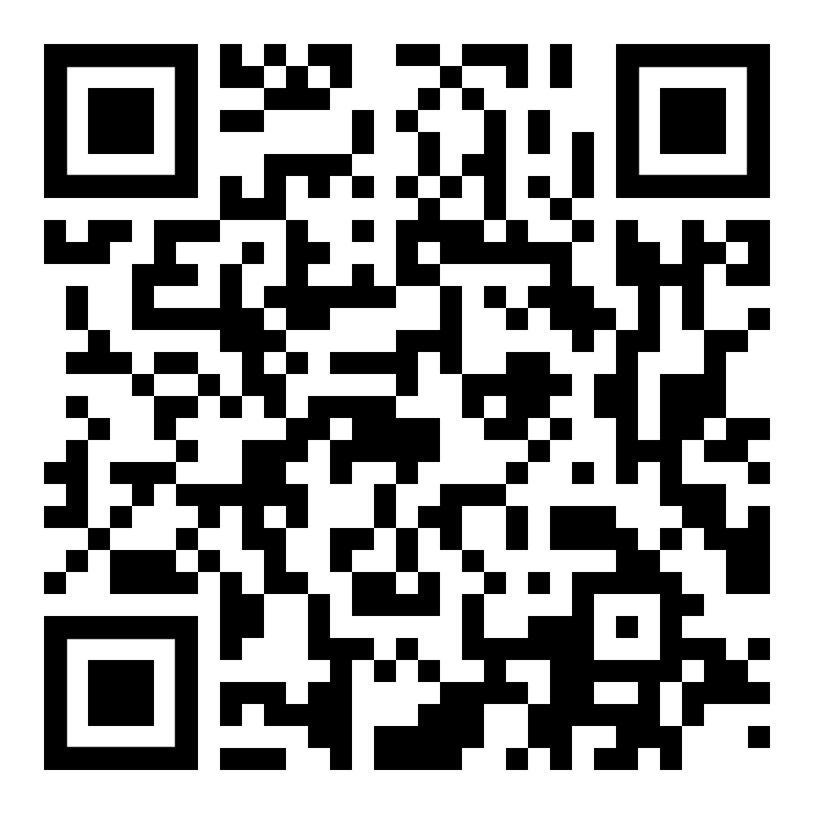

Additional Resources
Visit our NNAHRA page at https://www.pdssoftware.com/landing-nnahra
Visit our booth - #26
Notes:
Whitepapers to assist you on building a business case
Return on Investment Calculator to place $$$ to real automation savings

Slide 42
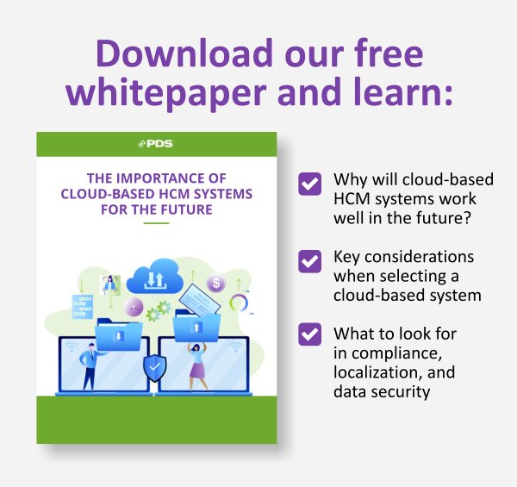
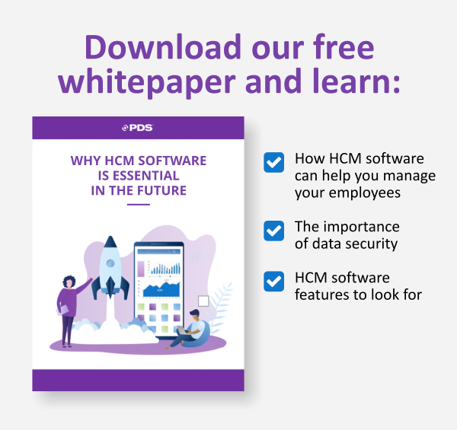
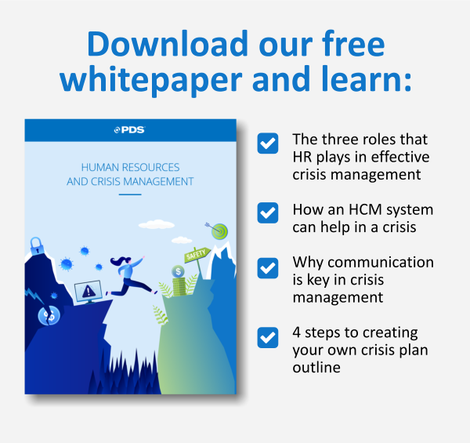
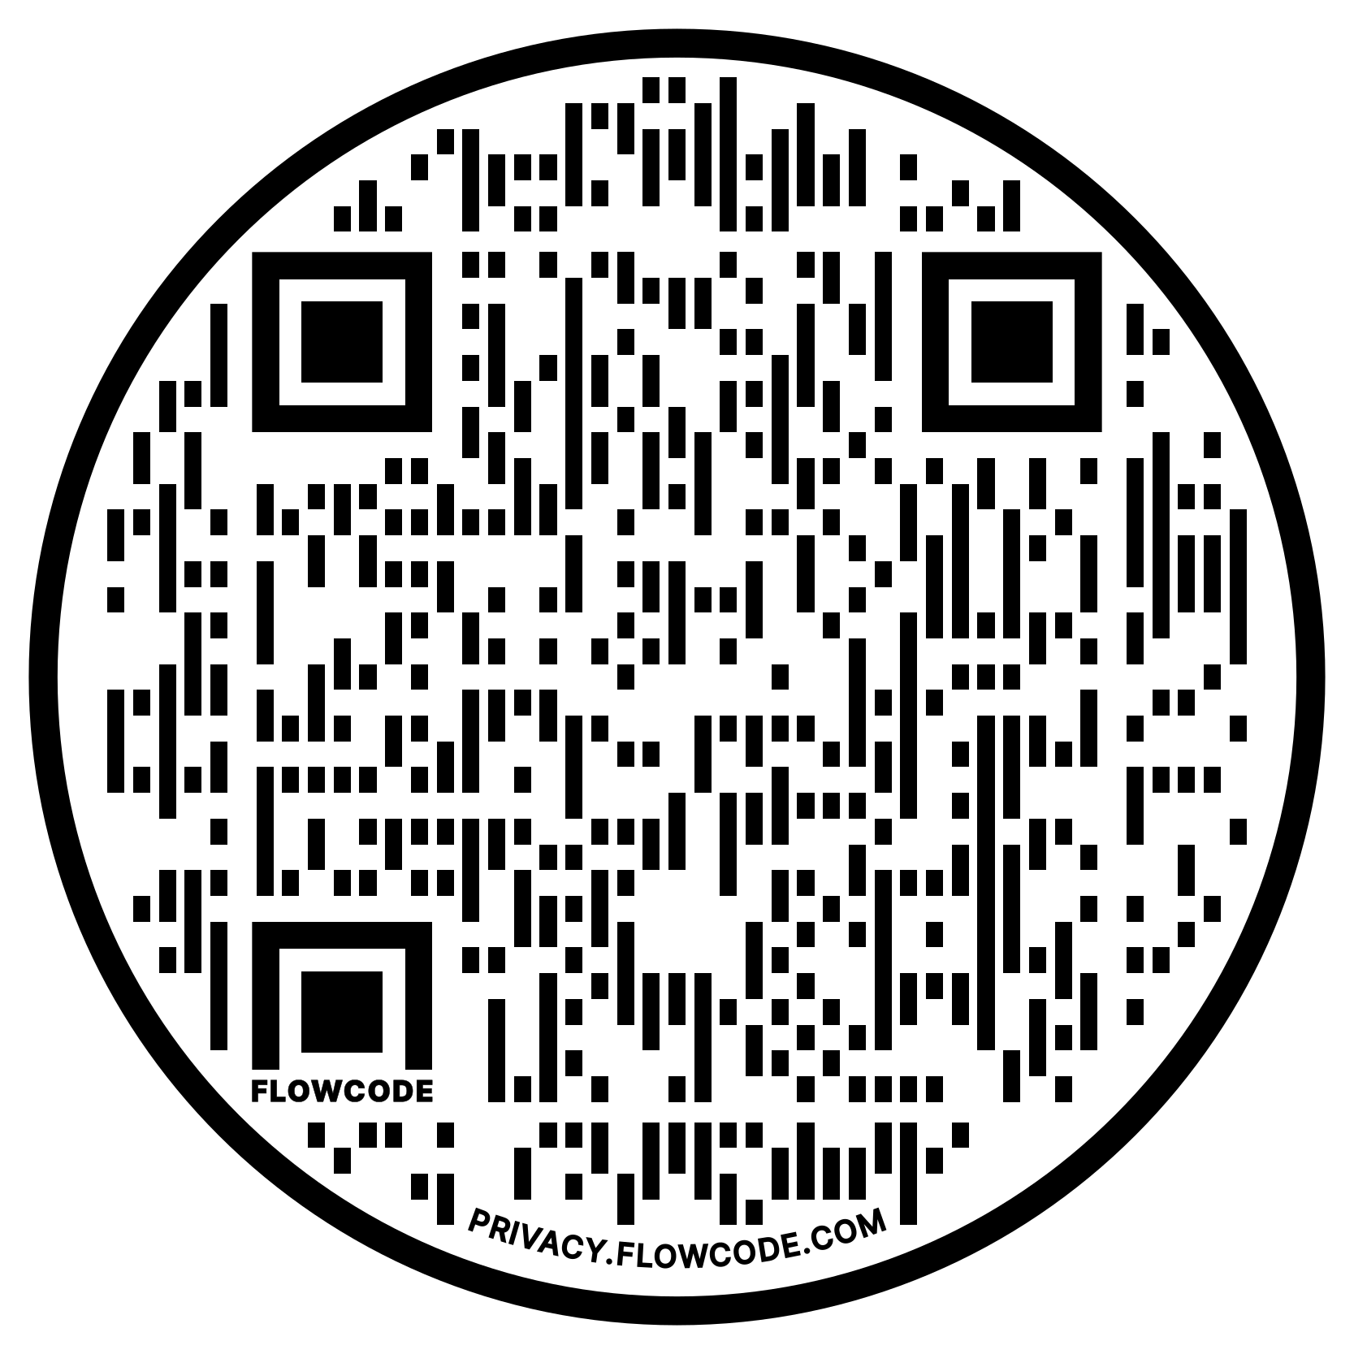
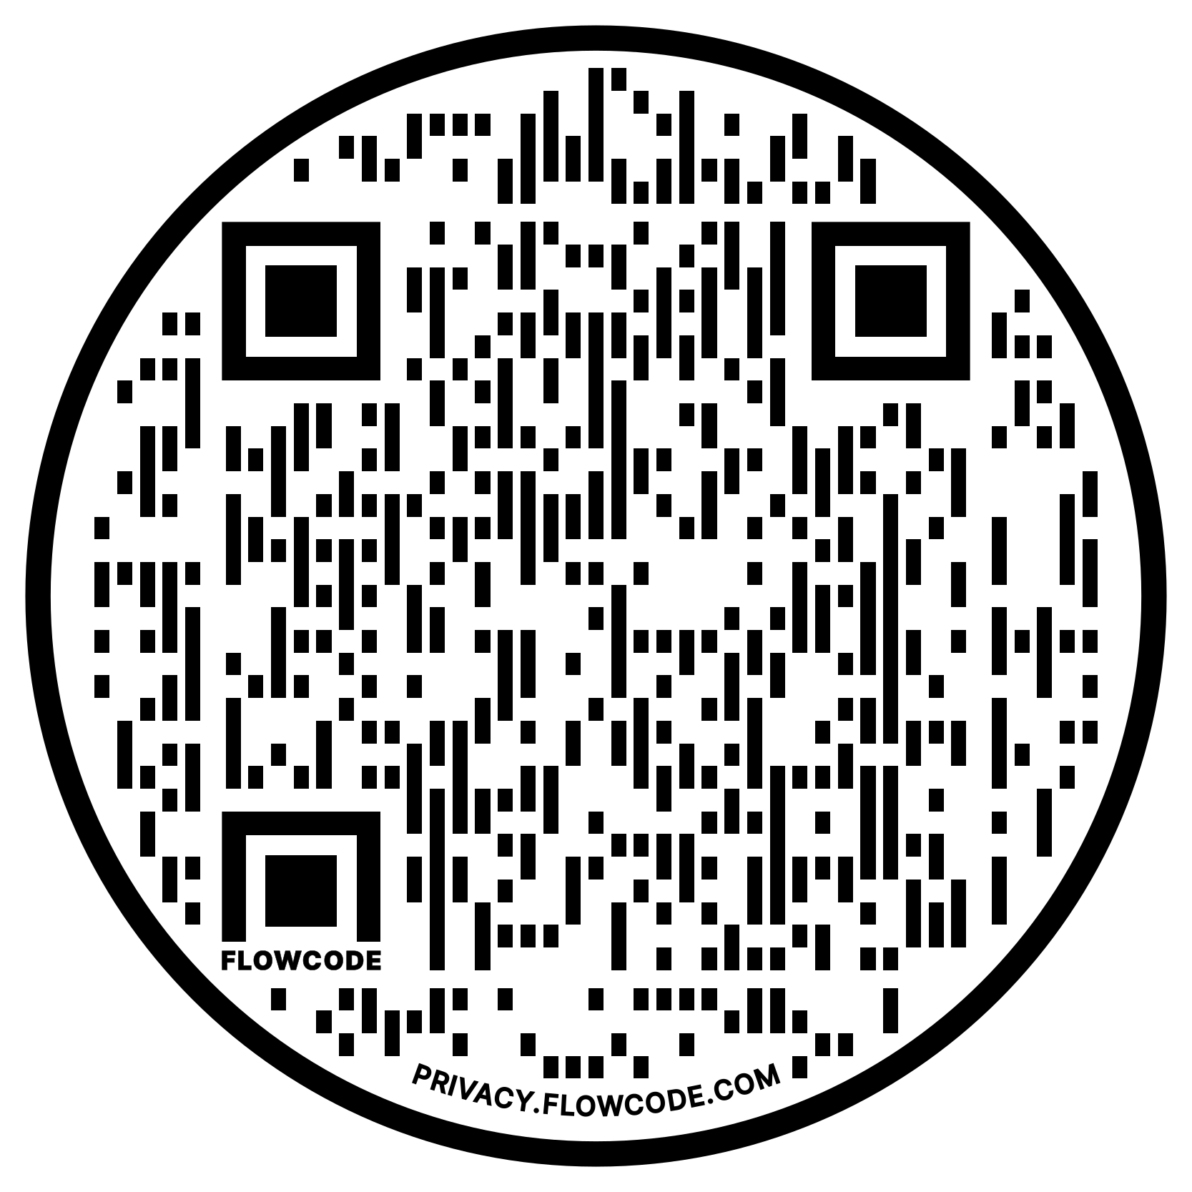
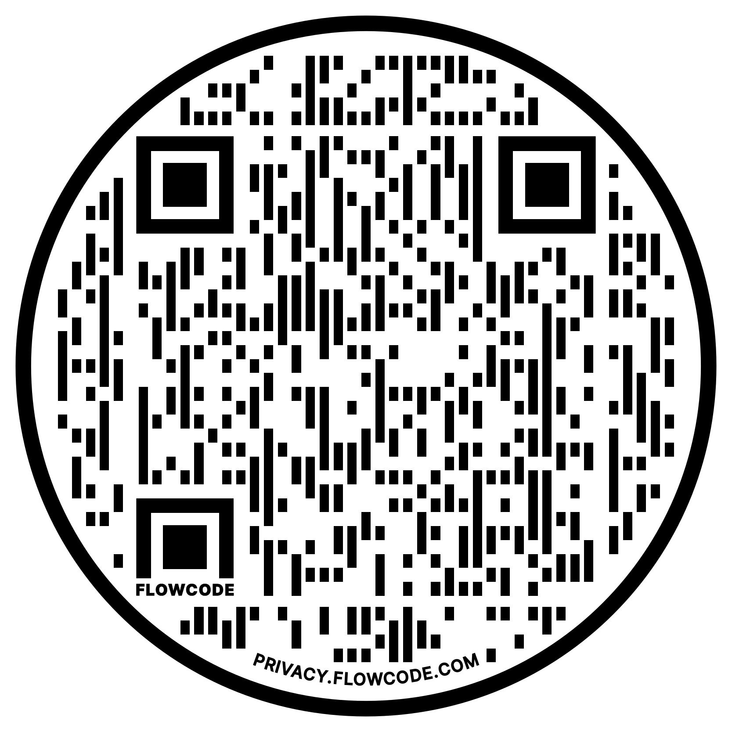
Three Helpful Whitepapers
Notes:
In addition to the content, we’ve covered today, you may find these whitepapers helpful to support any cloud initiatives you may have.
You can scan these QR codes to gain access to the papers.
<CLICK>

Slide 43


Chief Research Officer
HR Technology Advice
P: 954-235-5970
E: Chris@HRtechnologyadvice.com
LinkedIn: https://www.linkedin.com/in/chrisharvey/
Website: https://www.hrtechnologyadvice.com
Special Thanks!

Slide 44
THANK YOU!
WISHING YOU MUCH SUCCESS!
Dan Price
dprice@pdssoftware.com
www.pdssoftware.com
610.304.7524

