Slide 1
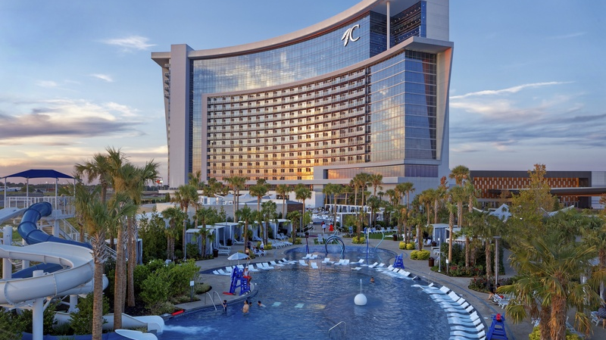

28th Annual Conference
September 23-25, 2024
Durant, Oklahoma

Slide 2


Slide 3



Slide 4
