Slide 1


Slide 2

Let’s Talk About Pay
Empowering Managers with Effective Strategies for Pay Discussions
Presented by Valliant Consulting Group
2024 National Native American HR Association Conference

Slide 3

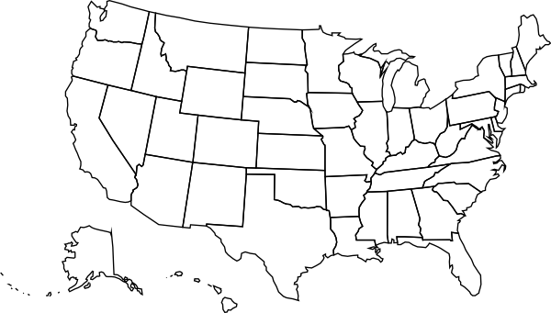

Who We Are
We are a native-owned consulting firm, specializing in compensation for tribes and tribal entities. We were established in 1998 in Albuquerque, New Mexico
and have become the foremost compensation experts in
Indian Country.

Slide 4




Valliant Consulting Group
Mike Canfield
President and Member of Laguna Pueblo
Kelly Steingreaber
Vice President of Operations
Kim DeFilippis
Project Director and HR Consultant
Stacie Jackson
Senior Compensation Consultant & Certified Compensation Professional

Slide 5
Pay Matters.

Slide 6








To Employers

Slide 7










To Employees

Slide 8
So, why aren’t we talking?
Are your managers trained to have pay conversations?
Source: Payscale.com

Slide 9
2024 Compensation Best Practices Report, Payscale.com

Slide 10
Increasing pressure to talk about pay
8
50%
3x
75%
States with pay transparency laws, resulting in 27% of organizations reporting increased questions about pay as a response
More applications when a job posting has salary information
More likely to find quality candidates
Of employees are more likely to trust an organization that provides salary ranges on job postings
Source: Payscale
Source: ZipRecruiter
Source: ZipRecruiter
Source: SHRM

Slide 11
We should get talking.
Improves working relationships
Eliminates confusion
Fosters trust and commitment
Reduces bias
Promotes engagement

Slide 12
Who should do the talking?
HR
Leaders
Managers

Slide 13
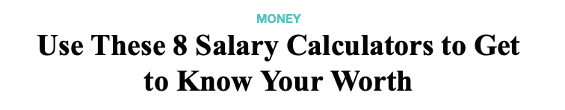
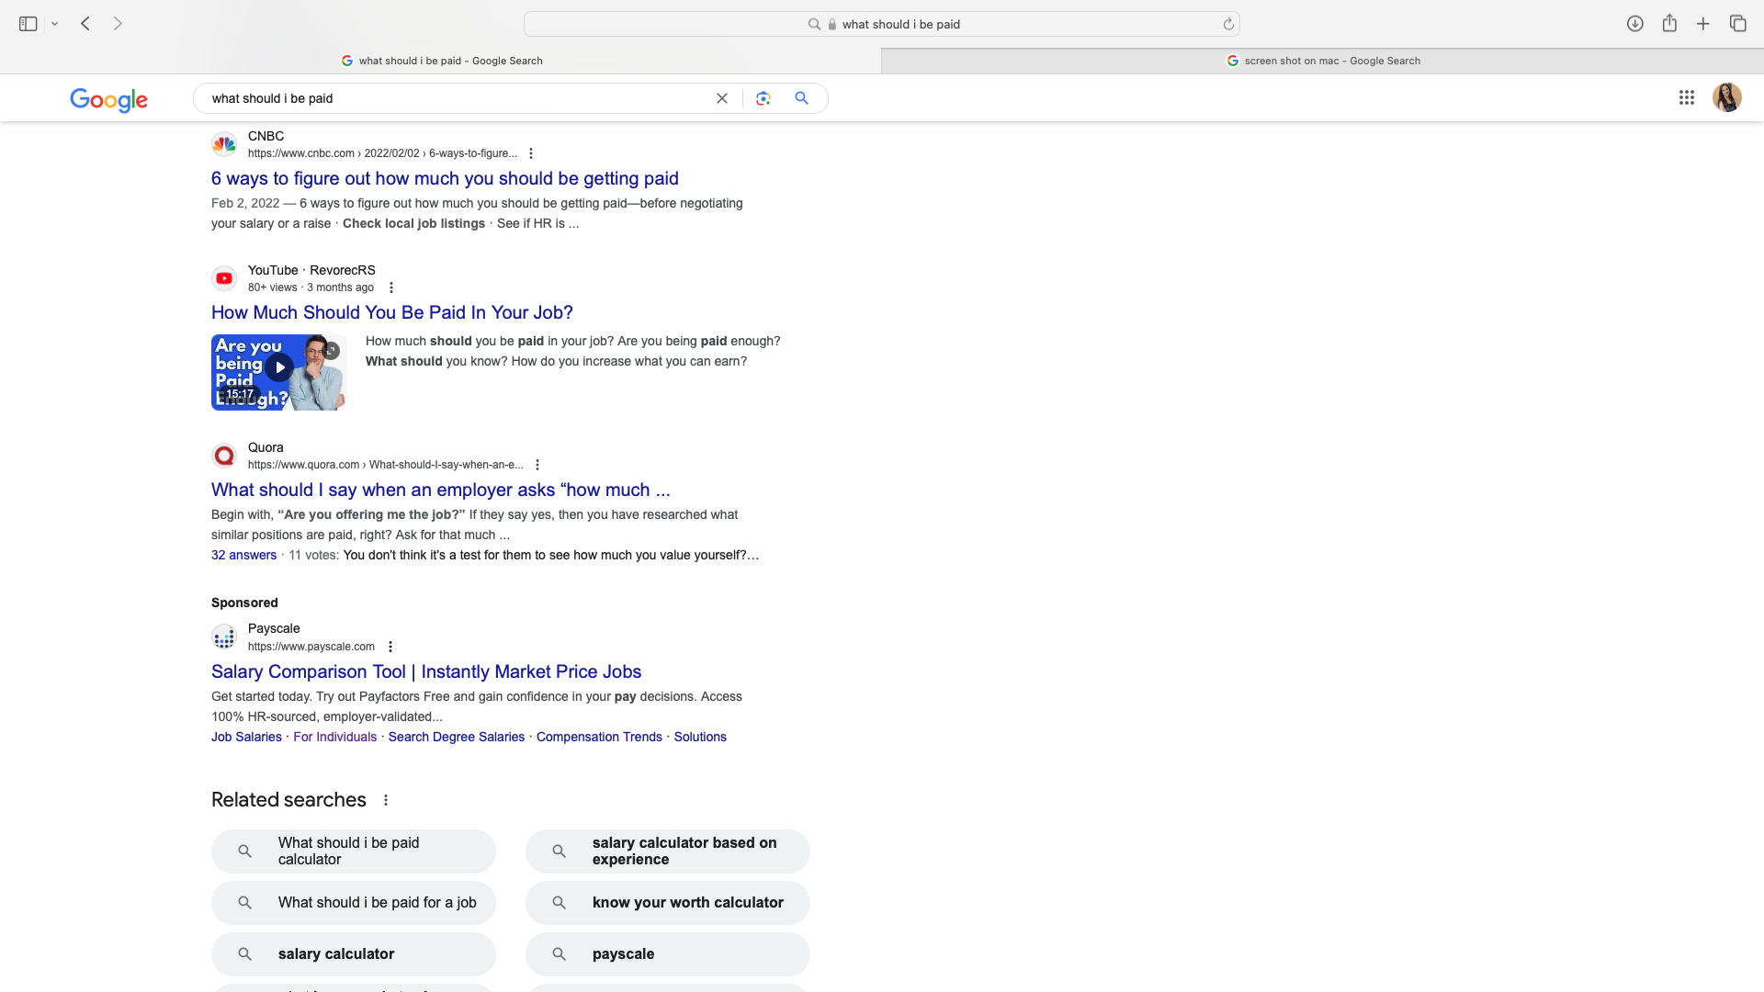
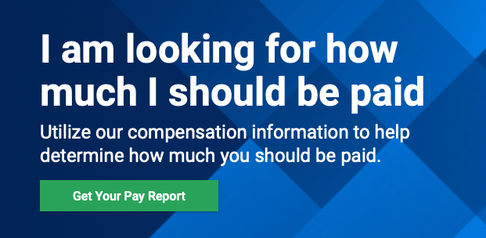
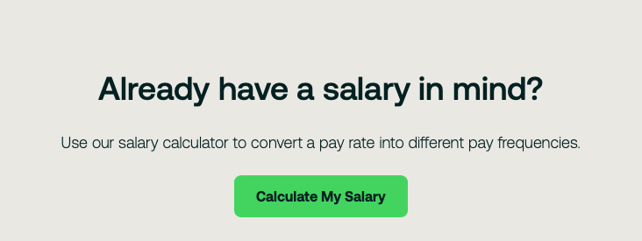
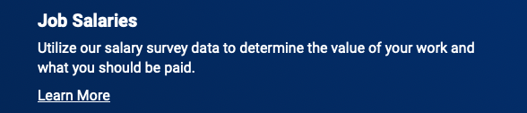
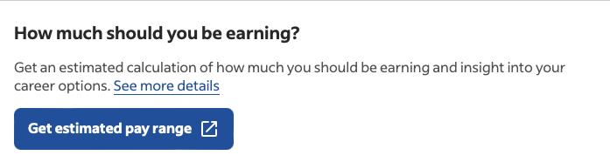
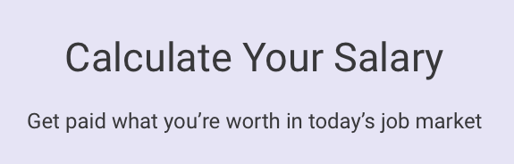
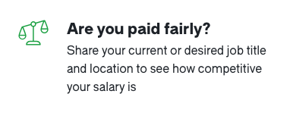
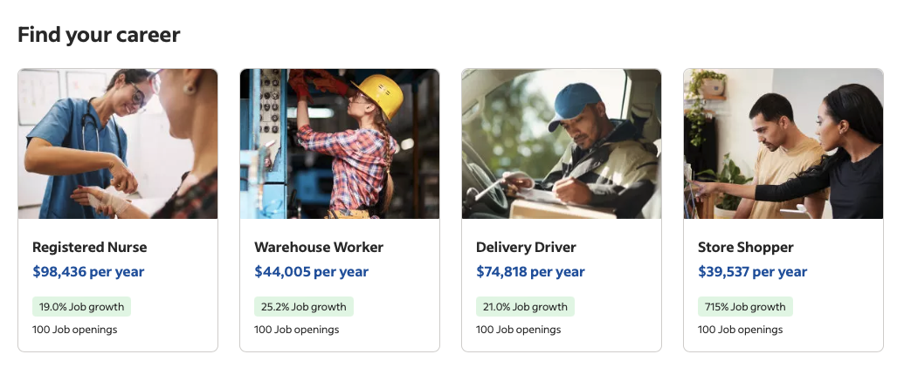
Am I being paid enough?

Slide 14
Am I being paid enough?
Am I valued?

Slide 15

The Value Exchange
Knowledge of our communities
Ideas and insights
Employees
Experience
Productivity
Education
Certifications

Slide 16

The Value Exchange
Compensation
Workplace flexibility
Organizational culture
Time off
Employers
Benefits
Learning

Slide 17
What went wrong here?

Slide 18


Manager’s Conversation
Checklist
Timing
Value
Total Rewards
Process
The do-nots
Follow-through

Slide 19


Find the right time.
Encourage frequent one-on-ones
Schedule specific time to talk
Share budget planning timelines
Educate managers/employees on when it isn’t the right time

Slide 20
Emphasize the value the employee brings.
Knowledge of our communities
Ideas and insights
Employees
Experience
Productivity
Education
Certifications

Slide 21
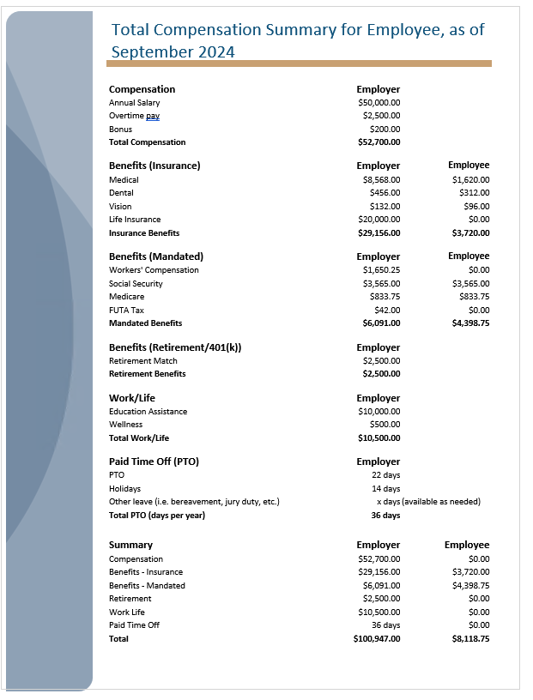
Explain the total rewards offered.

Slide 22
Explore other opportunities to recognize the employee’s value.
Compensation
Workplace flexibility
Organizational culture
Time off
Employers
Benefits
Learning

Slide 23
Explore other opportunities to recognize the employee’s value.
Support travel to conferences and job-related events
Offer low cost monetary rewards
Explore greater support for work-life needs
Introduce to professionals working in area of interest
Promote job shadowing
Assign interesting and challenging tasks
Employers
Look for ways to minimize frustrating assignments

Slide 24
Outline how pay decisions are made by the organization.
Budget
Equity
Policy
Practices
Salary structure

Slide 25


Refrain from unproductive topics.
Instead of talking about other individuals, talk about process
HR can help managers understand the system, policies and procedures
Encourage professionalism and respect for all areas of the organization

Slide 26
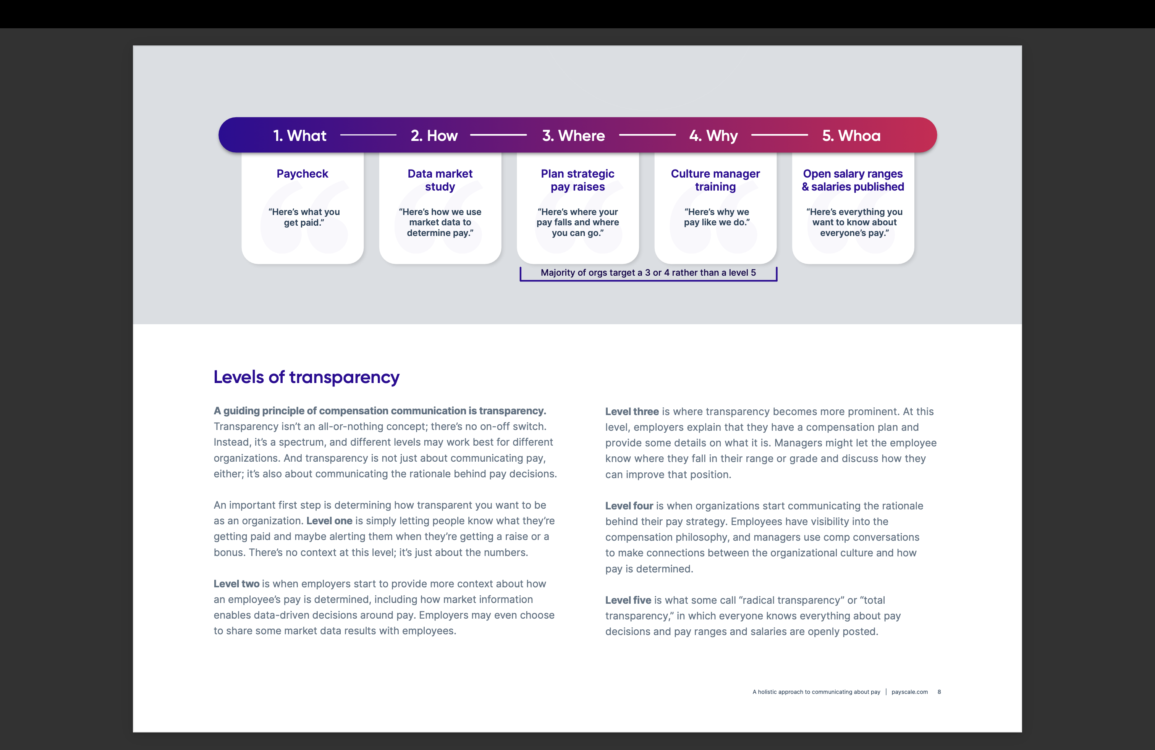
Navigating transparency
Source: Payscale.com

Slide 27


Follow-through.
Don’t make guarantees without approvals
Do indicate next steps and establish a date to follow-up with employee

Slide 28
Okay. Let’s try this again…

Slide 29
How HR can help
Be a champion for the value exchange
Ensure policies and practices effectively support and grow salaries
Provide training and support to managers
  Teach managers how to handle tough conversations with professionalism
  Help them understand the comp system

Slide 30
Policies
Budget
Support
Alignment
Practices
Salary Structure
Equity

Slide 31
Policies
Budget
Support
Alignment
Practices
Salary Structure
Equity

Slide 32
Hold on. What do I do if my compensation system is off balance?

Slide 33

An effective compensation system balances an organization’s need to be externally competitive and internally consistent.
Attract and retain optimal talent
Offer competitive wages aligned with market expectations
Comply with relevant laws and regulations
Align with internal culture and organizational values
Be easily understood and administered
Be cost effective
Be fair and equitable

Slide 34
Let’s keep talking.
Kim DeFilippis
kim@valliant.com
Stacie Jackson
stacie@valliant.com
https://valliant.com
505-246-8798

