Slide 1


28th Annual Conference
September 23-25, 2024
Durant, Oklahoma

Slide 2



Generative AI in the Workplace

Slide 3


Presented by
Elek A. Miller
Attorney

Slide 4
Introduction
What is Generative AI
and why is it relevant?

Slide 5

Generative AI refers to a class of artificial intelligence systems that have the capability to create or generate new content, without direct human intervention. These systems are designed to learn from patterns and data, enabling them to produce novel and creative outputs that resemble human-generated content.”
-OpenAI

Slide 6

Generative AI Services - Examples
ChatGPT
GPT4
Bard
Bing
DALL-E 2
Stable Diffusion
The list goes on…
Theatre D’opera Spatial – Jason Allen’s Colorado State Fair winning art from 2022 – created with MidJourney.
“I'm not going to apologize for it. I won, and I didn’t break any rules”
– J. Allen, in response to criticism.

Slide 7
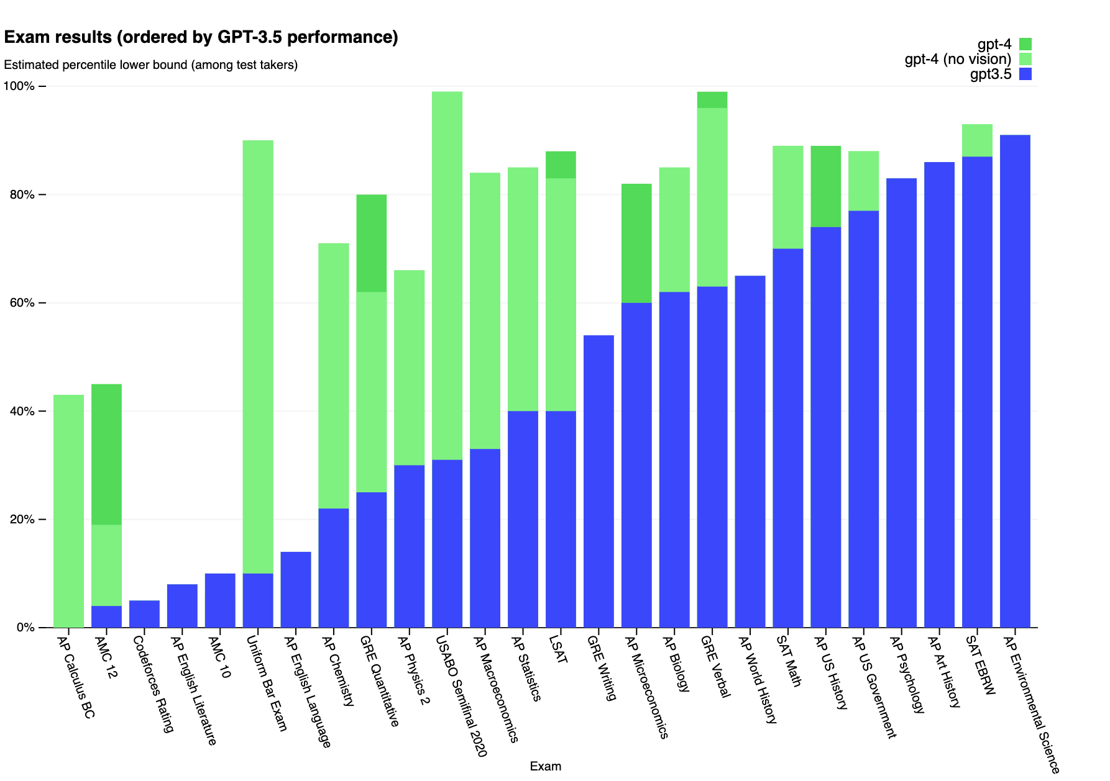
Rate of Improvement
Source: OpenAI

Slide 8
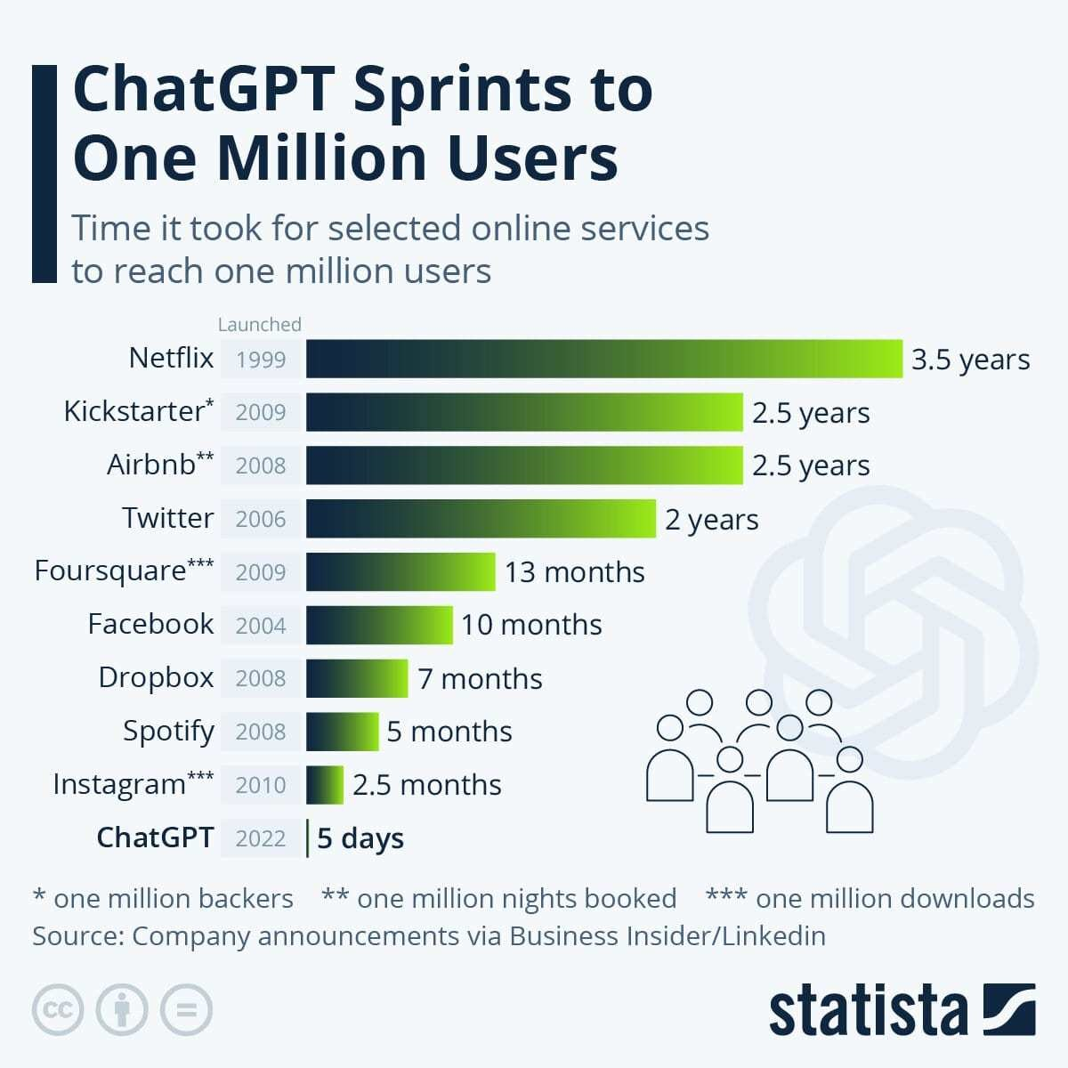
Who is Using Generative AI?
According to a Salesforce study: Three out of five workers (61%) currently use or plan to use generative AI; but half of the workers surveyed (54%) said they worry generative AI outputs are inaccurate, and 59% worry the outputs are biased.
OpenAI’s website currently generates 1.8 billion visitors per month.
According to a June 2023 McKinsey AI Report, about 75 percent of the value that generative AI use cases could deliver falls across four areas: Customer operations, marketing and sales, software engineering, and R&D

Slide 9
Prompt Engineering
“It’s almost like briefing an intern, like all the depth of detail of exactly what you need.” – OpenAI
Write clear instructions. Tactics to write clearer include: using more detail to get more relevant answers, asking the model to adopt a persona, and specifying the steps you want GPT-4 to take to do what you want.
Provide reference text. To cut down on hallucinations, it helps to instruct GPT-4 to use a reference text when answering. Says OpenAI: “In the same way that a sheet of notes can help a student do better on a test, providing reference text to GPTs can help in answering with fewer fabrications.”
Split complex tasks into simpler, smaller tasks. You can do this in a number of ways, including: prompting GPT-4 to use intent classification to identify the most relevant instruction, summarizing or filtering previous conversations with GPT-4, and summarizing long documents in smaller pieces.
Give it time to “think.” This means telling GPT-4 to give you its chain of reasoning before computing an answer. This gives the system the ability to reason more reliably.

Slide 10
Sample Prompts
I am the director of HR for a casino. Please draft a job description for a/an [insert position here]. [Include details here, if/as applicable/available].
Draft computer code in [insert programming language] to [insert task/desired outcome].
Draft a communication to the board of directors of a [insert type of organization here] notifying them about [insert issue/topic].
Draft personalized promotional content for [insert general description of customer base here] based on [insert information about customer base here to help create personalized content].
Recommend methods for providing constructive feedback to team members.
Summarize the key points of the following text for me: [insert text].

Slide 11
Demonstration
So how do these services work,
anyway?

Slide 12
Examples of Beneficial Uses
Highlighting some strengths
of Generative AI

Slide 13
Strengths
Document review/assessment
Explanations of complex topics
Document drafting
Data analytics
Research assistance – gathering information/sources
Translations
Replication

Slide 14
Weaknesses & Legal/
Practical Issues
Highlighting some of the weaknesses and legal/practical issues associated with use of Generative AI

Slide 15
Weaknesses & Legal/Practical Issues
Staff Use
  Confidentiality
    According to OpenAI - prompts are stored and can be used for training purposes by OpenAI.
    Consider sharing applicant or employee information. Do you have an obligation to keep that information confidential? If so, are you complying with that obligation?
    What about other confidential information (e.g., confidential business information)?
    OpenAI recommends that you do not share sensitive information.
    Samsung Case
  Ethics
    Certain GAI platforms have lawsuits pending against them related to claims ranging from invasion of privacy to copyright infringement.
    Users may be required by website terms to disclose use of GAI in creation of outputs used in certain ways.
  Intellectual property issues
    Content generated by GAI services is not subject to copyright protection according to the U.S. Copyright Office
    A recent DC Circuit decision has affirmed this position.
    Content generated by GAI could still violate someone else’s copyright rights.
  Inaccurate information/hallucinations/drift
  Difficulty resolving nuanced situations
  Staffing Decisions (increased efficiency/productivity)
  Bias

Slide 16
Existing Policy/Regulatory Framework
Staff Use
  Device Acceptable Use Policy
  Employee Handbook
  Computer and Internet Use Rules
  Confidentiality Policy
  Records Retention Rules/Policy
  Employment Agreements/Letters
  Laws, Rules, & Regulations
    Currently no comprehensive federal legislation or regulations.
    Few state laws (Colorado was first to enact comprehensive US AI legislation)
    Existing laws not specific to AI will be applied
    White House Executive Order on AI
    EU AI Act

Slide 17
So, what to do about staff use?
Option 1: No Use of AI
Objective: Prioritize traditional methods, eschewing AI-based approaches.
Implications:
  Avoids ethical, legal, and privacy concerns associated with AI.
  Might miss out on potential efficiencies, insights, and competitive advantages offered by AI.
  Relies solely on human decision-making processes and may disadvantage some/all staff by limiting their use of a technology that may become necessary to know how to use well in the future.
  Need policy (albeit brief).
Option 2: Unlimited Use within
Existing Policy Frameworks
Objective: Embrace AI fully in all aspects without restrictions.
Implications:
  Maximizes potential for innovation, efficiency, and data-driven insights.
  Risks regarding data privacy, ethical concerns, and biases can emerge.
  Employees may express concerns about transparency, job displacement, or decision-making processes.
  Does not require a policy.
Option 3: Regulated Use
Objective: Utilize AI within a defined set of ethical, legal, and operational guidelines.
Implications:
  Balances the benefits of AI with responsible use, mitigating risks.
  Requires regular audits and updates to ensure policies remain relevant.
  Requires employee training and oversight.
  Combines the strengths of AI with the insight and oversight of human intervention.
  Requires a more detailed
  policy or set of policies.

Slide 18
So, what to do about staff use (Cont'd.)?
Key elements in any policy that regulates use of GAI (*Note: this is not necessarily a comprehensive list*):
  Prohibit sharing confidential information.
  Require results to be verified using reliable sources.
  Ensure results are not biased before use.
  Prohibit use for legal advice.
  Make clear that all other policies, procedures, and guidelines apply to use of GAI services and require compliance with those documents vis-à-vis GAI use.
  Consider limiting the GAI services that can be used and be clear about which can be used and that use of others is prohibited.
  Require compliance with GAI service terms of use/service.

Slide 19
Questions?

Slide 20
THANK YOU!
Elek A. Miller
emiller@dwmlaw.com
DWMLAW.com

