Slide 1


28th Annual Conference
September 23-25, 2024
Durant, Oklahoma

Slide 2
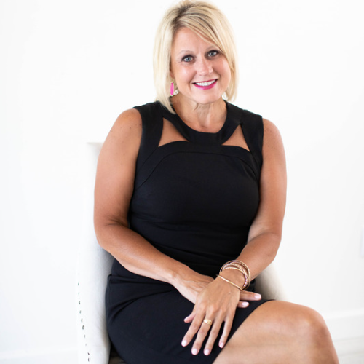
An Unconventional Approach:
Leveraging Kindness as a Strategy for Success
Cindy Rowe

Slide 3

random acts of

Slide 4
ONE KIND ACT HAS THE POTENTIAL TO REACH 125 PEOPLE
in one day!
@CINDYAROWE | LINKEDIN: CINDY ROWE

Slide 5

31 DAYS THAT CHANGED MY LIFE
@CINDYAROWE | LINKEDIN: CINDY ROWE
Notes:
Why am I qualified to stand up here and speak about the Culture of Kindness in the Workplace?

Slide 6
KINDNESS HAS A RIPPLE EFFECT AND IT STARTS WITH YOU
@CINDYAROWE | LINKEDIN: CINDY ROWE

Slide 7
BEING
KIND
BEING
NICE
Notes:
Being kind involves a deeper emotional connection and a genuine desire to make a positive impact on someone's life, while being nice often focuses on maintaining social harmony and politeness without necessarily forming a strong emotional bond.

Slide 8
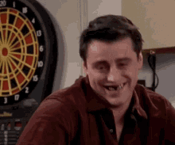
DO I HAVE FOOD IN MY TEETH?
Notes:
Let’s say an acquaintance has food stuck in their teeth. The kind thing is to tell them. But most won’t because it might make them feel uncomfortable or you will feel like you might embarrass them.

Slide 9


Kind:
Nice:
At work, a kind approach might involve giving constructive feedback to a colleague with the intention of helping them improve and grow in their role. You provide honest feedback, even if it's not easy to hear, because you genuinely want to support their development.
Being nice in this scenario might mean avoiding any criticism or sugar-coating feedback to spare their feelings. While this may temporarily make the person feel better, it doesn't necessarily help them in the long run.
@CINDYAROWE | LINKEDIN: CINDY ROWE
Notes:
How does look in a work environment?

Slide 10


Slide 11
WHAT IS YOUR DEFINITION OF
Kindness
@CINDYAROWE | LINKEDIN: CINDY ROWE
Notes:
Like success, I believe Kindness has many definitions. Together with your table, take a few minutes to create your defintion of kindness.

Slide 12

Kindness is
A commitment in thought, word & action to leave everyone & everything better
@CINDYAROWE | LINKEDIN: CINDY ROWE

Slide 13

NEARLY 1/2 OF AMERICAN WORKERS HATE THEIR JOBS SO MUCH THEY WOULDN'T WISH IT ON THEIR WORST ENEMY.
UKG REPORT 11/22
Notes:
Employees are searching for a better environment to work in. Leaving not because of pay, but because of how they are being treated. And that is why I am so passionate about talking to businesses and organizations—there needs to be a shift for more kindness.

Slide 14
SHOCKING
STATS
87% of organizations cite culture & engagement as one of their top challenges
Disengaged employees cost the economy up to $350 billion per year in lost productivity
#1 reason people quit their job is because they don't feel appreciated
Deloitte Research, Gallup's State of the Global Workplace: 2023 Report, OC Tanner Research
@CINDYAROWE | LINKEDIN: CINDY ROWE
Notes:
In my recent research, I uncovered these surprising statistics, which may be the reason you are here today.
I hope by the end of this program, you understand that

Slide 15
IN BUSINESS,
IT PAYS TO
BE KIND.
@CINDYAROWE | LINKEDIN: CINDY ROWE
Notes:
And it’s not about being soft or weak—or being someone you are not. It’s about the idea that we are all working with other humans. Each interaction we have with another person matters and makes a difference.

Slide 16
IS YOUR ORGANIZATION A PLACE OF
kindness & respect
@CINDYAROWE | LINKEDIN: CINDY ROWE
Notes:
Could a CULTURE OF KINDNESS be the solution for your organization? There is research to back up my experience—kindness has an impact on business.

Slide 17
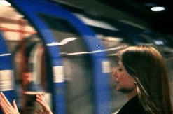
SLIDING
DOOR
MOMENTS
Notes:
Sliding door moments happen every day.
If you aren't familiar with the movie, Sliding Doors, it portrays two different scenarios for a woman--one where she makes the train and the other where she misses the train, and how her life unfolds in both scenarios.
What sliding door moments are you missing or engaging with?

Slide 18




Notes:
A team is discussing a new project, and there are differing opinions on the best approach. In one scenario, the loudest voices dominate the conversation, while others feel sidelined or unheard. In another scenario, the team leader actively seeks input from all members, ensuring that everyone's perspective is valued and considered.
Imagine a new employee on their first day, overwhelmed and unsure of their role. A friendly co-worker takes the time to offer help, answer questions, and show them the ropes. This small act of kindness can make a huge difference in their experience, boosting confidence and setting them up for success.
Imagine a busy morning in the office, with everyone rushing to meet deadlines. A colleague notices that another team member seems overwhelmed and stressed. Instead of just walking by, they stop and offer a genuine word of encouragement, a listening ear, or even a cup of coffee.

Slide 19
USE ONE WORD TO DESCRIBE YOUR WORKPLACE.

Slide 20



Please download and install the Slido app on all computers you use
Use one word to describe your workplace.
ⓘ Start presenting to display the poll results on this slide.

Slide 21
BACKED BY RESEARCH
93% of employees would stay with a kind employer/boss
Employees would take a kinder boss over a 10% raise
Companies that focus on a kindness culture retain employees
8-10 times more than companies that don't
BusinessSolver Report, NBC Poll, Kindness in the Workplace survey from the Born This Way Foundation
@CINDYAROWE | LINKEDIN: CINDY ROWE

Slide 22


73%
of employees say kindness at work impacts their overall work performance & productivity
@CINDYAROWE | LINKEDIN: CINDY ROWE
Notes:
More proof that a Kindness Culture might be the solution.

Slide 23
KINDNESS AT WORK:
REDUCES BURNOUT
BOOSTS PRODUCTIVITY
INCREASES ENERGY
LIGHTENS THE MOOD
INCREASES HAPPINESS
Journal of Applied Psychology
@CINDYAROWE | LINKEDIN: CINDY ROWE
Notes:
Multiple studies report that a Kindness-based culture

Slide 24

KINDNESS AT WORK:
FORGES STRONG TEAM
RELATIONSHIPS
BUILDS TRUST
BUILDS POSITIVE
CONNECTIONS
INCREASES ENGAGEMENT
LOWERS STRESS
Journal of Applied Psychology
@CINDYAROWE | LINKEDIN: CINDY ROWE

Slide 25

KINDNESS DECREASES
PAIN
HEART RATES
ANXIETY
DEPRESSION
BLOOD PRESSURE
which results in lower absenteeism
& sick days
Journal of Applied Psychology
@CINDYAROWE | LINKEDIN: CINDY ROWE
Notes:
Science has proved that when we do these kind gestures, our serotonin and dopamine levels increase.

Slide 26
KINDNESS
AT WORK
36%
more satisfaction in their work
44%
more commitment to organization
26%
more energy
Association of Professional Executives (APEX) Report
@CINDYAROWE | LINKEDIN: CINDY ROWE
Notes:
Recent surveys found that employees share Scott story. Share Diane story.

Slide 27
WHAT DOES
KINDNESS AT WORK LOOK LIKE?
@CINDYAROWE | LINKEDIN: CINDY ROWE
Notes:
I’d like you to come up with what kindness looks like at work. These are not acts. I’m looking for situations.

Slide 28
Kindness looks like...
PUSHING BACK AN IDEA YOU DON'T AGREE WITH
TREATING OTHERS WITH RESPECT
SPEAKING UP WHEN VOICES AREN'T BEING HEARD
VALUING THE VIEWS OF OTHERS
HONEST, DIRECT, & TOUGH FEEDBACK
COMMUNICATING WITH A PERSONAL TOUCH
GIVING CREDIT WHERE CREDIT IS DUE
ACCOMMODATING PERSONAL ISSUES
LISTENING WITHOUT INTERRUPTING
FOSTERING A SENSE OF INCLUSION
@CINDYAROWE | LINKEDIN: CINDY ROWE

Slide 29

HAPPIER PEOPLE ARE
12%
MORE PRODUCTIVE
@CINDYAROWE | LINKEDIN: CINDY ROWE
Notes:
When people feel valued and respected, they are more motivated and perform better. studies shown that kindness makes us happy.
According to a study by Warwick University,

Slide 30
KINDNESS
IS THE
SECRET WEAPON
@CINDYAROWE | LINKEDIN: CINDY ROWE

Slide 31
CREATING A
CULTURE OF
Kindness
@CINDYAROWE | LINKEDIN: CINDY ROWE
Notes:
Before you can change the culture of your company, you have to display the culture. Everything I am about to discuss takes action from the top level because

Slide 32

BEHAVIOR
DRIVES
CULTURE
@CINDYAROWE | LINKEDIN: CINDY ROWE
Notes:
behavior drives culture. WPF Story

Slide 33
WHEN KINDNESS IS PART OF THE COMPANY CULTURE COMPANIES WILL EXPERIENCE
@CINDYAROWE | LINKEDIN: CINDY ROWE
Notes:
When Kindness is part of the company culture, amazing things will happen. Here are a few perks of creating this kindness culture:

Slide 34
BETTER FINANCIAL PERFORMANCE
GREATER CONTENTMENT
REDUCED COSTS
IMPROVED MORALE
MORE EFFICIENCY
HIGHER MOTIVATION
INCREASED PRODUCTIVITY
HIGHER ENGAGEMENT & PARTICIPATION
HIGHER EMPLOYEE
RETENTION
SENSE OF BELONGING
@CINDYAROWE | LINKEDIN: CINDY ROWE
@CINDYAROWE | LINKEDIN: CINDY ROWE

Slide 35
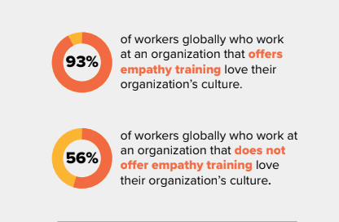
@CINDYAROWE | LINKEDIN: CINDY ROWE
@CINDYAROWE | LINKEDIN: CINDY ROWE

Slide 36
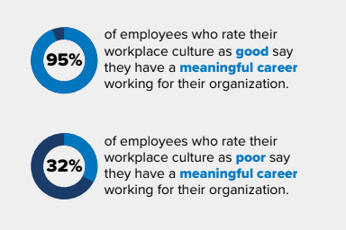
@CINDYAROWE | LINKEDIN: CINDY ROWE
@CINDYAROWE | LINKEDIN: CINDY ROWE

Slide 37
kindness
A CULTURE OF
POSITIVE
WORK
ENVIRONMENT
VALUE EMPLOYEES
ALLOW FOR FLEXIBILITY
@CINDYAROWE | LINKEDIN: CINDY ROWE
Notes:
A culture of kindness should include these three elements:

Slide 38

SHOW APPRECIATION & RECOGNITION
VALUE EMPLOYEES
START MEETINGS WITH RECOGNITION
SAY THANK YOU, BE SPECIFIC
MAKE A "RIGHT" LIST
ONE-ON-ONE MEETINGS
OFFER PERSONAL DEVELOPMENT OPPORTUNITIES
RECOGNIZE BIRTHDAYS & ANNIVERSARIES
@CINDYAROWE | LINKEDIN: CINDY ROWE

Slide 39

THINK OUTSIDE THE BOX
FLEXIBLE WORK HOURS
ALLOW FOR FLEXIBILITY
value employees
WORK REMOTELY
JOB SHARING
COMPRESSED WORK WEEK
SABBATICALS
@CINDYAROWE | LINKEDIN: CINDY ROWE

Slide 40
OPEN COMMUNICATION
POSITIVE
WORK
ENVIRONMENT
OPPORTUNITIES FOR FEEDBACK
DISCOURAGE TOXIC BEHAVIOR
REWARD POSITIVITY
GROWTH OPPORTUNITIES
COMFORTABLE & SAFE ENVIRONMENT
@CINDYAROWE | LINKEDIN: CINDY ROWE
Notes:
Are the ideas flowing? Do you feel like this is something that could be achievable in your organization?

Slide 41
WHAT DOES IT
TAKE TO BE A
KIND LEADER?
@CINDYAROWE | LINKEDIN: CINDY ROWE
Notes:
I mentioned that behavior drives culture and it starts from the top; so what does it take to be a KIND LEADER? Let’s go over what I have designed as the 6 C’s of Kind Leaders

Slide 42
6 KEYS OF KIND LEADERSHIP
CLARITY
COMPASSION
employees know goals and responsibilities
"walk in their shoes" attitude
CANDOR
COURAGE
direct, open, honest communication
sometimes being kind is not the easy things to do
CONSISTENCY
COMMUNICATE
Actions speak louder than words
keep staff informed
@CINDYAROWE | LINKEDIN: CINDY ROWE

Slide 43
An UNKIND LEADER has a 1 in 2000
chance to also be effective.
--LEADERSHIP STUDY
@CINDYAROWE | LINKEDIN: CINDY ROWE

Slide 44


HOW TO GET STARTED?
FOSTER A SENSE OF COMMUNITY, ESPECIALLY HYBRID
LEAD BY EXAMPLE
REMEMBER THE PLATINUM RULE
ENCOURAGE COMMUNICATION & FEEDBACK
EVALUATE - CHECK-IN
CELEBRATE SUCCESSES
@CINDYAROWE | LINKEDIN: CINDY ROWE

Slide 45
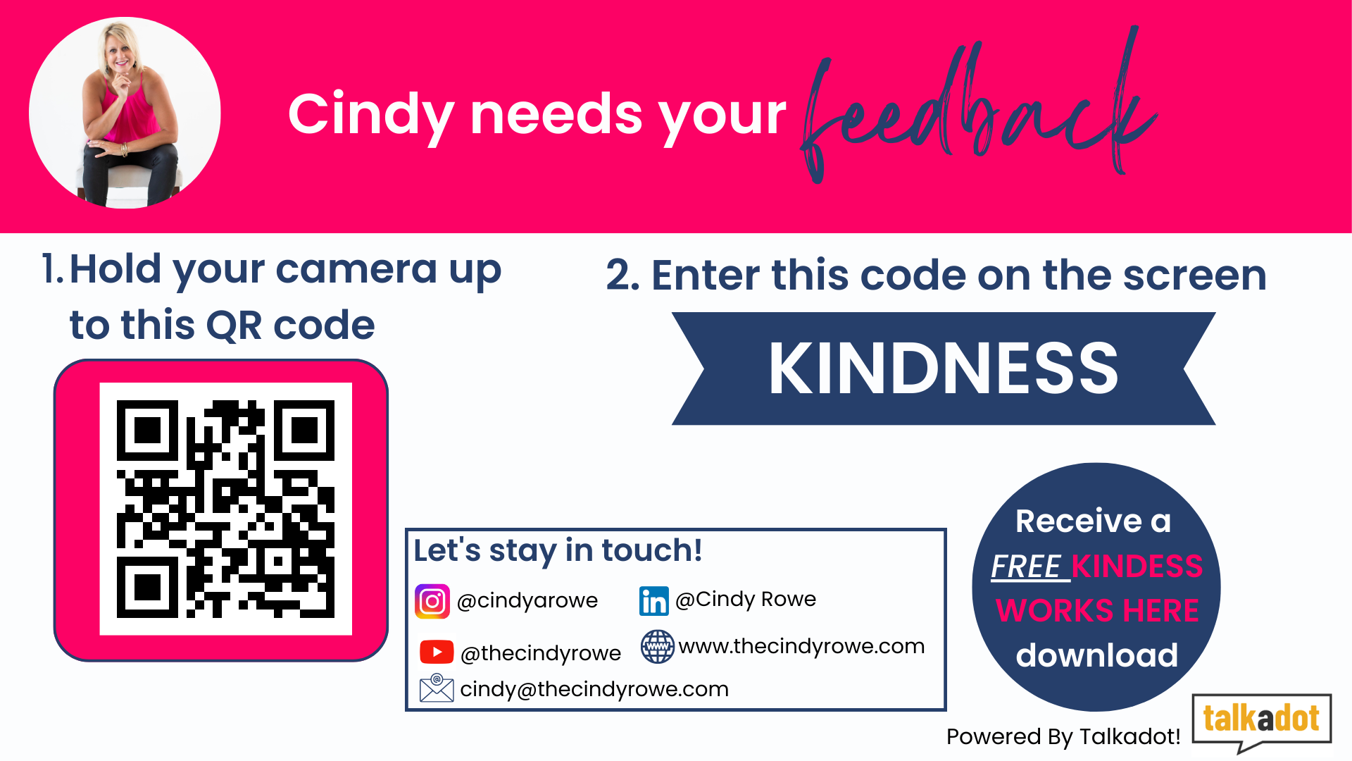
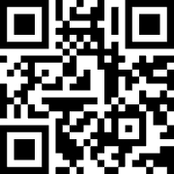

Slide 46
"The best HR managers understand that kindness is the bridge that connects policies with people, transforming workplaces into communities."
@CINDYAROWE | LINKEDIN: CINDY ROWE

Slide 47
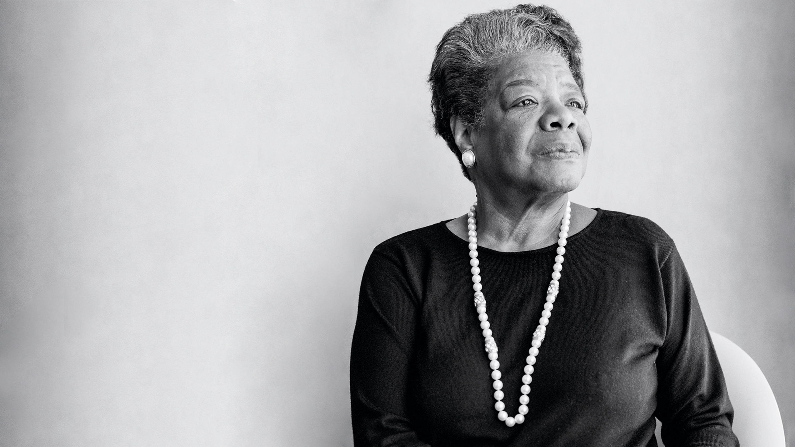
I’VE LEARNED THAT PEOPLE WILL FORGET WHAT YOU SAID, PEOPLE WILL FORGET WHAT YOU DID, BUT PEOPLE WILL NEVER FORGET HOW YOU MADE THEM FEEL.
@CINDYAROWE | LINKEDIN: CINDY ROWE

Slide 48
Challenge
DO ONE KIND THING FOR ANOTHER PERSON TODAY.
@CINDYAROWE | LINKEDIN: CINDY ROWE

Slide 49
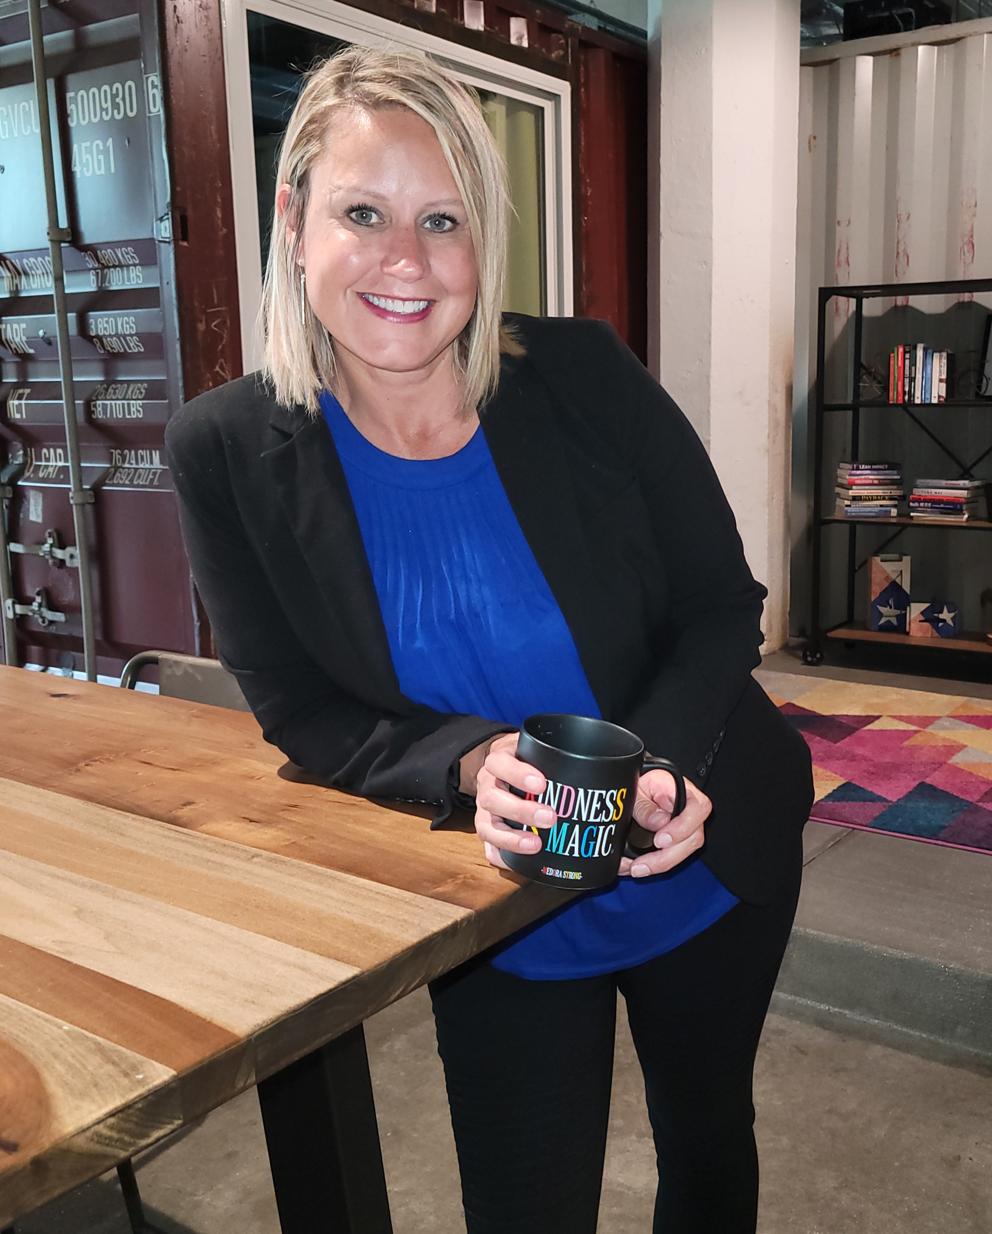
Thank YOU!
Be sure to check out:
The Kindness Advantage Podcast

