Slide 1


28th Annual Conference
September 23-25, 2024
Durant, Oklahoma

Slide 2



FROM PAPERWORK TO PROGRESS
A Digital HR Transformation Journey
Moderator: Sunshine Brown
Customer: Gila River
Event: National Native American HR Association 28th Annual Conference
Notes:
Welcome to:
We are scheduled for x amount of time.

Slide 3

A Digital HR Transformation
What can I take away from this fireside chat?
Why is it important?
What is digital transformation?
What should I consider for my transformation journey?
Where do I start?
But first …

Slide 4

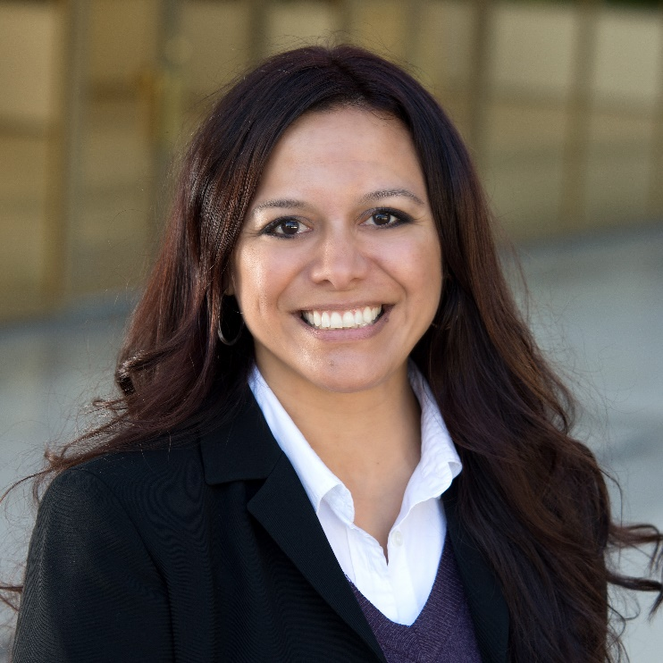



SUNSHINE
BROWN
KACEY
MCMANUS PELOSO
KAMIE
BEST
Ascend
Sales Executive
Gila River
VP of HR | MBA, SPHR
Gila River
L&D Manager | PhD
15 years of HCM Consulting
Hands on experience with organizations transforming their HR operations and technology
Operations Leader of a Great Place to work company for 7 years
15 years of Leading HR Management and Employee Relations
Proven mastery of business strategy positive work culture
MBA in Finance, SPHR certification and HRCI certificate in leadership
11 years with Gila River Resorts & Casino
Proven expertise with L&D and organization development
Development Professional with a Master of Science in Industrial and Organizational Psychology

Slide 5


Why is digital HR
transformation important?
01

Slide 6


What is digital HR transformation?
  “CHANGE IS THE LAW OF LIFE AND THOSE WHO LOOK ONLY TO THE PAST OR PRESENT ARE CERTAIN TO MISS THE FUTURE.” ~John F. Kennedy
  “HR TRANSFORMATION IS THE EVOLUTION OF HR TO DRIVE OPERATION EXCELLENT AND CREATE GREATER BUSINESS VALUE.” ~Gartner
  “STRATEGIC HUMAN RESOURCE MANAGEMENT INVOLVES A FUTURE ORIENTED PROCESS OF DEVELOPING AND IMPLEMENTING HR PROGRAMS THAT ADDRESS AND SOLVE BUSINESS PROBLEMS” ~SHRM
02
  It is a journey!

Slide 7





What should I consider on my journey?
Strategy
Leaders & People
Processes
Technology
  What are our business strategy and objectives?
  Why is transformation important?
  How will focusing on improving these areas help the organization overall?
  What are potential obstacles to growth and positive change?
  How might the strategy change over time?
  Who are the organizational leaders that support positive change?
  What generations exist within your HR population
  How should we incorporate these generations into planning?
  How can I solicit for champions for change or beta groups?
  What is important to what groups within my tribal entity?
  What processes should be reviewed based on current HR strategy and focus?
  Keep it simple:
  What is being done currently?
  What is working well and not well?
  Who is doing what and when?
  Why are we doing those things?
  What things need to continue to happen?
  What can we try and change?
  What technology are we using and why?
  How can technology support the positive changes we are trying to make?
  What technology can we improve and how?
  What is our appetite for new technology?
  How can we phase in optimizations and/or new implementations?
  What support do we need for technology?
03

Slide 8

WHERE DO I START?
?
Q&A
04

Slide 9





THANK YOU!
Ascend is one of the largest premier exclusive UKG partners in North America.
We offer comprehensive implementation services catering to both mid-market and enterprise organizations with a vast experience with tribal entities, healthcare, public sector and non-profit organizations.
With a focus on personalized service and a deep understanding of digital transformation, Ascend empowers businesses to fully leverage their technological investment.
Our talented team is dedicated to delivering exceptional value and ensuring a smooth and valuable experience for every customer.
Sunshine Brown
(909) 993-2576
sbrown@ascendps.com
VISIT BOOTH #41

