Slide 1




2024
Compensation
&
Benefits
Summit

Slide 2

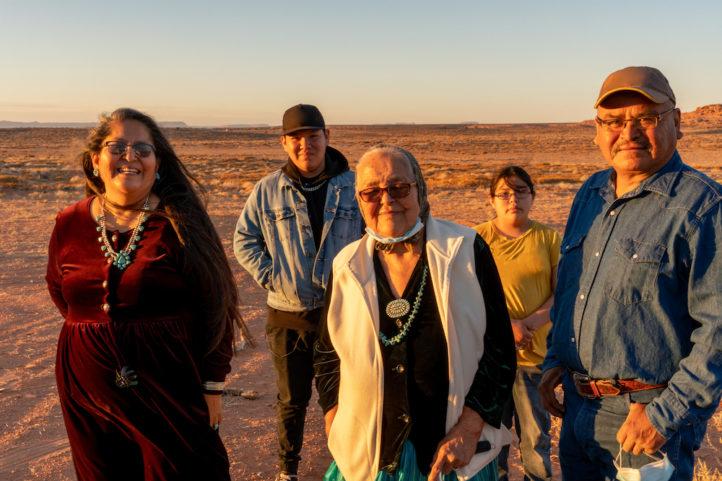
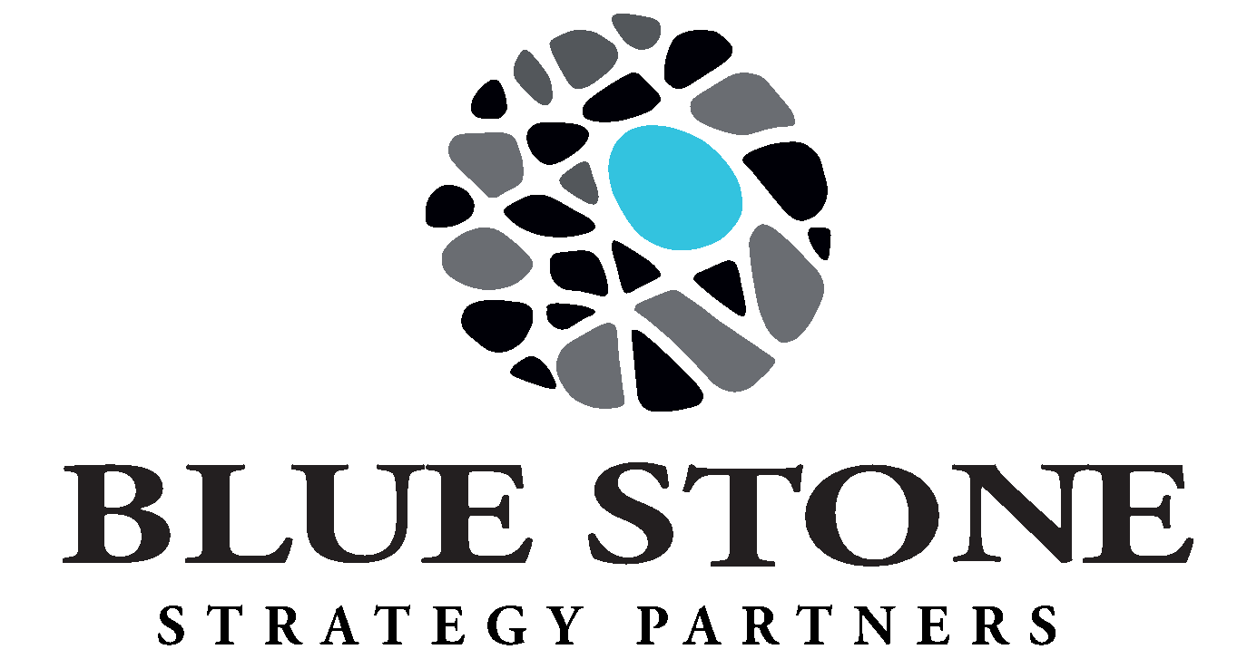
Blue Stone Strategy Partners
National, Native-Owned Advisory Firm
17th Year of Operations, 200+ Tribal Nations, 500+ Projects
Core Team of Leadership, Directors, Specialists, and Project Managers
Tribal Advisor Support and Use of Subject Matter Experts
Mission: Blue Stone Strategy Partners exists to provide Tribal economic development and governance advisory services by promoting fiscal and economic independence, protecting Tribal sovereignty and sustainability.
Vision: To be the Advisor of Choice for Indian Country economic development support and Tribal organizational planning; providing a “Clear Vision” with a culturally sensitive approach.

Slide 3





Meet Our Team
Alicia Finley, SPHR, SHRM-SCP, THRP
Elena Chavez, THRP, QKA, RPA
Dustin Haverkamp, SPHR, THRP
HR Services Director
Compensation Specialist
HR Operations Specialist

Slide 4

Compensation Trends
Top Five Trends We’re Seeing
Retention is as important as recruitment
Lack of upward mobility/succession planning
Unable to implement compensation recommendations
Healthcare positions are included in Tribal Government compensation structure
Compensation and benefits are not competitive

Slide 5

Keeping Your Employees
R E T E N T I O N
Aims to keep your existing, qualified employees engaged, satisfied and committed
Reduces turnover costs and loss of institutional knowledge
Addresses employee burnout, conflict, opportunities for advancement, and change management

Slide 6
Upward Mobility
Many long-term employees came back after COVID due to loyalty
Not really performing their job duties at a high level
High turnover in mid-level and director-level management positions
Loss of institutional knowledge
Costly to replace
ARPA and available grants = growth
Do you have the skillsets to support this?
Succession planning is a large part of this equation

Slide 7
Successful Compensation Study
Reduces turnover and improves recruitment
Ensures equity internally, as well as competitive to market
Motivates and engages employees
Ensures compliance to applicable laws and regulations specific toTribes
Ensures solutions and impact is financially feasible
Addresses performance management
Creates a strong organizational culture
Includes IMPLEMENTATION and training

Slide 8
Healthcare & HR
In most Tribal Governments, healthcare positions are included in their structure
This is not a best practice, as healthcare positions are highly technical and not necessarily comparable to government positions
Healthcare can also be a revenue generator, which is different from the government, which relies on grants and funding from enterprises (such as a Casino/Resort)
There is a lot of crossover between Healthcare and HR

Slide 9

Non-Competitive Comp and Benefits
B
Compensation structure is often outdated
Reclassifications diminish structure
Benefits review
Most Tribes and their enterprises have great benefits but they are not advertised
If not competitive, then a review is needed
Employees don’t always understand the benefits, leading to misperception

Slide 10

HOT Topic
Impending FLSA increase to the standard salary level for Exempt employees…what is the impact to your Tribe?

Slide 11




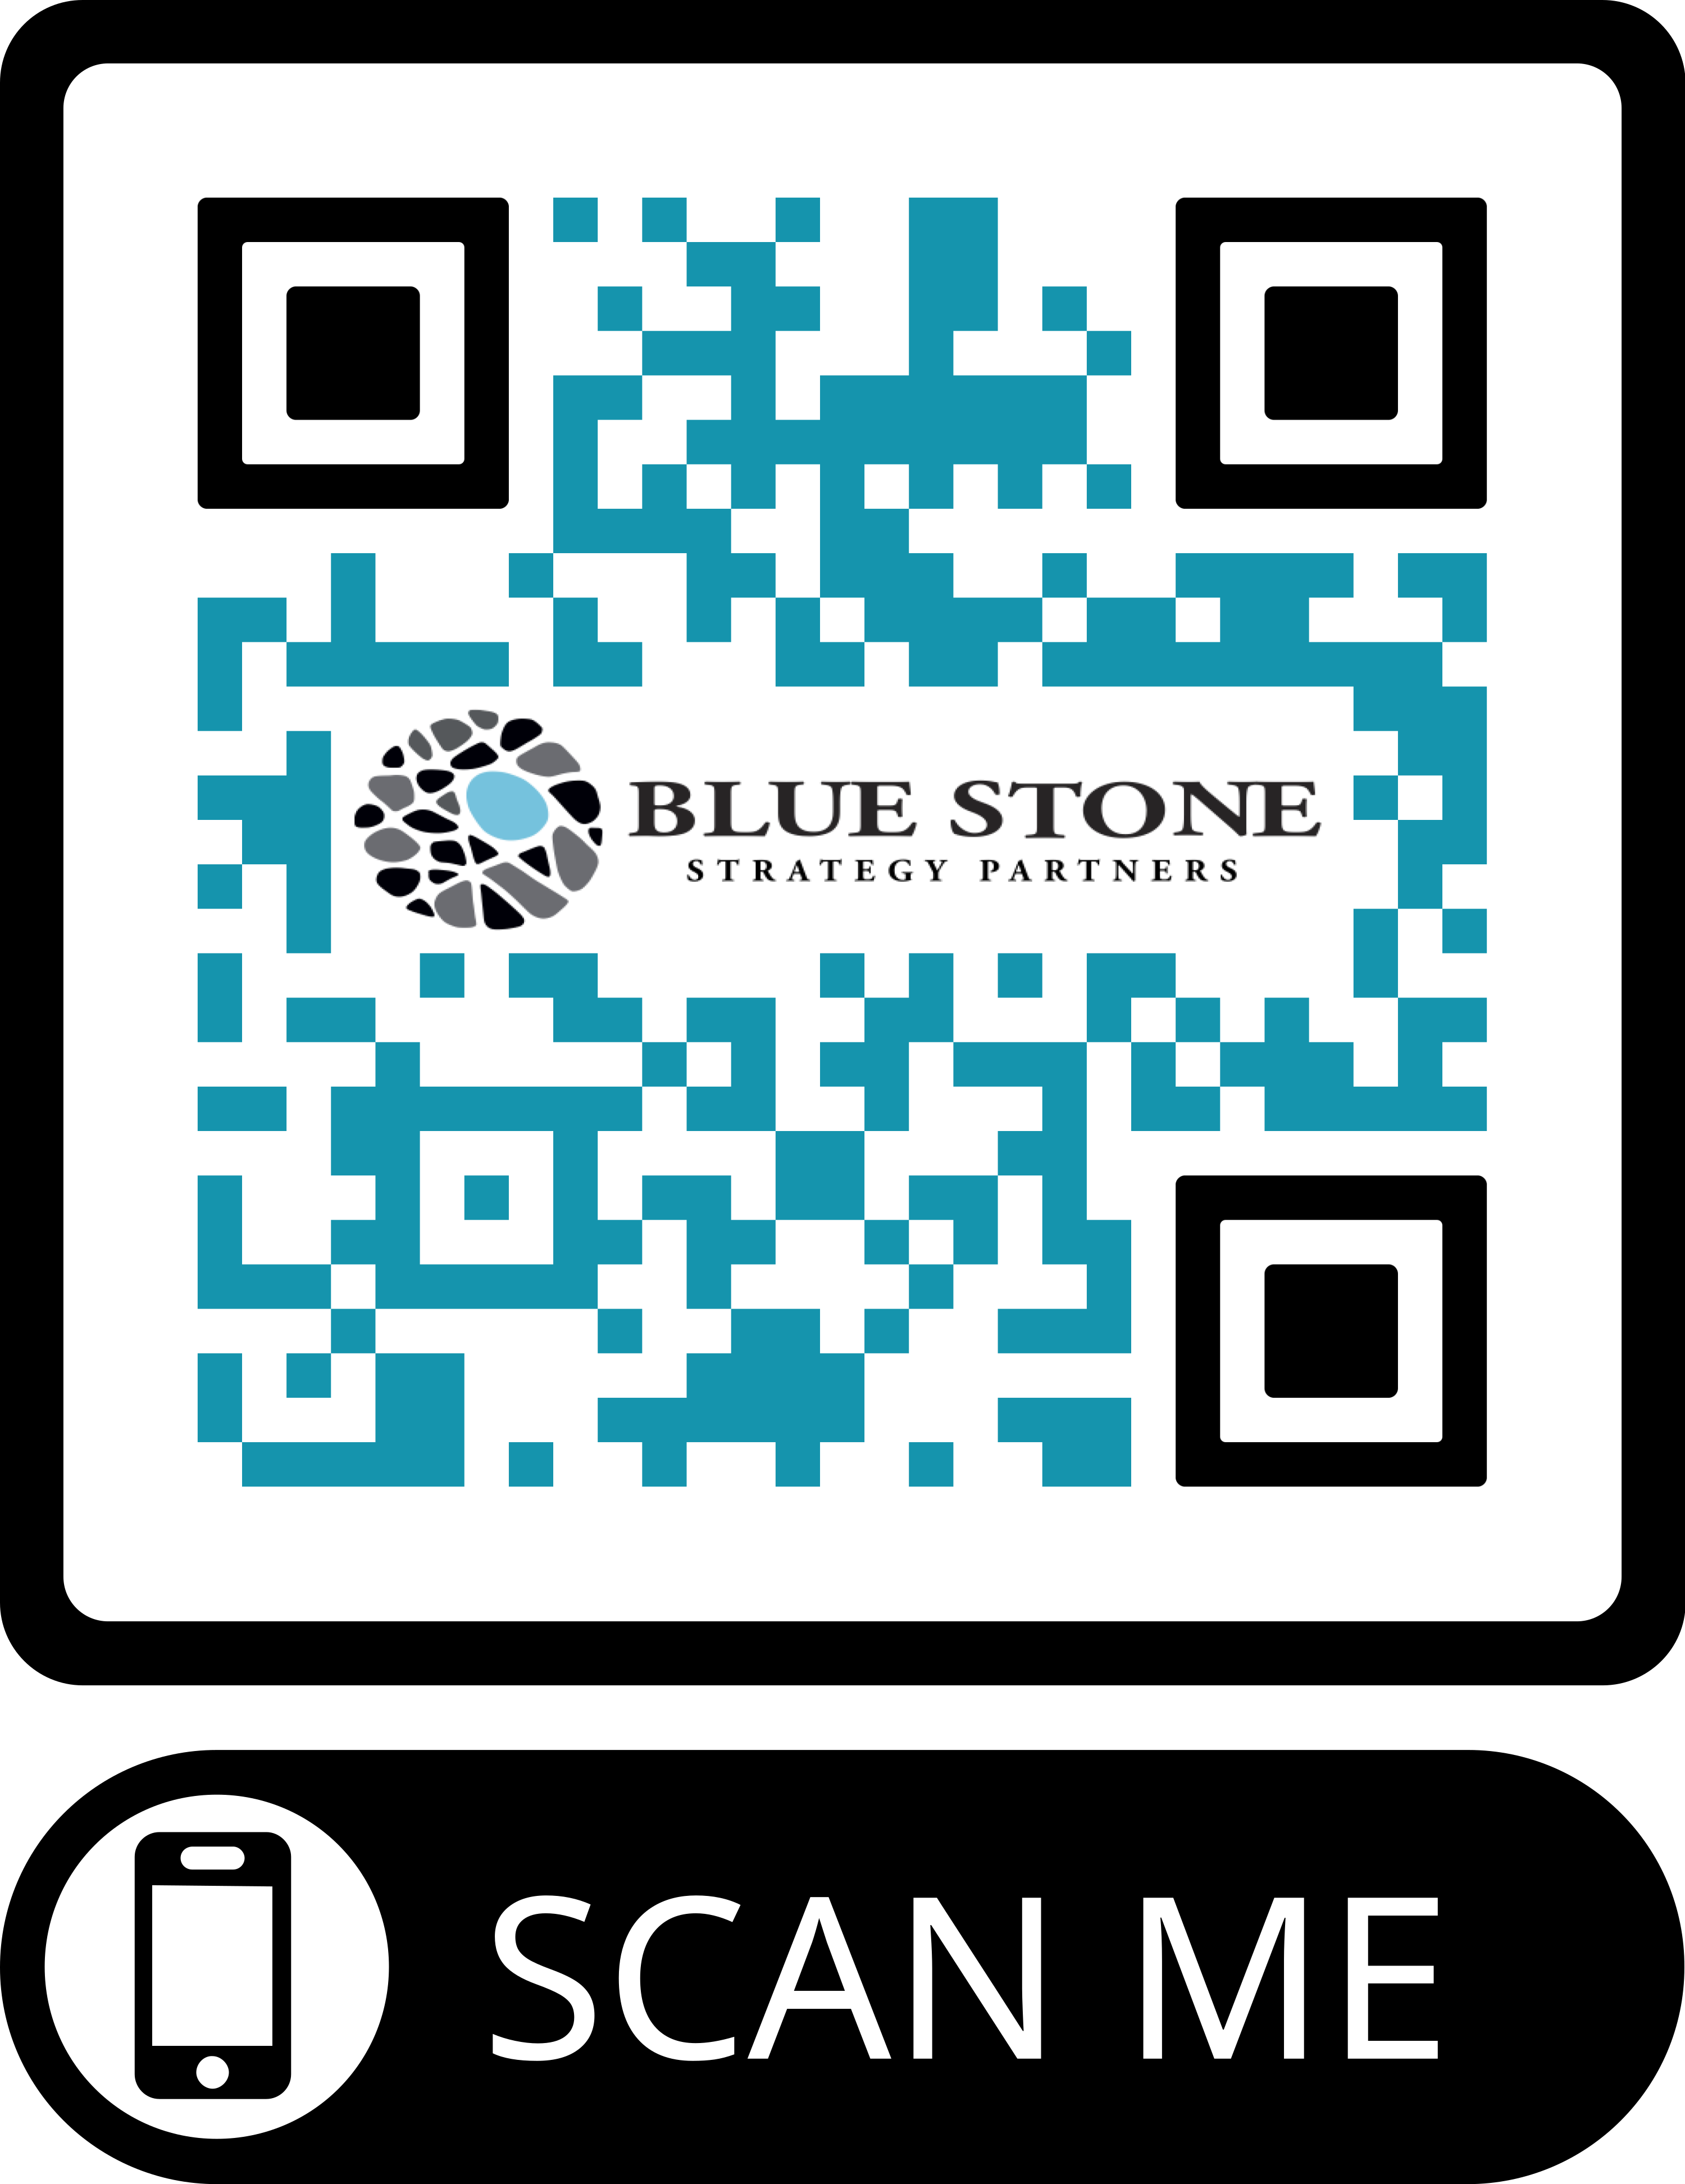
Contact us to get more info
Get in Touch
afinley@bluestonestrategy.com
25431 Cabot Road, Ste 200E, Laguna Hills, CA 92653
505-459-2597
www.bluestonestrategy.com

