Slide 1




2024
Compensation
&
Benefits
Summit

Slide 2

Compensation Technology & Innovation
in 2024 and Beyond

Slide 3


Compensation & Benefits Summit
Objectives
Compensation Matters
Compensation Technology
Compensation Survey Tools

Slide 4



Meet the Team
Cristin Heyns-Bousliman,
Esq., THRP
Rachel Overmier, MPA,
SHRM-SCP, THRP
Principal & Practice Leader
HR Consulting
Compensation Consulting
Manager

Slide 5


Compensation & Benefits Summit
Compensation Matters
Attracting Top Talent
Market Positioning
Financial Security
Recognition and Value
Organizational Commitment
Talent Retention
Career Development
Engagement and Satisfaction

Slide 6

Compensation & Benefits Summit
2024 Job Market
Focus on Total Rewards
Pay Equity & Transparency
Hybrid or Remote Options
Customized Incentives
Technology & Automation
Inflation & Cost of Living

Slide 7
Compensation & Benefits Summit
Market Trends Shaping Compensation in Indian Country
Limited Talent Pool
Benefits Beyond Salary
Adaptation to Remote Work
Recruitment & Retention Strategies
Childcare Deserts
Diversification

Slide 8
Compensation & Benefits Summit
Enter: Compensation Tools
Compease from HR Performance Solutions
CompAnalyst from Salary.com
PayScale/
PayFactors

Slide 9

Compensation & Benefits Summit
Compease by
Highlights:
  Tribal Government, Gaming, and Healthcare Models
  14 salary surveys, including REDW’s proprietary Tribal Compensation Surveys
  10 Compensable Factors
  Merit Modeling
  Optional Data Integration with Performance Pro – the best-in-class performance management technology that works directly with your Compease Structured Compensation
Cost: Based on employee count
Contact:
Maria Martinez – Compensation Consultant
Maria.Martinez@redw.com
505.998.3259

Slide 10

Compensation & Benefits Summit
Compease by
Job Evaluation System
Salary Grade & Ranges
Merit Increase Planning
Compensation Management
Salary Updates
Job Description Library

Slide 11

Compensation & Benefits Summit
CompAnalyst by
Highlights:
  HR-Reported pay data
  15,000 unique job titles
  27,000+ Compensable Factors
  225 Industry Breakouts
  42,000+ Geographies
  Merit Modeling
Cost: Based on employee count
Contact:
Amber Corrigan – Enterprise Account Executive
Amber.corrigan@salary.com
(0)+1.781.496.2716

Slide 12

Compensation & Benefits Summit
CompAnalyst by
Market Datasets
Survey Management
Equity
Pay Framework
Communications
Recruiting
Onboarding
Consulting
Survey Participation

Slide 13
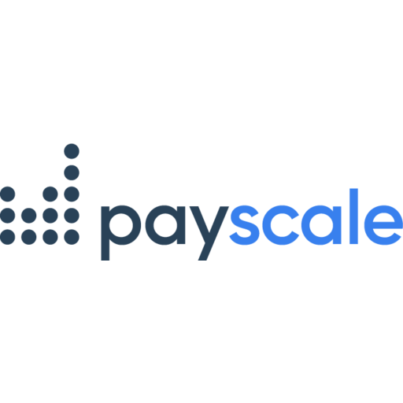
Compensation & Benefits Summit
Highlights:
  3 types of data sources
  Survey participation and management
  Complete complex pay equity analytics
  Customizable technology
  Market pricing
  Structure Development
  Custom Analytics
  Pay Communications Training
  Dedicated Implementation Manager
Cost: Based on employee count
Contact:
Chris Sharpless – National Account Executive
Chris.Sharpless@payscale.com
206.753.4058

Slide 14

Compensation & Benefits Summit
Advanced Search
Development Resources
Market Match
Data Collection
Data Standardization
Reporting & Analysis
API & Data Licensing

Slide 15
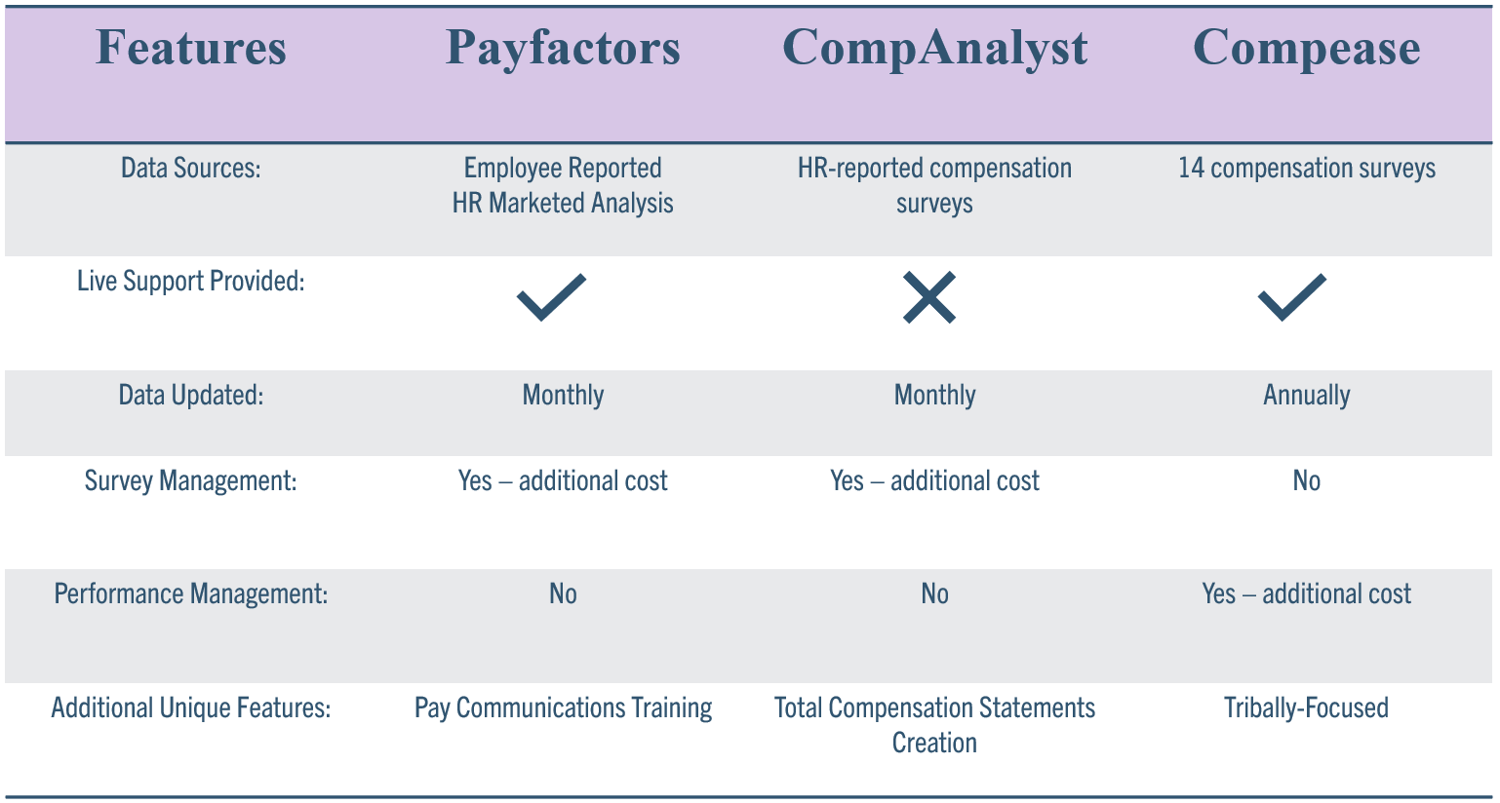
Compensation & Benefits Summit

Slide 16
Compensation & Benefits Summit
Salary Surveys – How to Select Them
Know Your Market
Easy Data Submission/Retrieval
Survey Vendor and Data Quality
Added Value?

Slide 17
Compensation & Benefits Summit
Salary Surveys – How to Use Them
Write or Update Your Job Descriptions
Apply Your Geographic Factor(s)
Strengthen Your Compensation Strategy
Adjust Compensation During Performance Reviews

Slide 18
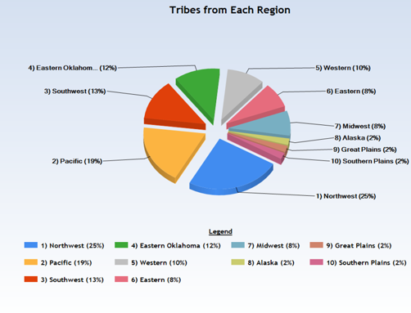
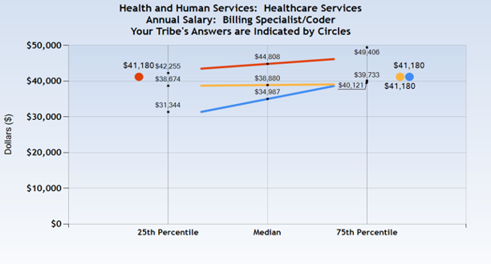
Compensation & Benefits Summit
  Includes four percentiles
  In 2023, our 13th consecutive year, we collected information on more positions than ever before:
    319 Government positions
    269 Gaming positions
  The 2024 survey platform opened in March to contribute data.
  Contributors get a discount!
Government & Gaming
Tribal Compensation Surveys

Slide 19




Questions?
Get in Touch!
Contact us to get more info
Cristin.Heyns-Bousliman@redw.com
505.998.3452
www.redw.com

