Slide 1
Retirement Planning for Indian Country: Individual and Community Wealth Matters
Exploring the Path to Financial Security and Retirement Success
May 22, 2024
Notes:
Slide 1:
Retirement Planning for Indian Country: Individual and Community Wealth Matters – xx minutes
Speaker 1 (Lisa Loughry, Executive Vice President, National Accounts):
The presentation will begin in a few minutes.
Presentation time: 9:15 AM – 10 AM (10:15 AM FIRST BREAK)

Slide 2
INTRODUCTIONS

Slide 3

PURPOSE
IMPORTANCE:
Acknowledge Tribal Sovereignty and Self-Governance
Empower Tribal entities to maintain control over their financial planning and decision making
BENEFIT:
Establish Long-Term Financial Security
Preservation of Wealth for Future Generations in Indian Country

Slide 4
ABOUT MUTUAL OF AMERICA

Slide 5

More than 75 years’ experience in Retirement Services
In 1945, Mutual of America was founded with a mission: to provide retirement services to nonprofit organizations. Our product offering has evolved over time, but our reason for being remains the same to this day.

Slide 6


Flexibility: Because one size does not fit all
People are diverse. Business needs are different.
Flexibility to customize your retirement plan options to align with your retirement objectives and your employees' objectives.

Slide 7
Plan Sponsors may have challenges running a retirement plan
Participants may:
Feel they can’t afford to save
Believe they have plenty of time
before retirement
Save at a rate too low to reach retirement readiness
Sponsors may:
Have limited personnel to manage a retirement program
Have limited ability to match employee contributions
Want to reduce the cost of administering a plan
That said, a well-run retirement program can be a differentiator in attracting and retaining employees.

Slide 8
ADMINISTRATION

Slide 9

Mutual of America facilitates plan committee review meetings
Industry and economic trends
Plan participation analysis
Legislative and regulatory updates
Plan design and compliance review
Summary of investment option characteristics
Independent assessment of fees and services

Slide 10

Our recordkeeping and administrative services mean less work for you
Recordkeeping
Compliance support services
Plan documents
Fiduciary support services
Payroll integration
Participant education

Slide 11

Recordkeeping services help ensure your plan is compliant
Form 5500s
Comprehensive compliance testing platform
Audit liaison
Participant information maintenance
Location services
Employer information maintenance
Qualified Domestic Relations Orders (QDROs)
Loan application processing
Regulatory notices

Slide 12
Plan Overview
Plan Features
 | As of XX/XX/XXXX | Benchmark*
Pre-Tax Contributions | Offered / Not Offered | 90.70%
Roth Contributions | Offered / Not Offered | 75.10%
Catch-Up Contributions | Offered / Not Offered | 84.80%
Rollovers | Offered / Not Offered | 93.50%
Safe Harbor Contributions | Offered / Not Offered | —
Matching Contributions | Offered / Not Offered | 90.20%
Loans | Permitted / Not Permitted | 82.60%
Hardship Withdrawals | Permitted / Not Permitted | 78.00%
Investment-Related Features
 | As of XX/XX/XXXX | Benchmark*
Asset Allocation Funds | Offered / Not Offered | —
Target Date Retirement Funds | Offered / Not Offered | 80.40%
 | As of XX/XX/XXXX
Total Plan Assets | $XXX,XXX
Active Contributing Participants | XXX
Active- Not Contributing | XXX
Eligible Nonparticipating | XXX
Participation Rate | XX%
Total Contributions | $XXX,XXX
Total number of loans | XXX
Terminated EEs | XXX

Slide 13



What is SECURE 2.0?
NEW LEGISLATION
The SECURE 2.0 Act of 2022, part of the Consolidated Appropriations Act, 2023 (CAA), builds on and expands the SECURE Act of 2019 to improve retirement savings opportunities:
Signed into law as part of a massive year-end 2022 government funding bill.
Aimed at expanding plan coverage, preserving retirement income and simplifying administrative rules.
Includes incentives for plan sponsors and features for plan participants, like automatic enrollment, that encourage retirement saving.

Slide 14
SECURE ACT 2.0 — Setting Every Community Up for
Retirement Enhancement
NEW LEGISLATION
Employees 50+
Employees with student loan debt
Saver’s Match
Emergency savings and withdrawals
Timing for implementation
Higher catch-up contributions*
Later age requirements for required minimum distributions (RMDs)
Matching contributions based on student loan repayments, 2024
Automatic portability for transferring low-balance retirement accounts
Saver’s Tax Credit helps lower- and middle-income Americans who contribute
to a retirement plan by cutting up to $1,000
($2,000 for married
couples) off their tax bill
Converts the Saver’s Tax Credit into a government matching program for retirement plan contributions
Withdrawals of up to $1,000 a year for emergencies
Up to $22,000 in hardship withdrawals related to a natural disaster
Emergency savings account for Roth contributions up to $2,500 a year
An extended remedial amendment date gives most plan sponsors until December 31, 2025
Required automatic enrollment and automatic escalation features for 401(k) and 403(b) plans to be established on or after January 1, 2025**
*Contributions for employees earning more than $145,000 in the prior calendar year will need to be made in a Roth account as after-tax dollars. Employers will be able to offer vested matching contributions to Roth accounts.
** There are exceptions for small employers, new employers, and non-ERISA church and governmental plans.

Slide 15
EDUCATION

Slide 16
The Importance of Employee Education
Participant education is critical to success. We ensure that your employees receive the knowledge they need to make the right choices and participate fully in the retirement options you offer them.
Percentage of workers who expect workplace retirement savings to be a source of income in retirement:
82%
59%
Percentage who report feeling stressed about preparing for retirement:
Percentage who believe workplace education about financial priorities would be helpful:
70%
Source: "2019 Retirement Confidence Survey," Employee Benefit Research Institute/Greenwald & Associates, April 2019.

Slide 17
Participant Resources and Tools
Participant Account Representatives
Group seminars / HR meetings
One-on-one employee meetings
Customized enrollment assistance
Termination/retirement/rollover assistance
New-hire orientations
Pre-retirement seminars
After-hours workshops
Account Representative support services
Group participant meetings (including unlimited on-site meetings)
Services provided at no additional cost
Retirement Planning Tools at mutualofamerica.com
Educational resources
Retirement Calculators*
Account information
Personal rate of return
Recent financial transactions
Balance and allocation information
Financial Consulting Services**
Help with assessing financial situation
*Information and interactive calculators are made available as self-help tools for independent use and are not intended to provide investment advice. We cannot and do not guarantee their applicability or accuracy in regard to individual circumstances. All examples are hypothetical and are for illustrative purposes only. We encourage individuals to seek personalized advice from qualified professionals regarding all personal finance issues.
**There is no separate fee for Mutual of America’s Financial Consulting Services, although there are minimum account balance requirements. The information provided by Mutual of America’s Financial Consultants is educational in nature and is not intended to serve as a primary basis for investment decisions. Mutual of America’s Financial Consulting Services do not create an investment advisory or a fiduciary relationship (including under ERISA) between you or your employees and Mutual of America. Mutual of America and its Financial Consultants do not provide tax or legal advice. Consult your personal tax adviser or attorney for matters involving taxation and tax planning and your attorney for matters involving personal trusts and estate planning.

Slide 18



Promoting retirement readiness through effective participant engagement
Evaluating readiness involves determining a participant’s ability to cover expenses …
… for as long as he or she will be in retirement.
20 Years | 30 Years | 40 Years
Retirement readiness means being financially prepared to achieve one’s retirement objectives.

Slide 19
Financial Consulting Services can help participants develop their personalized retirement road maps
Individual education on:
Personal financial analysis
Estate planning
Retirement planning
Investment strategies
Insurance needs
There is no separate fee for Mutual of America’s Financial Consulting Services, although there are minimum account balance requirements. The information provided by Mutual of America’s Financial Consultants is educational in nature and is not intended to serve as a primary basis for investment decisions. Mutual of America’s Financial Consulting Services do not create an investment advisory or a fiduciary relationship (including under ERISA) between you or your employees and Mutual of America. Mutual of America and its Financial Consultants do not provide tax or legal advice. Consult your personal tax adviser or attorney for matters involving taxation and tax planning and your attorney for matters involving personal trusts and estate planning.

Slide 20
INVESTMENTS

Slide 21
Mutual of America Capital Management LLC presents
Economic & Market Perspective
Investment Overview
Jamie Zendel, FRM
EVP, Head of Quantitative Strategies

Slide 22
Strong Start for Stocks in 1st Quarter 2024
Source: FactSet.
Performance of
select indexes
Year to date, as of March 31, 2024
S&P 500’s strongest start since 2019
S&P 500 sets 22 new record highs
S&P 500®
Index
Russell 1000®
Growth
Russell 1000®
Value
Russell
2000®
Russell 2000®
Growth
Russell 2000®
Value

Slide 23
1-Year Performance of Magnificent 7 Stocks
Source: Bloomberg.
Performance of
select indexes
Year over Year, as of March 31, 2024
Five of seven stocks in Magnificent 7 had returns greater than 40%
These seven names account for ~29% of the weight in the S&P 500

Slide 24
Inflation still above the Fed’s Target
Sources: U.S. Bureau of Labor Statistics; FactSet.
U.S. Consumer Price Index
% 1 year
3.5%
March 2024
9.1%
June 2022
March 2024 | 3.5%
February 2024 | 3.2%
January 2024 | 3.1%
December 2023 | 3.3%
November 2023 | 3.1%
October 2023 | 3.2%
1.5%
March 2020
6-Month Average CPI is 3.2%

Slide 25
Consumer Price Index –
Select Categories See Prices are Sticky
Source: U.S. Bureau of Labor Statistics; FactSet.
Year-over-Year
percentage change
As of March 31, 2024, 2023 and 2022
Dining Out: Food away from home
Housing/Rent: Shelter
Pet Services: Includes veterinary services
Vehicle Insurance: Motor Vehicle Insurance
Notes:
Two bars for each category going back one year

Slide 26
Federal Reserve interest rates are on hold for now
Sources: U.S. Federal Reserve; FactSet.
Federal Funds target rate
As of March 31, 2024
11 interest rate hikes for a total increase of 5.25% since
March 2022
What will the Fed do in 2024 and beyond?
Market participants expect two rate cuts of 0.50% during 2024. Will it happen?

Slide 27
Unemployment rate remains below 4%
Sources: U.S. Bureau of Labor Statistics; FactSet.
U.S. unemployment rate
As of March 31, 2024
Reached 3.4% in January, lowest since 1969
26 straight months of the unemployment rate below 4%, longest streak since the 1960s
Average hourly earnings up 4.1% year over year
8.8 million job openings nationwide

Slide 28
Retirement Plan Investment Fund Selection
    Offer a Diverse Menu of Investment Funds that are Appropriate and Prudent for Retirement Savings
    Seek Funds with Strong Risk-Adjusted Performance over Full Market Cycles
    Avoid Market Timing – for the Long Term
    Asset Allocation is the Key Driver of Success in Retirement Investing

Slide 29
A diverse range of available, pre-screened choices diverse range of available, pre-screened choices
FLEXIBLE, CUSTOMIZABLE INVESTMENT LINEUPS
Our platform offers a solid mix of asset classes
Small Cap
Equity
Real Estate
INCREASING POTENTIAL RETURN
Int’l
Equity
Mid Cap
Equity
Large Cap
Equity
Balanced / Target Date
Fixed Income
Money Market
INCREASING RISK
This chart shows how Mutual of America’s investment options, available through your retirement plan, compare in terms of risk and potential return. The spacing between funds is not meant to be exact, but rather to illustrate relative risk and potential return. The Retirement and Allocation Funds are grouped together above with the other balanced funds for illustrative purposes. The asset composition of these funds can differ significantly and therefore can have different risk and potential return characteristics among different asset classes. The actual performance of the funds may differ depending on the investment options selected, timing of transactions, market conditions and other factors.
The pre-screened investment options available through Mutual of America offer a variety of risk/return levels to satisfy a range of investor goals and styles. As the level of potential return increases, so too does the level of risk.

Slide 30
Rigorously selected, pre-screened investment options across multiple asset classes
We regularly review investment options against a wide array of quantifiable criteria, including:
FLEXIBLE, CUSTOMIZABLE INVESTMENT LINEUPS
Category, style of fund
Fit within the existing mix of funds, managers
Fund investment policy and objectives
Adherence to stated investment objectives and style
Investment management fees
Expertise, reputation and stability of fund’s investment
management team
Competitive historical fund performance*
Effectiveness of the investment manager’s research
*Past performance is no guarantee of future results.

Slide 31
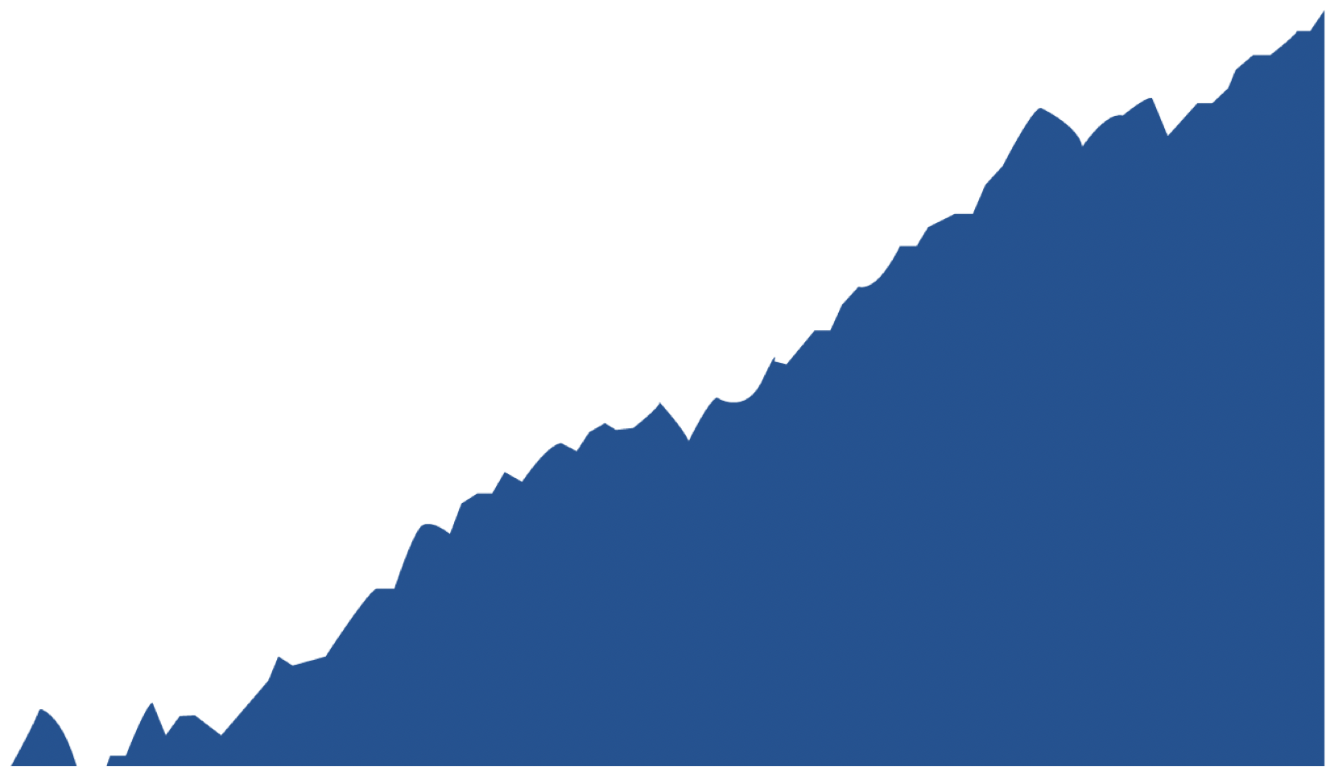
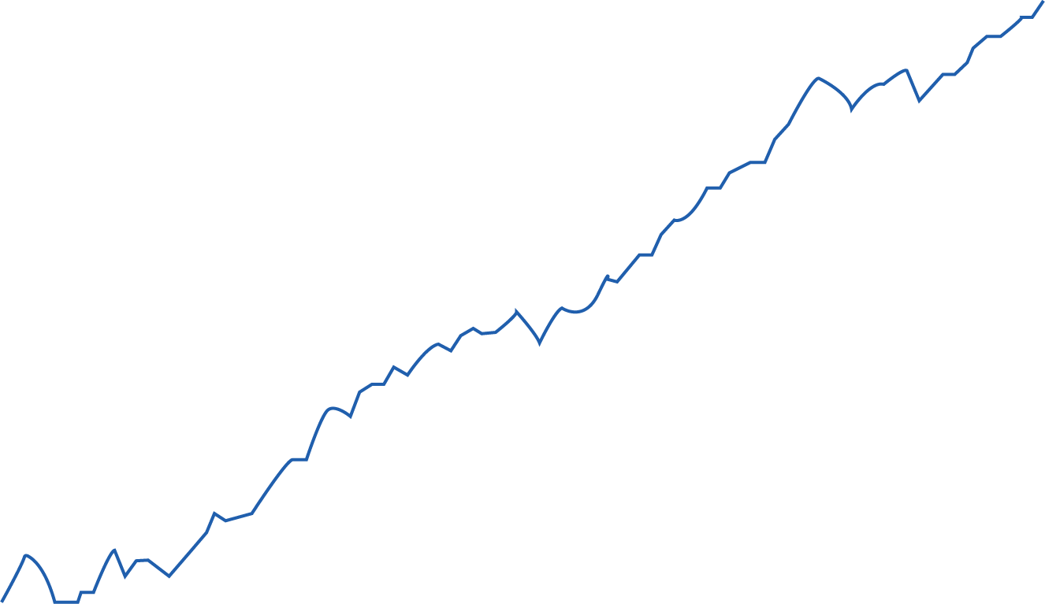
Market ups and downs are normal.
MARKET VOLATILITY
$10,000
The bull market that ended this year was the longest in history, having begun its run in 2009. And while we may not like to think about it, market downturns are normal. Economic recessions are normal. We’ve had many over the years—and valuations, overall, have always come back—and exceeded their previous highs.
$1,000
Economic recessions and cumulative growth of the S&P 500® Index
$100
The U.S. economy typically has experienced recession once or twice per decade, with each recession lasting nine months on average. Despite these setbacks, over the long term, the market has followed an upward trend.
$10
Recession
$1
1926
1932
1938
1944
1950
1956
1962
1968
1974
1980
1986
1992
1998
2004
2010
2016
Source: Recession data: Federal Reserve Bank of St. Louis, www.fred.stlouisfed.org; Annual S&P 500 Index data: www.slickcharts.com.
Past performance is no guarantee of future results.

Slide 32
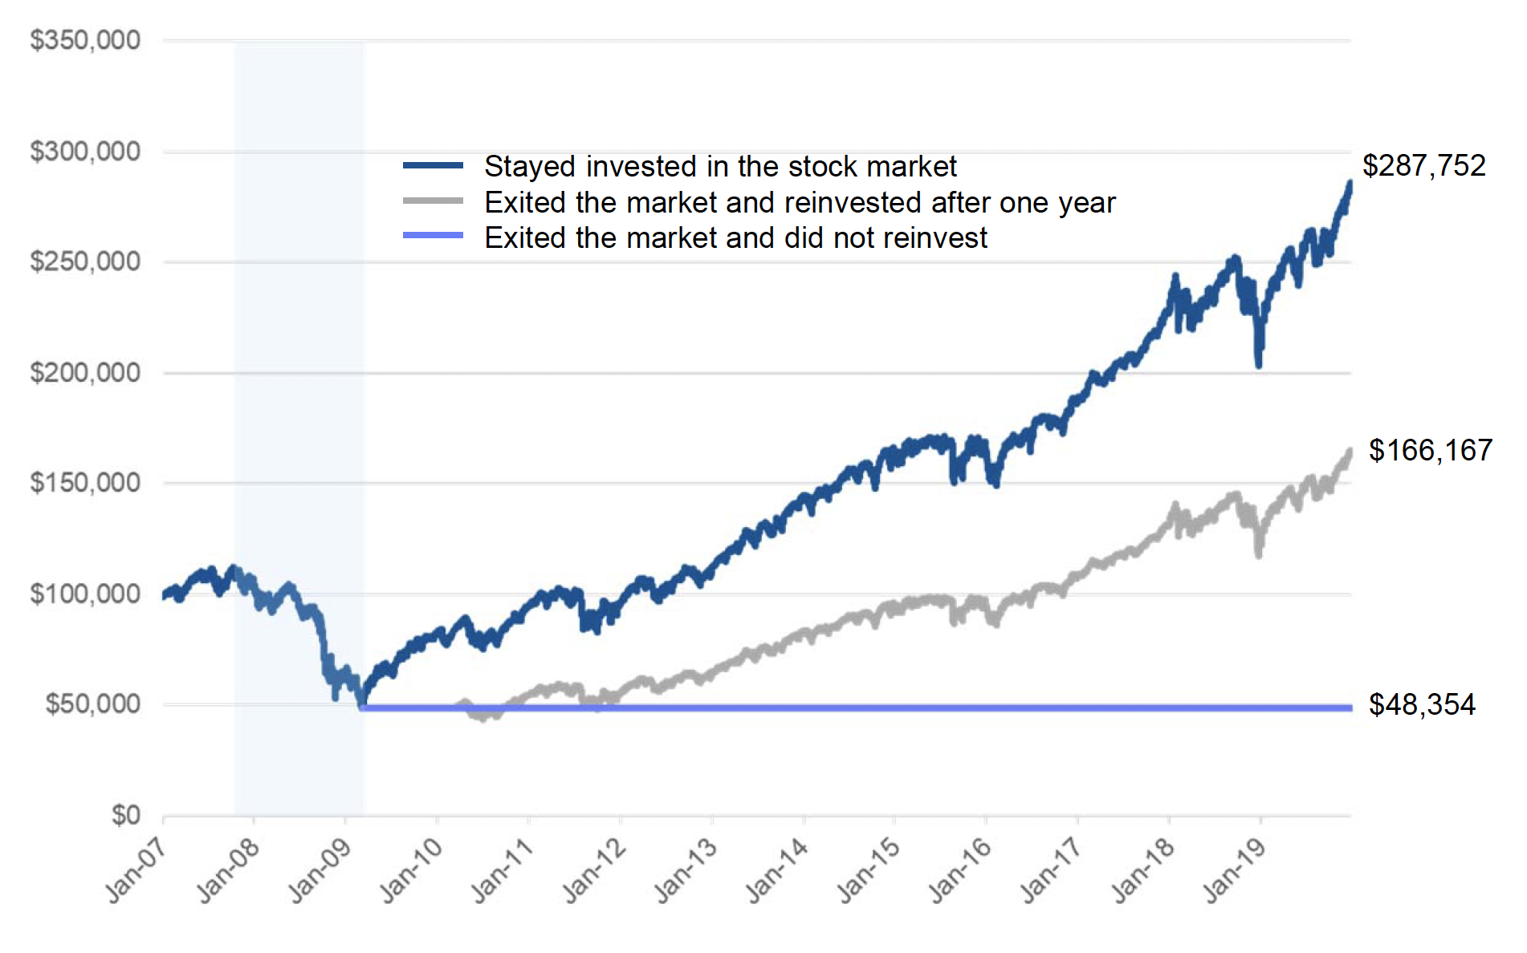
Don’t try to time the market.
MARKET VOLATILITY
The power of staying invested
Comparison of end wealth values after the December. 2007–June 2009 recession
Trying to time the market—to get out before it dips and get back in before it shoots back up—sounds like a great idea. Unfortunately, it’s almost impossible to execute. Simply staying invested
and riding out the downswing typically leads to the best outcome.
A helpful strategy for many people is dollar cost averaging—adding the same dollar amount to your retirement account every month, regardless of market value. This approach automatically ensures that you buy more when share prices dip and less when prices are high.
This comparison shows that those who stayed invested in the market at the bottom did better than those who sold at the bottom.
Dollar cost averaging can be a helpful tool for lowering risk. Investors who use dollar cost averaging may forfeit potentially higher returns, as a result.
Source: Morningstar.
Past performance is no guarantee of future results.

Slide 33
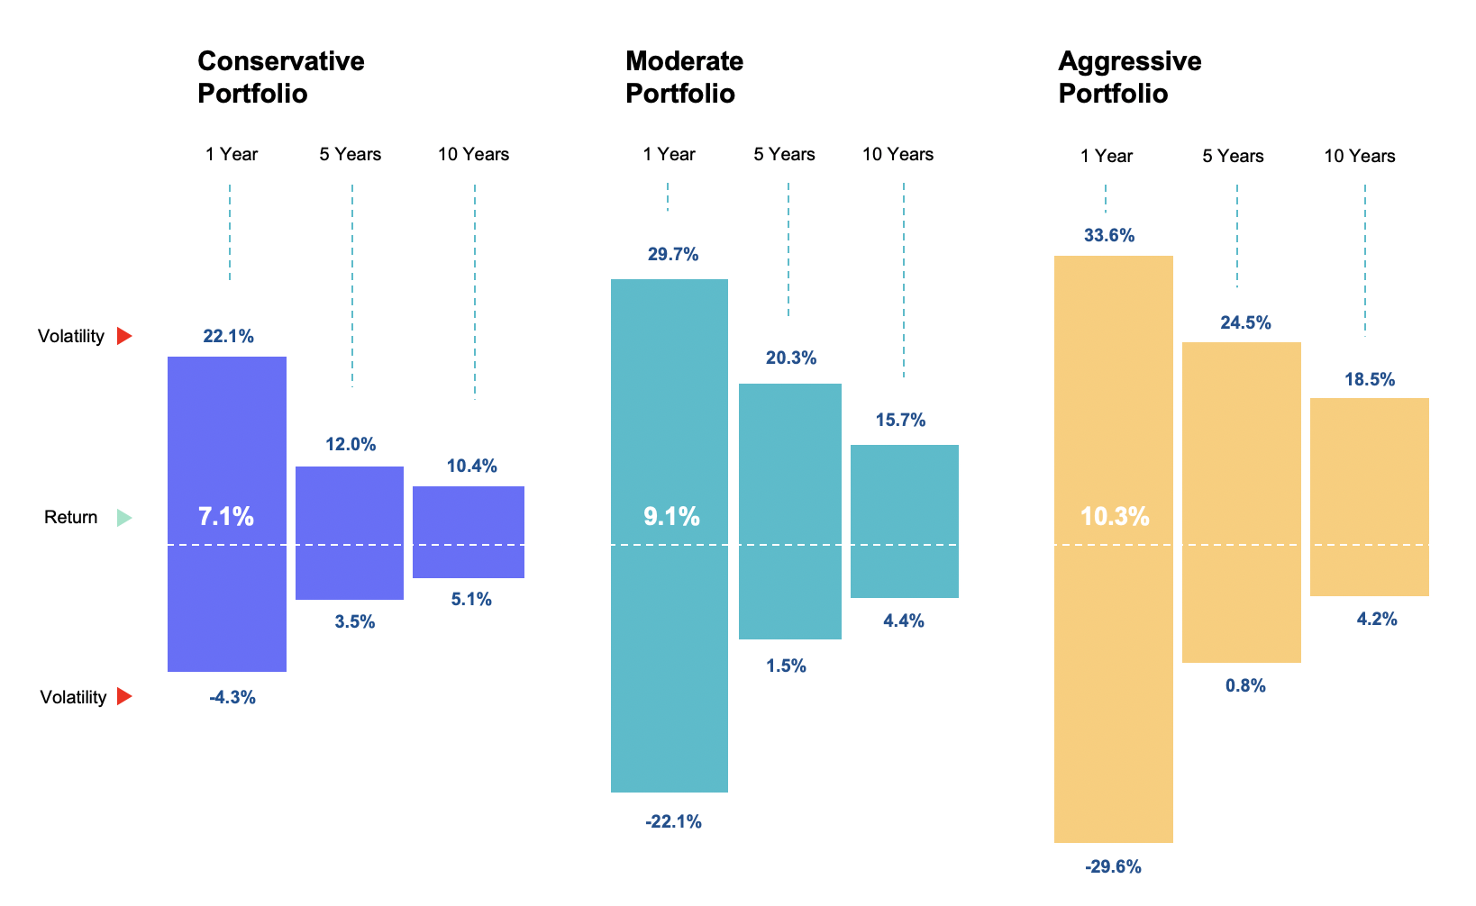
Be sure your portfolio is diversified and balanced.
Asset allocation and diversification can determine potential returns and portfolio volatility.
WHAT YOU CAN DO
Make sure your portfolio is diversified and appropriately balanced based on your:
Age and time horizon
Goals
Tolerance for risk
Comparison of volatility for sample conservative, moderate and aggressive portfolios over one-, five- and ten-year time frames.
This chart's hypothetical illustration uses historical annual performance from January 1, 1990, through December 31, 2019, from Morningstar Direct. Stocks are represented by the S&P 500 Index, bonds are represented by the Bloomberg Barclays U.S. Aggregate Bond Index ("BB Agg Index"). The hypothetical portfolios are composed as follows: Conservative (20% S&P 500 Index/80% BB Agg Index); Moderate (60% S&P 500 Index/40% BB Agg Index); Aggressive (80% S&P 500 Index/20% BB Agg Index). This chart is for illustrative and educational purposes only and is not indicative of any investment. Past performance is no guarantee of future results. It is not possible to invest directly in an index. Diversification does not guarantee investment returns or eliminate the risk of loss.

Slide 34
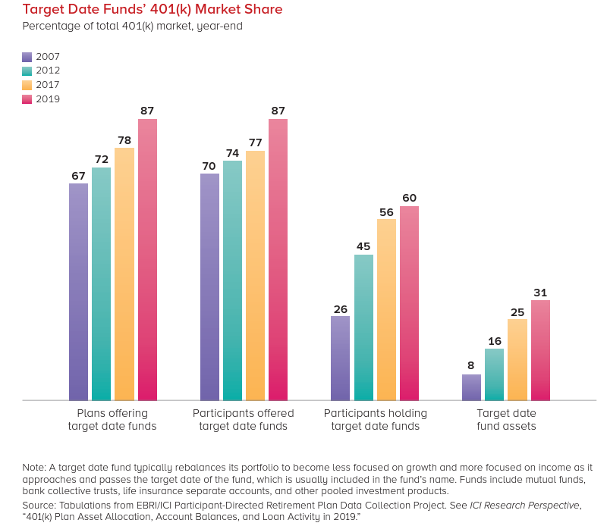
Target Date Fund Background
A Good Target Date Series is a Great Option
History
First funds launched in 1994
Substantial growth
Common QDIA

Slide 35

The Glide Path Governs The Asset Allocation
MoA CLEAR PASSAGE FUNDS™
Accumulation
Transition
Pre-Target Date
Post-Target Date
Asset growth
Asset growth
Gradual risk reduction
Capital preservation
Asset growth
Capital preservation
For illustrative purposes only. Fund allocations will vary and are subject to change.
35

Slide 36
MINOR’S TRUST PROGRAM

Slide 37
Our Minors Trust Solution
INVESTMENT MANAGEMENT TO SERVE MINORS OF ALL AGES
    Whether the child is a newborn or a teenager, Mutual of America Capital Management can provide expert investment management for all minor tribe members. Using our specialized approach to asset allocation, we offer date specific allocations from birth through age 18 or 21.
  MEMBER ADMINISTRATION BECOMES OUR RESPONSIBILITY
    Unlike current self-administered plans that require labor-intensive recordkeeping, Mutual of America Capital Management can take the administrative burden away. Our Minors Trust Program provides comprehensive recordkeeping, an online portal, statements for each member, and tribal government reporting.
  TEACHING YOUTH TO BECOME FINANCIALLY SMART YOUNG ADULTS
    Financial success later in life is often a function of education regarding a host of topics that focus on borrowing, saving, and budgeting. Our Minors Trust Program includes education on an array of financial topics geared to your high-school age members.

Slide 38
Class Participation Time

Slide 39

ADMINISTRATION
IMPORTANCE
BENEFIT

Slide 40

EDUCATION
IMPORTANCE
BENEFIT

Slide 41

INVESTMENTS
IMPORTANCE
BENEFIT
Notes:
Slide
Title
Speaker
Script

Slide 42

MINOR’S TRUST PROGRAM
IMPORTANCE
BENEFIT

Slide 43
Q & A Session
National accounts
Questions
Comments
Notes:
Slide 18:
Title: Q & A Session – 5 minutes
Speaker 1 (Lisa Loughry):
Open up the floor for Q & A.
Ask NNAHRA members to contact us directly for an in-depth analysis. Contact information on Flyer.
Let NNAHRA members that if they would like to contact us directly, feel free to stop by our booth or schedule a time to chat by contacting Lorilee, Lea, Jacob or yourself at Mutual of America.
Slide Script:
Please feel free to ask any questions related to retirement planning or any of the topics we have discussed.
We are here to address any inquiries you may have.

