Slide 1




2024
Compensation
&
Benefits
Summit
Notes:
INTRODUCTION: Thank you Mike. Thank you for this opportunity. It’s an honor to be here. A famous person once said “Genius is not knowing all the answers, it’s knowing where to find all the answers. Your job is difficult, and the goal is to provide you with a simplified offboarding process.

Slide 2

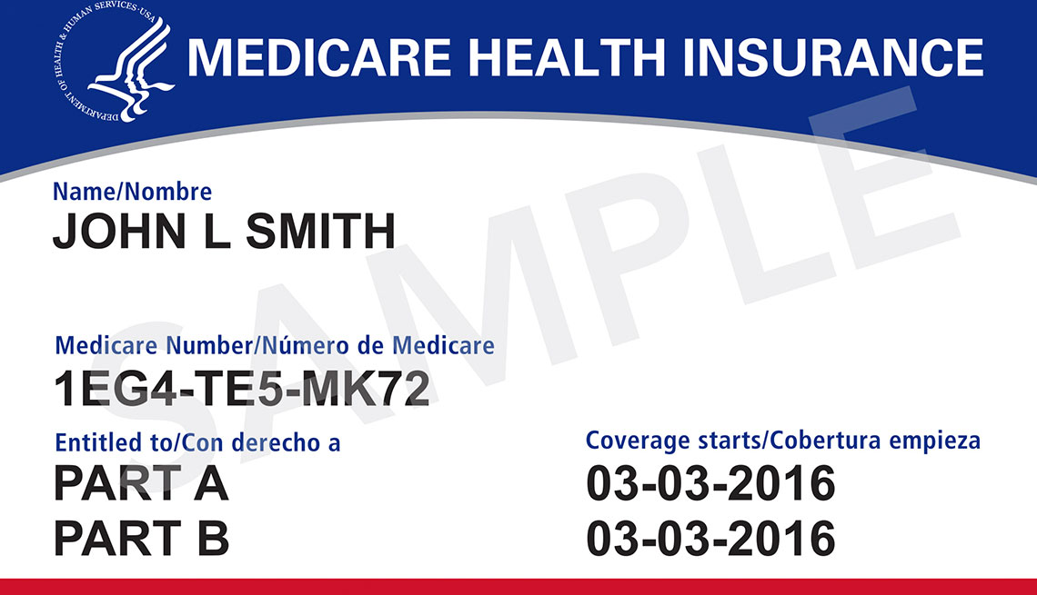



Compensation & Benefits Summit
Educating Employees on Retirement Stages
Medicare: 65+
Social Security: 62-70
401K: 59 1/2+
Notes:
WE KNOW HR plays a pivotal role with employees' retirement planning including MEDICARE, SOCIAL SECURITY AND 401K. When I met Mike, it was obvious he cared about employees. I know you do as well, and want to partner with those who shares that commitment. When their tenure ends with the company, it’s just the beginning with us. We provide a streamlined program to transition smoothly into their next chapter.
As a Director with the AHA, I worked with California Casinos on different projects. I knew whatever my next career path was, I had to impact and make a difference in people's lives. it's in my DNA, LOL. I blame my parents for that.
My Mother-in-Law lived with us, I helped both her and my Mom with Medicare. WOW! What a headache. It was confusing, overwhelming and a lot of information. We are intelligent women, but we sure didn't feel that way LOL. I LOVED both mothers and always had a passion for the ELDERLY. I realized there was a need for an advocate and resource in this offboarding space. The transition to Medicare Advisor was a perfect fit. True passion always leads to success.

Slide 3



PARTNERSHIP BENEFITS
OFF
BOARDING
One-on-One consultations
Educational Trainings
Tailored Workshops
Notes:
PARTNERSHIP BENEFITS with us FREES UP your VALUABLE time, while still prioritizing employees' well-being. We use a multi-point approach: actively listening, taking time to understand their concerns, addressing their needs, and laying the groundwork for employees to understand their options.
This is accomplished in several ways, 1-on-1 consultations can be by phone, zoom, webinar or in person . Educational trainings be conducted a variety of ways, including in-person, as well. Designed to ready employees with the knowledge and tools to make informed decisions about their retirement planning. HR can confidently delegate on-site training, starting as early as 60 years old. For you, retirement is the finish line, FOR US, it's the start.
Each Group is different, we TAILOR WORKSHOPS to your specific needs .
This proactive approach to employee development contributes to a more engaged and motivated workforce. Employees who feel supported in planning for their next phase are more likely to have higher levels of job satisfaction. And less anxiety about what’s ahead.
Together, we can create a culture of support within the Company, where employees feel valued, heard, and equipped to navigate the complexities of retirement planning with confidence.

Slide 4

PRE-RETIREMENT
EMPLOYEE CONSIDERATIONS
Health Care costs in Retirement
Social Security Questions
401K Questions
Notes:
Let’s imagine we are a potential retirees? What keeps us up at night. Where do we get help? How much is health care going to cost? Can we keep my doctors, are medications covered? Can we afford to retire? When to collect SSA, what to do with 401K. No wonder they can’t sleep. These are legitimate concerns retirees want to know the answers to and aren’t always sure where to find a reliable and trusted source.
STORY CW: I met a woman whose husband retired, and she heard from a friend she had time to make decisions about Medicare and Social Security. So she put it off – LIKE WE ALL PUT THINGS OFF She didn’t apply for anything. When we talked, she was completely stressed and didn’t have any health coverage. With no SSA benefits and financially strapped to pay Premiums to fill the gap, she didn’t know what to do. I suggested a rebate plan to help pay premiums. She had never heard of that. We enrolled her on Jan 1st. On Jan 5th, she went into the hospital. She saved thousands of dollars and peace of mind knowing she had complete medical coverage. This is what we do for you.

Slide 5

Compensation & Benefits Summit
Overview of Medicare
Notes:
A reliable source says About 55% of people DO NOT understand Medicare
About 42% of people don’t even realize MEDICARE IS FEDERALLY managed.
It changes every year. Just received a 1400 page document with 2025 changes A LITTLE LIGHT reading for me. LOL
I BET YOU WANT THE CONDENSED VERSION? POINT She Does! Right

Slide 6




APPLICATION RULES
Turning age 65
Retiring age 65+
Notes:
Are you a RULE person? I am. There are lots of rules to remember with Medicare. I think they went a little overboard U65 you CAN apply online/in person.
But one day over 65 years old, NO CAN DO
OVER 65 Website says you can apply online, but they don’t mean ONLINE, they mean complete the application ONLINE and then PRINT IT and take to local office. People don’t understand that, they apply online and think they’re good. They get a letter in the mail several weeks later telling them to NEED TO apply in person or by phone. Our assistance prepares them to understand the Timelines well in advance.

Slide 7
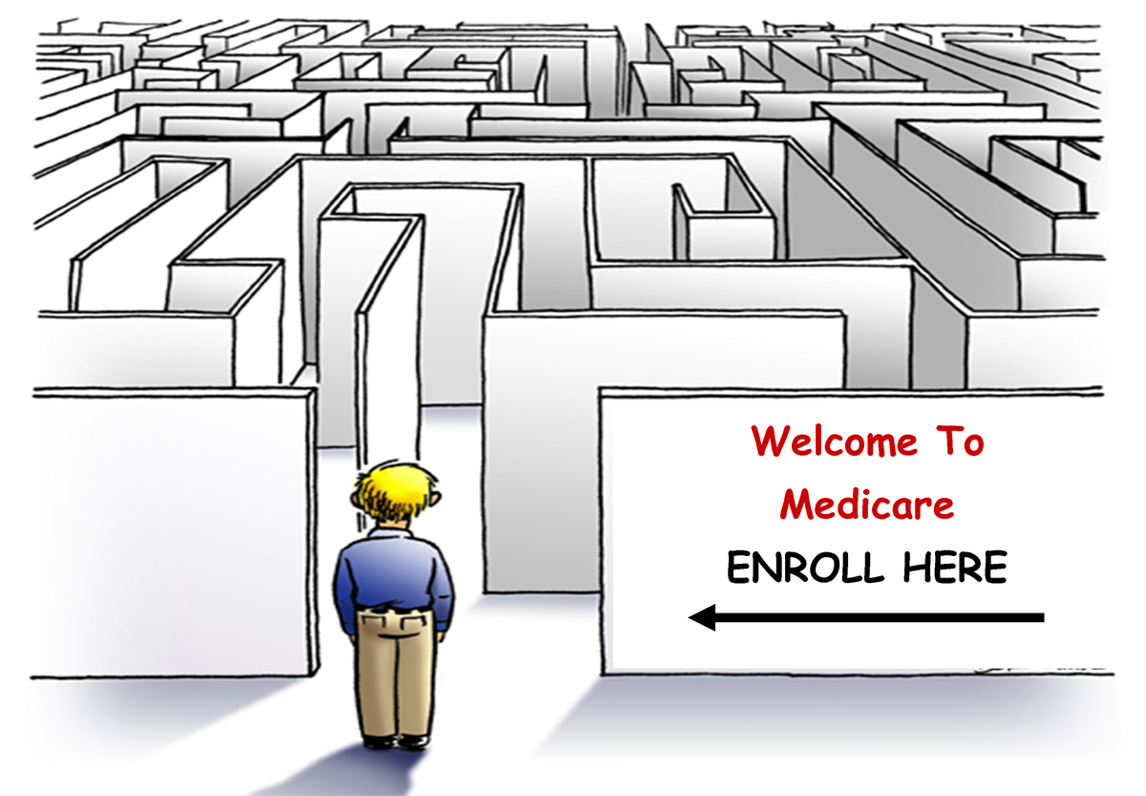
MEDICARE BASICS
Part A: $0 Premium and Part B: $174.70 Premium
Part B & D: Lifetime Late enrollment Penalty
MSP & LIS: Savings Programs
IRMAA : High Income Earners
Notes:
MEDICARE BASICS WHAT’S UP with the Alphabet soup? Remember making words with your letters? I do, LOL
People always ask me: Do I have everything, ABCDFGN, and WTH to they mean?
Part A can qualify several ways
Part B/D Premium is based on Income, Low Income can have premium paid by state.
IS THAT A TYPO!!! Do you really mean LIFETIME Penalty, not just like a year or something.
IRMAA Income Related Monthly Adjusted Amount HIGH Income Earners you’re in for some turbulence.

Slide 8

HURRICANE IRMAA
Notes:
IRMAA is what we call a Nasty HURRICANE that SWOOPS in and takes all the money out of your wallet, the higher your income, the higher your premium

Slide 9
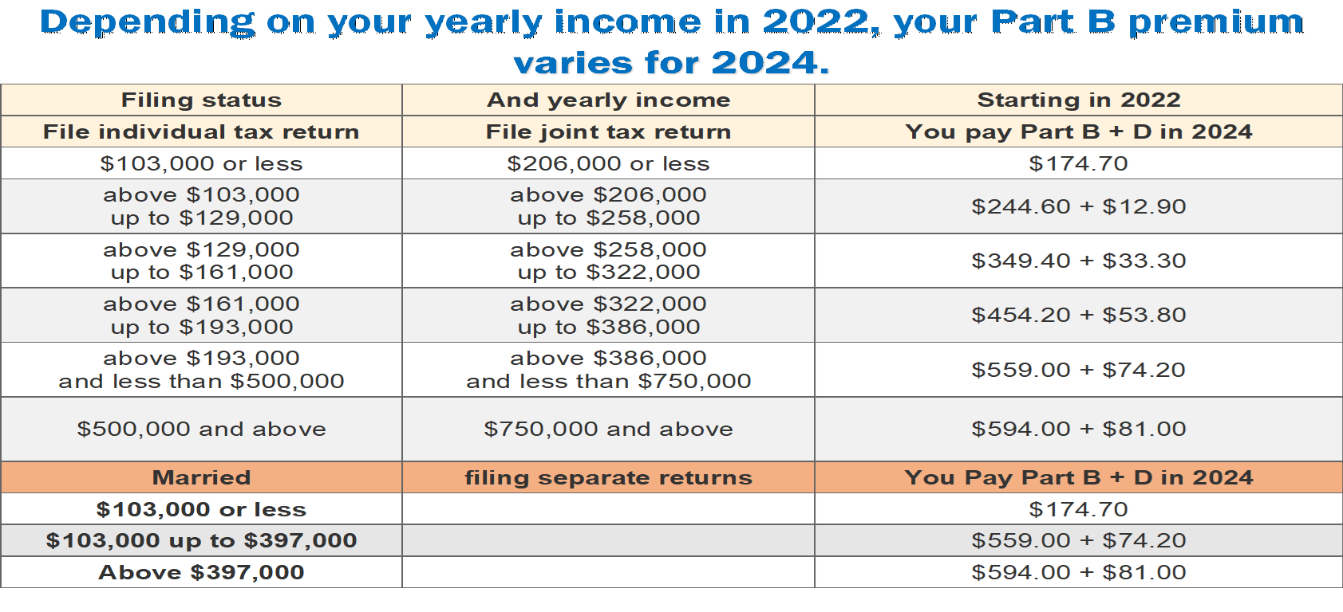
Medicare Part B & D premium
Notes:
This is collateral material in our “OFFBOARDING PACKET“
We update this every year with the new changes
STORY: This person had done extensive research on his own and didn’t realize his premium would be higher because of IRMAA. He talked to his brother who paid the standard amount. We met him in December. He waited an entire month to apply since he wasn’t exactly sure of the timelines. He finally received approval in late April. 4 MONTHS LATER. His letter came without his MBI #, we were able to get his number to enroll him. Once we went through our “OFFBOARDING PACKET, he said that this put “all the pieces together” that he was confused about. He felt relieved by this simplified manner. Breaking down the components, and presenting them in a clear, organized way, helped alleviate his stress and made the entire situation more manageable. Isn’t this what you want for your company’s employees.

Slide 10

MEDICARE TIMELINE & RULES
Avoid Lifetime Penalties
Understanding Options
Easy Pay (for Medicare)
Notes:
LIFETIME REALLY!!!!!
MEDICARE TIMELINE AND RULES
YOU DON'T KNOW WHAT YOU DON'T KNOW I see it over and over again, no off boarding in the workplace and people getting advice from friends and family .
Avoid Lifetime Penalties
SAD STORY: VA NO PART B MC I tried to help a client whose husband was very ill and needed more care than she could offer. He never signed up for Part B. He was told by someone since he was a Veteran and received benefits at the VA, he didn't REALLY need Part B. No one ever explained THE LIFETIME PENALTIES FOR NOT SIGNING UP. The LIFETIME penalties were so high, they couldn't afford to get Part B now when they wanted to go outside the VA facility. Had they completely understood the ramifications of NO PART B, they may have made a different choice.
Understanding Options We all talk to our friends and family about our life changes, because we want to get an opinion from someone we know and trust. I HEAR… My friend said… THIS IS WHAT I SHOULD DO WITH MY HEALTH CARE. This is the ONE time that you cannot use that advice, we all have unique health needs and prescriptions. That’s why they call It “PRACTICING MEDICINE, they’re practicing on you, because we’re all so different. Transitioning from Employer Plans to Medicare Plans can be a significant change. We know your employees want to talk to someone they know and trust. I don’t blame them, we all do. We recognize the importance of building trust and rapport with employees. Let’s not wait until the REITREMENT day. Starting educational training WITH US well in advance gives ample time to know us and creates a culture of continuous learning. Employees feel supported and valued, knowing that resources are available to help them navigate important life transitions effectively.
Easy Pay for Medicare A person referred to me had lost their Part B Premium and didn’t know what to do. This is a HUGE deal, a nightmare actually. He forgot to pay his bill. It took 5 months to reinstate, the entire 5 months he had no coverage. Social Security isn’t very kind about this error. “EASY PAY” could have been set up for recurring payments had he known. A simple fix could have avoided this devastating situation. This is for individuals who aren’t collecting their SSA benefits yet. This also takes care of “lump sump amount due” when you first apply for Medicare Part B.

Slide 11

Compensation & Benefits Summit
Indian Health Services

Slide 12
INDIAN HEALTH SERVICES
Non-Tribal Members IHS coverage ends at retirement
Tribal members can utilize both IHS and Medicare Plans
IHS and Medicare Plans vary by Region
Medicare considers IHS credible for Part D (prescriptions)
IHS is not Health Insurance
Notes:
READ SLIDE
CMS considers IHS credible for Part D. Members can use any Physician prescription to be filled at IHS Even people eligible for IHS need to have Health insurance, also this benefits the tribal health program by providing increased resources to provide more services . IHS gladly accepts many forms of Health Insurance

Slide 13


Compensation & Benefits Summit
Overview of Social Security

Slide 14
SOCIAL SECURITY – AGE AND TIMING
Applying for a Social Security Account
62 Age first eligible
67 Full Retirement Age (FRA-NRA)
70 Maximum earning benefit
70+ No additional earning benefits
Notes:
READ SLIDE About 56% of individuals feel they're behind on money saved for retirement?
A top concern is when is the best time to start collecting benefits and how much they will receive.

Slide 15
Age of first Social Security claim (Claiming early vs claiming later) | Benefits impact (% of benefit at full retirement) born 1960 or later
62 | -30%
63 | -25%
64 | -20%
65 | -13.33%
66 | -6.67%
67 | None
68 | +8%
69 | +16%
70 | +24%
Notes:
Another component of our OFFBOARDING PACKET CLEARLY shows the large gap in benefits. Taking benefits at 62 years old, one receive 30% less of FRA; or waiting until 70 and one receives 24% more income than at FRA Benefit . Knowing the implications helps individuals choose when to take benefits.

Slide 16
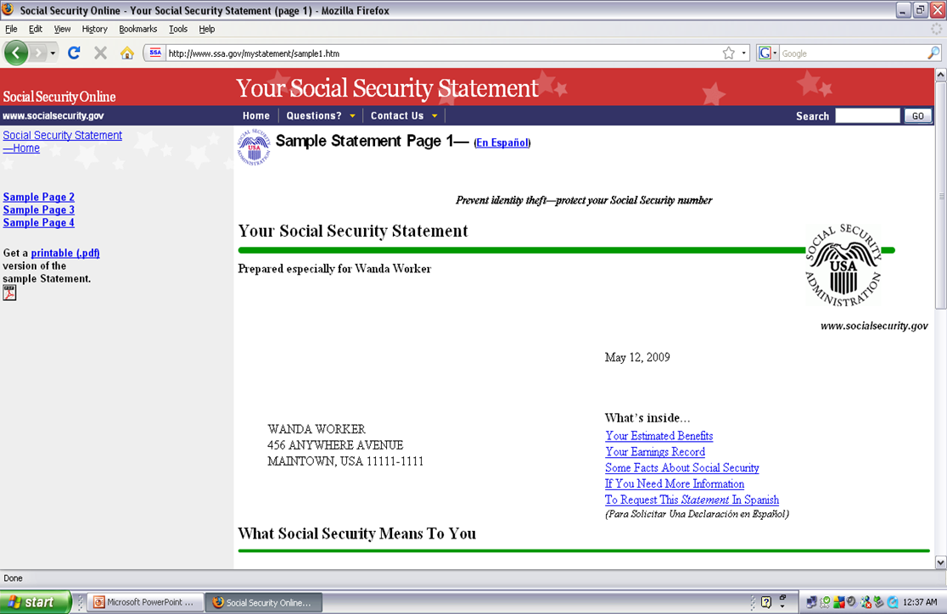
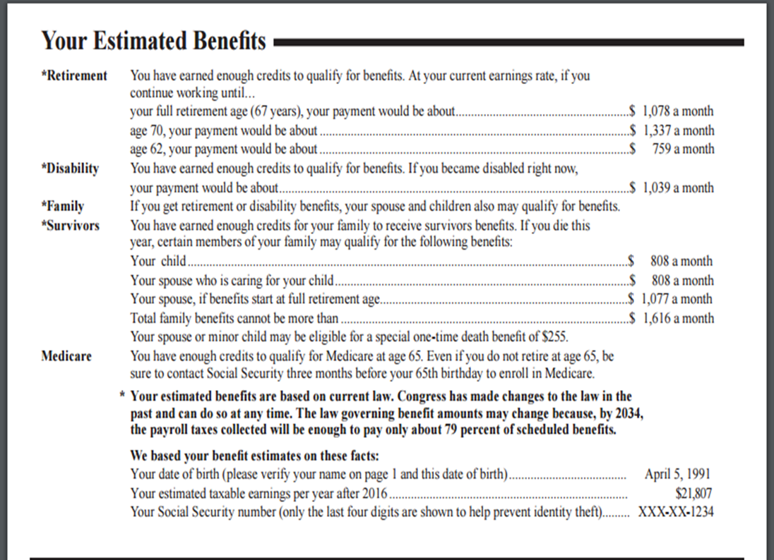
SOCIAL SECURITY STATEMENT
Notes:
Our offboarding packet includes crucial information on Medicare, IHS, Social Security, and 401(k). Unlike the 128 page "Medicare handbook, by condensing the vital information into a shorter, simpler format, we’re making it easier for employees to understand and navigate these complex topics.
We encourage and assist people to set up an SSA which helps prevent Fraud and allows them to verify earnings, address changes and order cards .
STORY: One employee we worked with, identified, and corrected missing work years from previous employment. This allowed him to accurately calculate his Social Security benefits. Without this correction, he may have received lower benefits than he was entitled to. An example of the importance of early intervention. By staying ahead of potential challenges and addressing them early on, we can ensure a smooth transition.

Slide 17

Compensation & Benefits Summit
Overview of 401K
Notes:
401K About 50% of employees have little understanding of their financial portfolio
When an employee retires, is when their 401K should get to work, LOL

Slide 18

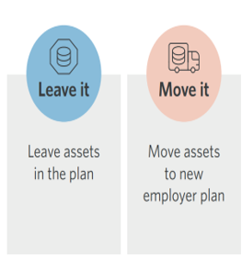
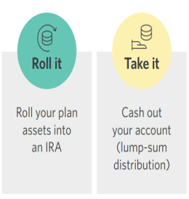
401K RETIREMENT OPTIONS
Notes:
401K Here are 401K options. LEAVE IT MOVE IT ROLL IT TAKE IT. We collaborate with Retirement experts to ensure that employees receive well-rounded advice tailored to their specific needs. Building partnerships with professionals outside our field is a sound strategy which allows us to concentrate on Medicare and Social Security.

Slide 19
3 TYPES OF FINANCIAL ADVISORS
Robo Advisor – “Do-it-yourself” mentality
Online Financial Planners
Traditional Financial Advisor
Notes:
3 TYPES OF FINANCIAL ADVISORS
Robo Advisor: PROS: Easy, less expensive CONS no personalized advice
Online Financial Planner: PROS More personalized CONS 800# no dedicated advisor
Traditional Financial Advisor: PROS Dedicated Person that knows individual’s specific needs and goals , We have found people like to work with people they know and trust. CONS: May be more expensive

Slide 20
EMPLOYEE BENEFITS COORDINATOR
MEDICARE – Timelines
Resources – Avoid Penalties & Coverage Gaps
SOCIAL SECURITY – Target Dates
401K – Distribution Strategy
Emergency Funds and Estate Planning
Strategies and risk tolerance
Retirement Benefit Consultations
How and when to apply?
Financial effect
Notes:
Think of us as “EMPLOYER BENEFITS COORDINATORS”. This is an offboarding program, created with you in mind. Hallelujah!!! Right Sister!
When workers are winding down with you, we step in with retirement support. Medicare Timelines, Retirement Benefit Consultations We break it into “bite size” pieces. Resource & Tools Employees rely on our expert guidance on deadline reminders, avoiding penalties & Coverage Gaps. Breaking down the process in an organized and simplified manner. Social Security Target Dates So important to know how and when to apply and the financial affect as mentioned throughout this presentation.
401K Distribution Strategy: Working with some level of a Financial Advisor to understand 401k options, necessity of emergency funds & Estate Planning. Learning Strategies and Risk tolerance We offer “THE WORKS” so employees know how to handle all aspects of retirement planning with confidence.

Slide 21
PARTNERSHIP BENEFITS INCLUDE
Dedicated Support
OFF
BOARDING
Comprehensive Services
Continued Engagement
Long-Term Partnership
Notes:
A benefits partnership is designed to be tailored to your organization's specific needs and the retirement goals of your employees. Here's what it looks like:
Dedicated Support: Our team is available to you every step of the way, providing dedicated support and guidance throughout the retirement planning process. Whether it's answering questions, resolving issues, or offering personalized consultations, we're just a phone call away. For you, retirement is the ending place, FOR US, it's just the beginning of a long and lasting relationship with your employee.
Comprehensive Services: We work closely with your organization to understand your unique requirements and develop tailored retirement benefit solutions that meet the needs of both your company and your employees.
Continued Engagement: We believe in ongoing engagement and communication to ensure that your employees remain informed and supported throughout their retirement journey. Whether it's updates on retirement trends, changes in benefits, or new resources and tools, we're here to keep them informed and empowered.
Long-Term Partnership: For us, retirement is not the end of the journey but the beginning of a lasting relationship with your employees. We're committed to supporting them throughout their retirement years, ensuring they have the resources and assistance they need to thrive in this next chapter of their lives.
In essence, a benefits partnership with us is designed to provide personalized, dedicated, and comprehensive support to your organization and its employees at every stage of the retirement process. It's a testament to your organization's commitment to the well-being of your employees and their continued success beyond the workplace. Together, we can make a meaningful difference in the lives of your employees as they embark on their next journey.

Slide 22




Meet the Team
Debbie Pucciarelli
Tamie Mongold
Alma Lafarga
Managing Partner
Agency Owner
Bilingual Team Leader
Notes:
Meet the Team I’m Debbie, surprise! Tamie Mongold successfully manages over 700 clients and almost 40 Agents/Medicare Advisors. She’s a “Certified Geek/Researcher” she would tell you that if she was here. Anyone attending the Oklahoma conference will meet her. Alma is one of our Bilingual Team Leaders.

Slide 23





Get in Touch
Contact us to get more info
ShopAgency65@gmail.com
California
Debbie (951) 526-6676
Tamie (951) 795-1943
Alma (619) 955-0640
www.MedicareMobileOffice.com
Notes:
Understandably you feel responsible for your companies’ employees. I look forward to connecting with each of you to see how our Offboarding Process could integrate in your organization. My Contact information is on the screen.

