Slide 1
Trauma and Resilience in Tribal Communities
2023 Mental Wellness Awareness Summit
Notes:
3 minutes

Slide 2
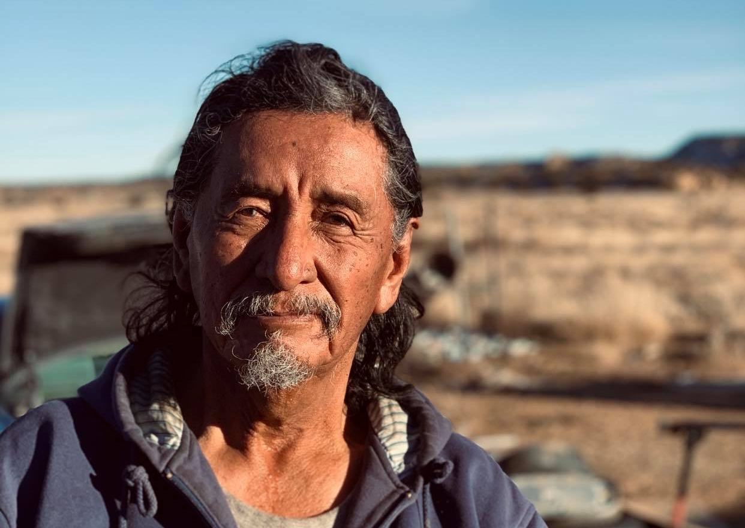
Why talk about historical trauma?
Historical trauma is the soil in which all other traumas take root.
Our people can heal from historical trauma.
Applying an historical trauma lens teaches us to ask the right question.
Notes:
Purpose:
This slide truly begins the conversation about why understanding trauma and talking about trauma matters. It is possible that the audience knows this and is the reason they chose to attend, but it is also possible this is a new concept to some. Use this slide as an opportunity to compel your audience, motivate your audience, and request of your audience that they come alongside the community as you work towards becoming trauma-informed.
Presenter Say:
Approaching our interactions with people both personal and professional using a trauma lens focuses on strengths and values resiliency. With this approach we begin asking what has happened to a person instead of what’s wrong with them or why they do what they do. We come to understand behavior as responses to what a person has experienced, and further understand those negative or unhealthy responses as serving a function to protect them at one time.
Adaptability:
This slide provides some universal truths about the importance of talking about trauma, but it’s not an exhaustive list or even a specific list. This slide should be adapted to represent the community and audience it is being presented to. Consider, why is it important to talk about trauma on this reservation, with our children, and for our tribe?
Supplemental for Participants:
Resources for Presenter:
References:

Slide 3
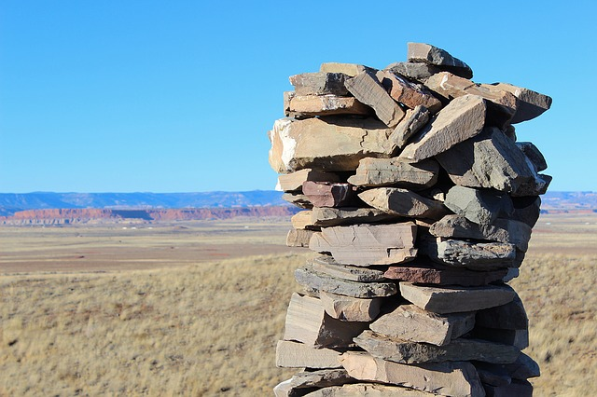
Your wellbeing is important
It is okay to ask for help
Notes:
3 minutes
Photo: The pictures on Max Pixel be freely distributed with a Creative Commons Zero - CC0.

Slide 4
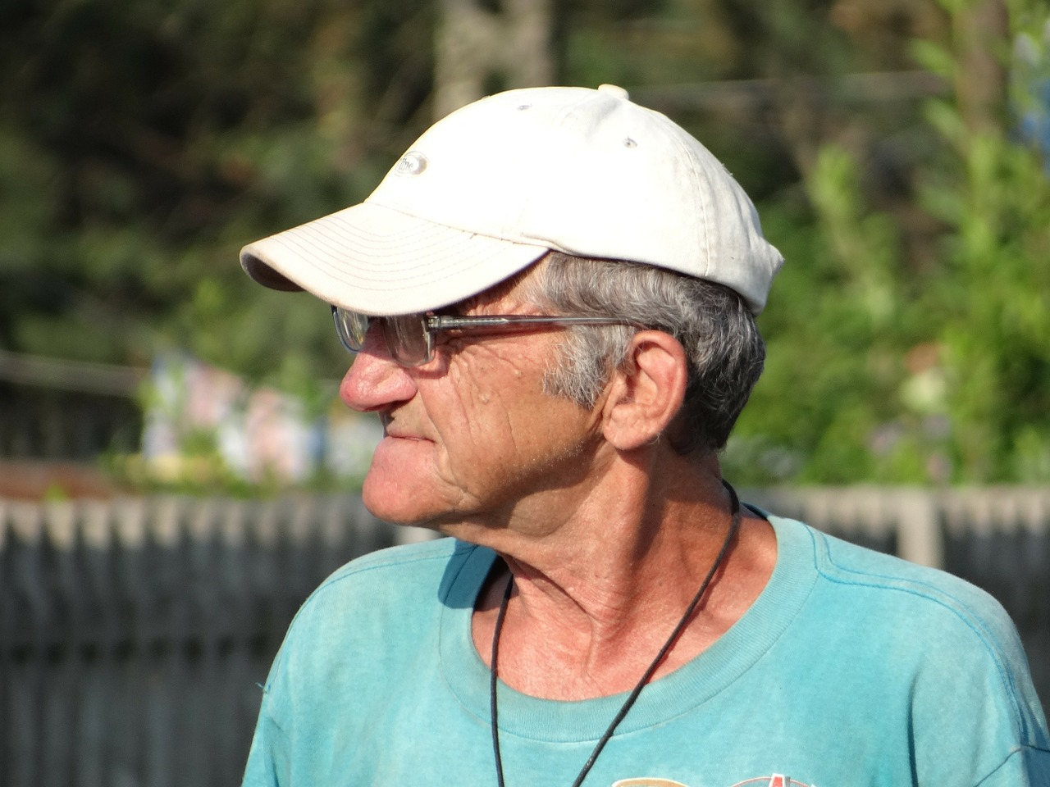
Grandpa Reggie's Story
The way Reggie remembers it, he was born speaking his own language, which he has always associated with the strong, peaceful features of his grandfather’s face. But then he was sent off to school and told it was wrong to use his own words. When he came back home after school nobody knew him. His grandfather had long since died, and his mother had passed, too, while he was away.
Reggie is not proud of the way he lived when he was a young man. He drank and ran around on his wife, and she did the same. When his wife left for good, she left their daughter Shari with her mother, Reggie’s mother-in-law.

Slide 5
Grandpa Reggie's Story continued...
Reggie got clean, though, and he married again, to Cecilia. With Cecilia’s encouragement Reggie took his daughter back in. By this time Shari was 11 years old and her grandmother was in bad health. Soon enough Shari was acting like her mother, only at a younger age, and it was not just alcohol nowadays, it was drugs. Reggie could not contain his anger at his daughter’s behavior. After the fourth or fifth time he and Cecilia caught Shari stealing from them, Reggie told Shari to leave and not come back. Shari was 18 at the time. Maybe being on her own would be good for her, he thought. Young people have to learn their own lessons. If he was able to figure out his own problems and get his life together, then his daughter should be able to do the same.

Slide 6
“The cumulative psychological wounding across generations, including the lifespan, which emanates from massive group trauma.”
- Maria Yellow Horse Brave Heart
Notes:
3 minutes
Picture: Agricultural Research Service, the research agency of the US Department of Agriculture.
I Stock Photo

Slide 7
Federal Indian Policy
1492–1787
Contact and Tribal Independence
1787–1828
Agreements/Treaty Making
1828–1887
Removal and Relocation and Reservation Era
1887–1934
Allotment and Assimilation
1934–1953
Indian Reorganization
1953–1968
Termination Era and Urban Relocation
1968-Present
Tribal Self-Determination
Notes:
Pevar, L. Stephen. (2012). The Rights of Indians & Tribes. Fourth Edition. Oxford University Press. NY: New York.

Slide 8
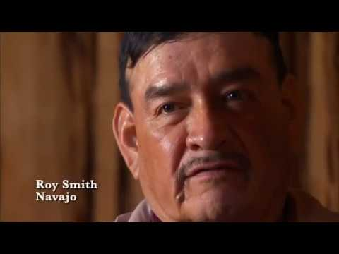

Slide 9
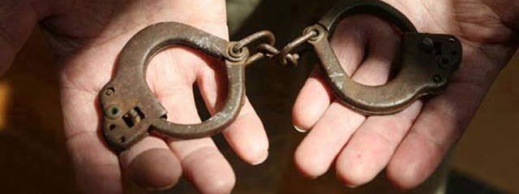
Removal
“A great general has said that the only good Indian is a dead one. In a sense, I agree with the sentiment, but only in this: that all the Indian there is in the race should be dead. Kill the Indian in him, and save the man.”
General Richard Henry Pratt
Carlisle Indian Industrial School
Carlisle, Pennsylvania
Notes:
What was most detrimental to Indian people were the Assimilation policies around Removal (removal from ancestral homelands, removal from places where they had held their ceremonies for 10,000 years, where their medicinal plants existed…and they were moved to places where they had to re-establish a knowledge about the medicinal plants…it had an impact on their economic stability in that their food sources changed, their seasons changed (Southern tribes may have been moved to Northern environments)…but what has been most detrimental, believed by many researchers and tribal nations is the idea of removing generations of children from their tribal families, from their homes and their communities and placing them in Boarding Schools. Some children left as young as 3 and didn’t return. If they did return and didn’t die from disease or accidents it wasn’t until they were 17 or 18 years old…the Boarding School experience was particularly harsh. It was an environment where the children often did not receive an adequate education, they were forced into labor for the local community where the boarding school existed, they often didn’t have adequate food, they were separated from their siblings, which was very different from what they were used to such as being in the same room with your siblings, sleeping, eating and playing together…in Boarding school 12 year old girls were on one floor, 5 year old girls were on another floor, boys and girls were separated, sisters and brothers were separated and you didn’t know where your siblings were and what was happening to them...there was also the harsh treatment by boarding school staff…children experienced neglect, physical, emotional, spiritual and sexual abuse at the hands of the would-be caretakers…and they often returned to their communities with the belief that the language and spiritual beliefs of their tribe were somehow inferior and something to be dismissed or to not participate in and it created a deep divide between the generations.
Later on Child Welfare played a huge role in removing children. In the mid-1970’s Congress began an investigation of state child welfare agencies that were removing children because they found that one fourth of all Indian children had been removed from their families by state welfare agencies and courts and then placed in foster care, which might not sound like a lot but if you think about your community and you think about taking away one quarter of all of the children of the families in your community - what an impact that would have on your community. So, after the investigation they created and passed what became known as the Indian Child Welfare Act in 1978 and it was meant to protect the best interests of the Indian children and promote the stability and security of Tribal nations and families because Congress became aware that the very existence and integrity of Tribal nations rested upon their children. What ICWA seeks to do is limit the state’s ability to remove Indian children from their families by giving tribal courts primary jurisdiction in most Indian custody cases. In fact, ICWA placed such significant restrictions on state courts in resolving Indian custody cases that it allows for Tribal Nations to have a say in the placement of where their children will live and what is in the best interest of their own children.
That is the beginning of the context of American history as it impacted tribal nations and communities.

Slide 10
Whitbeck, Walls, Johnson, Morrisseau, & McDougall, 2009
“The historical losses experienced by North American Indigenous people are not ‘historical’ in the sense that they happened long ago and a new life has begun. Rather, they are ‘historical’ in that they originated long ago and have persisted.”
Notes:
3 minutes
Big Stock Photo

Slide 11
Community and System Level Impacts
Examples of Current Impacts:
Examples of Historical Events:
Poor economic conditions on reservations
Persistent discrimination
Health disparities
Underfunding of service systems in Indian Country
Disparities in child protection and juvenile justice systems
The establishment of Reservations
Breaking of treaties
Forced assimilation
Boarding schools
Notes:
3 minutes

Slide 12
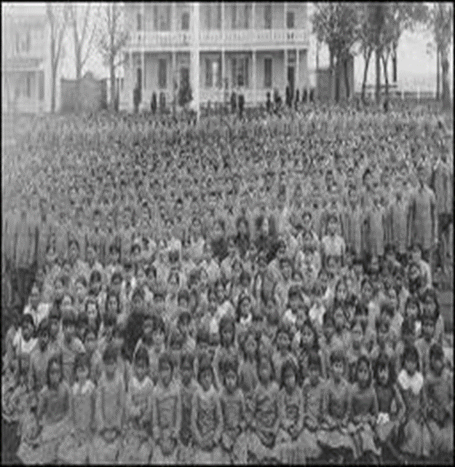
Impact on Families
Ineffective or destructive parenting
Authoritarian and inconsistent or rejecting of child
Insensitivity to child’s needs
Lack of parental involvement or bonding
Poor school relations
Weak spiritual foundations
Unhealthy family norms
Weak ethnic identity
(Yellow Horse Brave Heart, 2003)
Notes:
Key points:
What seems to be the most impactful on the well-being of Indian people was the consequences of the adverse boarding school experiences.
Very often, the parents had returned without that nurturing parenting; instead they engaged in the kind of parenting that they had in boarding school

Slide 13
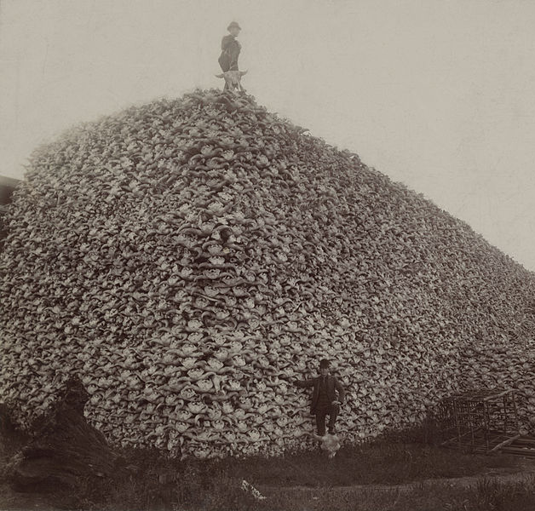
Individual Impacts
“I feel like I have been carrying a weight around that I’ve inherited. I have this theory that grief is passed on genetically because it’s there and I never knew where it came from. I feel a sense of responsibility to undo the pain of the past. I can’t separate myself from the past, the history and the trauma. It has been paralyzing to us as a group.”
A Lakota/Dakota Woman
(Brave Heart & DeBruyn, 1998)

Slide 14
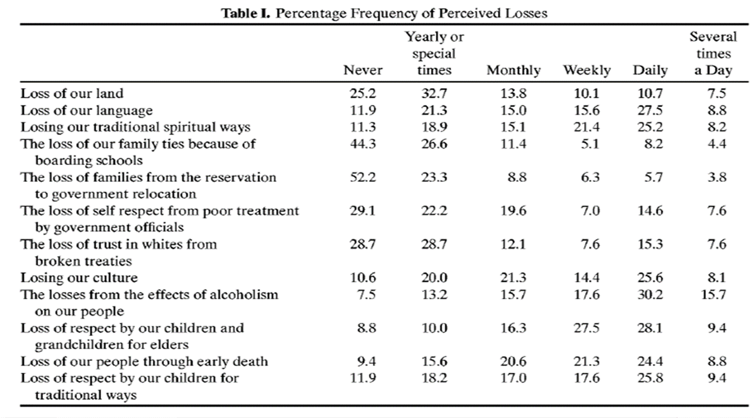
Whitbeck, Adams, Hoyt, & Chen (2004)
Notes:
Key points:
It was Dr. Les Whitbeck and his team that created the historical trauma and loss study
They asked American Indian Elders and adolescents questions about loss
How many times per day or per week do you think about what we as Indigenous people have lost?
Now what is most impactful about this is, if you are walking around within a society and as part of a race of people who have experienced the kinds of discrimination and mistreatment by the federal government as American Indian people have and at the same time you are potentially struggling with low employment or living at the poverty level, which is happening in our Tribal communities, it takes a toll. When you add these historical trauma stressors to your daily life stressors it has an impact.
References, Citations:
Whitbeck, L. B., Adams, G. W., Hoyt, D. R., & Chen, X. (2004). Conceptualizing and measuring historical trauma among American Indian people. American Journal of Community Psychology, 33(3-4), 119-130.

Slide 15
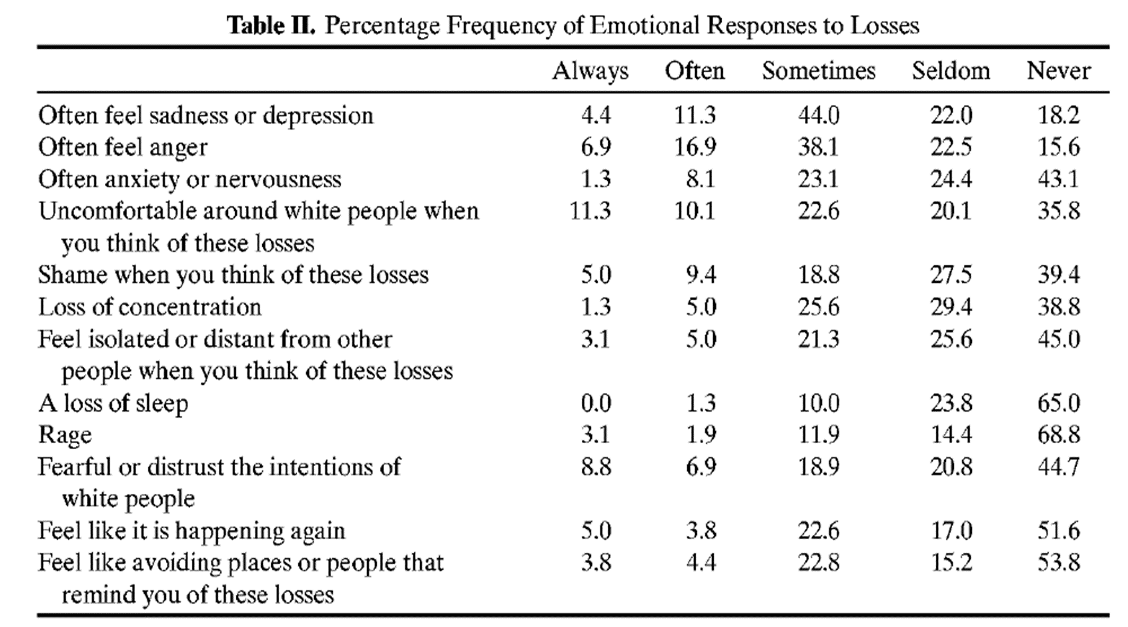
Whitbeck, Adams, Hoyt, & Chen (2004)
Notes:
Key points:
The purpose of the Historical Loss Associated Symptoms Scale is to identify prevalence of emotional responses, including anxiety/depression and anger/avoidance, to historical loss thoughts and reminders as opposed to current traumas.
Respondents were 143 (32 males and 111 females) adult parents and caregivers (28-59 years old) of children aged 10-12 years.
In Whitbeck’s research, he found that there is a connection between emotions and the current thoughts of past traumas.
Limitations of the study:
Severity of symptoms associated with historical loss is unknown, meaning we do not know the historical loss associated symptoms impact on functioning, parenting, or behaviors compared to current trauma experiences and symptoms.
These measures cannot be generalized across American Indians.
References, Citations:
Whitbeck, L. B., Adams, G. W., Hoyt, D. R., & Chen, X. (2004). Conceptualizing and measuring historical trauma among American Indian people. American Journal of Community Psychology, 33(3-4), 119-130.

Slide 16
Historical Trauma Responses
Identification with the dead
Depression
Psychic numbing
Attempts to numb the pain through substance abuse
Suicidal ideation and gestures
Fixation to trauma
Survivor guilt
Anger
Victim Identity
Maria Yellow Horse Brave Heart (2003)
Notes:
Key points:
From “Historical Trauma Response Among Natives and Its Relationship with Substance Abuse: A Lakota Illustration,”
Maria Yellow Horse Brave Heart calls HTRs “the constellation of features in reaction to historical trauma.”
She talks about how substance abuse is one of those HTRs ”as a vehicle for attempting to numb the pain associated with trauma.”
Others are listed here.

Slide 17
How is historical trauma passed down?
Epigenetics
Blood Memory
Heritable changes in gene expression as a result of environmental stress or major emotional trauma
Leave certain marks on the chemical coating, or methylation, of the chromosomes.
The coating becomes a sort of ‘memory’ of the cell and since all cells in our body carry this kind of memory, it becomes a constant physical reminder of past events.
Thoughts, beliefs and actions conveyed from one’s ancestors through the blood.
Spiritual Knowledge that is acquired through dreams, visions, and intuition that comes from the spirit world and ancestors.
(Lavellee, 2009)
Notes:
A couple of examples:
Traumatic experiences can leave epigenetic marks that alter the stress response in offspring (911 research-Yehuda, R. et al, 2005, &Yehuda, R. et al, 2009)
Mice trained to avoid a smell passed their aversion on to their offspring, and their offspring’s offspring (Dias & Ressler, 2013)

Slide 18
Back to Grandpa Reggie
What signs of historical trauma did you see in Reggie’s story?
How might these traumas be influencing Reggie’s life?
How might these traumas be affecting Reggie's worklife?
Notes:
20 minutes
10 minutes in small groups
5 minutes share out
Pixabay License: https://pixabay.com/photos/grandpa-cap-male-portrait-299711/

Slide 19
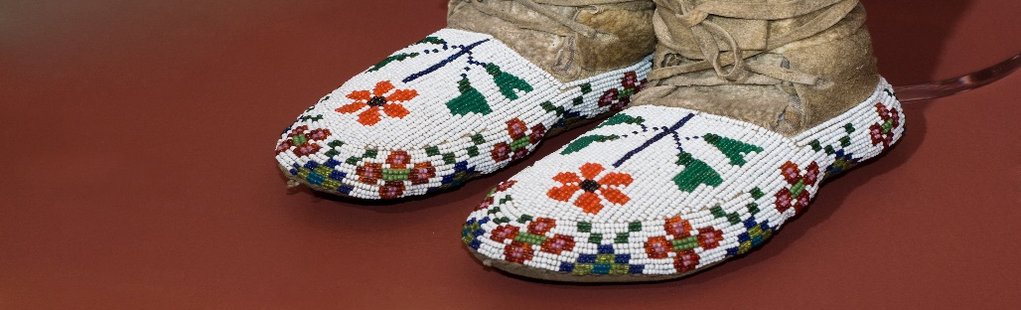
What is the impact on human resources?
Historic mistrust
Cumulative and complex trauma
Lack of cultural knowledge/humility
Services come from a Western worldview
Secondary Traumatic Stress, Burnout, Vicarious Trauma
Lateral Violence
Notes:
Key points:
We've discussed a lot about the impacts on tribal people and communities, there are service impacts as well.
Tribal peoples may not trust the services you are providing as educators
The students and families you are serving may come to you with cumulative trauma expeirences
The services being provided often come from a Western perspective and do not take into consideration Indigenous perspectives, ways of being, knowing, learning, teaching, etc.
Service providers tend to lack knowledge of tribal cultures and lack the comptency of working in and with tribal communities

Slide 20

Historical Trauma Lens
Behaviors, illnesses and adversity in the community are above the ground.
Historical trauma is what’s in the soil.
Notes:
Historical trauma is the soil in which other traumas take root.

Slide 21
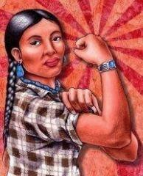
Intergenerational Transmission of Healing
Less researched
Not all families carry the burden of what happened generations ago (Durham & Webb, 2014)
The impact of historical trauma is unique to each tribe, community, family, individual.
Notes:
It is important for you to have this in mind when providing services. That the impacts on families are going to be different.

Slide 22
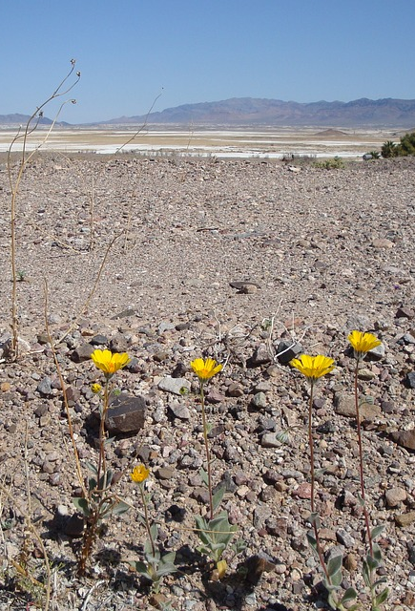
How do we continue the legacy of healing?
De-pathologize historical trauma
Shift the narrative to acknowledging strengths that have been passed down
Respect differing views of historical trauma
Acknowledge the colonial legacy imbedded in institutions
Decolonize your praxis
Revitalize and integrate traditional teachings
Have a 7 generations perspective

Slide 23
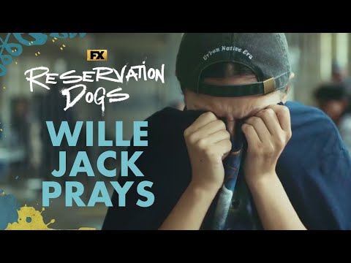

Slide 24
What would it look, smell, sound, taste and feel like if our ancestors had a say in our tribal institutions today?

Slide 25

Notes:
Wake up, greet the sun, and pr

Slide 26
Veronica Willeto DeCrane
Veronica.Willeto@mso.umt.edu
(406) 998-8953
Notes:
3 minutes

