Slide 1

Active Listening

Slide 2
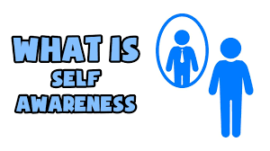
Emotional Intelligence
Self Awareness
Self (Management) Regulation
Notes:
Hope: We believe in the possibility of recovery, wellness and the potential in all of us
Inclusion: We embrace diverse backgrounds, cultures and perspectives
Empowerment: We promote confidence, self-efficacy and service to our mission
Compassion: We practice respect, kindness and empathy
Fairness: We fight for equity and justice

Slide 3
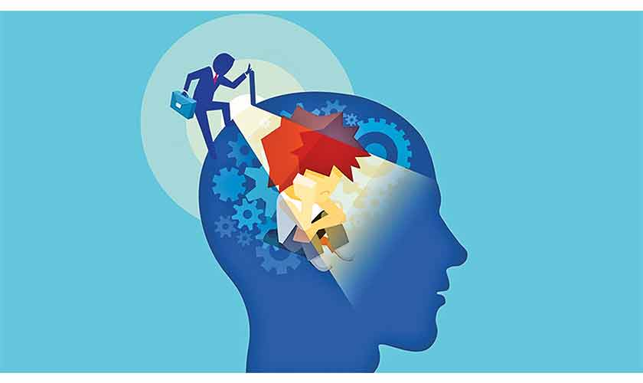
Emotional Intelligence
While you focus on the subject’s emotions and behaviors…
Notice your own thoughts, emotions, and how they are affecting your behaviors.
Notes:
Hope: We believe in the possibility of recovery, wellness and the potential in all of us
Inclusion: We embrace diverse backgrounds, cultures and perspectives
Empowerment: We promote confidence, self-efficacy and service to our mission
Compassion: We practice respect, kindness and empathy
Fairness: We fight for equity and justice

Slide 4

Active Listening
Introduce yourself
Say why you are there, and you are there to help
Eye Contact/body language
Speech and tone
Label the person’s emotion
Open ended questions
Paraphrase
Notes:
Hope: We believe in the possibility of recovery, wellness and the potential in all of us
Inclusion: We embrace diverse backgrounds, cultures and perspectives
Empowerment: We promote confidence, self-efficacy and service to our mission
Compassion: We practice respect, kindness and empathy
Fairness: We fight for equity and justice

Slide 5


Slide 6

Five Universal Truths
People Typically:
Feel the need to be respected
Would rather be asked than be told
Have a desire to know why
Prefer to have options over threats
Want to have a second chance
Dr. George Thompson, Verbal Judo Tactics and Techniques
Notes:
Hope: We believe in the possibility of recovery, wellness and the potential in all of us
Inclusion: We embrace diverse backgrounds, cultures and perspectives
Empowerment: We promote confidence, self-efficacy and service to our mission
Compassion: We practice respect, kindness and empathy
Fairness: We fight for equity and justice

Slide 7


Slide 8
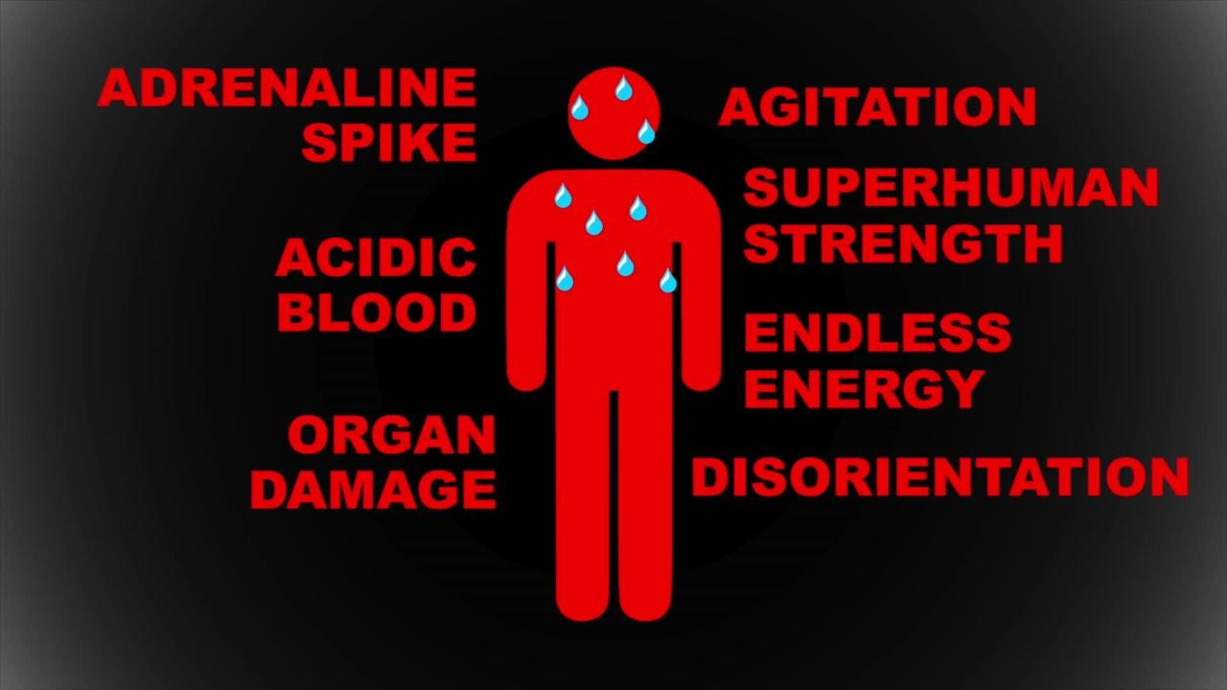
Excited Delirium
Delirium – acute transient disturbance in consciousness, orientation, cognition
Excited Delirium – Delirium combined with combative, agitated, violent behavior
Notes:
A mental illness is a medical condition of the brain – mental health challenges affects a person's thinking, feeling or mood
Such conditions may affect someone's ability to relate to others and function each day. Each person will have different experiences, even people with the same diagnosis
A mental health condition isn’t the result of one event. Research suggests multiple overlapping causes
Genetics, environment, and lifestyle influence whether someone develops a mental health condition
A stressful experience in life makes some people more susceptible, as do traumatic life events like being the victim of a crime. Biochemical processes and circuits and basic brain structure may play a role

Slide 9
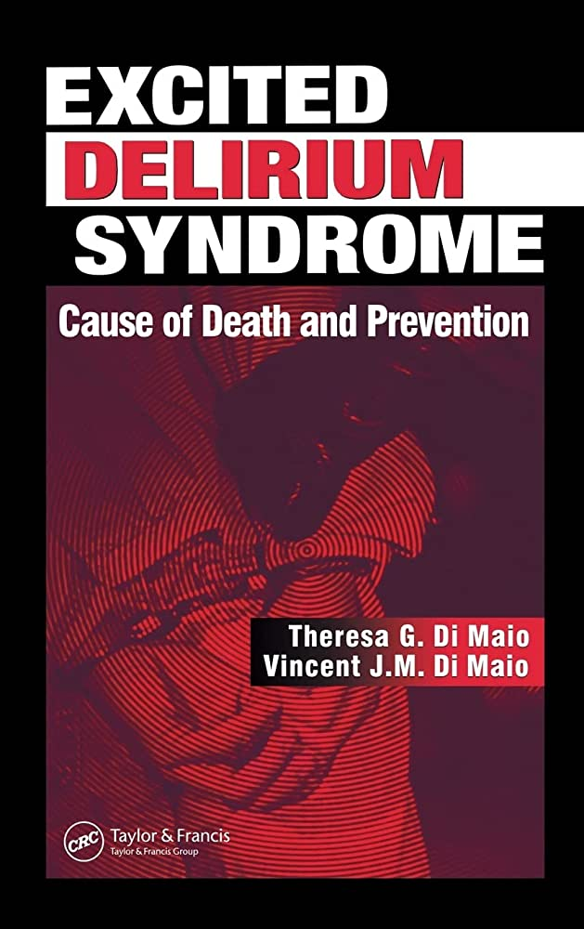
Excited Delirium
Unlimited endurance
Superhuman strength
Reduced sense of pain
Muscle rigidity
Violently resists- capture, restraint
Hallucinations
Intense paranoia
Extreme agitation
Disoriented
Delusional
Notes:
A mental illness is a medical condition of the brain – mental health challenges affects a person's thinking, feeling or mood
Such conditions may affect someone's ability to relate to others and function each day. Each person will have different experiences, even people with the same diagnosis
A mental health condition isn’t the result of one event. Research suggests multiple overlapping causes
Genetics, environment, and lifestyle influence whether someone develops a mental health condition
A stressful experience in life makes some people more susceptible, as do traumatic life events like being the victim of a crime. Biochemical processes and circuits and basic brain structure may play a role

Slide 10
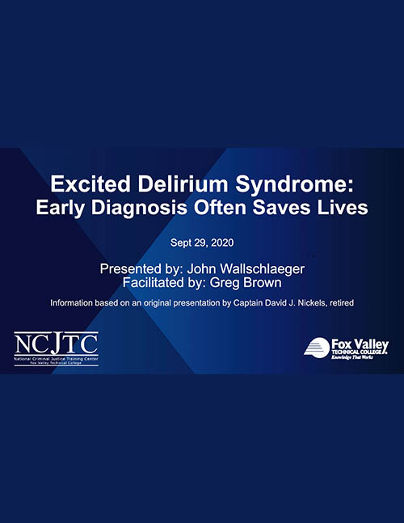
Excited Delirium
Scattered ideas
Easily distracted
Psychotic appearance
“Just snapped”, “ Flipped out”
Screaming for no apparent reason
Talking to imaginary people
Grunting guttural sounds
Pressured, loud, incoherent speech,
Irrational speech
Notes:
A mental illness is a medical condition of the brain – mental health challenges affects a person's thinking, feeling or mood
Such conditions may affect someone's ability to relate to others and function each day. Each person will have different experiences, even people with the same diagnosis
A mental health condition isn’t the result of one event. Research suggests multiple overlapping causes
Genetics, environment, and lifestyle influence whether someone develops a mental health condition
A stressful experience in life makes some people more susceptible, as do traumatic life events like being the victim of a crime. Biochemical processes and circuits and basic brain structure may play a role

Slide 11
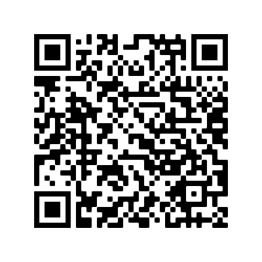

RESOURCES
First Responder’s Guide for Persons with Mental Illness or Developmental Disabilities

Slide 12
Thank you

