Slide 1


Mental Health 101
Learning from Lived Experience

Slide 2
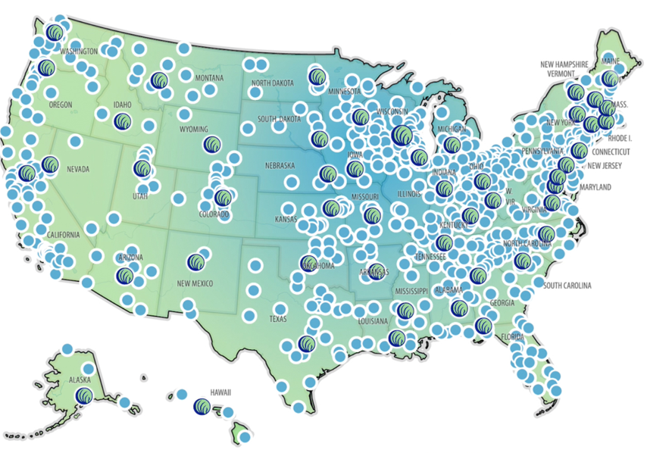
Who We Are…………..The Alliance
The National Alliance on Mental Illness (NAMI) is the nation’s largest grassroots mental health organization dedicated to building better lives for the millions of people affected by mental illness.
What started as two mothers gathered around a
kitchen table in 1979 has blossomed into the nation’s
leading voice on mental health. Today, NAMI is an
alliance of more than 600 local Affiliates and 49 State
Organizations who work in your community to raise awareness
and provide support and education that was not previously
available to those in need.

Slide 3
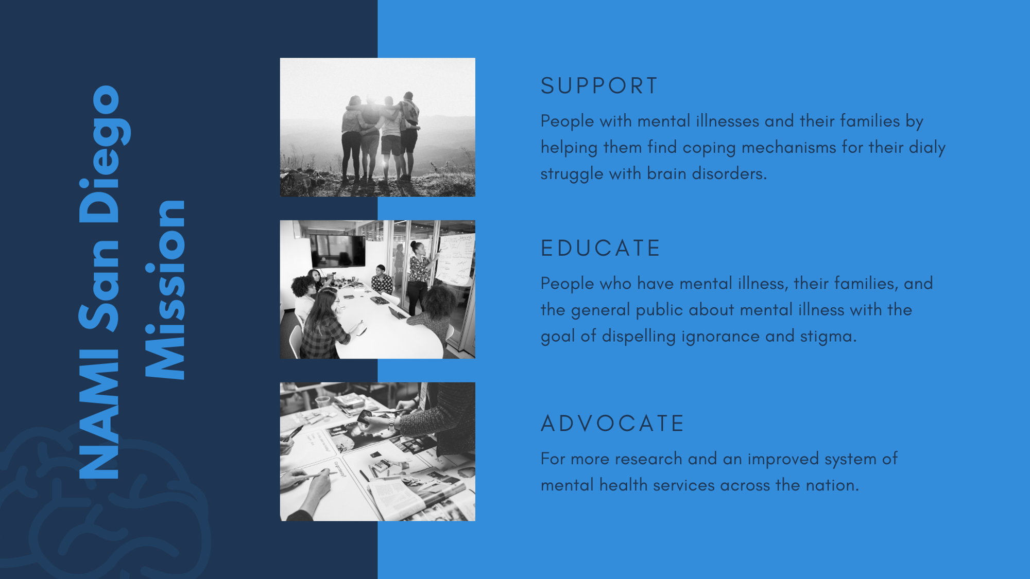
Who We Are……NAMI San Diego & Imperial Counties

Slide 4
Our Values
Hope: We believe in the possibility of recovery, wellness and the potential in all of us
Inclusion: We embrace diverse backgrounds, cultures and perspectives
Empowerment: We promote confidence, self-efficacy and service to our mission
Compassion: We practice respect, kindness and empathy
Fairness: We fight for equity and justice
Notes:
Hope: We believe in the possibility of recovery, wellness and the potential in all of us
Inclusion: We embrace diverse backgrounds, cultures and perspectives
Empowerment: We promote confidence, self-efficacy and service to our mission
Compassion: We practice respect, kindness and empathy
Fairness: We fight for equity and justice

Slide 5
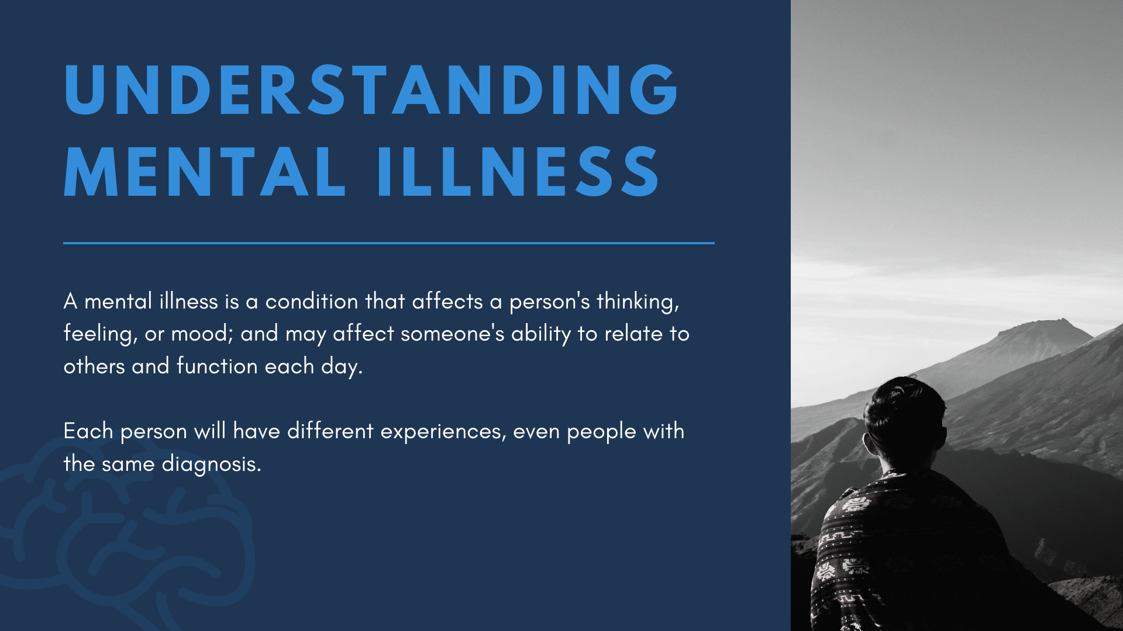

Slide 6
Understanding Mental Illness
A
A mental illness is a medical condition of the brain – mental health challenges affects a person's thinking, feeling or mood
Such conditions may affect someone's ability to relate to others and function each day. Each person will have different experiences, even people with the same diagnosis
A mental health condition isn’t the result of one event. Research suggests multiple overlapping causes
Genetics, environment, and lifestyle influence whether someone develops a mental health condition
A stressful experience in life makes some people more susceptible, as do traumatic life events like being the victim of a crime. Biochemical processes and circuits and basic brain structure may play a role
Notes:
A mental illness is a medical condition of the brain – mental health challenges affects a person's thinking, feeling or mood
Such conditions may affect someone's ability to relate to others and function each day. Each person will have different experiences, even people with the same diagnosis
A mental health condition isn’t the result of one event. Research suggests multiple overlapping causes
Genetics, environment, and lifestyle influence whether someone develops a mental health condition
A stressful experience in life makes some people more susceptible, as do traumatic life events like being the victim of a crime. Biochemical processes and circuits and basic brain structure may play a role

Slide 7
Mental Health by the Numbers*
1 in 5 U.S. adults experience mental illness each year
1 in 20 U.S. adults experience serious mental illness each year
1 in 6 U.S. youth aged 6–17 experience a mental health disorder each year
50% of all lifetime mental illness begins by age 14, and 75% by age 24
Suicide is the 2nd leading cause of death among people aged 10–34
*www.nami.org/mhstats

Slide 8
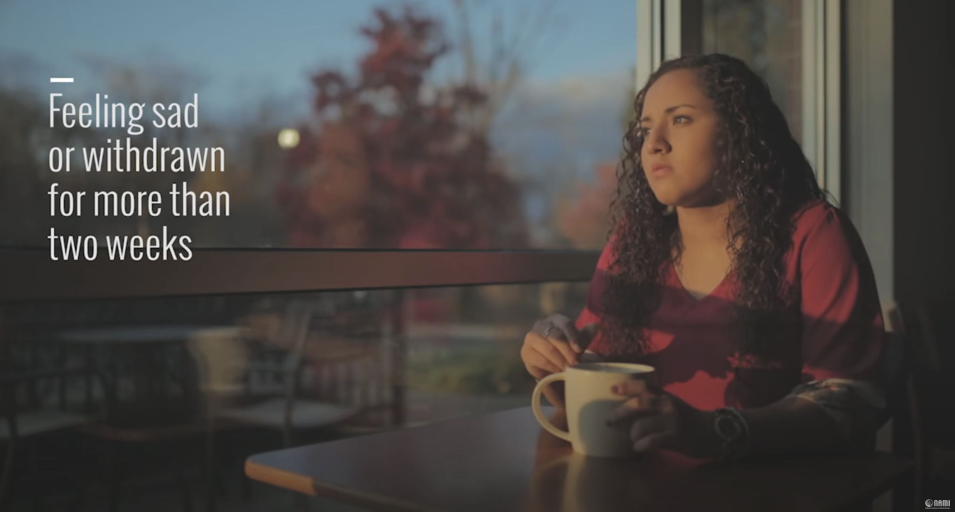
About Mental Illness – Warning Signs
Trying to tell the difference between what expected behaviors are and what might be the signs of a mental illness isn't always easy.
There's no easy test that can let someone know if there is mental illness or if actions and thoughts might be typical behaviors of a person or the result of a physical illness.
Each illness has its own symptoms, but common signs of mental illness in adults and adolescents can include those listed on our national website:
https://www.nami.org/About-Mental-Illness/Warning-Signs-and-Symptoms

Slide 9
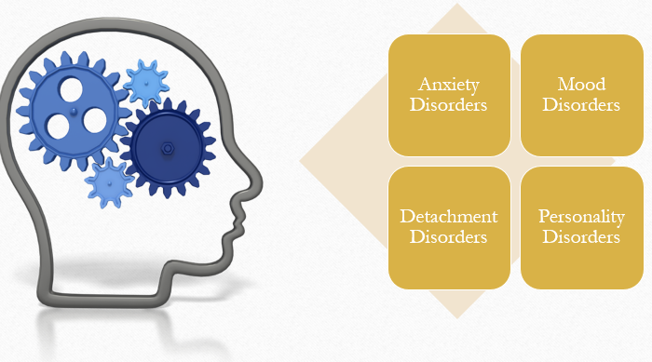
Common Conditions

Slide 10
Common Mental Health Disorders
1.1% of MI is Schizophrenia
  11 in 1,000 (2.4 million American Adults)
2.6% of MI is BiPolar Disorder
  26 in 1,000 (6.9 million American Adults)
6.9% of MI is Depression
  69 in 1,000 (16 million American Adults)
18.1% of MI is Anxiety
  181 in 1,000 (42 million American Adults)

Slide 11
Common Symptoms
Bipolar Disorder
Schizophrenia
Feeling sad, hopeless or irritable most of the time
Lacking energy
Difficulty concentrating and remembering things
Loss of interest in everyday activities
Feelings of emptiness or worthlessness
Feelings of guilt and despair
Feeling pessimistic about everything
Self-doubt
Delusions
Hallucinations
Disorganized speech
Disorganized behavior
The symptoms of schizophrenia vary dramatically from person to person, both in pattern and severity.

Slide 12
Common Symptoms
Depressive Disorder
Generalized Anxiety Disorder
Continuous low mood or sadness
Feeling hopeless and helpless
Having low self-esteem
Feeling tearful
Feeling guilt-ridden
Feeling irritable and intolerant of others
No motivation or interest in things
Finding it difficult to make decisions
Feeling restless, wound-up, or on-edge
Being easily fatigued
Having difficulty concentrating
Being irritable
Having headaches, muscle aches, stomachaches, or unexplained pains
Difficulty controlling feelings of worry
Having sleep problems, such as difficulty falling or staying asleep

Slide 13
Stigma & Communication

Slide 14
What is stigma?
What does stigma mean in society?
Stigma involves negative attitudes or discrimination against someone based on a distinguishing characteristic such as a mental illness, health condition, or disability. Social stigmas can also be related to other characteristics including gender, sexuality, race, religion, and culture

Slide 15
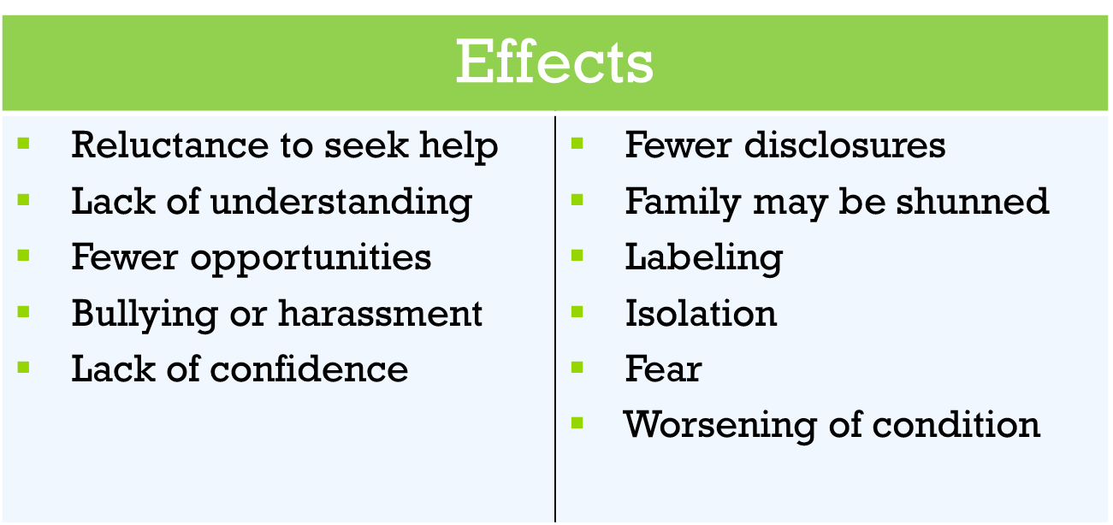
Got Stigma?

Slide 16
Stigma is responsible for……
Average delay between first symptoms and getting was 8 to 10 years IS NOW 10 – 12 YEARS
Half of people age 8 to 15 do not receive treatment
20% of 13 to 18 live with a mental health condition
Half aged 14 + drop out of school
Half of people age 8 to 15 do not receive treatment
70% of Youth in the Juvenile Justice System
90% + of Youth who have died by suicide have a mental health condition
Notes:
Average delay between first symptoms and getting was 8 to 10 years IS NOW 10 – 12 YEARS
Half of people age 8 to 15 do not receive treatment
20% of 13 to 18 live with a mental health condition
Half aged 14 + drop out of school
Half of people age 8 to 15 do not receive treatment
70% of Youth in the Juvenile Justice System
90% + of Youth who have died by suicide have a mental health condition

Slide 17
Communication
What are the 3 types of communication definition?
Communication can be categorized into three basic types: (1) verbal communication, in which you listen to a person to understand their meaning; (2) written communication, in which you read their meaning; and (3) nonverbal communication, in which you observe a person and infer meaning.

Slide 18
Mental Health May Influence
How We Communicate
Over stimulation ● Low motivation
Fear ● Quickly changing emotions
Insecurity ● Spontaneous plan changes
Difficulty concentrating ● Lack of empathy
Preoccupation ● Delusions
Easy agitation (short fuse) ● Low self-esteem
Poor judgment ● Trouble recognizing reality

Slide 19
Effective Communication
Be patient
Stay Calm with an even voice
Be accepting
Be brief
Limit input and not force discussion
Recognize agitation and allow escape
Be simple and truthful
Politely get his/her attention
Initiate relevant conversation
Keep to one plan
Recognize lack of empathy is biological
Ignore, don’t argue
Do not expect rationale discussion
Look for the positives

Slide 20
Take home skills
Basic communication guidelines to use when people with mental health challenges are experiencing distressing symptoms
USE “I” Statements
One request at a time
Be specific
Use Reflective Responses
One topic at a time
Keep the content simple

Slide 21
Tardive Dyskinesia

Slide 22
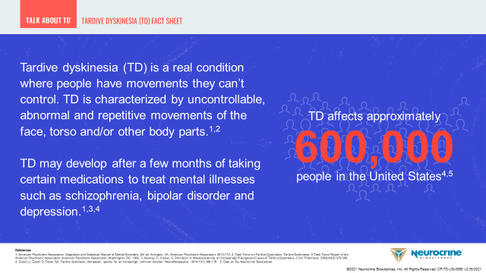
Tardive Dyskinesia

Slide 23
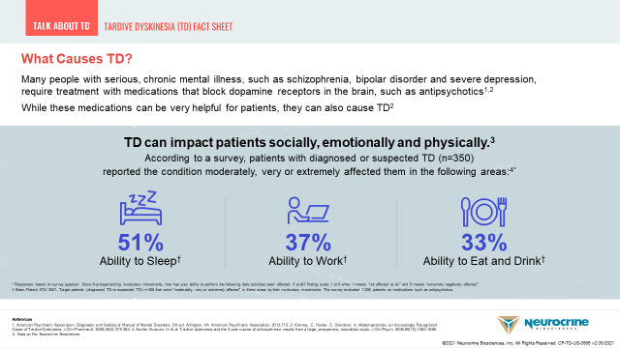
Tardive Dyskinesia

Slide 24
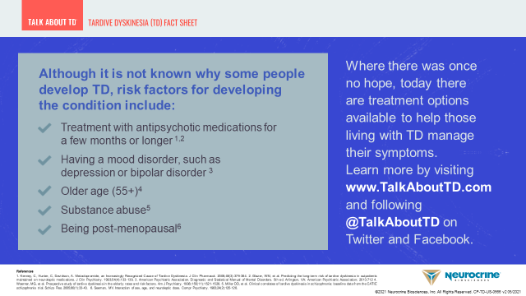
Tardive Dyskinesia

Slide 25
Recovery & the Power of Language

Slide 26
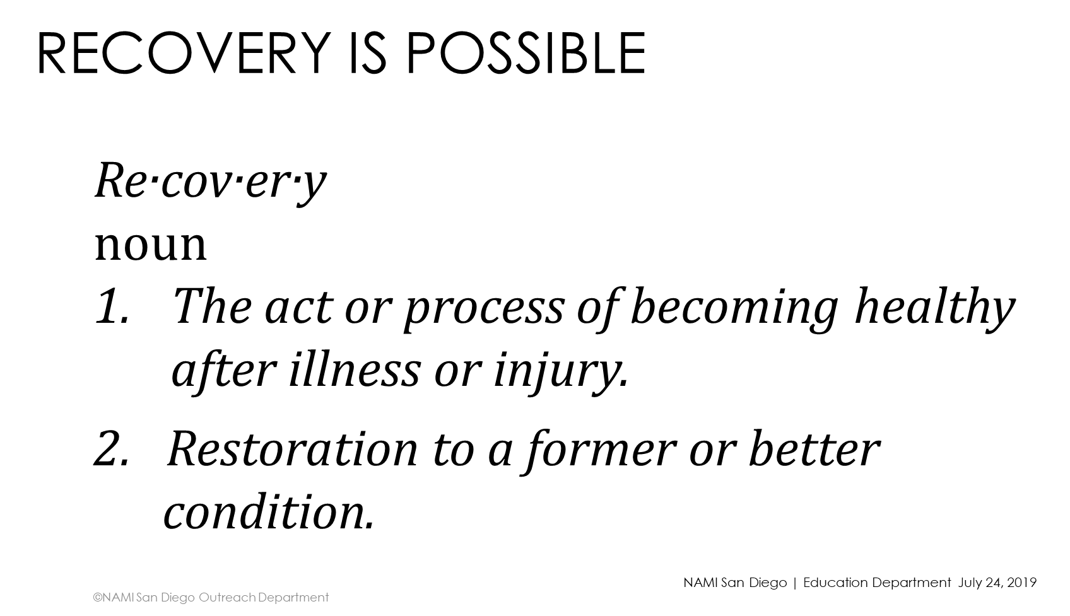
What is Recovery?
Psychotropic medication is NOT the only way to guarantee that someone with a mental illness will live well, and in recovery. There is no guarantee for anyone – whatever the treatment.
Medication, however, is part of several tools that are used with much success including, talk therapy, individual and group education, social networks, nutrition, meaningful community engagement

Slide 27
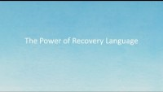
Recovery Language

Slide 28
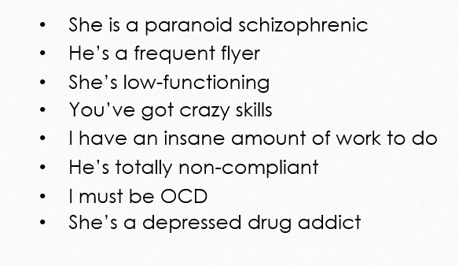
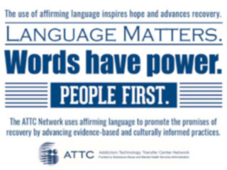
Language can be stigmatizing

Slide 29
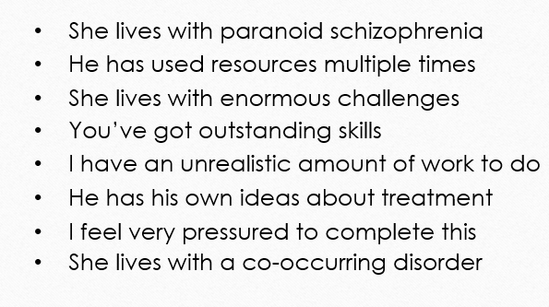
First person language

Slide 30
Benefits of first person language
Person centered
Strengths focused
Natural, human language that describes What Can Be Observed
Promotes Recovery
Emphasizes unique traits, strengths, and worth
People often identify with roles and words that help them find meaning. So when you choose person-first language, you support the pursuit of healing, progress, and goals
Placing the person at the center and above all other aspects of the treatment process is the foundation of The Recovery Model. It is important that people are seen first as people and not seen as their mental health condition

Slide 31
Support & Resources

Slide 32
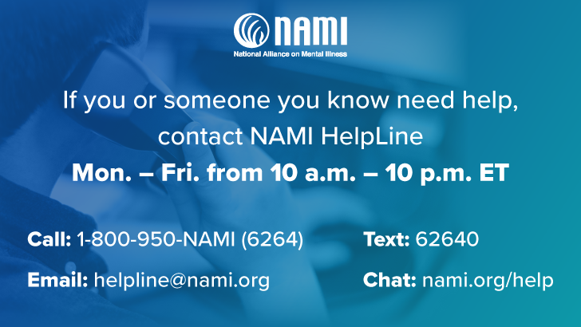
Support & Info …………..www.NAMI.org
By sharing your experiences in a safe setting, you can gain hope and develop supportive relationships.
NAMI’s support groups are unique because they follow a structured model to ensure you and others in the group have an opportunity to be heard and to get what you need.
Free of cost to participants
No specific medical therapy or treatment is endorsed
Confidential

Slide 33
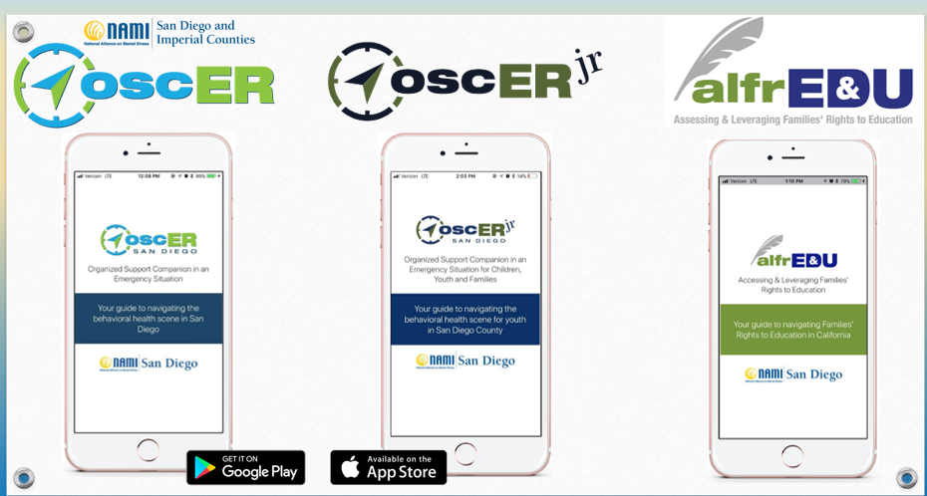
Got Apps?

Slide 34
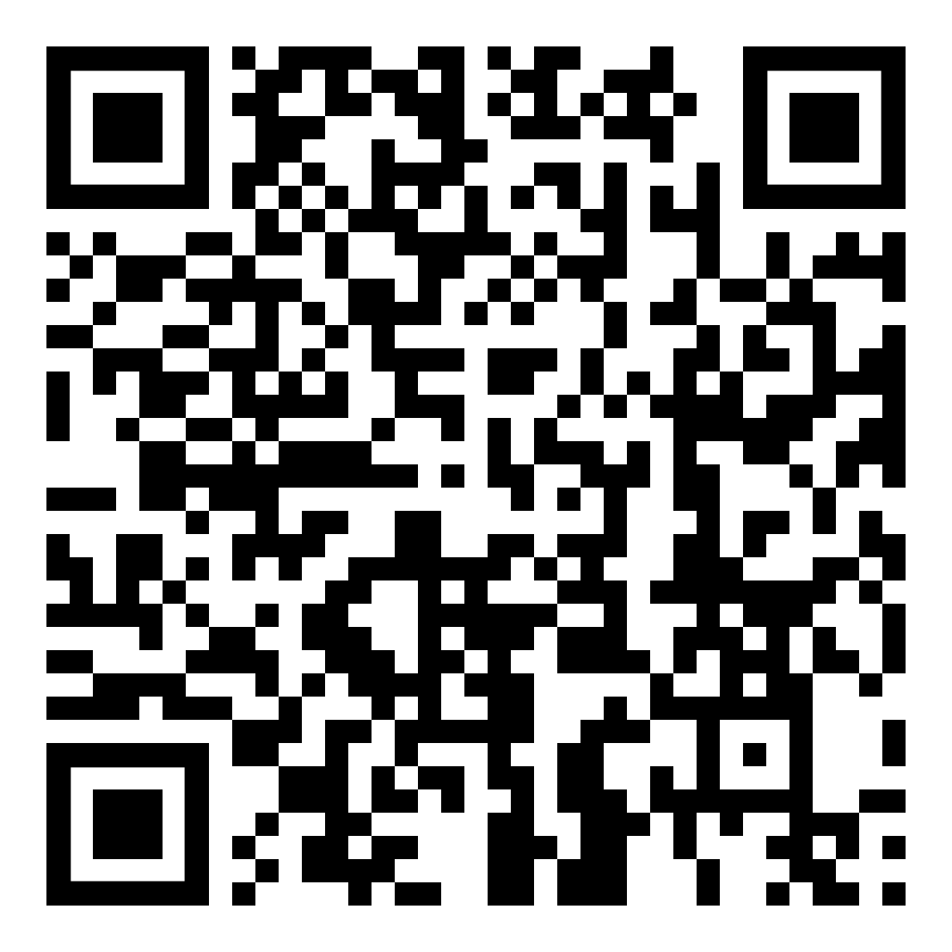
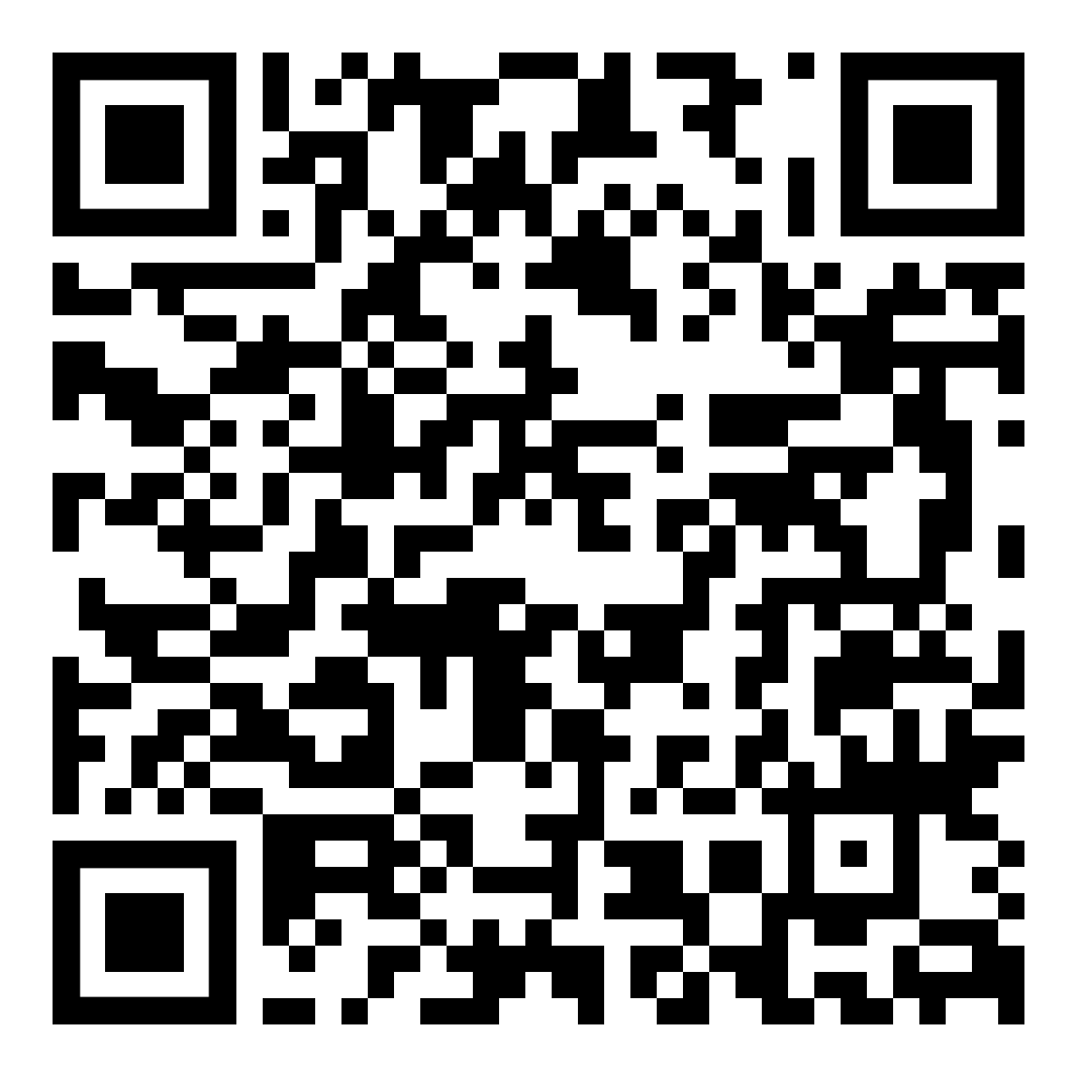
Got Apps?
Please scan the QR codes to download the apps
Android/Google Play Apple

Slide 35
You…..Importance of Self Care
What is one thing
you will do for yourself?

Slide 36
Thank You
Cathryn Nacario, RN, MHA
CEO, NAMI San Diego & Imperial Counties
NAMI National Board Member, Secretary cathrynnacario@namisd.org
Direct/Cell/Text: 858-800-4457
Julie Benn
NAMI San Diego & Imperial Counties
Wellness Coordinator/Communications/IOOV Presenter

