Slide 1
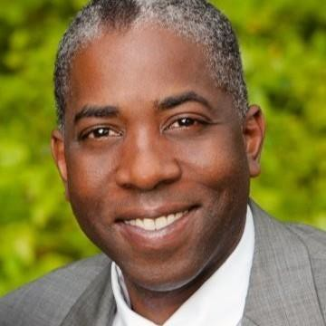
Wipfli Presenters
Tom Wilkins
Wipfli Director
Tribal Consulting Services
20+ Years working with Tribal Organizations
Works with casino, government, EDC and housing authority prospects to understand functional needs and pair with appropriate tribal consulting practice leads

Slide 2
Key Pillars of Environmental, social and governance (ESG)?
Advancing sustainability
Community investments
Responsible leadership
Strengthening DEI

Slide 3

What is Environmental, social and governance (ESG)?
Environmental: A company’s approach to being sustainable and environmentally friendly. How do actions of this organization help or hinder the sustainability of the resources for next generations?
Social: The ethical views and/or beliefs that the organization demonstrates. What are the actions that this organization leads that have a positive social impact?
Governance: The primary measurement of leadership and corporate visions and attitudes, examining how an organization operates and behaves overall. Is our organization demonstrating responsible, transparent leadership?

Slide 4
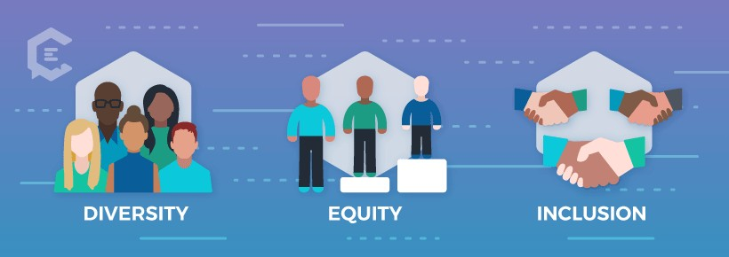
What is Diversity, Equity, & Inclusion (DEI)
Diversity is all the dimensions that make each person one of a kind, including ethnicity, race, age, style, gender, personality, beliefs, experiences, sexual orientation
Equity is the process of ensuring that processes and programs are impartial, fair
and provide equal possible outcomes for every individual
Inclusion is ensuring each person feels valued, connected, safe to express their
authentic selves and know they belong

Slide 5
What is DEI in Indian Country
Geography and Environment
Customs and Culture
Economy and Workforce
History and Traditions
© 2020 Wipfli LLP. All rights reserved.

Slide 6
What is DEI in Indian Country
Slide about ethic vs race
© 2020 Wipfli LLP. All rights reserved.

Slide 7
Diversity Compliance
Indian Preference
T.E.R.O
ICWA
DOD Indian Incentive Program (IIP)
© 2020 Wipfli LLP. All rights reserved.

Slide 8
Key Considerations
Changing demographics that make attracting, employing, and retaining diverse employees a business necessity.
Customer’s desire for diverse teams that reflect the communities the
business operates in.
Research that increasingly points to significant benefits to companies and teams that have a more diverse workforce.
Tribal Policies Federal & state laws, as well as local ordinances
Convergence of work-life and personal-life.
Need to be inclusive of a wide variety of perspectives, beliefs, and thoughts.

Slide 9
What happens when you don’t do DEI well
Attrition of top talent
Low engagement in existing talent
Damage to the brand
Risk of Litigation
Compliance issues
Reduced opportunity for growth
Actions may not live up to values

Slide 10
Realistic DEI Approach
While we can’t change many of the systemic issues in our country and world overnight, we can do our part by ensuring your organization has a seat and voice at the tables where those issues are being discussed.
We can work to address issues in our work environment.
11
© 2020 Wipfli LLP. All rights reserved.

Slide 11




Highlighting different perspectives: 8-10 years ago
Strong ideology or opinion
Strong ideology or
opinion
Moderate viewpoints or
ideology
© 2020 Wipfli LLP. All rights reserved.

Slide 12




Highlighting different perspectives: Now
Strong ideology or opinion
Strong ideology or opinion
Moderate viewpoints or
ideology
© 2020 Wipfli LLP. All rights reserved.

Slide 13
Navigating DEI in the workplace
How do we define what is acceptable in the workplace during a time of heightened divisiveness in the U.S. and the world
 Respect at work
  Are we showing respect towards others and treating people in a way that is inclusive
 Focus on behavior
  We aren’t trying to change beliefs but are focused on the behavior being demonstrated
 Values & employment law
  We can’t anticipate everything that could be said or done in the workplace but can use our organization’s values to help guide us, as applicable employment law.
  Is the behavior in line with the values of the company and the law?
© 2020 Wipfli LLP. All rights reserved.

Slide 14
Actions we can take
What can we as individuals or leaders do:
 Demonstrate Inclusive leadership
 Seek to understand and show empathy
 Live up to your stated values and desired company culture
 Be fair, and equitable in your processes and actions
 Create support and resources

Slide 15








Foundational elements of a DEI strategy
4
5
Communicatio n plan; Build awareness of efforts, structured conversations
6
1
2
3
7
Develop buy-in and
Align
diversity efforts with business needs and strategy, backed by data
Proactive recruiting efforts, external partnership development
Provide training, development
, mentoring opportunities
Measure and highlight efforts; adjust as needed
Create Business Resource Groups; leverage & grow
support from C-suite leaders; identify champions

Slide 16
DEI Focus Areas
Creating a more diverse workforce & inclusive culture through……..
Expanded Brand Awareness
Recruitment
& Retention
Learning &
Development
Engagement
© 2020 Wipfli LLP. All rights reserved.
17

Slide 17
Foundations of a DEI Strategy
Diversity, Equity & Inclusion Strategy
Drivers
Outcomes
Recruitment & Retention
Talent
Organization reflects the diversity of the marketplace.
Guiding Principles
Inclusion as a leadership
competency
Fair & transparent processes
  Align with business strategy
Accountability on every level
  Actions are measurable
Engagement
Markets
Maximize diversity of customers and communities we are able to serve.
Learning & Development
Culture
Develop and sustain diverse and inclusive environment.
Expand Brand Awareness
© 2020 Wipfli LLP. All rights reserved.

Slide 18
Vision
As part of your Diversity, Equity, and Inclusion efforts, your organization will be making greater efforts to create a more diverse workforce, to ensure your workforce reflects the communities we live in and the clients we serve.
You can accomplish this by creating a diverse talent pipeline that reflects your
aspirations as well as contributing to the creation of diverse talent in your industry.
Top priority areas will be focused on:
 Increased racial diversity at all levels
 Greater gender representation at leadership levels
 Grow age representation at all levels
 Military veterans & persons with disabilities
© 2020 Wipfli LLP. All rights reserved.

Slide 19
Creating a Diverse Talent Pipeline
1
Diversity Recruiting Training
2
Creation of a Diversity Dashboard
3
Influence Workforce Planning
4
Increased Diversity Recruiting Partnerships & Resources
5
Focused Support of DEI Champion with Recruiting Team & Practices
© 2020 Wipfli LLP. All rights reserved.

Slide 20
Foundations of a DEI Strategy
Diversity, Equity & Inclusion Strategy
Drivers
Outcomes
Recruitment & Retention
Talent
Organization reflects the diversity of the marketplace.
Guiding Principles
Inclusion as a leadership
competency
Fair & transparent processes
  Align with business strategy
Accountability on every level
  Actions are measurable
Engagement
Markets
Maximize diversity of customers and communities we are able to serve.
Learning & Development
Culture
Develop and sustain diverse and inclusive environment.
Expand Brand Awareness
21
© 2020 Wipfli LLP. All rights reserved.

Slide 21
DEI Engagement Vision
Introduce topics and structured conversations that may be of high concern or relevance to specific demographics at the firm and provide an opportunity to inform and influence others who may be unaware of these topics.
Build a foundation of awareness and understanding at Wipfli of diverse topics and concerns, as well as engage in empathetic and thoughtful dialogue.
© 2020 Wipfli LLP. All rights reserved.

Slide 22
DEI - Engagement
1
Business Resource Groups
2
Structured Discussions
3
Awareness & Experiences
© 2020 Wipfli LLP. All rights reserved.

Slide 23
Foundations of a DEI Strategy
Diversity, Equity & Inclusion Strategy
Drivers
Outcomes
Recruitment & Retention
Talent
Organization reflects the diversity of the marketplace.
Guiding Principles
Inclusion as a leadership
competency
Fair & transparent processes
  Align with business strategy
Accountability on every level
  Actions are measurable
Engagement
Markets
Maximize diversity of customers and communities we are able to serve.
Learning & Development
Culture
Develop and sustain diverse and inclusive environment.
Expand Brand Awareness
24
© 2020 Wipfli LLP. All rights reserved.

Slide 24
Learning & Development Vision
Vision
Incorporate Diversity, Equity, and Inclusion into organizations learning and development framework and provide consistent course offerings related to unconscious bias and inclusive leadership.
Offer sessions highlighting best practices occurring in the organizations to continue
to build competencies.
© 2020 Wipfli LLP. All rights reserved.

Slide 25
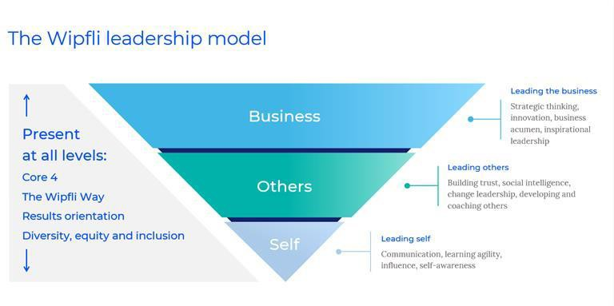
Learning & Development Vision
© 2020 Wipfli LLP. All rights reserved.

Slide 26
DEI – Learning & Development
1
Unconscious Bias
2
Inclusive Leadership
3
Inclusion Learning Series
4
Policy, Compliance, & team-specific training
© 2020 Wipfli LLP. All rights reserved.

Slide 27
Foundations of a DEI Strategy
Diversity, Equity & Inclusion Strategy
Drivers
Outcomes
Recruitment & Retention
Talent
Organization reflects the diversity of the marketplace.
Guiding Principles
Inclusion as a leadership
competency
Fair & transparent processes
  Align with business strategy
Accountability on every level
  Actions are measurable
Engagement
Markets
Maximize diversity of customers and communities we are able to serve.
Learning & Development
Culture
Develop and sustain diverse and inclusive environment.
Expand Brand Awareness
28
© 2020 Wipfli LLP. All rights reserved.

Slide 28
Expanding Brand Awareness through DEI
Vision
What does it mean?
Associate the firm positively from a DEI perspective.
Brand is the personality of a business. Its the first thing you think of, or how you feel, when you see a logo or hear a company /firm name.
What does it do:
Spreads awareness
Showcases the identity and aspirations of the business
Attracts a diverse variety of individuals and clients that the brand appeals to.
© 2020 Wipfli LLP. All rights reserved.

Slide 29
Expanding Brand Awareness
1
Business Case
2
Utilize Communication & Branding Channels
3
Emphasis on Story-Telling
4
Calendar of Diversity Themes & Events
© 2020 Wipfli LLP. All rights reserved.

Slide 30
What actions Tribes can take right now?
Educate your board/senior leadership on ESG
Determine what’s important
Identify your data points
Implement internal controls around your data

Slide 31
32

