Slide 1



26th Annual Conference
San Antonio, Texas | September 26-28

Slide 2

Financial Inclusion
for
Tribal Nations in a
Post-Pandemic Economy
Sherrie Grabot, CEO GuidedChoice

Slide 3


the Data
Strengthening the Economic Engine

Slide 4
strengths
Generational history of trade
Provide 1.1 million jobs
Approx 300,000 Native American-owned small businesses
Generate $50B in annual revenues
Notes:
https://www.sba.gov/blog/how-sba-helps-native-american-small-business-owners-succeed

Slide 5
Weaknesses
Median household income
Access to small business loans
Access to home ownership
Exclusion from financial conversation

Slide 6
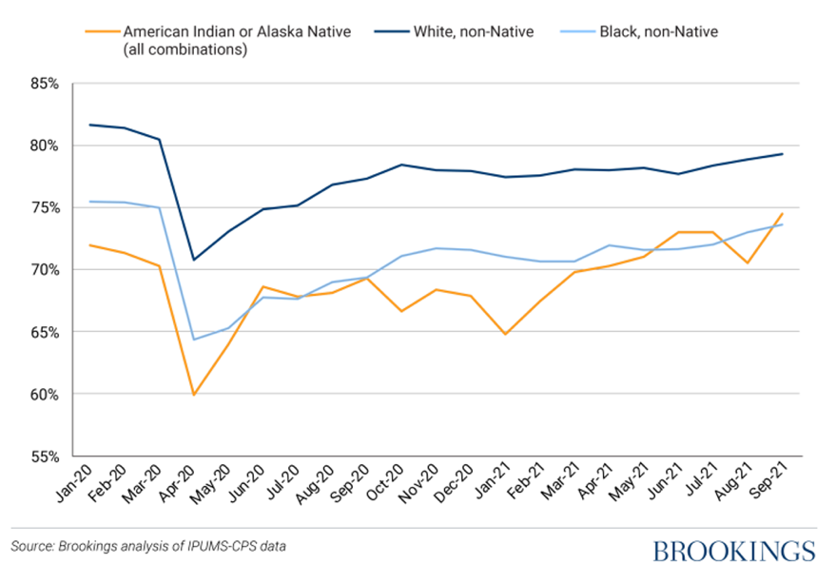
Native American workers have been among the most affected by the pandemic recession compared to other racial groups
Figure 1
Prime-age employment-to-population ratio, individuals 25–54 years old

Slide 7


How Does Financial Stress Impact You?
Which of the following causes you the most stress?
Employees who have less than $1,000 saved to deal with unexpected expenses
18% My Job
62% Gen Z
37% Millennials
34% Gen X
37% Baby Boomers
12% Relationships
11% Health Concerns
5% Other
Of All Employees
Financial or Money Matters/Challenges
Recently PwC conducted their 9th annual Employee Financial Wellness Survey of full-time employees in the U.S., 54% indicated that financial or money matters/challenges caused them the most stress. Likewise, 38% of all employees have less than $1,000 saved for an unexpected expense. For Millennial employees, 40% have a student loan(s) and of those 74% indicated that their student loans have a moderate or significant impact on their ability to meet other financial goals. And 56% of Baby Boomers expect to be working in their retirement either out of financial necessity or because they want to work.
Source: PwC’s 9th annual Employee Financial Wellness Survey COVID-19 Update, PwC US, 2020.

Slide 8

BUILDING AN
INCLUSIVE ECONOMY
Understanding the Economic Engine

Slide 9


TWO STEPS
Educate
Do

Slide 10





BENEFITS OF A
FINANCIAL WELLNESS PROGRAM
Positive impact on wellness
Reduces stress and healthcare costs
Improves employee productivity
Reduces absenteeism
Improves retirement outcomes

Slide 11


Potential tribal
Issues solved
Financial literacy enables tribal members
To make wise choices with their money
To be better employees
Enable the tribal economic engine
Gaming Compliance
Debt payment programs established and tracked
Education

Slide 12

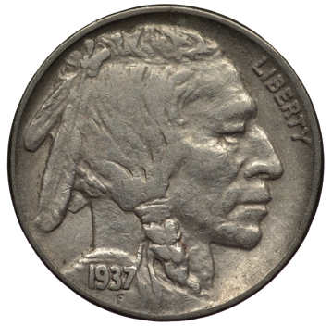
Three required aspects
Physical:
Financial Freedom
Emotional:
Financial happiness
Spiritual:
Financial Contentment
All aspects are of equal importance

Slide 13


Four elements of
Financial freedom
Having control over day-to-day and month-to-month finances
Having the capacity to absorb a financial shock
Being on track to meet and achieve financial goals you have set
Having the financial freedom to make choices that allow one to enjoy life

Slide 14


Five elements of
Financial happiness
Income is greater
than spending
Debt-free
Enough savings to cover emergencies and financial goals
Family agrees on values
Ability to give

Slide 15



three elements of
Financial contentment
Understanding you
have power over
your money
Limits are
established by us
Alignment of values and money

Slide 16

How to reach your population
One person at a time

Slide 17

Elements of success
Ongoing real-time education
Personal Care
Financial Coach
Financial Advisor
Leverages technology
Measurable
People need to see success
Ongoing personal care

Slide 18

Why technology
Objective and consistent
No personal biases
Ability to measure & track progress
Provides feedback
People alone is impractical & costly
1,000 employees
Need approximately 5 hours annually to teach, put together a plan and follow-up
Approximately $1.25 million in costs to reach all 1,000

Slide 19
Why people
Encourages to get on track and stay on track
Can provide commentary
Address any questions or issues

Slide 20

Decision making steps
Identify pain points
401(k) and other benefits data
Tribal economic data
Gaming compliance issues
Benefits and outcomes desired
Employee attraction and retention
Impact on employee benefit plans
Tribal economic impact

Slide 21
Decision making steps
Delivery methods
Identify demographics & locations
Below age 40: prefer technology with people available
Above age 40: prefer technology with people
Any specific needs/wants
Financial literacy test
Debt Pay-off plan
Understanding of tribal culture
Budget

Slide 22

THANK YOU
Thank you!
Sherrie Grabot, CEO GuidedChoice
guidedchoice.com
3nickels.com

