Slide 1

26TH ANNUAL CONFERENCE
San Antonio, Texas
September 26-28

Slide 2


The Innovation Bottleneck: How HR Can Fix Healthcare
Marcel Ocampo, Nava Benefits
Cam Cummins, Transparent by Design
Notes:
Marcel

Slide 3



Agenda
01
Introductions
02
Healthcare is broken
03
Implications for HR
04
Tactical takeaways
Notes:
Marcel

Slide 4



But first, who are we?
Marcel Ocampo
Partner, Market Director
Nava Benefits
Cam Cummins
Managing Partner
Transparent by Design
Notes:
MO then Cam
But let me back up…who are we and why are we here today talking to you about this?
I'm Marcel Ocampo, Partner and Market Director at Nava Benefits.
Nava is the first benefits brokerage oriented around the mission to provide high-quality, affordable healthcare to all Americans. I’m not going to pitch you on why we’re great, but I do want to share a personal story as to why Nava was founded and why I chose to make the move from one of our largest competitors.
Make it as personal as possible!
Cam shares his story/background

Slide 5

The US healthcare system is broken
(but you probably already knew that)
Notes:
Cam

Slide 6
Let’s unpack what’s going on
20%
>2x
1 in 2
The amount the US spends of its GDP on healthcare
US healthcare spend per person compared to other wealthy countries
Americans in medical debt
*National Health Expenditure Accounts (NHEA) 2020
*NHE & OECD data 2020
*Debt.com 2021
Notes:
Cam Healthcare is the most pressing economic problem facing the average American. Here’s what we’re seeing…

Slide 7


“Health insurance is like the world’s worst Costco membership.”
Notes:
Marcel Now before we go any further I want to put all of this in perspective with a metaphor and it relates to something many of you adore…Costco. Doesn’t healthcare feel a bit like the world’s absolute worst costco membership?

Slide 8
What are the implications of this for HR teams?
Notes:
Marcel

Slide 9
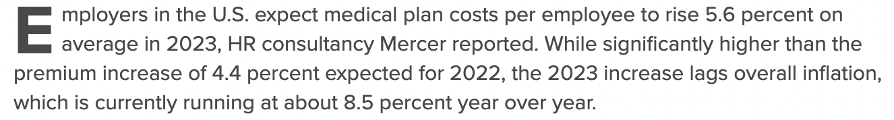
Pr
Impact to Employer
Medical Plan Costs Expected to See Bigger Rise in 2023
Employers avoid benefits cuts despite new cost pressures
Notes:
Marcel
How does this impact your company?
Your budget is being wasted. Benefits is likely the 2nd or 3rd most expensive line item on your P&L and it’s continuously on the rise. Your company pays more and they get less and less. Every excess dollar spent on benefits could be used to reinvest in your team, increase your employee’s salaries or your company’s growth.
Employer health insurance premiums up almost 10% last year most in a decade and trend expected to get worse next year.
Audience poll: Raise your hand if you’ve seen cost increases to your healthcare plans over the past few years.
https://www.shrm.org/resourcesandtools/hr-topics/benefits/pages/health-plan-costs-expected-to-rise-in-2023.aspx

Slide 10
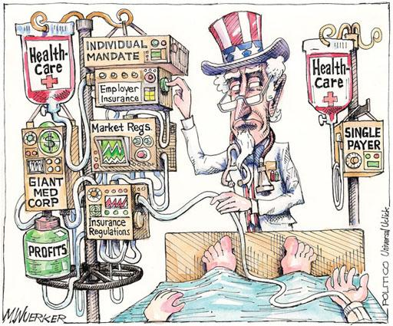
Pr
Impact to Employees
Notes:
Marcel
How does this impact your employees?
Employees paying more for worsening coverage, can’t afford deductibles, are deferring care in record amounts, and overall are completely frustrated.

Slide 11

Pr
Impact to HR
Notes:
Marcel
How does this impact you?
An avalanche of complexity
Your time is being wasted. This stuff has purposely been made confusing and slow. Every complex system, every employee question that needs an answer. All of this is wasting your time.
Audience poll: What’s your biggest time suck on a daily basis?

Slide 12
“
The future is already here, it’s just not evenly distributed.
William Gibson, science-fiction author
Notes:
Marcel
BUT the status quo is holding you back. The solutions may be here, but they’re not being distributed. Most HR leaders in America today are being advised to stay at “bad costco”.
This is the bottleneck. Even if you have been exposed to these companies there is a deployment problem that makes it extraordinarily hard to an employer to implement these solutions.

Slide 13
Let’s take a look at some real-life examples…
Notes:
Cam

Slide 14
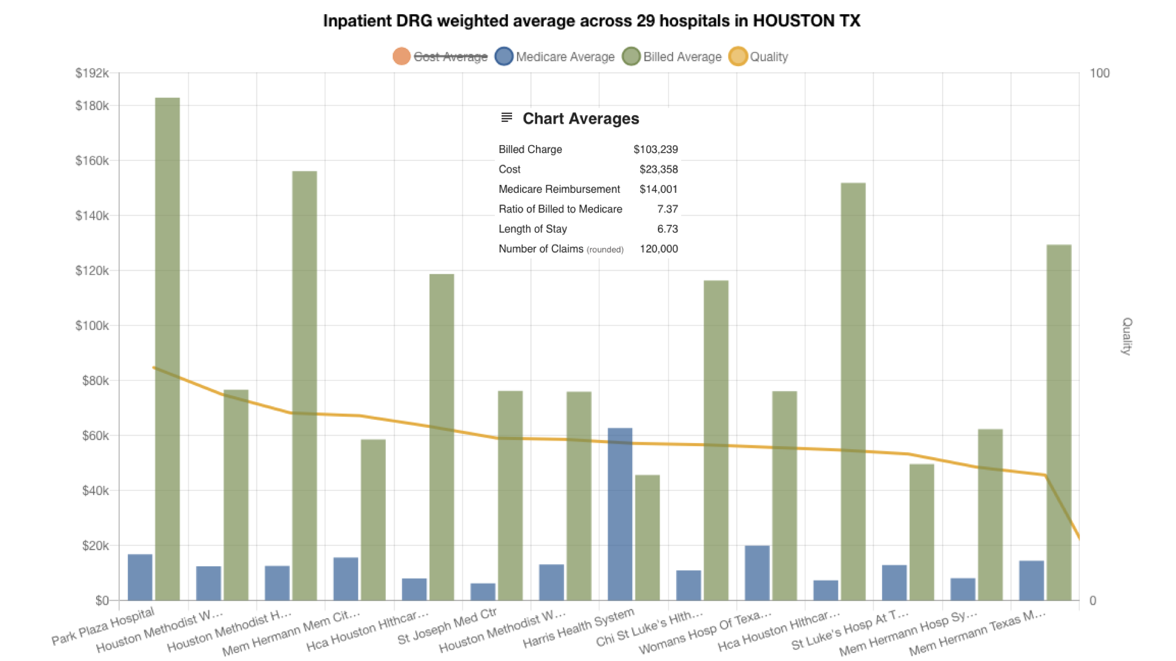
Cost vs. Quality
Notes:
Cam

Slide 15
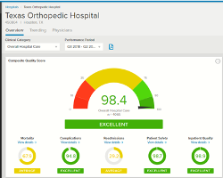
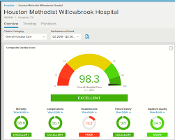
Quality Scores of Facilities
Out of this world

Slide 16
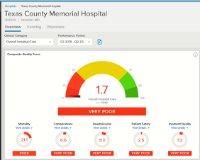
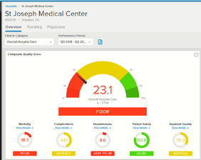
Quality Scores of Facilities
Crash Landings

Slide 17
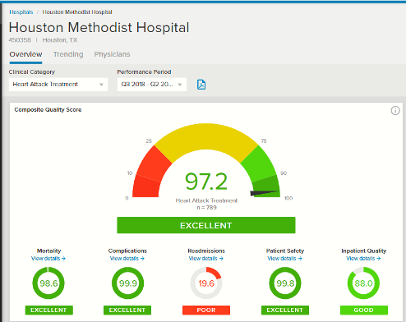
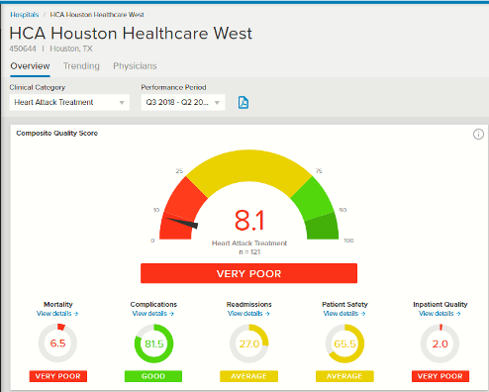
Heart Attack
Out of this world
Crash Landing

Slide 18
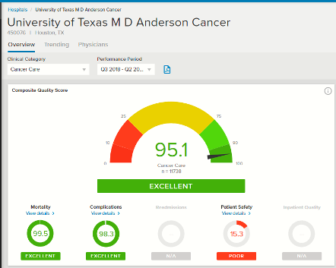
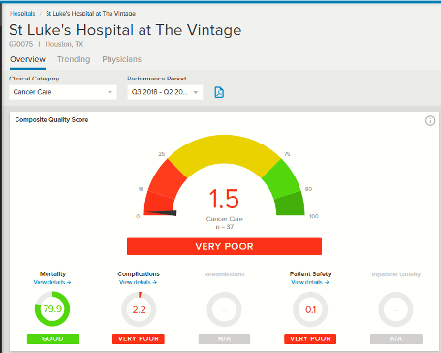
Cancer Care
Out of this world
Crash Landings

Slide 19



Innovative Vendors
01
02
03
Focused on providing affordable generic Rx
Provides transparency and financial alignment while cutting out PBMs and insurers
Using data to identify the best doctors in the country
Provides better quality of care and cost savings
Bringing users direct primary care
Offers in-house pharmacy, leveraging Prime delivery
Notes:
Marcel
Now we just unpacked a lot, and none of it was good. It’s easy to feel helpless and like it’s going to take eons to see change. We thought this too, but when we dug in we learned two big things:
#1 This has already been created - You don’t have to wait for something new. The solutions needed to drive change are already here.
There’s an entire ecosystem of solutions outside of bad costco that are delivering better outcomes, and the problem is that you’ve never heard of them. Let me give you something concrete.

Slide 20

The benefits marketplace is opaque
01
What’s causing the bottleneck?
There’s extreme complexity in buying & implementing
02
Brokers are gatekeeping distribution of innovation
03
Notes:
Marcel
I’m not going to mince words - there are 3 main components to this bottleneck.
The benefits market place was built to be an opaque black box and that makes it difficult for HR teams to learn about these new vendors on their own. Less knowledge leaves less opportunity for pushback on big carriers and brokers.
There’s extreme complexity in buying & implementing. I know most of you here are self-insured so you well know how much time and energy this takes.
This makes HR reliant on traditional brokerages who controls the distribution channel and have a business model and expertise oriented around maintaining the status quo.

Slide 21

But change is coming…
Notes:
Marcel
More change is coming to the benefits industry in the next 3 years than what’s occurred in the last 20. And I want to share [3] major leaps forward that will change the way you do benefits.

Slide 22


Influencers + Drivers of Change
Benefits Marketplace
HR Leaders
Modern Benefits Broker
Employers | Employees
CAA Legislation | Transparency
Notes:
Marcel
The mysterious black box of the benefits marketplace will be demolished
Buying benefits is going to move online and it’s going to demand transparency. You’ll be able to access, research, get live demos and quotes for every single one of the now hundreds vendor and insurance carrier in real time. No more waiting around to get prices for something you are exploring, or wondering if you’ve even seen all the options.
The Consolidated Appropriations Act (or CAA) that went into effect the beginning of this year is a good first step toward transparency as it requires disclosure of ALL fees, commissions and kickbacks.
You as an HR leader can bring about change by:
Asking tough questions to your broker about comp
Open-minded to working with innovative vendors to optimize benefits
What’s in it for you?
Attract and retain employees bc of benefits
Truly become a stakeholder in the benefits spend - empowerment

Slide 23


Personalized Benefits
401(k)
Pet Insurance
Mental Health
Medical
Dental
Vision
Life Insurance
Mental Health
Medical
Student Loan Repayment
Adoption Assistance
Wellness
Notes:
Marcel kick off, Cam chime in
Employees can pick and choose to build their own plans from what’s offered without additional burden on HR.

Slide 24








Disruption of the traditional broker model
}
{
Traditional Carriers
}
Employees
Employer Clients
Modern
Benefits Broker + HR Leaders
}
Innovative Vendors
Notes:
Marcel to kick off, Cam to add
The traditional brokerage model that benefits the large carriers is going to be fully disrupted. Their business model will finally be aligned to your success, they are responsible for delivering a tech solution, they are 100% responsible for keeping you up to speed on new categories and companies.
We touched on it earlier, but things like CAA legislation are driving compensation transparency in hopes of better aligning broker comp to client outcomes/goals instead of their premium increases. And we are just one are part of a rapidly growing change-maker ecosystem of HR leaders, vendors and advisors are that is pushing change forward.

Slide 25
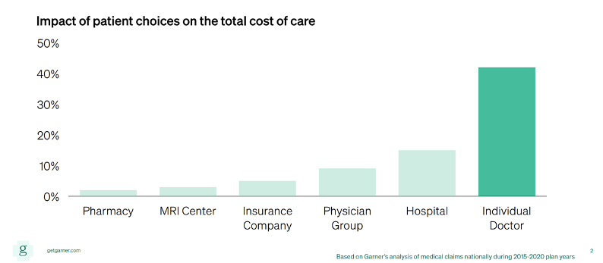
Better Healthcare + Lower Costs
Notes:
Cam

Slide 26
Recap: Where you’ll see change…
The mysterious black box of the benefits marketplace will be demolished
01
One-size-fits-all benefits paradigm will be replaced by personalized benefits
02
Brokers will work for you (even though they already should be)
03
Notes:
More change will is to coming the benefits industry in the next 3 years than occurred in the last 20. And I want to share [3] major leaps forward that will change the way you do benefits.
The mysterious black box of the benefits marketplace will be demolished
Buying benefits is going to move online and it’s going to demand transparency. You’ll be able to access, research, get live demos and quotes for every single one of the now hundreds vendor and insurance carrier in real time. No more waiting around to get prices for something you are exploring, or wondering if you’ve even seen all the options.
One size fits all benefits paradigm will be replaced by personalized benefits.
Your employee population has different needs. It’s insane that HR is forced to choose blanket benefits. 401k vs fertility. Transportation vs mental health. Soon your employees will be able to select their own benefits unique to their needs.
Brokers will work for you
Oh you thought they already did? Think again.

Slide 27
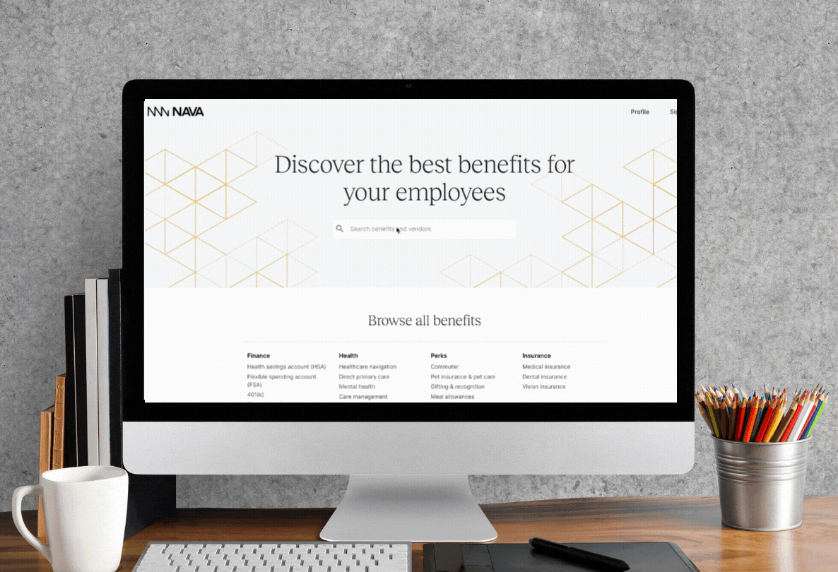
Join the movement to #FixHealthcare
Questions?
Notes:
Pretty exciting right?
Closing / CTA
If this interests you, you can email me personally at brandon@navabenefits.com. If you’re the right person to work with us - great - if not we will connect you with the right people and tools to start change at your own org.
Nava is proud to be a part of this amazing ecosystem and there a tidal wave of change coming towards us all.

Slide 28
THANK YOU
Marcel Ocampo Partner, Market Director
marcel@navabenefits.com
Nava Benefits
www.navabenefits.com
Cam Cummins Managing Partner
cam.cummins@transparentbydesign.com
Transparent by Design
www.transparentbydesign.com
Stop by the Nava Benefits booth to unlock benefits innovation (and get some cool swag).

