Slide 1








26TH ANNUAL CONFERENCE
San Antonio, Texas
September 26-28

Slide 2


HOW IS THE HEALTH OF YOUR HEALTHCARE HUMAN CAPITAL?
Alicia Finley, SPHR, SHRM-SCP, THRP
Dustin Haverkamp, SPHR, THRP

Slide 3


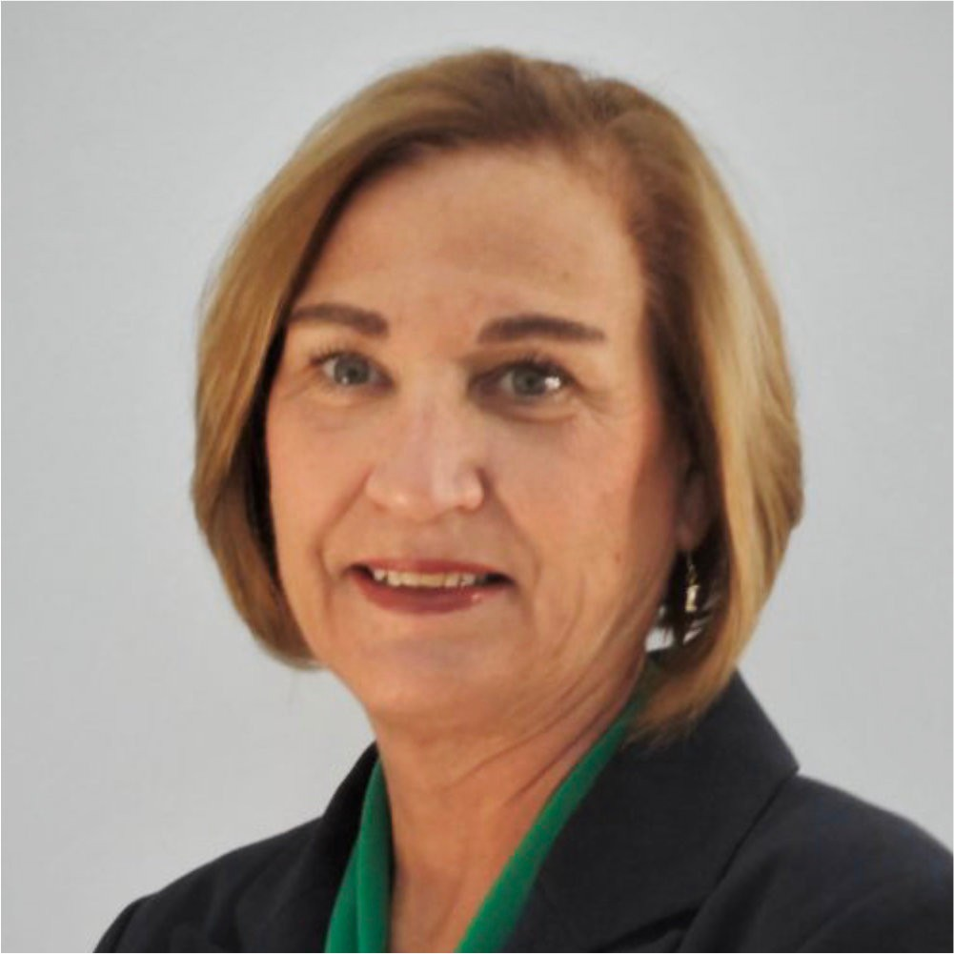


BLUE STONE STRATEGY PARTNERS
National, Native-Owned Advisory Firm
16th Year of Operations, 200+ Tribal Nations,
500+ Projects
Core Team of Leadership, Directors and Project Managers
Tribal Advisor Support and Use of Subject Matter Experts
Mission: Blue Stone Strategy Partners exists to provide Tribal economic development and governance advisory services by promoting fiscal and economic
independence, protecting Tribal sovereignty and sustainability.
Vision: To be the Advisor of Choice for Indian Country economic development support and Tribal
organizational planning; providing a “Clear Vision” with a culturally sensitive approach.

Slide 4

HEALTHCARE IS ONE INDUSTRY WHERE TALENT ACQUISITION CAN BE A LIFE-OR-DEATH ISSUE

Slide 5


LOOKING FOR A PURPLE SQUIRREL
Top Human Resources Challenges in Healthcare
Talent acquisition (particularly for rural locations)
Lack of candidates
Employee burnout
Constant need for retraining
Evolving State laws and licensing requirements
Operational and financial impacts
"There's probably not a worse industry out there than
Healthcare, as far as talent acquisition
is concerned. You have to be creative."
~Chief Talent Officer, AMN Healthcare

Slide 6

90%
OF HOSPITAL EXECUTIVES BELIEVE THAT IN THE NEXT 10 YEARS THEY WILL EXPERIENCE A
DEFICIENCY OF SPECIALISTS, GENERALISTS, PHYSICIANS, NURSES AND OTHER CLINICIANS,
WHICH WILL HAMPER THEIR ABILITY TO DELIVER
HIGH-QUALITY CARE

Slide 7
THE CURRENT STATE OF HEALTHCARE
The number of Healthcare jobs in the US will grow 12% through 2028, nearly double the projected rate for all occupations combined
Aging of the massive Baby Boomer generation; higher utilization as they
age
Nurses are retiring, as patient needs are increasing
51% of nurses are 50+
Shortage of nurses already being felt, a need for 3.44 million nurses in 2022
US nursing schools not keeping pace; producing approximately 158,000 graduates per year
As of 2017, 90% of Healthcare leadership worried about finding critical staff

Slide 8


OPERATIONAL IMPACTS
Communication
Silos
Provider availability
Increased office wait times
Increased time to schedule appointments
Maintain consistent leadership
Communicate productivity expectations as part of the recruitment process
Maintain accountability to standards

Slide 9

ANCILLARY STAFF SUPPORT
Front desk staff
Medical Assistants, LPNs and RNs
Turnover
Provide formal training to support staff
Routinely check market to establish competitive pay rates for positions with high turnover

Slide 10

QUALITY OF CARE
Credentialing lapse
Loss of continuity of care
Lack of understanding of trauma informed care or Tribal culture
Locums may not adhere to Tribe's standards of care
Credentialing should be a function of Human Resources or consider outsourcing
HR should be actively involved in developing a robust onboarding and training program

Slide 11

FINANCIAL IMPACTS
4
Cost of Locum Tenens is exorbitant
Unfilled provider positions = revenue loss of at least $1.8 million/year
Revenue losses from underperforming and unaccountable providers
patients/day
= $614,400
Total loss =
$1.2 M
12
patients/day
= $1.8 M
Proactively identify recruiters who specialize in recruiting health professionals
Identify University-level Tribal health professional programs and align with Native American Physician Association (NAPA)
Consider sponsoring MDs in training, in collaboration with local hospital systems and medical schools

Slide 12
HEALTH ADMIN SUPPORT
Demanding job
Health Directors oversee staff across many disciplines
Government HR supports Tribal Clinics
Clinic often underserved
Lack of HR expertise needed to provide support
Have at least one dedicated HR professional located within the Clinic to provide support

Slide 13

GROUP DISCUSSION
How is the healthcare recruiting, hiring, onboarding, and training handled by your Tribe?
What about credentialing?

Slide 14


RECRUITING
Inherently different in Healthcare
Possible non-compete clauses in previous contracts
Long ramp-up
Personal bonds with patients at clinics and hospitals are important
Understanding of and sensitivity to culture
Rural Healthcare
Local professionals
Tribal Members
Colleges
Community Colleges
Commissioned Corp
3RNET.org
Have potential candidates job shadow for a day so everyone has an opportunity to assess fit

Slide 15


ENTICING WORKERS
To attract top talent consider focusing on:
Offering training/advancement opportunities
Providing flexible work conditions Offering signing bonuses
Offering relocation allowance
Ensuring that total compensation (including benefits) are competitive or leading the market
If you don't think outside the box, you are going to struggle with turnover

Slide 16
RECRUITING FOR RETENTION
Recruitment for Retention focuses on attracting, acclimating,
and retaining healthcare professionals
Think long-term to develop ongoing process of retention
Form a recruitment and retention committee
Budget for retention
Meet face-to-face to determine fit within the community and culture
Prepare for the site visit
Evaluate current environment – does it make staff feel valued?
Identify areas of opportunity for improvement

Slide 17
BURNOUT
Clinics and hospitals must keep shifts filled to take care of the patients who depend on them
Staffing shortages lead to forced overtime hours
"Mental load" that doctors and providers must carry; emotional burnout
Clinical documentation and responding to emails from patients

Slide 18

THE TWO MOST COMPELLING INCENTIVES FOR PHYSICIANS TO REMAIN IN ONE POSITION FOR FIVE OR MORE YEARS ARE INCREASED COMPENSATION FOR CLINICAL OR LEADERSHIP DUTIES, REDUCED HOURS, OR A MORE FLEXIBLE WORK SCHEDULE

Slide 19
RURAL RECRUITMENT CONCERNS
Heavy workload with a large number of patients
Patients who require more care
Difficulty taking time off
Call frequency
Professional isolation
Limited job opportunities for spouses
Schooling for children
Availability of afterschool programs and daycare
Lack of groups and support for special interests

Slide 20
RURAL RECRUITMENT TECHNIQUES
Track down as many nearby qualified applicants as you can and "stalk" them
Look for people who grew up in/near your area that might want to return
Look for people who like the idea of practicing in the type of environment that allows for closer connections with patients
Look at nearby colleges and medical trade schools
Invest in higher wages, benefit packages, and training
Commissioned Corp or 3RNET (non-profit network funded by the Federal Office of Rural Health Policy
Ask your current staff who they know!

Slide 21
COMPENSATION
A major tool in attracting, retaining and motivating
Base wages, benefits, vacations/sick leave, company culture, employee recognition
Identify compensation philosophy
Factors that drive pay
In-demand skills ("hard-to-fill," "hot jobs," difficulty in recruiting)
Internal value and impact
Education/Experience
Location

Slide 22
RURAL RECRUITMENT BENEFITS
Insurance (health, dental, vision, life)
Coverage of malpractice insurance
Payment of licensure fees and association dues
Payment and time off for continuing education
PTO, sick leave, sabbaticals
Bonuses (sign-on, retention, performance, staff recruitment)
Relocation expenses
Assistance with finding spousal employment/daycare
Loan repayment

Slide 23
RURAL RECRUITMENT REWARDS
Greater sense of mission and accomplishment
serving in an area of need
Develop stronger relationships with patients
Slower paced lifestyle
Greater access to outdoors
Opportunities for leadership
Opportunities for incentive programs such as loan repayment programs

Slide 24






PRESCRIPTIONS FOR SUCCESS
HEALTH CARE IS A CHALLENGING INDUSTRY FOR HR, BUT THESE TIPS M AY HELP:
Automate: Health care workers are more likely to stay with their current employer if automated processes are in place
Flexibility: Offer flexible schedules to attract and retain workers; this is especially true for health care clinics and hospitals in rural, underserved locations that may not be able to be competitive in pay
Compensation: Complete a compensation study to ensure that pay is in alignment with market, industry, and geographical elements
Recruiting: Consider a wider net when recruiting, and get creative with recruiting
Benefits: Consider a benefits review specific to the health care practice of your Tribe

Slide 25

GROUP DISCUSSION
Do you see a need or have a desire for specialization in this area?
Do you see a need or a desire for a Tribal Health Clinic HR certification, similar to the THRP?

Slide 26


THANK YOU
Alicia Finley, SPHR, SHRM-SCP, THRP
Human Resources Service Director afinley@bluestonestrategy.com 505.459.2957
Dustin Haverkamp, SPHR, THRP
Human Resources Specialist dhaverkamp@bluestonestrategy.com 785.383.8101
Kate Grismala
Health Care Services Director Kgrismala@bluestonestrategy.com 860.235.6371

