Slide 1





26th Annual Conference
San Antonio, Texas
September 26-28

Slide 2
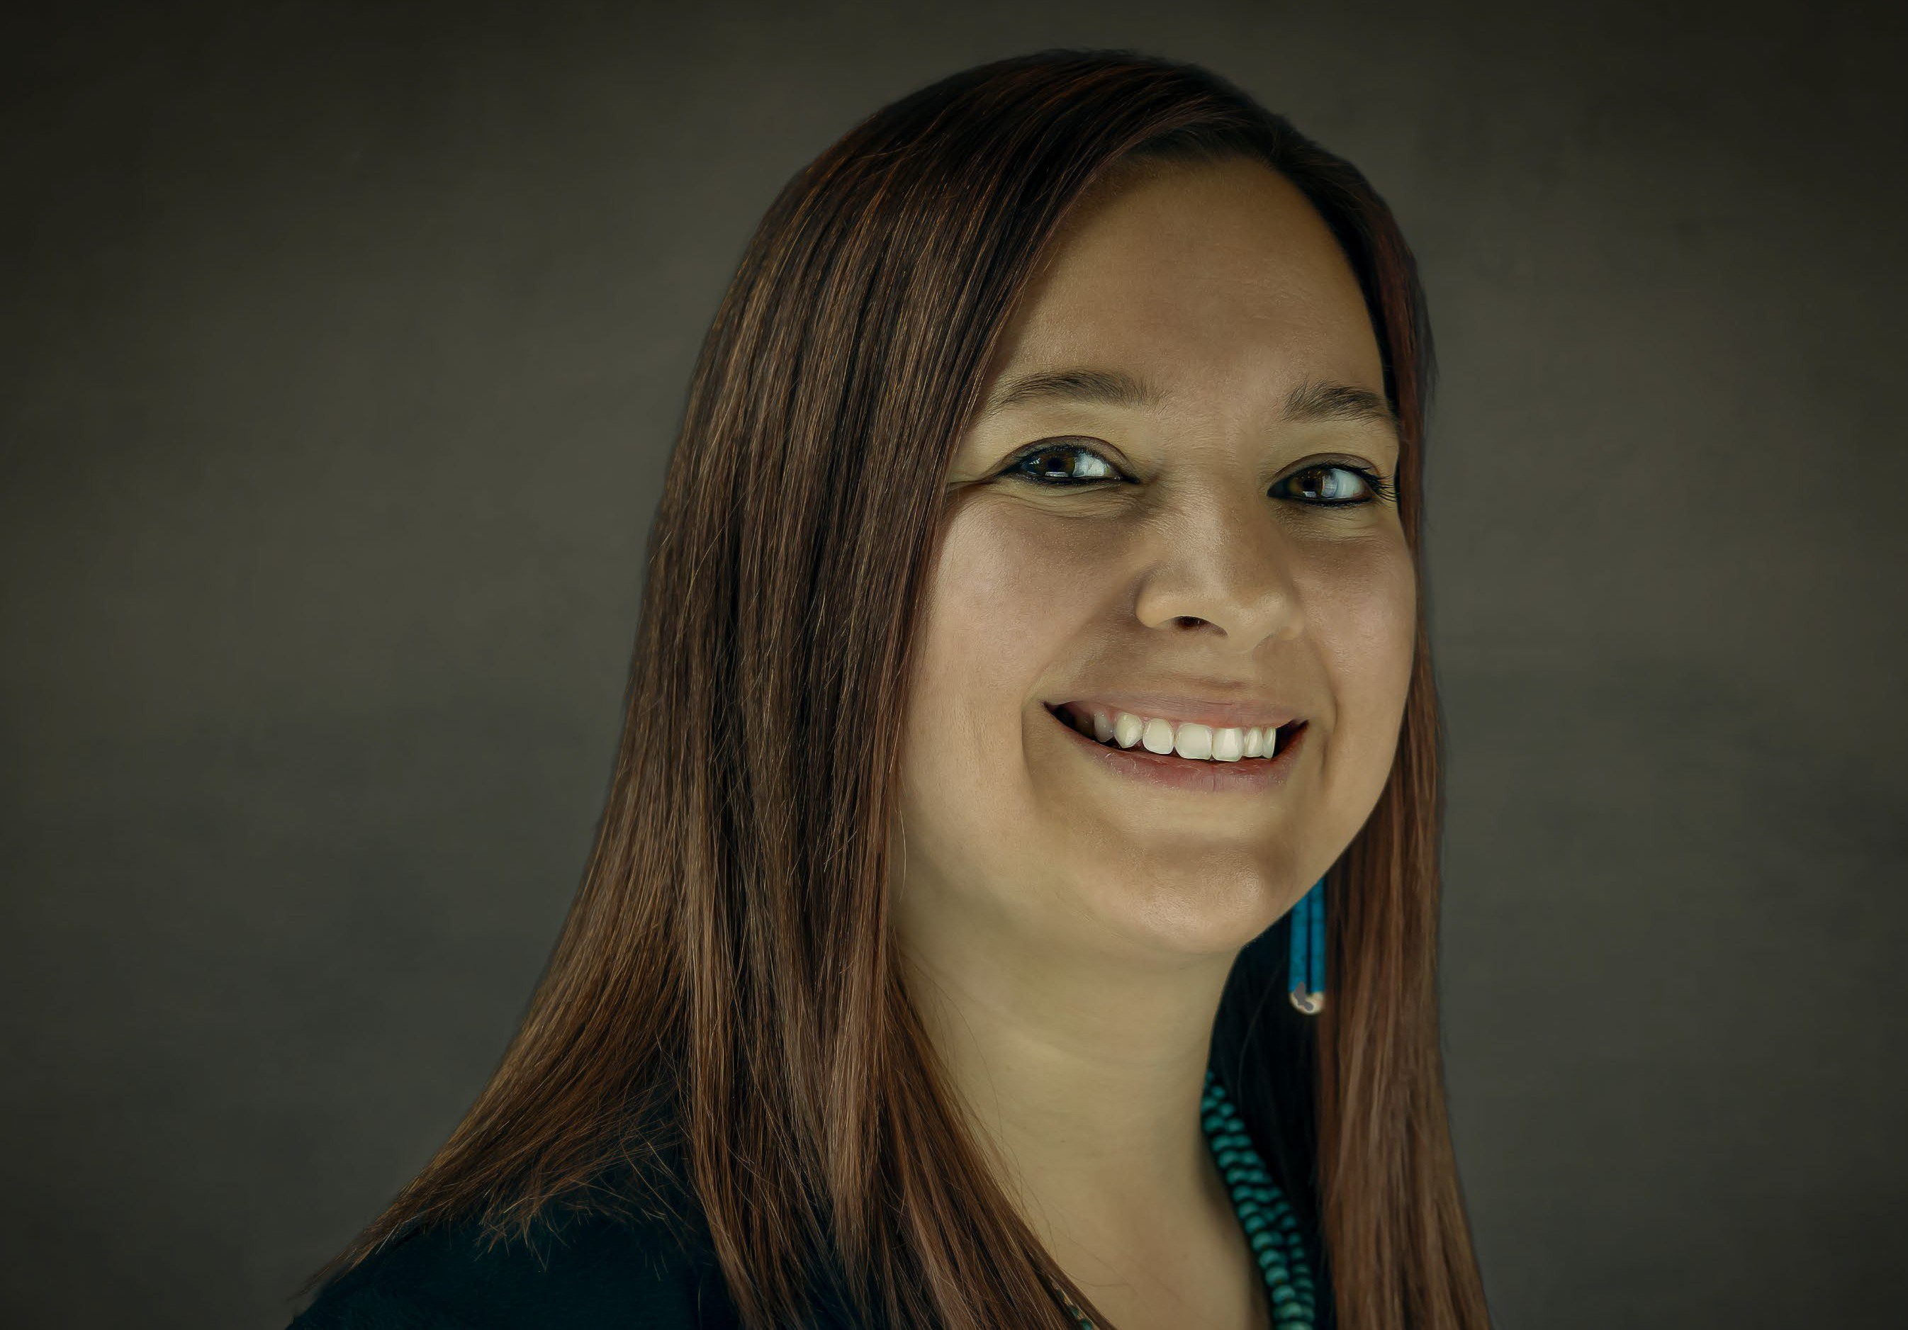

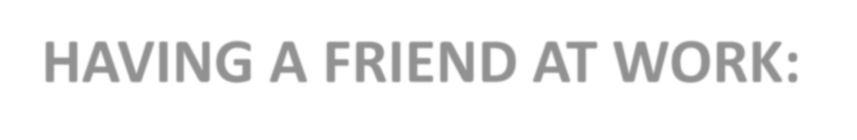


HAVING A FRIEND AT WORK:
THE KEY TO A HAPPIER WORKPLACE

Slide 3





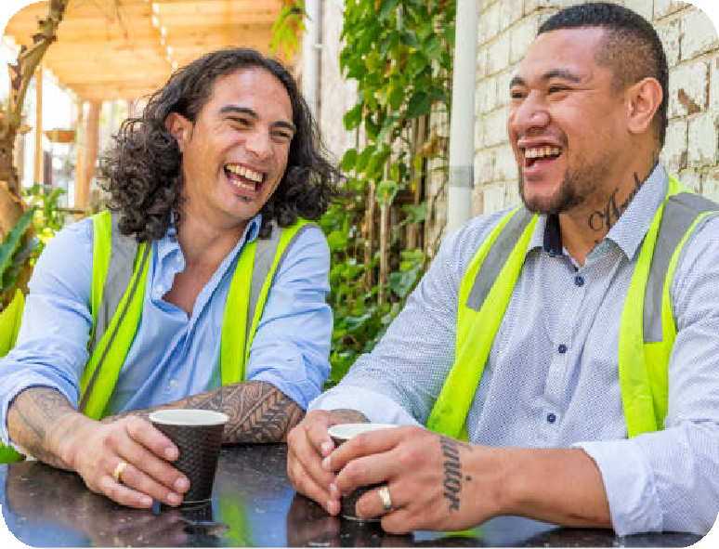





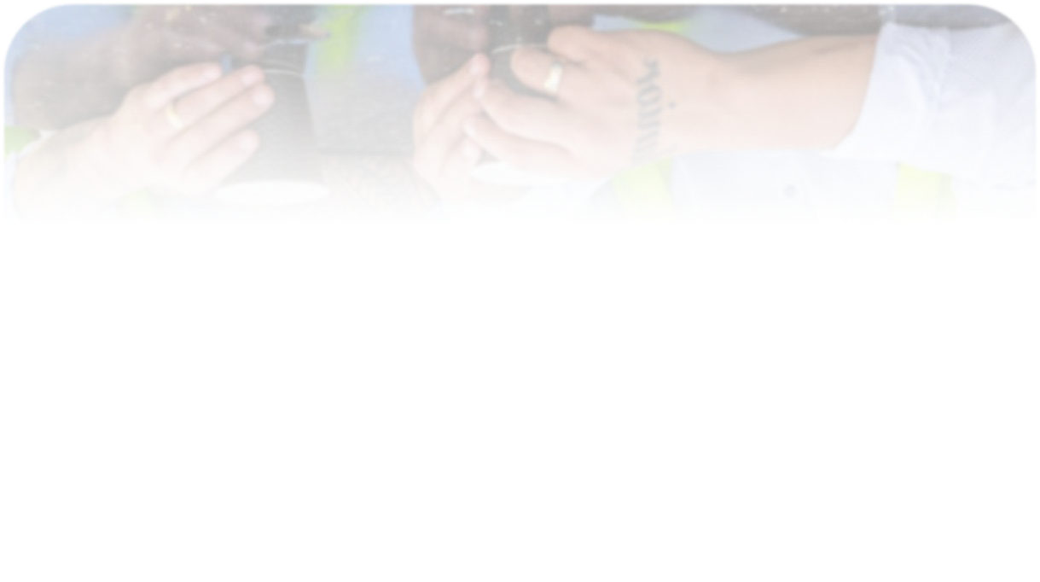


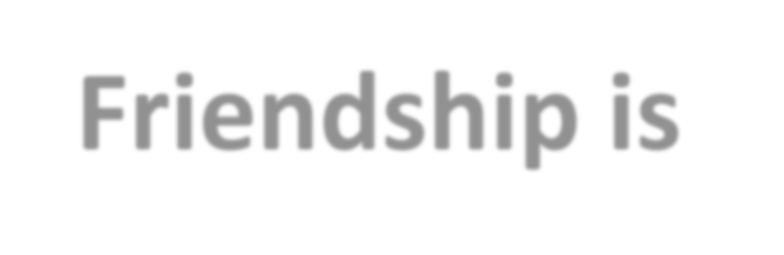

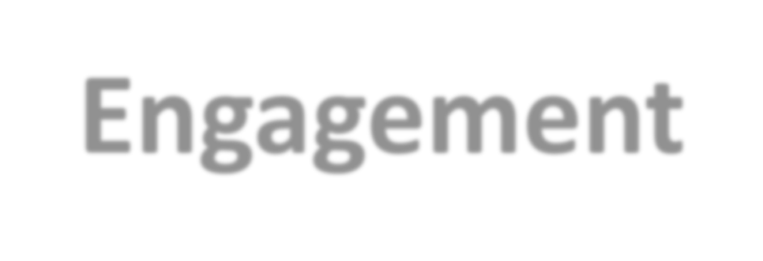
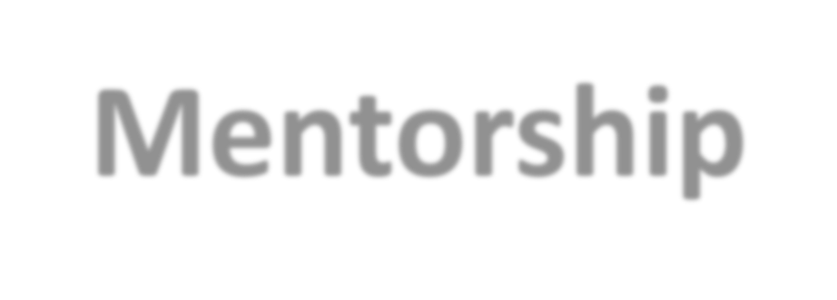


What we will share…
Retention and Engagement
Friendship is Mentorship
Intentional Friendship Culture

Slide 4
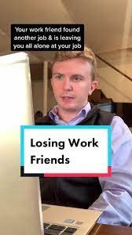
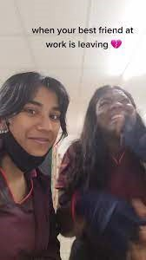
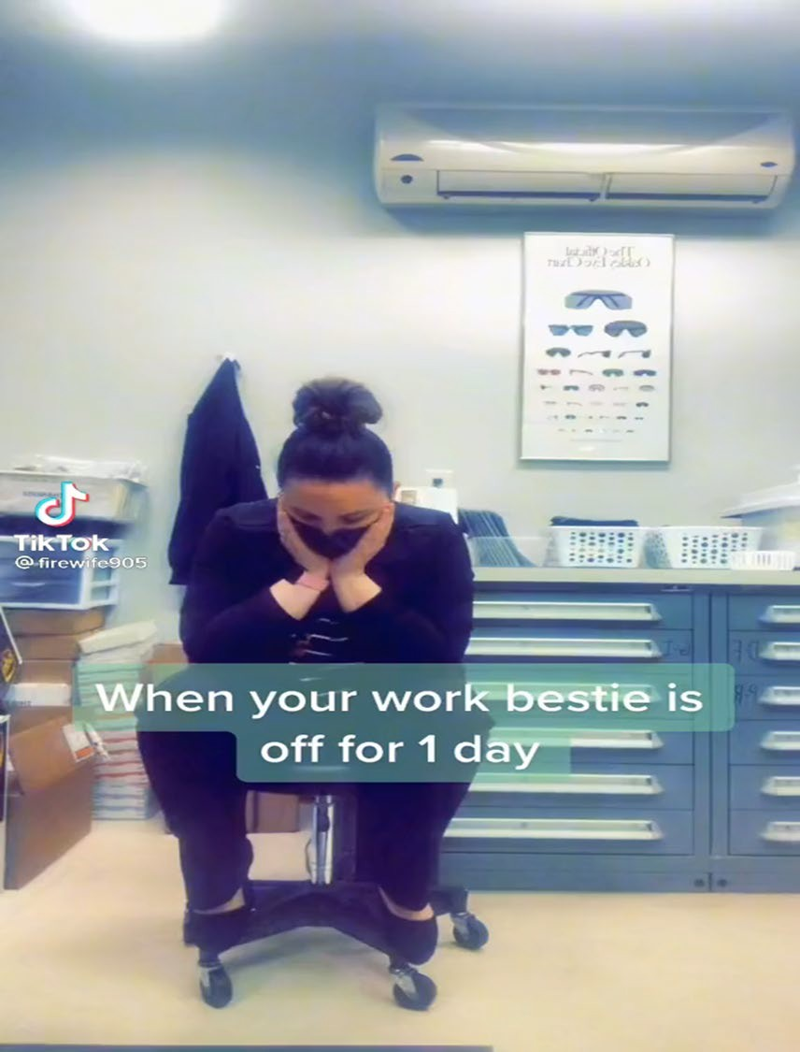
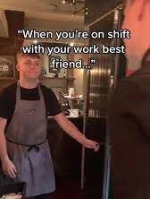
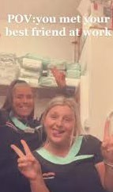



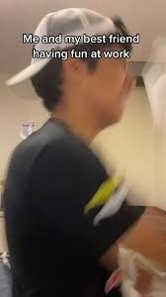
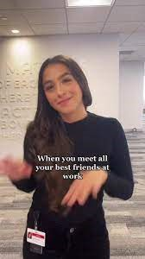
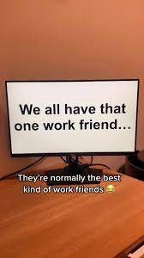


Slide 5



RETENTION
& ENGAGEMENT

Slide 7
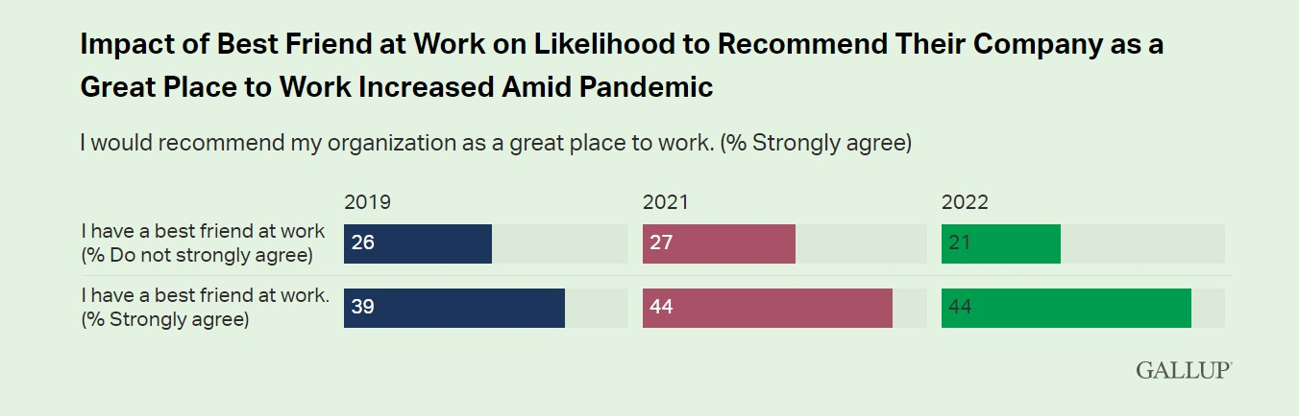
Recent Gallup data show that having a "best friend" at work has become more important since the start of the pandemic, even considering the dramatic increase in remote and hybrid work.

Slide 8
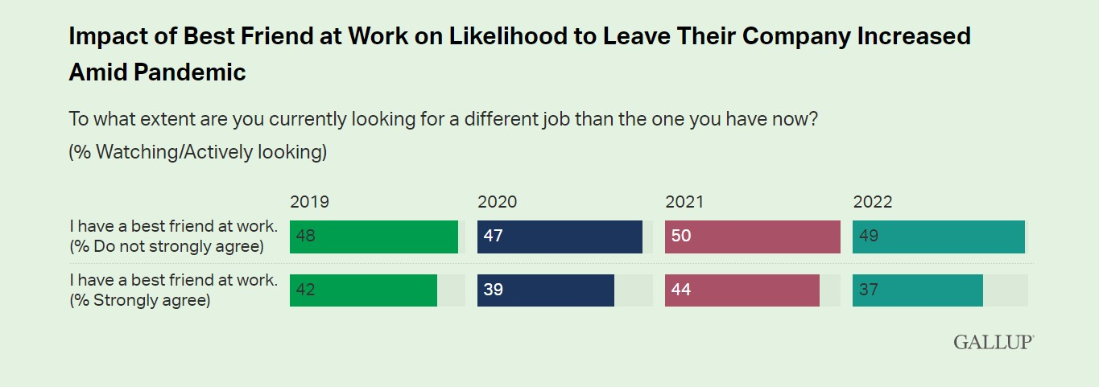
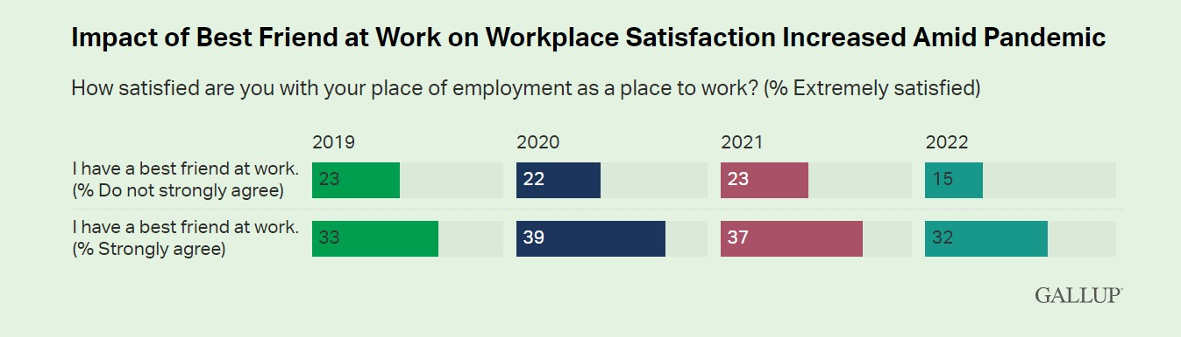

Slide 9






Benefits of having a friend/best friend at work:
Fuels Performance and Desire to Go to Work
Instills Empathy
Creates Trust
Fun Environment and Culture Add
Inclusion/Belonging
Accountability

Slide 10


FRIENDSHIP IS MENTORSHIP

Slide 12

STORY TIME

Slide 13



INTENTIONAL FRIENDSHIP CULTURE

Slide 15

ELEMENTS

Slide 16
Ask Yourself:
Do employees have time?
Are there curated opportunities for friendships to form?
Has leadership given permission for these types of connections?
Do people talk about their friendships at work, can you see the evidence of these connections?

