Slide 1




FMLA, Paid Sick Days, PFML, State Disability – Can it get More Complicated?
James Albright
©2021 ARTHUR J. GALLAGHER & CO.

Slide 2


Agenda
FMLA Growth and Solutions in the market
Gallagher National Benchmark Information
Parental Leave
Unlimited PTO
Disability and Life Options in the market
ADA options
State Disability and Paid Family Medical Leave Update
Paid Sick Day Laws
Compliance Case Studies
©2021 ARTHUR J. GALLAGHER & CO.
2
©2019 ARTHUR J. GALLAGHER & CO.

Slide 3
FMLA Growth and Solutions in the market
©2021 ARTHUR J. GALLAGHER & CO.

Slide 4
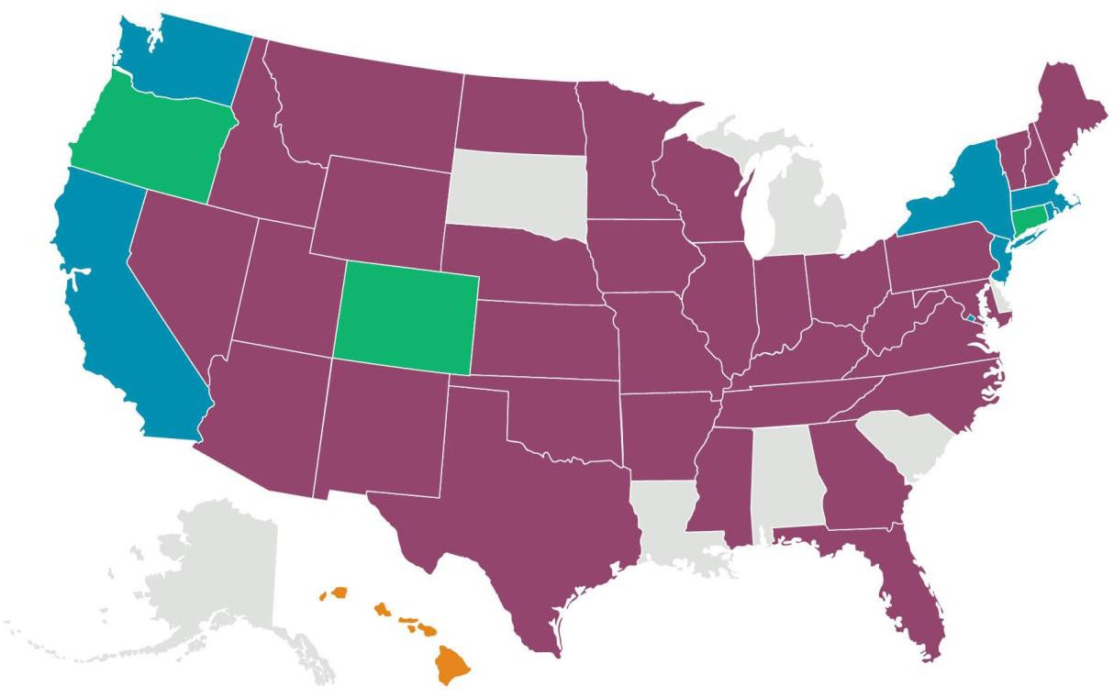

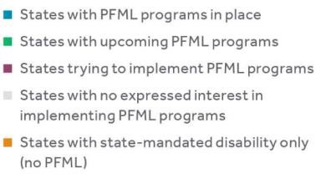
Growth in State Paid Family & Medical Leave Laws
Employers are looking for a partner who can help them navigate new regulations
©2021 ARTHUR J. GALLAGHER & CO.

Slide 5


Key Concerns with Leave
Very difficult to manager Intermittent FMLA for all employers and FMLA partners.
Almost impossible to question an FMLA Medical Certification.
The rise of State Leaves that have to be coordinated with FMLA. Nationally there are over
200+ state leaves.
Typically there is a gap between lost time Workers’ Compensation and the FMLA process.
Tools are lacking for groups that want to administer FMLA and leaves internally.
Paid Sick Days are growing, and clients are having to adjust current Time Away from Work benefits such as sick or PTO to try and meet the requirement.
Pandemic Claims for exposure to, or being tested positive for Covid.
Parental, Caregiver, and Maternity benefits are a hot topic right now for employers.
©2021 ARTHUR J. GALLAGHER & CO.

Slide 6
Administration Considerations for Leave
Internal Administration
Legal Landscape
Inconsistency
Individual interpretation of leave policies/processes
Managers can be personally liable for
non-compliance
Lack of expertise and time
Concerns about litigation
Liability
Inaccurate tracking
Over/under leave allowances
Personal Health Information
Consistent application of FMLA with lost time Workers’ Compensation claims
Multiple levels
Federal/state/municipal
Variables:
Notification
Reporting
Communications
Frequent Changes
Over 200+ State Leave Laws Nationally
©2021 ARTHUR J. GALLAGHER & CO.

Slide 7
FMLA and State Leave Outsourcing Options
©2021 ARTHUR J. GALLAGHER & CO.

Slide 8
Solutions in the Marketplace
Some groups built their LOA solution, while others bought the expertise. Those
are the 2 first bullets.
Carrier Internal FMLA options – Unum, The Standard, The Hartford, Reliance Standard, Cigna, Metlife, Symetra, Aflac, Sun Life, Voya, and Lincoln all have the administration of the FMLA through themselves.
Other Carrier Partner FMLA options –Mutual of Omaha, Dearborn, and a few others have partnered with FMLASource which is a division of ComPsych, that is an expert on FMLA.
FMLA Software options – This would be for a group that does not want to let go of the
control of their leave program.
For clients from 100-500 lives, The Standard and the Guardian have developed programs that do NOT need an eligibility file. The Standard is for groups 200-500.
Unum has a partnership with Workday, ADP, and UKG that allows for real time updates between Unum and Workday, and there is no eligibility file needed. Others are following suit and this should open up opportunities for streamline and integration with other carriers.
©2021 ARTHUR J. GALLAGHER & CO.
©2019 ARTHUR J. GALLAGHER & CO.

Slide 9
Important Items to Consider with Outsourcing
Indemnification – Some of the carriers and providers will remove the word “Gross” within the negligence section of the FMLA Agreement. This will allow for mistakes and simple negligence items to be covered by the insurance carrier or provider in case the employer gets sued.
Employee Experience – Matching up with the disability with the leave with a one stop phone call to initiate all programs the employee is eligible for, including Voluntary Benefits.
Communication – Making sure the insurance carrier or provider is educating employees of who to contact for both the State Disability and PFML.
Other Leaves – Parental Leave, Military, Personal, Medical, and other company defined leaves can also be outsourced.
Workers’ Compensation – This needs to be coordinated with the Leave programs for those claims with lost time. Also, usually there is a disconnect between LTD and Workers’ Compensation claims as well.
©2021 ARTHUR J. GALLAGHER & CO.
©2019 ARTHUR J. GALLAGHER & CO.

Slide 10
Gallagher National Benchmark Survey- 2022
©2021 ARTHUR J. GALLAGHER & CO.

Slide 11
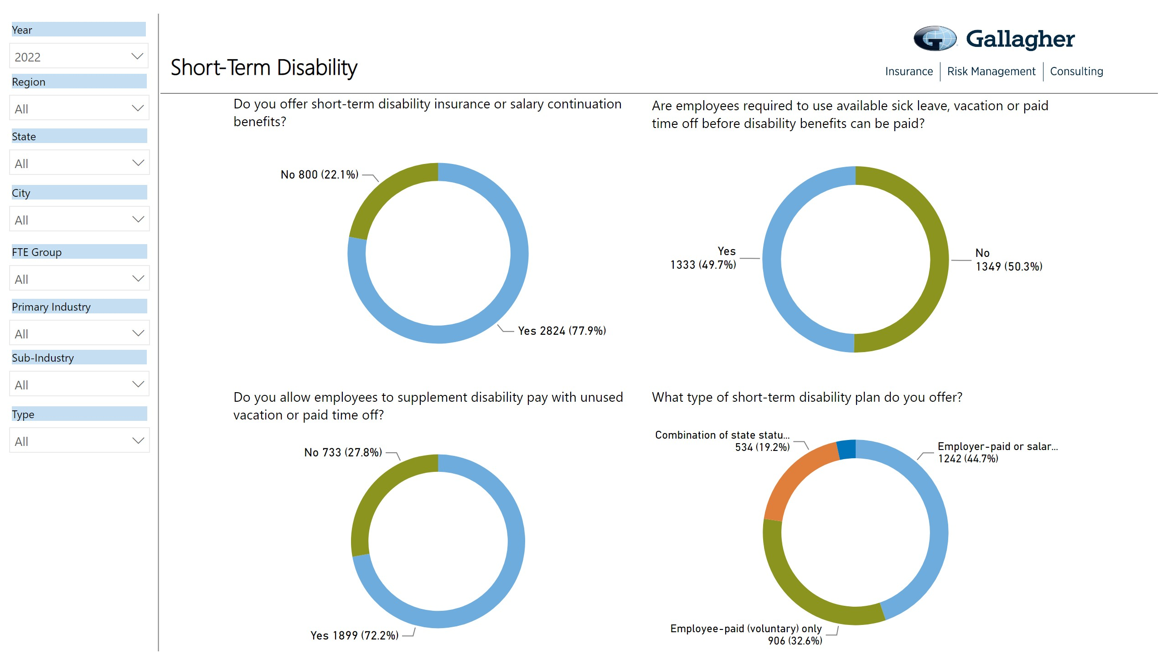
11

Slide 12
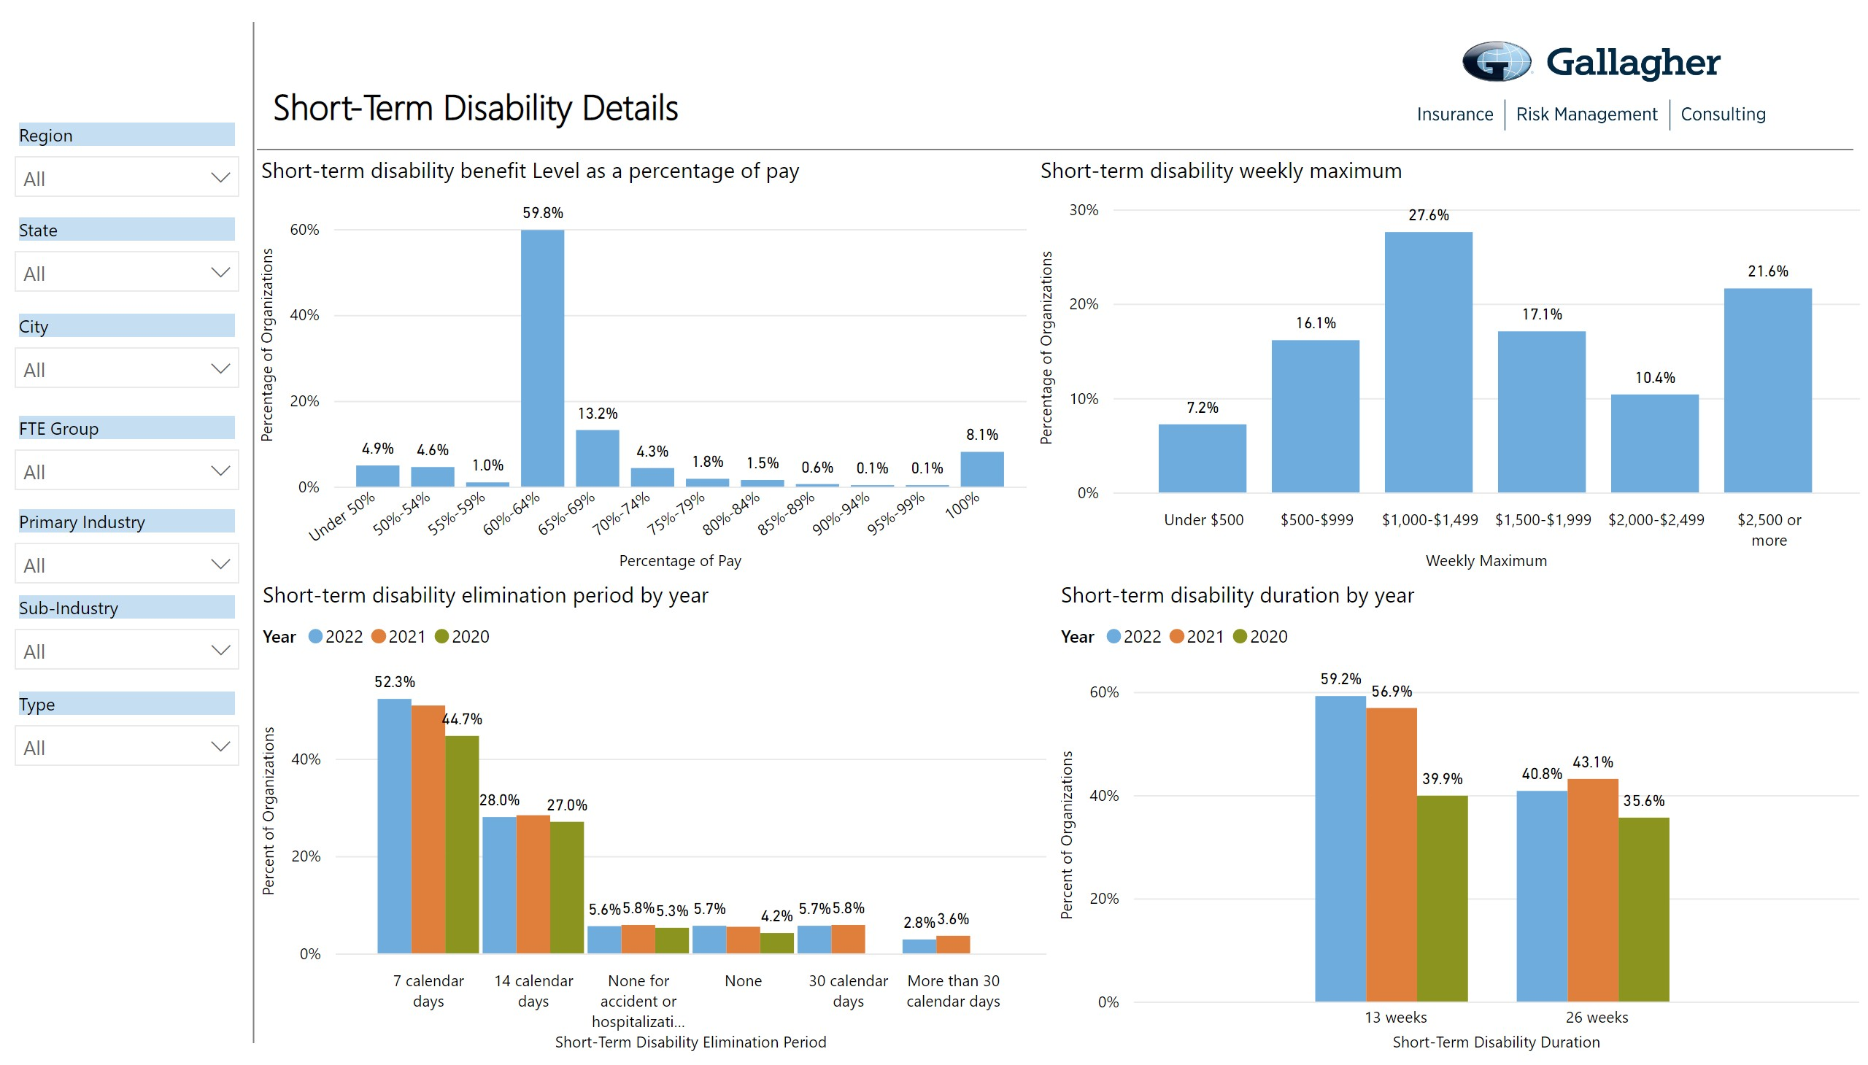
11

Slide 13
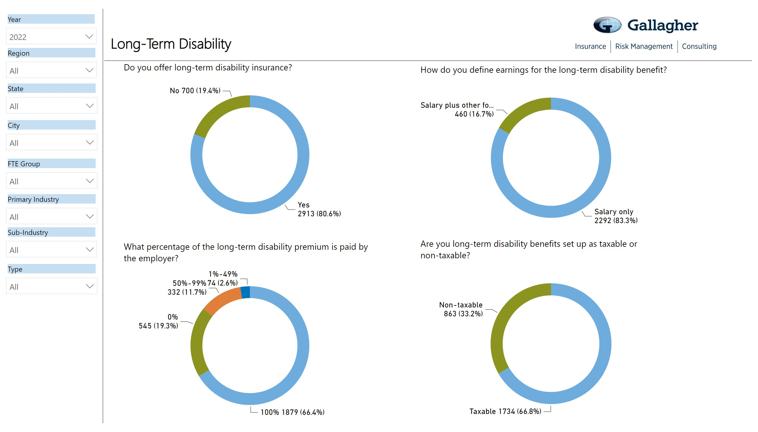
11

Slide 14
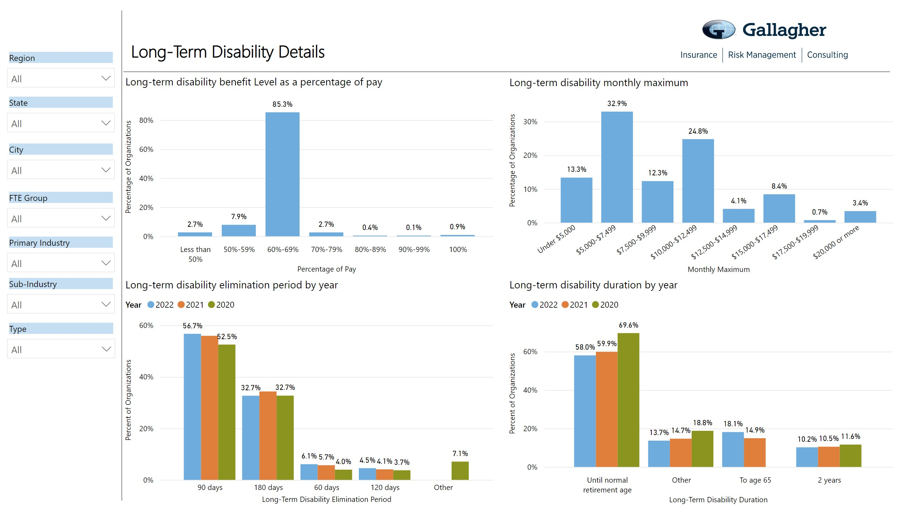
11

Slide 15
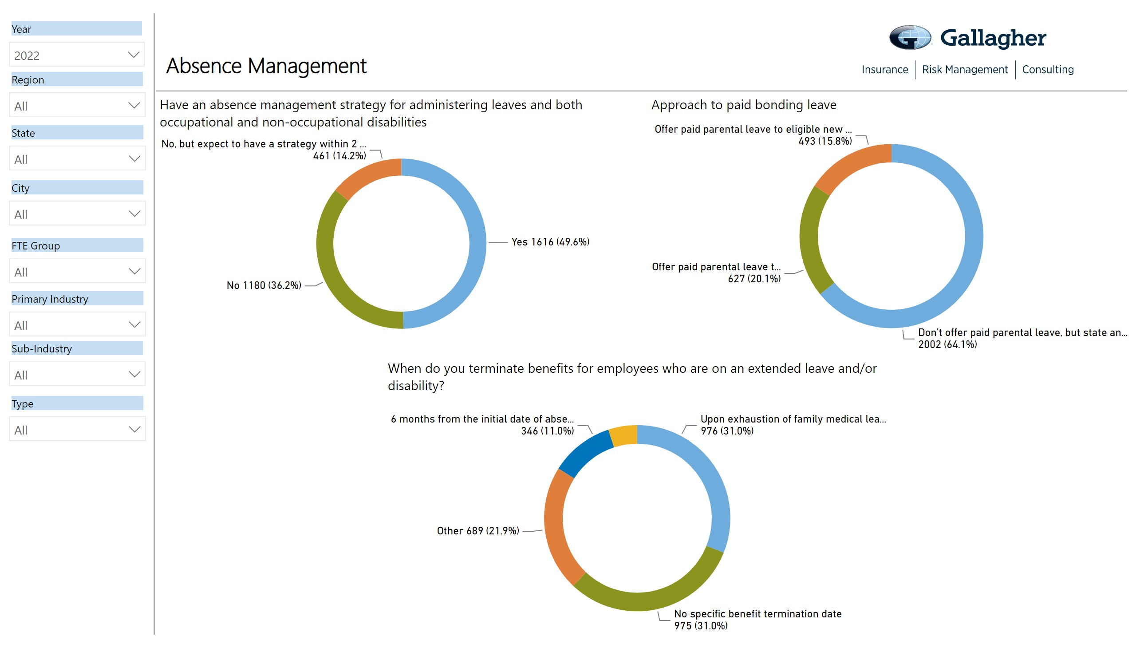
11

Slide 16
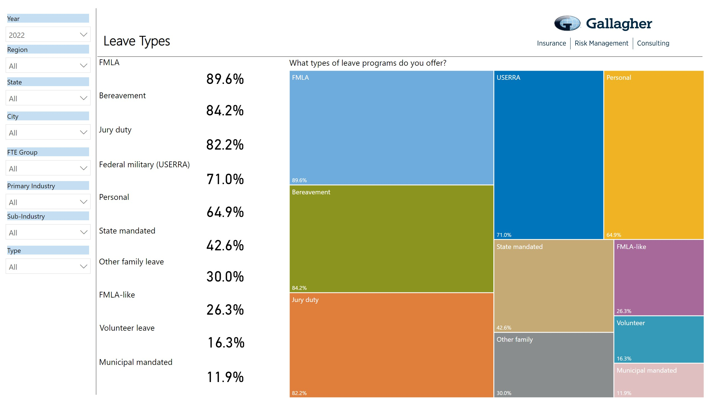
11

Slide 17
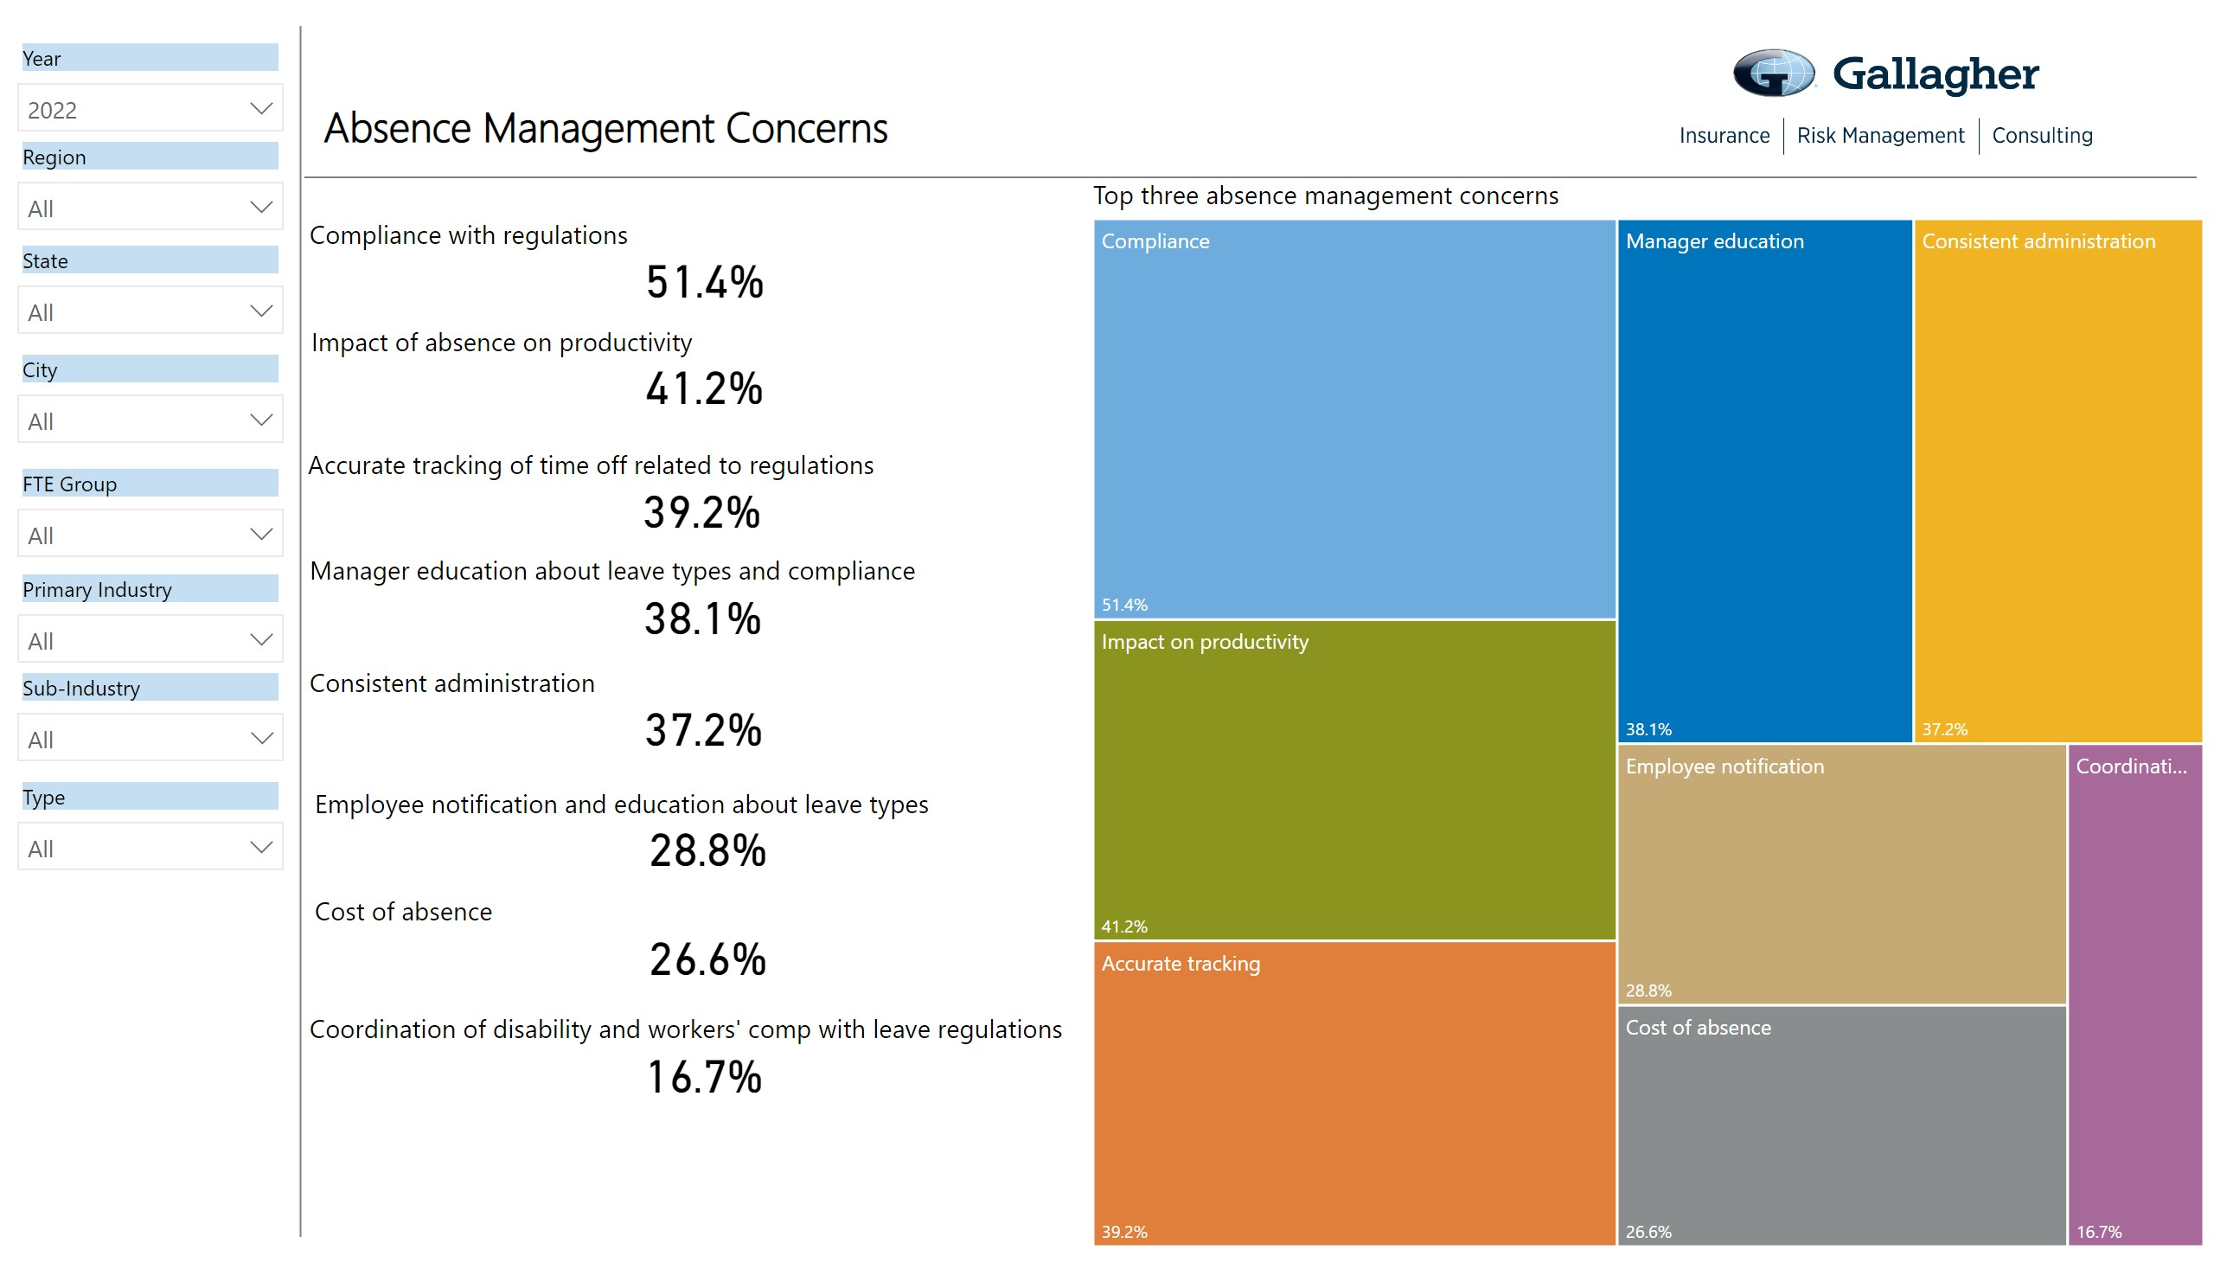
11

Slide 18
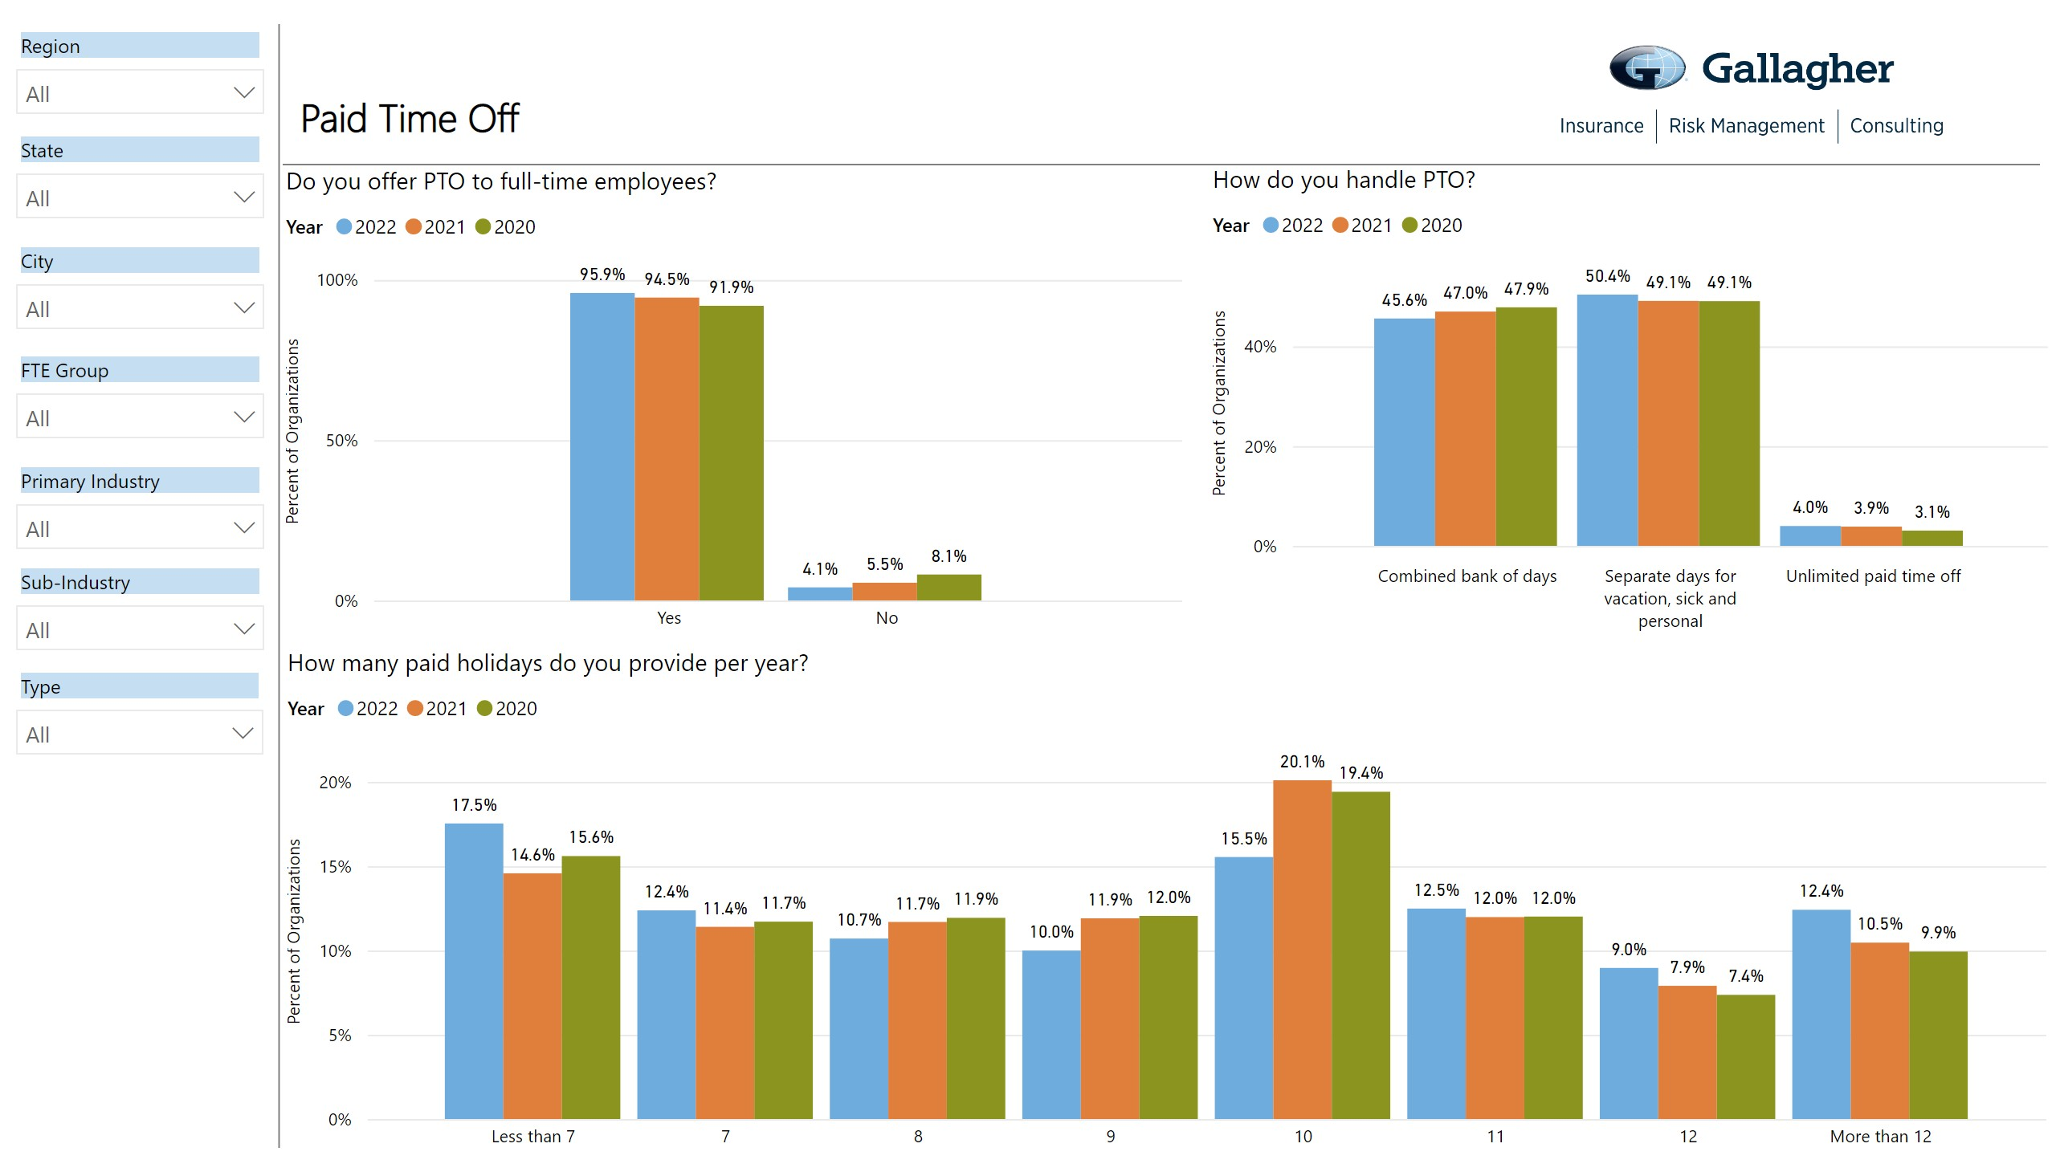
11

Slide 19
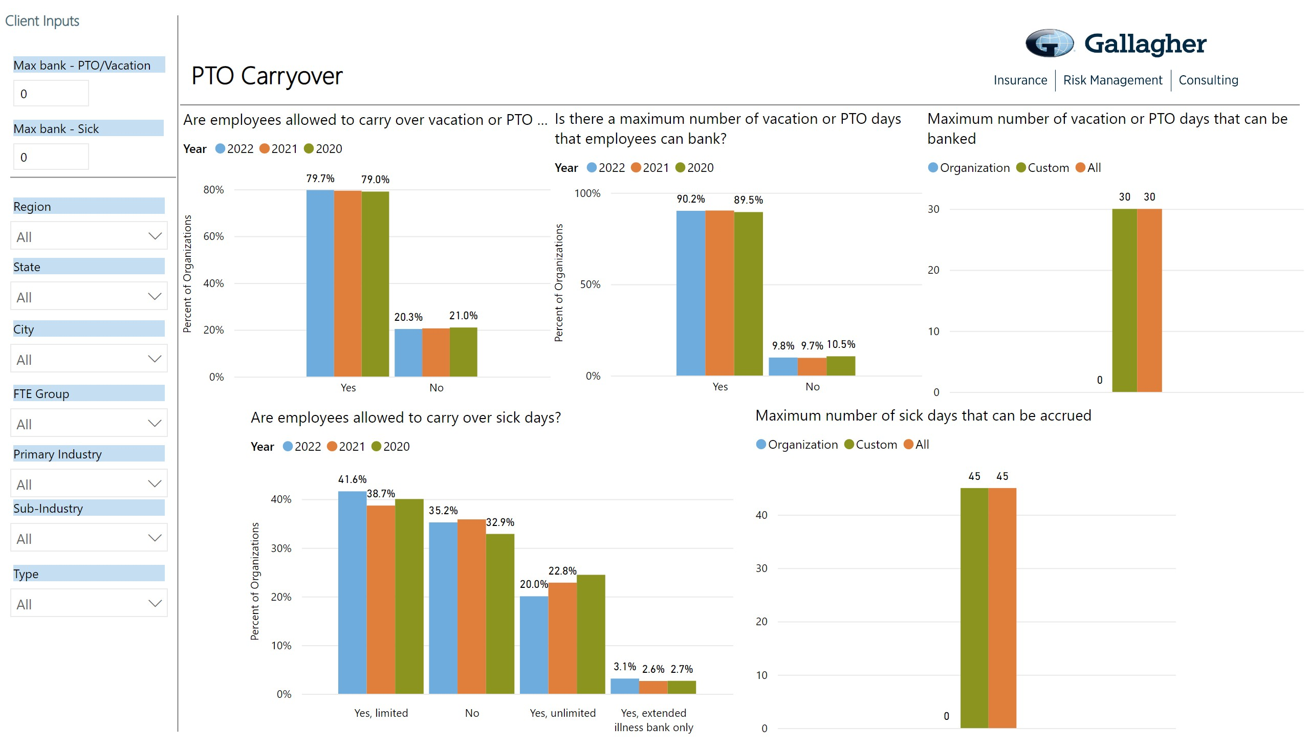
11

Slide 20
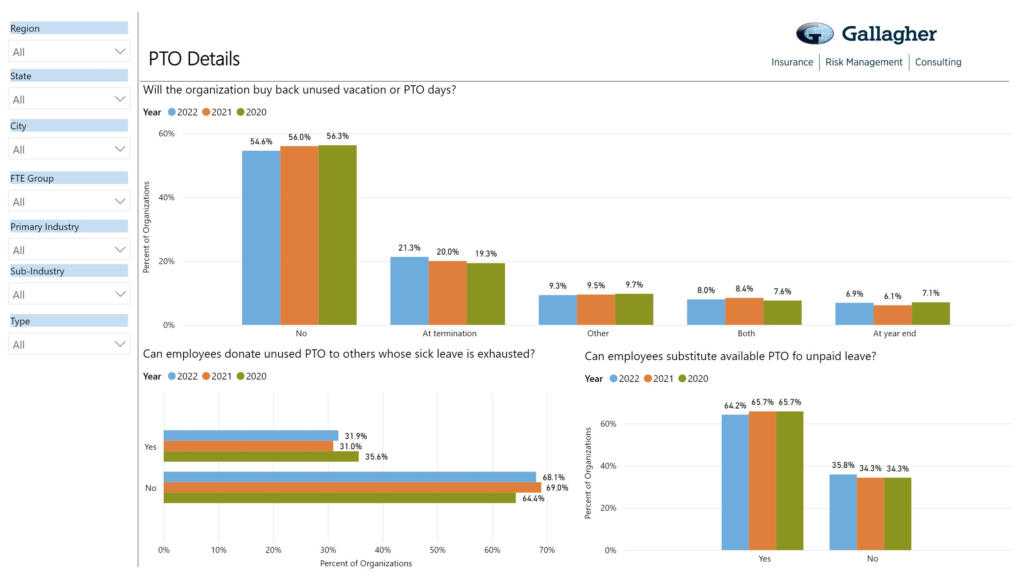
11

Slide 21
Parental Leave
©2021 ARTHUR J. GALLAGHER & CO.

Slide 22
Parental Leave
Types of Plans:
Bonding Only – We have several clients that have built this benefit to be paid upon the completion of
the disability for the birth Mother and for the Secondary Caregiver upon the need for bonding time.
Coordination with STD – We have also had several clients that have looked to integrate the STD benefit with a top up over the STD percentage to get the employees to 100% for a period of time, with some bonding time, usually up to 12 weeks.
Primary and Secondary Caregiver – This has been a popular way for groups to identify both parents. We have found that it may not be best for groups to designate which employee is in which designation. We have recommend that you let the employee self designate which role they fall into. If you have even amounts of time for Primary and Secondary, this could be a non issue.

Slide 23
Parental Leave Continued
Consider starting small – There are several large employers that offer a very large amount of Parental Leave that would exceed 12 weeks of benefits. We have found that most of our clients are really looking to provide 2-4 weeks of bonding time, knowing they can always add in the future. Some of those groups have also added a Maternity Birth type of benefit that would run 8 weeks. Coupled with the Maternity Birth benefit and the Parental Leave, groups are marrying this up with the expiration of FMLA.
Offsets – With the introduction of the PFML benefits around the country, we have advised our clients to add offset wording so that the PFML and any other benefits will be paid, and your Parental Leave plan can pay the difference only.
Outsourcing Options – If you have outsourced your leave of absence administration to a third party,
most of those organizations can track this type of plan along with your other leaves.

Slide 24
Unlimited PTO
©2021 ARTHUR J. GALLAGHER & CO.

Slide 25



Advantages of unlimited paid time off
Advantages
53% of employees say it’s “very
important” to have a job that allows them greater work-life balance and personal wellbeing¹
Employees can recharge
Sparks creativity
Trust and flexibility
Improved morale
Increase employee happiness
Better teamwork
Creates loyalty
1 Source: Gallup State of the American Workplace Report
25
©2020 ARTHUR J. GALLAGHER & CO.

Slide 26

Advantages of unlimited paid time off, cont.
Avoid the year-end scramble
Reduces “forced” usage at the end of the year
Recruiting
Employer of choice
Encourages a results-based rewards system
It’s cost-efficient¹
Reduces administrative burden on management
Reduces balance sheet liabilities
1 Source: Oxford Economics
26
©2021 ARTHUR J. GALLAGHER & CO.

Slide 27
Proceed with caution
It may sound great, but could it harm company culture?
Perceived loss of benefits
Employees might take less time off
Program not practicable with certain types of jobs
Not appropriate for all positions
Hard to implement fairly
Possibility of abuse or burnout
Legal challenges?
Little or no case, or laws to govern
27
©2020 ARTHUR J. GALLAGHER & CO.

Slide 28
Disability and Life Options
©2021 ARTHUR J. GALLAGHER & CO.

Slide 29
Current Opportunities
Integration of the leave, disability, and the Benefit Administration System
Ability to integrate with Workday, UKG, ADP Workforce Now, and others coming.
Ability to streamline all leave notifications into the Benefit Admin System to avoid manually keying employees out on leave statuses.
Ability to coordinate the Evidence of Insurability Process from the insurance carrier into the benefit
admin system.
Ability to outsource Portability and Conversion notification to the insurance partner.
Integration can also include payroll and time tracking systems.
Benefit Administration Subsidy programs- These are offered by most of the carriers on the Voluntary Benefits, but a few of the carriers also provide this subsidy for fully insured Disability and Life Insurance.
Payable every year of the relationship
Is usually between 3-4% of the premium
©2021 ARTHUR J. GALLAGHER & CO.
©2019 ARTHUR J. GALLAGHER & CO.

Slide 30
Current Opportunities Continued
Potential Plan Changes
If you outsource leave administration, we would suggest the following plan changes:
Renewal Notification should be 180 days. Difficult to move a leave program without at least 180 days.
Make sure you read the “Indemnification” wording to see if it has the “Gross” negligence wording, and if it needs to be changed to remove the “Gross” wording.
We would recommend an RFP with specific questions around all lines of coverage so there are no surprises later.
Contingent Loss Ratios – This is something you can ask for that will allow for a long Rate Guarantee if the case is running well.
Time Away from Work Policies
You will need to review your other time away from work policies to make sure they all integrate together. This is seen more often around the use of PTO or sick time during the elimination period, or before the benefit would begin.
We would recommend looking at all of your policies around the process of reporting lost time.
©2021 ARTHUR J. GALLAGHER & CO.
©2019 ARTHUR J. GALLAGHER & CO.

Slide 31
ADA Outsourcing Options
©2021 ARTHUR J. GALLAGHER & CO.

Slide 32
ADA Items to Consider
Most of the large insurance carriers and FMLA providers will manage the ADA process for employers. Things to keep in mind:
All of the carriers have different approaches to the administration of ADA.
Make sure the service you are requesting would include the interactive process with the employee and you. A couple of providers may not provide this service.
Some of the carriers will offer a few options. The first option which is usually the cheapest is typically for ADA coaching, and may not bring the value you believe it will. We usually look for the full services pricing.
Some of the carriers will also indemnify for the ADA as well as FMLA.
Make sure the insurance carriers are leveraging the Workplace Accommodation wording within the LTD contract.
Does a medical leave benefit help with the ADA process?
©2021 ARTHUR J. GALLAGHER & CO.
32
©2019 ARTHUR J. GALLAGHER & CO.

Slide 33
State Disability and PFML
©2021 ARTHUR J. GALLAGHER & CO.

Slide 34
Paid State Disability & PFMLA Information
State | Statutory Disability & Leave Plan Name | Statutory Disability Benefits | State Phone Numbers | State Website Addresses
California | California State Disability Insurance (SDI) | 8 Day Elimination Period with benefits payable up to 52 weeks | 800-480-3287 English | www.edd.ca.gov/disability
 | Paid Family Leave | 60% or 70% of earnings up to $1,357 per week | 866-658-8846 Spanish
 |  | Up to 8 weeks of benefits in any 12 month period.
 |  | 60% or 70% of earnings up to between $100 and $1,357 per week. No waiting period.
Hawaii | Temporary Disability Insurance Law (TDI) | 8 Day Elimination Period with benefits payable up to 26 weeks | 808-586-9188 | www.labor.hawaii.gov/dcd
 |  | 58% of earnings up to $640 per week
New Jersey | Temporary Disability Benefit (TDB) | 8 Day Elimination Period with benefits payable up to 26 weeks | 609-292-7060 | www.myleavebenefits.nj.gov
 |  | 85% of earnings up to $903 per week
 | Family Leave Insurance | Up to 12 weeks or 56 intermittent days of benefits in a 12 month period beginning with first day of claim.
 |  | 85% of weekly earnings up to $903 per week
34
©2021 ARTHUR J. GALLAGHER & CO.

Slide 35
Paid State Disability & PFMLA Information
State | Statutory Disability & Leave Plan Name | Statutory Disability Benefits | State Phone Numbers | State Website Addresses
New York | Disability Benefits Law (DBL) | 8 Day Elimination Period with benefits payable up to 26 weeks | 800-353-3092 | www.health.ny.gov/community/di sability
 |  | 50% of earnings up to $170 week
 | Paid Family Leave | Benefits begin 1st day of Leave and payable up to 12 weeks or 60 intermittent days.
 |  | 67% of earnings up to $971.61 per week
Rhode Island | Temporary Disability Insurance Law (TDI) | 1 Day Elimination Period with benefits payable up to 30 weeks | 401-462-8420 | www.dlt.ri.gov/tdi
 |  | 60% of earnings up to $887 per week You must be disabled 7 consecutive days to receive benefits payable from the 1st day of disability.
 | Temporary Care Giver Insurance Program | Up to 4 weeks of benefits in a 12 month period.
 |  | 60% of earnings up to $887 per week.
Washington | Paid Family Leave | 8 Day Elimination Period with benefits up to 12 weeks. Pays 1st day if PFL taken for birth or placement of child. Maximum is $1,206 per week. | 833-717-2273 | www.paidleave.wa.gov
Washington DC 35 | Paid Family Leave | 8 Day Elimination Period with benefits up to 6 weeks for care of a family member and 8 weeks for parental leave. Maximum is $1,000 per week. | NA | www.dcpaidfamilyleave.dc.gov ©2021 ARTHUR J. GALLAGHER & CO.

Slide 36
Paid State Disability & PFMLA Information
State | Statutory Disability & Leave Plan Name | Statutory Disability Benefits | State Phone Numbers | State Website Addresses
Massachusetts | Paid Family Leave | 8 Day Elimination Period with benefits up to 12 weeks. Maximum is $850 per week. | 833-344-7365 | www.mass.gov
Connecticut | FMLI | 1st Day Benefits for up to 12 weeks. Maximum is $840 per week. | NA | www.ctpaidleave.org
Oregon | Paid Family Leave | 1st Day Benefits for up to 12 weeks. Please see website for details regarding benefits. | NA | www.oregon.gov/Employ/PMFLI
36
©2021 ARTHUR J. GALLAGHER & CO.

Slide 37
Paid Sick Days
©2021 ARTHUR J. GALLAGHER & CO.

Slide 38
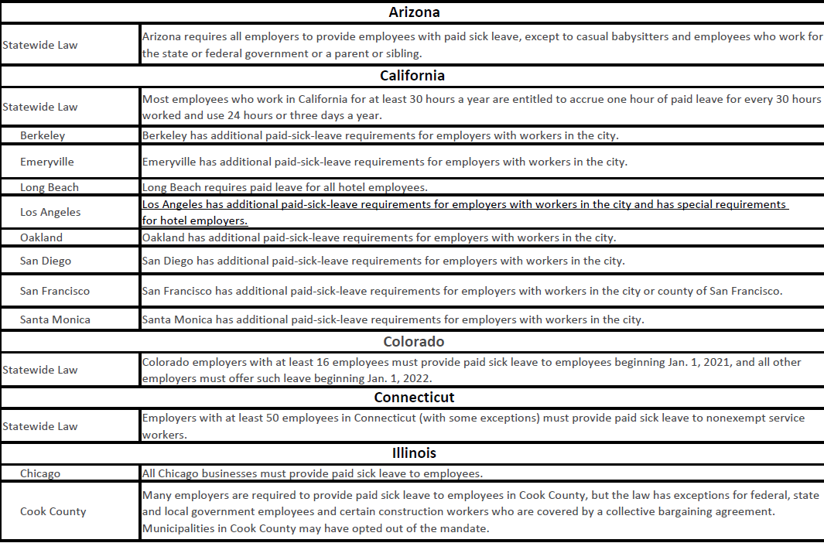
Paid Sick Day Laws
©2021 ARTHUR J. GALLAGHER & CO.

Slide 39
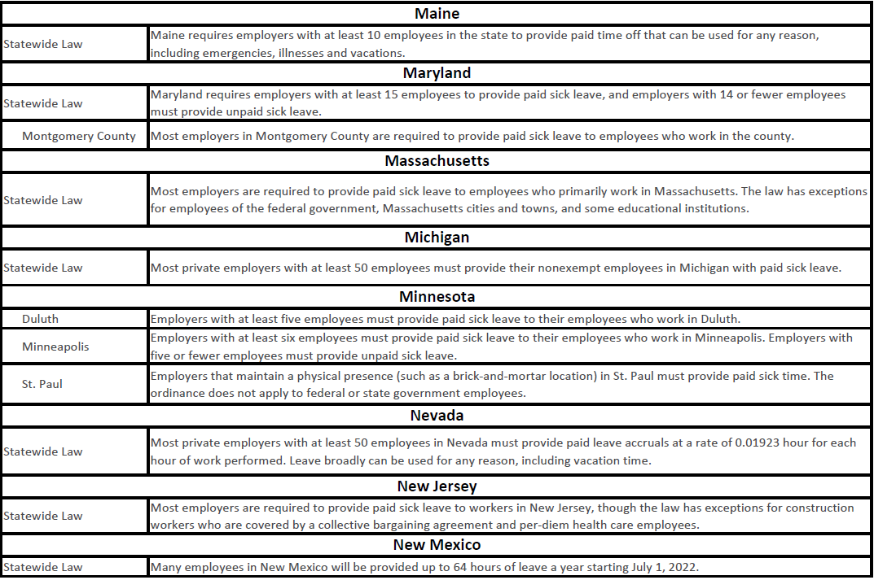
Administration Considerations for Leave
©2021 ARTHUR J. GALLAGHER & CO.

Slide 40
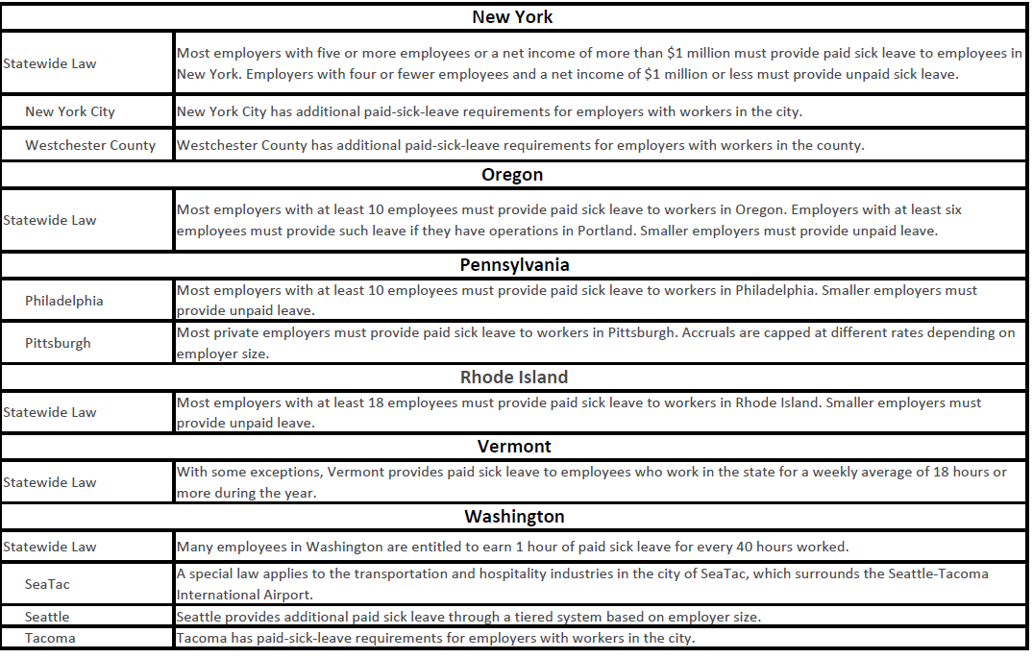
Administration Considerations for Leave
©2021 ARTHUR J. GALLAGHER & CO.

Slide 41
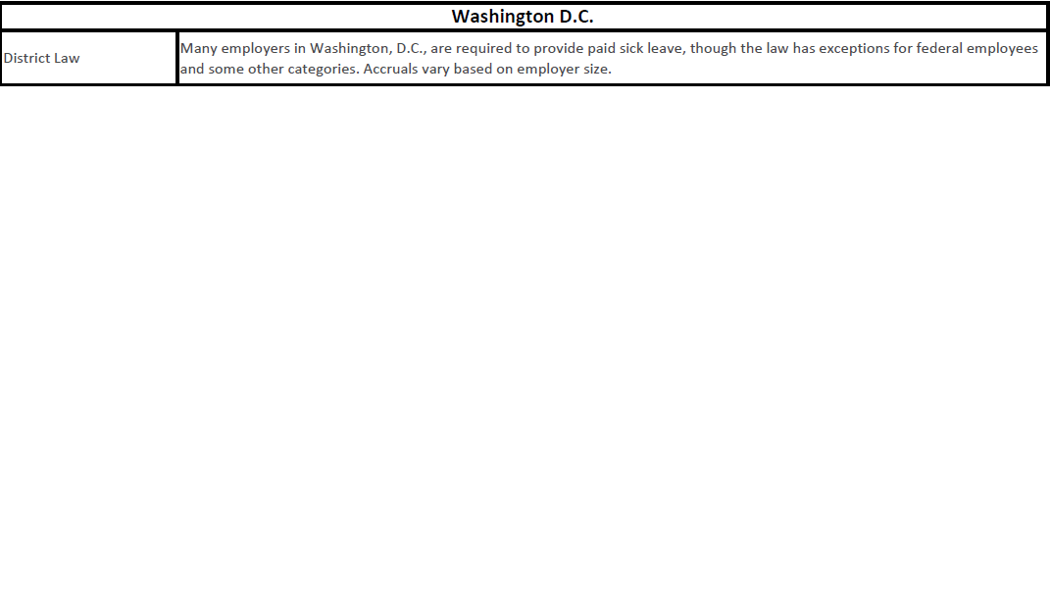
Administration Considerations for Leave
©2021 ARTHUR J. GALLAGHER & CO.

Slide 42
Case Studies for Non Compliance
©2021 ARTHUR J. GALLAGHER & CO.

Slide 43
Direct Cost of Non-Compliance
The Case: Schultz v. Advocate Health & Hospitals Corp.¹
A long-time employee alleged his former employer terminated him in retaliation for using FMLA to care for his two ill parents.
The employee took intermittent leave over several months and during this period began having problems with his supervisors who established performance standards he was unable to meet. The problem escalated until the employee was terminated.
The Result
A federal jury awarded $11.65 million to the employee. The award consisted of $10.75
million against the employer and $900,000 individually against the two supervisors.¹
1 Schultz v. Advocate Health and Hospitals Corp., N.,D. Ill., No. 01 CV 702, 10/30/02.
2 NASD #04-06092, June 26, 2006
3 2006 WL1793268, June 30, 2006 US Court of Appeal, Fifth Circuit
4 2008 Lore v. Chase Manhattan Mortgage Co., 2008 WL 2404425 (N.D. Ga., 2008)
43

Slide 44
Direct Cost of Non-Compliance
The Case: Allen v. A.G. Edwards & Sons, Inc.²
The plaintiff brought suit against his employer for violations of the ADA and FMLA as well as
state laws on constructive discharge.
In 2001, he was diagnosed with bi-polar disorder and briefly hospitalized. When he returned to work, the company refused to reinstate him to his old job. A.G. Edwards had options under FMLA and ADA but was concerned about the plaintiff’s ability to perform his job.
Allen claimed he was demoted to a financial consultant job that required him to report to the former assistant branch manager and was not reinstated to an equivalent position. The employer argued that there was no FMLA violation because they had returned him to a manager position.
The Result
The arbitration panel ultimately found for the plaintiff and found that the employer violated
the FMLA laws. Allen was awarded $1.25 million.
44
1 Schultz v. Advocate Health and Hospitals Corp., N.,D. Ill., No. 01 CV 702, 10/30/02.
2 NASD #04-06092, June 26, 2006
4 2008 Lore v. Chase Manhattan Mortgage Co., 2008 WL 2404425 (N.D. Ga., 2008) 3 2006 WL1793268, June 30, 2006 US Court of Appeal, Fifth Circuit

Slide 45
Direct Cost of Non-Compliance
The Case: Lubke v. City of Arlington³
Lubke was scheduled to work from December 31, 1999 through January 1, 2000. On December 30, 1999, Lubke telephoned a call box and left a message stating that he would not be working during the Y2K weekend because he needed to stay home with a sick wife. Lubke was terminated for dereliction of duty, unauthorized absence and insubordination.
The plaintiff sued the City of Arlington, alleging he was discharged in violation of FMLA as a
result of missing work to care for his ill wife. At trial, the employer asserted that Lubke’s leave was not protected by the FMLA because he failed to provide timely and adequate medical certification supporting his leave.
The Result
The jury rejected the employer’s claim and found that the employer had violated the FMLA.
They awarded the plaintiff over $1 million in damage.
1 Schultz v. Advocate Health and Hospitals Corp., N.,D. Ill., No. 01 CV 702, 10/30/02.
2 NASD #04-06092, June 26, 2006
3 2006 WL1793268, June 30, 2006 US Court of Appeal, Fifth Circuit
4 2008 Lore v. Chase Manhattan Mortgage Co., 2008 WL 2404425 (N.D. Ga., 2008)

Slide 46
Direct Cost of Non-Compliance
The Case: Lore v. Chase Manhattan Mortgage Corp.⁴
The plaintiff requested leave to address several health issues. He was told an additional manager would be hired to assist with his responsibilities and enable him to take leave. When the additional manager was not hired, Lore inquired of his manager again requesting leave. Less than one month later, Lore was terminated.
Lore sued Chase Manhattan for failing to grant him, an eligible employee, leave under the FMLA. In addition, Lore argued Chase Manhattan unlawfully retaliated against him for his attempts to exercise his rights under the FMLA.
The Result
A jury found for the employee and awarded him $2,227,241. With liquidated damages equal to the amount of
the verdict and prejudgment interest added in, the recovery equaled between $6.2 and $7.6 million.
1 Schultz v. Advocate Health and Hospitals Corp., N.,D. Ill., No. 01 CV 702, 10/30/02.
2 NASD #04-06092, June 26, 2006
3 2006 WL1793268, June 30, 2006 US Court of Appeal, Fifth Circuit
4 2008 Lore v. Chase Manhattan Mortgage Co., 2008 WL 2404425 (N.D. Ga., 2008)

Slide 47


Thank You!!
©2021 ARTHUR J. GALLAGHER & CO.

