Slide 1
Employee Benefits Update 2022 and Beyond
September 27,2022

Slide 2

Liliana Salazar, Esq.
Senior Vice President, Client Strategic Solutions Chief Compliance Officer Pacific Region HUB International
liliana.salazar@hubinternational.com

Slide 3
Notice Of Disclaimer The information herein is intended to be educational only and is based on information that is generally available. HUB International makes no representation or warranty as to its accuracy and is not obligated to update the information should it change in the future. The information is not intended to be legal or tax advice. Consult your attorney and/or professional advisor as to your organization’s specific circumstances and legal, tax or other requirements.

Slide 4
1 | SCOTUS Decision and Impact on Group Health Plans
2 | COVID Updates
3 | ACA Updates – Reporting and IRS Enforcement
4 | Transparency Rules
5 | No Surprises Act and MHPAEA Enforcement
6 | What to Expect in 2023
7 | Q&A

Slide 5
1
SCOTUS Decision and Impact on GHP

Slide 6
SCOTUS Overturns Roe v. Wade – Benefit Implications
Dobbs v. Jackson Women’s Health Organization – Abortion is not a constitutional right; revert to states the right to regulate abortion.
States will determine which restrictions will be allowed
CA,OR,WA,CO,NY,MA,NV,WA D.C.,NM,AK and others (refer to map) allow for elective abortions to be performed (most impose number of weeks limit)
TX,OH,AL,MS,LA, ID,UT,KY have strict guidelines regarding timeframes and reason why an abortion may be pursued- Many trigger laws are being challenged in state Courts. Fluid and nuanced topic
Insured plans: Carriers will determine the coverage limits based on state law. Employer will have to follow carrier guidelines.
Self-insured plans: Must abide by state law regarding abortion coverage. Employer can amend plan to include cost of travel and lodging for participants pursuing abortions out-of-state. Follow TPA guidelines, risk lies with employer / plan sponsor.
Notes:
Why New Requirement? There were many grey areas and questions around compliant NQTLs in the past and the CAA is pushing GHPs and the government to review plans so that the government can clarify what NQTLs are or are not compliant
In addition to the DOL, FAQs indicate that it may be required for plans to disclose this report in connection with an appeal of a denied claim.

Slide 7
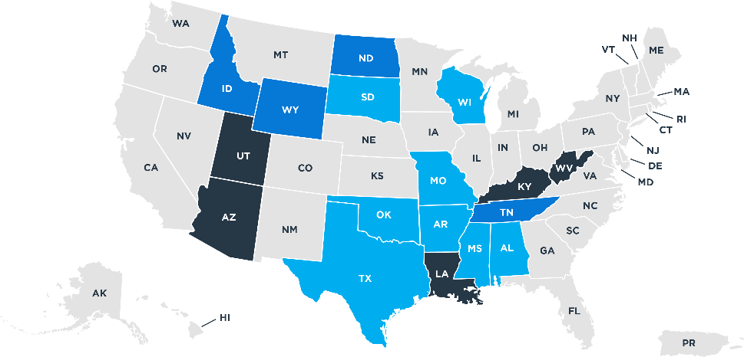
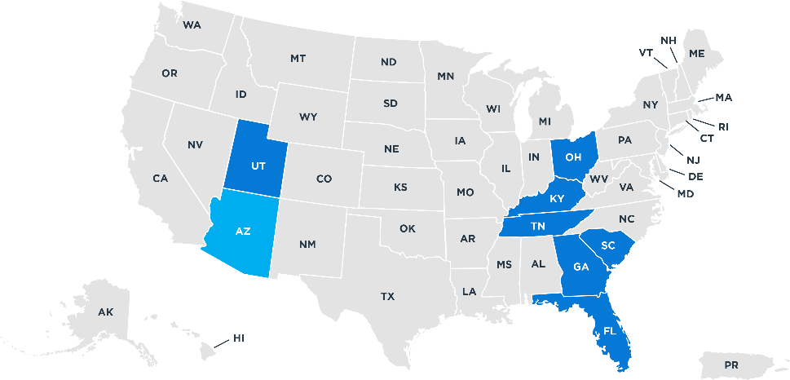
Banned / Restricted
Banned
Restricted
Ban in effect Expected soon Ban Blocked
Gestational limit in effect Expected soon Blocked
States highlighted in light blue have implemented restrictions on elective abortions after a set number of weeks (usually 6 weeks) and allow abortions after six weeks only if the mother’s life is in jeopardy or if the child is not viable (limited states). ID enacted a law that bans abortion in its entirety, law is being legally challenged by the Biden Administration

Slide 8
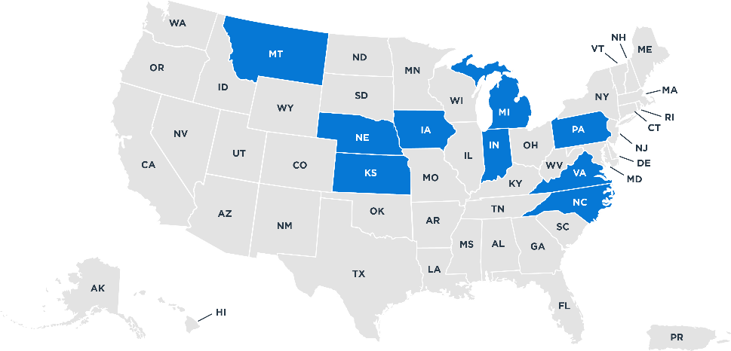
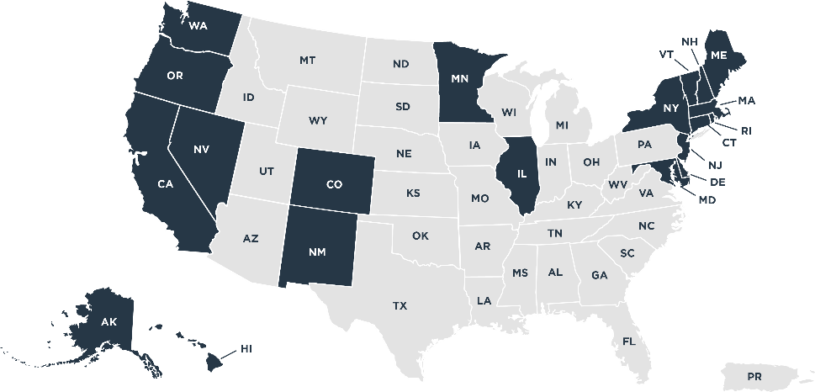
Banned / Restricted
Legal for Now
Legal
Lawmakers or courts will decide
Legal or protected

Slide 9
Employer Options
The Medical Travel Benefit can be added as a part of the company's existing major medical plan, subject to coinsurance and deductibles just as most other covered benefits would be. Many major medical plans already reimburse travel for transplant procedures—the company would simply expand that benefit to cover additional travel.
The Medical Travel Benefit can be offered as an integrated program with a health plan: To employees enrolled in the company's major medical plan and, To employees enrolled in another employer's major medical plan via an Integrated HRA To all employees (or any nondiscriminatory group of employees), provided that the program does not provide "substantial benefits in the nature of medical care,” such as in the case of an EAP. MUST SEEK LEGAL COUNSEL ADVICE TO DO THIS – HUB CANNOT RECOMMEND THIS
Notes:
For employers, Dobbs impacts:
employer-sponsored group health plan coverage for abortion services in states where abortion is, or becomes illegal, and
abortion-related travel benefits.

Slide 10
Medical Travel Benefits – IRS Limits
Adding a travel benefit inside or outside of a group health plan has compliance challenges created by a daunting patchwork of laws. Planning amid a rapidly shifting legal landscape will be difficult.
The tax code imposes the following dollar limits on tax-free travel benefits IRS limits under Code Section 213(d)(2):
Automobiles: The standard medical mileage rate will increase from $0.18 per mile to $0.22 per mile on July 1, 2022.
Planes, Trains, and Buses: Ticket cost can be reimbursed so long as the price is reasonable, and the travel is primarily for and essential to medical care.
Lodging Expenses: Lodging expenses can be reimbursed up to $50 per night per person, provided that the expenses are primarily for and essential to medical care provided the physician is in a licensed hospital or medical facility which is related to or the equivalent of a licensed hospital. When including a parent, nurse, companion, etc. would increase the benefit to $100 per night.
Meal expenses: are not deductible as expenses for medical care unless they are provided at a hospital or similar institution at which the taxpayer, the taxpayer’s spouse, or dependent is receiving medical care.
In order to qualify for the deduction, the travel must be primarily for and essential to medical care, and not for vacation or recreation, Reimbursements for abortion-related travel that exceed these amounts are gross income and wages and are, as a result, subject to income and payroll taxes.
MUST CONSULT WITH TAX ADVISOR / ATTORNEY

Slide 11
Medical Travel Benefits – Limitations
A company cannot simply amend its corporate travel reimbursement policy.
Because the reimbursement is contingent upon receipt of medical care, the arrangement will be a group health plan, or part of one.
Making the reimbursement taxable does not change that fact.
If the Medical Travel Benefit is not properly designed, it will violate the Affordable Care Act (ACA).
The penalty for such a violation is $100 per affected person per day of noncompliance.
Medical Travel Benefit must also comply with other employee benefit laws.

Slide 12
Medical Travel Benefits – Regulatory Complexity
ERISA The Medical Travel Benefit must be embodied in a plan document and summary plan description, which must include ERISA-compliant claims and appeals procedures. The Medical Travel Benefit will generally be subject to the Form 5500 requirement.
COBRA If the employer had at least 20 full-time employees in the prior calendar year, the Medical Travel Benefit must comply with COBRA. Among other things, companies will need to determine a COBRA premium and contact their COBRA administrators to ensure that the Medical Travel Benefit is included in any COBRA election notices.
HIPAA Unless the Medical Travel Benefit is administered by the company in-house and covers fewer than 50 employees, it will be subject to HIPAA privacy and security. The company should ensure that it has established an effective HIPAA compliance program to protect individually identifiable health information.

Slide 13
Medical Travel Benefits – Regulatory Complexity, Continued
Mental Health Parity With an addition of an abortion-related travel benefit as a medical benefit, an analysis should be undertaken to ensure that there are comparable benefits for mental health and substance use disorders in quantitative and non-quantitative terms.
ACA and Limits Abortion and abortion-related services are not, however, essential health benefits. Thus, an abortion travel benefit can be subject to an annual limit or cap.

Slide 14
2
COVID-19 Updates

Slide 15
COVID-19 Extensions- COBRA & Special Enrollment Rights
COBRA
Timing | Regulations | COVID-19
Election | 60 days | 60 days following the end of the Outbreak Period
Initial Payment | 45 days | 45 days following the end of the Outbreak Period
Subsequent Payments | 30 days | 30 days following the end of the Outbreak Period
Notify Plans of Qualifying Events | 30 – 60 days generally depending on event | 30 – 60 days following the end of the Outbreak Period
Emergency declaration in effect until March 1,2023, unless revoked by the President
HIPAA
Special Enrollment Rights
Event | Regulations | COVID-19
Loss of Other Coverage | 30 days | 30 days following the end of the Outbreak Period
Acquisition of a New Dependent | 30 days | 30 days following the end of the Outbreak Period
Eligibility for State Assistance | 60 days | 60 days following the end of the Outbreak Period

Slide 16
Extensions to ERISA Claims Procedures
ERISA Claims Procedures
Timing | Regulations | COVID-19
Initial Claim filing | 12 months or as allowed by the plan | Outbreak period is not included in determining if the claim was filed on a timely basis
Appeal a Denied Claim | 180 days of denial | Outbreak period is not included in determining if the claim was filed on a timely basis
External Review Determination | Four months after the notice of denial | Outbreak period is not included in determining if the claim was filed on a timely basis
Submit additional information to appeal a claim (external review) | Within the four months of the denial or 48-hours of notice being granted | Outbreak period is not included in determining if the claim was filed on a timely basis
Emergency declaration in effect until March 1,2023, unless revoked by the President

Slide 17
COVID-19- Testing and Vaccination
FAQ 50 establishes that any vaccine that receives FDA approval (Emergency Use Authorization or Biologics License Application) will be covered as of the date the vaccine is approved.
Non-grandfathered group and individual health insurance issuers are required to cover qualifying coronavirus preventive services (including vaccine and its administration) as a preventive care expense at no cost to the participant, immediately after the date that the Advisory Committee on Immunization Practices (ACIP) or US Preventive Services Task Force (USPSTF) makes recommendation for the qualifying COVID-19 preventive service.
Coverage of testing for COVID-19 must be provided at no cost to participant
In-Network: Cover without cost-sharing
At negotiated rates
If a COVID-19 vaccine is not billed separately (or is not tracked as individual encounter data separately) from an office visit and the primary purpose of the office visit is the delivery of the COVID-19 vaccine, then the issuer may not impose cost-sharing requirements with respect to the office visit.
COVID-19 testing for reasons other than work-related
Out-of-Network: During the Public Health Emergency, cover without cost-sharing through October 15,2022. Another extension is anticipated through January 15,2023.
Notes:
require that plans and issuers subject to section 2713 of the PHS Act must cover
without cost sharing a qualifying coronavirus preventive service, regardless of whether such
service is delivered by an in-network or out-of-network provider. This is based on the
Departments’ view that participants, beneficiaries, and enrollees may not be able to locate innetwork providers consistently during the emergency period.
The Medicare payment rates will be $28.39 to administer single-dose vaccines. For a COVID-19 vaccine requiring a series of two or more doses, the initial dose(s) administration payment rate will be $16.94, and $28.39 for the administration of the final dose in the series. These rates will be geographically adjusted and recognize the costs involved in administering the vaccine, including the additional resources involved with required public health reporting, conducting important outreach and patient education, and spending additional time with patients answering any questions they may have about the vaccine.
CMS is encouraging state policymakers and other private insurance agencies to utilize the information on the Medicare reimbursement strategy to develop their vaccine administration payment plan in the Medicaid program, CHIP, the Basic Health Program (BHP), and private plans.

Slide 18

COVID-19 Testing
Coverage of Over-the-counter COVID-19 Rapid Home Test Kits
Effective Date: January 15, 2022
Covered Plans: Grandfathered and non-grandfathered medical plans in the group and the individual market (insured, self-insured and level funded medical plans)
Requirements: Plan must cover the cost of FDA approved over-the-counter COVID-19 test kits at no cost to the participant (no co-payment, coinsurance or deductible applies)
No medical management requirements may apply (no need for a doctor’s note or visit)
Covers up to 8 home test kits per month per covered participant (for reasons other than employment purposes or public health surveillance) due to close contact or COVID symptoms.
No monthly limit applies to home test kits ordered by a physician (unlimited)
In-network purchases of tests kits from approved providers must be covered at no cost while the declared emergency is in effect
Out-of-network providers- tests will be reimbursed for up to $12 per testing kit
Resources: https://www.dol.gov/sites/dolgov/files/EBSA/about-ebsa/our-activities/resource-center/faqs/aca-part-51.pdf and https://www.hubinternational.com/products/employee-benefits/compliance-bulletins/2022/01/at-home-covid-test-coverage/
7

Slide 19
3
ACA Updates Reporting & IRS Enforcement

Slide 20
Good Faith Effort: Extension is Ended in 2021
The IRS has indicated that they will NOT be allowing a good faith effort relief for reporting years after 2020! Therefore, accuracy and timeliness is critical for this year’s Forms!
$280 for each return or statement to which a failure relates, capped at $3,426,000 per calendar year. This applies separately to: Each failure to send the statement to the employee; and Each failure to send the statement to the IRS.
Penalty amounts are reduced if failures are corrected by the following dates: Thirty-Day Rule – If a failure is corrected within 30 days after the required filing date (or the deadline for furnishing individual statements), the penalty is reduced to $50 per return or statement, and the calendar-year maximum penalty is capped at $571,000 ($199,500 for smaller entities). August 1 Rule – If a failure is corrected after the 30-day rule described above but on or before August 1, the penalty is reduced to $110 per return or statement, and the calendar-year maximum penalty is capped at $1,713,000 ($571,000 for smaller entities).

Slide 21
Filing Corrected 1095-C Returns
How do I know if there were errors on my returns?
E-Filing thru AIR:
Filings that are “Accepted with Errors” or “Partially Accepted” should be corrected.
Filings that are “Rejected” or “Not Found” should be resubmitted as quickly as possible. These are not corrections; they are resubmissions.
If the Reporting Entity (i.e., the employer) is aware of errors, corrected returns should be filed to avoid penalties.
Corrected 1095-C Forms (filed with the IRS) should be marked as “Corrected” and furnished to the employee.
All 1095-C “corrected” forms should be transmitted to the IRS with the 1094-C form.
Do not mark “corrected” on 1094-C unless there are errors on that form.
de minimis errors new safe harbor: If the listed dollar amount on Line 15 of the 1095-C is off by no more than $100, there is no correction required, unless the employee requests a corrected form.

Slide 22
State Individual ACA Reporting Mandate Deadlines
Insurance carriers and self-funded medical plans (ICHRAs, level-funded and ​MEC plans) covering residents in 2021
California
1095 C/B mailed to employees by January 31, 2022
1095 C/B filed with State of CA Franchise Tax Board by March 31, 2022
File the State Healthcare MEC on paper if under 250 files; otherwise, must file electronically
Production files accepted as of January 4,2022.
Mandate distribution deadline is not automatically extended to mirror the federal deadline.
Massachusetts
Form MA 1099-HC annually to employees enrolled in their health plan (whether insured or self-funded) no later than January 31, 2022
Complete HIRD Form for Six (6) or more employees and submit each year on December 15th
Will be required to file on MassTaxConnect (MTC) portal
New Jersey
1095 C/B to be distributed to employees by March 2, 2022
File NJ-1095 form by March 31, 2022, with the New Jersey Division of Taxation Payroll Taxes and Wage Withholding Login (state.nj.us)
NJ Health Insurance Mandate - Employers and Coverage Providers outlines state penalty for 2021 tax year $695 per taxpayer or 2.5% of gross income for people above the New Jersey tax filing threshold, whichever is higher.
Rhode Island
Forms 1095-C/B must be distributed to covered participants by January 31, 2022
Forms 1095 C/B must be filed with the RI Division on Taxation by March 31, 2022, giving employers a two (2) month extension from the January 31, 2022, deadline.
Washington D.C.
Employers that have Washington D.C. residence and have 50 or more employees
Forms 1095-C/B must be ​distributed to covered participants as outlined by IRS, including any extensions (4/30/22)
1095 C/B must be filed with ​the Office of Tax and Revenue no later than ​30 days after the deadline established by ​the IRS to file returns, including extensions.
Electronically submitted only D.C Office of Tax and Revenue (OTR) electronically through MyTaxDC​
Notes:
District of Columbia - 30 days after the IRS deadline for submitting 1095-B or 1095-C forms, including any extensions granted by the IRS. For tax year 2020, information returns (Form 1095-B or Form 1095-C) will be due to OTR on April 30, 2021. FAQ reporting SRP Update.3.31.20.pdf (dc.gov)

Slide 23

ACA Enforcement Reminders

Slide 24
2023 ACA Affordability
Affordability of Employee-only Coverage
Lowest cost plan that is minimum value. Safe harbor decreased from 9.61% to 9.12% based on one of the three safe harbors:
1
2
3
Rate of Pay
W-2 Safe Harbor
Federal Poverty Level (FPL)
(Hourly rate of pay x 130) 9.12% Maximum amount to charge for employee-only coverage would be less in 2023 than 2022
Example: An employee earning $15.00 an hour in 2022 cannot pay more than $187.39 per month if the plan is to be deemed affordable; however, in 2023, that employee earning $15/hr cannot pay more than $177.84.
Calendar year plans must use 2022 FPL x 9.12% / 12 to assess affordability for 2023 ($13,590 x 9.12% / 12) = $103.28 vs. the 2022 rate of $104.14 per month.
Non-calendar year plans unknown as 2023 FPL guidelines have not been issued
Use Box 1 of employee’s W-2 earnings. Must use projected 2023 income; amount cannot change throughout the year.
Box 1 = gross earnings minus pre-tax deductions under a cafeteria plan and a 401(k) plan.
Notes:
2022 ACA Affordability
Remember when determining ACA Affordability each year, it is based off the Employee-only Coverage. That is the Lowest cost plan that is minimum value.
In 2022 Safe harbor decreased from 9.83% to 9.61% based on one of the three safe harbors calculation methods: Rate of Pay, FPL, or W-2.
Remember 11/1, and 12/1 renewals will use the 9.83% for affordability. A 1/1/22 and after renewal will use the 9.61% for affordability.
For your convenience, we created examples of how to calculate each of the 3 affordability safe harbors for plans that renew in 2022.

Slide 25
Who Does this Change Impact and When?
Which employers are impacted by the decrease in the affordability safe harbor? Employers who are Applicable Large Employers (ALEs). An ALE is an employer with 50FT and FTE employees in the prior calendar year.
When does the new affordability safe harbor apply to ALEs? On the first day of the plan’s renewal in 2023. For example, a calendar year plan would be required to use 9.12% on January 1,2023 to assess the affordability of their plans. However, a plan renewing on 7/1 would not be required to use the new affordability safe harbor until 7/1/23.
HUB Resources: July 2022 InCompliance Bulletin – Pros and Cons of Each Affordability Safe Harbor
ACA Affordability Safe Harbors | HUB International

Slide 26
IRS Enforcement of ESRP- Letter 226J
Under the new Administration enhanced focus on ACA enforcement efforts from the IRS
IRS is currently auditing employer compliance with the 2018 / 2019 ESRP provisions of the ACA
Letters 226-J mailed to employers informing them of failure to comply with IRS 4980H(a) or (b) provisions
Letter provides employer 30 days to respond to the inquiry
Employer agrees and pays penalty
Employer appeals the penalty and supports additional information with the appeal
Employer should file an extension with the IRS to appeal decision- fax request to the number that appears at on right-hand corner of letter. Will be granted a 30-day extension to appeal decision.
NEW: Letters 226J question if a plan is deemed to be affordable under the ACA, new codes used in Form 14765. Employer is required to show proof that plans are deemed to be affordable.
Notes:
IRS is currently auditing employer compliance with the 2018 ESRP provisions of the ACA
Letters 226-J mailed to employers informing them of failure to comply with IRS 4980H(a) or (b) provisions
Letter provides employer 30 days to respond to the inquiry
Employer agrees and pays penalty
Employer appeals the penalty and supports additional information with the appeal
Employer should file an extension with the IRS to appeal decision- fax request to the number that appears at on right-hand corner of letter. Will be granted a 30-day extension to appeal decision.
NEW- Letters 226J question if a plan is deemed to be affordable under the ACA, new codes used in Form 14765. Employer is required to show proof that plans are deemed to be affordable.

Slide 27
Letter 226J Common Mistakes
Employer mistakes triggering enforcement letters Checking “No” on Form 1094-C, Part III, Column A indicating that MEC was not offered to 95% of the full-time employees Leaving line 16 on Form 1095-C blank after saying no coverage is offered Failing to include an affordability safe harbor (Codes 2F, 2G, 2H)
IRS mistakes triggering enforcement letters Information that does not match information on employer filings
Employee actions triggering enforcement letters Receiving a premium tax credit for coverage (PTC) that they were not qualified to receive – Automatic 226J Trigger.

Slide 28
Penalties Through the Years
 |  | 2016 | 2017 | 2018 | 2019 | 2020 | 2021 | 2022
4980H(a) Penalty | Annual Amount | $2,160 | $2,260 | $2,320 | $2,500 | $2,570 | $2,700 | $2,750
 | Monthly Amount | $180.00 | $188.33 | $193.33 | $208.33 | $214.17 | $225.00 | $229.16
 | MEC Offer % of FT | 95% | 95% | 95% | 95% | 95% | 95% | 95%
 | FT Headcount Reduction | 30 | 30 | 30 | 30 | 30 | 30 | 30
4980H(b) Penalty | Annual Amount | $3,240 | $3,390 | $3,480 | $3,750 | $3,860 | $ 4,060 | $4,120
 | Monthly Amount | $270.00 | $ 282.50 | $290.00 | $312.50 | $321.67 | $338.33 | $343.33
 | Affordability Safe Harbor % | 9.66% | 9.69% | 9.56% | 9.86% | 9.78% | 9.83% | 9.61%
 | FPL Annual Amount(individual) | $11,770 | $11,880 | $12,060 | $12,140 | $12,490 | $12,880 | $13,950
]\] FT exemption for 2015 only applied if 2015 ALE "size" was 100 or more

Slide 29
4
Transparency Rules

Slide 30
Provider Directories, Continuity of Care, ID Cards
What? Produce the following:
Provider Directory Updates – Plans will be required to keep their provider directories up to date. They must verify the accuracy of the information at least every 90 days. Update the directory within 2 business days of receiving updated information from a provider. Respond to requests from participants/beneficiaries within 1 business day of receipt. If a participant / beneficiary receives inaccurate information or no response, the plan can only apply in-network cost-sharing.
Continuity of Care Warnings – Plans will be required to notify patients if they are receiving continuing care with a provider and the plan’s contract with that provider is terminated. The individual has the option to continue care with that provider or at that facility, under certain circumstances, and requires the provider to accept the in-network payment from the plan or carrier. All of these apply to all group health plans, including grandfathered plans
Health Insurance Cards and Other Disclosure Requirements GHPs and carriers must add specific information to participant insurance cards, including deductibles and OOP maximums both INN and OON, phone number and web address where individuals can obtain consumer assistance
When? For all plan years commencing on / after January 1, 2022
Notes:
The Transparency rules reiterate the plans obligation to keep:
provider up to date physician directories
participants or beneficiaries informed if a doctor providing them care is terminated – giving them the option to continue care or facility and require the provider to accept the in-network rate.
Health insurance ID cards – up to date with specific information printed on the card that includes OOP max both in and OON, phone number web address and where individuals can obtain consumer assistance.
Importantly, this rule applies to all both GF and NGF plans.

Slide 31
Transparency – Publish Machine-Readable Files
All non-grandfathered plans must publish on a public site the GHP medical services rates and historical pricing information that participants and beneficiary can access
INN: Publish negotiated rates for all covered items and services between the plan or issuer and in-network providers. Must post dollar amount or formula on how cost is determined
OON: Publish the historical payments to, and billed charges from, out-of-network providers (a minimum of at least 20 entries is required). Historical payments must have a minimum of twenty entries in order to protect consumer privacy.
Rx: Delayed – In-network negotiated rates and historical net prices for all covered prescription drugs by plan or issuer at the pharmacy location level.
Fully insured, self-insured and level funded plans must comply with posting requirements
Deadline: July 1, 2022 (for plan years that began January - June); for others, the first plan year beginning on or after July 1, 2022

Slide 32
Self-Service EOB Estimator
What Plans are required to provide access to an internet based, self-service tool containing pricing info for plan items and services
When For plan years that start on or after January 1, 2023.
Contents of “self-service advance EOB”:
Estimates cost-sharing liability for the covered item or service
Provides the in-network rate for in-network providers for the covered item or service (includes negotiated rate and the underlying fee schedule)
Provides the out-of-network allowed amount for the covered item or service; Explains when a bundled payment arrangement is available for a list of the items or services; Notes whether there are any prerequisites for the covered item or service; Include caveats (e.g., this is only an estimate)
Note that there is also a planned “Advanced EOB” requirement, but it is suspended until further notice.
Notes:
Self-service EOB
Plans are required to provide access to an internet based, self-service tool containing pricing info for plan items and services
For plan years that start on or after January 1, 2023. The original rules only required this for 500 items and services on January 1, 2023 with the remaining coming January 1, 2024. However, FAQs issued August 20, 2021 seemed to suggest that this must be available for all items and services on January 1, 2023.
Contents of “self-service advance EOB”:
Estimate of cost-sharing liability for the covered item or service
Accumulated amounts incurred to date
In-network rate for in-network providers for the covered item or service (includes negotiated rate and the underlying fee schedule)
Out-of-network allowed amount for the covered item or service
If a bundled payment arrangement, a list of the items or services
Any prerequisite for the covered item or service

Slide 33
Broker / Consultant Compensation Disclosure
What Obtain a services-compensation disclosure from brokers / consultants
How The brokers / consultants prepares and delivers a compensation disclosure to plan fiduciary
Who Plan fiduciaries of fully insured and self-insured ERISA governed group health plans
When On or after December 27, 2021. The compensation disclosure should be presented prior to engaging the broker / consultant to perform services or any renewal / extension of that relationship. (Note, this timing does not necessarily tie to the plan year or policy renewal date.)
This disclosure is different from the information included on the Form 5500 because it contains compensation not disclosed on Schedule A; it will look different; it is provided in advance; and it applies to all ERISA-covered clients.
If the fiduciary does not receive the disclosure, it should request one. If no response in 90 days, the fiduciary must report broker/consultant to the DOL to avoid a prohibited transaction.
Notes:
On or after December 27, 2021, GHP fiduciaries must obtain a disclosure from the brokers/consultant regarding services and compensation information
It does not necessarily tie to the plan year or policy renewal date, so 1/1 plan years are likely not affected
This disclosure is different from the information included on the Form 5500 too, because the disclosure:
Is to contain compensation not disclosed on Schedule A
It will look different as well
It’s provided in advance
It applies to all ERISA-covered clients
Largely modeled on 401(k)/retirement plan fee disclosures effective in 2012

Slide 34
Prescription Drug Reporting- RxDC Report Section 204
Which plans are subject to reporting? Grandfathered and non-grandfathered self-insured, level funded and insured medical plans report prescription drug & health plan cost information to HHS, DOL and Treasury Department. HRAs, HSAs and health FSAs are exempt from reporting. TPAs / PBMs and insurance carriers may report on behalf of the reporting entity.
What do they report?
Information about the plan year, its enrollment
Employer / employee premiums and employee cost-sharing information and other general plan information
50 most frequently dispensed brand drugs
50 costliest drugs
50 drugs with the most year-over-year increase in expenditures
RX rebate information
When Starting December 27, 2022, and June 1 of each year following. Reporting in December 2022 will cover 2020 and 2021 plan years.
Notes:
Prescription Drugs
During this transition, group health plans and insurance carriers will be required to Report prescription information to HHS 2 times per year, that includes (among other items) the plan’s:
50 most frequently dispensed brand drugs,
50 costliest drugs,
50 drugs with the most year-over-year increase in expenditures
First Report was delayed until: December 27, 2022 and June 1 each year following. It is expected that reporting in December 2022 will cover 2020 and 2021 plan years.
In addition,
Group health plans insurance carriers, and air ambulance service providers are required to report information to HHS and the Secretary of Transportation, regarding
Emergency v. non-emergency flights
Whether the provider is part of a hospital program, municipal program, or certain other programs.
Rural v. urban flights
The type of aircraft used (e.g., helicopter v. airplane)
Whether the air ambulance provider has a contract with the plan/carrier (e.g., is in-network)
When: Reporting begins no later than 90 days after last day of calendar year beginning after final rule is promulgated – No immediate action here.

Slide 35
Prescription Drug Reporting – RxDC Report Section 204
RxDC reporting requirements All group health plans must submit a Plan lists (P2), eight data files (D1-D8), and a narrative response.
Data File Number | Description
D1 | Premiums and Life Years
D2 | Spending by Category
D3 | Top 50 Most Frequent Brand Drugs
D4 | Top 50 Most Costly Drugs
D5 | Top 50 Drugs by Spending Increase
D6 | Rx Totals
D7 | Rx Rebates by Therapeutic Class
D8 | D8 Rx Rebates for the Top 25 Drugs
Notes:
Prescription Drugs
During this transition, group health plans and insurance carriers will be required to Report prescription information to HHS 2 times per year, that includes (among other items) the plan’s:
50 most frequently dispensed brand drugs,
50 costliest drugs,
50 drugs with the most year-over-year increase in expenditures
First Report was delayed until: December 27, 2022 and June 1 each year following. It is expected that reporting in December 2022 will cover 2020 and 2021 plan years.
In addition,
Group health plans insurance carriers, and air ambulance service providers are required to report information to HHS and the Secretary of Transportation, regarding
Emergency v. non-emergency flights
Whether the provider is part of a hospital program, municipal program, or certain other programs.
Rural v. urban flights
The type of aircraft used (e.g., helicopter v. airplane)
Whether the air ambulance provider has a contract with the plan/carrier (e.g., is in-network)
When: Reporting begins no later than 90 days after last day of calendar year beginning after final rule is promulgated – No immediate action here.

Slide 36
Prescription Drug Reporting – RxDC Report Section 204
How do entities report the RxDC files? All data must be submitted through the RxDC module in the Health Insurance Oversight System (HIOS). To log in to HIOS, go to the CMS Enterprise Portal at https://portal.cms.gov/portal/
If a TPA / PBM or carrier will be reporting on behalf of a group health plan, the plan is not required to create an account on HIOS
Multiple entities can report on behalf of a group health plan as long as each entity reports different information
Next Steps
Contact the PBM and / or TPA to inquire if they will assist self-insured plans / level funded plans with the RxDC reporting requirements.
Determine which reporting requirements the employer will have to assume responsibility for and create a HIOS account to comply with the reporting requirements before December 27,2022.
Resources: CMS Reporting Instructions
Notes:
Prescription Drugs
During this transition, group health plans and insurance carriers will be required to Report prescription information to HHS 2 times per year, that includes (among other items) the plan’s:
50 most frequently dispensed brand drugs,
50 costliest drugs,
50 drugs with the most year-over-year increase in expenditures
First Report was delayed until: December 27, 2022 and June 1 each year following. It is expected that reporting in December 2022 will cover 2020 and 2021 plan years.
In addition,
Group health plans insurance carriers, and air ambulance service providers are required to report information to HHS and the Secretary of Transportation, regarding
Emergency v. non-emergency flights
Whether the provider is part of a hospital program, municipal program, or certain other programs.
Rural v. urban flights
The type of aircraft used (e.g., helicopter v. airplane)
Whether the air ambulance provider has a contract with the plan/carrier (e.g., is in-network)
When: Reporting begins no later than 90 days after last day of calendar year beginning after final rule is promulgated – No immediate action here.

Slide 37
Air Ambulance Reporting
What Group health plans insurance carriers, along with air ambulance service providers will also be required to report information on air ambulance services and costs which will be reported by HHS in conjunction with the Secretary of Transportation:​
Emergency v. non-emergency​
Whether the provider is part of a hospital program, municipal program, or certain other programs.​
Rural v. urban​
The type of aircraft (e.g., helicopter v. airplane)​
Whether the air ambulance provider has a contract with the plan / carrier (e.g., is in-network) ​
When Reporting begins no later than 90 days after last day of calendar year beginning after final rule is promulgated (March 31)
Notes:
Prescription Drugs
During this transition, group health plans and insurance carriers will be required to Report prescription information to HHS 2 times per year, that includes (among other items) the plan’s:
50 most frequently dispensed brand drugs,
50 costliest drugs,
50 drugs with the most year-over-year increase in expenditures
First Report was delayed until: December 27, 2022 and June 1 each year following. It is expected that reporting in December 2022 will cover 2020 and 2021 plan years.
In addition,
Group health plans insurance carriers, and air ambulance service providers are required to report information to HHS and the Secretary of Transportation, regarding
Emergency v. non-emergency flights
Whether the provider is part of a hospital program, municipal program, or certain other programs.
Rural v. urban flights
The type of aircraft used (e.g., helicopter v. airplane)
Whether the air ambulance provider has a contract with the plan/carrier (e.g., is in-network)
When: Reporting begins no later than 90 days after last day of calendar year beginning after final rule is promulgated – No immediate action here.

Slide 38
5
No Surprises Act and MHPAEA Enforcement

Slide 39
No Surprises Act
“No Surprises Act” – effective January 1, 2022 for providers, for group health plans plan year beginning on or after January 1, 2022. Self-insured plans to decide to retain WA state balance billing or federal No Surprises Act
Purpose: Protect plan participants from receiving surprise medical bills from out-of-network (OON) providers requiring more money from the patient after the plan has paid its part
A health plan or carrier must apply the in-network (INN) rules for prior authorization and in-network cost-sharing for a patient who receives:
Emergency services from an OON provider
Non-emergency services from an OON provider at an INN facility, or
OON air ambulance services
Apply to insured, self-insured and level funded plans in all 50 states.
Participant’s expense is capped at the INN provider reimbursement cost.
Notes:
There was general bi-partisan support in Congress for dealing with surprise billing
This was part of the Consolidated Appropriations Act of 2020 and signed into law in December of 2020
This would likely occur in a situation when a patient did not have the option to choose to use an in-network provider, think car crash and emergency surgery just to name 1 situation

Slide 40
No Surprises Act
It implements an independent dispute resolution process if the health plan (carrier or self-insured / level-funded plan) and the healthcare provider fail to agree on the qualified payment amount for services rendered. IDR provisions extend to Grandfathered plans.
To do list for self-insured and level-funded plans:
Confirm TPA will be including new DOL No Surprises Act notice with EOBs and also posting notice on website or including notice in SPDs or other plan documentation
Confirm with TPA amendment to plan language to account for IDR process
Assess cost of IDR services
Formalize definition of Qualifying Payment Amount that will be used by the plan for OON providers – suspended due to an injunction (emergency services and OON providers in an INN setting)
Prepare SMM for plan to include IDR process
Notes:
Encompassing more than 300 pages within the Act, the “No Surprises Act” sets forth new rules that begin in 2022
Example: A patient goes into an in-network hospital facility, but is treated by an out-of-network provider, or emergency setting where person does not really have a choice, also frequent with air ambulance providers
*Any cost sharing paid by the participant for out of network emergency services must be counted toward the in-network deductible and maximum out of pocket amount
Regulations to be established by July 1, 2021 by HHS, DOL and Treasury on establishing method for determining qualifying payment amount (median of contracted rates), differentiating among large, small and individual markets ; Gov’t will begin auditing plans in 2022.

Slide 41
NQTL Comparative Analysis
MHPAEA = Mental Health Parity and Addiction Equity Act
MHPAEA prohibits a group health plan from applying financial requirements or treatment limitations to mental health and substance abuse disorder benefits that are more restrictive than the financial requirements or treatment limitations that apply to the medical / surgical benefits that are provided by the plan
NQTL = Non-quantitative Treatment Limitation
Under the terms of the plan, any processes, strategies, evidentiary standards, or other factors used to apply the nonquantitative treatment limitation to mental health or substance use disorder benefits in the classification must be comparable to (and applied no more stringently than) the processes, strategies, evidentiary standards, or other factors used in applying the limitation to medical / surgical benefits in the classification
Group health plans are required to conduct and document an analysis of their In general, a group health plan offering mental health or substance use disorder (“MH / SUD”) benefits cannot apply more restrictive NQTLs than it applies for medical/surgical benefits. The NQTLs do not have to be identical for both MH / SUD and medical or surgical (M/S) benefits, but the processes, strategies, evidentiary standards, and other factors underlying those NQTLs must be comparable.
The required analysis is designed to demonstrate that the NQTLs for MH / SUD benefits are applied no more stringently than those for medical / surgical benefits.
Notes:
The new Act strengthens these parity rules by requiring plans to complete a comparative analysis of the NQTL between services; this new information and review process will help the agencies assist individuals and plans to determine whether NQTLs comply with MHPAEA; any NQTLS found to be noncompliant will need to be corrected and if not remedied (which can include retroactively reprocessing claims), will be communicated to participants
NOTE: Plans should already be conducting MHPAEA testing and analysis to determine whether their plans are complying with Q and NQ TLs (carriers should do this analysis for insured plans, but ask for report; self-funded plans may need to conduct their own analysis)

Slide 42
NQTL Comparative Analysis
DOL audits coming!
The NQTL analysis does not have to be filed or provided to the government, but after February 10, the Department of Labor (DOL) or Health and Human Services (HHS), or state enforcement authorities, could start requesting reports from employers and carriers.
Requirement: Group health plans / heath insurance issuers that offer both M/S and MH/SUD benefits and impose NQTLs on MH / SUD benefits, must conduct and document a comparative analysis of the design and application of their nonquantitative treatment limitations (“NQTLs”)
What is my NQTL deadline? The CAA specifies that group health plan NQTL results must be documented and ready to hand over to the government. It also requires the government to audit and report findings as well as create and update guidance documents.
Notes:
In addition to the DOL, FAQs indicate that it may be required for plans to disclose this report in connection with an appeal of a denied claim.

Slide 43
NQTL Comparative Analysis – Next Steps
Fully insured plan sponsors: Confirm that plans are in compliance and request documentation
Self-insured plan sponsors: Ensure the comparative analysis is conducted (at least start process) and correct any issues (ASO / TPAs likely won’t do it for you)
The DOL does not give much time to respond, so waiting to perform the analysis until you get a request may not work
Note: Reviewing plan designs and Summary Plan Descriptions is not sufficient to determine compliance Where complaints are made, the DOL follows
Notes:
Why New Requirement? There were many grey areas and questions around compliant NQTLs in the past and the CAA is pushing GHPs and the government to review plans so that the government can clarify what NQTLs are or are not compliant
In addition to the DOL, FAQs indicate that it may be required for plans to disclose this report in connection with an appeal of a denied claim.

Slide 44
6
What to expect in 2023?

Slide 45
Washington Cares Act
Washington CARES ACT / LTSS
December 31, 2022 – Last day to file for an exemption with ESD to be excluded from the WA Cares Act
WA Cares Fund - Long-Term Care Benefits, exemption will be accepted by WA ESD from groups who did not previously qualify, beginning on January 1, 2023:
Living out of state – Your primary residence must be outside of Washington.
Temporarily working in Washington with a nonimmigrant visa – You must hold a nonimmigrant visa for temporary workers.
You will no longer qualify if your nonimmigrant visa status changes and you become a permanent resident or citizen employed in Washington.
A spouse or registered domestic partner of an active-duty military member – You must be married to or have a registered domestic partnership with an active-duty service member in the U.S. armed forces.
A veteran with a 70% or greater service-connected disability – You must be rated by the U.S. Department of Veterans Affairs as having a service-connected disability of 70% or greater.
Requirement to notify Employment Security Department (ESD) and the employer within 90 days of no longer qualifying for the exemption.
Failure to notify the Employment Security Department and employer within 90 days will result in payment of any unpaid premiums with interest at the rate of 1% per month to the Employment Security Department.
July 1,2023 – Employers must begin collection of the WA Cares Act premiums
July1,2026 – WA Cares Act become payable to those eligible to receive benefits

Slide 46
What to Expect in 2023 – Federal
Federal Developments
MHPAEA Civil monetary penalties
Transparency Disclosure and reporting
Update to the affordability calculations for family coverage
Potential cap to affordability safe harbors (8.5%)
End of Emergency Declaration and Public Health Emergency
Exchange subsidy expansion
ACA 1557- New education and reporting requirements and coverage for sex affirmation services
Notes:
Why New Requirement? There were many grey areas and questions around compliant NQTLs in the past and the CAA is pushing GHPs and the government to review plans so that the government can clarify what NQTLs are or are not compliant
In addition to the DOL, FAQs indicate that it may be required for plans to disclose this report in connection with an appeal of a denied claim.

Slide 47
Q&A

Slide 48
Thank You
For more information visit hubinternational.com

