Slide 1


Slide 2
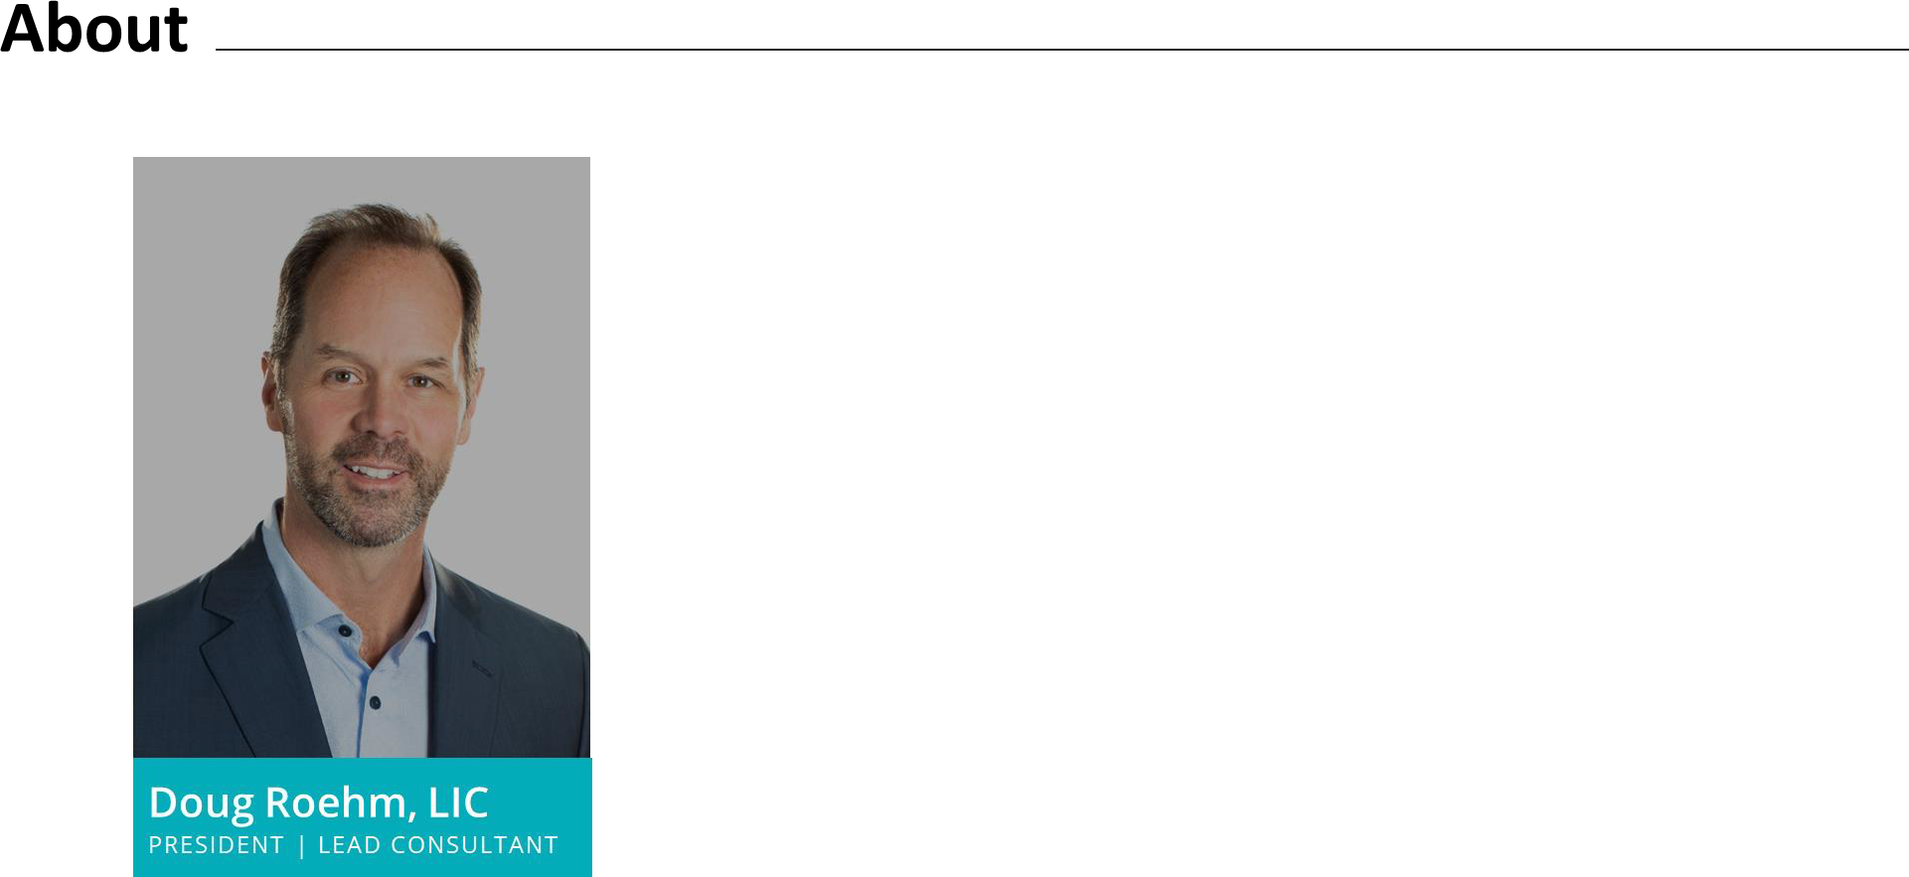

ABOUT
Michigan native and proud husband and father
Co-Owner and President of Strategic Services Group (SSG)
30+ years’ experience in the benefits/insurance industry
EDUCATION
Hope College, B.A. In Business, Economics & Math
EXPERIENCE
Specialize with tribes and their enterprises and design, manage and implement innovative and cost-effective employee benefit solutions
Aetna employee benefits consulting & brokerage experience
CREDENTIALS & AFFILIATIONS
Shareholder, UBA Partner Firm
Co-Chair, Products, Tools & Services Committee within UBA
Michigan SHRM Resource Partner Chair
Licensed Insurance Counselor (LIC)
Licensed Life, Accident, Health Insurance Agent
Published & copywritten benefits material
Served on various insurance company agent advisory boards
BIG DATA: BENEFITS | NNAHRA 2022
©STRATEGIC SERVICES GROUP, INC

Slide 3
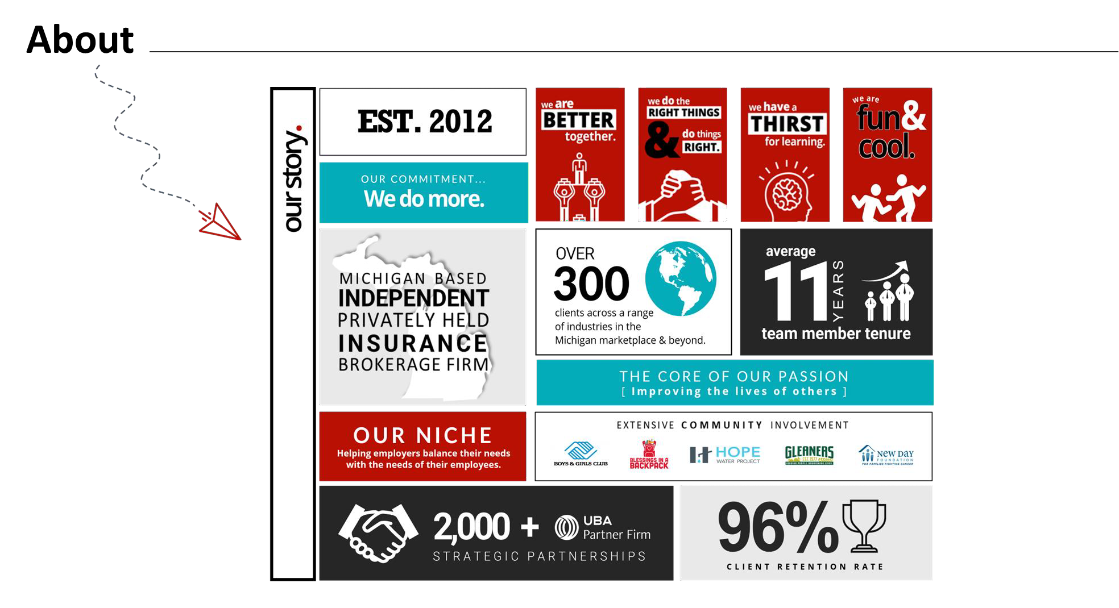
BIG DATA: BENEFITS | NNAHRA 2022
©STRATEGIC SERVICES GROUP, INC

Slide 4


Slide 5












Data Sources
5
BIG DATA: BENEFITS | NNAHRA 2022
©STRATEGIC SERVICES GROUP, INC

Slide 6


Slide 7
Fully Insured to Self-Insured Programs
FU L LY INS U R E D PROGR AMS
Administration
Reserves
Claims
Predictable cost & cash flow
 Not favorable toward Tribes
Shift 100% risk to insurance
 Margin / profit for insurance company
Better for small groups
 Poor transparency generally
Carrier determines plan design
 No incentives to drive costs
down / engage
Inflexible / few exceptions
 Price generally goes up each
year: claims +
BIG DATA: BENEFITS | NNAHRA 2022
©STRATEGIC SERVICES GROUP, INC

Slide 8

Self-Insured Programs
S E L F | IN S U R E D PROGR AM S
You determine plan design / complete flexibility | Administration | Stop loss contract Level funding to fully self-funding Realize every dollar in savings Options for 638 Tribes
Less predictable cash flow
Lower expenses / remove margin | Claims
Full transparency / reporting
BIG DATA: BENEFITS | NNAHRA 2022
©STRATEGIC SERVICES GROUP, INC

Slide 9



All Things Virtual | DATATRENDS
Covid-19 Virtual Care Explosion
Amazon Care Model
Virtual Centers of Excellence
Site of Care / Infusion at Home
On Demand & Virtual Care
Virtual or In-Person
Balance of Care/Need
Second Opinions
Specialists
Surgery
BIG DATA: BENEFITS | NNAHRA 2022
©STRATEGIC SERVICES GROUP, INC

Slide 10
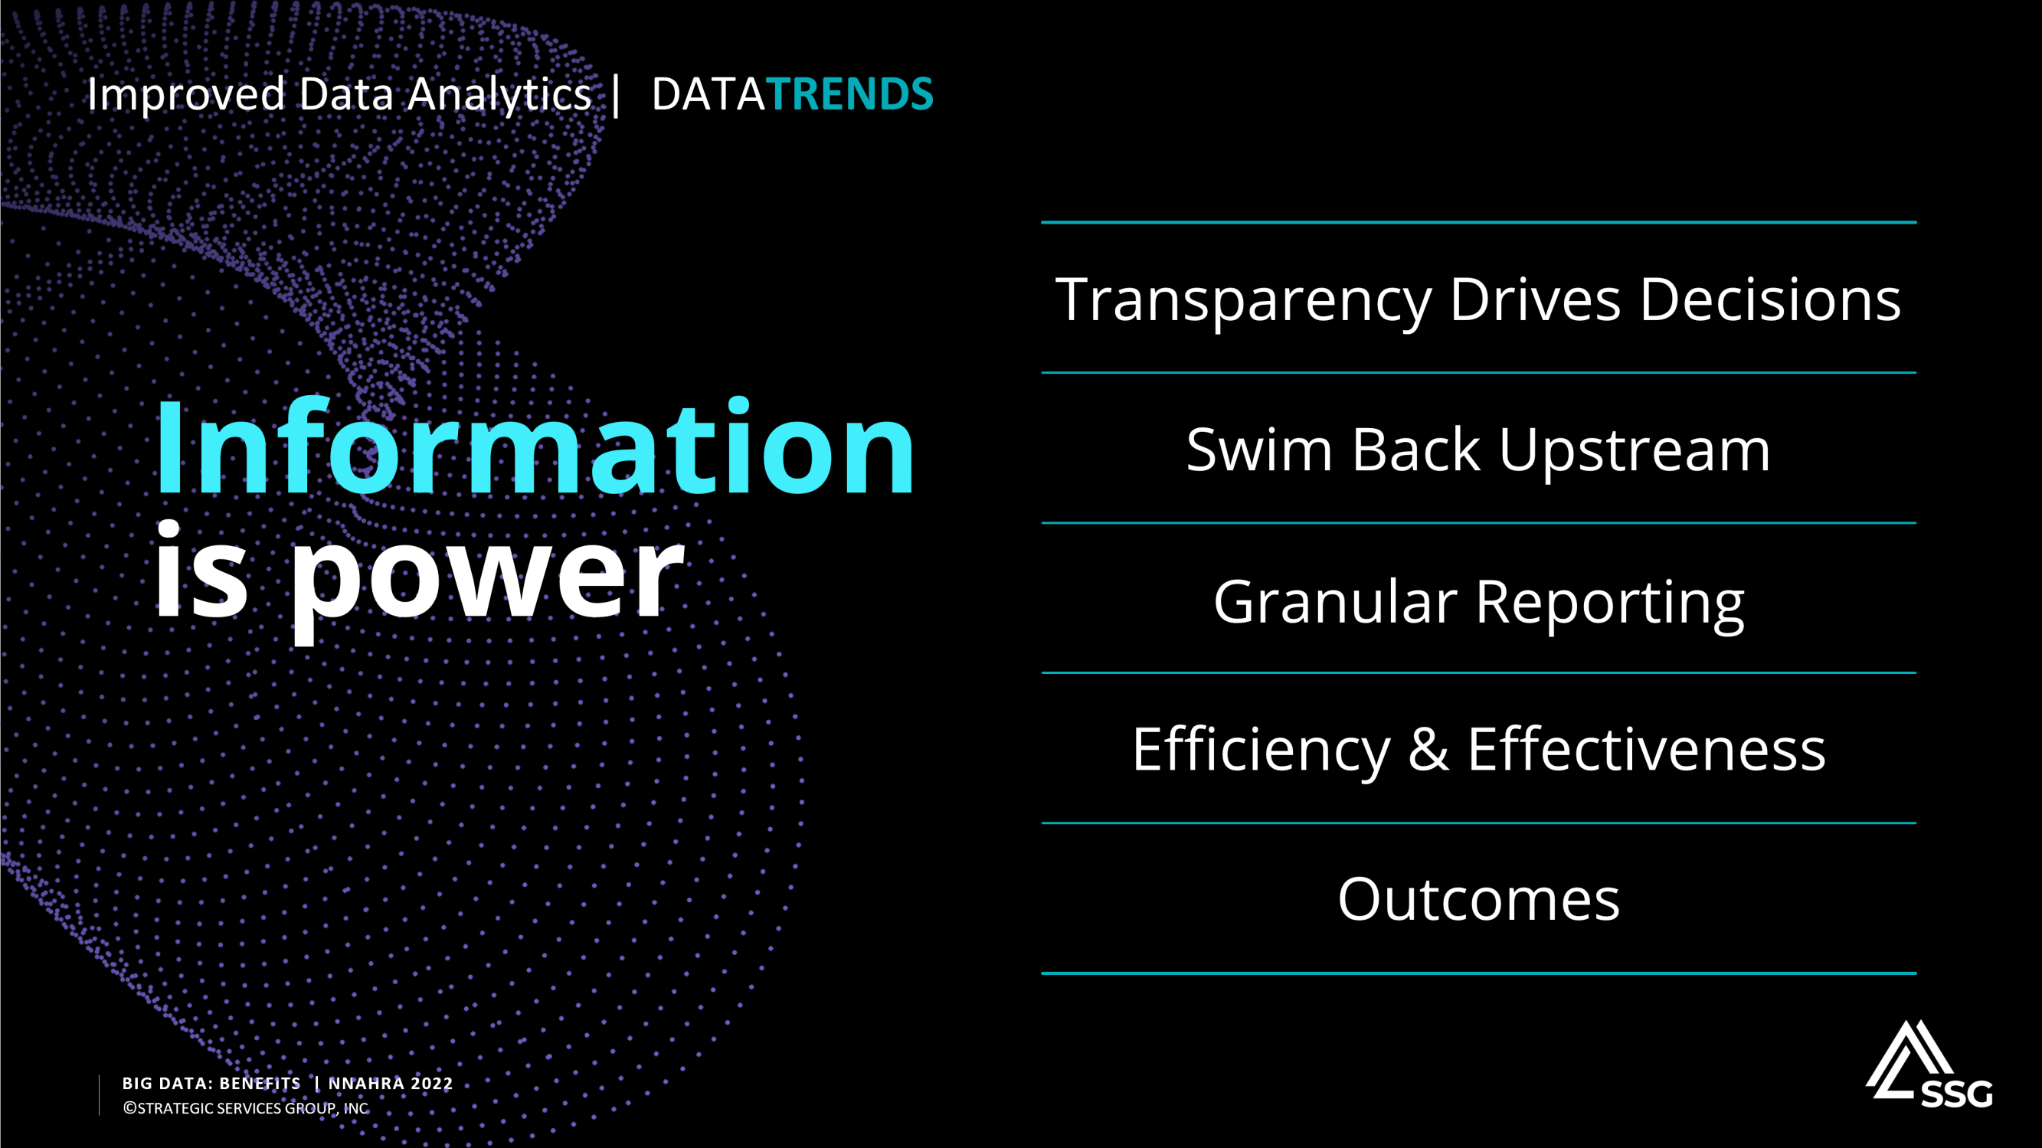
10

Slide 11
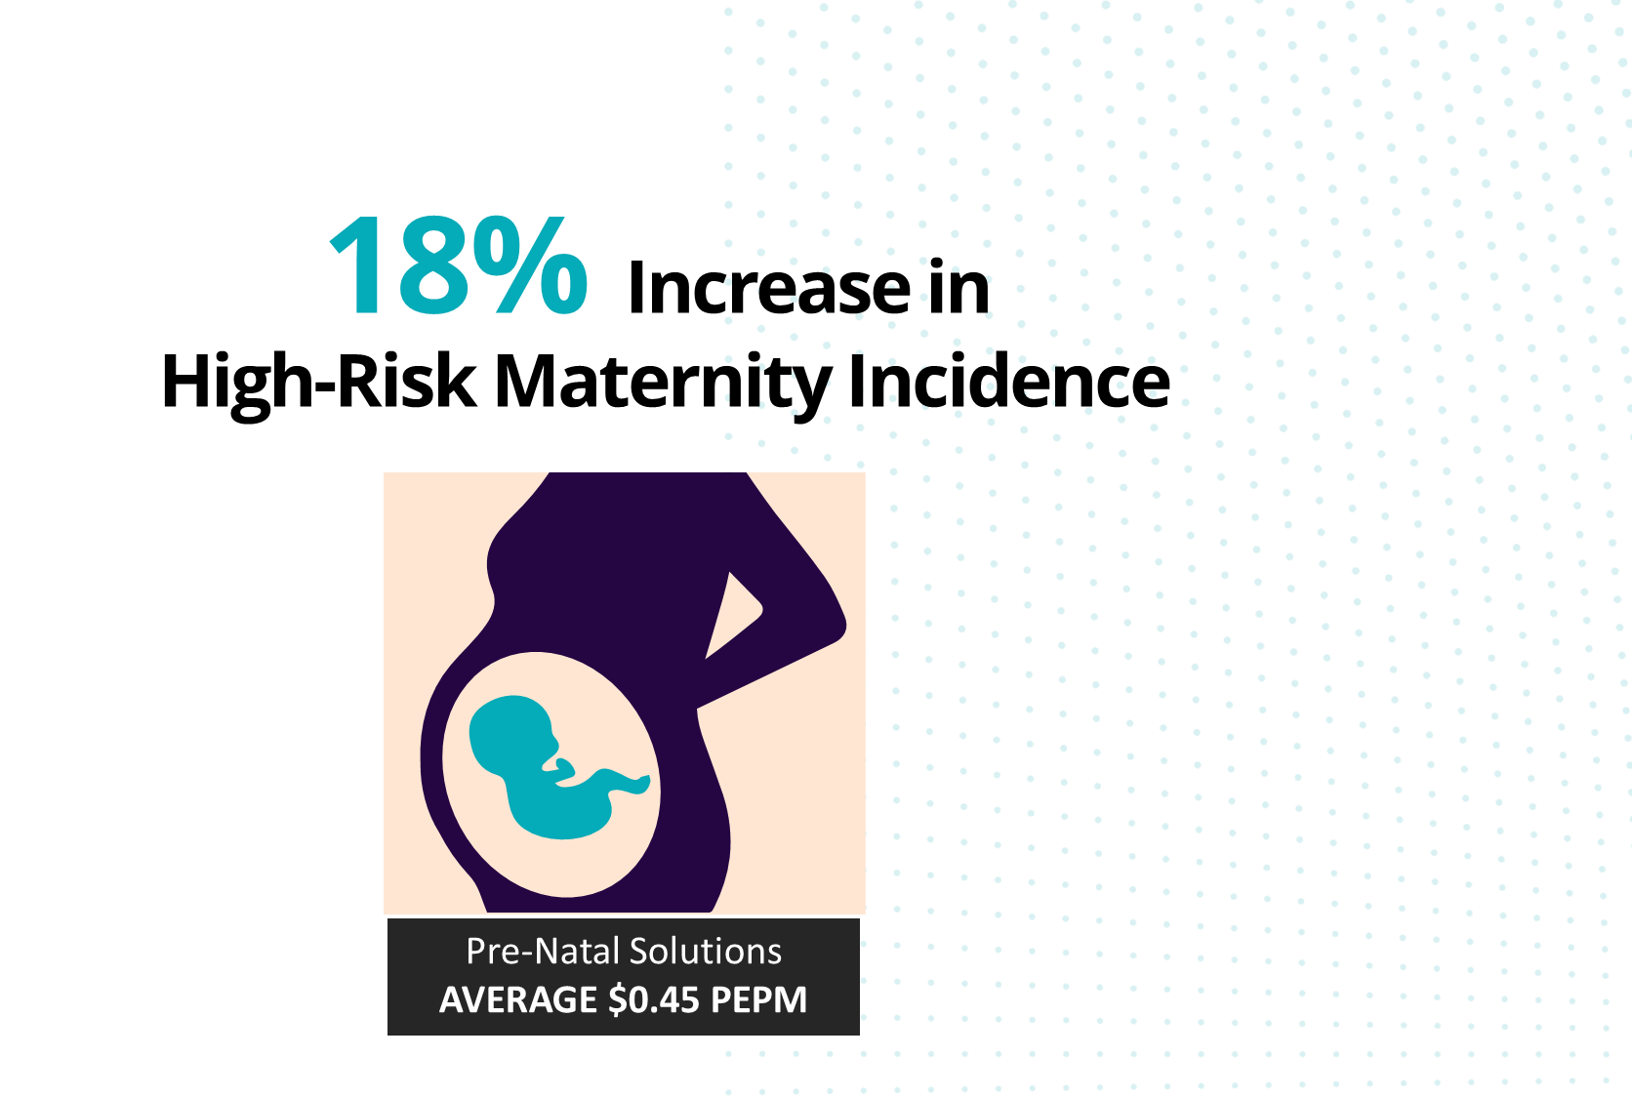
High Risk / Complex Maternities | DATATRENDS
3-Year Trend
Covid Impact
More Complex Cases
No Clear Pattern of Tribal vs. Non-Tribal
Premature Birth Claims
Incentive Programs for Engagement
BIG DATA: BENEFITS | NNAHRA 2022
©STRATEGIC SERVICES GROUP, INC

Slide 12

Validation Institute
Are the results what they claim to be?
Low cost for vendor to become validated
BIG DATA: BENEFITS | NNAHRA 2022
©STRATEGIC SERVICES GROUP, INC

Slide 13



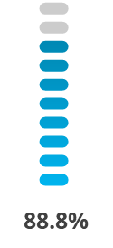

Musculoskeletal (MSK) | DATATRENDS
What is MSK?
MSK is the treatment of disease, disorders, or injury to the muscles, tendons, ligaments, or bones.
Move To Virtual / Technology
Telehealth
Mobile app
Physical therapy, coaching & exercise tracking
Use “Validated Vendors”
G O A L
Reducing Pain and Restoring Function
– Major Cost & Utilization Driver
– 15-25% of Spend and Growing
Digital musculoskeletal clinic
Reduced spend by $2,244 per
participant vs. control group
Results validate 88.88% lower costs across many services
68.7% of participants
undergoing invasive procedures
BIG DATA: BENEFITS | NNAHRA 2022
©STRATEGIC SERVICES GROUP, INC

Slide 14


Musculoskeletal (MSK) | DATATRENDS
10x
5x 65%
$$
Knee replacement
Hip replacement
Arthroplasty
with
Major Joint
surgeries’ readmission rate 0.95% compared to 9.87% in hospital
surgeries’ readmission rate 1.36% compared to 7.69% in hospital
complications cost only around 65% in price compared to Medicare standard target price.
Replacement
bundled payment service package is 62% to 110% compared to 143% to 264% on average for employers.
Source: : Crovetti Orthopedics

Slide 15

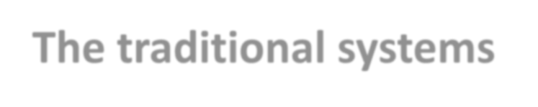



Value-Based Care represents a shift from the traditional fee-for-service payment structure toward a model of “fee for value” where good health outcomes are rewarded.
Value Based Care (VBC) 1 | DATATRENDS
The traditional systems for delivering health care are not working…
CMS (Medicare) has been moving to performance-based payments, incentives, outcome and evidence-based care:
Provider TEAM coordinating the right level of care in the
right setting at the right time.
Maintaining or improving care quality and outcomes is a prerequisite to VBC.
Source: EY 2022: Why Health Organizations need to move to value-based care now.

Slide 16



Value Based Care (VBC) 2 | DATATRENDS
Patients
Providers
Payers
– Lower out-of-pocket costs
Improved alignment and coordination of physician behavior
Financial incentives to drive meaningful changes in care delivery
Differentiated approach drives customer retention through affordability
Higher value elevating organizations to be seen as health advocates and stewards of enhanced health data
– Higher quality
Better coordinated care
Informed decision-making reduced frustration and confusion

Slide 17

Value Based Care (VBC) 3 | DATATRENDS
Slow Road to Success…
Take long-term view as government drives more transparency and change.
Providers that do not embrace VBC mindset will be crushed by those that do.
Covid-19 impact significant impact to drive provider alignment.
More non-traditional care delivery in telehealth, dialysis, infusions at home.
Lower revenue for providers trade-off with otherwise lost revenue / access.
Lack of provider
preparedness and capabilities.
Differentiation of high and
low performer reward systems.
Availability of enhanced data and achievable targets driving providers to drop out to avoid losing $.

Slide 18


Slide 19
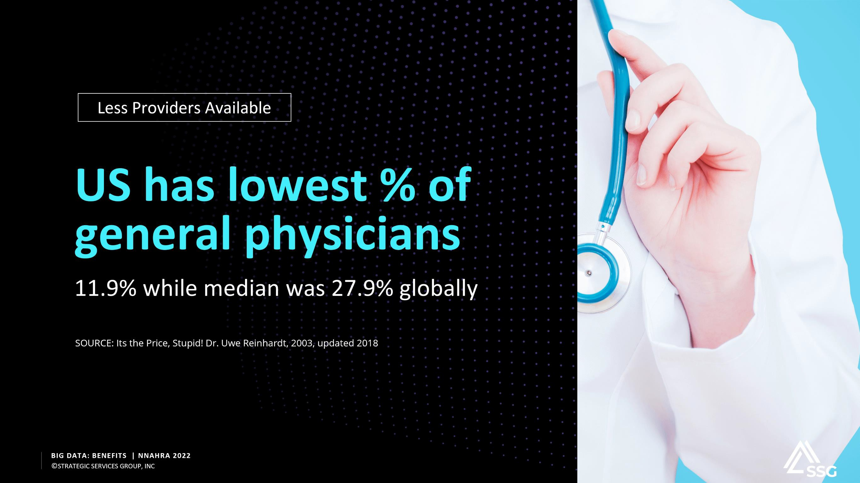

Slide 20

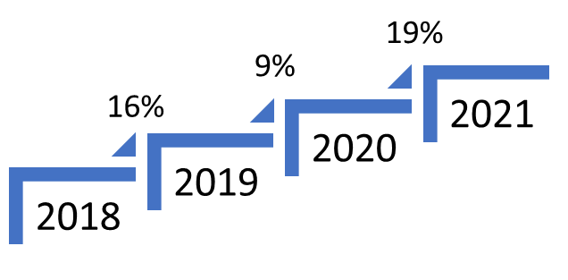

Million Dollar Claims | DATATRENDS
Conditions with Highest Number of Million-Dollar Claimants by Year
Hospital Capacity has Returned
More Extreme Efforts
Increase in Million-Dollar Claimants
Cancer Remains #1 & #2
Hemophilia most expensive
High-cost drugs
 | 2019 | 2020 | 2021
1 | Newborns | Leukemia | Leukemia
2 | Leukemia | Newborn | Malignant Neoplasm
3 | Cardiovascular | Malignant Neoplasm | Newborn
4 | Hemophilia | Cardiovascular | Covid-19
5 | Congenital Anomaly | Respiratory | Congenital Anomaly

Slide 21

The $3+ Million Claim | DATATRENDS
Respiratory
Newborn
Congenital Anomaly (Structural)
Newborn
Additional Condition: Septicemia
$4.05M
$5.43M
Neurological
Age 10-20
Additional Condition: Cerebral Palsy, Respiratory, Cardiac
Leukemia, Lymphoma,
Multiple Myeloma
Age 10-20
$4.2M
$5.41M
$4.2 &
Burns
Age 20-30
Hemophilia
Age 40-50
Additional Condition: Lupus
$6.23M
$7.4M
BIG DATA: BENEFITS | NNAHRA 2022
©STRATEGIC SERVICES GROUP, INC

Slide 22

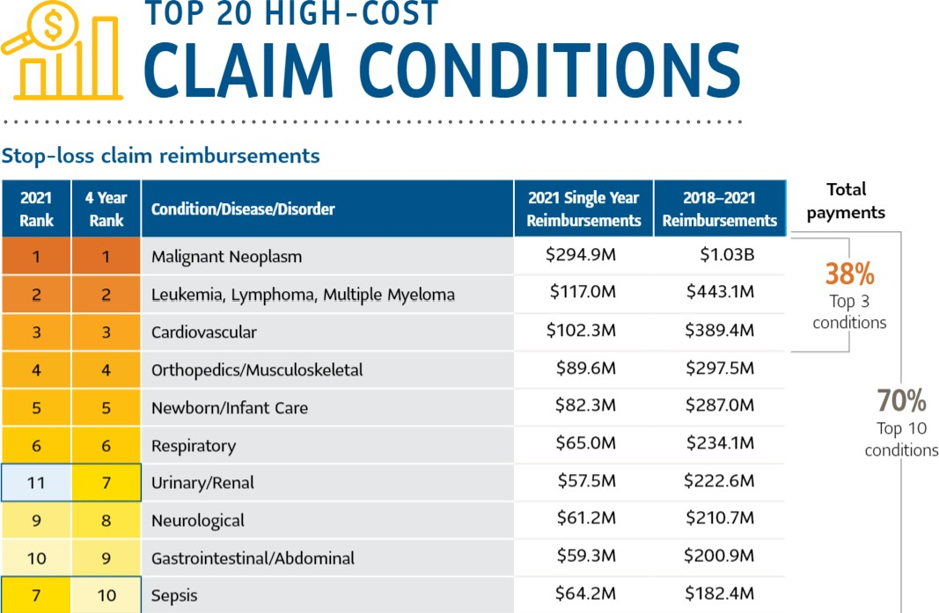
Large Claims | DATATRENDS
TOP 10
$3.50B (70%)
TOP 20
$4.54B (91%)
ALL
$4.97B
SOURCE: Sun Life 2022 Large Claim Report
BIG DATA: BENEFITS | NNAHRA 2022
©STRATEGIC SERVICES GROUP, INC

Slide 23
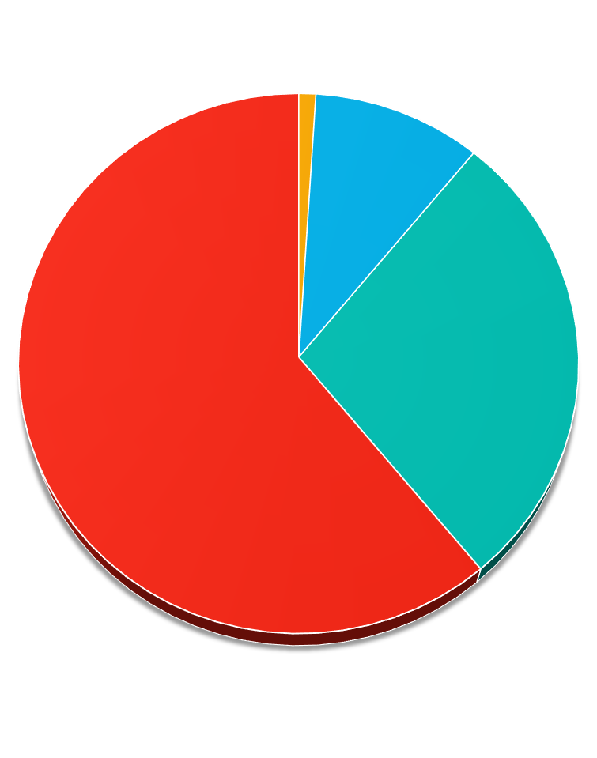
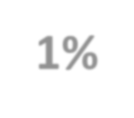
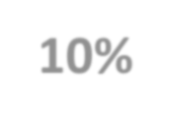
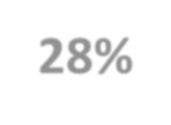
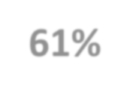

Two Years of Covid-19 | DATATRENDS
POPULATIONS WITH COVID-19
19 & Younger 20-39 40-59 60 & Over
2021 vs. 2020
Long-Haul
6th to 8th highest
S P E N D I T E M
Covid Patient Unknowns
1%
10%
Important Disruptions
2022/2023
Later stage diagnosis of cancers
Mental Health
Delayed care resulting in
worsened severity of conditions
TRENDING DOWN
28%
2022/2023
61%
Average cost of complex Covid treatment down by over
$50K / Claimant to $114K
23

Slide 24
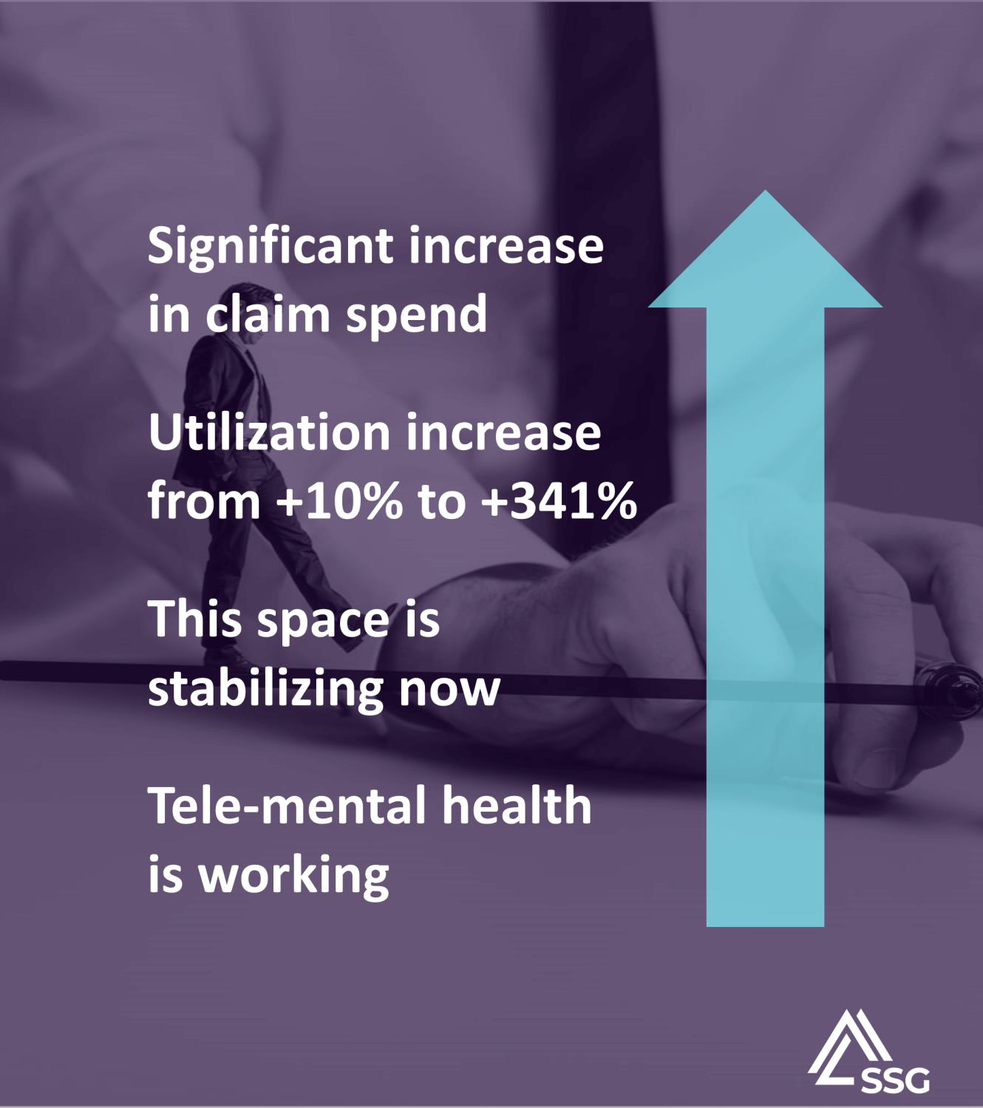
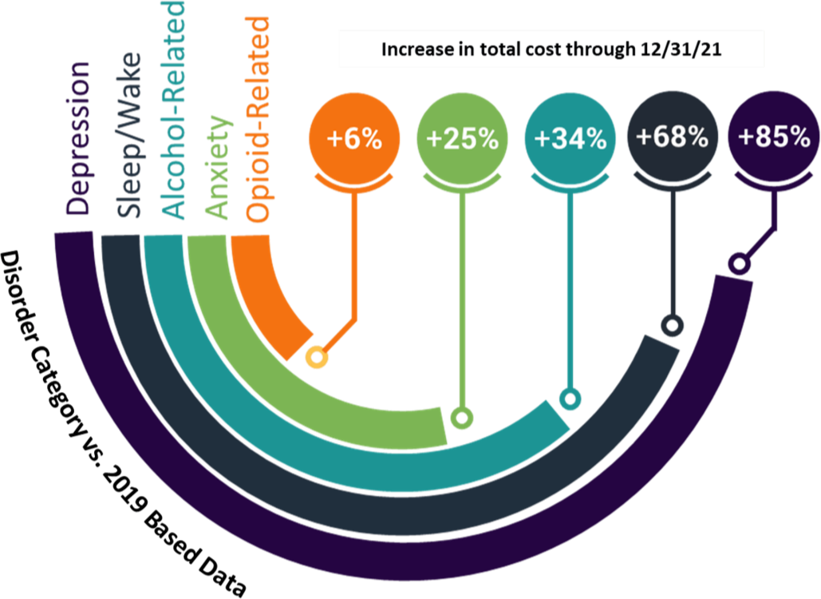
Pandemic Mental Health Impact
24
BIG DATA: BENEFITS | NNAHRA 2022
©STRATEGIC SERVICES GROUP, INC

Slide 25
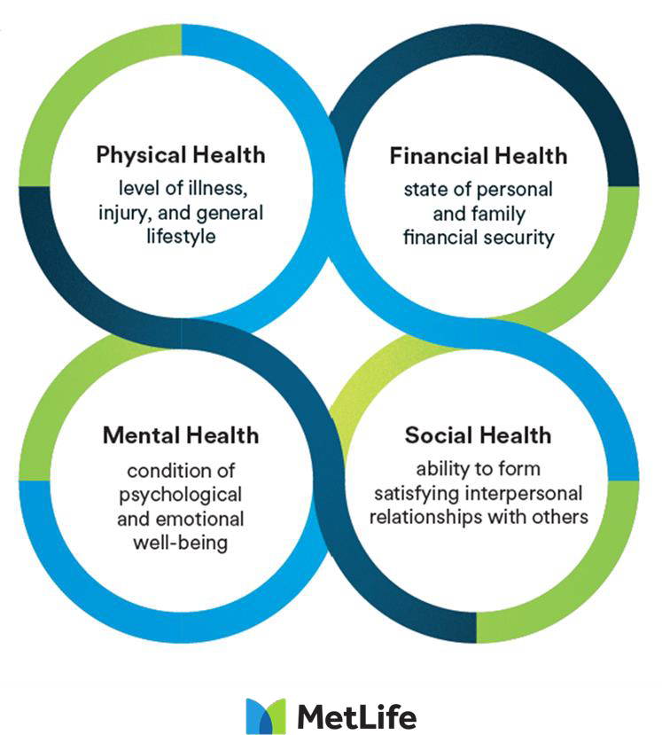
Whole Person Focus
More Than Mental Health
DATATRENDS
Average Cost per Claimant Stabilizing
Better Early Outcomes
Better Care / Less Complications
Better Pricing
Tele-Mental Health Impact
Shifting Employer Behaviors
More Holistic Approach
Less Cost Focused
Stabilizing the Population & Expectations
SOURCE: MetLife Annual Report

Slide 26
Less Transplants | DATATRENDS
Transplant Type | 2021 Average Cost
Heart | $1.66M
Intestine | $1.24M
Bone Marrow | $1.07M
Lung | $929K
Liver | $878K
Bone Marrow (autologous) | $471K
Kidney | $442K
Pancreas | $409K
Cornea | $33K
23% decrease in transplants
over past 4 years
Average cost decreasing from
$238.9k to $184.8k
Better Early Outcomes
Better Care
Less Complications
Better Pricing

Slide 27


Slide 28
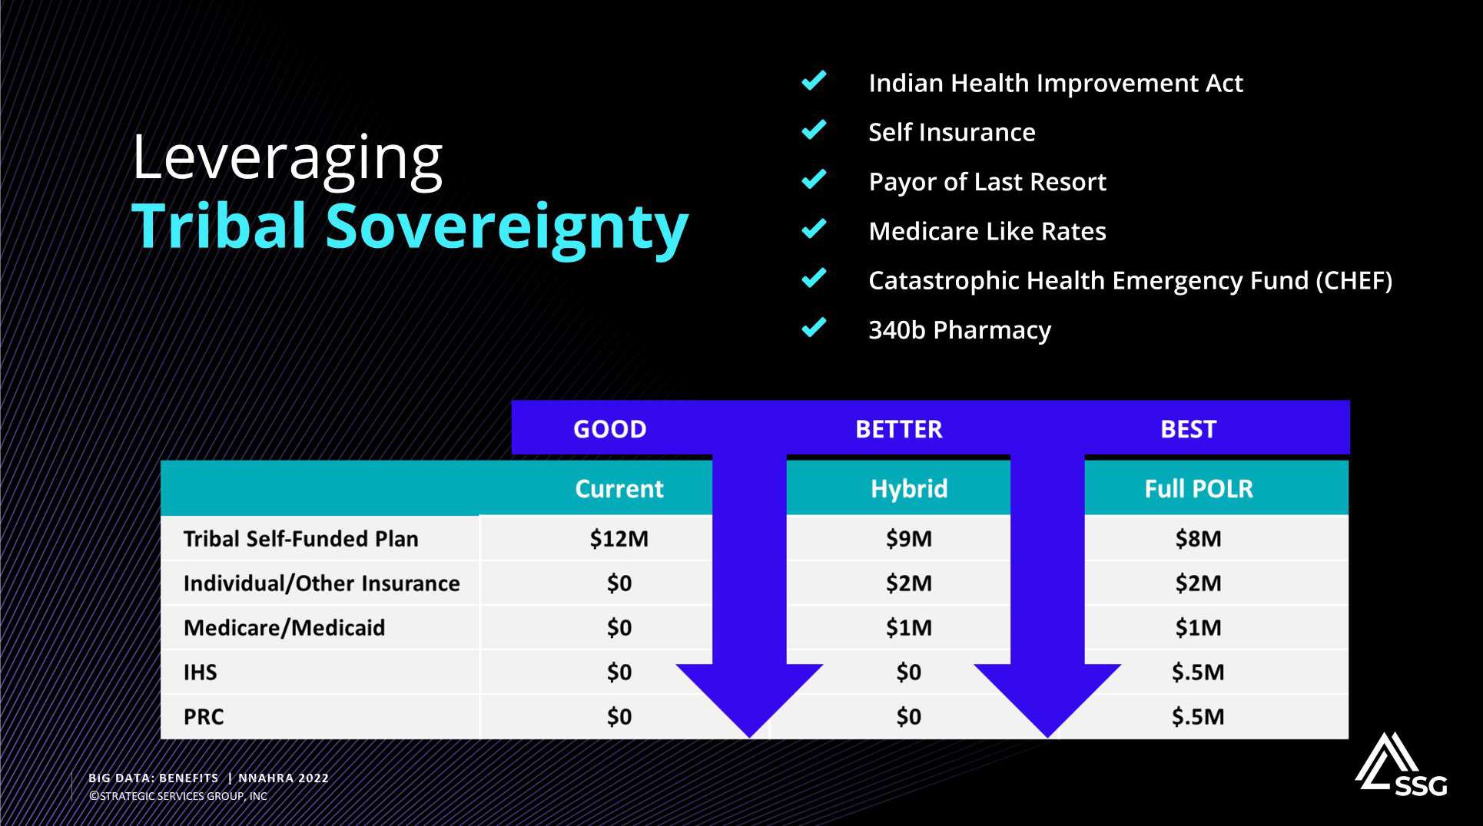

Slide 29
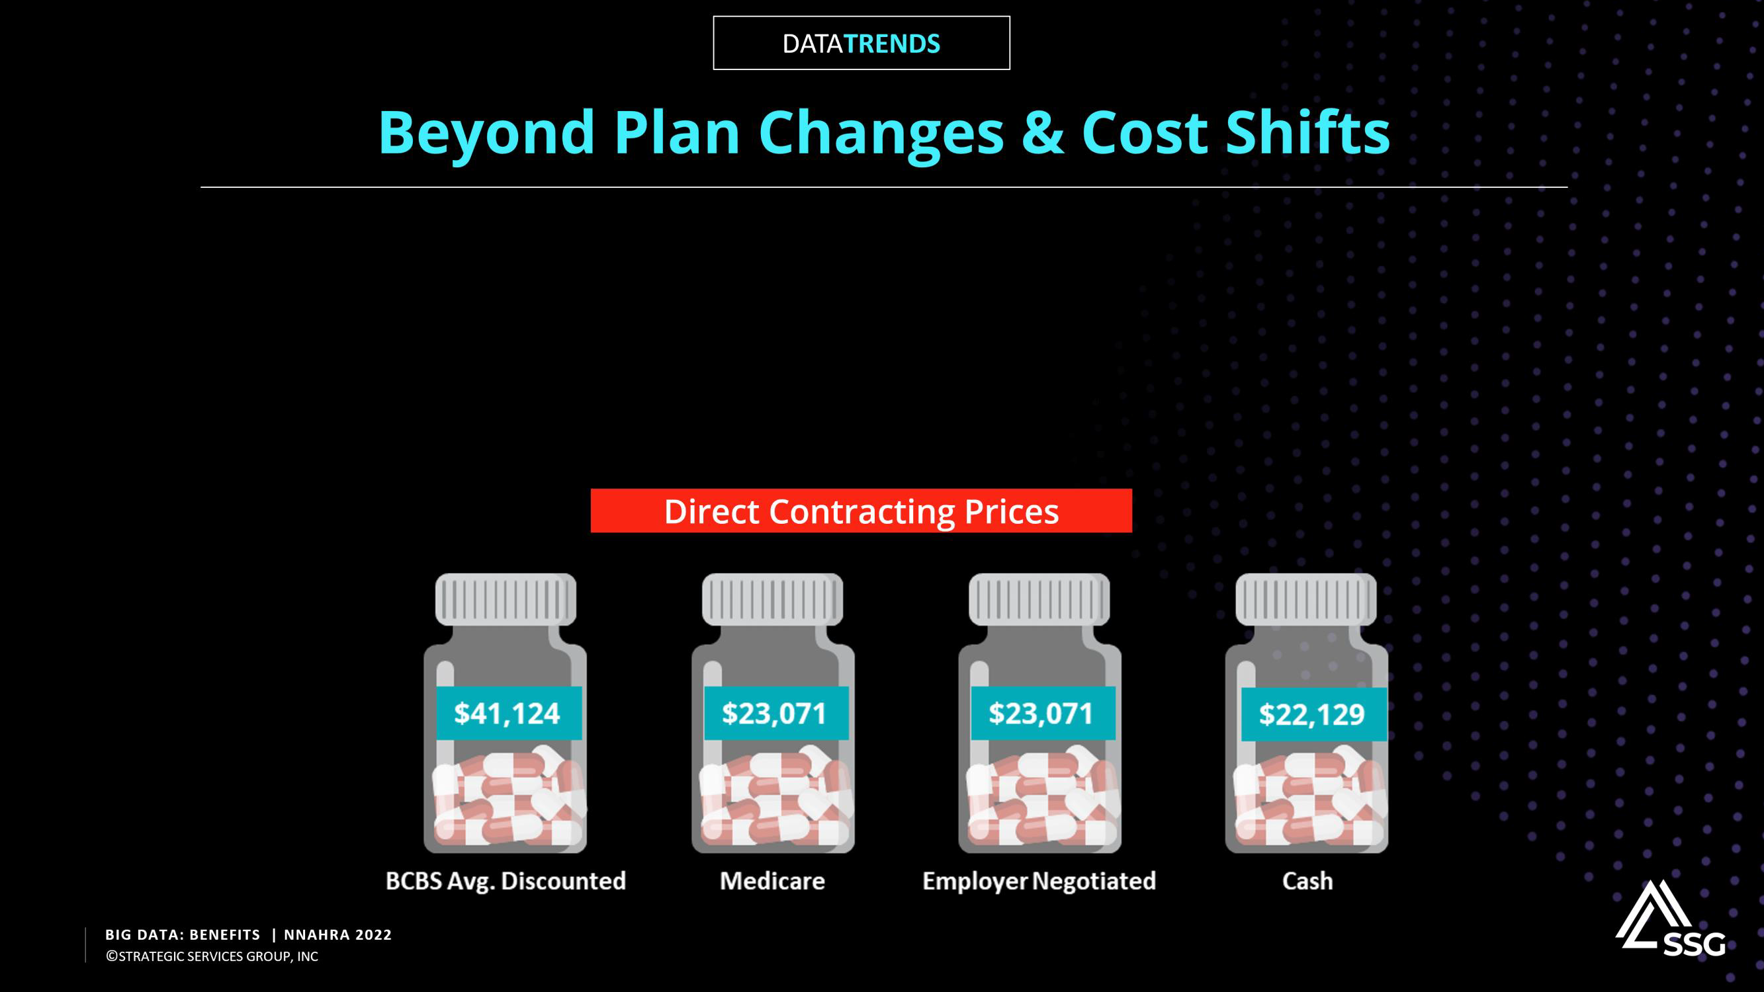







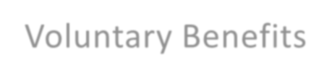
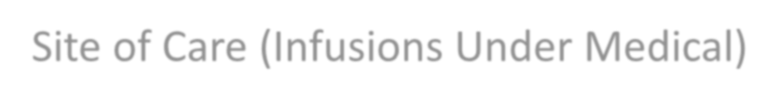
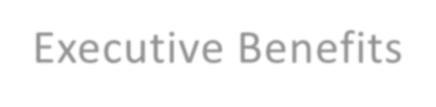
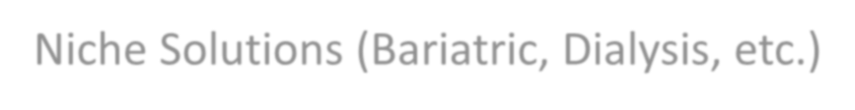


Domestic Clinics
Domestic Pharmacies
Pharmacy Review
Site of Care (Infusions Under Medical)
Niche Solutions (Bariatric, Dialysis, etc.)
Gamification / Drive Engagement Wellness
Direct Contracting
Voluntary Benefits
Executive Benefits
Leveraging the Data

Slide 30


Slide 31


Slide 32



NNAHRA – Tribal Member Health Plan Survey Sneak Peak
Ben Butler
Senior Vice President
September 27, 2022

Slide 33

NNAHRA – Benchmarking Study
(Sneak Peak)
NNAHRA and TribalCare/TribalFirst have partnered on a first of it’s kind benchmarking survey specifically designed to address the most commonly asked questions around what tribes are doing for health-related benefits for members and their families.
Unfortunately, there is no single source of information available that helps showcase what tribes are providing to their members in regards to healthcare, especially on a national level.
The goal of the survey is to capture key information pertaining to access to health and welfare benefits for tribal members. While some general information is captured regarding the demographics of the tribe, most of the survey focuses on what access and/or offerings are readily available to non-working tribal members and their families.
By obtaining information directly from Tribes who complete the survey, we are putting the
information back and directly into the hands of tribes. The more tribes that complete the survey,
the more helpful and powerful the data becomes.
33

Slide 34





Who is making the decisions around benefits?
How are the final key decisions about the health plan ultimately made? (Please answer, even if your tribe doesn’t provide any form of health benefits coverage).
Answer Choices | Responses
Tribal Council | 52.00% | 52
Benefits Committee | 21.00% | 21
Health Plan Administrator/Appointee/Executive | 20.00% | 20
Other | 7.00% | 7
How are the final key decisions about the health plan ultimately made? (Please answer, even if your tribe doesn’t provide any form of health benefits coverage). 60.00% 50.00% 40.00% 30.00% 20.00% 10.00% _{0.00%} Responses
38

Slide 35
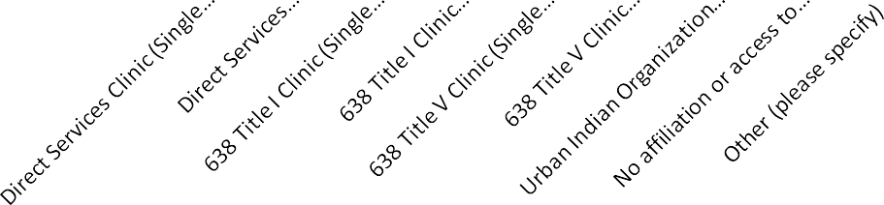
How are tribes and members accessing Care?
(Federal Provided Care)
What best describes your Tribe’s access to care provided by or in conjunction with Indian Health Services (IHS)?
Answer Choices | Responses
Direct Services Clinic (Single Tribe) – Managed by IHS | 21.00% | 21
Direct Services Clinic (Consortium) – Managed by IHS | 19.00% | 19
638 Title I Clinic (Single Tribe) – Adheres to IHS guidelines | 11.00% | 11
638 Title I Clinic (Consortium) – Adheres to HIS guidelines | 1.00% | 1
638 Title V Clinic (Single Tribe) – Self Governing | 24.00% | 24
638 Title V Clinic (Consortium) – Self Governing | 3.00% | 3
Urban Indian Organization (UIO) – Inclusion w/in a Robust Tribal Care Network | 0.00% | 0
No affiliation or access to Federally Sponsored Health Care Service Providers | 6.00% | 6
Other (please specify) | 15.00% | 15
Of the options below, what best describes your Tribe’s access to care provided by or in conjunction with Indian Health Services(IHS)?
30.00%
25.00%
20.00%
15.00%
10.00%
5.00%
Responses
0.00%
38

Slide 36
Does your tribe provide any health- related benefits on behalf of the trib
members?
Does your tribe provide any health-related benefits on behalf of the tribal members
Answer Choices | Responses
Yes | 55.00% | 22
No | 45.00% | 18
Availability of Health Plans provided by the Tribe for members
60.00%
50.00%
40.00%
30.00%
20.00%
10.00%
0.00%
38

Slide 37
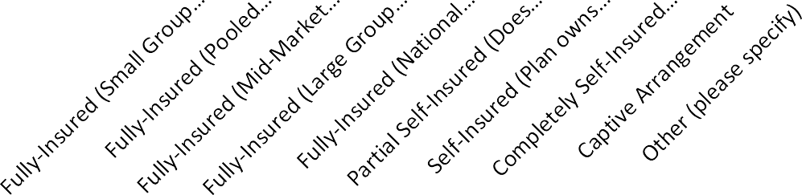
Funding of Tribal Provided Health Benefits
How is your tribal member health plan funded?
Answer Choices | Responses
Fully-Insured (Small Group Segment: Less than 100 Benefit Eligible L | 5.56% | 1
Fully-Insured (Pooled Group Segment: 101-249 Benefit Eligible Lives | 0.00% | 0
Fully-Insured (Mid-Market Segment: 250-999 Benefit Eligible Lives) | 5.56% | 1
Fully-Insured (Large Group Market Segment: 1,000-2,499 Benefit Elig | 5.56% | 1
Fully-Insured (National Account Segment: 2,500 Benefit Eligible Lives | 0.00% | 0
Partial Self-Insured (Does NOT carve-out Stop-Loss or Administrativ | 11.11% | 2
Self-Insured (Plan owns 100% of all claims, but utilizes Stop-Loss an | 50.00% | 9
Completely Self-Insured (No Stop-Loss Insurance Coverage) | 0.00% | 0
Captive Arrangement | 0.00% | 0
Other (please specify) | 22.22% | 4
How is your tribal member health plan funded? 60.00% 50.00% 40.00% 30.00% 20.00% 10.00% _{0.00%} Responses
38

Slide 38
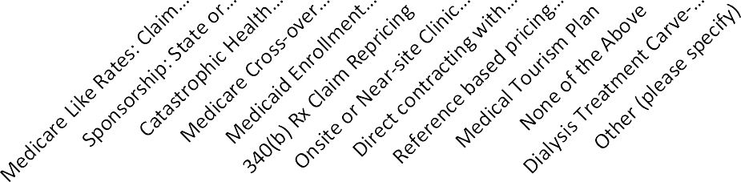
Does your plan incorporate any of the following risk offsets?
Answer Choices | Responses
Medicare Like Rates: Claim Repricing using PRC authorities to disco | 72.22% | 13
Sponsorship: State or Federal Exchange Enrollment Support and clai | 33.33% | 6
Catastrophic Health Emergency Fund (CHEF) | 22.22% | 4
Medicare Cross-over (enrollment support for Medicare Eligible Mem | 33.33% | 6
Medicaid Enrollment Support | 16.67% | 3
340(b) Rx Claim Repricing | 38.89% | 7
Onsite or Near-site Clinic or Pharmacy | 44.44% | 8
Direct contracting with local or semi-local providers | 33.33% | 6
Reference based pricing program | 5.56% | 1
Medical Tourism Plan | 0.00% | 0
None of the Above | 5.56% | 1
Dialysis Treatment Carve-Out | 11.11% | 2
Other (please specify) | 22.22% | 4
Does your plan incorporate any of the following risk offsets? 80.00% 70.00% 60.00% 50.00% 40.00% 30.00% 20.00% 10.00% _{0.00%} Responses
Tribal Plan Advantages
38

Slide 39
Does your tribe utilize an electronic administration system/software to manage benefits eligibility and enrollment for your tribal member population? (aka. Benefit Admin System/Software/Platform, HRIS, EDI Feeds to Carriers, etc.)
Answer Choices | Responses
Yes | 55.56% | 10
No | 44.44% | 8
Does your tribe utilize an electronic administration system/software to manage benefits eligibility and enrollment for your tribal member population? (aka. Benefit Admin System/Software/Platform, HRIS, EDI Feeds to Carriers, etc.) 60.00% 50.00% 40.00% 30.00% Responses 20.00% 10.00% 0.00% Yes No
Benefits Admin and Technology
38

Slide 40
What types of Medical Plans does the tribe offer?
Answer Choices | Responses
PPO | 92.86% | 13
HMO | 7.14% | 1
EPO | 7.14% | 1
POS | 0.00% | 0
Indemnity Plan | 7.14% | 1
What types of Medical Plans does the tribe offer?
What’s being
offered?
100.00%
90.00%
80.00%
70.00%
60.00%
50.00%
40.00%
30.00%
20.00%
10.00%
0.00%
Responses
PPO HMO EPO POS Indemnity
Plan
38

Slide 41

Admin and Coverage for
Dependents
Does your tribal administration department track key identifying information pertain to non-tribal dependents?
(Non-Tribal Dependents are spouses/partners, children, grandchildren, and/or any other traditional dependent that isn’t a member of your tribe.)
Are non-tribal member dependents (Spouses, Children, Other) allowed to participate as members of the plan?
Answer Choices Responses
Answer Choices | Responses
Yes | 34.15% | 14
No | 65.85% | 27
Does your tribal administration department track key identifying information pertain to non-tribal dependents? (Non-Tribal Dependents are spouses/partners, children, grandchildren, and/or any other… 80.00% 60.00% 40.00% Responses 20.00% 0.00% Yes No
Yes | 77.78% | 14
No | 22.22% | 4
Are non-tribal member dependents (Spouses, Children, Other) allowed to participate as members of the plan?
90.00%
80.00%
70.00%
60.00%
50.00%
40.00%
30.00%
20.00%
10.00%
0.00%
Responses
Yes
No
41

Slide 42

Next Steps
Survey is Still Open!
About 10-20 Minutes to complete
Raffle Prize of a $500 Amazon Gift Card is still available to survey participants before the deadline
Survey Closes 10/01/2022
Published Benchmarking Results
ETA: Will be released prior to 11/04/2022
Available for FREE!
But only to those tribal entities that participate in completing the survey
Survey may become available at a later date to those tribal entities that didn’t participate, which will include a nominal fee.
Questions? Stop by the TribalCare/Tribal First booth or contact tribalcare@tribalfirst.com
42

Slide 43
Thank you
tribalcaret@tribalfirst.com www.tribalfirst.com

