Slide 1

26th Annual Conference
San Antonio, Texas
September 26-28

Slide 2
Attributes of a good mentor
Presented by: TeriLynne Kisto

Slide 3
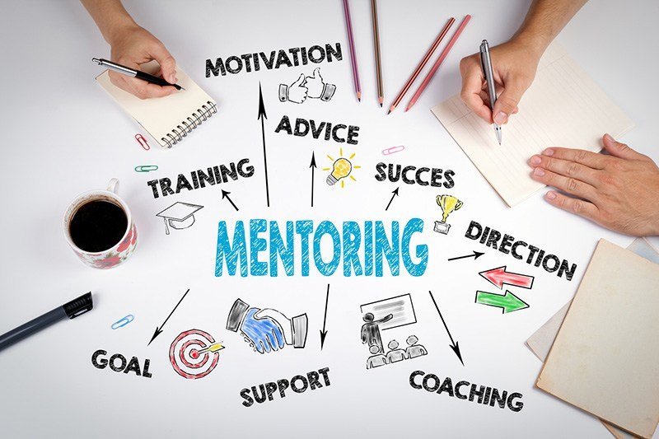
AGENDA
Introduction
Definitions and Vocabulary
Types of Work Mentors
Mentoring Skills Model
The Mentoring Skills Model and Roles
Developing a Mentoring Program
Sharing Relevant Knowledge and Expertise
Setting Boundaries
Conclusion
Topic two
Topic three
Topic four

Slide 4
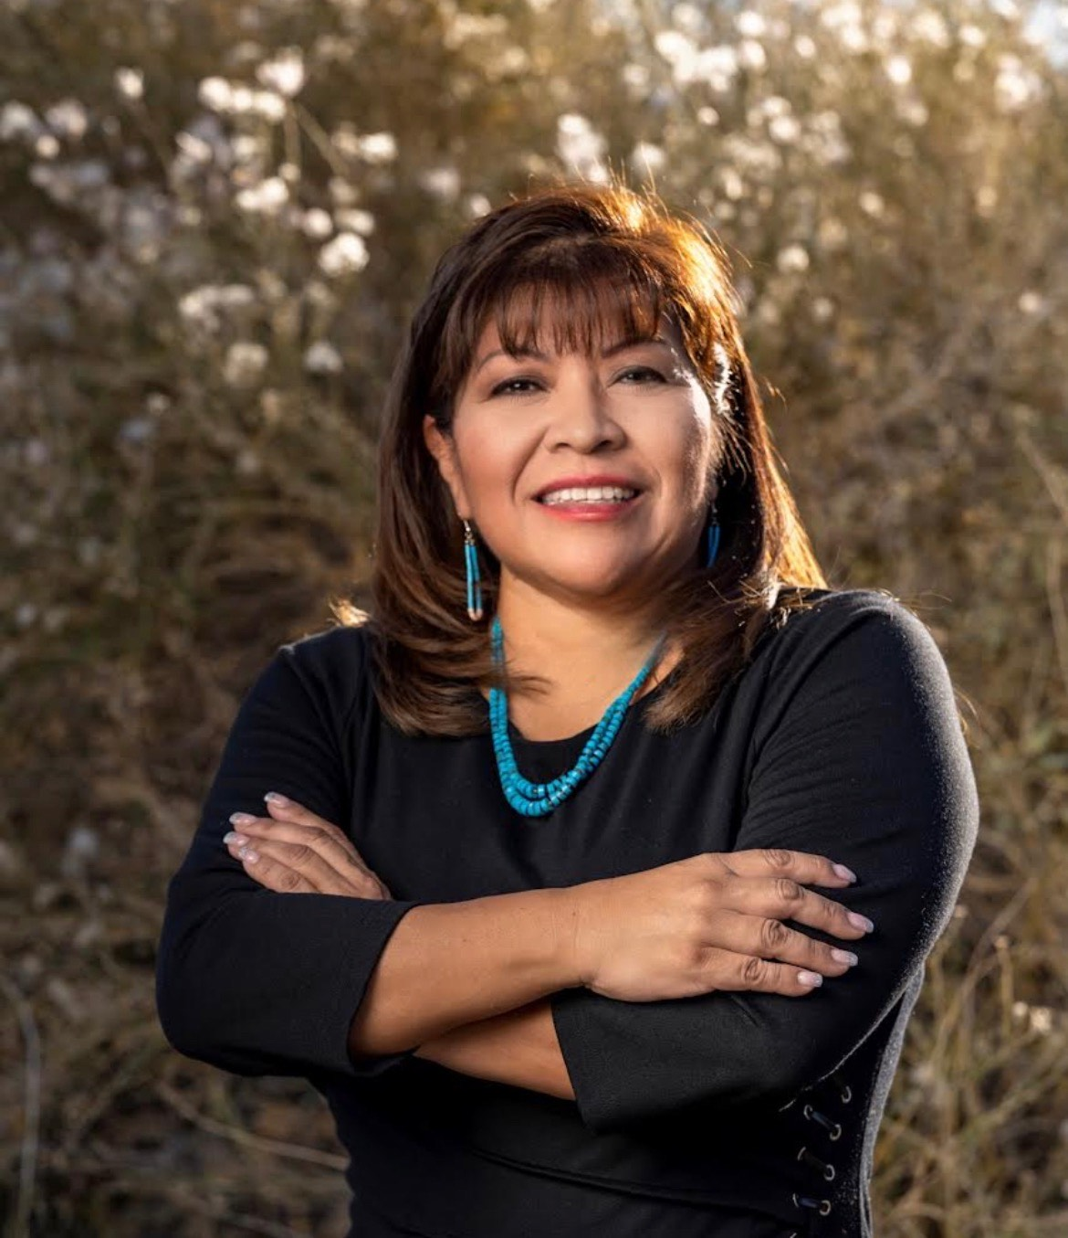
Your Presenter
Pima Tribe from Gila River Indian Community
TeriLynne Kisto
Founder CEO
Kisto HR Consulting, LLC
Bachelor of Science Degree in Organizational Development with a Specialization Human Resources Development
Certified Mediator and Mediation Trainer
THRP Certification

Slide 5


introduction
Mentoring is essential for Human Resources professionals and their leadership in Tribal organizations, entities and Casinos throughout the United States. All too often we see leadership positions go unfilled or filled then vacated and filled again as if it were a revolving door.
This presentation will discussion terminology, key fundamentals to be an effective mentor while strengthening retention of employees through engagement of mentorship.

Slide 6
“A Mentor is someone who allows you to see the hope inside of yourself”
~ Oprah Winfrey

Slide 7
Definitions and Vocabulary
Mentor is one who has a wealth of expertise in a specific area and wants to teach this knowledge to a mentee through engagement and excitement while possessing empathy through the process of mentoring.
Mentee is one who has the desire and demonstrates the potential to be mentored and is often referred to as a protégé.
Mentoring is a connection between two or more people who are focused on a professional development of the mentee.
Workplace Mentoring is a learning partnership between employees for the purpose of sharing technical information, organization knowledge with respect to a particular position.
Mentoring Skills is a set of skills that help in your ability to mentor as well as be mentored.
Mentoring Plan is essential for any successful mentorship program. It defines the objectives, goals, and timeline of a mentorship program.

Slide 8
Types of work mentors
One-on-One Mentoring
Peer Mentoring
Group Mentoring
Reverse Mentoring

Slide 9
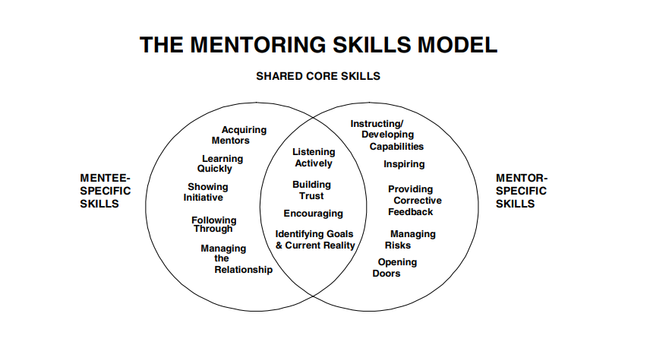
Mentoring skills model
Linda Phillips-Jones, Ph D

Slide 10
The mentoring skills model and roles
Mentee specific skills
Shared core skills
Mentor-specific skills
Acquiring mentors
Learning quickly
Showing Initiative
Following Through
Managing the relationship
Listening Actively
Building Trust
Encouraging
Identifying Goals and Current Reality
Instructing/Developing Capabilities
Inspiring
Providing Corrective Feedback
Managing Risk
Opening Doors

Slide 11
Developing a mentoring Program
Define a purpose and goal
Define the details of the mentoring program
Determination of onboarding mentors and mentees
Matching mentors and mentees
Maintain mentoring momentum
Measuring the success and ROI of the mentoring program

Slide 12
Sharing relevant Knowledge and expertise
Some leaders may worry by sharing too much puts them in a position of vulnerability. However, it quite the opposite.
As a mentor sharing relevant knowledge and expertise is very important for the mentee. This requires devoting time as well.
Being able to share experiences of trials and success helps the mentee understand that each experience is a building block toward the success of a mentee.
Mentorship should never be a chore it should be positive and engaging in the process. Good mentors take it as an opportunity to build their team stronger.

Slide 13
Setting boundaries
Mentor and mentee should discuss boundaries early on in the mentoring relationship.
Define what you will and will not discuss
Discuss if there any potential conflicts of interest and how those will be handled.
Maintaining confidentiality

Slide 14
Conclusion
Employees are eager to grow professionally and as leaders we should always look within our organizations and department for the talent that lies within our employees long before a critical position becomes vacant.
The effectiveness of a good mentor is in the mentoring skill, the ability share knowledge and providing honest corrective feedback that the mentee knows it’s a learning experience that will help them get to end goal of a mentorship.

Slide 15


THANK YOU
TeriLynne Kisto
kisto_hrconsulting@outlook.com
Phone: (480) 876-8970

