Slide 1


Active Shooter Preparedness:
NNAHRA, San Antonio, Texas
Notes:
Eddie Ilko Introduction of Topic

Slide 2

Your Presenters
Tammy Jelinek
Principal
Wipfli LLP
25 years of experience working in and with nonprofit organizations and for-profit businesses
Nationally recognized regulatory trainer

Slide 3
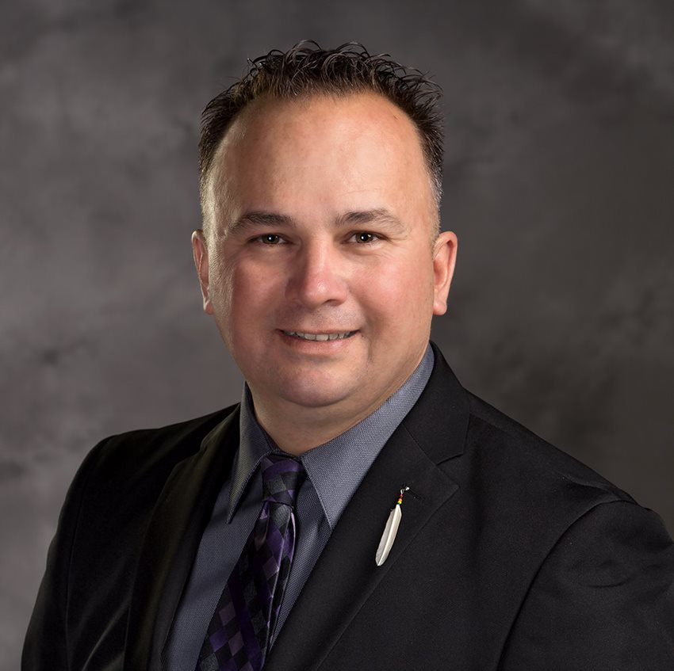
Your presenters
Andrew Hofstetter
Director, Tribal Industry
Wipfli LLP
    Enrolled Confederated Tribes of Warm Springs
    Active in Indian Gaming for 28 years
    Served on the TGPN for 10 years
    Certified Active Shooter Instructor
© 2022 Wipfli LLP. All rights reserved.
Notes:
Andrew Hofstetter, Eddie Ilko, Grant Hirata

Slide 4
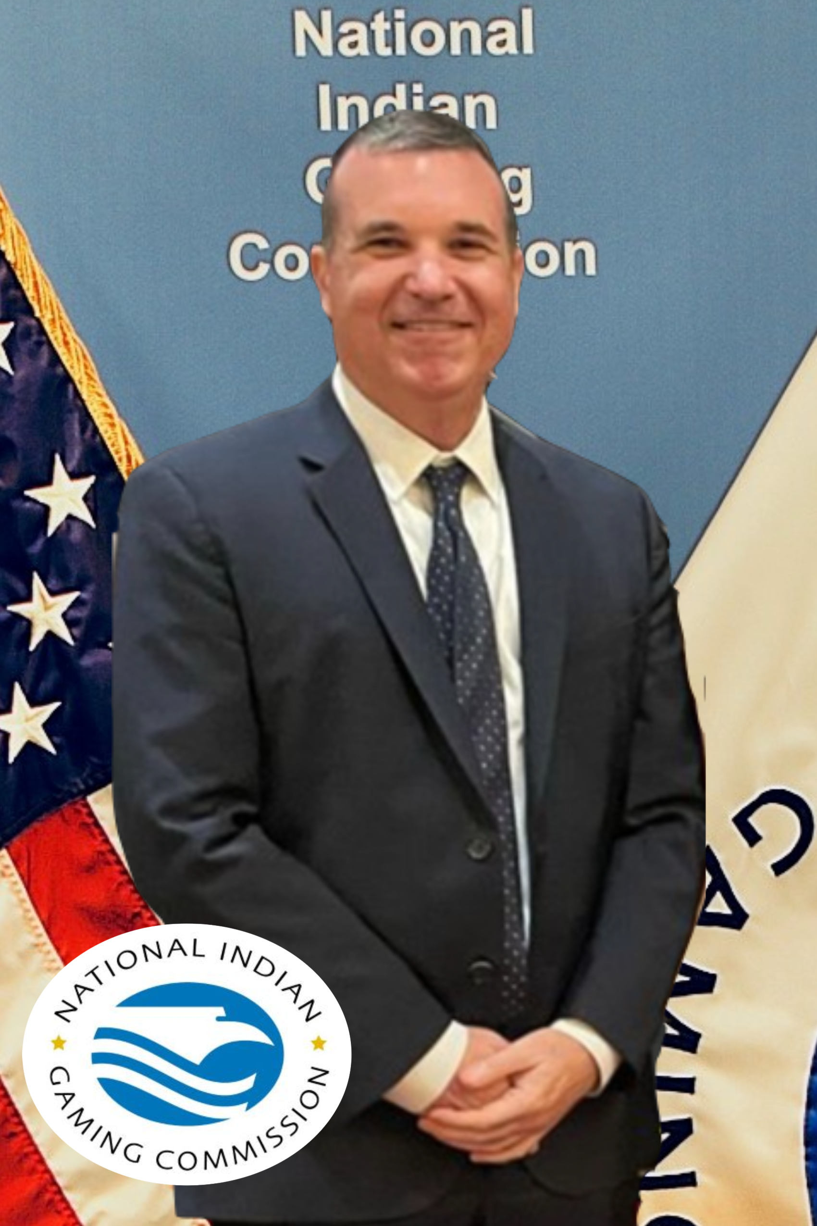
Your presenters
Eddie Ilko
Safety and Occupational Health Manager
National Indian Gaming Commission
16 years in Tribal Gaming industry
Authorized OSHA trainer
Fire Inspector 1
Former Chairman of National Indian Casino Safety & Security Association (NICSSA)
© 2022 Wipfli LLP. All rights reserved.

Slide 5
Agenda
Profile of an Active Shooter
Characteristics of Active Shooter
Preparing for Active Shooter Situations
Your Casino
Emergency Action Plan
Emergency Action Plan: Active Shooter
Calling 911
Preparation Items
Active Shooter Incidents
Run, Hide, Fight
FBI Video
Active Shooter Protocol
Active Shooter Protocol
Instructions for your staff
If Confronted by an Active Shooter
Emergency Responders may ask you
When you make it to safety
Active Shooter Information Links
Questions
© 2022 Wipfli LLP. All rights reserved.
Notes:
Andrew Hofstetter, Eddie Ilko

Slide 6
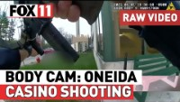
Body Camera Footage: Oneida Casino complex shooting

Slide 7
Profile of an Active Shooter
An individual actively engaged in killing or attempting to kill people
Usually target a confined and populated area
Weapons can include, but are not limited to:
  firearms (most frequently used)
  bladed weapons
  Vehicles
  any tool that in the circumstance in which it is used constitutes deadly physical force
In most cases, there is no pattern or method to their selection of victims
Most active shooter situations are unpredictable, evolve quickly, and are over within minutes
© 2022 Wipfli LLP. All rights reserved.

Slide 8
Characteristics of Active Shooters
Likely to engage more than one target
Intention is usually an expression of hatred or rage, or extremist ideology
Often, but not always, suicidal
Often well-planned, well-armed, and familiar with target location
  Use of booby-traps, explosives, diversion tactics
Location may be chosen for tactical advantage
Likely to remain mobile in location, rather than fixed in one location
© 2022 Wipfli LLP. All rights reserved.

Slide 9

Preparing for active shooter situations
Develop an Active Shooter Response Plan and practice for emergencies. Include first responders in your training.
Have emergency numbers ready:
  Law Enforcement
  Fire, Hospital
  Security (if available)
Know your casino’s address
Have a plan that not only takes staff into consideration, but guests/customers as well. Patrons will more than likely follow your staff.
Have an individual escape route and plan in mind.
© 2022 Wipfli LLP. All rights reserved.

Slide 10

Your casino
You know your location the best.
Use hallways, entrances, exits, alternative routes to navigate away from the gunfire and threat.
Use what is around you:
  Duck around gaming machines and furniture or physical items in the location to conceal yourself.
  Move to a secure area or other controlled- access area if available.
No matter what is going on around you, focus and be aware of your surroundings, use what you have around you, what is available, what you see.
© 2022 Wipfli LLP. All rights reserved.

Slide 11

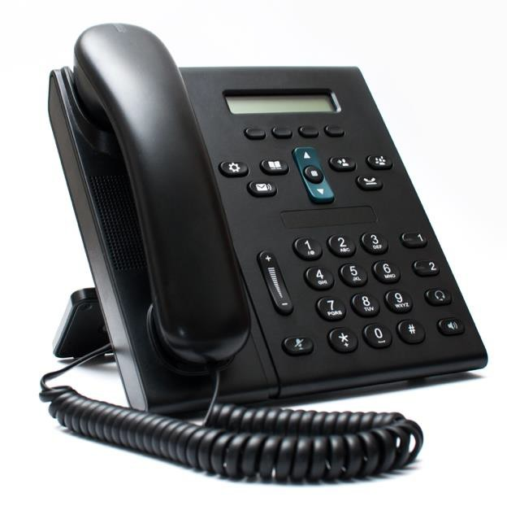
Emergency Preparedness Plans
A preferred method for reporting emergencies
EPPs
include:
An evacuation policy and procedure
  At least two designated evacuation points
  Posted evacuation routes
Emergency escape procedure and route assignments
(floor plan, safe areas, rally point)
Contact information for, and responsibilities of individuals to be contacted under the EPP
Information on local hospital(s), name, telephone number, and distance from the facility
© 2022 Wipfli LLP. All rights reserved.

Slide 12
Emergency Action Plan: Active Shooter
Cyber Security & Infrastructure Security Agency (CSISA)
Active Shooter Emergency Action Plan Template (Nov 2017) (cisa.gov)
© 2022 Wipfli LLP. All rights reserved.

Slide 13
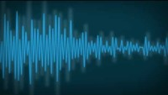
911 audio from panic on Michigan campus amid “active ...

Slide 14

Calling 911
Dial 911 (if available) to alert police
If you cannot speak, leave the line open and allow the dispatcher to listen, then speak when it is safe
Know your address
State number of shooter(s)
Describe shooter(s)
Describe weapon(s)
State location of shooter(s)
State number of victims
© 2022 Wipfli LLP. All rights reserved.

Slide 15

Preparation items
Coordinate with security to ensure physical security:
Assemble crisis kits:
  Radios
  Floor plans
  Staff roster and staff emergency contact numbers
  First aid kits
  Flashlights
Place removable floor plans near entrances and exits for emergency responders
Activate emergency notification system when an emergency occurs
© 2022 Wipfli LLP. All rights reserved.

Slide 16
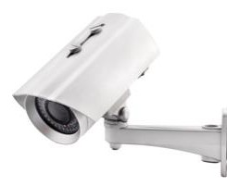
Active shooter incidents
Most incidents occur at locations where the Shooter(s) find little impediment in presenting their attack.
Locations are generally described as soft targets, that is, they carry limited security measures to protect employees and members of the public.
In most instances, shooters commit suicide, are shot by police, or surrender when confronted by responding law enforcement.
© 2022 Wipfli LLP. All rights reserved.

Slide 17

RUN
Pre-plan your escape
Leave your belongings behind
Take your cell phone if safe to retrieve
Keep your hands visible
Only stop to help others if safe to do so
© 2022 Wipfli LLP. All rights reserved.

Slide 18
RUN
At the first sound of gunshots, flee in the opposite direction
Distance = Safety
Warn others as you leave and urge them to follow you
Don’t stop until you are sure you are clear from danger
Check yourself for injury when you arrive at a place of safety
© 2022 Wipfli LLP. All rights reserved.

Slide 19

HIDE
Hide in an area out of the shooter’s view
Block entry to your hiding place and lock doors
Silence your cell phones or any device that makes noise
Remain silent
© 2022 Wipfli LLP. All rights reserved.

Slide 20

FIGHT
As a last resort and only when your life is in imminent danger
Attempt to incapacitate the shooter
Act with physical aggression and throw items at the shooter
This is the final option, so give it all you have
Group action is more effective than individual action
© 2022 Wipfli LLP. All rights reserved.

Slide 21
FIGHT
Prepare mentally to fight back
Don’t leave an area of safety to fight
Commit to your actions
Maintain your survival mindset
Throw things, shout, and move around to keep your attacker off-guard
Swarm the attacker
Secure the weapon
Mentally practice your personal protection plan
© 2022 Wipfli LLP. All rights reserved.

Slide 22

FBI Video
© 2022 Wipfli LLP. All rights reserved.

Slide 23
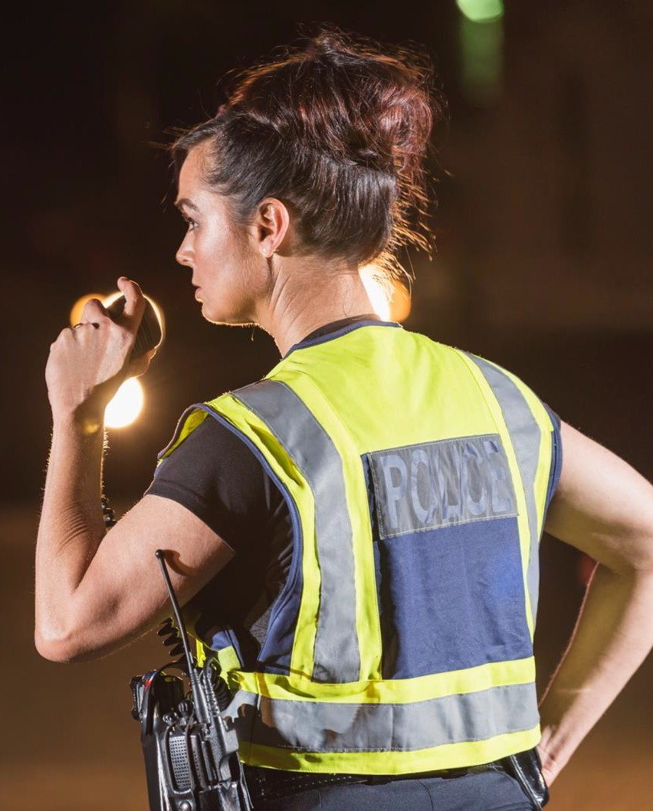
Active Shooter Protocol
Law enforcement has changed from isolate and negotiate to actively seek and neutralize assailants
Protocol is designed for a minimum
of two officers
All officers are trained the same
Law enforcement will bypass victims to locate and neutralize the suspect(s)
Law enforcement response may involve multi-agency personnel, including plainclothes officers
Active shooters are treated differently
from hostage situations
© 2022 Wipfli LLP. All rights reserved.

Slide 24
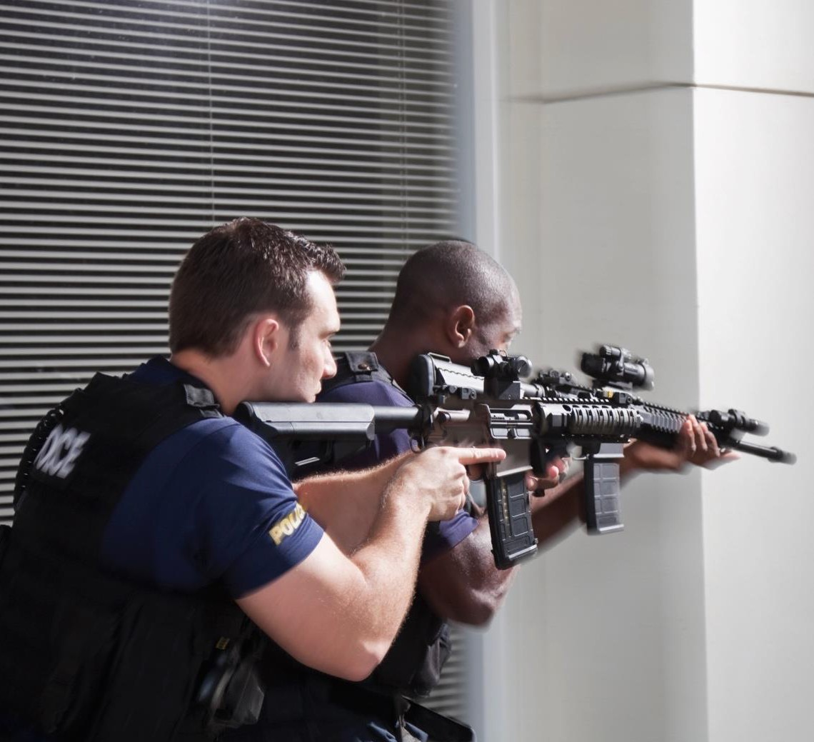
Active Shooter Protocol
Law enforcement officers will enter with weapons drawn
Officers may not know who the shooter is, so everyone is a potential suspect
Officers will shout and may physically restrain or control you
© 2022 Wipfli LLP. All rights reserved.

Slide 25
Instructions for your staff
Remain calm and follow instructions
Put down any items in your hands (i.e., phone, bag, jacket)
Raise hands and spread fingers
Keep your hands visible at all times
Avoid quick movements toward officers such as holding on to them for safety
Avoid pointing, screaming or yelling
Do not stop to ask officers for help or directions when evacuating
© 2022 Wipfli LLP. All rights reserved.

Slide 26
If confronted by an Active Shooter situation
Do not freeze, and remember that the situation is not hopeless
Denial can waste precious time
  Act quickly and safely
Assist others only if safe to do so
Distance = Safety
Make it hard for the offender to reach you and they will likely move on
© 2022 Wipfli LLP. All rights reserved.

Slide 27
Emergency responders may ask you…
The number of persons shooting
The location of the shooter(s)
Clothing, gender, race, age of the shooter(s)
Type of weapon(s) (i.e., handgun, rifle, shotgun, explosives)
Number of victims you have seen
If you know people are hidden or barricaded and their location(s)
© 2022 Wipfli LLP. All rights reserved.

Slide 28
When you make it to safety
Follow the instructions of emergency personnel
DO NOT LEAVE without telling someone
Go to a pre-determined place to be counted by staff to make sure everyone is accounted for
Call 911 and provide details to dispatcher
Seek counseling for trauma, if needed
© 2022 Wipfli LLP. All rights reserved.

Slide 29
Active Shooter Information Links
Video: Run Hide, Fight. Surviving an Active Shooter Event https://police.utexas.edu/file/33
FEMA Active Shooter: What You Can Do Course – No Cost
https://training.fema.gov/is/courseoverview.aspx?code=is-907
DHS Active Shooter Response Pocket Card https://www.dhs.gov/xlibrary/assets/active_shooter_pocket_card.pdf
DHS Active Shooter Preparedness
https://www.cisa.gov/active-shooter-preparedness
FBI Active Shooter Resources
https://www.fbi.gov/about/partnerships/office-of-partner-engagement/active-shooter-resources
Secret Service National Threat Assessment Center https://www.secretservice.gov/protection/ntac/
© 2022 Wipfli LLP. All rights reserved.

Slide 30

Questions?

Slide 31

Thank you
Contact Us
Andrew Hofstetter, Director (Tribal Industry)
Wipfli LLP
andrew.hofstetter@wipfli.com
(951) 923-8144
Eddie Ilko, Safety and Occupational Health Manager
National Indian Gaming Commission
eddie.ilko@nigc.gov
(619) 380-4581
Tammy Jelinek, Principal
Wipfli LLP
tjelinek@wipfli.com
(608) 270-2954

