Slide 1

26th Annual Conference
San Antonio, Texas
September 26-28

Slide 2


What YOUR numbers are telling us… 2022 Tribal Benefits Survey RESULTS
Doug Roehm, LIC Ben Butler

Slide 3
AGENDA
Topic one
Topic two
Topic three
Topic four
Part 1 What Your Numbers Are Telling Us Doug Roehm, LIC, President
Strategic Services Group
Part 2 2022 Tribal First Benefits Survey Results Tim Ayala, Vice President
Tribal First, An Alliant Company

Slide 4

Topic One
Employee Benefits:
What Your Numbers Are Telling Us.

Slide 5












Data Sources
Thank you to the many claim administrators and vendor partners that provided both their wisdom, insights and meaningful data.

Slide 6
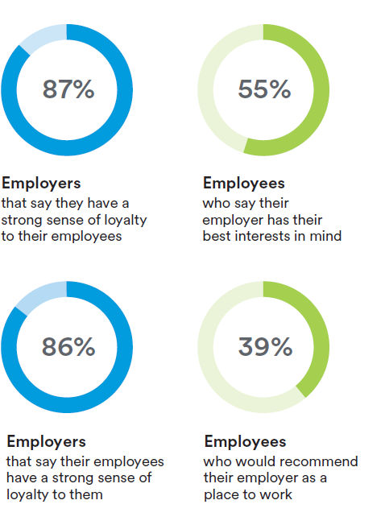
Covid-19 Factor
47.4 million people quit their jobs in 2021
Satisfaction rates have NEVER been lower
Loyalty is falling – 66% of employees report being satisfied with their jobs 10/2021
Notes:
US Dept Labor
2) Met Life 2021 Survey
3) Met Life 20th Annual US Employee Benefit Trends Study Report
Graphic Met Life 2022

Slide 7
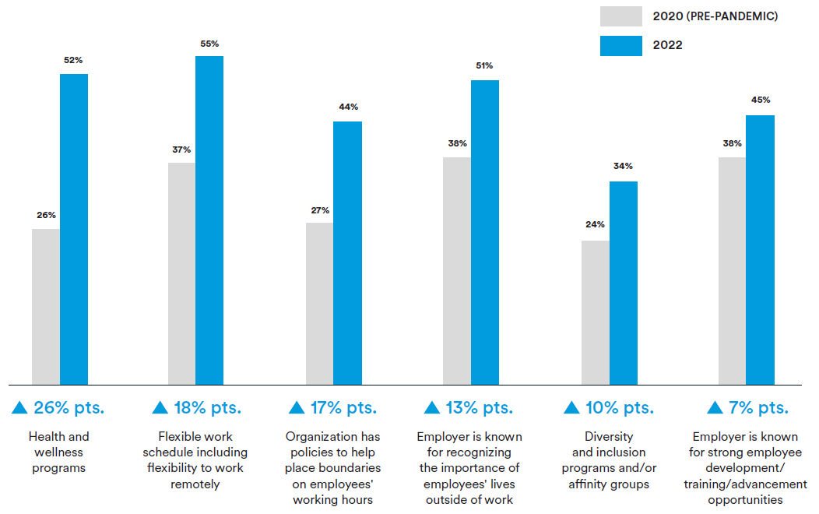
Employee Must Haves for a new job

Slide 8
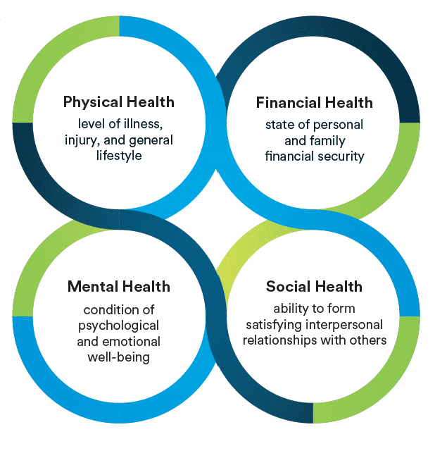
It’s a new world
Notes:
Post Covid

Slide 9
rebalancing of power between employers and employees
Enhancing & expanding offerings
Reducing contributions
Reducing deductibles
Reducing or eliminating new hire waiting periods
All equate to higher cost of labor and overhead for your organization.
Need better Graphic of More, more, more Cost
Costs Going Up!
Notes:
Title quote met life

Slide 10
So What’s up?
What’s Happening TO us….
Covid cost volatility
Hospital Cost Pressures
Emerging Specialty Therapies
Shifting Provider Behavior
Advancement of Disease Care/Deferral
“Long-Covid”
Changes in Member Utilization
High-Cost Pharmacy / Specialty Drugs
IS SHAPING What’s Happening…
Understanding patterns & treatment for accurate projections
Long-term provider contracts
Clinical appropriateness, optimizing cost & dose
Value-based provider reimbursement
Stronger targeting for care support
Addressing health disparity
Products/programs to navigate through the system

Slide 11
What to Expect
REDO SLIDE
Claim Costs / No Covid Impact
2020 Baseline
2021 +5%
2022 +5%
2023 +5%
With Covid Impact
2020 Baseline
2021 Actual +7% + 5% Deferred Claims
2022 +6% + 3-4% Deferred Claims
2023 +7% + 2-3% Deferred Claims
Important Factors: Regional Differences, Plan Design, Demographics
Notes:
Regional Differences
Outliers

Slide 12
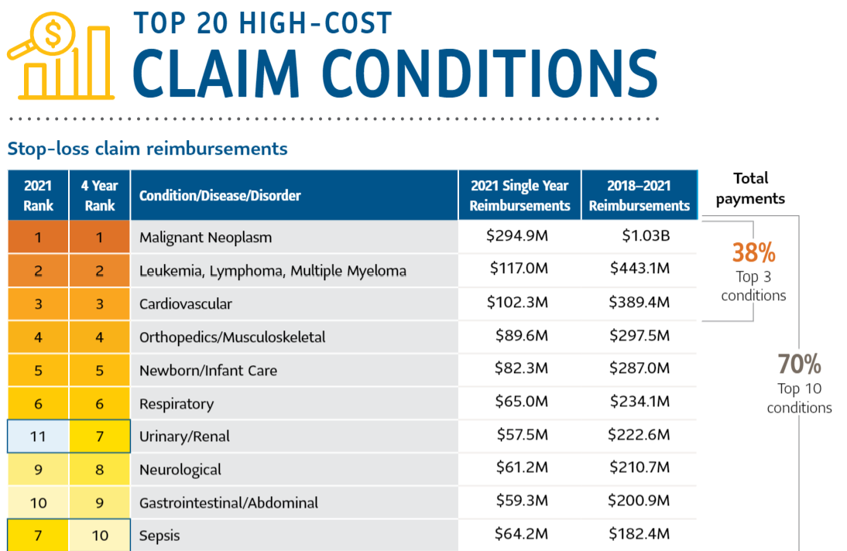

Large Claim Trends
Sun Life 2022 Large Claim Report
Top 10 $3.50B (70%)
Top 20 $4.54B (91%)
All $4.97B

Slide 13
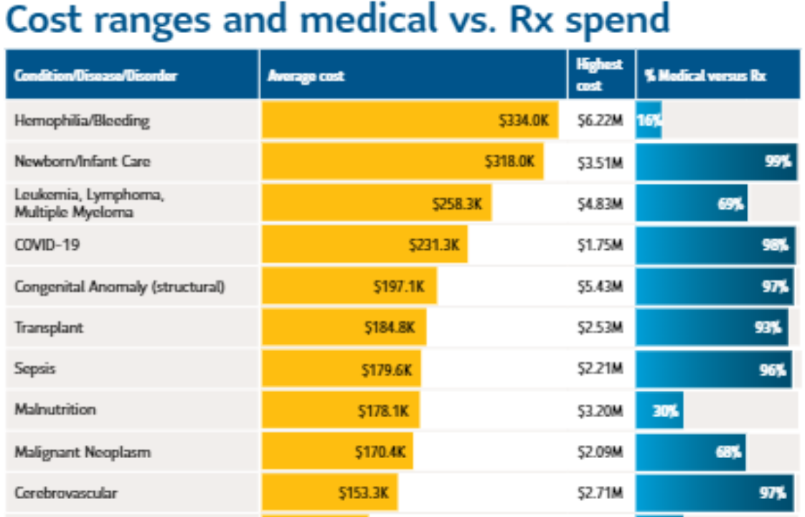
Large Claim Trends
REDO
Sun Life 2022 Large Claim Report
Top 10 $3.50B (70%)
Top 20 $4.54B (91%)
All $4.97B

Slide 14
Large Claim Trends
22% of groups have $1.0m+ claims each year
Cancer remain #1 & #2 past 10 years across all vendors
From 2020 to 2021, Million-dollar claims increased by 19%
Volume of claims increased by 21% per million lives (utilization)
Average COVID19 reimbursement $234,568
Mental Health Claims +21%
2021 Largest Claims $6.23m hemophiliac, $7.8m burn victim
Notes:
Sun Life
Met Life

Slide 15
Drug Claim Trends
Cancer Drugs make up 11 of top 20 high-cost injectable drugs
Waiting on Data

Slide 16
Disturbing trends
COVID Patients no-longer overwhelming health systems
Improved Hospital Bandwidth: Providers going to extreme lifesaving measures
Claim Lag is a Problem
Federal Emergency Services Act / 1 Year Statute
Stretching Claims Over 2-3 Years
Stop Loss Leveraging / Cost Impact

Slide 17
Disturbing trends
Muskuloskeletal
Maternity
See Kristen’s Data

Slide 18
Diabetes to CKD
Livongo / Renalogic Data Coming

Slide 19
Tribal vs. non-tribal trends
Tribal
Non-Tribal

Slide 20
Aging Workforce
Aging Population
Retirement Readiness All Time Low
Working To Survive / Inflation Impact
Homelessness
Family Unit / Moving Back In
Insert BLS Inflation Graphic Here
Notes:
Hard to find people
Upward wage pressure

Slide 21
Who’s Winning? Why?
note
Notes:
Hard to find people
Upward wage pressure

Slide 22
Indian Health Care Improvement Act
25 USC 1601 and 1602:
Congress declares that it is the policy of this Nation, in fulfillment of its special trust responsibilities and legal obligations to Indians... to ensure the highest possible health status for Indians and urban Indians and to provide all resources necessary to affect that policy.
A major national goal... is to provide the resources, processes, and structure that will enable Indian Tribes and tribal members to obtain the quantity and quality of health care services and opportunities that will eradicate the health disparities between Indians and the general population of the United States.

Slide 23
638 Status Self-insurance
638 “Status” – Drive Your Own Destiny
Fully Insured or Self-Insured?
Plan Design(s)
Demographics & Lifestyle
Claim Data = What’s Driving Your Spend?
What are you doing about it? What can you do?
Notes:
Some insured “tribal” plans like “tribal blue” in Oklahoma with 5-10% deeper discounts

Slide 24
Domestic Clinic
Winning – saving 30-40% on average

Slide 25
Domestic Pharmacy
Winning
340(b)

Slide 26
Other STrategies

Slide 27
Next STeps

Slide 28
Ben Butler Benchmarking

Slide 31
Content
Subtitle
Subtitle
Add text, images, art, and videos.
Add transitions, animations, and motion.
Save to OneDrive, to get to your presentations from your computer, tablet, or phone.
Open the Design Ideas pane for instant slide makeovers.
When we have design ideas, we’ll show them to you right there.

Slide 32
Timeline
Title
To start a presentation, go to the Slide Show tab, and select From Beginning
Title
To display Presenter view, in Slide Show view, on the control bar at the bottom left select the three dots, and then Show Presenter View
Title
During your presentation, the speaker notes are visible on your monitor, but aren't visible to the audience.
Title
The Notes pane is a box that appears below each slide. Tap it to add notes.
Title
If you don’t see the Notes pane or it is completely minimized, click Notes on the task bar across the bottom of the PowerPoint window.

Slide 33
Additional content
Subtitle
Subtitle
Subtitle
Add text, images, art, and videos.
Add transitions, animations, and motion.
Save to OneDrive, to get to your presentations from your computer, tablet, or phone.
Open the Design Ideas pane for instant slide makeovers.
When we have design ideas, we’ll show them to you right there.
This PowerPoint theme uses its own unique set of colors, fonts, and effects to create the overall look and feel of these slides.
PowerPoint has tons of themes to give your presentation just the right personality.

Slide 34
SUMMARY
With PowerPoint, you can create presentations and share your work with others, wherever they are. Type the text you want here to get started. You can also add images, art, and videos on this template. Save to OneDrive and access your presentations from your computer, tablet, or phone.

Slide 35
THANK YOU
Presenter name
Email address
Website

