Slide 1

26th Annual Conference
San Antonio, Texas
September 26-28

Slide 2
12 Habits of exceptional leaders
Presented by David Miller

Slide 3


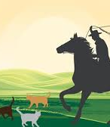
Leadership

Slide 4

Never follow a leaders who is more in love with power than people.
Native American Proverb

Slide 5

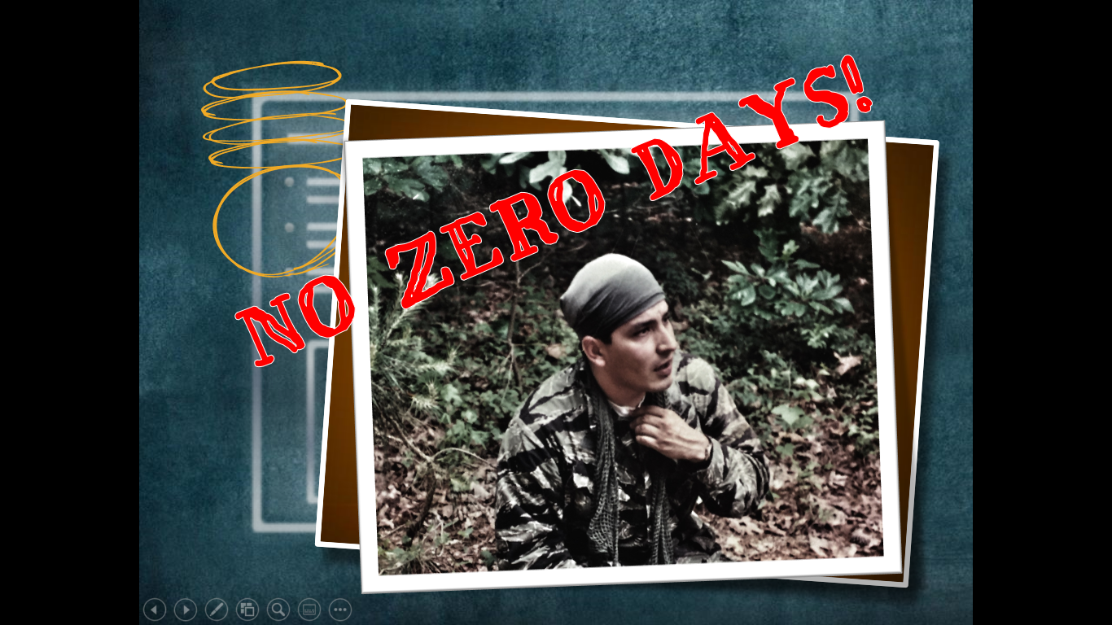
No Zero Days
This is a concept of when you have to ensure that you do at least one thing, no matter how small, that can help you in the pursuit of a particular goal. Motivation to pursue your goals is easy to find but hard to maintain.

Slide 6
Habit 1 Courage
“Courage is the first virtue that makes all other virtues possible.” —Aristotle

Slide 7
Habit 2 Effective communication
“The more elaborate our means of communication, the less we communicate.” —Joseph Priestley

Slide 8
Habit 3 Generosity
“A good leader is a person who takes a little more than his share of the blame and a little less than his share of the credit.” —John Maxwell

Slide 9
Habit 4 Humility
“Humility is not thinking less of yourself, it’s thinking of yourself less.” – C.S. Lewis

Slide 10
Habit 5 Self-awreness
“It is absurd that a man should rule others, who cannot rule himself.” —Latin Proverb

Slide 11
Habit 6 stick to the golden rule
“The way you see people is the way you treat them, and the way you treat them is what they become.”
– Jon Wolfgang von Goethe

Slide 12
Habit 7 passion
“If you just work on stuff that you like and are passionate about, you don’t have to have a master plan with how things will play out.”
– Mark Zuckerberg

Slide 13
Habit 8 infectiousness
“The very essence of leadership is that you have to have a vision. It’s got to be a vision you articulate clearly and forcefully on every occasion. You can’t blow an uncertain trumpet.” —Reverend Theodore Hesburgh

Slide 14
Habit 9 authenticity
“Just be who you are and speak from your guts and heart – it’s all a man has.”
– Hubert Humphrey

Slide 15
Habit 10 approachability
“Management is like holding a dove in your hand. Squeeze too hard and you kill it, not hard enough and it flies away.” – Tommy Lasorda

Slide 16
Habit 11 accountability
“The ancient Romans had a tradition: Whenever one of their engineers constructed an arch, as the capstone was hoisted into place, the engineer assumed accountability for his work in the most profound way possible: He stood under the arch.”
– Michael Armstrong

Slide 17
Habit 12 sense of purpose
“You don’t lead by pointing and telling people some place to go. You lead by going to that place and making a case.” – Ken Kesey

Slide 18
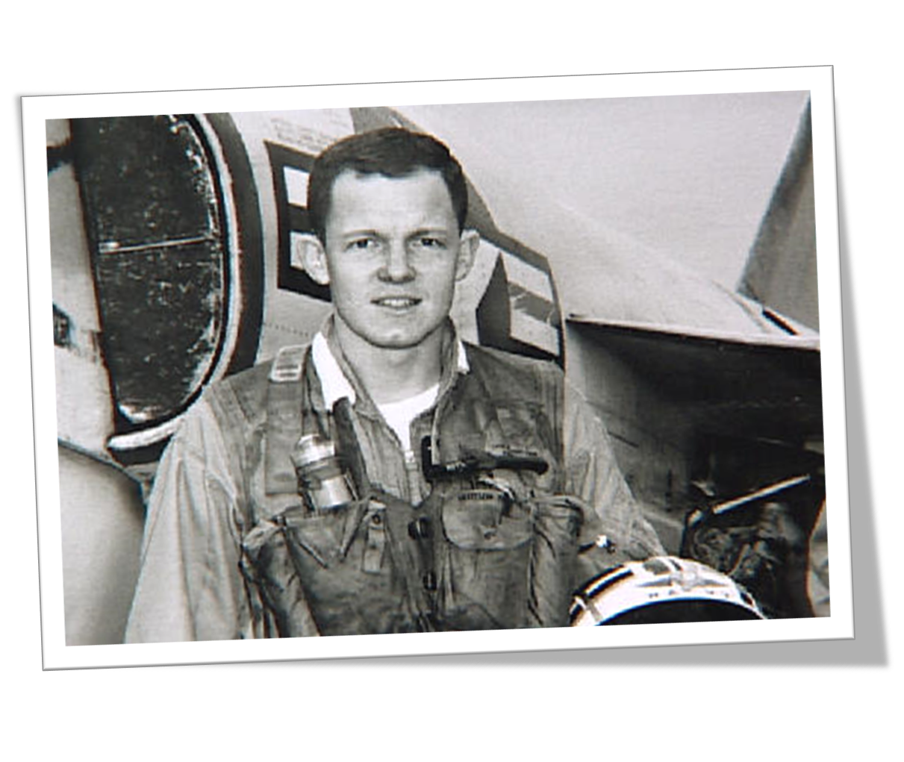
Thank you!
David Miller
David@bwilearning.com
www.bwilearning.com

Slide 19
26th Annual Conference
San Antonio, Texas
September 26-28

